Slide 1
LOWER SIXTH ARTS
GEOGRAPHY
Practical Work 1
Determining Soil Texture
Notes:
Good morning, class, and welcome to our geography lesson. I am your geography teacher, Mr Kamdem. Today we are starting Practical Work 1: Determining Soil Texture.

Slide 2
CLASS INFO
Class, Chapter and Duration
Class | Lower Sixth Arts
Chapter | Module 3: Understanding and managing biogeographic zones across the world in general and Cameroon in particular
Duration | 2 periods (2 × 50 minutes)
Notes:
This lesson is for Lower Sixth Arts. It belongs to Module 3: Understanding and managing biogeographic zones across the world in general and Cameroon in particular. We shall need 2 periods to cover it.

Slide 3
IDENTIFICATION
Lesson Identification
Topic | Soil and its Properties
Sub-topic | Soil Properties and their Significance
Lesson | Practical Work 1: Determining Soil Texture
Notions / Concepts | Feel method, moulding, ribbon test, sieving, textural class, ternary graph.
Syllabus focus | In the field: feeling, moulding and ribbon methods. In the laboratory: sieving, percentages and plotting on a ternary graph.
Competence | Learners are able to determine soil texture in the field and in the laboratory and plot it on a texture triangle.
Notes:
Our topic is Soil and its Properties, and the sub-topic is Soil Properties and their Significance. The key notions we shall use today are: feel method, moulding, ribbon test, sieving, textural class, ternary graph. At the end, you should be able to do this: learners are able to determine soil texture in the field and in the laboratory and plot it on a texture triangle.

Slide 4

HOMEWORK CORRECTION
Correction of the Homework
Question (Lesson 2: Physical Properties of the Soil: Texture):
Test three soils from home by feel and give the texture of each.
Notes:
Before we start the new lesson, let us correct the homework I gave you at the end of Lesson 2: Physical Properties of the Soil: Texture. The question was: Test three soils from home by feel and give the texture of each. Take out your exercise books.

Slide 5
HOMEWORK CORRECTION
Correction: Possible Answer
Example: soil from the garden feels smooth and slightly sticky (loam); soil from the road feels gritty (sandy); soil from the river bank is sticky and forms a ribbon (clay).
Notes:
Here is a good answer. Example: soil from the garden feels smooth and slightly sticky (loam); soil from the road feels gritty (sandy); soil from the river bank is sticky and forms a ribbon (clay). Compare it with your own answer and correct your work in red.

Slide 6
LESSON PLAN
Lesson Plan
Correction of the homework
Objectives and recall
Real-life situation and action to take
Learning activities
Board summary
Evaluation, remediation and homework
Notes:
Here is the plan of our lesson today. First, we shall correct the homework. Then we shall look at the objectives and recall what you already know. After that, we shall study a situation from real life and the action to take, and do the learning activities. Finally, we shall copy the board summary, do the evaluation and the remediation, and I will give you the homework.

Slide 7
OBJECTIVES
Objectives
By the end of this lesson, you should be able to:
Collect soil samples correctly.
Determine texture by feeling, moulding and ribbon methods.
Notes:
Take your time to copy this part; we will continue together.

Slide 8
OBJECTIVES
Objectives (continued)
Sieve a sample, calculate percentages and plot them on a texture triangle.
Notes:
By the end of this lesson, you should be able to do three things. Number 1: collect soil samples correctly. Number 2: determine texture by feeling, moulding and ribbon methods. Number 3: sieve a sample, calculate percentages and plot them on a texture triangle.

Slide 9
PREVIOUS KNOWLEDGE
Previous Knowledge
Sand is gritty, silt smooth and clay sticky.
The texture triangle shows the class of a soil.
Notes:
Let us first remember what you already know. Sand is gritty, silt smooth and clay sticky. The texture triangle shows the class of a soil. Keep this in mind, because we shall build on it today.

Slide 10
REAL-LIFE SITUATION
Situation in Real Life
The school wants to start a vegetable garden. The teacher asks the class to test the soils in three places in the school compound and to choose the best one.
Notes:
Listen carefully to this situation from real life. The school wants to start a vegetable garden. The teacher asks the class to test the soils in three places in the school compound and to choose the best one. Think about it, because I am going to ask you some questions.

Slide 11
REAL-LIFE SITUATION
Situation: Question 1
What is the problem in the situation?
Notes:
Question 1: What is the problem in the situation? Think for a moment, then raise your hand to answer.

Slide 12
REAL-LIFE SITUATION
Answer
The class must find the best soil for a garden.
Notes:
Good. The class must find the best soil for a garden.

Slide 13
REAL-LIFE SITUATION
Situation: Question 2
What property will they test?
Notes:
Question 2: What property will they test? Think for a moment, then raise your hand to answer.

Slide 14
REAL-LIFE SITUATION
Answer
Soil texture.
Notes:
Good. Soil texture.

Slide 15
REAL-LIFE SITUATION
Situation: Question 3
Which texture is best for vegetables?
Notes:
Question 3: Which texture is best for vegetables? Think for a moment, then raise your hand to answer.

Slide 16
REAL-LIFE SITUATION
Possible Answer
A loam.
Notes:
Good. A loam.

Slide 17
ACTION TO TAKE
Action to Take
Determine the texture of school soils to choose the best site for the school garden.
Notes:
From this situation, the action we are working towards in this lesson is the following: determine the texture of school soils to choose the best site for the school garden.

Slide 18
JUSTIFICATION
Justification of the Lesson
This practical work helps us to test soils ourselves and choose good land for crops.
Notes:
Why is this lesson important for you? This practical work helps us to test soils ourselves and choose good land for crops.

Slide 19

1. SAMPLING
Activity 1
Taking samples from a soil pit.
Notes:
Activity 1. Look carefully at this picture: taking samples from a soil pit. Observe every detail before I ask the question.

Slide 20
1. SAMPLING
Activity 1: Question
Why do we take samples from several places?
Notes:
Here is the question for Activity 1: Why do we take samples from several places? Take one minute to think and write your answer in your rough notebook.

Slide 21
1. SAMPLING
Activity 1: Answer
Soils change from place to place, so one sample is not enough.
Notes:
Let us check the answer together. Soils change from place to place, so one sample is not enough.

Slide 22
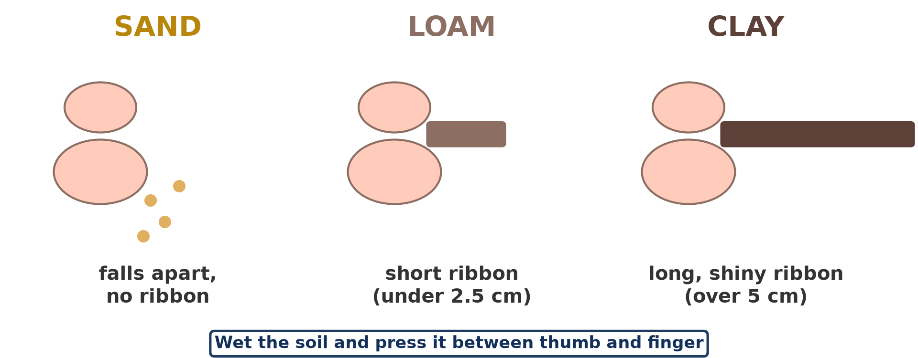
2. FIELD METHODS
Activity 2
The feel and ribbon test.
Notes:
Activity 2. Look carefully at this diagram: the feel and ribbon test. Observe every detail before I ask the question.

Slide 23
2. FIELD METHODS
Activity 2: Question
A wet sample makes a long, shiny ribbon. What is its texture?
Notes:
Here is the question for Activity 2: A wet sample makes a long, shiny ribbon. What is its texture? Take one minute to think and write your answer in your rough notebook.

Slide 24
2. FIELD METHODS
Activity 2: Answer
Clay.
Notes:
Let us check the answer together. Clay.

Slide 25
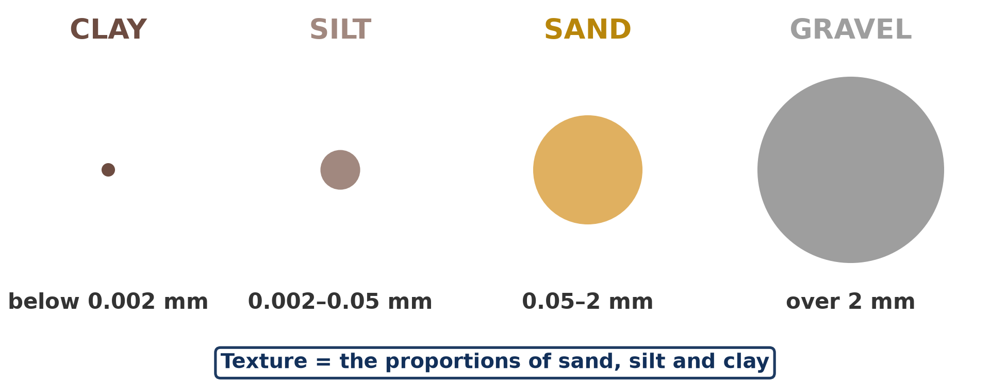
3. LABORATORY METHOD
Activity 3
Particles separated by sieves.
Notes:
Activity 3. Look carefully at this diagram: particles separated by sieves. Observe every detail before I ask the question.

Slide 26
3. LABORATORY METHOD
Activity 3: Question
Why do we dry and crush the soil before sieving?
Notes:
Here is the question for Activity 3: Why do we dry and crush the soil before sieving? Take one minute to think and write your answer in your rough notebook.

Slide 27
3. LABORATORY METHOD
Activity 3: Answer
So the particles separate and pass through the right sieve.
Notes:
Let us check the answer together. So the particles separate and pass through the right sieve.

Slide 28
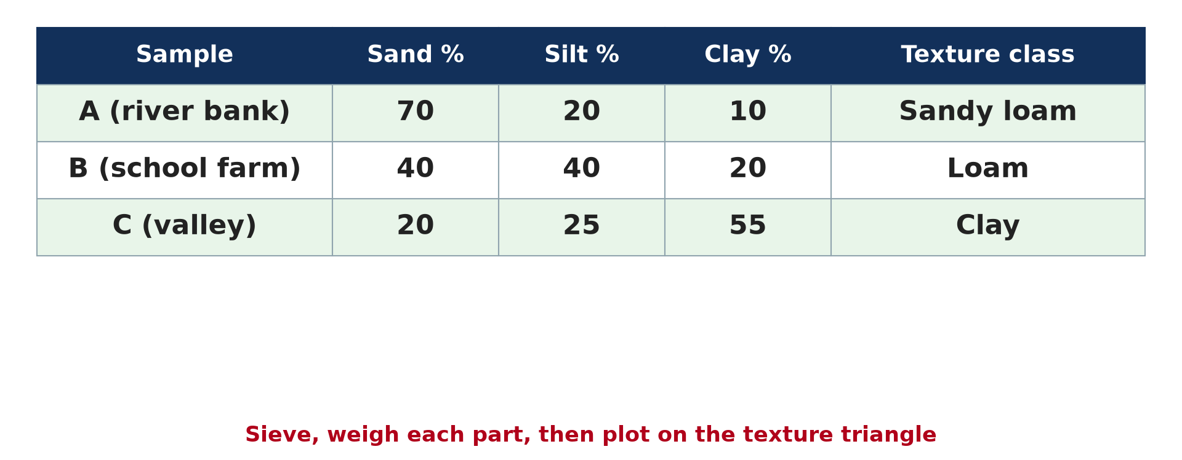
3. LABORATORY METHOD
Activity 4
Results for three samples.
Notes:
Activity 4. Look carefully at this diagram: results for three samples. Observe every detail before I ask the question.

Slide 29
3. LABORATORY METHOD
Activity 4: Question
Which sample is best for the school garden? Why?
Notes:
Here is the question for Activity 4: Which sample is best for the school garden? Why? Take one minute to think and write your answer in your rough notebook.

Slide 30
3. LABORATORY METHOD
Activity 4: Answer
Sample B (loam): it holds water and drains well.
Notes:
Let us check the answer together. Sample B (loam): it holds water and drains well.

Slide 31
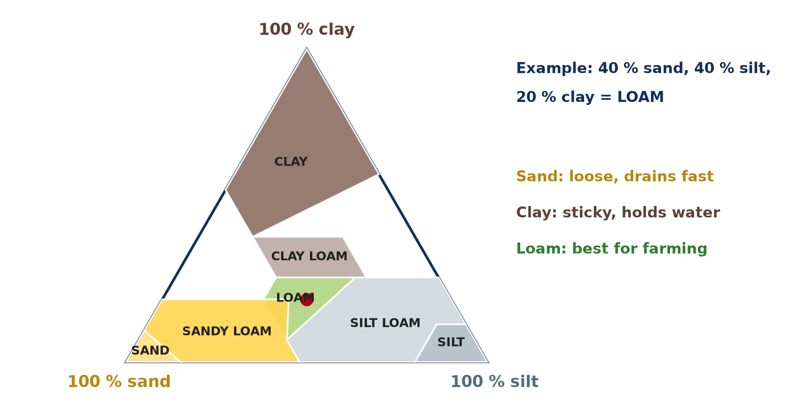
4. PLOTTING ON A TERNARY GRAPH
Activity 5
Plotting a sample on the triangle.
Notes:
Activity 5. Look carefully at this diagram: plotting a sample on the triangle. Observe every detail before I ask the question.

Slide 32
4. PLOTTING ON A TERNARY GRAPH
Activity 5: Question
Plot sample C (20 % sand, 25 % silt, 55 % clay). In which class does it fall?
Notes:
Here is the question for Activity 5: Plot sample C (20 % sand, 25 % silt, 55 % clay). In which class does it fall? Take one minute to think and write your answer in your rough notebook.

Slide 33
4. PLOTTING ON A TERNARY GRAPH
Activity 5: Answer
Clay.
Notes:
Let us check the answer together. Clay.

Slide 34
BOARD SUMMARY
Board Summary
Topic: Soil and its Properties
Sub-topic: Soil Properties and their Significance
Practical Work 1: Determining Soil Texture
Notes:
Now we are going to copy the board summary. Write the title and the headings neatly in your notebooks. I will give you enough time for each slide, so do not rush.

Slide 35
BOARD SUMMARY
DEFINITIONS
The key terms of this lesson are defined as follows:
Soil sample: It is a small quantity of soil taken to represent the soil of a place.
Ternary graph: It is a triangular graph used to plot three percentages that add up to 100.
Notes:
Let us copy the definitions. The key terms of this lesson are defined as follows. On this slide we have Soil sample and Ternary graph. Write each point on a new line, with the key term first, and explain it in your own words when we revise.

Slide 36
BOARD SUMMARY
1. Field Methods
In the school locality, texture is determined by feel:
Sampling: Take samples from several places at the same depth, label them and note the site. Several samples give a reliable result.
Notes:
Let us copy Field Methods. In the school locality, texture is determined by feel. On this slide we have Sampling. Write each point on a new line, with the key term first, and explain it in your own words when we revise. When you finish, we go to the next slide.

Slide 37
BOARD SUMMARY
1. Field Methods (continued)
Feeling method: Rub moist soil between the fingers: gritty means sand, smooth means silt and sticky means clay. Record the texture of each sample.
Notes:
We continue with Field Methods. On this slide we have Feeling method. Write each point on a new line, with the key term first, and explain it in your own words when we revise. When you finish, we go to the next slide.

Slide 38
BOARD SUMMARY
1. Field Methods (continued)
Moulding and ringing methods: Roll the moist soil into a ribbon and a ring. Clay makes a long ribbon and a complete ring; sand breaks at once.
Notes:
We continue with Field Methods. On this slide we have Moulding and ringing methods. Write each point on a new line, with the key term first, and explain it in your own words when we revise.

Slide 39
BOARD SUMMARY
2. Laboratory Method
In the laboratory, texture is measured by sieving:
Preparation: Dry and crush each sample and weigh it (for example 100 g). This separates the particles.
Notes:
Let us copy Laboratory Method. In the laboratory, texture is measured by sieving. On this slide we have Preparation. Write each point on a new line, with the key term first, and explain it in your own words when we revise. When you finish, we go to the next slide.

Slide 40
BOARD SUMMARY
2. Laboratory Method (continued)
Sieving: Pass the soil through a set of sieves (2 mm, 0.05 mm) and weigh the soil left on each. Calculate the percentage of sand, silt and clay.
Notes:
We continue with Laboratory Method. On this slide we have Sieving. Write each point on a new line, with the key term first, and explain it in your own words when we revise.

Slide 41
BOARD SUMMARY
2. Laboratory Method
Illustration: results of three samples
Notes:
Now draw this illustration in your notebook: results of three samples. Give it a title and label it clearly.

Slide 42
BOARD SUMMARY
3. Plotting and Interpretation
The results are plotted and interpreted as follows:
Plotting: Read the sand, silt and clay percentages along the three sides of the triangle. The point where the three lines meet gives the textural class.
Notes:
Let us copy Plotting and Interpretation. The results are plotted and interpreted as follows. On this slide we have Plotting. Write each point on a new line, with the key term first, and explain it in your own words when we revise. When you finish, we go to the next slide.

Slide 43
BOARD SUMMARY
3. Plotting and Interpretation (continued)
Interpretation: A loam is best for the school garden because it drains well and holds water. Sandy soils need organic matter and clay soils need drainage.
Notes:
We continue with Plotting and Interpretation. On this slide we have Interpretation. Write each point on a new line, with the key term first, and explain it in your own words when we revise.

Slide 44
BOARD SUMMARY
3. Plotting and Interpretation
Illustration: plotting samples on the texture triangle
Notes:
Now draw this illustration in your notebook: plotting samples on the texture triangle. Give it a title and label it clearly.

Slide 45
FORMATIVE EVALUATION
Evaluation 1
A sample weighs 200 g: 80 g sand, 80 g silt, 40 g clay. Give the percentages.
Notes:
Now let us check what you have understood. Question 1: A sample weighs 200 g: 80 g sand, 80 g silt, 40 g clay. Give the percentages. Answer in your exercise book.

Slide 46
FORMATIVE EVALUATION
Expected Answer
Sand 40 %, silt 40 %, clay 20 % (loam).
Notes:
The expected answer is: sand 40 %, silt 40 %, clay 20 % (loam). If you got it right, well done.

Slide 47
FORMATIVE EVALUATION
Evaluation 2
Give two field methods to find texture.
Notes:
Now let us check what you have understood. Question 2: Give two field methods to find texture. Answer in your exercise book.

Slide 48
FORMATIVE EVALUATION
Expected Answer
Feel method and ribbon test (also moulding).
Notes:
The expected answer is: feel method and ribbon test (also moulding). If you got it right, well done.

Slide 49
REMEDIATION
Remediation
Fill in the blanks:
A gritty soil is rich in ______.
A long ribbon shows much ______.
The three percentages must add up to ______ %.
Notes:
For those who need more practice, fill in the blanks in your exercise book. The answers are: number 1, sand; number 2, clay; number 3, 100.

Slide 50
HOMEWORK
Homework
Write a short report on the three school samples and the best place for the garden.
Notes:
For your homework: Write a short report on the three school samples and the best place for the garden. We shall correct it at the beginning of our next lesson.

Slide 51
NEXT LESSON
Next Lesson
Our next lesson will be on:
Lesson 3: Soil Structure
Notes:
Our next lesson will be on Lesson 3: Soil Structure. Thank you for your attention, and see you next time.

Slide 52
BILINGUAL GAME
Bilingual Game (Jeu Bilingue)
English | Français
Sample | L'échantillon
Sieve | Le tamis
Weigh | Peser
Percentage | Le pourcentage
Triangle | Le triangle
Garden | Le jardin
Notes:
Let us play the bilingual game. I say a word in English, and you give me the French word. Then we do the reverse.

Slide 53
LOGBOOK
Official Logbook (1/2)
Module / Topic | Soil and its Properties
Lesson Title | Practical Work 1: Determining Soil Texture
Expected Learning Outcomes | Collect soil samples correctly. Determine texture by feeling, moulding and ribbon methods. Sieve a sample, calculate percentages and plot them on a texture triangle.
Competence | Learners are able to determine soil texture in the field and in the laboratory and plot it on a texture triangle.
Notes:
I record this information in the official logbook of the class after the lesson.

Slide 54
LOGBOOK
Official Logbook (2/2)
Matter Taught | DEFINITIONS; Field Methods; Laboratory Method; Plotting and Interpretation.
Evaluation | Formative evaluation and remediation exercise.
Homework | Write a short report on the three school samples and the best place for the garden.
Enrolment / Present / Absent | ____ / ____ / ____
Achievement | To be completed after the lesson.
Notes:
I complete the second page of the logbook: the matter taught, the evaluation, the homework and the attendance.

Slide 55
TEACHER'S NOTE
Teacher's Note
Timing: Homework correction, plan, objectives 8 min | Recall, situation, action 10 min | 5 activities 30 min | Board summary (copying) 30 min | Evaluation, remediation 10 min | Homework, next lesson 5 min | Logbook 7 min
Without the projector (Activity 1): mark three sample points in the compound.
Without the projector (Activity 2): do the ribbon test with the class.
Without the projector (Activity 3): use kitchen sieves of different sizes.
Without the projector (Activity 4): copy the table.
Without the projector (Activity 5): plot the three samples.
Notes:
This slide is for me, the teacher: it gives the timing of the lesson and what to do if the projector is not available.

Slide 56
REFERENCES
References
National Geography Syllabus, MINESEC/IGE/IP-SS, 2019 — Module 3 (Biogeography).
Photo, Activity 1: “Humic Dystrudept (fine-loamy, isotic, frigid)” by SoilScience.info, CC BY 2.0, via Flickr (https://www.flickr.com/photos/22503286@N06/5140645742)
Diagrams and animations: drawn for this lesson (Geography Department).
Notes:
These are the references and picture credits used to prepare this lesson.

