Slide 1
LOWER SIXTH ARTS
GEOGRAPHY
Lesson 3
Soil Structure
Notes:
Good morning, class, and welcome to our geography lesson. I am your geography teacher, Mr Kamdem. Today we are starting Lesson 3: Soil Structure.

Slide 2
CLASS INFO
Class, Chapter and Duration
Class | Lower Sixth Arts
Chapter | Module 3: Understanding and managing biogeographic zones across the world in general and Cameroon in particular
Duration | 2 periods (2 × 50 minutes)
Notes:
This lesson is for Lower Sixth Arts. It belongs to Module 3: Understanding and managing biogeographic zones across the world in general and Cameroon in particular. We shall need 2 periods to cover it.

Slide 3
IDENTIFICATION
Lesson Identification
Topic | Soil and its Properties
Sub-topic | Soil Properties and their Significance
Lesson | Lesson 3: Soil Structure
Notions / Concepts | Soil structure, ped, crumb, blocky, platy, prismatic, compaction.
Syllabus focus | Meaning and types of soil structure; factors; significance.
Competence | Learners are able to identify soil structures and explain how to keep a good structure.
Notes:
Our topic is Soil and its Properties, and the sub-topic is Soil Properties and their Significance. The key notions we shall use today are: soil structure, ped, crumb, blocky, platy, prismatic, compaction. At the end, you should be able to do this: learners are able to identify soil structures and explain how to keep a good structure.

Slide 4

HOMEWORK CORRECTION
Correction of the Homework
Question (Practical Work 1: Determining Soil Texture):
Write a short report on the three school samples and the best place for the garden.
Notes:
Before we start the new lesson, let us correct the homework I gave you at the end of Practical Work 1: Determining Soil Texture. The question was: Write a short report on the three school samples and the best place for the garden. Take out your exercise books.

Slide 5
HOMEWORK CORRECTION
Correction: Possible Answer
Sample A (sandy) drains too fast; sample B (loam) is well balanced; sample C (clay, 55 %) holds too much water. The best place for the garden is where sample B was taken.
Notes:
Here is a good answer. Sample A (sandy) drains too fast; sample B (loam) is well balanced; sample C (clay, 55 %) holds too much water. The best place for the garden is where sample B was taken. Compare it with your own answer and correct your work in red.

Slide 6
LESSON PLAN
Lesson Plan
Correction of the homework
Objectives and recall
Real-life situation and action to take
Learning activities
Board summary
Evaluation, remediation and homework
Notes:
Here is the plan of our lesson today. First, we shall correct the homework. Then we shall look at the objectives and recall what you already know. After that, we shall study a situation from real life and the action to take, and do the learning activities. Finally, we shall copy the board summary, do the evaluation and the remediation, and I will give you the homework.

Slide 7
OBJECTIVES
Objectives
By the end of this lesson, you should be able to:
Define soil structure.
Describe the main types of structure.
Explain the factors and significance of structure.
Notes:
By the end of this lesson, you should be able to do three things. Number 1: define soil structure. Number 2: describe the main types of structure. Number 3: explain the factors and significance of structure.

Slide 8
PREVIOUS KNOWLEDGE
Previous Knowledge
Texture is the proportion of sand, silt and clay.
Earthworms mix the soil.
Notes:
Let us first remember what you already know. Texture is the proportion of sand, silt and clay. Earthworms mix the soil. Keep this in mind, because we shall build on it today.

Slide 9
REAL-LIFE SITUATION
Situation in Real Life
On a school farm, the soil where tractors pass is hard and water lies on it after rain. Under the bushes, the soil is loose and crumbly and water soaks in quickly.
Notes:
Listen carefully to this situation from real life. On a school farm, the soil where tractors pass is hard and water lies on it after rain. Under the bushes, the soil is loose and crumbly and water soaks in quickly. Think about it, because I am going to ask you some questions.

Slide 10
REAL-LIFE SITUATION
Situation: Question 1
What is the problem in the situation?
Notes:
Question 1: What is the problem in the situation? Think for a moment, then raise your hand to answer.

Slide 11
REAL-LIFE SITUATION
Answer
Some soils are hard and do not let water in.
Notes:
Good. Some soils are hard and do not let water in.

Slide 12
REAL-LIFE SITUATION
Situation: Question 2
What property is different?
Notes:
Question 2: What property is different? Think for a moment, then raise your hand to answer.

Slide 13
REAL-LIFE SITUATION
Answer
Soil structure.
Notes:
Good. Soil structure.

Slide 14
REAL-LIFE SITUATION
Situation: Question 3
What damaged the structure?
Notes:
Question 3: What damaged the structure? Think for a moment, then raise your hand to answer.

Slide 15
REAL-LIFE SITUATION
Possible Answer
Compaction by heavy machines.
Notes:
Good. Compaction by heavy machines.

Slide 16
ACTION TO TAKE
Action to Take
Maintain a good soil structure through good farming practices.
Notes:
From this situation, the action we are working towards in this lesson is the following: maintain a good soil structure through good farming practices.

Slide 17
JUSTIFICATION
Justification of the Lesson
This lesson helps us to understand how soil particles are arranged, which controls water, air and roots.
Notes:
Why is this lesson important for you? This lesson helps us to understand how soil particles are arranged, which controls water, air and roots.

Slide 18
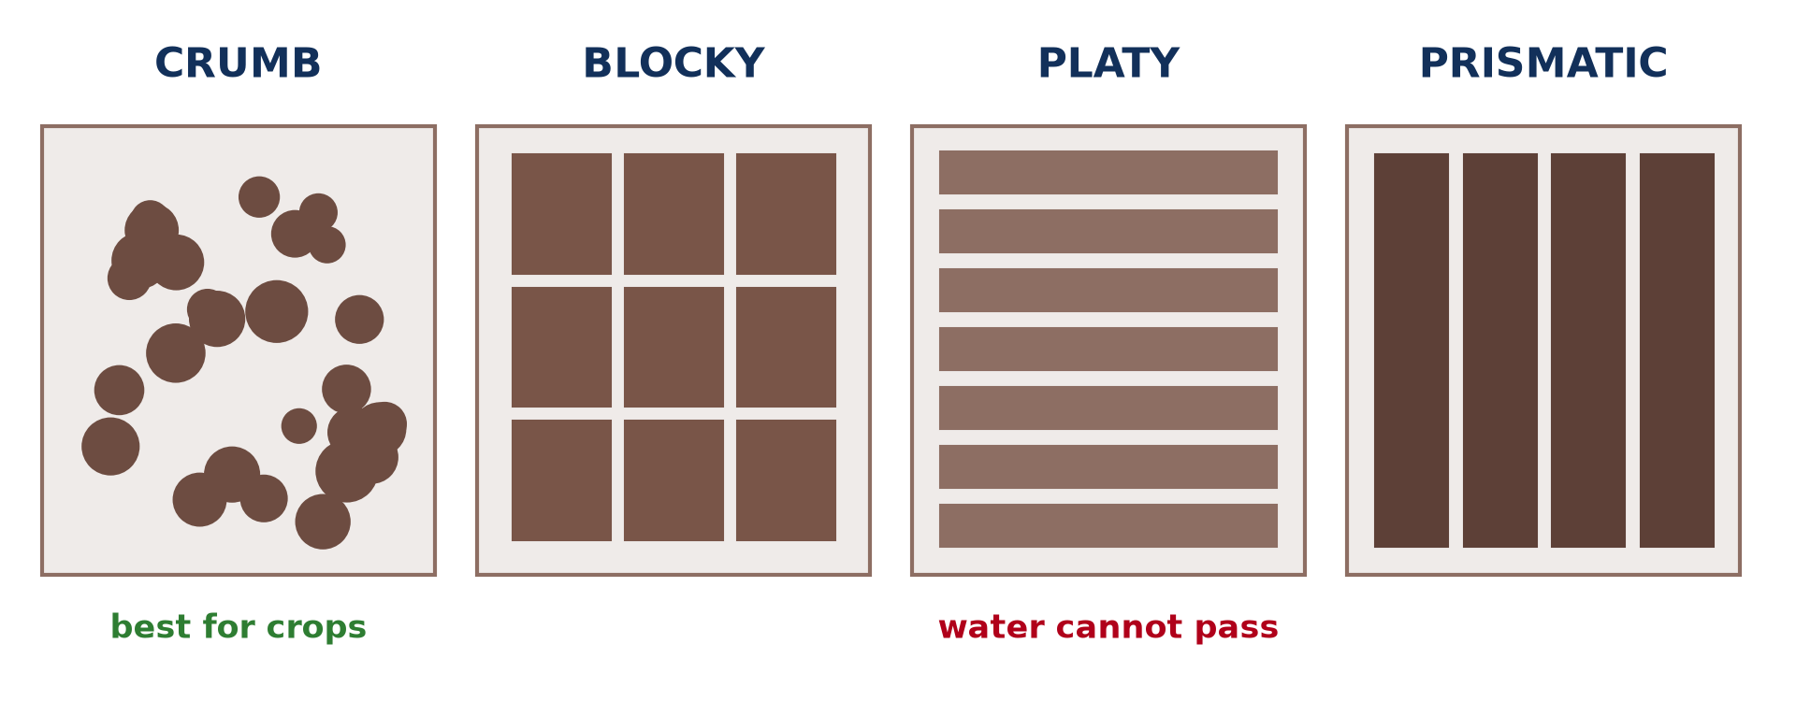
1. MEANING AND TYPES
Activity 1
The main types of soil structure.
Notes:
Activity 1. Look carefully at this diagram: the main types of soil structure. Observe every detail before I ask the question.

Slide 19
1. MEANING AND TYPES
Activity 1: Question
Which structure is best for crops? Why?
Notes:
Here is the question for Activity 1: Which structure is best for crops? Why? Take one minute to think and write your answer in your rough notebook.

Slide 20
1. MEANING AND TYPES
Activity 1: Answer
Crumb: it lets water, air and roots pass easily.
Notes:
Let us check the answer together. Crumb: it lets water, air and roots pass easily.

Slide 21
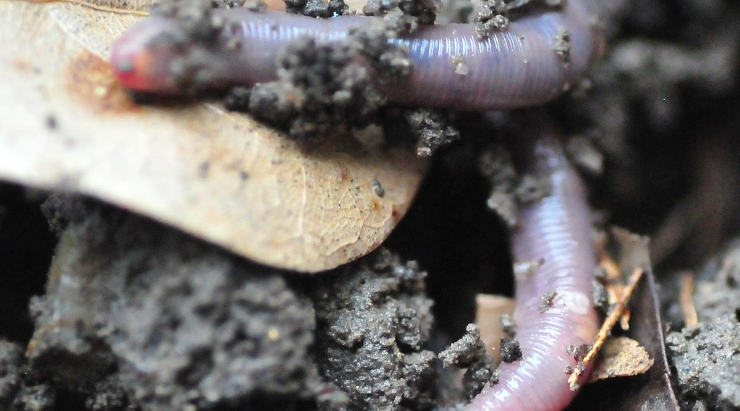
2. FACTORS: ORGANISMS
Activity 2
An earthworm in the soil.
Notes:
Activity 2. Look carefully at this picture: an earthworm in the soil. Observe every detail before I ask the question.

Slide 22
2. FACTORS: ORGANISMS
Activity 2: Question
How do earthworms improve soil structure?
Notes:
Here is the question for Activity 2: How do earthworms improve soil structure? Take one minute to think and write your answer in your rough notebook.

Slide 23
2. FACTORS: ORGANISMS
Activity 2: Answer
They mix the soil and glue particles into crumbs.
Notes:
Let us check the answer together. They mix the soil and glue particles into crumbs.

Slide 24

2. FACTORS: CLAY AND WEATHER
Activity 3
Cracked clay soil in the dry season.
Notes:
Activity 3. Look carefully at this picture: cracked clay soil in the dry season. Observe every detail before I ask the question.

Slide 25
2. FACTORS: CLAY AND WEATHER
Activity 3: Question
What happens to clay soils when they dry?
Notes:
Here is the question for Activity 3: What happens to clay soils when they dry? Take one minute to think and write your answer in your rough notebook.

Slide 26
2. FACTORS: CLAY AND WEATHER
Activity 3: Answer
They shrink and crack into large blocks or columns.
Notes:
Let us check the answer together. They shrink and crack into large blocks or columns.

Slide 27

2. FACTORS: MAN
Activity 4
A heavy farm machine.
Notes:
Activity 4. Look carefully at this picture: a heavy farm machine. Observe every detail before I ask the question.

Slide 28
2. FACTORS: MAN
Activity 4: Question
How can heavy machines damage soil structure?
Notes:
Here is the question for Activity 4: How can heavy machines damage soil structure? Take one minute to think and write your answer in your rough notebook.

Slide 29
2. FACTORS: MAN
Activity 4: Answer
They press the soil and make it compact, so water cannot enter.
Notes:
Let us check the answer together. They press the soil and make it compact, so water cannot enter.

Slide 30

3. SIGNIFICANCE
Activity 5
Roots growing through soil and rock.
Notes:
Activity 5. Look carefully at this picture: roots growing through soil and rock. Observe every detail before I ask the question.

Slide 31
3. SIGNIFICANCE
Activity 5: Question
Why do roots grow better in soils with a good structure?
Notes:
Here is the question for Activity 5: Why do roots grow better in soils with a good structure? Take one minute to think and write your answer in your rough notebook.

Slide 32
3. SIGNIFICANCE
Activity 5: Answer
There are many pores for roots, air and water.
Notes:
Let us check the answer together. There are many pores for roots, air and water.

Slide 33
BOARD SUMMARY
Board Summary
Topic: Soil and its Properties
Sub-topic: Soil Properties and their Significance
Lesson 3: Soil Structure
Notes:
Now we are going to copy the board summary. Write the title and the headings neatly in your notebooks. I will give you enough time for each slide, so do not rush.

Slide 34
BOARD SUMMARY
1. Meaning and Types of Soil Structure
Soil structure can be understood as follows:
Soil structure: It is the way soil particles are grouped together into aggregates (peds).
Crumb and granular structure: Small, rounded, porous aggregates are found in topsoils rich in humus. It is the best structure for crops.
Notes:
Let us copy Meaning and Types of Soil Structure. Soil structure can be understood as follows. On this slide we have Soil structure and Crumb and granular structure. Write each point on a new line, with the key term first, and explain it in your own words when we revise. When you finish, we go to the next slide.

Slide 35
BOARD SUMMARY
1. Meaning and Types of Soil Structure (continued)
Blocky, platy and prismatic structure: Blocky peds are found in subsoils, platy peds in compacted layers and prismatic columns in dry clay soils. Single-grain sand has no structure.
Notes:
We continue with Meaning and Types of Soil Structure. On this slide we have Blocky, platy and prismatic structure. Write each point on a new line, with the key term first, and explain it in your own words when we revise.

Slide 36
BOARD SUMMARY
1. Meaning and Types of Soil Structure
Illustration: types of soil structure
Notes:
Now draw this illustration in your notebook: types of soil structure. Give it a title and label it clearly.

Slide 37
BOARD SUMMARY
2. Factors Affecting Soil Structure
Soil structure depends on the following factors:
Organic matter and organisms: Humus and earthworm casts glue particles into crumbs. Roots and fungi also bind aggregates.
Notes:
Let us copy Factors Affecting Soil Structure. Soil structure depends on the following factors. On this slide we have Organic matter and organisms. Write each point on a new line, with the key term first, and explain it in your own words when we revise. When you finish, we go to the next slide.

Slide 38
BOARD SUMMARY
2. Factors Affecting Soil Structure (continued)
Clay and climate: Clay swells when wet and shrinks when dry, forming cracks and blocks. Wetting, drying and freezing break up large clods.
Notes:
We continue with Factors Affecting Soil Structure. On this slide we have Clay and climate. Write each point on a new line, with the key term first, and explain it in your own words when we revise. When you finish, we go to the next slide.

Slide 39
BOARD SUMMARY
2. Factors Affecting Soil Structure (continued)
Human activities: Heavy machines and trampling by cattle compact the soil. Burning and continuous cropping destroy organic matter and crumbs.
Notes:
We continue with Factors Affecting Soil Structure. On this slide we have Human activities. Write each point on a new line, with the key term first, and explain it in your own words when we revise.

Slide 40
BOARD SUMMARY
3. Significance of Soil Structure
Soil structure is important because:
Water and air: A good structure has many pores that allow infiltration, drainage and aeration. Roots can breathe and grow deep.
Erosion and farming: Stable crumbs resist erosion by rain. Well-structured soils are easy to plough and give good yields.
Notes:
Let us copy Significance of Soil Structure. Soil structure is important because. On this slide we have Water and air and Erosion and farming. Write each point on a new line, with the key term first, and explain it in your own words when we revise.

Slide 41
FORMATIVE EVALUATION
Evaluation 1
Distinguish soil texture and soil structure.
Notes:
Now let us check what you have understood. Question 1: Distinguish soil texture and soil structure. Answer in your exercise book.

Slide 42
FORMATIVE EVALUATION
Expected Answer
Texture is the proportion of particles; structure is how particles are grouped.
Notes:
The expected answer is: texture is the proportion of particles; structure is how particles are grouped. If you got it right, well done.

Slide 43
FORMATIVE EVALUATION
Evaluation 2
Give two ways to improve soil structure.
Notes:
Now let us check what you have understood. Question 2: Give two ways to improve soil structure. Answer in your exercise book.

Slide 44
FORMATIVE EVALUATION
Expected Answer
Add manure (humus) and avoid compaction (also mulching).
Notes:
The expected answer is: add manure (humus) and avoid compaction (also mulching). If you got it right, well done.

Slide 45
REMEDIATION
Remediation
Fill in the blanks:
A lump of soil particles is a ______.
The best structure for crops is ______.
Heavy machines cause ______.
Notes:
For those who need more practice, fill in the blanks in your exercise book. The answers are: number 1, ped; number 2, crumb; number 3, compaction.

Slide 46
HOMEWORK
Homework
Break soil from a path and from a garden. Describe the structure of each.
Notes:
For your homework: Break soil from a path and from a garden. Describe the structure of each. We shall correct it at the beginning of our next lesson.

Slide 47
NEXT LESSON
Next Lesson
Our next lesson will be on:
Lesson 4: Soil Depth, Organic Matter and Soil Organisms
Notes:
Our next lesson will be on Lesson 4: Soil Depth, Organic Matter and Soil Organisms. Thank you for your attention, and see you next time.

Slide 48
BILINGUAL GAME
Bilingual Game (Jeu Bilingue)
English | Français
Structure | La structure
Crumb | Grumeleuse
Compaction | Le tassement
Root | La racine
Manure | Le fumier
Mulch | Le paillis
Notes:
Let us play the bilingual game. I say a word in English, and you give me the French word. Then we do the reverse.

Slide 49
LOGBOOK
Official Logbook (1/2)
Module / Topic | Soil and its Properties
Lesson Title | Lesson 3: Soil Structure
Expected Learning Outcomes | Define soil structure. Describe the main types of structure. Explain the factors and significance of structure.
Competence | Learners are able to identify soil structures and explain how to keep a good structure.
Notes:
I record this information in the official logbook of the class after the lesson.

Slide 50
LOGBOOK
Official Logbook (2/2)
Matter Taught | Meaning and Types of Soil Structure; Factors Affecting Soil Structure; Significance of Soil Structure.
Evaluation | Formative evaluation and remediation exercise.
Homework | Break soil from a path and from a garden. Describe the structure of each.
Enrolment / Present / Absent | ____ / ____ / ____
Achievement | To be completed after the lesson.
Notes:
I complete the second page of the logbook: the matter taught, the evaluation, the homework and the attendance.

Slide 51
TEACHER'S NOTE
Teacher's Note
Timing: Homework correction, plan, objectives 8 min | Recall, situation, action 10 min | 5 activities 30 min | Board summary (copying) 30 min | Evaluation, remediation 10 min | Homework, next lesson 5 min | Logbook 7 min
Without the projector (Activity 1): break a lump of soil in the hand.
Without the projector (Activity 2): look for worm casts.
Without the projector (Activity 3): describe dry clay in the north.
Without the projector (Activity 4): compare a path and a field.
Without the projector (Activity 5): pull a plant from loose and hard soil.
Notes:
This slide is for me, the teacher: it gives the timing of the lesson and what to do if the projector is not available.

Slide 52
REFERENCES
References
National Geography Syllabus, MINESEC/IGE/IP-SS, 2019 — Module 3 (Biogeography).
Photo, Activity 2: “Earthworm In Soil” by jwinfred, CC BY-NC-ND 2.0, via Flickr (https://www.flickr.com/photos/98937825@N00/3532746937)
Photo, Activity 3: “Cracked Earth” by Aleatoric Consonance, CC BY 2.0, via Flickr (https://www.flickr.com/photos/93921318@N00/3772011444)
Photo, Activity 4: “John Deere Combine” by SnoShuu, CC BY-NC-ND 2.0, via Flickr (https://www.flickr.com/photos/85888233@N00/2776467094)
Photo, Activity 5: “Stones 'n' Roots” by erix!, CC BY 2.0, via Flickr (https://www.flickr.com/photos/68387408@N00/55692423)
Diagrams and animations: drawn for this lesson (Geography Department).
Notes:
These are the references and picture credits used to prepare this lesson.

