Slide 1
LOWER SIXTH ARTS
GEOGRAPHY
Lesson 8
The Soil Profile
Notes:
Good morning, class, and welcome to our geography lesson. I am your geography teacher, Mr Kamdem. Today we are starting Lesson 8: The Soil Profile.

Slide 2
CLASS INFO
Class, Chapter and Duration
Class | Lower Sixth Arts
Chapter | Module 3: Understanding and managing biogeographic zones across the world in general and Cameroon in particular
Duration | 2 periods (2 × 50 minutes)
Notes:
This lesson is for Lower Sixth Arts. It belongs to Module 3: Understanding and managing biogeographic zones across the world in general and Cameroon in particular. We shall need 2 periods to cover it.

Slide 3
IDENTIFICATION
Lesson Identification
Topic | Soil Development
Sub-topic | Soil Profile Development and Forming Processes
Lesson | Lesson 8: The Soil Profile
Notions / Concepts | Soil profile, horizon, O, A, E, B, C, R horizons, eluviation, illuviation.
Syllabus focus | Meaning of soil profile; the ideal profile and its horizons; reasons for horizons.
Competence | Learners are able to describe a soil profile and explain why soils have horizons.
Notes:
Our topic is Soil Development, and the sub-topic is Soil Profile Development and Forming Processes. The key notions we shall use today are: soil profile, horizon, O, A, E, B, C, R horizons, eluviation, illuviation. At the end, you should be able to do this: learners are able to describe a soil profile and explain why soils have horizons.

Slide 4

HOMEWORK CORRECTION
Correction of the Homework
Question (Lesson 7: Soil Formation):
Explain why the soils of Mount Cameroon differ from those of the Far North.
Notes:
Before we start the new lesson, let us correct the homework I gave you at the end of Lesson 7: Soil Formation. The question was: Explain why the soils of Mount Cameroon differ from those of the Far North. Take out your exercise books.

Slide 5
HOMEWORK CORRECTION
Correction: Possible Answer
Soils of Mount Cameroon are young volcanic soils, rich in minerals, formed in a very wet climate. Soils of the Far North formed in a dry climate on old rocks and sediments, so they are thinner, sandier and poorer in humus.
Notes:
Here is a good answer. Soils of Mount Cameroon are young volcanic soils, rich in minerals, formed in a very wet climate. Soils of the Far North formed in a dry climate on old rocks and sediments, so they are thinner, sandier and poorer in humus. Compare it with your own answer and correct your work in red.

Slide 6
LESSON PLAN
Lesson Plan
Correction of the homework
Objectives and recall
Real-life situation and action to take
Learning activities
Board summary
Evaluation, remediation and homework
Notes:
Here is the plan of our lesson today. First, we shall correct the homework. Then we shall look at the objectives and recall what you already know. After that, we shall study a situation from real life and the action to take, and do the learning activities. Finally, we shall copy the board summary, do the evaluation and the remediation, and I will give you the homework.

Slide 7
OBJECTIVES
Objectives
By the end of this lesson, you should be able to:
Define soil profile and horizon.
Describe the ideal soil profile.
Explain why horizons form.
Notes:
By the end of this lesson, you should be able to do three things. Number 1: define soil profile and horizon. Number 2: describe the ideal soil profile. Number 3: explain why horizons form.

Slide 8
PREVIOUS KNOWLEDGE
Previous Knowledge
Soil forms in stages.
Water moves down through the soil.
Notes:
Let us first remember what you already know. Soil forms in stages. Water moves down through the soil. Keep this in mind, because we shall build on it today.

Slide 9
REAL-LIFE SITUATION
Situation in Real Life
During the building of a road near Dschang, learners see a fresh cutting with a dark layer at the top, a red layer in the middle and broken rock at the bottom.
Notes:
Listen carefully to this situation from real life. During the building of a road near Dschang, learners see a fresh cutting with a dark layer at the top, a red layer in the middle and broken rock at the bottom. Think about it, because I am going to ask you some questions.

Slide 10
REAL-LIFE SITUATION
Situation: Question 1
What is the problem in the situation?
Notes:
Question 1: What is the problem in the situation? Think for a moment, then raise your hand to answer.

Slide 11
REAL-LIFE SITUATION
Answer
Learners do not know why the soil has layers.
Notes:
Good. Learners do not know why the soil has layers.

Slide 12
REAL-LIFE SITUATION
Situation: Question 2
What are these layers called?
Notes:
Question 2: What are these layers called? Think for a moment, then raise your hand to answer.

Slide 13
REAL-LIFE SITUATION
Answer
Horizons.
Notes:
Good. Horizons.

Slide 14
REAL-LIFE SITUATION
Situation: Question 3
What is the whole section called?
Notes:
Question 3: What is the whole section called? Think for a moment, then raise your hand to answer.

Slide 15
REAL-LIFE SITUATION
Possible Answer
A soil profile.
Notes:
Good. A soil profile.

Slide 16
ACTION TO TAKE
Action to Take
Read soil profiles to judge the quality of soils for farming and building.
Notes:
From this situation, the action we are working towards in this lesson is the following: read soil profiles to judge the quality of soils for farming and building.

Slide 17
JUSTIFICATION
Justification of the Lesson
This lesson helps us to read soil profiles, which tell us how a soil formed and how it can be used.
Notes:
Why is this lesson important for you? This lesson helps us to read soil profiles, which tell us how a soil formed and how it can be used.

Slide 18
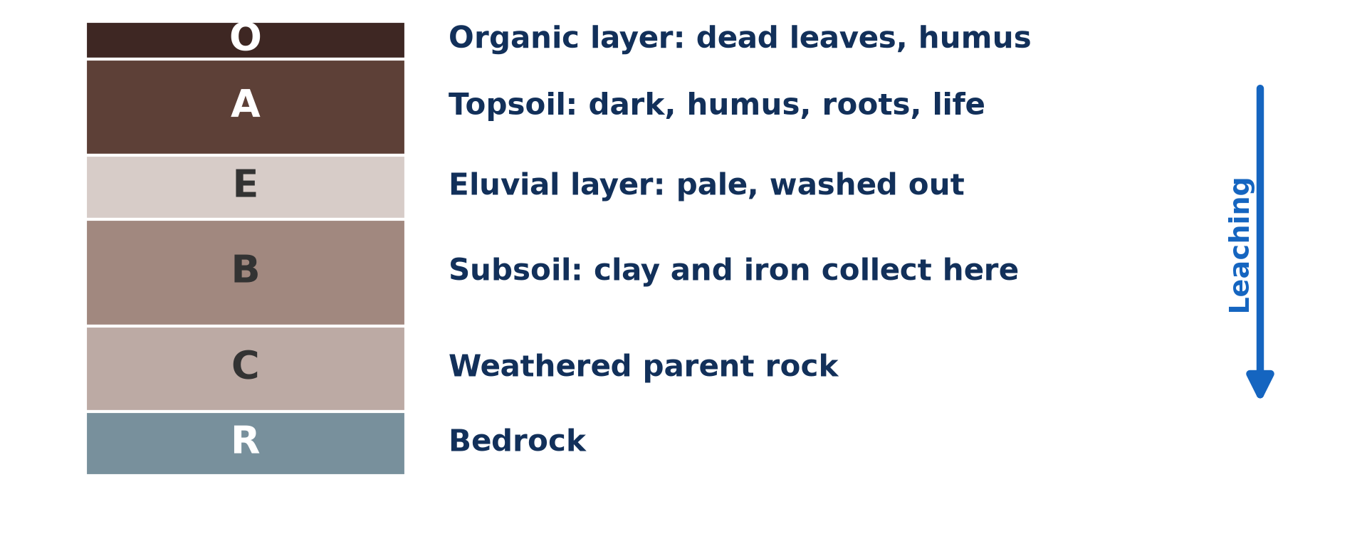
1. MEANING
Activity 1
The ideal soil profile.
Notes:
Activity 1. Look carefully at this diagram: the ideal soil profile. Observe every detail before I ask the question.

Slide 19
1. MEANING
Activity 1: Question
Name the horizons from the top to the bottom.
Notes:
Here is the question for Activity 1: Name the horizons from the top to the bottom. Take one minute to think and write your answer in your rough notebook.

Slide 20
1. MEANING
Activity 1: Answer
O, A, E, B, C and R.
Notes:
Let us check the answer together. O, A, E, B, C and R.

Slide 21

2. THE IDEAL SOIL PROFILE
Activity 2
A real soil profile in a pit.
Notes:
Activity 2. Look carefully at this picture: a real soil profile in a pit. Observe every detail before I ask the question.

Slide 22
2. THE IDEAL SOIL PROFILE
Activity 2: Question
Which horizon is darkest? Why?
Notes:
Here is the question for Activity 2: Which horizon is darkest? Why? Take one minute to think and write your answer in your rough notebook.

Slide 23
2. THE IDEAL SOIL PROFILE
Activity 2: Answer
The A horizon, because it is rich in humus.
Notes:
Let us check the answer together. The A horizon, because it is rich in humus.

Slide 24

2. HORIZONS
Activity 3
Dead leaves on the surface.
Notes:
Activity 3. Look carefully at this picture: dead leaves on the surface. Observe every detail before I ask the question.

Slide 25
2. HORIZONS
Activity 3: Question
Which horizon is made of dead leaves and humus?
Notes:
Here is the question for Activity 3: Which horizon is made of dead leaves and humus? Take one minute to think and write your answer in your rough notebook.

Slide 26
2. HORIZONS
Activity 3: Answer
The O (organic) horizon.
Notes:
Let us check the answer together. The O (organic) horizon.

Slide 27
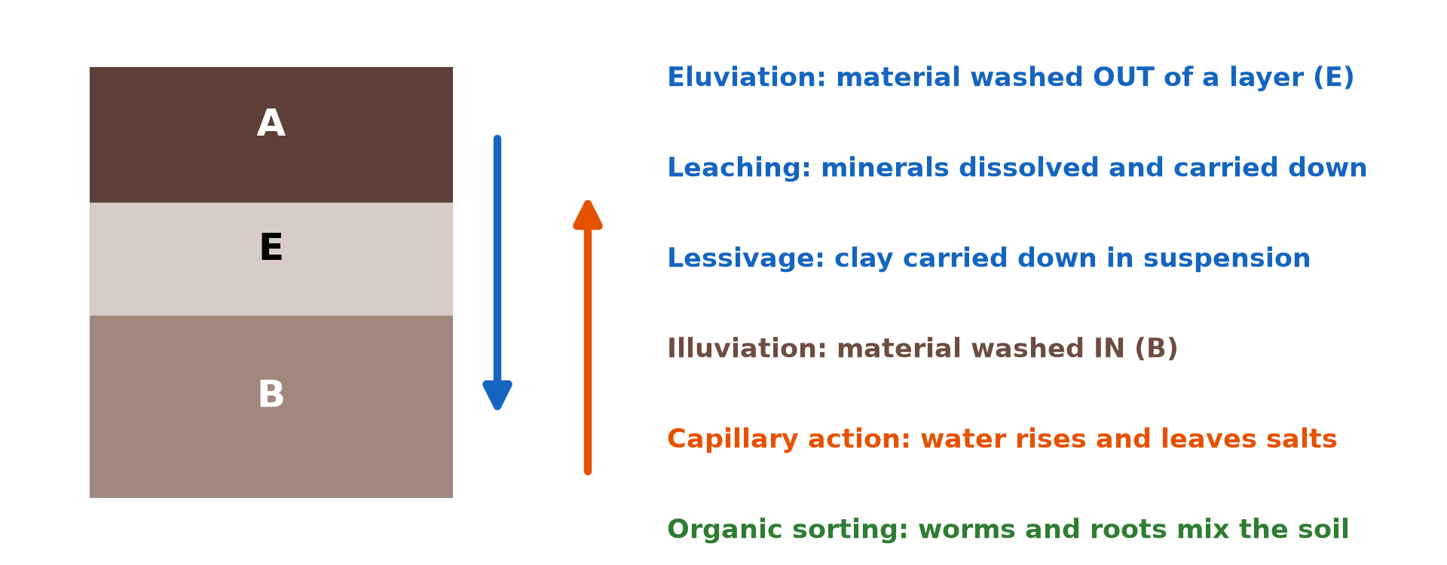
3. REASONS FOR HORIZONS
Activity 4
Materials washed out and washed in.
Notes:
Activity 4. Look carefully at this diagram: materials washed out and washed in. Observe every detail before I ask the question.

Slide 28
3. REASONS FOR HORIZONS
Activity 4: Question
Why is the E horizon pale and the B horizon rich in clay?
Notes:
Here is the question for Activity 4: Why is the E horizon pale and the B horizon rich in clay? Take one minute to think and write your answer in your rough notebook.

Slide 29
3. REASONS FOR HORIZONS
Activity 4: Answer
Water washes clay and iron out of E (eluviation) and leaves them in B (illuviation).
Notes:
Let us check the answer together. Water washes clay and iron out of E (eluviation) and leaves them in B (illuviation).

Slide 30

3. REASONS FOR HORIZONS
Activity 5
Weathering from the bottom and humus from the top.
Notes:
Activity 5. Look carefully at this diagram: weathering from the bottom and humus from the top. Observe every detail before I ask the question.

Slide 31
3. REASONS FOR HORIZONS
Activity 5: Question
Give two other reasons why horizons form.
Notes:
Here is the question for Activity 5: Give two other reasons why horizons form. Take one minute to think and write your answer in your rough notebook.

Slide 32
3. REASONS FOR HORIZONS
Activity 5: Answer
Humus is added from the top, and weathering works from the rock below.
Notes:
Let us check the answer together. Humus is added from the top, and weathering works from the rock below.

Slide 33
BOARD SUMMARY
Board Summary
Topic: Soil Development
Sub-topic: Soil Profile Development and Forming Processes
Lesson 8: The Soil Profile
Notes:
Now we are going to copy the board summary. Write the title and the headings neatly in your notebooks. I will give you enough time for each slide, so do not rush.

Slide 34
BOARD SUMMARY
1. Meaning of the Soil Profile
The soil profile can be understood as follows:
Soil profile: It is a vertical section of the soil from the surface down to the parent rock, showing its layers.
Notes:
Let us copy Meaning of the Soil Profile. The soil profile can be understood as follows. On this slide we have Soil profile. Write each point on a new line, with the key term first, and explain it in your own words when we revise. When you finish, we go to the next slide.

Slide 35
BOARD SUMMARY
1. Meaning of the Soil Profile (continued)
Horizon: It is a layer of the soil with its own colour, texture and structure. Horizons are named with letters.
Notes:
We continue with Meaning of the Soil Profile. On this slide we have Horizon. Write each point on a new line, with the key term first, and explain it in your own words when we revise.

Slide 36
BOARD SUMMARY
2. The Ideal Soil Profile
An ideal soil profile has the following horizons:
O horizon: It is the surface layer of litter and humus. It is dark and rich in organic matter.
Notes:
Let us copy The Ideal Soil Profile. An ideal soil profile has the following horizons. On this slide we have O horizon. Write each point on a new line, with the key term first, and explain it in your own words when we revise. When you finish, we go to the next slide.

Slide 37
BOARD SUMMARY
2. The Ideal Soil Profile (continued)
A horizon (topsoil): It is dark, fertile and full of roots and organisms. Materials are washed out of it (eluviation).
E and B horizons: The E horizon is pale because clay and iron are washed out. The B horizon (subsoil) collects clay, iron and humus (illuviation).
Notes:
We continue with The Ideal Soil Profile. On this slide we have A horizon (topsoil) and E and B horizons. Write each point on a new line, with the key term first, and explain it in your own words when we revise. When you finish, we go to the next slide.

Slide 38
BOARD SUMMARY
2. The Ideal Soil Profile (continued)
C and R horizons: C is the weathered parent material and R is the solid bedrock. They supply the minerals of the soil.
Notes:
We continue with The Ideal Soil Profile. On this slide we have C and R horizons. Write each point on a new line, with the key term first, and explain it in your own words when we revise.

Slide 39
BOARD SUMMARY
2. The Ideal Soil Profile
Illustration: the ideal soil profile
Notes:
Now draw this illustration in your notebook: the ideal soil profile. Give it a title and label it clearly.

Slide 40
BOARD SUMMARY
3. Reasons for Horizons
Soil profiles have horizons for the following reasons:
Movement of water: Water moving down carries clay, iron and nutrients from the top to lower layers. In dry areas, water moving up brings salts to the surface.
Notes:
Let us copy Reasons for Horizons. Soil profiles have horizons for the following reasons. On this slide we have Movement of water. Write each point on a new line, with the key term first, and explain it in your own words when we revise. When you finish, we go to the next slide.

Slide 41
BOARD SUMMARY
3. Reasons for Horizons (continued)
Organic matter and weathering: Organic matter is added at the surface, so the top is darker. Weathering is strongest near the surface and weaker at depth.
Organisms: Worms and roots are concentrated in the topsoil. They mix and enrich the upper horizons.
Notes:
We continue with Reasons for Horizons. On this slide we have Organic matter and weathering and Organisms. Write each point on a new line, with the key term first, and explain it in your own words when we revise.

Slide 42
FORMATIVE EVALUATION
Evaluation 1
What is a soil profile?
Notes:
Now let us check what you have understood. Question 1: What is a soil profile? Answer in your exercise book.

Slide 43
FORMATIVE EVALUATION
Expected Answer
A vertical section of soil from the surface to the rock.
Notes:
The expected answer is: a vertical section of soil from the surface to the rock. If you got it right, well done.

Slide 44
FORMATIVE EVALUATION
Evaluation 2
Distinguish eluviation and illuviation.
Notes:
Now let us check what you have understood. Question 2: Distinguish eluviation and illuviation. Answer in your exercise book.

Slide 45
FORMATIVE EVALUATION
Expected Answer
Eluviation washes materials out of a horizon; illuviation deposits them in a lower horizon.
Notes:
The expected answer is: eluviation washes materials out of a horizon; illuviation deposits them in a lower horizon. If you got it right, well done.

Slide 46
REMEDIATION
Remediation
Fill in the blanks:
The dark topsoil is the ______ horizon.
Clay and iron collect in the ______ horizon.
The bedrock is the ______ horizon.
Notes:
For those who need more practice, fill in the blanks in your exercise book. The answers are: number 1, A; number 2, B; number 3, R.

Slide 47
HOMEWORK
Homework
Draw a soil profile seen in a road cutting near your home and label the horizons.
Notes:
For your homework: Draw a soil profile seen in a road cutting near your home and label the horizons. We shall correct it at the beginning of our next lesson.

Slide 48
NEXT LESSON
Next Lesson
Our next lesson will be on:
Lesson 9: Major Pedogenic Regimes
Notes:
Our next lesson will be on Lesson 9: Major Pedogenic Regimes. Thank you for your attention, and see you next time.

Slide 49
BILINGUAL GAME
Bilingual Game (Jeu Bilingue)
English | Français
Profile | Le profil
Horizon | L'horizon
Topsoil | La couche arable
Subsoil | Le sous-sol
Bedrock | La roche en place
Eluviation | L'éluviation
Notes:
Let us play the bilingual game. I say a word in English, and you give me the French word. Then we do the reverse.

Slide 50
LOGBOOK
Official Logbook (1/2)
Module / Topic | Soil Development
Lesson Title | Lesson 8: The Soil Profile
Expected Learning Outcomes | Define soil profile and horizon. Describe the ideal soil profile. Explain why horizons form.
Competence | Learners are able to describe a soil profile and explain why soils have horizons.
Notes:
I record this information in the official logbook of the class after the lesson.

Slide 51
LOGBOOK
Official Logbook (2/2)
Matter Taught | Meaning of the Soil Profile; The Ideal Soil Profile; Reasons for Horizons.
Evaluation | Formative evaluation and remediation exercise.
Homework | Draw a soil profile seen in a road cutting near your home and label the horizons.
Enrolment / Present / Absent | ____ / ____ / ____
Achievement | To be completed after the lesson.
Notes:
I complete the second page of the logbook: the matter taught, the evaluation, the homework and the attendance.

Slide 52
TEACHER'S NOTE
Teacher's Note
Timing: Homework correction, plan, objectives 8 min | Recall, situation, action 10 min | 5 activities 30 min | Board summary (copying) 30 min | Evaluation, remediation 10 min | Homework, next lesson 5 min | Logbook 7 min
Without the projector (Activity 1): draw the profile.
Without the projector (Activity 2): describe a road cutting.
Without the projector (Activity 3): scrape the surface under a tree.
Without the projector (Activity 4): pour muddy water through sand.
Without the projector (Activity 5): draw arrows on the profile.
Notes:
This slide is for me, the teacher: it gives the timing of the lesson and what to do if the projector is not available.

Slide 53
REFERENCES
References
National Geography Syllabus, MINESEC/IGE/IP-SS, 2019 — Module 3 (Biogeography).
Photo, Activity 2: “Humic Dystrudept (fine-loamy, isotic, frigid)” by SoilScience.info, CC BY 2.0, via Flickr (https://www.flickr.com/photos/22503286@N06/5140645742)
Photo, Activity 3: “Heavily earthworm-infested soil” by esagor, CC BY-NC 2.0, via Flickr (https://www.flickr.com/photos/7357861@N03/1993224477)
Diagrams and animations: drawn for this lesson (Geography Department).
Notes:
These are the references and picture credits used to prepare this lesson.

