Slide 1
LOWER SIXTH ARTS
GEOGRAPHY
Lesson 10
Minor Soil Forming Processes
Notes:
Good morning, class, and welcome to our geography lesson. I am your geography teacher, Mr Kamdem. Today we are starting Lesson 10: Minor Soil Forming Processes.

Slide 2
CLASS INFO
Class, Chapter and Duration
Class | Lower Sixth Arts
Chapter | Module 3: Understanding and managing biogeographic zones across the world in general and Cameroon in particular
Duration | 2 periods (2 × 50 minutes)
Notes:
This lesson is for Lower Sixth Arts. It belongs to Module 3: Understanding and managing biogeographic zones across the world in general and Cameroon in particular. We shall need 2 periods to cover it.

Slide 3
IDENTIFICATION
Lesson Identification
Topic | Soil Development
Sub-topic | Soil Profile Development and Forming Processes
Lesson | Lesson 10: Minor Soil Forming Processes
Notions / Concepts | Weathering, eluviation, lessivage, leaching, illuviation, organic sorting, capillary action, translocation.
Syllabus focus | Weathering; eluviation (lessivage and leaching); illuviation; organic sorting; capillary action; translocation.
Competence | Learners are able to explain the small processes that move and change materials in soils.
Notes:
Our topic is Soil Development, and the sub-topic is Soil Profile Development and Forming Processes. The key notions we shall use today are: weathering, eluviation, lessivage, leaching, illuviation, organic sorting, capillary action, translocation. At the end, you should be able to do this: learners are able to explain the small processes that move and change materials in soils.

Slide 4

HOMEWORK CORRECTION
Correction of the Homework
Question (Lesson 9: Major Pedogenic Regimes):
Copy the pedogenic diagram and give one climate for each regime.
Notes:
Before we start the new lesson, let us correct the homework I gave you at the end of Lesson 9: Major Pedogenic Regimes. The question was: Copy the pedogenic diagram and give one climate for each regime. Take out your exercise books.

Slide 5
HOMEWORK CORRECTION
Correction: Possible Answer
Podsolisation: cool, wet taiga. Laterisation: hot, wet equatorial and savanna. Calcification: semi-arid steppe. Salinisation: hot desert. Gleying: swamps and floodplains.
Notes:
Here is a good answer. Podsolisation: cool, wet taiga. Laterisation: hot, wet equatorial and savanna. Calcification: semi-arid steppe. Salinisation: hot desert. Gleying: swamps and floodplains. Compare it with your own answer and correct your work in red.

Slide 6
LESSON PLAN
Lesson Plan
Correction of the homework
Objectives and recall
Real-life situation and action to take
Learning activities
Board summary
Evaluation, remediation and homework
Notes:
Here is the plan of our lesson today. First, we shall correct the homework. Then we shall look at the objectives and recall what you already know. After that, we shall study a situation from real life and the action to take, and do the learning activities. Finally, we shall copy the board summary, do the evaluation and the remediation, and I will give you the homework.

Slide 7
OBJECTIVES
Objectives
By the end of this lesson, you should be able to:
Explain weathering and translocation.
Distinguish eluviation, leaching, lessivage and illuviation.
Notes:
Take your time to copy this part; we will continue together.

Slide 8
OBJECTIVES
Objectives (continued)
Explain organic sorting and capillary action.
Notes:
By the end of this lesson, you should be able to do three things. Number 1: explain weathering and translocation. Number 2: distinguish eluviation, leaching, lessivage and illuviation. Number 3: explain organic sorting and capillary action.

Slide 9
PREVIOUS KNOWLEDGE
Previous Knowledge
Horizons form because materials move.
Pedogenic regimes depend on climate.
Notes:
Let us first remember what you already know. Horizons form because materials move. Pedogenic regimes depend on climate. Keep this in mind, because we shall build on it today.

Slide 10
REAL-LIFE SITUATION
Situation in Real Life
A learner fills a bottle with soil, pours water on it and sees brown water coming out at the bottom. He asks what the water took from the soil.
Notes:
Listen carefully to this situation from real life. A learner fills a bottle with soil, pours water on it and sees brown water coming out at the bottom. He asks what the water took from the soil. Think about it, because I am going to ask you some questions.

Slide 11
REAL-LIFE SITUATION
Situation: Question 1
What is the problem in the situation?
Notes:
Question 1: What is the problem in the situation? Think for a moment, then raise your hand to answer.

Slide 12
REAL-LIFE SITUATION
Answer
Water removes materials from the soil.
Notes:
Good. Water removes materials from the soil.

Slide 13
REAL-LIFE SITUATION
Situation: Question 2
What is this washing out called?
Notes:
Question 2: What is this washing out called? Think for a moment, then raise your hand to answer.

Slide 14
REAL-LIFE SITUATION
Answer
Eluviation (leaching for dissolved matter).
Notes:
Good. Eluviation (leaching for dissolved matter).

Slide 15
REAL-LIFE SITUATION
Situation: Question 3
Where do these materials go?
Notes:
Question 3: Where do these materials go? Think for a moment, then raise your hand to answer.

Slide 16
REAL-LIFE SITUATION
Possible Answer
Lower down, where they can be deposited (illuviation).
Notes:
Good. Lower down, where they can be deposited (illuviation).

Slide 17
ACTION TO TAKE
Action to Take
Understand small soil processes to manage leaching and salinity.
Notes:
From this situation, the action we are working towards in this lesson is the following: understand small soil processes to manage leaching and salinity.

Slide 18
JUSTIFICATION
Justification of the Lesson
This lesson helps us to understand the processes that build soil horizons and change fertility.
Notes:
Why is this lesson important for you? This lesson helps us to understand the processes that build soil horizons and change fertility.

Slide 19
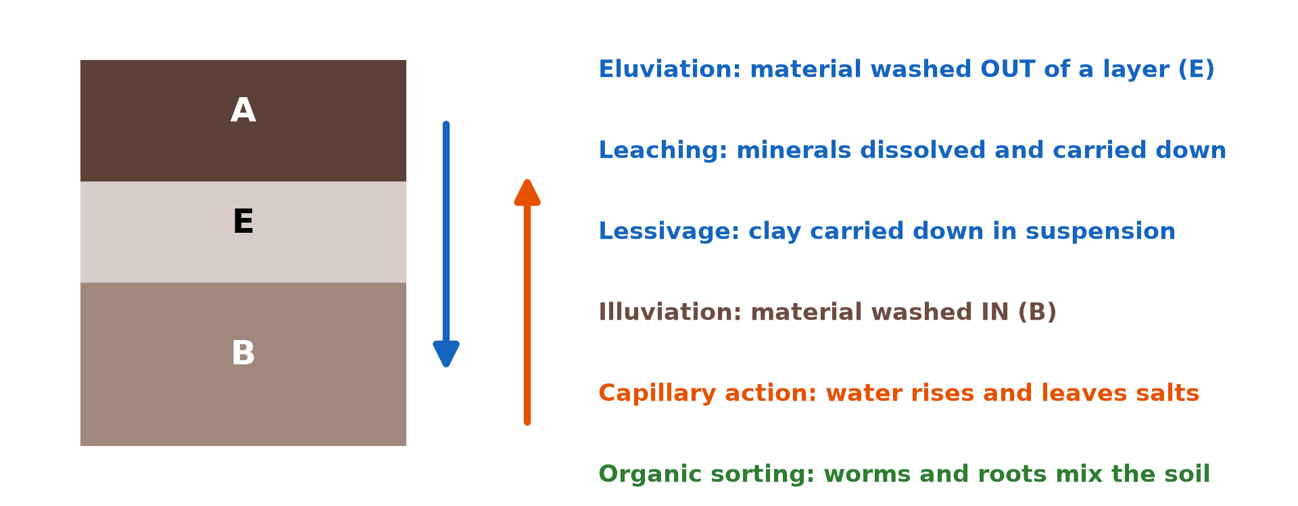
1. THE PROCESSES
Activity 1
The minor soil forming processes.
Notes:
Activity 1. Look carefully at this diagram: the minor soil forming processes. Observe every detail before I ask the question.

Slide 20
1. THE PROCESSES
Activity 1: Question
Distinguish leaching and lessivage.
Notes:
Here is the question for Activity 1: Distinguish leaching and lessivage. Take one minute to think and write your answer in your rough notebook.

Slide 21
1. THE PROCESSES
Activity 1: Answer
Leaching removes dissolved minerals; lessivage carries fine clay particles in suspension.
Notes:
Let us check the answer together. Leaching removes dissolved minerals; lessivage carries fine clay particles in suspension.

Slide 22

2. WEATHERING
Activity 2
Rust: iron oxidised by air and water.
Notes:
Activity 2. Look carefully at this picture: rust: iron oxidised by air and water. Observe every detail before I ask the question.

Slide 23
2. WEATHERING
Activity 2: Question
Which weathering process gives red soils?
Notes:
Here is the question for Activity 2: Which weathering process gives red soils? Take one minute to think and write your answer in your rough notebook.

Slide 24
2. WEATHERING
Activity 2: Answer
Oxidation of iron.
Notes:
Let us check the answer together. Oxidation of iron.

Slide 25

3. ELUVIATION: LEACHING
Activity 3
The humid rainforest.
Notes:
Activity 3. Look carefully at this picture: the humid rainforest. Observe every detail before I ask the question.

Slide 26
3. ELUVIATION: LEACHING
Activity 3: Question
Why is leaching strong under rainforest?
Notes:
Here is the question for Activity 3: Why is leaching strong under rainforest? Take one minute to think and write your answer in your rough notebook.

Slide 27
3. ELUVIATION: LEACHING
Activity 3: Answer
Heavy rain moves down through the soil all year.
Notes:
Let us check the answer together. Heavy rain moves down through the soil all year.

Slide 28
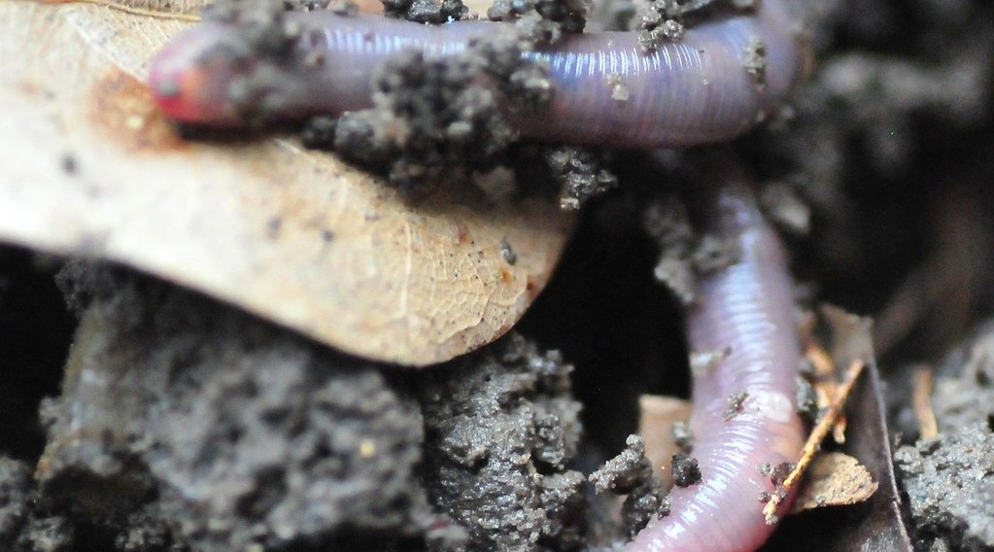
5. ORGANIC SORTING
Activity 4
An earthworm in the soil.
Notes:
Activity 4. Look carefully at this picture: an earthworm in the soil. Observe every detail before I ask the question.

Slide 29
5. ORGANIC SORTING
Activity 4: Question
How do worms sort and mix the soil?
Notes:
Here is the question for Activity 4: How do worms sort and mix the soil? Take one minute to think and write your answer in your rough notebook.

Slide 30
5. ORGANIC SORTING
Activity 4: Answer
They carry fine soil and humus up and down through their tunnels.
Notes:
Let us check the answer together. They carry fine soil and humus up and down through their tunnels.

Slide 31

6. CAPILLARY ACTION
Activity 5
A white salt crust.
Notes:
Activity 5. Look carefully at this picture: a white salt crust. Observe every detail before I ask the question.

Slide 32
6. CAPILLARY ACTION
Activity 5: Question
How does capillary action form this crust?
Notes:
Here is the question for Activity 5: How does capillary action form this crust? Take one minute to think and write your answer in your rough notebook.

Slide 33
6. CAPILLARY ACTION
Activity 5: Answer
Water rises in small pores, evaporates and leaves salts.
Notes:
Let us check the answer together. Water rises in small pores, evaporates and leaves salts.

Slide 34
BOARD SUMMARY
Board Summary
Topic: Soil Development
Sub-topic: Soil Profile Development and Forming Processes
Lesson 10: Minor Soil Forming Processes
Notes:
Now we are going to copy the board summary. Write the title and the headings neatly in your notebooks. I will give you enough time for each slide, so do not rush.

Slide 35
BOARD SUMMARY
Minor Soil-Forming Processes
A) Weathering and Eluviation
The first minor processes are:
Weathering: It breaks the parent rock into mineral particles and releases nutrients. Oxidation of iron gives red and yellow soils.
Notes:
Let us copy Weathering and Eluviation. The first minor processes are. On this slide we have Weathering. Write each point on a new line, with the key term first, and explain it in your own words when we revise. When you finish, we go to the next slide.

Slide 36
BOARD SUMMARY
Minor Soil-Forming Processes
A) Weathering and Eluviation (continued)
Leaching: It is the washing down of soluble nutrients (calcium, potassium) by water. It is strong under heavy rain and makes soils acid.
Notes:
We continue with Weathering and Eluviation. On this slide we have Leaching. Write each point on a new line, with the key term first, and explain it in your own words when we revise. When you finish, we go to the next slide.

Slide 37
BOARD SUMMARY
Minor Soil-Forming Processes
A) Weathering and Eluviation (continued)
Lessivage: It is the washing down of fine clay particles in suspension. It leaves a sandier upper horizon.
Notes:
We continue with Weathering and Eluviation. On this slide we have Lessivage. Write each point on a new line, with the key term first, and explain it in your own words when we revise.

Slide 38
BOARD SUMMARY
Minor Soil-Forming Processes
Illustration: minor soil processes
Notes:
Now draw this illustration in your notebook: minor soil processes. Give it a title and label it clearly.

Slide 39
BOARD SUMMARY
Minor Soil-Forming Processes
B) Illuviation, Sorting and Translocation
Other minor processes are:
Illuviation: It is the deposition in the B horizon of the materials washed down from above. Clay and iron accumulate there.
Notes:
Let us copy Illuviation, Sorting and Translocation. Other minor processes are. On this slide we have Illuviation. Write each point on a new line, with the key term first, and explain it in your own words when we revise. When you finish, we go to the next slide.

Slide 40
BOARD SUMMARY
Minor Soil-Forming Processes
B) Illuviation, Sorting and Translocation (continued)
Organic sorting: Earthworms, termites and ants move and mix soil particles and organic matter. They bring fine material to the surface.
Notes:
We continue with Illuviation, Sorting and Translocation. On this slide we have Organic sorting. Write each point on a new line, with the key term first, and explain it in your own words when we revise. When you finish, we go to the next slide.

Slide 41
BOARD SUMMARY
Minor Soil-Forming Processes
B) Illuviation, Sorting and Translocation (continued)
Capillary action: In dry areas water rises through fine pores and evaporates, leaving salts at the surface. This can form salt crusts.
Notes:
We continue with Illuviation, Sorting and Translocation. On this slide we have Capillary action. Write each point on a new line, with the key term first, and explain it in your own words when we revise. When you finish, we go to the next slide.

Slide 42
BOARD SUMMARY
Minor Soil-Forming Processes
B) Illuviation, Sorting and Translocation (continued)
Translocation: It is the general movement of materials within the profile, up or down. It creates the differences between horizons.
Notes:
We continue with Illuviation, Sorting and Translocation. On this slide we have Translocation. Write each point on a new line, with the key term first, and explain it in your own words when we revise.

Slide 43
FORMATIVE EVALUATION
Evaluation 1
Distinguish eluviation and illuviation.
Notes:
Now let us check what you have understood. Question 1: Distinguish eluviation and illuviation. Answer in your exercise book.

Slide 44
FORMATIVE EVALUATION
Expected Answer
Eluviation washes materials out of a horizon; illuviation deposits them in a lower horizon.
Notes:
The expected answer is: eluviation washes materials out of a horizon; illuviation deposits them in a lower horizon. If you got it right, well done.

Slide 45
FORMATIVE EVALUATION
Evaluation 2
What is capillary action?
Notes:
Now let us check what you have understood. Question 2: What is capillary action? Answer in your exercise book.

Slide 46
FORMATIVE EVALUATION
Expected Answer
The rise of water through small pores, leaving salts when it evaporates.
Notes:
The expected answer is: the rise of water through small pores, leaving salts when it evaporates. If you got it right, well done.

Slide 47
REMEDIATION
Remediation
Fill in the blanks:
Removal of dissolved minerals is ______.
Movement of clay in suspension is ______.
Mixing by worms is organic ______.
Notes:
For those who need more practice, fill in the blanks in your exercise book. The answers are: number 1, leaching; number 2, lessivage; number 3, sorting.

Slide 48
HOMEWORK
Homework
Pour water through soil in a bottle and describe the water that comes out.
Notes:
For your homework: Pour water through soil in a bottle and describe the water that comes out. We shall correct it at the beginning of our next lesson.

Slide 49
NEXT LESSON
Next Lesson
Our next lesson will be on:
Lesson 11: Classes of Soil
Notes:
Our next lesson will be on Lesson 11: Classes of Soil. Thank you for your attention, and see you next time.

Slide 50
BILINGUAL GAME
Bilingual Game (Jeu Bilingue)
English | Français
Leaching | Le lessivage (dissolution)
Suspension | La suspension
Capillary | Capillaire
Salt | Le sel
Oxidation | L'oxydation
Translocation | La migration
Notes:
Let us play the bilingual game. I say a word in English, and you give me the French word. Then we do the reverse.

Slide 51
LOGBOOK
Official Logbook (1/2)
Module / Topic | Soil Development
Lesson Title | Lesson 10: Minor Soil Forming Processes
Expected Learning Outcomes | Explain weathering and translocation. Distinguish eluviation, leaching, lessivage and illuviation. Explain organic sorting and capillary action.
Competence | Learners are able to explain the small processes that move and change materials in soils.
Notes:
I record this information in the official logbook of the class after the lesson.

Slide 52
LOGBOOK
Official Logbook (2/2)
Matter Taught | Weathering and Eluviation; Illuviation, Sorting and Translocation.
Evaluation | Formative evaluation and remediation exercise.
Homework | Pour water through soil in a bottle and describe the water that comes out.
Enrolment / Present / Absent | ____ / ____ / ____
Achievement | To be completed after the lesson.
Notes:
I complete the second page of the logbook: the matter taught, the evaluation, the homework and the attendance.

Slide 53
TEACHER'S NOTE
Teacher's Note
Timing: Homework correction, plan, objectives 8 min | Recall, situation, action 10 min | 5 activities 30 min | Board summary (copying) 30 min | Evaluation, remediation 10 min | Homework, next lesson 5 min | Logbook 7 min
Without the projector (Activity 1): filter muddy and salty water.
Without the projector (Activity 2): show rusty metal.
Without the projector (Activity 3): compare with the Sahel.
Without the projector (Activity 4): look for worm casts.
Without the projector (Activity 5): dip a sugar cube in coloured water.
Notes:
This slide is for me, the teacher: it gives the timing of the lesson and what to do if the projector is not available.

Slide 54
REFERENCES
References
National Geography Syllabus, MINESEC/IGE/IP-SS, 2019 — Module 3 (Biogeography).
Photo, Activity 2: “Lock down!” by ViNo Gv, CC BY 2.0, via Flickr (https://www.flickr.com/photos/38217093@N03/20143584561)
Photo, Activity 3: “Amazon 11” by CIAT International Center for Tropical Agriculture, CC BY-SA 2.0, via Flickr (https://www.flickr.com/photos/38476503@N08/5641587148)
Photo, Activity 4: “Earthworm In Soil” by jwinfred, CC BY-NC-ND 2.0, via Flickr (https://www.flickr.com/photos/98937825@N00/3532746937)
Photo, Activity 5: “Salt” by Phillie Casablanca, CC BY 2.0, via Flickr (https://www.flickr.com/photos/19451080@N00/2052715618)
Diagrams and animations: drawn for this lesson (Geography Department).
Notes:
These are the references and picture credits used to prepare this lesson.

