Slide 1
LOWER SIXTH ARTS
GEOGRAPHY
Lesson 11
Classes of Soil
Notes:
Good morning, class, and welcome to our geography lesson. I am your geography teacher, Mr Kamdem. Today we are starting Lesson 11: Classes of Soil.

Slide 2
CLASS INFO
Class, Chapter and Duration
Class | Lower Sixth Arts
Chapter | Module 3: Understanding and managing biogeographic zones across the world in general and Cameroon in particular
Duration | 2 periods (2 × 50 minutes)
Notes:
This lesson is for Lower Sixth Arts. It belongs to Module 3: Understanding and managing biogeographic zones across the world in general and Cameroon in particular. We shall need 2 periods to cover it.

Slide 3
IDENTIFICATION
Lesson Identification
Topic | Soil Development
Sub-topic | Classification of Soils
Lesson | Lesson 11: Classes of Soil
Notions / Concepts | Soil classification, zonal, intrazonal, azonal soils.
Syllabus focus | Basis of classification; zonal, intrazonal and azonal soils: meaning and characteristics.
Competence | Learners are able to classify soils into zonal, intrazonal and azonal groups with examples.
Notes:
Our topic is Soil Development, and the sub-topic is Classification of Soils. The key notions we shall use today are: soil classification, zonal, intrazonal, azonal soils. At the end, you should be able to do this: learners are able to classify soils into zonal, intrazonal and azonal groups with examples.

Slide 4

HOMEWORK CORRECTION
Correction of the Homework
Question (Lesson 10: Minor Soil Forming Processes):
Pour water through soil in a bottle and describe the water that comes out.
Notes:
Before we start the new lesson, let us correct the homework I gave you at the end of Lesson 10: Minor Soil Forming Processes. The question was: Pour water through soil in a bottle and describe the water that comes out. Take out your exercise books.

Slide 5
HOMEWORK CORRECTION
Correction: Possible Answer
The water coming out of the bottle is coloured (brown) and cloudy, because it carries dissolved nutrients and fine clay particles washed out of the soil (leaching and lessivage).
Notes:
Here is a good answer. The water coming out of the bottle is coloured (brown) and cloudy, because it carries dissolved nutrients and fine clay particles washed out of the soil (leaching and lessivage). Compare it with your own answer and correct your work in red.

Slide 6
LESSON PLAN
Lesson Plan
Correction of the homework
Objectives and recall
Real-life situation and action to take
Learning activities
Board summary
Evaluation, remediation and homework
Notes:
Here is the plan of our lesson today. First, we shall correct the homework. Then we shall look at the objectives and recall what you already know. After that, we shall study a situation from real life and the action to take, and do the learning activities. Finally, we shall copy the board summary, do the evaluation and the remediation, and I will give you the homework.

Slide 7
OBJECTIVES
Objectives
By the end of this lesson, you should be able to:
Explain the basis of soil classification.
Describe zonal soils.
Describe intrazonal and azonal soils.
Notes:
By the end of this lesson, you should be able to do three things. Number 1: explain the basis of soil classification. Number 2: describe zonal soils. Number 3: describe intrazonal and azonal soils.

Slide 8
PREVIOUS KNOWLEDGE
Previous Knowledge
Climate controls the main pedogenic regimes.
Young soils have few horizons.
Notes:
Let us first remember what you already know. Climate controls the main pedogenic regimes. Young soils have few horizons. Keep this in mind, because we shall build on it today.

Slide 9
REAL-LIFE SITUATION
Situation in Real Life
Along the Logone, farmers grow rice on grey, wet soils, while a few kilometres away the soils are dry and sandy. On the slopes of Mount Cameroon, young ash soils have no clear layers.
Notes:
Listen carefully to this situation from real life. Along the Logone, farmers grow rice on grey, wet soils, while a few kilometres away the soils are dry and sandy. On the slopes of Mount Cameroon, young ash soils have no clear layers. Think about it, because I am going to ask you some questions.

Slide 10
REAL-LIFE SITUATION
Situation: Question 1
What is the problem in the situation?
Notes:
Question 1: What is the problem in the situation? Think for a moment, then raise your hand to answer.

Slide 11
REAL-LIFE SITUATION
Answer
Soils in the same region are very different.
Notes:
Good. Soils in the same region are very different.

Slide 12
REAL-LIFE SITUATION
Situation: Question 2
Why are the Logone soils grey and wet?
Notes:
Question 2: Why are the Logone soils grey and wet? Think for a moment, then raise your hand to answer.

Slide 13
REAL-LIFE SITUATION
Answer
They are waterlogged (a local factor).
Notes:
Good. They are waterlogged (a local factor).

Slide 14
REAL-LIFE SITUATION
Situation: Question 3
How are soils grouped?
Notes:
Question 3: How are soils grouped? Think for a moment, then raise your hand to answer.

Slide 15
REAL-LIFE SITUATION
Possible Answer
Into zonal, intrazonal and azonal soils.
Notes:
Good. Into zonal, intrazonal and azonal soils.

Slide 16
ACTION TO TAKE
Action to Take
Identify the soil classes of our area to use them properly.
Notes:
From this situation, the action we are working towards in this lesson is the following: identify the soil classes of our area to use them properly.

Slide 17
JUSTIFICATION
Justification of the Lesson
This lesson helps us to classify soils and understand why they differ even in the same climate.
Notes:
Why is this lesson important for you? This lesson helps us to classify soils and understand why they differ even in the same climate.

Slide 18
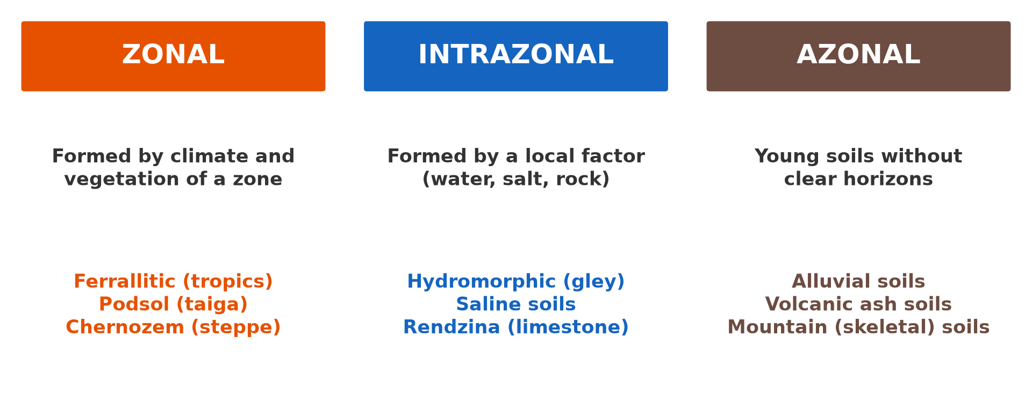
1. BASIS OF CLASSIFICATION
Activity 1
The three classes of soil.
Notes:
Activity 1. Look carefully at this diagram: the three classes of soil. Observe every detail before I ask the question.

Slide 19
1. BASIS OF CLASSIFICATION
Activity 1: Question
On what basis are soils divided into zonal, intrazonal and azonal?
Notes:
Here is the question for Activity 1: On what basis are soils divided into zonal, intrazonal and azonal? Take one minute to think and write your answer in your rough notebook.

Slide 20
1. BASIS OF CLASSIFICATION
Activity 1: Answer
On the main factor that formed them and on their maturity.
Notes:
Let us check the answer together. On the main factor that formed them and on their maturity.

Slide 21

2. ZONAL SOILS
Activity 2
A ferrallitic soil of the humid tropics.
Notes:
Activity 2. Look carefully at this picture: a ferrallitic soil of the humid tropics. Observe every detail before I ask the question.

Slide 22
2. ZONAL SOILS
Activity 2: Question
Why is this a zonal soil?
Notes:
Here is the question for Activity 2: Why is this a zonal soil? Take one minute to think and write your answer in your rough notebook.

Slide 23
2. ZONAL SOILS
Activity 2: Answer
It was formed mainly by the climate and vegetation of its zone.
Notes:
Let us check the answer together. It was formed mainly by the climate and vegetation of its zone.

Slide 24

3. INTRAZONAL SOILS
Activity 3
Rice on a waterlogged soil.
Notes:
Activity 3. Look carefully at this picture: rice on a waterlogged soil. Observe every detail before I ask the question.

Slide 25
3. INTRAZONAL SOILS
Activity 3: Question
Why are waterlogged soils called intrazonal?
Notes:
Here is the question for Activity 3: Why are waterlogged soils called intrazonal? Take one minute to think and write your answer in your rough notebook.

Slide 26
3. INTRAZONAL SOILS
Activity 3: Answer
A local factor (water) is stronger than the climate.
Notes:
Let us check the answer together. A local factor (water) is stronger than the climate.

Slide 27
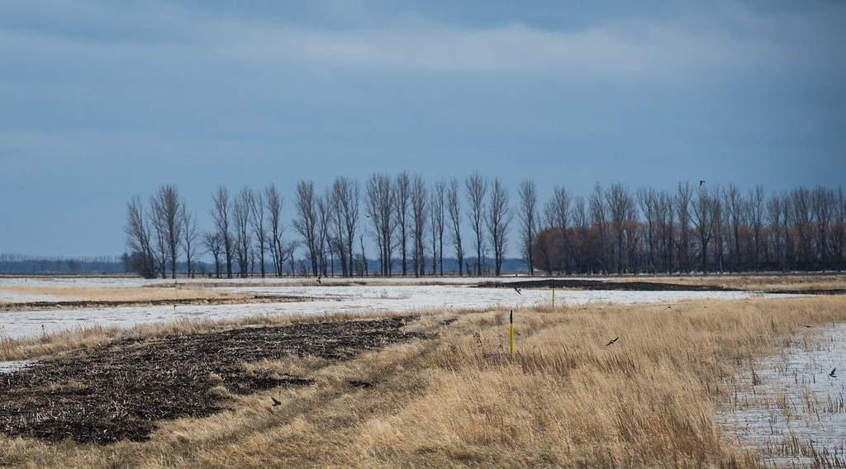
4. AZONAL SOILS
Activity 4
A river floodplain.
Notes:
Activity 4. Look carefully at this picture: a river floodplain. Observe every detail before I ask the question.

Slide 28
4. AZONAL SOILS
Activity 4: Question
Why are alluvial soils azonal?
Notes:
Here is the question for Activity 4: Why are alluvial soils azonal? Take one minute to think and write your answer in your rough notebook.

Slide 29
4. AZONAL SOILS
Activity 4: Answer
They are young, new layers of mud with no clear horizons.
Notes:
Let us check the answer together. They are young, new layers of mud with no clear horizons.

Slide 30
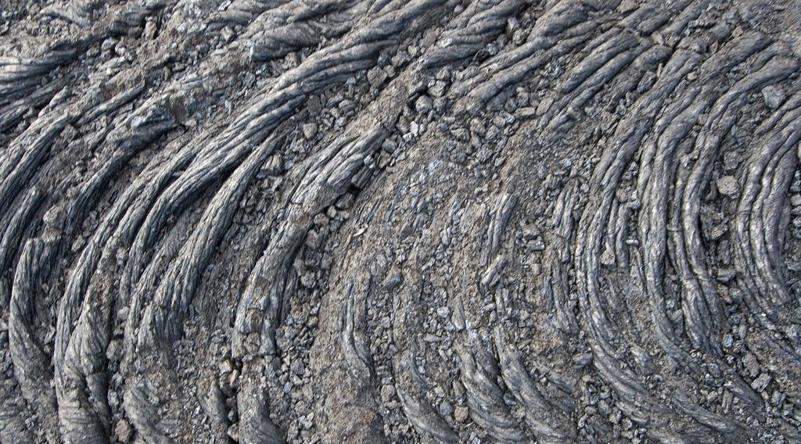
4. AZONAL SOILS
Activity 5
Young lava.
Notes:
Activity 5. Look carefully at this picture: young lava. Observe every detail before I ask the question.

Slide 31
4. AZONAL SOILS
Activity 5: Question
Why are soils on young lava or ash azonal?
Notes:
Here is the question for Activity 5: Why are soils on young lava or ash azonal? Take one minute to think and write your answer in your rough notebook.

Slide 32
4. AZONAL SOILS
Activity 5: Answer
There has not been enough time for horizons to form.
Notes:
Let us check the answer together. There has not been enough time for horizons to form.

Slide 33
BOARD SUMMARY
Board Summary
Topic: Soil Development
Sub-topic: Classification of Soils
Lesson 11: Classes of Soil
Notes:
Now we are going to copy the board summary. Write the title and the headings neatly in your notebooks. I will give you enough time for each slide, so do not rush.

Slide 34
BOARD SUMMARY
1. Basis of Soil Classification
Soils are classified as follows:
Basis: Soils are classified according to their degree of development and the main factor that formed them. Climate and vegetation are the main basis of the zonal classification.
Notes:
Let us copy Basis of Soil Classification. Soils are classified as follows. On this slide we have Basis. Write each point on a new line, with the key term first, and explain it in your own words when we revise. When you finish, we go to the next slide.

Slide 35
BOARD SUMMARY
1. Basis of Soil Classification (continued)
Three classes: Zonal soils reflect climate, intrazonal soils reflect a local factor, and azonal soils are young and immature. This classification is used on the soil maps of Cameroon.
Notes:
We continue with Basis of Soil Classification. On this slide we have Three classes. Write each point on a new line, with the key term first, and explain it in your own words when we revise.

Slide 36
BOARD SUMMARY
1. Basis of Soil Classification
Illustration: classes of soil
Notes:
Now draw this illustration in your notebook: classes of soil. Give it a title and label it clearly.

Slide 37
BOARD SUMMARY
2. Zonal, Intrazonal and Azonal Soils
The meaning and characteristics of each class are:
Zonal soils: They are mature soils with well-developed horizons, formed mainly by climate and vegetation over a long time. Examples are ferrallitic soils, podsols and chernozems.
Notes:
Let us copy Zonal, Intrazonal and Azonal Soils. The meaning and characteristics of each class are. On this slide we have Zonal soils. Write each point on a new line, with the key term first, and explain it in your own words when we revise. When you finish, we go to the next slide.

Slide 38
BOARD SUMMARY
2. Zonal, Intrazonal and Azonal Soils (continued)
Intrazonal soils: They are soils formed mainly by a local factor such as bad drainage, salt or limestone. Examples are hydromorphic (gley) soils and saline soils.
Notes:
We continue with Zonal, Intrazonal and Azonal Soils. On this slide we have Intrazonal soils. Write each point on a new line, with the key term first, and explain it in your own words when we revise. When you finish, we go to the next slide.

Slide 39
BOARD SUMMARY
2. Zonal, Intrazonal and Azonal Soils (continued)
Azonal soils: They are young soils without clear horizons, because they formed recently or are constantly renewed. Examples are alluvial soils, volcanic ash soils and mountain soils.
Notes:
We continue with Zonal, Intrazonal and Azonal Soils. On this slide we have Azonal soils. Write each point on a new line, with the key term first, and explain it in your own words when we revise.

Slide 40
FORMATIVE EVALUATION
Evaluation 1
Distinguish zonal and azonal soils.
Notes:
Now let us check what you have understood. Question 1: Distinguish zonal and azonal soils. Answer in your exercise book.

Slide 41
FORMATIVE EVALUATION
Expected Answer
Zonal soils are mature and follow climate; azonal soils are young without clear horizons.
Notes:
The expected answer is: zonal soils are mature and follow climate; azonal soils are young without clear horizons. If you got it right, well done.

Slide 42
FORMATIVE EVALUATION
Evaluation 2
Give one example of each class.
Notes:
Now let us check what you have understood. Question 2: Give one example of each class. Answer in your exercise book.

Slide 43
FORMATIVE EVALUATION
Expected Answer
Zonal: ferrallitic; intrazonal: hydromorphic; azonal: alluvial.
Notes:
The expected answer is: zonal: ferrallitic; intrazonal: hydromorphic; azonal: alluvial. If you got it right, well done.

Slide 44
REMEDIATION
Remediation
Fill in the blanks:
Soils formed by climate are ______.
Waterlogged soils are ______.
Alluvial soils are ______.
Notes:
For those who need more practice, fill in the blanks in your exercise book. The answers are: number 1, zonal; number 2, intrazonal; number 3, azonal.

Slide 45
HOMEWORK
Homework
Give one zonal, one intrazonal and one azonal soil found in Cameroon.
Notes:
For your homework: Give one zonal, one intrazonal and one azonal soil found in Cameroon. We shall correct it at the beginning of our next lesson.

Slide 46
NEXT LESSON
Next Lesson
Our next lesson will be on:
Further Study 1: Soils of Cameroon
Notes:
Our next lesson will be on Further Study 1: Soils of Cameroon. Thank you for your attention, and see you next time.

Slide 47
BILINGUAL GAME
Bilingual Game (Jeu Bilingue)
English | Français
Classification | La classification
Zonal | Zonal
Alluvial | Alluvial
Waterlogged | Engorgé d'eau
Mature | Évolué
Young | Jeune
Notes:
Let us play the bilingual game. I say a word in English, and you give me the French word. Then we do the reverse.

Slide 48
LOGBOOK
Official Logbook (1/2)
Module / Topic | Soil Development
Lesson Title | Lesson 11: Classes of Soil
Expected Learning Outcomes | Explain the basis of soil classification. Describe zonal soils. Describe intrazonal and azonal soils.
Competence | Learners are able to classify soils into zonal, intrazonal and azonal groups with examples.
Notes:
I record this information in the official logbook of the class after the lesson.

Slide 49
LOGBOOK
Official Logbook (2/2)
Matter Taught | Basis of Soil Classification; Zonal, Intrazonal and Azonal Soils.
Evaluation | Formative evaluation and remediation exercise.
Homework | Give one zonal, one intrazonal and one azonal soil found in Cameroon.
Enrolment / Present / Absent | ____ / ____ / ____
Achievement | To be completed after the lesson.
Notes:
I complete the second page of the logbook: the matter taught, the evaluation, the homework and the attendance.

Slide 50
TEACHER'S NOTE
Teacher's Note
Timing: Homework correction, plan, objectives 8 min | Recall, situation, action 10 min | 5 activities 30 min | Board summary (copying) 30 min | Evaluation, remediation 10 min | Homework, next lesson 5 min | Logbook 7 min
Without the projector (Activity 1): draw the three boxes.
Without the projector (Activity 2): match soils to climate zones.
Without the projector (Activity 3): describe swampy valleys.
Without the projector (Activity 4): describe fields beside a river.
Without the projector (Activity 5): mention Mount Cameroon lava flows.
Notes:
This slide is for me, the teacher: it gives the timing of the lesson and what to do if the projector is not available.

Slide 51
REFERENCES
References
National Geography Syllabus, MINESEC/IGE/IP-SS, 2019 — Module 3 (Biogeography).
Photo, Activity 2: “in the middle of nowhere, morocco” by mariusz kluzniak, CC BY-NC-ND 2.0, via Flickr (https://www.flickr.com/photos/39997856@N03/8398997251)
Photo, Activity 3: “Irrigated rice fields in Sefula, Zambia. Photo by Kate Longley, 2013.” by WorldFish, CC BY-NC-ND 2.0, via Flickr (https://www.flickr.com/photos/61545321@N06/8608804590)
Photo, Activity 4: “20130501-NRCS-LSC-0605” by USDAgov, Public domain 1.0, via Flickr (https://www.flickr.com/photos/41284017@N08/8725089904)
Photo, Activity 5: “Pahoehoe Lava Flow” by graysky., CC BY-NC-SA 2.0, via Flickr (https://www.flickr.com/photos/20021588@N00/540223861)
Diagrams and animations: drawn for this lesson (Geography Department).
Notes:
These are the references and picture credits used to prepare this lesson.

