Slide 1
LOWER SIXTH ARTS
GEOGRAPHY
Lesson 20
Interactions within Ecosystems
Notes:
Good morning, class, and welcome to our geography lesson. I am your geography teacher, Mr Kamdem. Today we are starting Lesson 20: Interactions within Ecosystems.

Slide 2
CLASS INFO
Class, Chapter and Duration
Class | Lower Sixth Arts
Chapter | Module 3: Understanding and managing biogeographic zones across the world in general and Cameroon in particular
Duration | 2 periods (2 × 50 minutes)
Notes:
This lesson is for Lower Sixth Arts. It belongs to Module 3: Understanding and managing biogeographic zones across the world in general and Cameroon in particular. We shall need 2 periods to cover it.

Slide 3
IDENTIFICATION
Lesson Identification
Topic | Ecological Systems (Ecosystems)
Sub-topic | The Structure of an Ecosystem
Lesson | Lesson 20: Interactions within Ecosystems
Notions / Concepts | Compartment, four-compartment model, equilibrium, dynamic equilibrium, disequilibrium, feedback.
Syllabus focus | Structure with four compartments; interrelations; equilibrium and its nature; factors of disequilibrium, notably man.
Competence | Learners are able to explain the equilibrium of ecosystems and how man can upset it.
Notes:
Our topic is Ecological Systems (Ecosystems), and the sub-topic is The Structure of an Ecosystem. The key notions we shall use today are: compartment, four-compartment model, equilibrium, dynamic equilibrium, disequilibrium, feedback. At the end, you should be able to do this: learners are able to explain the equilibrium of ecosystems and how man can upset it.

Slide 4

HOMEWORK CORRECTION
Correction of the Homework
Question (Lesson 19: Examples of Ecosystems: The Pond):
Observe a pond or stream and list what lives in it.
Notes:
Before we start the new lesson, let us correct the homework I gave you at the end of Lesson 19: Examples of Ecosystems: The Pond. The question was: Observe a pond or stream and list what lives in it. Take out your exercise books.

Slide 5
HOMEWORK CORRECTION
Correction: Possible Answer
In a pond or stream: water plants, algae, frogs and tadpoles, insects (mosquito larvae, water beetles), small fish, snails and birds that feed there.
Notes:
Here is a good answer. In a pond or stream: water plants, algae, frogs and tadpoles, insects (mosquito larvae, water beetles), small fish, snails and birds that feed there. Compare it with your own answer and correct your work in red.

Slide 6
LESSON PLAN
Lesson Plan
Correction of the homework
Objectives and recall
Real-life situation and action to take
Learning activities
Board summary
Evaluation, remediation and homework
Notes:
Here is the plan of our lesson today. First, we shall correct the homework. Then we shall look at the objectives and recall what you already know. After that, we shall study a situation from real life and the action to take, and do the learning activities. Finally, we shall copy the board summary, do the evaluation and the remediation, and I will give you the homework.

Slide 7
OBJECTIVES
Objectives
By the end of this lesson, you should be able to:
Describe the four compartments of an ecosystem.
Explain the interrelations and the equilibrium between them.
Notes:
Take your time to copy this part; we will continue together.

Slide 8
OBJECTIVES
Objectives (continued)
Explain the factors of disequilibrium, especially man.
Notes:
By the end of this lesson, you should be able to do three things. Number 1: describe the four compartments of an ecosystem. Number 2: explain the interrelations and the equilibrium between them. Number 3: explain the factors of disequilibrium, especially man.

Slide 9
PREVIOUS KNOWLEDGE
Previous Knowledge
An ecosystem is an open system.
Nutrients move between biomass, litter and soil.
Notes:
Let us first remember what you already know. An ecosystem is an open system. Nutrients move between biomass, litter and soil. Keep this in mind, because we shall build on it today.

Slide 10
REAL-LIFE SITUATION
Situation in Real Life
For many years, farmers around Garoua cleared land, burned bush and kept large herds. Now the soils are poor, the grass is thin and the rains wash the soil away.
Notes:
Listen carefully to this situation from real life. For many years, farmers around Garoua cleared land, burned bush and kept large herds. Now the soils are poor, the grass is thin and the rains wash the soil away. Think about it, because I am going to ask you some questions.

Slide 11
REAL-LIFE SITUATION
Situation: Question 1
What is the problem in the situation?
Notes:
Question 1: What is the problem in the situation? Think for a moment, then raise your hand to answer.

Slide 12
REAL-LIFE SITUATION
Answer
The ecosystem has lost its balance.
Notes:
Good. The ecosystem has lost its balance.

Slide 13
REAL-LIFE SITUATION
Situation: Question 2
What caused this?
Notes:
Question 2: What caused this? Think for a moment, then raise your hand to answer.

Slide 14
REAL-LIFE SITUATION
Answer
Human activities: clearing, burning and overgrazing.
Notes:
Good. Human activities: clearing, burning and overgrazing.

Slide 15
REAL-LIFE SITUATION
Situation: Question 3
What do we call the balance of an ecosystem?
Notes:
Question 3: What do we call the balance of an ecosystem? Think for a moment, then raise your hand to answer.

Slide 16
REAL-LIFE SITUATION
Possible Answer
Equilibrium.
Notes:
Good. Equilibrium.

Slide 17
ACTION TO TAKE
Action to Take
Avoid human actions that upset the balance of ecosystems.
Notes:
From this situation, the action we are working towards in this lesson is the following: avoid human actions that upset the balance of ecosystems.

Slide 18
JUSTIFICATION
Justification of the Lesson
This lesson helps us to understand the balance of nature and our role in keeping it.
Notes:
Why is this lesson important for you? This lesson helps us to understand the balance of nature and our role in keeping it.

Slide 19
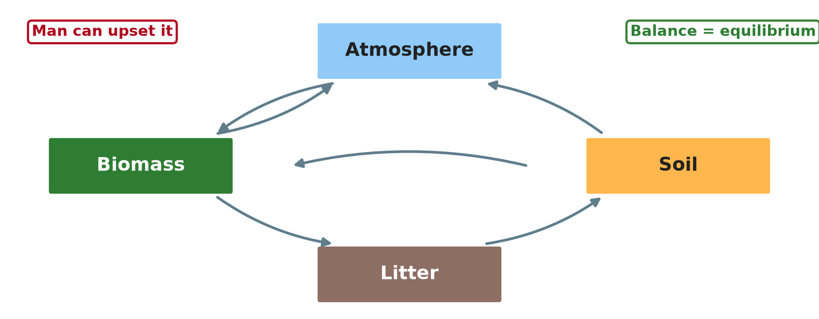
1. THE FOUR COMPARTMENTS
Activity 1
The four compartments of an ecosystem.
Notes:
Activity 1. Look carefully at this diagram: the four compartments of an ecosystem. Observe every detail before I ask the question.

Slide 20
1. THE FOUR COMPARTMENTS
Activity 1: Question
Name the four compartments.
Notes:
Here is the question for Activity 1: Name the four compartments. Take one minute to think and write your answer in your rough notebook.

Slide 21
1. THE FOUR COMPARTMENTS
Activity 1: Answer
Atmosphere, biomass, litter and soil.
Notes:
Let us check the answer together. Atmosphere, biomass, litter and soil.

Slide 22

2. INTERRELATIONS
Activity 2
Nutrients moving between biomass, litter and soil.
Notes:
Activity 2. Look carefully at this diagram: nutrients moving between biomass, litter and soil. Observe every detail before I ask the question.

Slide 23
2. INTERRELATIONS
Activity 2: Question
How do nutrients move from biomass to litter to soil?
Notes:
Here is the question for Activity 2: How do nutrients move from biomass to litter to soil? Take one minute to think and write your answer in your rough notebook.

Slide 24
2. INTERRELATIONS
Activity 2: Answer
Leaves fall (fallout), then decompose into the soil.
Notes:
Let us check the answer together. Leaves fall (fallout), then decompose into the soil.

Slide 25

3. EQUILIBRIUM
Activity 3
Litter on the forest floor.
Notes:
Activity 3. Look carefully at this picture: litter on the forest floor. Observe every detail before I ask the question.

Slide 26
3. EQUILIBRIUM
Activity 3: Question
Why is the equilibrium called dynamic?
Notes:
Here is the question for Activity 3: Why is the equilibrium called dynamic? Take one minute to think and write your answer in your rough notebook.

Slide 27
3. EQUILIBRIUM
Activity 3: Answer
Matter keeps moving, but inputs and outputs stay balanced.
Notes:
Let us check the answer together. Matter keeps moving, but inputs and outputs stay balanced.

Slide 28

4. FACTORS OF DISEQUILIBRIUM
Activity 4
Logs from a cleared forest.
Notes:
Activity 4. Look carefully at this picture: logs from a cleared forest. Observe every detail before I ask the question.

Slide 29
4. FACTORS OF DISEQUILIBRIUM
Activity 4: Question
How does logging upset the equilibrium?
Notes:
Here is the question for Activity 4: How does logging upset the equilibrium? Take one minute to think and write your answer in your rough notebook.

Slide 30
4. FACTORS OF DISEQUILIBRIUM
Activity 4: Answer
It removes biomass and nutrients and exposes the soil to erosion.
Notes:
Let us check the answer together. It removes biomass and nutrients and exposes the soil to erosion.

Slide 31
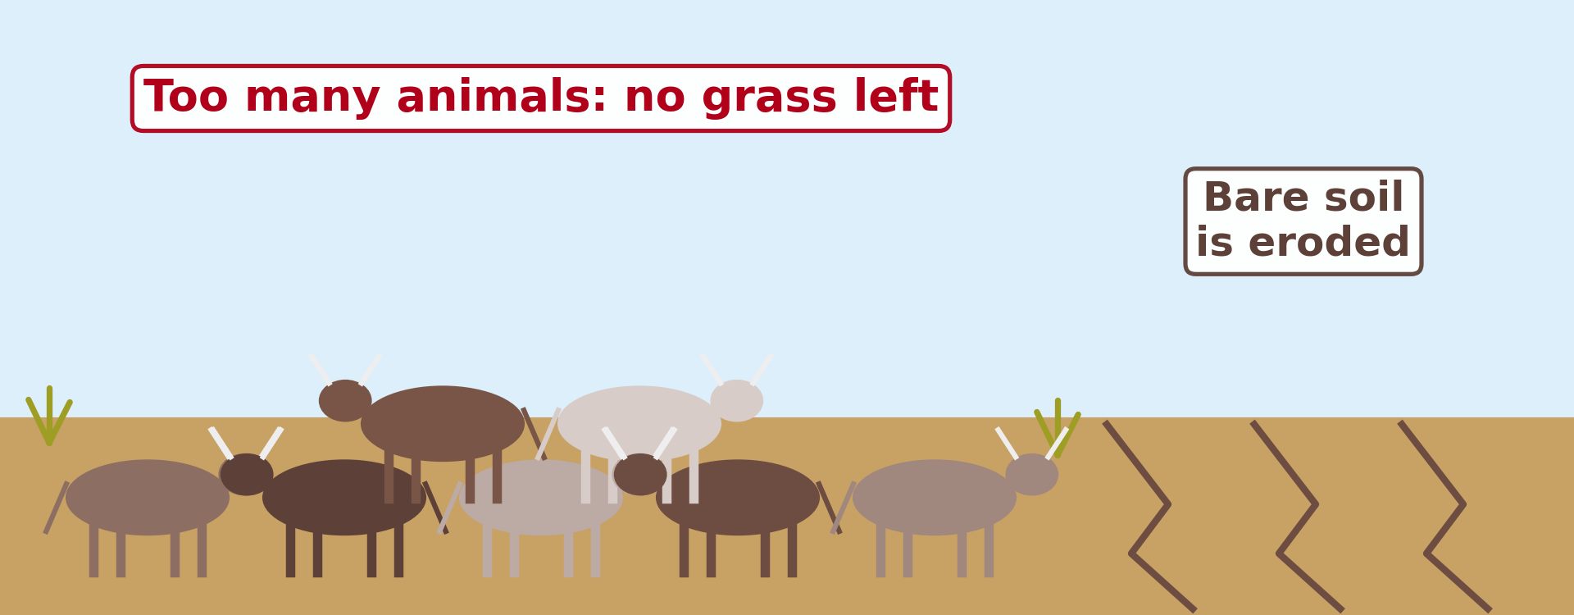
4. FACTORS OF DISEQUILIBRIUM
Activity 5
Overgrazing leaves bare soil.
Notes:
Activity 5. Look carefully at this diagram: overgrazing leaves bare soil. Observe every detail before I ask the question.

Slide 32
4. FACTORS OF DISEQUILIBRIUM
Activity 5: Question
Give two human factors of disequilibrium.
Notes:
Here is the question for Activity 5: Give two human factors of disequilibrium. Take one minute to think and write your answer in your rough notebook.

Slide 33
4. FACTORS OF DISEQUILIBRIUM
Activity 5: Answer
Overgrazing and bush fires (also logging, pollution).
Notes:
Let us check the answer together. Overgrazing and bush fires (also logging, pollution).

Slide 34
BOARD SUMMARY
Board Summary
Topic: Ecological Systems (Ecosystems)
Sub-topic: The Structure of an Ecosystem
Lesson 20: Interactions within Ecosystems
Notes:
Now we are going to copy the board summary. Write the title and the headings neatly in your notebooks. I will give you enough time for each slide, so do not rush.

Slide 35
BOARD SUMMARY
1. Structure of the Ecosystem
A four-compartment ecosystem has:
Abiotic compartment: It includes the atmosphere, water, rocks and soil minerals. It supplies energy and materials.
Notes:
Let us copy Structure of the Ecosystem. A four-compartment ecosystem has. On this slide we have Abiotic compartment. Write each point on a new line, with the key term first, and explain it in your own words when we revise. When you finish, we go to the next slide.

Slide 36
BOARD SUMMARY
1. Structure of the Ecosystem (continued)
Biotic compartments: They are producers (plants), consumers (animals) and decomposers. Each compartment stores energy and nutrients.
Notes:
We continue with Structure of the Ecosystem. On this slide we have Biotic compartments. Write each point on a new line, with the key term first, and explain it in your own words when we revise.

Slide 37
BOARD SUMMARY
1. Structure of the Ecosystem
Illustration: the four compartments
Notes:
Now draw this illustration in your notebook: the four compartments. Give it a title and label it clearly.

Slide 38
BOARD SUMMARY
2. Interrelations and Equilibrium
The compartments are linked and balanced as follows:
Interrelations: Nutrients move from the soil to plants, from plants to animals, and back to the soil through litter and decomposition. Energy flows in one direction from the sun to decomposers.
Notes:
Let us copy Interrelations and Equilibrium. The compartments are linked and balanced as follows. On this slide we have Interrelations. Write each point on a new line, with the key term first, and explain it in your own words when we revise. When you finish, we go to the next slide.

Slide 39
BOARD SUMMARY
2. Interrelations and Equilibrium (continued)
Equilibrium: When inputs equal outputs, the ecosystem is in balance. The equilibrium is dynamic, because numbers and flows change but stay within limits.
Notes:
We continue with Interrelations and Equilibrium. On this slide we have Equilibrium. Write each point on a new line, with the key term first, and explain it in your own words when we revise.

Slide 40
BOARD SUMMARY
3. Factors of Disequilibrium
The balance can be upset by:
Natural factors: Droughts, floods, fires, diseases and volcanic eruptions disturb ecosystems. Most ecosystems recover over time.
Notes:
Let us copy Factors of Disequilibrium. The balance can be upset by. On this slide we have Natural factors. Write each point on a new line, with the key term first, and explain it in your own words when we revise. When you finish, we go to the next slide.

Slide 41
BOARD SUMMARY
3. Factors of Disequilibrium (continued)
Man: Deforestation, overgrazing, bush fires, pollution and hunting are the main causes of disequilibrium. For example, logging removes the biomass store and exposes the soil to erosion.
Notes:
We continue with Factors of Disequilibrium. On this slide we have Man. Write each point on a new line, with the key term first, and explain it in your own words when we revise.

Slide 42
FORMATIVE EVALUATION
Evaluation 1
Name the four compartments of an ecosystem.
Notes:
Now let us check what you have understood. Question 1: Name the four compartments of an ecosystem. Answer in your exercise book.

Slide 43
FORMATIVE EVALUATION
Expected Answer
Atmosphere, biomass, litter and soil.
Notes:
The expected answer is: atmosphere, biomass, litter and soil. If you got it right, well done.

Slide 44
FORMATIVE EVALUATION
Evaluation 2
Explain how man causes disequilibrium.
Notes:
Now let us check what you have understood. Question 2: Explain how man causes disequilibrium. Answer in your exercise book.

Slide 45
FORMATIVE EVALUATION
Expected Answer
Logging, fire, overgrazing and pollution remove stores and increase losses.
Notes:
The expected answer is: logging, fire, overgrazing and pollution remove stores and increase losses. If you got it right, well done.

Slide 46
REMEDIATION
Remediation
Fill in the blanks:
Balance in an ecosystem is ______.
A store in an ecosystem is a ______.
Overgrazing causes ______.
Notes:
For those who need more practice, fill in the blanks in your exercise book. The answers are: number 1, equilibrium; number 2, compartment; number 3, disequilibrium.

Slide 47
HOMEWORK
Homework
Give an example of an ecosystem in your area that has lost its balance and explain why.
Notes:
For your homework: Give an example of an ecosystem in your area that has lost its balance and explain why. We shall correct it at the beginning of our next lesson.

Slide 48
NEXT LESSON
Next Lesson
Our next lesson will be on:
Lesson 21: Energy Flows in Ecosystems
Notes:
Our next lesson will be on Lesson 21: Energy Flows in Ecosystems. Thank you for your attention, and see you next time.

Slide 49
BILINGUAL GAME
Bilingual Game (Jeu Bilingue)
English | Français
Compartment | Le compartiment
Equilibrium | L'équilibre
Feedback | La rétroaction
Overgrazing | Le surpâturage
Pollution | La pollution
Recovery | Le rétablissement
Notes:
Let us play the bilingual game. I say a word in English, and you give me the French word. Then we do the reverse.

Slide 50
LOGBOOK
Official Logbook (1/2)
Module / Topic | Ecological Systems (Ecosystems)
Lesson Title | Lesson 20: Interactions within Ecosystems
Expected Learning Outcomes | Describe the four compartments of an ecosystem. Explain the interrelations and the equilibrium between them. Explain the factors of disequilibrium, especially man.
Competence | Learners are able to explain the equilibrium of ecosystems and how man can upset it.
Notes:
I record this information in the official logbook of the class after the lesson.

Slide 51
LOGBOOK
Official Logbook (2/2)
Matter Taught | Structure of the Ecosystem; Interrelations and Equilibrium; Factors of Disequilibrium.
Evaluation | Formative evaluation and remediation exercise.
Homework | Give an example of an ecosystem in your area that has lost its balance and explain why.
Enrolment / Present / Absent | ____ / ____ / ____
Achievement | To be completed after the lesson.
Notes:
I complete the second page of the logbook: the matter taught, the evaluation, the homework and the attendance.

Slide 52
TEACHER'S NOTE
Teacher's Note
Timing: Homework correction, plan, objectives 8 min | Recall, situation, action 10 min | 5 activities 30 min | Board summary (copying) 30 min | Evaluation, remediation 10 min | Homework, next lesson 5 min | Logbook 7 min
Without the projector (Activity 1): draw four boxes with arrows.
Without the projector (Activity 2): describe the cycle.
Without the projector (Activity 3): compare with a full bucket with a tap and a hole.
Without the projector (Activity 4): discuss logging.
Without the projector (Activity 5): describe bare grazing land.
Notes:
This slide is for me, the teacher: it gives the timing of the lesson and what to do if the projector is not available.

Slide 53
REFERENCES
References
National Geography Syllabus, MINESEC/IGE/IP-SS, 2019 — Module 3 (Biogeography).
Photo, Activity 3: “Heavily earthworm-infested soil” by esagor, CC BY-NC 2.0, via Flickr (https://www.flickr.com/photos/7357861@N03/1993224477)
Photo, Activity 4: “Logging truck, Cameroon” by World Resources, CC BY-NC-SA 2.0, via Flickr (https://www.flickr.com/photos/26107309@N05/4764354366)
Diagrams and animations: drawn for this lesson (Geography Department).
Notes:
These are the references and picture credits used to prepare this lesson.

