Slide 1
LOWER SIXTH ARTS
GEOGRAPHY
Lesson 1
The Meaning and Composition of the Atmosphere
Notes:
Good morning, class, and welcome to our geography lesson. I am your geography teacher, Mr Kamdem. Today we are starting Lesson 1: The Meaning and Composition of the Atmosphere.

Slide 2
CLASS INFO
Class, Chapter and Duration
Class | Lower Sixth Arts
Chapter | Module 1: Understanding and managing atmospheric and hydrological phenomena and hazards across the world in general and Cameroon in particular
Duration | 2 periods (2 × 50 minutes)
Notes:
This lesson is for Lower Sixth Arts. It belongs to Module 1: Understanding and managing atmospheric and hydrological phenomena and hazards across the world in general and Cameroon in particular. We shall need 2 periods to cover it.

Slide 3
IDENTIFICATION
Lesson Identification
Topic | The Atmosphere as a Centre of Weather and Climate
Sub-topic | The Atmosphere
Lesson | Lesson 1: The Meaning and Composition of the Atmosphere
Notions / Concepts | Atmosphere, weather, climate, constant gases, variable gases, aerosols.
Syllabus focus | The gases of the atmosphere (constant and variable) and the aerosols (liquid and solid).
Competence | Learners are able to describe what the atmosphere is made of and explain why each part matters for weather and life.
Notes:
Our topic is The Atmosphere as a Centre of Weather and Climate, and the sub-topic is The Atmosphere. The key notions we shall use today are: atmosphere, weather, climate, constant gases, variable gases, aerosols. At the end, you should be able to do this: learners are able to describe what the atmosphere is made of and explain why each part matters for weather and life.

Slide 4

LESSON PLAN
Lesson Plan
Objectives and recall
Real-life situation and action to take
Learning activities
Board summary
Evaluation, remediation and homework
Notes:
Here is the plan of our lesson today. First, we shall look at the objectives and recall what you already know. After that, we shall study a situation from real life and the action to take, and do the learning activities. Finally, we shall copy the board summary, do the evaluation and the remediation, and I will give you the homework.

Slide 5
OBJECTIVES
Objectives
By the end of this lesson, you should be able to:
Define the atmosphere, weather and climate.
Name the constant and the variable gases.
Notes:
Take your time to copy this part; we will continue together.

Slide 6
OBJECTIVES
Objectives (continued)
Explain what aerosols are and give examples.
Notes:
By the end of this lesson, you should be able to do three things. Number 1: define the atmosphere, weather and climate. Number 2: name the constant and the variable gases. Number 3: explain what aerosols are and give examples.

Slide 7
PREVIOUS KNOWLEDGE
Previous Knowledge
Air is all around us, even if we cannot see it.
Plants need carbon dioxide and we need oxygen.
Notes:
Let us first remember what you already know. Air is all around us, even if we cannot see it. Plants need carbon dioxide and we need oxygen. Keep this in mind, because we shall build on it today.

Slide 8
REAL-LIFE SITUATION
Situation in Real Life
During the Harmattan in Garoua, the sky is grey with dust for many days. A student says that the air is only made of oxygen, so the dust must come from the sky itself.
Notes:
Listen carefully to this situation from real life. During the Harmattan in Garoua, the sky is grey with dust for many days. A student says that the air is only made of oxygen, so the dust must come from the sky itself. Think about it, because I am going to ask you some questions.

Slide 9
REAL-LIFE SITUATION
Situation: Question 1
What is the problem in the situation?
Notes:
Question 1: What is the problem in the situation? Think for a moment, then raise your hand to answer.

Slide 10
REAL-LIFE SITUATION
Answer
The student does not know what the air is made of.
Notes:
Good. The student does not know what the air is made of.

Slide 11
REAL-LIFE SITUATION
Situation: Question 2
Is the air made only of oxygen?
Notes:
Question 2: Is the air made only of oxygen? Think for a moment, then raise your hand to answer.

Slide 12
REAL-LIFE SITUATION
Answer
No. It is mostly nitrogen, with oxygen and other gases.
Notes:
Good. No. It is mostly nitrogen, with oxygen and other gases.

Slide 13
REAL-LIFE SITUATION
Situation: Question 3
Where does the dust come from?
Notes:
Question 3: Where does the dust come from? Think for a moment, then raise your hand to answer.

Slide 14
REAL-LIFE SITUATION
Possible Answer
It is lifted by the wind from the Sahara: it is a solid aerosol.
Notes:
Good. It is lifted by the wind from the Sahara: it is a solid aerosol.

Slide 15
ACTION TO TAKE
Action to Take
Adapt to and mitigate climatic extremes: avoid burning waste and bush fires that fill the air with smoke, and protect ourselves from Harmattan dust.
Notes:
From this situation, the action we are working towards in this lesson is the following: adapt to and mitigate climatic extremes: avoid burning waste and bush fires that fill the air with smoke, and protect ourselves from Harmattan dust.

Slide 16
JUSTIFICATION
Justification of the Lesson
This lesson helps us to understand the air we breathe and the parts of the atmosphere that make weather and climate.
Notes:
Why is this lesson important for you? This lesson helps us to understand the air we breathe and the parts of the atmosphere that make weather and climate.

Slide 17
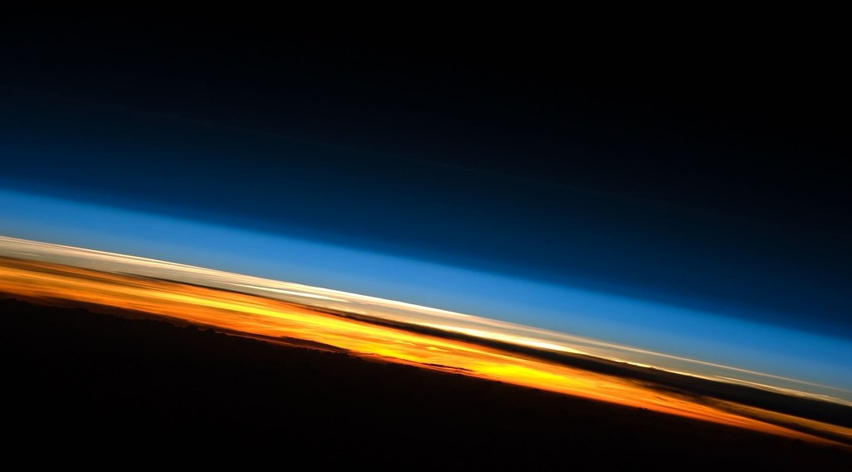
1. MEANING
Activity 1
The thin layer of the atmosphere seen from the International Space Station.
Notes:
Activity 1. Look carefully at this picture: the thin layer of the atmosphere seen from the International Space Station. Observe every detail before I ask the question.

Slide 18
1. MEANING
Activity 1: Question
What is the thin blue and orange layer above the Earth?
Notes:
Here is the question for Activity 1: What is the thin blue and orange layer above the Earth? Take one minute to think and write your answer in your rough notebook.

Slide 19
1. MEANING
Activity 1: Answer
The atmosphere: the layer of air that surrounds the Earth.
Notes:
Let us check the answer together. The atmosphere: the layer of air that surrounds the Earth.

Slide 20
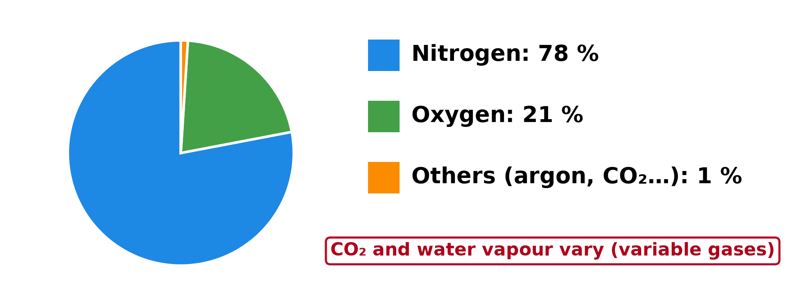
2. A) GASEOUS COMPONENTS
Activity 2
The main gases of dry air.
Notes:
Activity 2. Look carefully at this diagram: the main gases of dry air. Observe every detail before I ask the question.

Slide 21
2. A) GASEOUS COMPONENTS
Activity 2: Question
Which gas is the most common in the air? Which gas do we breathe to live?
Notes:
Here is the question for Activity 2: Which gas is the most common in the air? Which gas do we breathe to live? Take one minute to think and write your answer in your rough notebook.

Slide 22
2. A) GASEOUS COMPONENTS
Activity 2: Answer
Nitrogen (78 %) is the most common. We breathe oxygen (21 %).
Notes:
Let us check the answer together. Nitrogen (78 %) is the most common. We breathe oxygen (21 %).

Slide 23

2. A) GASEOUS COMPONENTS
Activity 3
Smoke from factory chimneys.
Notes:
Activity 3. Look carefully at this picture: smoke from factory chimneys. Observe every detail before I ask the question.

Slide 24
2. A) GASEOUS COMPONENTS
Activity 3: Question
Factories and cars add carbon dioxide to the air. Is it a constant or a variable gas?
Notes:
Here is the question for Activity 3: Factories and cars add carbon dioxide to the air. Is it a constant or a variable gas? Take one minute to think and write your answer in your rough notebook.

Slide 25
2. A) GASEOUS COMPONENTS
Activity 3: Answer
A variable gas: its amount changes from place to place and over time.
Notes:
Let us check the answer together. A variable gas: its amount changes from place to place and over time.

Slide 26

2. B) AEROSOLS
Activity 4
Dust carried by a strong wind.
Notes:
Activity 4. Look carefully at this picture: dust carried by a strong wind. Observe every detail before I ask the question.

Slide 27
2. B) AEROSOLS
Activity 4: Question
Dust, smoke and salt float in the air. What do we call these small particles?
Notes:
Here is the question for Activity 4: Dust, smoke and salt float in the air. What do we call these small particles? Take one minute to think and write your answer in your rough notebook.

Slide 28
2. B) AEROSOLS
Activity 4: Answer
Solid aerosols.
Notes:
Let us check the answer together. Solid aerosols.

Slide 29

2. B) AEROSOLS
Activity 5
Fog: tiny drops of water in the air.
Notes:
Activity 5. Look carefully at this picture: fog: tiny drops of water in the air. Observe every detail before I ask the question.

Slide 30
2. B) AEROSOLS
Activity 5: Question
Fog is made of tiny water drops. What type of aerosol is it?
Notes:
Here is the question for Activity 5: Fog is made of tiny water drops. What type of aerosol is it? Take one minute to think and write your answer in your rough notebook.

Slide 31
2. B) AEROSOLS
Activity 5: Answer
A liquid aerosol.
Notes:
Let us check the answer together. A liquid aerosol.

Slide 32
BOARD SUMMARY
Board Summary
Topic: The Atmosphere as a Centre of Weather and Climate
Sub-topic: The Atmosphere
Lesson 1: The Meaning and Composition of the Atmosphere
Notes:
Now we are going to copy the board summary. Write the title and the headings neatly in your notebooks. I will give you enough time for each slide, so do not rush.

Slide 33
BOARD SUMMARY
1. Meaning of the Atmosphere
The atmosphere can be understood as follows:
Atmosphere: It is the thin layer of gases, water and tiny particles that surrounds the Earth and is held to it by gravity. It is the part of the Earth where weather and climate take place.
Notes:
Let us copy Meaning of the Atmosphere. The atmosphere can be understood as follows. On this slide we have Atmosphere. Write each point on a new line, with the key term first, and explain it in your own words when we revise.

Slide 34
BOARD SUMMARY
2. Composition of the Atmosphere
The atmosphere is made up of two main components:
Gaseous components: These are the different gases that make up the air. They are divided into variable gases and constant gases.
Notes:
Let us copy Composition of the Atmosphere. The atmosphere is made up of two main components. On this slide we have Gaseous components. Write each point on a new line, with the key term first, and explain it in your own words when we revise. When you finish, we go to the next slide.

Slide 35
BOARD SUMMARY
2. Composition of the Atmosphere (continued)
Aerosols: These are tiny liquid or solid particles suspended in the air. They are divided into liquid aerosols and solid aerosols.
Notes:
We continue with Composition of the Atmosphere. On this slide we have Aerosols. Write each point on a new line, with the key term first, and explain it in your own words when we revise.

Slide 36
BOARD SUMMARY
2. Composition of the Atmosphere
A) Gaseous Components
The gaseous components of the atmosphere are of two types:
Variable gases: These are gases whose amount changes from place to place and from time to time.
Notes:
Let us copy Gaseous Components. The gaseous components of the atmosphere are of two types. On this slide we have Variable gases. Write each point on a new line, with the key term first, and explain it in your own words when we revise. When you finish, we go to the next slide.

Slide 37
BOARD SUMMARY
2. Composition of the Atmosphere
A) Gaseous Components (continued)
04 %) and ozone, which control rain, temperature and life.
Constant gases: These are gases whose proportion in dry air hardly changes. They are nitrogen (78 %), oxygen (21 %) and argon (0.93 %), with traces of neon and helium.
Notes:
We continue with Gaseous Components. On this slide we have Constant gases. Write each point on a new line, with the key term first, and explain it in your own words when we revise.

Slide 38
BOARD SUMMARY
2. Composition of the Atmosphere
Illustration: the main gases of dry air
Notes:
Now draw this illustration in your notebook: the main gases of dry air. Give it a title and label it clearly.

Slide 39
BOARD SUMMARY
2. Composition of the Atmosphere
B) Aerosols
The different types of aerosols include:
Liquid aerosols: These are tiny drops of water or other liquids that float in the air. Examples are the droplets that form clouds, fog and mist.
Notes:
Let us copy Aerosols. The different types of aerosols include. On this slide we have Liquid aerosols. Write each point on a new line, with the key term first, and explain it in your own words when we revise. When you finish, we go to the next slide.

Slide 40
BOARD SUMMARY
2. Composition of the Atmosphere
B) Aerosols (continued)
Solid aerosols: These are tiny solid particles suspended in the air, such as dust, smoke, sea salt, pollen and volcanic ash. They act as condensation nuclei on which cloud droplets form.
Notes:
We continue with Aerosols. On this slide we have Solid aerosols. Write each point on a new line, with the key term first, and explain it in your own words when we revise.

Slide 41
FORMATIVE EVALUATION
Evaluation 1
Distinguish between weather and climate.
Notes:
Now let us check what you have understood. Question 1: Distinguish between weather and climate. Answer in your exercise book.

Slide 42
FORMATIVE EVALUATION
Expected Answer
Weather is the state of the air for a short time; climate is the average weather over about 30 years.
Notes:
The expected answer is: weather is the state of the air for a short time; climate is the average weather over about 30 years. If you got it right, well done.

Slide 43
FORMATIVE EVALUATION
Evaluation 2
Give two variable gases and two aerosols.
Notes:
Now let us check what you have understood. Question 2: Give two variable gases and two aerosols. Answer in your exercise book.

Slide 44
FORMATIVE EVALUATION
Expected Answer
Water vapour and carbon dioxide; dust and smoke.
Notes:
The expected answer is: water vapour and carbon dioxide; dust and smoke. If you got it right, well done.

Slide 45
REMEDIATION
Remediation
Fill in the blanks:
The most common gas in the air is ______.
Dust and smoke are solid ______.
Carbon dioxide is a ______ gas.
Notes:
For those who need more practice, fill in the blanks in your exercise book. The answers are: number 1, nitrogen; number 2, aerosols; number 3, variable.

Slide 46
HOMEWORK
Homework
List three sources of dust and smoke in your town and say how they affect people.
Notes:
For your homework: List three sources of dust and smoke in your town and say how they affect people. We shall correct it at the beginning of our next lesson.

Slide 47
NEXT LESSON
Next Lesson
Our next lesson will be on:
Lesson 2: Structure of the Atmosphere
Notes:
Our next lesson will be on Lesson 2: Structure of the Atmosphere. Thank you for your attention, and see you next time.

Slide 48
BILINGUAL GAME
Bilingual Game (Jeu Bilingue)
English | Français
Atmosphere | L'atmosphère
Nitrogen | L'azote
Oxygen | L'oxygène
Water vapour | La vapeur d'eau
Dust | La poussière
Weather | Le temps (météo)
Notes:
Let us play the bilingual game. I say a word in English, and you give me the French word. Then we do the reverse.

Slide 49
LOGBOOK
Official Logbook (1/2)
Module / Topic | The Atmosphere as a Centre of Weather and Climate
Lesson Title | Lesson 1: The Meaning and Composition of the Atmosphere
Expected Learning Outcomes | Define the atmosphere, weather and climate. Name the constant and the variable gases. Explain what aerosols are and give examples.
Competence | Learners are able to describe what the atmosphere is made of and explain why each part matters for weather and life.
Notes:
I record this information in the official logbook of the class after the lesson.

Slide 50
LOGBOOK
Official Logbook (2/2)
Matter Taught | Meaning of the Atmosphere; Composition of the Atmosphere; Gaseous Components; Aerosols.
Evaluation | Formative evaluation and remediation exercise.
Homework | List three sources of dust and smoke in your town and say how they affect people.
Enrolment / Present / Absent | ____ / ____ / ____
Achievement | To be completed after the lesson.
Notes:
I complete the second page of the logbook: the matter taught, the evaluation, the homework and the attendance.

Slide 51
TEACHER'S NOTE
Teacher's Note
Timing: Homework correction, plan, objectives 8 min | Recall, situation, action 10 min | 5 activities 30 min | Board summary (copying) 30 min | Evaluation, remediation 10 min | Homework, next lesson 5 min | Logbook 7 min
Without the projector (Activity 1): ask learners to breathe in and out: the air is real.
Without the projector (Activity 2): draw the pie chart on the board.
Without the projector (Activity 3): mention smoke from cars and from bush fires.
Without the projector (Activity 4): describe the Harmattan dust in the north.
Without the projector (Activity 5): describe morning fog in the rainy season.
Notes:
This slide is for me, the teacher: it gives the timing of the lesson and what to do if the projector is not available.

Slide 52
REFERENCES
References
National Geography Syllabus, MINESEC/IGE/IP-SS, 2019 — Module 1 (Meteorology, Climatology & Hydrology).
Photo, Activity 1: “Sunset Over the Indian Ocean (NASA, International Space Station Scienc” by NASA's Marshall Space Flight Center, CC BY-NC 2.0, via nasa (https://www.flickr.com/photos/28634332@N05/8134997029)
Photo, Activity 3: “image replaced (thanks Anne :) )” by why 137, CC BY 2.0, via Flickr (https://www.flickr.com/photos/78752351@N03/8464430910)
Photo, Activity 4: “Sandstorm at Camp Bastion, Afghanistan” by Defence Images, CC BY-NC 2.0, via Flickr (https://www.flickr.com/photos/48399297@N04/10343833885)
Photo, Activity 5: “Mist” by Art by MarkAC, CC BY-SA 2.0, via Flickr (https://www.flickr.com/photos/60580775@N08/40783321332)
Diagrams and animations: drawn for this lesson (Geography Department).
Notes:
These are the references and picture credits used to prepare this lesson.

