Slide 1
LOWER SIXTH ARTS
GEOGRAPHY
Lesson 2
Structure of the Atmosphere
Notes:
Good morning, class, and welcome to our geography lesson. I am your geography teacher, Mr Kamdem. Today we are starting Lesson 2: Structure of the Atmosphere.

Slide 2
CLASS INFO
Class, Chapter and Duration
Class | Lower Sixth Arts
Chapter | Module 1: Understanding and managing atmospheric and hydrological phenomena and hazards across the world in general and Cameroon in particular
Duration | 2 periods (2 × 50 minutes)
Notes:
This lesson is for Lower Sixth Arts. It belongs to Module 1: Understanding and managing atmospheric and hydrological phenomena and hazards across the world in general and Cameroon in particular. We shall need 2 periods to cover it.

Slide 3
IDENTIFICATION
Lesson Identification
Topic | The Atmosphere as a Centre of Weather and Climate
Sub-topic | The Atmosphere
Lesson | Lesson 2: Structure of the Atmosphere
Notions / Concepts | Homosphere, heterosphere, troposphere, stratosphere, mesosphere, thermosphere, tropopause, ozone layer.
Syllabus focus | Layers of the atmosphere, their thermal characteristics and the ozone layer.
Competence | Learners are able to describe the layers of the atmosphere and explain how to protect the ozone layer.
Notes:
Our topic is The Atmosphere as a Centre of Weather and Climate, and the sub-topic is The Atmosphere. The key notions we shall use today are: homosphere, heterosphere, troposphere, stratosphere, mesosphere, thermosphere, tropopause, ozone layer. At the end, you should be able to do this: learners are able to describe the layers of the atmosphere and explain how to protect the ozone layer.

Slide 4

HOMEWORK CORRECTION
Correction of the Homework
Question (Lesson 1: The Meaning and Composition of the Atmosphere):
List three sources of dust and smoke in your town and say how they affect people.
Notes:
Before we start the new lesson, let us correct the homework I gave you at the end of Lesson 1: The Meaning and Composition of the Atmosphere. The question was: List three sources of dust and smoke in your town and say how they affect people. Take out your exercise books.

Slide 5
HOMEWORK CORRECTION
Correction: Possible Answer
Sources of dust and smoke in Garoua include the Harmattan wind, untarred roads, bush fires, burning of rubbish and car exhausts. They cause coughs, eye and lung diseases, reduce visibility and dirty houses and clothes.
Notes:
Here is a good answer. Sources of dust and smoke in Garoua include the Harmattan wind, untarred roads, bush fires, burning of rubbish and car exhausts. They cause coughs, eye and lung diseases, reduce visibility and dirty houses and clothes. Compare it with your own answer and correct your work in red.

Slide 6
LESSON PLAN
Lesson Plan
Correction of the homework
Objectives and recall
Real-life situation and action to take
Learning activities
Board summary
Evaluation, remediation and homework
Notes:
Here is the plan of our lesson today. First, we shall correct the homework. Then we shall look at the objectives and recall what you already know. After that, we shall study a situation from real life and the action to take, and do the learning activities. Finally, we shall copy the board summary, do the evaluation and the remediation, and I will give you the homework.

Slide 7
OBJECTIVES
Objectives
By the end of this lesson, you should be able to:
Name and describe the layers of the atmosphere.
Explain how temperature changes in each layer.
Notes:
Take your time to copy this part; we will continue together.

Slide 8
OBJECTIVES
Objectives (continued)
Explain the role and depletion of the ozone layer.
Notes:
By the end of this lesson, you should be able to do three things. Number 1: name and describe the layers of the atmosphere. Number 2: explain how temperature changes in each layer. Number 3: explain the role and depletion of the ozone layer.

Slide 9
PREVIOUS KNOWLEDGE
Previous Knowledge
The atmosphere is mostly nitrogen and oxygen.
Ozone is a variable gas.
Notes:
Let us first remember what you already know. The atmosphere is mostly nitrogen and oxygen. Ozone is a variable gas. Keep this in mind, because we shall build on it today.

Slide 10
REAL-LIFE SITUATION
Situation in Real Life
A pilot tells a class that at 10,000 metres the air outside the plane is at −50 °C, although it is 32 °C on the ground in Garoua. The learners wonder why the air gets colder as we go up.
Notes:
Listen carefully to this situation from real life. A pilot tells a class that at 10,000 metres the air outside the plane is at −50 °C, although it is 32 °C on the ground in Garoua. The learners wonder why the air gets colder as we go up. Think about it, because I am going to ask you some questions.

Slide 11
REAL-LIFE SITUATION
Situation: Question 1
What is the problem in the situation?
Notes:
Question 1: What is the problem in the situation? Think for a moment, then raise your hand to answer.

Slide 12
REAL-LIFE SITUATION
Answer
Learners do not know how temperature changes with height.
Notes:
Good. Learners do not know how temperature changes with height.

Slide 13
REAL-LIFE SITUATION
Situation: Question 2
In which layer do planes fly?
Notes:
Question 2: In which layer do planes fly? Think for a moment, then raise your hand to answer.

Slide 14
REAL-LIFE SITUATION
Answer
Near the top of the troposphere.
Notes:
Good. Near the top of the troposphere.

Slide 15
REAL-LIFE SITUATION
Situation: Question 3
Does the air always get colder upwards?
Notes:
Question 3: Does the air always get colder upwards? Think for a moment, then raise your hand to answer.

Slide 16
REAL-LIFE SITUATION
Possible Answer
No. In some layers it gets warmer.
Notes:
Good. No. In some layers it gets warmer.

Slide 17
ACTION TO TAKE
Action to Take
Protect the ozone layer and ourselves: avoid products with CFCs and avoid direct sun rays at midday.
Notes:
From this situation, the action we are working towards in this lesson is the following: protect the ozone layer and ourselves: avoid products with CFCs and avoid direct sun rays at midday.

Slide 18
JUSTIFICATION
Justification of the Lesson
This lesson helps us to understand the layers of the atmosphere and why the ozone layer must be protected.
Notes:
Why is this lesson important for you? This lesson helps us to understand the layers of the atmosphere and why the ozone layer must be protected.

Slide 19

1. A) LAYERS OF THE HOMOSPHERE
Activity 1
The four main layers of the atmosphere.
Notes:
Activity 1. Look carefully at this diagram: the four main layers of the atmosphere. Observe every detail before I ask the question.

Slide 20
1. A) LAYERS OF THE HOMOSPHERE
Activity 1: Question
In which layer do we find weather, clouds and rain?
Notes:
Here is the question for Activity 1: In which layer do we find weather, clouds and rain? Take one minute to think and write your answer in your rough notebook.

Slide 21
1. A) LAYERS OF THE HOMOSPHERE
Activity 1: Answer
In the troposphere (0–12 km).
Notes:
Let us check the answer together. In the troposphere (0–12 km).

Slide 22
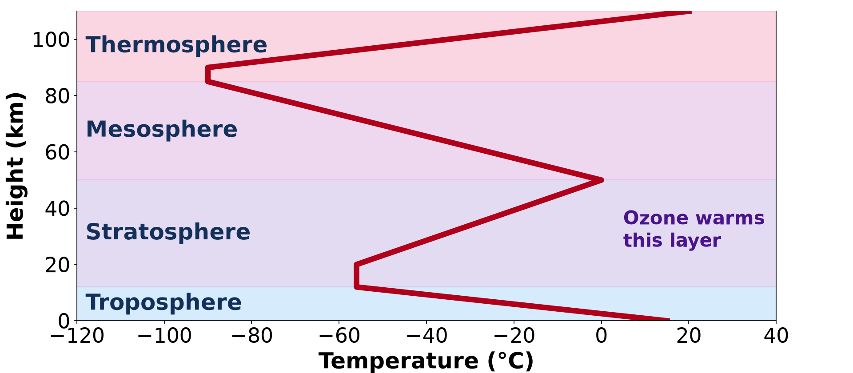
1. B) THERMAL CHARACTERISTICS
Activity 2
Temperature from the ground to 110 km.
Notes:
Activity 2. Look carefully at this diagram: temperature from the ground to 110 km. Observe every detail before I ask the question.

Slide 23
1. B) THERMAL CHARACTERISTICS
Activity 2: Question
In which layers does temperature rise with height?
Notes:
Here is the question for Activity 2: In which layers does temperature rise with height? Take one minute to think and write your answer in your rough notebook.

Slide 24
1. B) THERMAL CHARACTERISTICS
Activity 2: Answer
In the stratosphere and in the thermosphere.
Notes:
Let us check the answer together. In the stratosphere and in the thermosphere.

Slide 25

1. B) THERMAL CHARACTERISTICS
Activity 3
A plane flying above the clouds.
Notes:
Activity 3. Look carefully at this picture: a plane flying above the clouds. Observe every detail before I ask the question.

Slide 26
1. B) THERMAL CHARACTERISTICS
Activity 3: Question
Planes fly near the tropopause. Why is the air so cold there?
Notes:
Here is the question for Activity 3: Planes fly near the tropopause. Why is the air so cold there? Take one minute to think and write your answer in your rough notebook.

Slide 27
1. B) THERMAL CHARACTERISTICS
Activity 3: Answer
In the troposphere temperature falls with height, to about −56 °C at the top.
Notes:
Let us check the answer together. In the troposphere temperature falls with height, to about −56 °C at the top.

Slide 28

2. THE OZONE LAYER
Activity 4
The ozone hole over Antarctica (in blue).
Notes:
Activity 4. Look carefully at this picture: the ozone hole over Antarctica (in blue). Observe every detail before I ask the question.

Slide 29
2. THE OZONE LAYER
Activity 4: Question
What does the ozone layer do? What destroyed part of it?
Notes:
Here is the question for Activity 4: What does the ozone layer do? What destroyed part of it? Take one minute to think and write your answer in your rough notebook.

Slide 30
2. THE OZONE LAYER
Activity 4: Answer
It absorbs harmful ultraviolet rays. CFC gases from sprays and fridges destroyed part of it.
Notes:
Let us check the answer together. It absorbs harmful ultraviolet rays. CFC gases from sprays and fridges destroyed part of it.

Slide 31
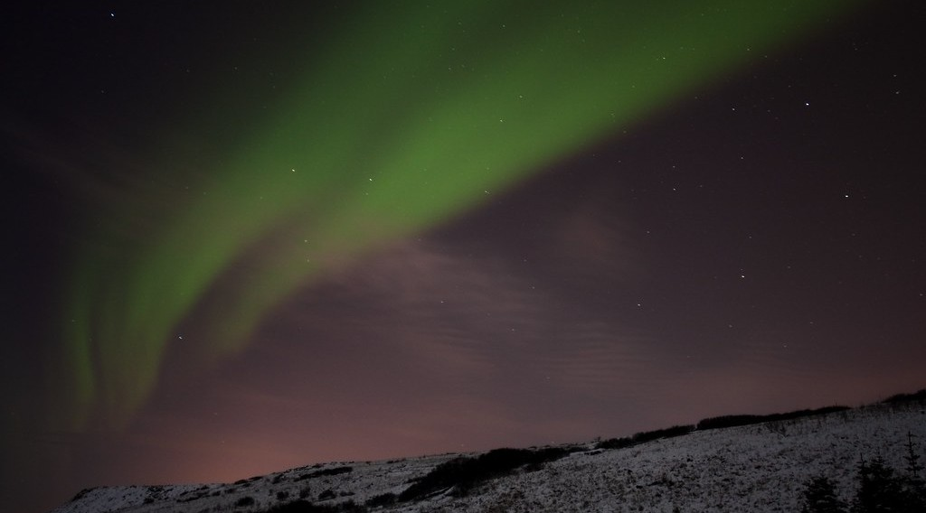
1. C) HETEROSPHERE
Activity 5
An aurora (northern lights) in the upper atmosphere.
Notes:
Activity 5. Look carefully at this picture: an aurora (northern lights) in the upper atmosphere. Observe every detail before I ask the question.

Slide 32
1. C) HETEROSPHERE
Activity 5: Question
These lights appear above 85 km. In which layer are they?
Notes:
Here is the question for Activity 5: These lights appear above 85 km. In which layer are they? Take one minute to think and write your answer in your rough notebook.

Slide 33
1. C) HETEROSPHERE
Activity 5: Answer
In the thermosphere (the ionosphere is part of it).
Notes:
Let us check the answer together. In the thermosphere (the ionosphere is part of it).

Slide 34
BOARD SUMMARY
Board Summary
Topic: The Atmosphere as a Centre of Weather and Climate
Sub-topic: The Atmosphere
Lesson 2: Structure of the Atmosphere
Notes:
Now we are going to copy the board summary. Write the title and the headings neatly in your notebooks. I will give you enough time for each slide, so do not rush.

Slide 35
BOARD SUMMARY
DEFINITIONS
The key terms of this lesson are defined as follows:
Homosphere: It is the lower part of the atmosphere, up to about 80 km, where the gases are well mixed.
Notes:
Let us copy the definitions. The key terms of this lesson are defined as follows. On this slide we have Homosphere. Write each point on a new line, with the key term first, and explain it in your own words when we revise. When you finish, we go to the next slide.

Slide 36
BOARD SUMMARY
DEFINITIONS (continued)
Heterosphere: It is the upper part of the atmosphere, above about 80 km, where the gases form layers according to their weight.
Ozone layer: It is the part of the stratosphere, between 20 and 30 km, where ozone is concentrated.
Notes:
We continue with the definitions. On this slide we have Heterosphere and Ozone layer. Write each point on a new line, with the key term first, and explain it in your own words when we revise.

Slide 37
BOARD SUMMARY
1. Structure of the Atmosphere
A) Layers of the Homosphere
The homosphere is divided into the following layers:
Troposphere: This is the lowest layer, from the ground to about 8 km at the poles and 16 km at the Equator.
Notes:
Let us copy Layers of the Homosphere. The homosphere is divided into the following layers. On this slide we have Troposphere. Write each point on a new line, with the key term first, and explain it in your own words when we revise. When you finish, we go to the next slide.

Slide 38
BOARD SUMMARY
1. Structure of the Atmosphere
A) Layers of the Homosphere (continued)
It contains about 75 % of the air and almost all the water vapour, so all weather occurs here.
Notes:
We continue with Layers of the Homosphere. Copy this carefully. When you finish, we go to the next slide.

Slide 39
BOARD SUMMARY
1. Structure of the Atmosphere
A) Layers of the Homosphere (continued)
Stratosphere: This is the layer from the tropopause to about 50 km. It is calm and dry, and it contains the ozone layer.
Mesosphere: This is the layer from about 50 to 80 km. It is the coldest layer, where meteors burn up.
Notes:
We continue with Layers of the Homosphere. On this slide we have Stratosphere and Mesosphere. Write each point on a new line, with the key term first, and explain it in your own words when we revise.

Slide 40
BOARD SUMMARY
1. Structure of the Atmosphere
Illustration: the layers of the atmosphere
Notes:
Now draw this illustration in your notebook: the layers of the atmosphere. Give it a title and label it clearly.

Slide 41
BOARD SUMMARY
1. Structure of the Atmosphere
B) Chemical and Thermal Characteristics
Each layer has its own chemical and thermal characteristics:
Chemical characteristics: In the homosphere, nitrogen and oxygen are mixed in the same proportions.
Notes:
Let us copy Chemical and Thermal Characteristics. Each layer has its own chemical and thermal characteristics. On this slide we have Chemical characteristics. Write each point on a new line, with the key term first, and explain it in your own words when we revise. When you finish, we go to the next slide.

Slide 42
BOARD SUMMARY
1. Structure of the Atmosphere
B) Chemical and Thermal Characteristics (continued)
In the heterosphere, the gases separate: nitrogen below, then oxygen, helium and hydrogen higher up.
Notes:
We continue with Chemical and Thermal Characteristics. Copy this carefully. When you finish, we go to the next slide.

Slide 43
BOARD SUMMARY
1. Structure of the Atmosphere
B) Chemical and Thermal Characteristics (continued)
Temperature changes: Temperature falls with height in the troposphere (about 6.5 °C per km) and in the mesosphere. It rises in the stratosphere, because ozone absorbs ultraviolet rays, and in the thermosphere.
Notes:
We continue with Chemical and Thermal Characteristics. On this slide we have Temperature changes. Write each point on a new line, with the key term first, and explain it in your own words when we revise. When you finish, we go to the next slide.

Slide 44
BOARD SUMMARY
1. Structure of the Atmosphere
B) Chemical and Thermal Characteristics (continued)
Isothermal layers: These are the pauses (tropopause, stratopause, mesopause) where temperature stays the same with height. They separate the layers.
Notes:
We continue with Chemical and Thermal Characteristics. On this slide we have Isothermal layers. Write each point on a new line, with the key term first, and explain it in your own words when we revise.

Slide 45
BOARD SUMMARY
1. Structure of the Atmosphere
Illustration: temperature changes with height
Notes:
Now draw this illustration in your notebook: temperature changes with height. Give it a title and label it clearly.

Slide 46
BOARD SUMMARY
1. Structure of the Atmosphere
C) The Heterosphere
The heterosphere includes the following layers:
Thermosphere (ionosphere): This is the layer above 80 km where temperature rises to over 1,000 °C. Its charged particles reflect radio waves and produce the aurora.
Notes:
Let us copy The Heterosphere. The heterosphere includes the following layers. On this slide we have Thermosphere (ionosphere). Write each point on a new line, with the key term first, and explain it in your own words when we revise. When you finish, we go to the next slide.

Slide 47
BOARD SUMMARY
1. Structure of the Atmosphere
C) The Heterosphere (continued)
Exosphere: This is the outermost layer, above about 500 km, where the air is extremely thin. Gases escape slowly into space from it.
Notes:
We continue with The Heterosphere. On this slide we have Exosphere. Write each point on a new line, with the key term first, and explain it in your own words when we revise.

Slide 48
BOARD SUMMARY
2. The Ozone Layer
The ozone layer can be studied under three points:
Function: Ozone absorbs most of the harmful ultraviolet rays of the sun. It protects people from skin cancer and eye diseases and protects plants and animals.
Notes:
Let us copy The Ozone Layer. The ozone layer can be studied under three points. On this slide we have Function. Write each point on a new line, with the key term first, and explain it in your own words when we revise. When you finish, we go to the next slide.

Slide 49
BOARD SUMMARY
2. The Ozone Layer (continued)
Depletion: Chlorofluorocarbons (CFCs) from old refrigerators, air conditioners and sprays destroy ozone molecules. This created the ozone hole over Antarctica.
Notes:
We continue with The Ozone Layer. On this slide we have Depletion. Write each point on a new line, with the key term first, and explain it in your own words when we revise. When you finish, we go to the next slide.

Slide 50
BOARD SUMMARY
2. The Ozone Layer (continued)
Measures: The Montreal Protocol (1987) banned CFCs, and the ozone layer is slowly recovering. People should use ozone-friendly products and protect their skin from strong sun.
Notes:
We continue with The Ozone Layer. On this slide we have Measures. Write each point on a new line, with the key term first, and explain it in your own words when we revise.

Slide 51
FORMATIVE EVALUATION
Evaluation 1
Name the four layers of the atmosphere from the ground up.
Notes:
Now let us check what you have understood. Question 1: Name the four layers of the atmosphere from the ground up. Answer in your exercise book.

Slide 52
FORMATIVE EVALUATION
Expected Answer
Troposphere, stratosphere, mesosphere and thermosphere.
Notes:
The expected answer is: troposphere, stratosphere, mesosphere and thermosphere. If you got it right, well done.

Slide 53
FORMATIVE EVALUATION
Evaluation 2
Why does temperature rise in the stratosphere?
Notes:
Now let us check what you have understood. Question 2: Why does temperature rise in the stratosphere? Answer in your exercise book.

Slide 54
FORMATIVE EVALUATION
Expected Answer
Ozone absorbs ultraviolet rays and warms the air.
Notes:
The expected answer is: ozone absorbs ultraviolet rays and warms the air. If you got it right, well done.

Slide 55
REMEDIATION
Remediation
Fill in the blanks:
Weather happens in the ______.
The ozone layer is in the ______.
CFC gases destroy ______.
Notes:
For those who need more practice, fill in the blanks in your exercise book. The answers are: number 1, troposphere; number 2, stratosphere; number 3, ozone.

Slide 56
HOMEWORK
Homework
Draw the layers of the atmosphere with their heights and one feature of each.
Notes:
For your homework: Draw the layers of the atmosphere with their heights and one feature of each. We shall correct it at the beginning of our next lesson.

Slide 57
NEXT LESSON
Next Lesson
Our next lesson will be on:
Lesson 3: Solar Radiation
Notes:
Our next lesson will be on Lesson 3: Solar Radiation. Thank you for your attention, and see you next time.

Slide 58
BILINGUAL GAME
Bilingual Game (Jeu Bilingue)
English | Français
Layer | La couche
Ozone layer | La couche d'ozone
Troposphere | La troposphère
Ultraviolet rays | Les rayons ultraviolets
Height | L'altitude
Boundary | La limite
Notes:
Let us play the bilingual game. I say a word in English, and you give me the French word. Then we do the reverse.

Slide 59
LOGBOOK
Official Logbook (1/2)
Module / Topic | The Atmosphere as a Centre of Weather and Climate
Lesson Title | Lesson 2: Structure of the Atmosphere
Expected Learning Outcomes | Name and describe the layers of the atmosphere. Explain how temperature changes in each layer. Explain the role and depletion of the ozone layer.
Competence | Learners are able to describe the layers of the atmosphere and explain how to protect the ozone layer.
Notes:
I record this information in the official logbook of the class after the lesson.

Slide 60
LOGBOOK
Official Logbook (2/2)
Matter Taught | DEFINITIONS; Layers of the Homosphere; Chemical and Thermal Characteristics; The Heterosphere; The Ozone Layer.
Evaluation | Formative evaluation and remediation exercise.
Homework | Draw the layers of the atmosphere with their heights and one feature of each.
Enrolment / Present / Absent | ____ / ____ / ____
Achievement | To be completed after the lesson.
Notes:
I complete the second page of the logbook: the matter taught, the evaluation, the homework and the attendance.

Slide 61
TEACHER'S NOTE
Teacher's Note
Timing: Homework correction, plan, objectives 8 min | Recall, situation, action 10 min | 5 activities 30 min | Board summary (copying) 30 min | Evaluation, remediation 10 min | Homework, next lesson 5 min | Logbook 7 min
Without the projector (Activity 1): draw four bands on the board.
Without the projector (Activity 2): draw the zigzag curve.
Without the projector (Activity 3): describe the cold felt on a mountain.
Without the projector (Activity 4): mention old fridges and aerosol sprays.
Without the projector (Activity 5): explain that radio waves bounce on this layer.
Notes:
This slide is for me, the teacher: it gives the timing of the lesson and what to do if the projector is not available.

Slide 62
REFERENCES
References
National Geography Syllabus, MINESEC/IGE/IP-SS, 2019 — Module 1 (Meteorology, Climatology & Hydrology).
Photo, Activity 3: “flying” by { pranav }, CC BY 2.0, via Flickr (https://www.flickr.com/photos/29220600@N08/3469129491)
Photo, Activity 4: “Sauron's Eye” by sjrankin, CC BY-NC 2.0, via Flickr (https://www.flickr.com/photos/24354425@N03/15252220086)
Photo, Activity 5: “Aurora Borealis” by Haukur H., CC BY-NC-ND 2.0, via Flickr (https://www.flickr.com/photos/34699962@N04/3256810738)
Diagrams and animations: drawn for this lesson (Geography Department).
Notes:
These are the references and picture credits used to prepare this lesson.

