Slide 1
LOWER SIXTH ARTS
GEOGRAPHY
Lesson 4
The Earth's Radiation Balance
Notes:
Good morning, class, and welcome to our geography lesson. I am your geography teacher, Mr Kamdem. Today we are starting Lesson 4: The Earth's Radiation Balance.

Slide 2
CLASS INFO
Class, Chapter and Duration
Class | Lower Sixth Arts
Chapter | Module 1: Understanding and managing atmospheric and hydrological phenomena and hazards across the world in general and Cameroon in particular
Duration | 2 periods (2 × 50 minutes)
Notes:
This lesson is for Lower Sixth Arts. It belongs to Module 1: Understanding and managing atmospheric and hydrological phenomena and hazards across the world in general and Cameroon in particular. We shall need 2 periods to cover it.

Slide 3
IDENTIFICATION
Lesson Identification
Topic | Energy in the Atmosphere
Sub-topic | The Earth's Heat Budget on a Global Scale
Lesson | Lesson 4: The Earth's Radiation Balance
Notions / Concepts | Heat budget, terrestrial radiation, long-wave radiation, surplus, deficit, balancing mechanisms.
Syllabus focus | Incoming solar radiation equals outgoing terrestrial radiation; zones of surplus and deficit; reasons and balancing mechanisms.
Competence | Learners are able to explain why the tropics gain energy and the poles lose energy, and how heat is shared.
Notes:
Our topic is Energy in the Atmosphere, and the sub-topic is The Earth's Heat Budget on a Global Scale. The key notions we shall use today are: heat budget, terrestrial radiation, long-wave radiation, surplus, deficit, balancing mechanisms. At the end, you should be able to do this: learners are able to explain why the tropics gain energy and the poles lose energy, and how heat is shared.

Slide 4

HOMEWORK CORRECTION
Correction of the Homework
Question (Lesson 3: Solar Radiation):
Put a white cloth and a black cloth in the sun for 10 minutes. Touch them and explain the difference.
Notes:
Before we start the new lesson, let us correct the homework I gave you at the end of Lesson 3: Solar Radiation. The question was: Put a white cloth and a black cloth in the sun for 10 minutes. Touch them and explain the difference. Take out your exercise books.

Slide 5
HOMEWORK CORRECTION
Correction: Possible Answer
The black cloth becomes hotter than the white cloth. Black has a low albedo and absorbs most of the sunlight, while white has a high albedo and reflects it.
Notes:
Here is a good answer. The black cloth becomes hotter than the white cloth. Black has a low albedo and absorbs most of the sunlight, while white has a high albedo and reflects it. Compare it with your own answer and correct your work in red.

Slide 6
LESSON PLAN
Lesson Plan
Correction of the homework
Objectives and recall
Real-life situation and action to take
Learning activities
Board summary
Evaluation, remediation and homework
Notes:
Here is the plan of our lesson today. First, we shall correct the homework. Then we shall look at the objectives and recall what you already know. After that, we shall study a situation from real life and the action to take, and do the learning activities. Finally, we shall copy the board summary, do the evaluation and the remediation, and I will give you the homework.

Slide 7
OBJECTIVES
Objectives
By the end of this lesson, you should be able to:
Define the heat budget.
Identify zones of positive and negative balance.
Explain the balancing mechanisms.
Notes:
By the end of this lesson, you should be able to do three things. Number 1: define the heat budget. Number 2: identify zones of positive and negative balance. Number 3: explain the balancing mechanisms.

Slide 8
PREVIOUS KNOWLEDGE
Previous Knowledge
About half of the sunlight reaches the ground.
The Sun is overhead between the tropics.
Notes:
Let us first remember what you already know. About half of the sunlight reaches the ground. The Sun is overhead between the tropics. Keep this in mind, because we shall build on it today.

Slide 9
REAL-LIFE SITUATION
Situation in Real Life
A learner reads that the tropics receive more energy than they lose every year. He asks why the tropics do not become hotter and hotter, and why the poles do not freeze more every year.
Notes:
Listen carefully to this situation from real life. A learner reads that the tropics receive more energy than they lose every year. He asks why the tropics do not become hotter and hotter, and why the poles do not freeze more every year. Think about it, because I am going to ask you some questions.

Slide 10
REAL-LIFE SITUATION
Situation: Question 1
What is the problem in the situation?
Notes:
Question 1: What is the problem in the situation? Think for a moment, then raise your hand to answer.

Slide 11
REAL-LIFE SITUATION
Answer
The learner does not understand how the Earth keeps its heat in balance.
Notes:
Good. The learner does not understand how the Earth keeps its heat in balance.

Slide 12
REAL-LIFE SITUATION
Situation: Question 2
Which zone has a surplus of energy?
Notes:
Question 2: Which zone has a surplus of energy? Think for a moment, then raise your hand to answer.

Slide 13
REAL-LIFE SITUATION
Answer
The inter-tropical zone.
Notes:
Good. The inter-tropical zone.

Slide 14
REAL-LIFE SITUATION
Situation: Question 3
How is the extra heat removed?
Notes:
Question 3: How is the extra heat removed? Think for a moment, then raise your hand to answer.

Slide 15
REAL-LIFE SITUATION
Possible Answer
Winds and ocean currents carry it towards the poles.
Notes:
Good. Winds and ocean currents carry it towards the poles.

Slide 16
ACTION TO TAKE
Action to Take
Understand why some regions are hot and others cold, and adapt our clothing and houses.
Notes:
From this situation, the action we are working towards in this lesson is the following: understand why some regions are hot and others cold, and adapt our clothing and houses.

Slide 17
JUSTIFICATION
Justification of the Lesson
This lesson helps us to understand why the Earth keeps an almost constant average temperature.
Notes:
Why is this lesson important for you? This lesson helps us to understand why the Earth keeps an almost constant average temperature.

Slide 18

1. THE HEAT BUDGET
Activity 1
The Earth receives sunlight and gives out heat.
Notes:
Activity 1. Look carefully at this diagram: the Earth receives sunlight and gives out heat. Observe every detail before I ask the question.

Slide 19
1. THE HEAT BUDGET
Activity 1: Question
The ground gives heat back to the sky as long waves. What is this radiation called?
Notes:
Here is the question for Activity 1: The ground gives heat back to the sky as long waves. What is this radiation called? Take one minute to think and write your answer in your rough notebook.

Slide 20
1. THE HEAT BUDGET
Activity 1: Answer
Terrestrial (long-wave) radiation.
Notes:
Let us check the answer together. Terrestrial (long-wave) radiation.

Slide 21
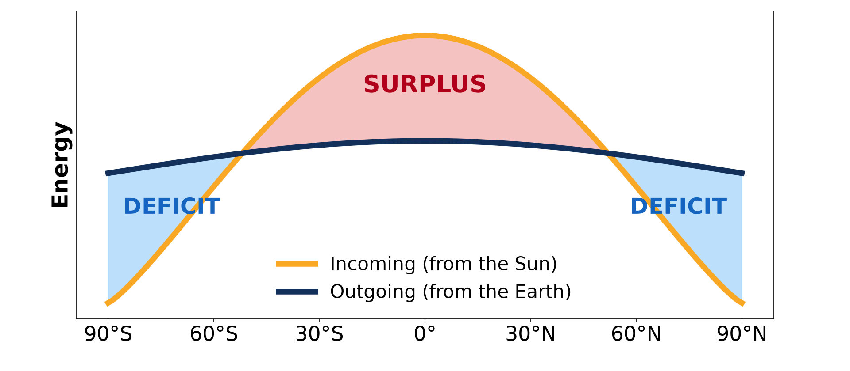
2. SURPLUS AND DEFICIT ZONES
Activity 2
Incoming and outgoing energy by latitude.
Notes:
Activity 2. Look carefully at this diagram: incoming and outgoing energy by latitude. Observe every detail before I ask the question.

Slide 22
2. SURPLUS AND DEFICIT ZONES
Activity 2: Question
Between which latitudes is there a surplus? Where is there a deficit?
Notes:
Here is the question for Activity 2: Between which latitudes is there a surplus? Where is there a deficit? Take one minute to think and write your answer in your rough notebook.

Slide 23
2. SURPLUS AND DEFICIT ZONES
Activity 2: Answer
Surplus between about 38°N and 38°S; deficit towards the poles.
Notes:
Let us check the answer together. Surplus between about 38°N and 38°S; deficit towards the poles.

Slide 24

3. REASONS FOR DIFFERENCES
Activity 3
Rays are direct at the Equator and spread at the poles.
Notes:
Activity 3. Look carefully at this diagram: rays are direct at the Equator and spread at the poles. Observe every detail before I ask the question.

Slide 25
3. REASONS FOR DIFFERENCES
Activity 3: Question
Why do the poles receive less energy?
Notes:
Here is the question for Activity 3: Why do the poles receive less energy? Take one minute to think and write your answer in your rough notebook.

Slide 26
3. REASONS FOR DIFFERENCES
Activity 3: Answer
The rays are slanting, so the energy is spread over a large area and crosses more air.
Notes:
Let us check the answer together. The rays are slanting, so the energy is spread over a large area and crosses more air.

Slide 27
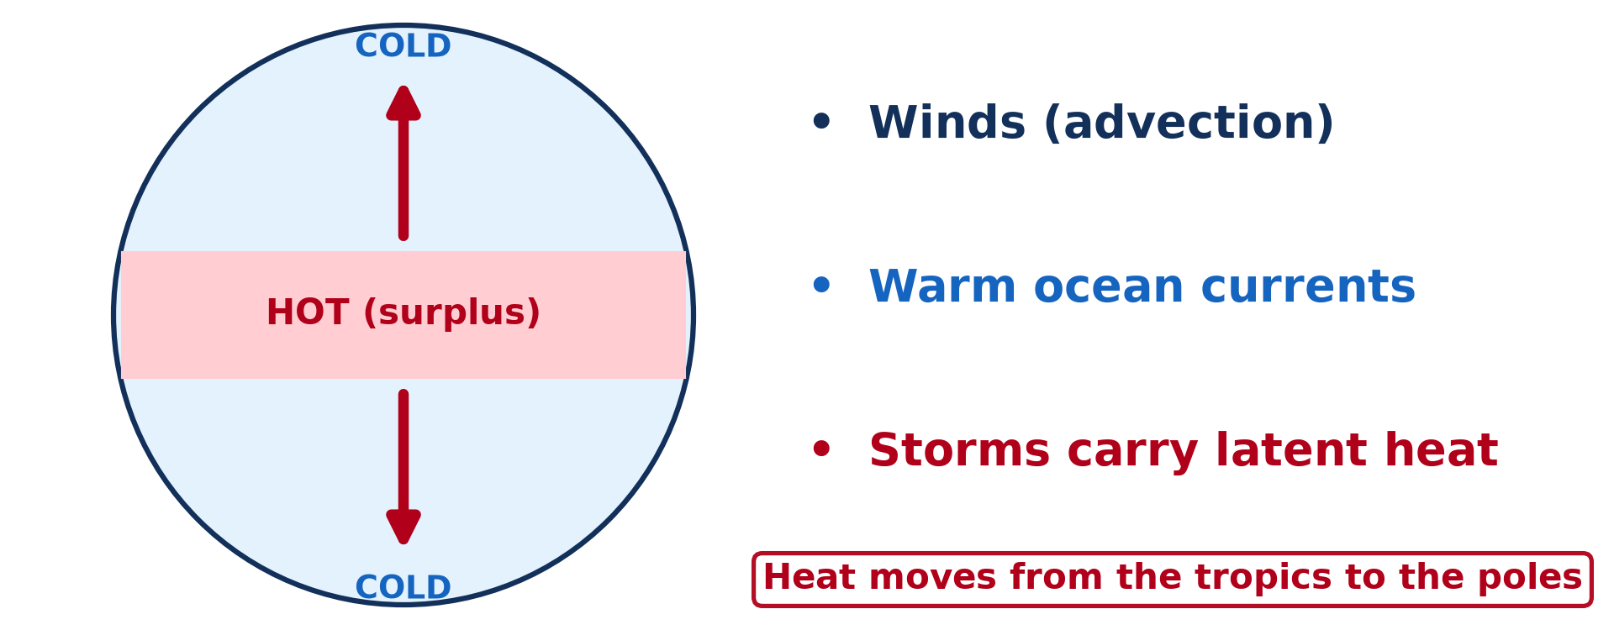
4. BALANCING MECHANISMS
Activity 4
Heat moves from the tropics to the poles.
Notes:
Activity 4. Look carefully at this diagram: heat moves from the tropics to the poles. Observe every detail before I ask the question.

Slide 28
4. BALANCING MECHANISMS
Activity 4: Question
Name two ways heat is carried to the poles.
Notes:
Here is the question for Activity 4: Name two ways heat is carried to the poles. Take one minute to think and write your answer in your rough notebook.

Slide 29
4. BALANCING MECHANISMS
Activity 4: Answer
Winds (air masses) and warm ocean currents.
Notes:
Let us check the answer together. Winds (air masses) and warm ocean currents.

Slide 30

4. BALANCING MECHANISMS
Activity 5
A tropical cyclone seen from space.
Notes:
Activity 5. Look carefully at this picture: a tropical cyclone seen from space. Observe every detail before I ask the question.

Slide 31
4. BALANCING MECHANISMS
Activity 5: Question
How do storms help to share heat?
Notes:
Here is the question for Activity 5: How do storms help to share heat? Take one minute to think and write your answer in your rough notebook.

Slide 32
4. BALANCING MECHANISMS
Activity 5: Answer
They carry latent heat from warm tropical seas towards higher latitudes.
Notes:
Let us check the answer together. They carry latent heat from warm tropical seas towards higher latitudes.

Slide 33
BOARD SUMMARY
Board Summary
Topic: Energy in the Atmosphere
Sub-topic: The Earth's Heat Budget on a Global Scale
Lesson 4: The Earth's Radiation Balance
Notes:
Now we are going to copy the board summary. Write the title and the headings neatly in your notebooks. I will give you enough time for each slide, so do not rush.

Slide 34
BOARD SUMMARY
DEFINITIONS
The key terms of this lesson are defined as follows:
Heat budget: It is the balance between the energy the Earth receives from the sun and the energy it loses to space.
Terrestrial radiation: It is the long-wave radiation given out by the Earth's surface.
Notes:
Let us copy the definitions. The key terms of this lesson are defined as follows. On this slide we have Heat budget and Terrestrial radiation. Write each point on a new line, with the key term first, and explain it in your own words when we revise. When you finish, we go to the next slide.

Slide 35
BOARD SUMMARY
DEFINITIONS (continued)
Net radiation: It is the difference between incoming and outgoing radiation at a place.
Notes:
We continue with the definitions. On this slide we have Net radiation. Write each point on a new line, with the key term first, and explain it in your own words when we revise.

Slide 36
BOARD SUMMARY
1. The Global Heat Budget
For the Earth as a whole, the heat budget is balanced:
Incoming radiation: Of 100 units of insolation, about 30 are reflected, 20 absorbed by the air and 50 absorbed by the surface. The surface warms and gives the heat back.
Notes:
Let us copy The Global Heat Budget. For the Earth as a whole, the heat budget is balanced. On this slide we have Incoming radiation. Write each point on a new line, with the key term first, and explain it in your own words when we revise. When you finish, we go to the next slide.

Slide 37
BOARD SUMMARY
1. The Global Heat Budget (continued)
Outgoing radiation: The Earth sends back the same amount of energy as long waves, by radiation, convection and latent heat. So the Earth does not keep getting warmer or colder on average.
Notes:
We continue with The Global Heat Budget. On this slide we have Outgoing radiation. Write each point on a new line, with the key term first, and explain it in your own words when we revise.

Slide 38
BOARD SUMMARY
1. The Global Heat Budget
Illustration: incoming and outgoing radiation
Notes:
Now draw this illustration in your notebook: incoming and outgoing radiation. Give it a title and label it clearly.

Slide 39
BOARD SUMMARY
2. Positive and Negative Balance
The balance is not the same at all latitudes:
Surplus zone: Between about 35° N and 35° S, more energy is received than lost. The inter-tropical zone therefore has a net positive balance.
Notes:
Let us copy Positive and Negative Balance. The balance is not the same at all latitudes. On this slide we have Surplus zone. Write each point on a new line, with the key term first, and explain it in your own words when we revise. When you finish, we go to the next slide.

Slide 40
BOARD SUMMARY
2. Positive and Negative Balance (continued)
Deficit zones: Beyond 35° of latitude, the mid-latitudes and polar zones lose more energy than they receive. They have a net negative balance.
Notes:
We continue with Positive and Negative Balance. On this slide we have Deficit zones. Write each point on a new line, with the key term first, and explain it in your own words when we revise.

Slide 41
BOARD SUMMARY
2. Positive and Negative Balance
Illustration: surplus and deficit by latitude
Notes:
Now draw this illustration in your notebook: surplus and deficit by latitude. Give it a title and label it clearly.

Slide 42
BOARD SUMMARY
3. Reasons for the Differences
The main reasons for these differences are:
Angle of the sun's rays: Near the Equator the sun is high, so its rays are concentrated on a small area. Near the poles the rays are slanting and spread over a large area.
Notes:
Let us copy Reasons for the Differences. The main reasons for these differences are. On this slide we have Angle of the sun's rays. Write each point on a new line, with the key term first, and explain it in your own words when we revise. When you finish, we go to the next slide.

Slide 43
BOARD SUMMARY
3. Reasons for the Differences (continued)
Thickness of atmosphere crossed: Slanting rays cross more air and lose more energy by absorption and scattering. Less energy reaches the ground at high latitudes.
Notes:
We continue with Reasons for the Differences. On this slide we have Thickness of atmosphere crossed. Write each point on a new line, with the key term first, and explain it in your own words when we revise. When you finish, we go to the next slide.

Slide 44
BOARD SUMMARY
3. Reasons for the Differences (continued)
Albedo and day length: Snow and ice at the poles reflect much of the insolation. The poles also have months of darkness in winter.
Notes:
We continue with Reasons for the Differences. On this slide we have Albedo and day length. Write each point on a new line, with the key term first, and explain it in your own words when we revise.

Slide 45
BOARD SUMMARY
4. Balancing Mechanisms
Heat is moved from the surplus zone to the deficit zones by:
Winds and air masses: The atmospheric circulation carries about 80 % of the heat towards the poles. Warm tropical air moves poleward and cold polar air moves towards the Equator.
Notes:
Let us copy Balancing Mechanisms. Heat is moved from the surplus zone to the deficit zones by. On this slide we have Winds and air masses. Write each point on a new line, with the key term first, and explain it in your own words when we revise. When you finish, we go to the next slide.

Slide 46
BOARD SUMMARY
4. Balancing Mechanisms (continued)
Ocean currents: Warm currents like the Gulf Stream carry heat to high latitudes. Cold currents return cool water to the tropics.
Storms and latent heat: Tropical cyclones and thunderstorms release huge amounts of latent heat. They move energy upwards and polewards.
Notes:
We continue with Balancing Mechanisms. On this slide we have Ocean currents and Storms and latent heat. Write each point on a new line, with the key term first, and explain it in your own words when we revise.

Slide 47
FORMATIVE EVALUATION
Evaluation 1
What is the heat budget?
Notes:
Now let us check what you have understood. Question 1: What is the heat budget? Answer in your exercise book.

Slide 48
FORMATIVE EVALUATION
Expected Answer
The balance between the energy received and the energy lost by the Earth.
Notes:
The expected answer is: the balance between the energy received and the energy lost by the Earth. If you got it right, well done.

Slide 49
FORMATIVE EVALUATION
Evaluation 2
Explain why the tropics do not get hotter every year.
Notes:
Now let us check what you have understood. Question 2: Explain why the tropics do not get hotter every year. Answer in your exercise book.

Slide 50
FORMATIVE EVALUATION
Expected Answer
Winds and ocean currents carry their extra heat towards the poles.
Notes:
The expected answer is: winds and ocean currents carry their extra heat towards the poles. If you got it right, well done.

Slide 51
REMEDIATION
Remediation
Fill in the blanks:
The inter-tropical zone has an energy ______.
The Earth gives out ______-wave radiation.
The Gulf Stream is a warm ocean ______.
Notes:
For those who need more practice, fill in the blanks in your exercise book. The answers are: number 1, surplus; number 2, long; number 3, current.

Slide 52
HOMEWORK
Homework
Draw the radiation balance graph and colour the surplus and deficit zones.
Notes:
For your homework: Draw the radiation balance graph and colour the surplus and deficit zones. We shall correct it at the beginning of our next lesson.

Slide 53
NEXT LESSON
Next Lesson
Our next lesson will be on:
Lesson 5: Heat Transport
Notes:
Our next lesson will be on Lesson 5: Heat Transport. Thank you for your attention, and see you next time.

Slide 54
BILINGUAL GAME
Bilingual Game (Jeu Bilingue)
English | Français
Heat budget | Le bilan thermique
Surplus | L'excédent
Deficit | Le déficit
Ocean current | Le courant marin
Balance | L'équilibre
Long-wave | Grande longueur d'onde
Notes:
Let us play the bilingual game. I say a word in English, and you give me the French word. Then we do the reverse.

Slide 55
LOGBOOK
Official Logbook (1/2)
Module / Topic | Energy in the Atmosphere
Lesson Title | Lesson 4: The Earth's Radiation Balance
Expected Learning Outcomes | Define the heat budget. Identify zones of positive and negative balance. Explain the balancing mechanisms.
Competence | Learners are able to explain why the tropics gain energy and the poles lose energy, and how heat is shared.
Notes:
I record this information in the official logbook of the class after the lesson.

Slide 56
LOGBOOK
Official Logbook (2/2)
Matter Taught | DEFINITIONS; The Global Heat Budget; Positive and Negative Balance; Reasons for the Differences; Balancing Mechanisms.
Evaluation | Formative evaluation and remediation exercise.
Homework | Draw the radiation balance graph and colour the surplus and deficit zones.
Enrolment / Present / Absent | ____ / ____ / ____
Achievement | To be completed after the lesson.
Notes:
I complete the second page of the logbook: the matter taught, the evaluation, the homework and the attendance.

Slide 57
TEACHER'S NOTE
Teacher's Note
Timing: Homework correction, plan, objectives 8 min | Recall, situation, action 10 min | 5 activities 30 min | Board summary (copying) 30 min | Evaluation, remediation 10 min | Homework, next lesson 5 min | Logbook 7 min
Without the projector (Activity 1): feel the heat of a wall after sunset.
Without the projector (Activity 2): draw the two curves.
Without the projector (Activity 3): shine a torch straight and slanted on a table.
Without the projector (Activity 4): draw arrows from the Equator to the poles.
Without the projector (Activity 5): mention the hurricanes of the Caribbean.
Notes:
This slide is for me, the teacher: it gives the timing of the lesson and what to do if the projector is not available.

Slide 58
REFERENCES
References
National Geography Syllabus, MINESEC/IGE/IP-SS, 2019 — Module 1 (Meteorology, Climatology & Hydrology).
Photo, Activity 5: “NASA's Aqua Satellite Captures Hurricane Danielle” by NASA Goddard Photo and Video, CC BY 2.0, via nasa (https://www.flickr.com/photos/24662369@N07/4931591817)
Diagrams and animations: drawn for this lesson (Geography Department).
Notes:
These are the references and picture credits used to prepare this lesson.

