Slide 1
LOWER SIXTH ARTS
GEOGRAPHY
Lesson 7
Geographical Factors Affecting Temperature
Notes:
Good morning, class, and welcome to our geography lesson. I am your geography teacher, Mr Kamdem. Today we are starting Lesson 7: Geographical Factors Affecting Temperature.

Slide 2
CLASS INFO
Class, Chapter and Duration
Class | Lower Sixth Arts
Chapter | Module 1: Understanding and managing atmospheric and hydrological phenomena and hazards across the world in general and Cameroon in particular
Duration | 2 periods (2 × 50 minutes)
Notes:
This lesson is for Lower Sixth Arts. It belongs to Module 1: Understanding and managing atmospheric and hydrological phenomena and hazards across the world in general and Cameroon in particular. We shall need 2 periods to cover it.

Slide 3
IDENTIFICATION
Lesson Identification
Topic | Energy in the Atmosphere
Sub-topic | Global Distribution of Heat (Temperature)
Lesson | Lesson 7: Geographical Factors Affecting Temperature
Notions / Concepts | Continentality, maritime influence, altitude, aspect, ocean current, heat island, cloud cover.
Syllabus focus | Nature of the surface, relief, ocean currents, winds, cloud cover and urbanisation.
Competence | Learners are able to explain why places on the same latitude have different temperatures.
Notes:
Our topic is Energy in the Atmosphere, and the sub-topic is Global Distribution of Heat (Temperature). The key notions we shall use today are: continentality, maritime influence, altitude, aspect, ocean current, heat island, cloud cover. At the end, you should be able to do this: learners are able to explain why places on the same latitude have different temperatures.

Slide 4

HOMEWORK CORRECTION
Correction of the Homework
Question (Lesson 6: Latitudinal Distribution of Temperature):
Find the January and July temperatures of Douala and Paris and compare the annual range.
Notes:
Before we start the new lesson, let us correct the homework I gave you at the end of Lesson 6: Latitudinal Distribution of Temperature. The question was: Find the January and July temperatures of Douala and Paris and compare the annual range. Take out your exercise books.

Slide 5
HOMEWORK CORRECTION
Correction: Possible Answer
Douala is about 27 °C in January and 24 °C in July: range about 3 °C. Paris is about 5 °C in January and 20 °C in July: range about 15 °C. Paris has a larger range because it is at a higher latitude with marked seasons.
Notes:
Here is a good answer. Douala is about 27 °C in January and 24 °C in July: range about 3 °C. Paris is about 5 °C in January and 20 °C in July: range about 15 °C. Paris has a larger range because it is at a higher latitude with marked seasons. Compare it with your own answer and correct your work in red.

Slide 6
LESSON PLAN
Lesson Plan
Correction of the homework
Objectives and recall
Real-life situation and action to take
Learning activities
Board summary
Evaluation, remediation and homework
Notes:
Here is the plan of our lesson today. First, we shall correct the homework. Then we shall look at the objectives and recall what you already know. After that, we shall study a situation from real life and the action to take, and do the learning activities. Finally, we shall copy the board summary, do the evaluation and the remediation, and I will give you the homework.

Slide 7
OBJECTIVES
Objectives
By the end of this lesson, you should be able to:
Explain the effect of land, sea and distance from the sea.
Explain the effect of altitude and aspect.
Notes:
Take your time to copy this part; we will continue together.

Slide 8
OBJECTIVES
Objectives (continued)
Explain the effect of currents, winds, clouds and towns.
Notes:
By the end of this lesson, you should be able to do three things. Number 1: explain the effect of land, sea and distance from the sea. Number 2: explain the effect of altitude and aspect. Number 3: explain the effect of currents, winds, clouds and towns.

Slide 9
PREVIOUS KNOWLEDGE
Previous Knowledge
Temperature falls from the Equator to the poles.
Warm currents warm coasts.
Notes:
Let us first remember what you already know. Temperature falls from the Equator to the poles. Warm currents warm coasts. Keep this in mind, because we shall build on it today.

Slide 10
REAL-LIFE SITUATION
Situation in Real Life
Douala and Ngaoundéré are both in southern and central Cameroon, but Ngaoundéré is much cooler. Also, Douala has almost the same temperature all year, while Kousseri has very hot and cooler months.
Notes:
Listen carefully to this situation from real life. Douala and Ngaoundéré are both in southern and central Cameroon, but Ngaoundéré is much cooler. Also, Douala has almost the same temperature all year, while Kousseri has very hot and cooler months. Think about it, because I am going to ask you some questions.

Slide 11
REAL-LIFE SITUATION
Situation: Question 1
What is the problem in the situation?
Notes:
Question 1: What is the problem in the situation? Think for a moment, then raise your hand to answer.

Slide 12
REAL-LIFE SITUATION
Answer
Learners do not know why temperature differs at similar latitudes.
Notes:
Good. Learners do not know why temperature differs at similar latitudes.

Slide 13
REAL-LIFE SITUATION
Situation: Question 2
Why is Ngaoundéré cooler?
Notes:
Question 2: Why is Ngaoundéré cooler? Think for a moment, then raise your hand to answer.

Slide 14
REAL-LIFE SITUATION
Answer
It is high on the Adamawa Plateau (about 1,100 m).
Notes:
Good. It is high on the Adamawa Plateau (about 1,100 m).

Slide 15
REAL-LIFE SITUATION
Situation: Question 3
Why does Douala have a small range?
Notes:
Question 3: Why does Douala have a small range? Think for a moment, then raise your hand to answer.

Slide 16
REAL-LIFE SITUATION
Possible Answer
It is near the sea, which keeps the temperature steady.
Notes:
Good. It is near the sea, which keeps the temperature steady.

Slide 17
ACTION TO TAKE
Action to Take
Adapt to temperature differences caused by relief, the sea and towns, for example by planting trees in towns.
Notes:
From this situation, the action we are working towards in this lesson is the following: adapt to temperature differences caused by relief, the sea and towns, for example by planting trees in towns.

Slide 18
JUSTIFICATION
Justification of the Lesson
This lesson helps us to explain local differences in temperature in Cameroon and in the world.
Notes:
Why is this lesson important for you? This lesson helps us to explain local differences in temperature in Cameroon and in the world.

Slide 19
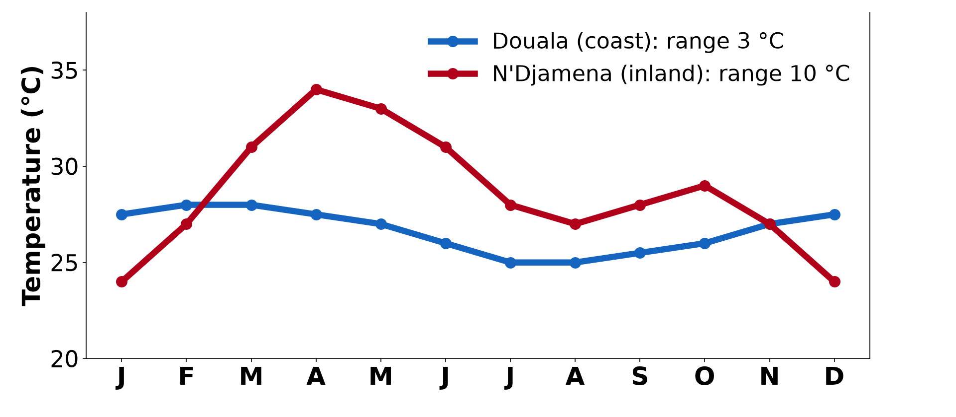
1. NATURE OF SURFACE
Activity 1
Monthly temperatures of Douala and N'Djamena.
Notes:
Activity 1. Look carefully at this diagram: monthly temperatures of Douala and N'Djamena. Observe every detail before I ask the question.

Slide 20
1. NATURE OF SURFACE
Activity 1: Question
Which town has the larger range? Why?
Notes:
Here is the question for Activity 1: Which town has the larger range? Why? Take one minute to think and write your answer in your rough notebook.

Slide 21
1. NATURE OF SURFACE
Activity 1: Answer
N'Djamena, because it is far from the sea (continentality).
Notes:
Let us check the answer together. N'Djamena, because it is far from the sea (continentality).

Slide 22

2. RELIEF: ALTITUDE
Activity 2
Snow on Mount Kilimanjaro near the Equator.
Notes:
Activity 2. Look carefully at this picture: snow on Mount Kilimanjaro near the Equator. Observe every detail before I ask the question.

Slide 23
2. RELIEF: ALTITUDE
Activity 2: Question
Why is there snow on a mountain near the Equator?
Notes:
Here is the question for Activity 2: Why is there snow on a mountain near the Equator? Take one minute to think and write your answer in your rough notebook.

Slide 24
2. RELIEF: ALTITUDE
Activity 2: Answer
Temperature falls with height (altitude).
Notes:
Let us check the answer together. Temperature falls with height (altitude).

Slide 25
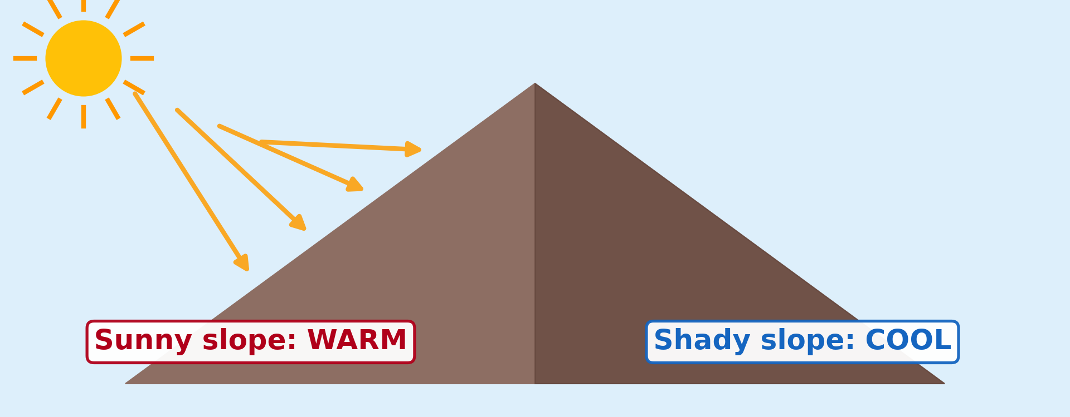
2. RELIEF: ASPECT
Activity 3
A sunny slope and a shady slope.
Notes:
Activity 3. Look carefully at this diagram: a sunny slope and a shady slope. Observe every detail before I ask the question.

Slide 26
2. RELIEF: ASPECT
Activity 3: Question
Why is one side of a hill warmer than the other?
Notes:
Here is the question for Activity 3: Why is one side of a hill warmer than the other? Take one minute to think and write your answer in your rough notebook.

Slide 27
2. RELIEF: ASPECT
Activity 3: Answer
The sunny slope faces the Sun (aspect) and receives more direct rays.
Notes:
Let us check the answer together. The sunny slope faces the Sun (aspect) and receives more direct rays.

Slide 28

3. OCEAN CURRENTS AND WINDS
Activity 4
Warm and cold ocean currents.
Notes:
Activity 4. Look carefully at this diagram: warm and cold ocean currents. Observe every detail before I ask the question.

Slide 29
3. OCEAN CURRENTS AND WINDS
Activity 4: Question
Why is the coast of Namibia cool and dry?
Notes:
Here is the question for Activity 4: Why is the coast of Namibia cool and dry? Take one minute to think and write your answer in your rough notebook.

Slide 30
3. OCEAN CURRENTS AND WINDS
Activity 4: Answer
The cold Benguela current cools the air along the coast.
Notes:
Let us check the answer together. The cold Benguela current cools the air along the coast.

Slide 31
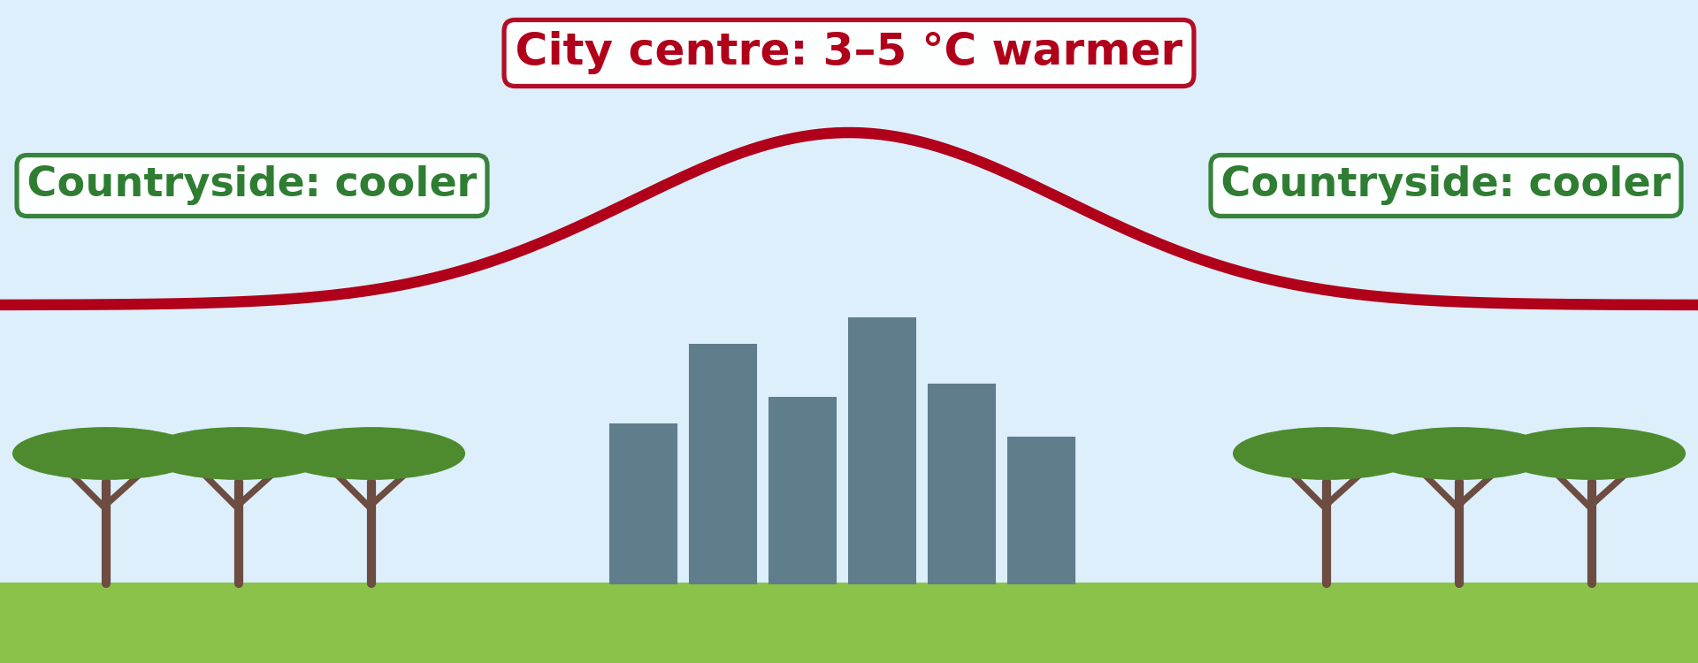
4. URBANISATION
Activity 5
A town is warmer than the countryside.
Notes:
Activity 5. Look carefully at this diagram: a town is warmer than the countryside. Observe every detail before I ask the question.

Slide 32
4. URBANISATION
Activity 5: Question
Why is the centre of a town warmer than the countryside?
Notes:
Here is the question for Activity 5: Why is the centre of a town warmer than the countryside? Take one minute to think and write your answer in your rough notebook.

Slide 33
4. URBANISATION
Activity 5: Answer
Concrete and tar store heat, and cars and factories give out heat: an urban heat island.
Notes:
Let us check the answer together. Concrete and tar store heat, and cars and factories give out heat: an urban heat island.

Slide 34
BOARD SUMMARY
Board Summary
Topic: Energy in the Atmosphere
Sub-topic: Global Distribution of Heat (Temperature)
Lesson 7: Geographical Factors Affecting Temperature
Notes:
Now we are going to copy the board summary. Write the title and the headings neatly in your notebooks. I will give you enough time for each slide, so do not rush.

Slide 35
BOARD SUMMARY
DEFINITIONS
The key terms of this lesson are defined as follows:
Adret: It is the sunny slope of a valley, facing the sun.
Ubac: It is the shady slope of a valley, turned away from the sun.
Notes:
Let us copy the definitions. The key terms of this lesson are defined as follows. On this slide we have Adret and Ubac. Write each point on a new line, with the key term first, and explain it in your own words when we revise. When you finish, we go to the next slide.

Slide 36
BOARD SUMMARY
DEFINITIONS (continued)
Heat island: It is a town area that is warmer than the surrounding countryside.
Temperature lapsing: It is the fall of temperature with height.
Notes:
We continue with the definitions. On this slide we have Heat island and Temperature lapsing. Write each point on a new line, with the key term first, and explain it in your own words when we revise.

Slide 37
BOARD SUMMARY
1. Geographical Factors of Temperature
A) Nature of Surface and Distance from the Sea
Land and water heat and cool differently:
Land and water: Land heats and cools quickly, while water heats and cools slowly. Coastal places therefore have mild temperatures and small ranges.
Notes:
Let us copy Nature of Surface and Distance from the Sea. Land and water heat and cool differently. On this slide we have Land and water. Write each point on a new line, with the key term first, and explain it in your own words when we revise. When you finish, we go to the next slide.

Slide 38
BOARD SUMMARY
1. Geographical Factors of Temperature
A) Nature of Surface and Distance from the Sea (continued)
Distance from the sea: Places far inland have hot summers, cold winters and large ranges; this is continentality. Kousseri has a larger range than Douala.
Notes:
We continue with Nature of Surface and Distance from the Sea. On this slide we have Distance from the sea. Write each point on a new line, with the key term first, and explain it in your own words when we revise.

Slide 39
BOARD SUMMARY
1. Geographical Factors of Temperature
Illustration: coastal and continental temperatures
Notes:
Now draw this illustration in your notebook: coastal and continental temperatures. Give it a title and label it clearly.

Slide 40
BOARD SUMMARY
1. Geographical Factors of Temperature
B) Relief
Relief affects temperature in two ways:
Altitude: Temperature falls by about 6.5 °C for every 1,000 m of height. This is why Buea is cooler than Limbe and Mount Kilimanjaro has snow.
Notes:
Let us copy Relief. Relief affects temperature in two ways. On this slide we have Altitude. Write each point on a new line, with the key term first, and explain it in your own words when we revise. When you finish, we go to the next slide.

Slide 41
BOARD SUMMARY
1. Geographical Factors of Temperature
B) Relief (continued)
Aspect of slope: Slopes facing the sun (adret) are warmer than slopes in the shade (ubac). In the Alps, villages and vineyards are on the adret.
Notes:
We continue with Relief. On this slide we have Aspect of slope. Write each point on a new line, with the key term first, and explain it in your own words when we revise.

Slide 42
BOARD SUMMARY
1. Geographical Factors of Temperature
Illustration: adret and ubac
Notes:
Now draw this illustration in your notebook: adret and ubac. Give it a title and label it clearly.

Slide 43
BOARD SUMMARY
1. Geographical Factors of Temperature
C) Currents, Winds, Clouds and Towns
Other geographical factors include:
Ocean currents and winds: Warm currents and winds from the sea raise coastal temperatures. Cold currents such as the Benguela and dry desert winds lower them.
Notes:
Let us copy Currents, Winds, Clouds and Towns. Other geographical factors include. On this slide we have Ocean currents and winds. Write each point on a new line, with the key term first, and explain it in your own words when we revise. When you finish, we go to the next slide.

Slide 44
BOARD SUMMARY
1. Geographical Factors of Temperature
C) Currents, Winds, Clouds and Towns (continued)
Cloud cover: Clouds reduce heating by day and reduce cooling at night. Cloudy regions therefore have a small daily range, while deserts have a large one.
Notes:
We continue with Currents, Winds, Clouds and Towns. On this slide we have Cloud cover. Write each point on a new line, with the key term first, and explain it in your own words when we revise. When you finish, we go to the next slide.

Slide 45
BOARD SUMMARY
1. Geographical Factors of Temperature
C) Currents, Winds, Clouds and Towns (continued)
Urbanisation: Concrete, tar, traffic and factories store and produce heat. City centres can be 2–10 °C warmer than the countryside; this is the urban heat island.
Notes:
We continue with Currents, Winds, Clouds and Towns. On this slide we have Urbanisation. Write each point on a new line, with the key term first, and explain it in your own words when we revise.

Slide 46
FORMATIVE EVALUATION
Evaluation 1
Why are coastal places cooler in summer than inland places?
Notes:
Now let us check what you have understood. Question 1: Why are coastal places cooler in summer than inland places? Answer in your exercise book.

Slide 47
FORMATIVE EVALUATION
Expected Answer
The sea heats slowly and keeps coastal temperatures steady.
Notes:
The expected answer is: the sea heats slowly and keeps coastal temperatures steady. If you got it right, well done.

Slide 48
FORMATIVE EVALUATION
Evaluation 2
Give three geographical factors of temperature.
Notes:
Now let us check what you have understood. Question 2: Give three geographical factors of temperature. Answer in your exercise book.

Slide 49
FORMATIVE EVALUATION
Expected Answer
Altitude, distance from the sea, ocean currents (also aspect, winds, clouds, towns).
Notes:
The expected answer is: altitude, distance from the sea, ocean currents (also aspect, winds, clouds, towns). If you got it right, well done.

Slide 50
REMEDIATION
Remediation
Fill in the blanks:
The effect of distance from the sea is called ______.
The direction a slope faces is its ______.
A town warmer than its surroundings is an urban ______.
Notes:
For those who need more practice, fill in the blanks in your exercise book. The answers are: number 1, continentality; number 2, aspect; number 3, heat island.

Slide 51
HOMEWORK
Homework
Compare the temperature of Buea and Limbe and explain the difference.
Notes:
For your homework: Compare the temperature of Buea and Limbe and explain the difference. We shall correct it at the beginning of our next lesson.

Slide 52
NEXT LESSON
Next Lesson
Our next lesson will be on:
Lesson 8: Vertical Distribution of Temperature
Notes:
Our next lesson will be on Lesson 8: Vertical Distribution of Temperature. Thank you for your attention, and see you next time.

Slide 53
BILINGUAL GAME
Bilingual Game (Jeu Bilingue)
English | Français
Altitude | L'altitude
Continentality | La continentalité
Slope | Le versant
Heat island | Îlot de chaleur
Coast | La côte
Cloud cover | La nébulosité
Notes:
Let us play the bilingual game. I say a word in English, and you give me the French word. Then we do the reverse.

Slide 54
LOGBOOK
Official Logbook (1/2)
Module / Topic | Energy in the Atmosphere
Lesson Title | Lesson 7: Geographical Factors Affecting Temperature
Expected Learning Outcomes | Explain the effect of land, sea and distance from the sea. Explain the effect of altitude and aspect. Explain the effect of currents, winds, clouds and towns.
Competence | Learners are able to explain why places on the same latitude have different temperatures.
Notes:
I record this information in the official logbook of the class after the lesson.

Slide 55
LOGBOOK
Official Logbook (2/2)
Matter Taught | DEFINITIONS; Nature of Surface and Distance from the Sea; Relief; Currents, Winds, Clouds and Towns.
Evaluation | Formative evaluation and remediation exercise.
Homework | Compare the temperature of Buea and Limbe and explain the difference.
Enrolment / Present / Absent | ____ / ____ / ____
Achievement | To be completed after the lesson.
Notes:
I complete the second page of the logbook: the matter taught, the evaluation, the homework and the attendance.

Slide 56
TEACHER'S NOTE
Teacher's Note
Timing: Homework correction, plan, objectives 8 min | Recall, situation, action 10 min | 5 activities 30 min | Board summary (copying) 30 min | Evaluation, remediation 10 min | Homework, next lesson 5 min | Logbook 7 min
Without the projector (Activity 1): write both ranges on the board.
Without the projector (Activity 2): compare Buea and Limbe.
Without the projector (Activity 3): describe the sunny side of a hill.
Without the projector (Activity 4): show Namibia on an atlas.
Without the projector (Activity 5): compare the heat in a market and in a field.
Notes:
This slide is for me, the teacher: it gives the timing of the lesson and what to do if the projector is not available.

Slide 57
REFERENCES
References
National Geography Syllabus, MINESEC/IGE/IP-SS, 2019 — Module 1 (Meteorology, Climatology & Hydrology).
Photo, Activity 2: “Kilimanjaro” by ian 1602, CC BY-NC 2.0, via Flickr (https://www.flickr.com/photos/98181641@N00/2179855841)
Diagrams and animations: drawn for this lesson (Geography Department).
Notes:
These are the references and picture credits used to prepare this lesson.

