Slide 1
LOWER SIXTH ARTS
GEOGRAPHY
Lesson 8
Vertical Distribution of Temperature
Notes:
Good morning, class, and welcome to our geography lesson. I am your geography teacher, Mr Kamdem. Today we are starting Lesson 8: Vertical Distribution of Temperature.

Slide 2
CLASS INFO
Class, Chapter and Duration
Class | Lower Sixth Arts
Chapter | Module 1: Understanding and managing atmospheric and hydrological phenomena and hazards across the world in general and Cameroon in particular
Duration | 2 periods (2 × 50 minutes)
Notes:
This lesson is for Lower Sixth Arts. It belongs to Module 1: Understanding and managing atmospheric and hydrological phenomena and hazards across the world in general and Cameroon in particular. We shall need 2 periods to cover it.

Slide 3
IDENTIFICATION
Lesson Identification
Topic | Energy in the Atmosphere
Sub-topic | Vertical Distribution of Heat in the Atmosphere
Lesson | Lesson 8: Vertical Distribution of Temperature
Notions / Concepts | Lapse rate, environmental lapse rate, adiabatic cooling, air pressure, altitude.
Syllabus focus | How temperature changes with height and the reasons for lapse rate.
Competence | Learners are able to calculate temperature at different heights and explain why air is colder higher up.
Notes:
Our topic is Energy in the Atmosphere, and the sub-topic is Vertical Distribution of Heat in the Atmosphere. The key notions we shall use today are: lapse rate, environmental lapse rate, adiabatic cooling, air pressure, altitude. At the end, you should be able to do this: learners are able to calculate temperature at different heights and explain why air is colder higher up.

Slide 4

HOMEWORK CORRECTION
Correction of the Homework
Question (Lesson 7: Geographical Factors Affecting Temperature):
Compare the temperature of Buea and Limbe and explain the difference.
Notes:
Before we start the new lesson, let us correct the homework I gave you at the end of Lesson 7: Geographical Factors Affecting Temperature. The question was: Compare the temperature of Buea and Limbe and explain the difference. Take out your exercise books.

Slide 5
HOMEWORK CORRECTION
Correction: Possible Answer
Buea (about 900 m) is cooler than Limbe (sea level). Buea is higher, so temperature falls with altitude, and it also has more cloud and mist; Limbe is warmed by the sea.
Notes:
Here is a good answer. Buea (about 900 m) is cooler than Limbe (sea level). Buea is higher, so temperature falls with altitude, and it also has more cloud and mist; Limbe is warmed by the sea. Compare it with your own answer and correct your work in red.

Slide 6
LESSON PLAN
Lesson Plan
Correction of the homework
Objectives and recall
Real-life situation and action to take
Learning activities
Board summary
Evaluation, remediation and homework
Notes:
Here is the plan of our lesson today. First, we shall correct the homework. Then we shall look at the objectives and recall what you already know. After that, we shall study a situation from real life and the action to take, and do the learning activities. Finally, we shall copy the board summary, do the evaluation and the remediation, and I will give you the homework.

Slide 7
OBJECTIVES
Objectives
By the end of this lesson, you should be able to:
Define lapse rate.
Calculate temperature at a given height.
Explain the reasons why temperature falls with height.
Notes:
By the end of this lesson, you should be able to do three things. Number 1: define lapse rate. Number 2: calculate temperature at a given height. Number 3: explain the reasons why temperature falls with height.

Slide 8
PREVIOUS KNOWLEDGE
Previous Knowledge
Temperature falls with altitude in the troposphere.
The ground heats the air.
Notes:
Let us first remember what you already know. Temperature falls with altitude in the troposphere. The ground heats the air. Keep this in mind, because we shall build on it today.

Slide 9
REAL-LIFE SITUATION
Situation in Real Life
Climbers of Mount Cameroon leave Buea in T-shirts but need warm coats near the top. A learner thinks that the top should be hotter because it is closer to the Sun.
Notes:
Listen carefully to this situation from real life. Climbers of Mount Cameroon leave Buea in T-shirts but need warm coats near the top. A learner thinks that the top should be hotter because it is closer to the Sun. Think about it, because I am going to ask you some questions.

Slide 10
REAL-LIFE SITUATION
Situation: Question 1
What is the problem in the situation?
Notes:
Question 1: What is the problem in the situation? Think for a moment, then raise your hand to answer.

Slide 11
REAL-LIFE SITUATION
Answer
The learner does not know why the top of a mountain is cold.
Notes:
Good. The learner does not know why the top of a mountain is cold.

Slide 12
REAL-LIFE SITUATION
Situation: Question 2
Is the top of the mountain hotter?
Notes:
Question 2: Is the top of the mountain hotter? Think for a moment, then raise your hand to answer.

Slide 13
REAL-LIFE SITUATION
Answer
No, it is colder.
Notes:
Good. No, it is colder.

Slide 14
REAL-LIFE SITUATION
Situation: Question 3
What heats the air?
Notes:
Question 3: What heats the air? Think for a moment, then raise your hand to answer.

Slide 15
REAL-LIFE SITUATION
Possible Answer
The ground, not the Sun directly.
Notes:
Good. The ground, not the Sun directly.

Slide 16
ACTION TO TAKE
Action to Take
Understand why high places are cool and adapt our clothing and farming to altitude.
Notes:
From this situation, the action we are working towards in this lesson is the following: understand why high places are cool and adapt our clothing and farming to altitude.

Slide 17
JUSTIFICATION
Justification of the Lesson
This lesson helps us to understand why mountains and highlands are cooler than lowlands.
Notes:
Why is this lesson important for you? This lesson helps us to understand why mountains and highlands are cooler than lowlands.

Slide 18

1. NATURE OF VARIATION
Activity 1
Mount Cameroon (4,095 m).
Notes:
Activity 1. Look carefully at this picture: mount Cameroon (4,095 m). Observe every detail before I ask the question.

Slide 19
1. NATURE OF VARIATION
Activity 1: Question
Is the top of the mountain warmer or colder than Buea? Why?
Notes:
Here is the question for Activity 1: Is the top of the mountain warmer or colder than Buea? Why? Take one minute to think and write your answer in your rough notebook.

Slide 20
1. NATURE OF VARIATION
Activity 1: Answer
Colder, because temperature falls with height.
Notes:
Let us check the answer together. Colder, because temperature falls with height.

Slide 21

1. NATURE OF VARIATION
Activity 2
Temperature falls 6.5 °C every 1,000 m.
Notes:
Activity 2. Look carefully at this diagram: temperature falls 6.5 °C every 1,000 m. Observe every detail before I ask the question.

Slide 22
1. NATURE OF VARIATION
Activity 2: Question
If it is 27 °C at sea level, what is the temperature at 2,000 m?
Notes:
Here is the question for Activity 2: If it is 27 °C at sea level, what is the temperature at 2,000 m? Take one minute to think and write your answer in your rough notebook.

Slide 23
1. NATURE OF VARIATION
Activity 2: Answer
27 − (2 × 6.5) = 14 °C.
Notes:
Let us check the answer together. 27 − (2 × 6.5) = 14 °C.

Slide 24
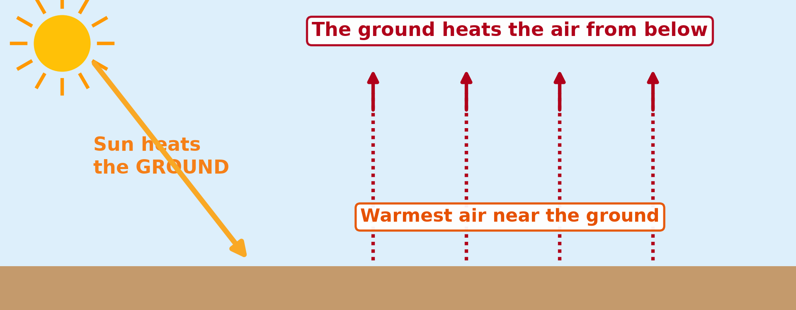
2. REASONS: HEATING FROM BELOW
Activity 3
The ground heats the air from below.
Notes:
Activity 3. Look carefully at this diagram: the ground heats the air from below. Observe every detail before I ask the question.

Slide 25
2. REASONS: HEATING FROM BELOW
Activity 3: Question
Why is air warmest near the ground?
Notes:
Here is the question for Activity 3: Why is air warmest near the ground? Take one minute to think and write your answer in your rough notebook.

Slide 26
2. REASONS: HEATING FROM BELOW
Activity 3: Answer
The ground absorbs sunlight and heats the air above it.
Notes:
Let us check the answer together. The ground absorbs sunlight and heats the air above it.

Slide 27

2. REASONS: THIN AIR
Activity 4
A plane at 10,000 m, where the air is about −50 °C.
Notes:
Activity 4. Look carefully at this picture: a plane at 10,000 m, where the air is about −50 °C. Observe every detail before I ask the question.

Slide 28
2. REASONS: THIN AIR
Activity 4: Question
Why is the air thin and cold so high up?
Notes:
Here is the question for Activity 4: Why is the air thin and cold so high up? Take one minute to think and write your answer in your rough notebook.

Slide 29
2. REASONS: THIN AIR
Activity 4: Answer
The air is less dense and holds less water vapour, so it keeps less heat.
Notes:
Let us check the answer together. The air is less dense and holds less water vapour, so it keeps less heat.

Slide 30
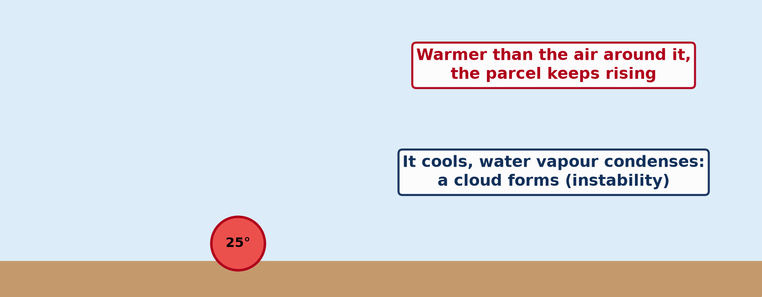
2. REASONS: ADIABATIC COOLING
Activity 5
Animation: rising air cools as it expands.
Notes:
Activity 5. Look carefully at this animation: animation: rising air cools as it expands. Watch the animation to the end; it will play again.

Slide 31
2. REASONS: ADIABATIC COOLING
Activity 5: Question
What happens to air when it rises?
Notes:
Here is the question for Activity 5: What happens to air when it rises? Take one minute to think and write your answer in your rough notebook.

Slide 32
2. REASONS: ADIABATIC COOLING
Activity 5: Answer
It expands because pressure is lower, and it cools (adiabatic cooling).
Notes:
Let us check the answer together. It expands because pressure is lower, and it cools (adiabatic cooling).

Slide 33
BOARD SUMMARY
Board Summary
Topic: Energy in the Atmosphere
Sub-topic: Vertical Distribution of Heat in the Atmosphere
Lesson 8: Vertical Distribution of Temperature
Notes:
Now we are going to copy the board summary. Write the title and the headings neatly in your notebooks. I will give you enough time for each slide, so do not rush.

Slide 34
BOARD SUMMARY
DEFINITIONS
The key terms of this lesson are defined as follows:
Lapse rate: It is the rate at which temperature falls with height in the troposphere.
Notes:
Let us copy the definitions. The key terms of this lesson are defined as follows. On this slide we have Lapse rate. Write each point on a new line, with the key term first, and explain it in your own words when we revise. When you finish, we go to the next slide.

Slide 35
BOARD SUMMARY
DEFINITIONS (continued)
Adiabatic change: It is a change of temperature in rising or sinking air without adding or removing heat.
Notes:
We continue with the definitions. On this slide we have Adiabatic change. Write each point on a new line, with the key term first, and explain it in your own words when we revise.

Slide 36
BOARD SUMMARY
1. Nature of the Variation of Temperature with Height
In the troposphere, temperature changes with height as follows:
Environmental lapse rate: Temperature falls by about 6.5 °C for every 1,000 m of height. If it is 27 °C at sea level, it is about 14 °C at 2,000 m.
Notes:
Let us copy Nature of the Variation of Temperature with Height. In the troposphere, temperature changes with height as follows. On this slide we have Environmental lapse rate. Write each point on a new line, with the key term first, and explain it in your own words when we revise. When you finish, we go to the next slide.

Slide 37
BOARD SUMMARY
1. Nature of the Variation of Temperature with Height (continued)
Variations: The lapse rate changes with the time of day, the season and humidity. Sometimes temperature even rises with height; this is an inversion.
Notes:
We continue with Nature of the Variation of Temperature with Height. On this slide we have Variations. Write each point on a new line, with the key term first, and explain it in your own words when we revise.

Slide 38
BOARD SUMMARY
1. Nature of the Variation of Temperature with Height
Illustration: fall of temperature with height
Notes:
Now draw this illustration in your notebook: fall of temperature with height. Give it a title and label it clearly.

Slide 39
BOARD SUMMARY
2. Reasons for the Lapsing of Temperature
Temperature falls with height for the following reasons:
Heating from below: The atmosphere is heated mainly by the ground, not directly by the sun. Air near the ground is warmest, and it gets colder farther from the source of heat.
Notes:
Let us copy Reasons for the Lapsing of Temperature. Temperature falls with height for the following reasons. On this slide we have Heating from below. Write each point on a new line, with the key term first, and explain it in your own words when we revise. When you finish, we go to the next slide.

Slide 40
BOARD SUMMARY
2. Reasons for the Lapsing of Temperature (continued)
Thin air at altitude: High up, the air is less dense and contains less water vapour and carbon dioxide. It absorbs and keeps less heat.
Adiabatic cooling: Rising air expands because pressure falls, and it cools. Dry air cools by about 10 °C per 1,000 m.
Notes:
We continue with Reasons for the Lapsing of Temperature. On this slide we have Thin air at altitude and Adiabatic cooling. Write each point on a new line, with the key term first, and explain it in your own words when we revise.

Slide 41
BOARD SUMMARY
2. Reasons for the Lapsing of Temperature
Illustration: the atmosphere is heated from below
Notes:
Now draw this illustration in your notebook: the atmosphere is heated from below. Give it a title and label it clearly.

Slide 42
FORMATIVE EVALUATION
Evaluation 1
What is the environmental lapse rate?
Notes:
Now let us check what you have understood. Question 1: What is the environmental lapse rate? Answer in your exercise book.

Slide 43
FORMATIVE EVALUATION
Expected Answer
The fall of about 6.5 °C per 1,000 m of height.
Notes:
The expected answer is: the fall of about 6.5 °C per 1,000 m of height. If you got it right, well done.

Slide 44
FORMATIVE EVALUATION
Evaluation 2
It is 30 °C at sea level. Find the temperature at 1,000 m.
Notes:
Now let us check what you have understood. Question 2: It is 30 °C at sea level. Find the temperature at 1,000 m. Answer in your exercise book.

Slide 45
FORMATIVE EVALUATION
Expected Answer
30 − 6.5 = 23.5 °C.
Notes:
The expected answer is: 30 − 6.5 = 23.5 °C. If you got it right, well done.

Slide 46
REMEDIATION
Remediation
Fill in the blanks:
Temperature falls by about ______ °C every 1,000 m.
The air is heated by the ______.
Rising air expands and ______.
Notes:
For those who need more practice, fill in the blanks in your exercise book. The answers are: number 1, ; number 6, 5; number 2, ground; number 3, cools.

Slide 47
HOMEWORK
Homework
Calculate the temperature at the top of Mount Cameroon if it is 28 °C in Limbe.
Notes:
For your homework: Calculate the temperature at the top of Mount Cameroon if it is 28 °C in Limbe. We shall correct it at the beginning of our next lesson.

Slide 48
NEXT LESSON
Next Lesson
Our next lesson will be on:
Lesson 9: Temperature Inversion
Notes:
Our next lesson will be on Lesson 9: Temperature Inversion. Thank you for your attention, and see you next time.

Slide 49
BILINGUAL GAME
Bilingual Game (Jeu Bilingue)
English | Français
Lapse rate | Le gradient thermique
Height | L'altitude
Expansion | La détente
Dense | Dense
Mountain | La montagne
Pressure | La pression
Notes:
Let us play the bilingual game. I say a word in English, and you give me the French word. Then we do the reverse.

Slide 50
LOGBOOK
Official Logbook (1/2)
Module / Topic | Energy in the Atmosphere
Lesson Title | Lesson 8: Vertical Distribution of Temperature
Expected Learning Outcomes | Define lapse rate. Calculate temperature at a given height. Explain the reasons why temperature falls with height.
Competence | Learners are able to calculate temperature at different heights and explain why air is colder higher up.
Notes:
I record this information in the official logbook of the class after the lesson.

Slide 51
LOGBOOK
Official Logbook (2/2)
Matter Taught | DEFINITIONS; Nature of the Variation of Temperature with Height; Reasons for the Lapsing of Temperature.
Evaluation | Formative evaluation and remediation exercise.
Homework | Calculate the temperature at the top of Mount Cameroon if it is 28 °C in Limbe.
Enrolment / Present / Absent | ____ / ____ / ____
Achievement | To be completed after the lesson.
Notes:
I complete the second page of the logbook: the matter taught, the evaluation, the homework and the attendance.

Slide 52
TEACHER'S NOTE
Teacher's Note
Timing: Homework correction, plan, objectives 8 min | Recall, situation, action 10 min | 5 activities 30 min | Board summary (copying) 30 min | Evaluation, remediation 10 min | Homework, next lesson 5 min | Logbook 7 min
Activity 5 is an animation (GIF): it plays automatically in slide-show mode.
Without the projector (Activity 1): describe the cold of Buea at night.
Without the projector (Activity 2): do the calculation on the board.
Without the projector (Activity 3): touch the warm ground at midday.
Without the projector (Activity 4): mention breathing problems on high mountains.
Without the projector (Activity 5): feel the cold air from a pumped tyre valve.
Notes:
This slide is for me, the teacher: it gives the timing of the lesson and what to do if the projector is not available.

Slide 53
REFERENCES
References
National Geography Syllabus, MINESEC/IGE/IP-SS, 2019 — Module 1 (Meteorology, Climatology & Hydrology).
Photo, Activity 1: “Mount Cameroon” by John & Mel Kots, CC BY-NC-ND 2.0, via Flickr (https://www.flickr.com/photos/26745817@N00/2347261849)
Photo, Activity 4: “flying” by { pranav }, CC BY 2.0, via Flickr (https://www.flickr.com/photos/29220600@N08/3469129491)
Diagrams and animations: drawn for this lesson (Geography Department).
Notes:
These are the references and picture credits used to prepare this lesson.

