Slide 1
LOWER SIXTH ARTS
GEOGRAPHY
Lesson 9
Temperature Inversion
Notes:
Good morning, class, and welcome to our geography lesson. I am your geography teacher, Mr Kamdem. Today we are starting Lesson 9: Temperature Inversion.

Slide 2
CLASS INFO
Class, Chapter and Duration
Class | Lower Sixth Arts
Chapter | Module 1: Understanding and managing atmospheric and hydrological phenomena and hazards across the world in general and Cameroon in particular
Duration | 2 periods (2 × 50 minutes)
Notes:
This lesson is for Lower Sixth Arts. It belongs to Module 1: Understanding and managing atmospheric and hydrological phenomena and hazards across the world in general and Cameroon in particular. We shall need 2 periods to cover it.

Slide 3
IDENTIFICATION
Lesson Identification
Topic | Energy in the Atmosphere
Sub-topic | Vertical Distribution of Heat in the Atmosphere
Lesson | Lesson 9: Temperature Inversion
Notions / Concepts | Temperature inversion, surface inversion, upper-air inversion, frost hollow, radiation fog, smog.
Syllabus focus | Meaning, types, causes and effects of temperature inversion; fog formation.
Competence | Learners are able to explain temperature inversion and its effects on weather and people.
Notes:
Our topic is Energy in the Atmosphere, and the sub-topic is Vertical Distribution of Heat in the Atmosphere. The key notions we shall use today are: temperature inversion, surface inversion, upper-air inversion, frost hollow, radiation fog, smog. At the end, you should be able to do this: learners are able to explain temperature inversion and its effects on weather and people.

Slide 4

HOMEWORK CORRECTION
Correction of the Homework
Question (Lesson 8: Vertical Distribution of Temperature):
Calculate the temperature at the top of Mount Cameroon if it is 28 °C in Limbe.
Notes:
Before we start the new lesson, let us correct the homework I gave you at the end of Lesson 8: Vertical Distribution of Temperature. The question was: Calculate the temperature at the top of Mount Cameroon if it is 28 °C in Limbe. Take out your exercise books.

Slide 5
HOMEWORK CORRECTION
Correction: Possible Answer
Mount Cameroon is about 4,040 m high. Temperature falls by 6.5 °C per 1,000 m: 4.04 × 6.5 ≈ 26 °C. The top is about 28 − 26 = 2 °C.
Notes:
Here is a good answer. Mount Cameroon is about 4,040 m high. Temperature falls by 6.5 °C per 1,000 m: 4.04 × 6.5 ≈ 26 °C. The top is about 28 − 26 = 2 °C. Compare it with your own answer and correct your work in red.

Slide 6
LESSON PLAN
Lesson Plan
Correction of the homework
Objectives and recall
Real-life situation and action to take
Learning activities
Board summary
Evaluation, remediation and homework
Notes:
Here is the plan of our lesson today. First, we shall correct the homework. Then we shall look at the objectives and recall what you already know. After that, we shall study a situation from real life and the action to take, and do the learning activities. Finally, we shall copy the board summary, do the evaluation and the remediation, and I will give you the homework.

Slide 7
OBJECTIVES
Objectives
By the end of this lesson, you should be able to:
Define temperature inversion.
Explain the types and causes of inversion.
Explain the effects of inversion, including fog and smog.
Notes:
By the end of this lesson, you should be able to do three things. Number 1: define temperature inversion. Number 2: explain the types and causes of inversion. Number 3: explain the effects of inversion, including fog and smog.

Slide 8
PREVIOUS KNOWLEDGE
Previous Knowledge
Normally temperature falls with height.
Cold air is heavy and sinks.
Notes:
Let us first remember what you already know. Normally temperature falls with height. Cold air is heavy and sinks. Keep this in mind, because we shall build on it today.

Slide 9
REAL-LIFE SITUATION
Situation in Real Life
On cold mornings in the Bamenda Highlands, the valleys are full of thick fog while the hilltops are clear and sunny. Drivers must go slowly in the valleys.
Notes:
Listen carefully to this situation from real life. On cold mornings in the Bamenda Highlands, the valleys are full of thick fog while the hilltops are clear and sunny. Drivers must go slowly in the valleys. Think about it, because I am going to ask you some questions.

Slide 10
REAL-LIFE SITUATION
Situation: Question 1
What is the problem in the situation?
Notes:
Question 1: What is the problem in the situation? Think for a moment, then raise your hand to answer.

Slide 11
REAL-LIFE SITUATION
Answer
Fog in the valleys makes driving dangerous.
Notes:
Good. Fog in the valleys makes driving dangerous.

Slide 12
REAL-LIFE SITUATION
Situation: Question 2
Why is the fog in the valleys and not on the hills?
Notes:
Question 2: Why is the fog in the valleys and not on the hills? Think for a moment, then raise your hand to answer.

Slide 13
REAL-LIFE SITUATION
Answer
Cold air has sunk into the valleys and is trapped below warmer air.
Notes:
Good. Cold air has sunk into the valleys and is trapped below warmer air.

Slide 14
REAL-LIFE SITUATION
Situation: Question 3
What is this situation called?
Notes:
Question 3: What is this situation called? Think for a moment, then raise your hand to answer.

Slide 15
REAL-LIFE SITUATION
Possible Answer
A temperature inversion.
Notes:
Good. A temperature inversion.

Slide 16
ACTION TO TAKE
Action to Take
Reduce the dangers of inversions: avoid burning waste in the evening and drive carefully in fog.
Notes:
From this situation, the action we are working towards in this lesson is the following: reduce the dangers of inversions: avoid burning waste in the evening and drive carefully in fog.

Slide 17
JUSTIFICATION
Justification of the Lesson
This lesson helps us to understand fog, frost and air pollution in valleys and towns.
Notes:
Why is this lesson important for you? This lesson helps us to understand fog, frost and air pollution in valleys and towns.

Slide 18
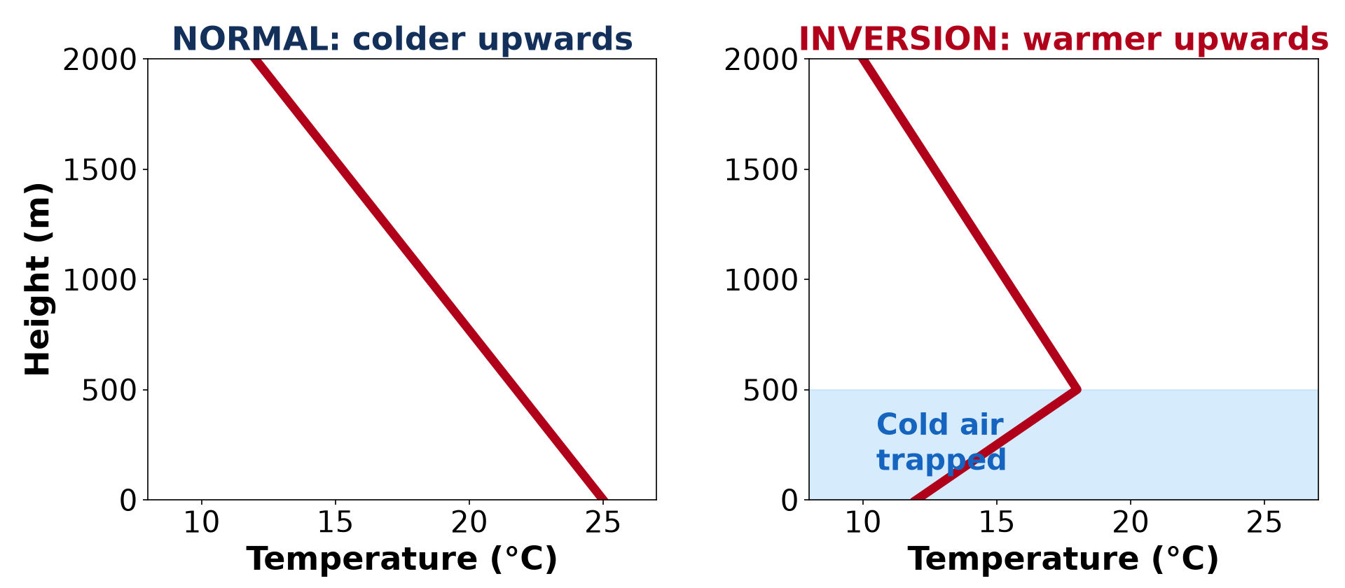
1. MEANING
Activity 1
Normal temperature and an inversion.
Notes:
Activity 1. Look carefully at this diagram: normal temperature and an inversion. Observe every detail before I ask the question.

Slide 19
1. MEANING
Activity 1: Question
In an inversion, how does temperature change with height?
Notes:
Here is the question for Activity 1: In an inversion, how does temperature change with height? Take one minute to think and write your answer in your rough notebook.

Slide 20
1. MEANING
Activity 1: Answer
It rises with height instead of falling.
Notes:
Let us check the answer together. It rises with height instead of falling.

Slide 21
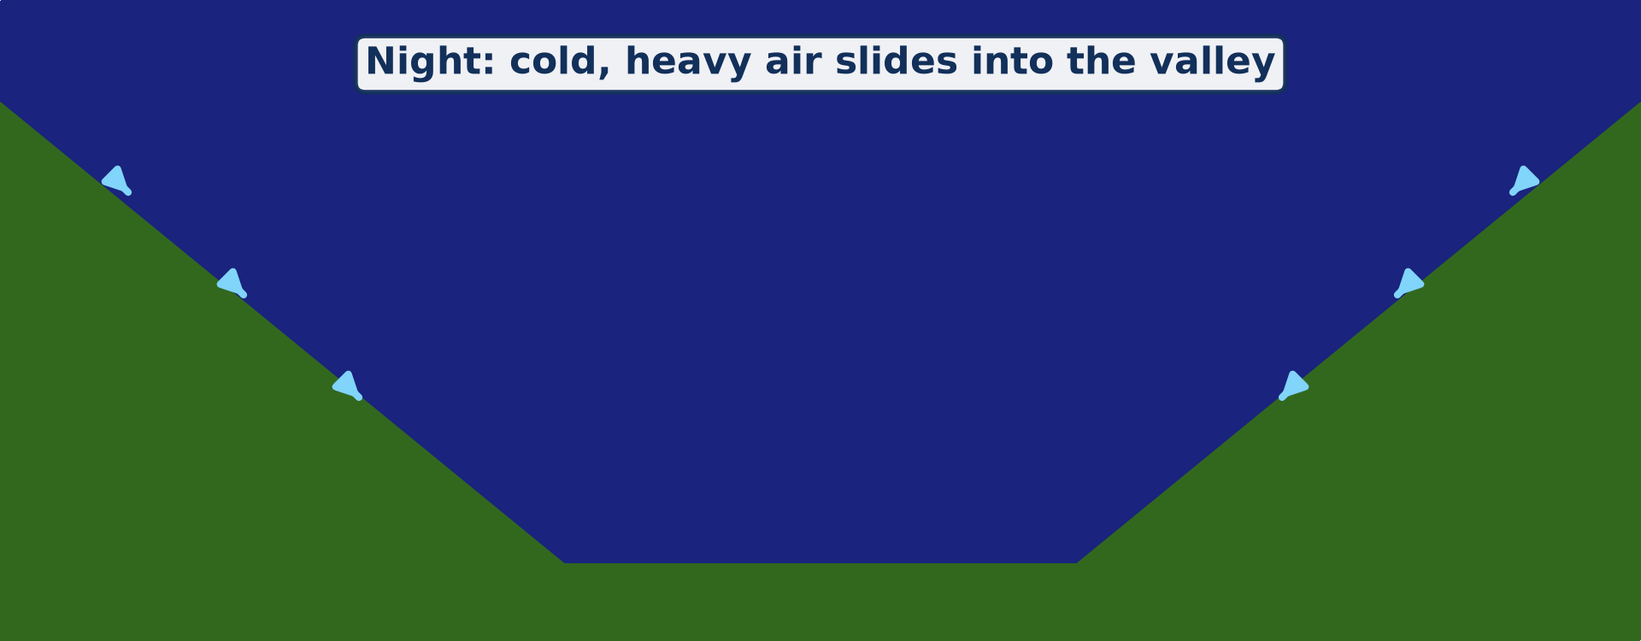
2. TYPES AND CAUSES
Activity 2
Animation: cold air slides into a valley at night.
Notes:
Activity 2. Look carefully at this animation: animation: cold air slides into a valley at night. Watch the animation to the end; it will play again.

Slide 22
2. TYPES AND CAUSES
Activity 2: Question
Why does cold air collect in valleys at night?
Notes:
Here is the question for Activity 2: Why does cold air collect in valleys at night? Take one minute to think and write your answer in your rough notebook.

Slide 23
2. TYPES AND CAUSES
Activity 2: Answer
The ground cools fast on clear nights; cold, heavy air slides down into the valley.
Notes:
Let us check the answer together. The ground cools fast on clear nights; cold, heavy air slides down into the valley.

Slide 24
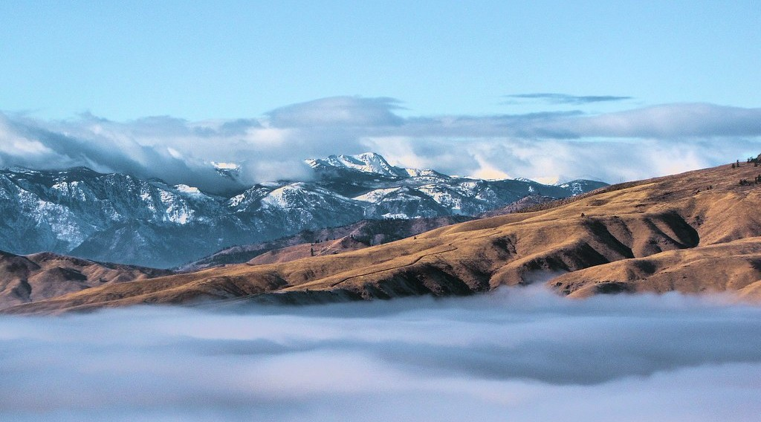
3. EFFECTS: FOG
Activity 3
Hilltops above a sea of cloud trapped by an inversion.
Notes:
Activity 3. Look carefully at this picture: hilltops above a sea of cloud trapped by an inversion. Observe every detail before I ask the question.

Slide 25
3. EFFECTS: FOG
Activity 3: Question
Why is the fog trapped in the valley?
Notes:
Here is the question for Activity 3: Why is the fog trapped in the valley? Take one minute to think and write your answer in your rough notebook.

Slide 26
3. EFFECTS: FOG
Activity 3: Answer
The warm air above acts like a lid and stops the cold air from rising.
Notes:
Let us check the answer together. The warm air above acts like a lid and stops the cold air from rising.

Slide 27
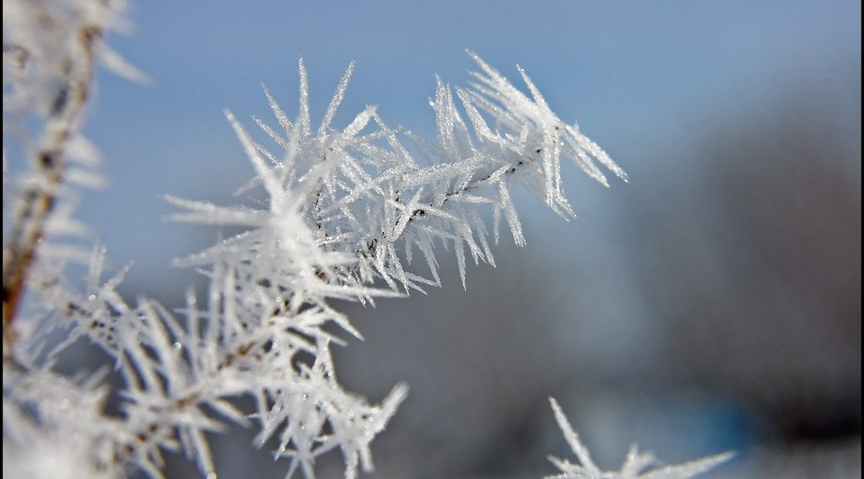
3. EFFECTS ON CROPS
Activity 4
Frost on plants on a cold morning.
Notes:
Activity 4. Look carefully at this picture: frost on plants on a cold morning. Observe every detail before I ask the question.

Slide 28
3. EFFECTS ON CROPS
Activity 4: Question
Why do crops in valley bottoms suffer from frost?
Notes:
Here is the question for Activity 4: Why do crops in valley bottoms suffer from frost? Take one minute to think and write your answer in your rough notebook.

Slide 29
3. EFFECTS ON CROPS
Activity 4: Answer
The coldest air collects in the valley bottom (frost hollow).
Notes:
Let us check the answer together. The coldest air collects in the valley bottom (frost hollow).

Slide 30

3. EFFECTS ON MAN: POLLUTION
Activity 5
Smog in a big city (Beijing).
Notes:
Activity 5. Look carefully at this picture: smog in a big city (Beijing). Observe every detail before I ask the question.

Slide 31
3. EFFECTS ON MAN: POLLUTION
Activity 5: Question
Why is air pollution worse during an inversion?
Notes:
Here is the question for Activity 5: Why is air pollution worse during an inversion? Take one minute to think and write your answer in your rough notebook.

Slide 32
3. EFFECTS ON MAN: POLLUTION
Activity 5: Answer
Smoke cannot rise, so it is trapped near the ground as smog.
Notes:
Let us check the answer together. Smoke cannot rise, so it is trapped near the ground as smog.

Slide 33
BOARD SUMMARY
Board Summary
Topic: Energy in the Atmosphere
Sub-topic: Vertical Distribution of Heat in the Atmosphere
Lesson 9: Temperature Inversion
Notes:
Now we are going to copy the board summary. Write the title and the headings neatly in your notebooks. I will give you enough time for each slide, so do not rush.

Slide 34
BOARD SUMMARY
1. Meaning of Temperature Inversion
A temperature inversion can be understood as follows:
Temperature inversion: It is a situation where temperature increases with height instead of decreasing. A layer of warm air lies above cooler air.
Notes:
Let us copy Meaning of Temperature Inversion. A temperature inversion can be understood as follows. On this slide we have Temperature inversion. Write each point on a new line, with the key term first, and explain it in your own words when we revise.

Slide 35
BOARD SUMMARY
1. Meaning of Temperature Inversion
Illustration: normal lapse rate and inversion
Notes:
Now draw this illustration in your notebook: normal lapse rate and inversion. Give it a title and label it clearly.

Slide 36
BOARD SUMMARY
2. Types and Causes of Inversion
Inversions are of two main types:
Surface (ground) inversion: It forms on clear, calm nights when the ground loses heat quickly by radiation and cools the air above it. Cold, heavy air also drains down slopes and collects in valleys.
Notes:
Let us copy Types and Causes of Inversion. Inversions are of two main types. On this slide we have Surface (ground) inversion. Write each point on a new line, with the key term first, and explain it in your own words when we revise. When you finish, we go to the next slide.

Slide 37
BOARD SUMMARY
2. Types and Causes of Inversion (continued)
Above-surface inversion: It forms high above the ground, for example when air sinks and warms in a high-pressure area (subsidence inversion). A capping inversion stops clouds from rising.
Notes:
We continue with Types and Causes of Inversion. On this slide we have Above-surface inversion. Write each point on a new line, with the key term first, and explain it in your own words when we revise. When you finish, we go to the next slide.

Slide 38
BOARD SUMMARY
2. Types and Causes of Inversion (continued)
Frontal and advection inversions: Warm air can slide over cold air at a front. Warm air moving over a cold surface is also cooled from below.
Notes:
We continue with Types and Causes of Inversion. On this slide we have Frontal and advection inversions. Write each point on a new line, with the key term first, and explain it in your own words when we revise.

Slide 39
BOARD SUMMARY
3. Effects of Temperature Inversion
Inversions affect weather conditions and man in the following ways:
Fog formation: Cold air near the ground cools to dew point and fog forms in valleys. Fog reduces visibility and causes road and air accidents.
Notes:
Let us copy Effects of Temperature Inversion. Inversions affect weather conditions and man in the following ways. On this slide we have Fog formation. Write each point on a new line, with the key term first, and explain it in your own words when we revise. When you finish, we go to the next slide.

Slide 40
BOARD SUMMARY
3. Effects of Temperature Inversion (continued)
Frost: Valley bottoms become colder than slopes and suffer frost. Farmers plant sensitive crops such as coffee and tea on the slopes.
Notes:
We continue with Effects of Temperature Inversion. On this slide we have Frost. Write each point on a new line, with the key term first, and explain it in your own words when we revise. When you finish, we go to the next slide.

Slide 41
BOARD SUMMARY
3. Effects of Temperature Inversion (continued)
Air pollution: The warm layer acts as a lid and traps smoke and dust near the ground. This causes smog and breathing diseases in towns.
Stable weather: Inversions stop air from rising, so clouds and rain do not form. The weather stays dry and calm.
Notes:
We continue with Effects of Temperature Inversion. On this slide we have Air pollution and Stable weather. Write each point on a new line, with the key term first, and explain it in your own words when we revise.

Slide 42
FORMATIVE EVALUATION
Evaluation 1
What is a temperature inversion?
Notes:
Now let us check what you have understood. Question 1: What is a temperature inversion? Answer in your exercise book.

Slide 43
FORMATIVE EVALUATION
Expected Answer
A layer of air where temperature rises with height.
Notes:
The expected answer is: a layer of air where temperature rises with height. If you got it right, well done.

Slide 44
FORMATIVE EVALUATION
Evaluation 2
Give two effects of inversion on man.
Notes:
Now let us check what you have understood. Question 2: Give two effects of inversion on man. Answer in your exercise book.

Slide 45
FORMATIVE EVALUATION
Expected Answer
Fog makes transport dangerous; smog harms health (frost damages crops).
Notes:
The expected answer is: fog makes transport dangerous; smog harms health (frost damages crops). If you got it right, well done.

Slide 46
REMEDIATION
Remediation
Fill in the blanks:
In an inversion, temperature ______ with height.
Valley bottoms where frost forms are frost ______.
Notes:
Take your time to copy this part; we will continue together.

Slide 47
REMEDIATION
Remediation (continued)
Smoke and fog trapped together form ______.
Notes:
For those who need more practice, fill in the blanks in your exercise book. The answers are: number 1, rises; number 2, hollows; number 3, smog.

Slide 48
HOMEWORK
Homework
Observe the morning sky for three days and note whether smoke rises or lies low.
Notes:
For your homework: Observe the morning sky for three days and note whether smoke rises or lies low. We shall correct it at the beginning of our next lesson.

Slide 49
NEXT LESSON
Next Lesson
Our next lesson will be on:
Lesson 10: Nature of Moisture
Notes:
Our next lesson will be on Lesson 10: Nature of Moisture. Thank you for your attention, and see you next time.

Slide 50
BILINGUAL GAME
Bilingual Game (Jeu Bilingue)
English | Français
Inversion | L'inversion
Fog | Le brouillard
Frost | Le gel
Smog | Le smog
Valley | La vallée
Stable air | L'air stable
Notes:
Let us play the bilingual game. I say a word in English, and you give me the French word. Then we do the reverse.

Slide 51
LOGBOOK
Official Logbook (1/2)
Module / Topic | Energy in the Atmosphere
Lesson Title | Lesson 9: Temperature Inversion
Expected Learning Outcomes | Define temperature inversion. Explain the types and causes of inversion. Explain the effects of inversion, including fog and smog.
Competence | Learners are able to explain temperature inversion and its effects on weather and people.
Notes:
I record this information in the official logbook of the class after the lesson.

Slide 52
LOGBOOK
Official Logbook (2/2)
Matter Taught | Meaning of Temperature Inversion; Types and Causes of Inversion; Effects of Temperature Inversion.
Evaluation | Formative evaluation and remediation exercise.
Homework | Observe the morning sky for three days and note whether smoke rises or lies low.
Enrolment / Present / Absent | ____ / ____ / ____
Achievement | To be completed after the lesson.
Notes:
I complete the second page of the logbook: the matter taught, the evaluation, the homework and the attendance.

Slide 53
TEACHER'S NOTE
Teacher's Note
Timing: Homework correction, plan, objectives 8 min | Recall, situation, action 10 min | 5 activities 30 min | Board summary (copying) 30 min | Evaluation, remediation 10 min | Homework, next lesson 5 min | Logbook 7 min
Activity 2 is an animation (GIF): it plays automatically in slide-show mode.
Without the projector (Activity 1): draw the two graphs.
Without the projector (Activity 2): pour water down a slope into a bowl.
Without the projector (Activity 3): describe morning fog in a valley.
Without the projector (Activity 4): mention cold mornings in the highlands.
Without the projector (Activity 5): describe smoke lying low in the morning.
Notes:
This slide is for me, the teacher: it gives the timing of the lesson and what to do if the projector is not available.

Slide 54
REFERENCES
References
National Geography Syllabus, MINESEC/IGE/IP-SS, 2019 — Module 1 (Meteorology, Climatology & Hydrology).
Photo, Activity 3: “Rising above the Inversion” by Pictoscribe -, CC BY-NC-ND 2.0, via Flickr (https://www.flickr.com/photos/70414856@N00/6535713585)
Photo, Activity 4: “Frosty Morning” by Tom Gill., CC BY-NC-ND 2.0, via Flickr (https://www.flickr.com/photos/10199807@N00/4283143427)
Photo, Activity 5: “Beijing smog” by kevin dooley, CC BY 2.0, via Flickr (https://www.flickr.com/photos/12836528@N00/386198516)
Diagrams and animations: drawn for this lesson (Geography Department).
Notes:
These are the references and picture credits used to prepare this lesson.

