Slide 1
LOWER SIXTH ARTS
GEOGRAPHY
Lesson 10
Nature of Moisture
Notes:
Good morning, class, and welcome to our geography lesson. I am your geography teacher, Mr Kamdem. Today we are starting Lesson 10: Nature of Moisture.

Slide 2
CLASS INFO
Class, Chapter and Duration
Class | Lower Sixth Arts
Chapter | Module 1: Understanding and managing atmospheric and hydrological phenomena and hazards across the world in general and Cameroon in particular
Duration | 2 periods (2 × 50 minutes)
Notes:
This lesson is for Lower Sixth Arts. It belongs to Module 1: Understanding and managing atmospheric and hydrological phenomena and hazards across the world in general and Cameroon in particular. We shall need 2 periods to cover it.

Slide 3
IDENTIFICATION
Lesson Identification
Topic | Moisture in the Atmosphere
Sub-topic | Atmospheric Humidity
Lesson | Lesson 10: Nature of Moisture
Notions / Concepts | Humidity, absolute humidity, relative humidity, saturation, dew point, hygrometer.
Syllabus focus | Sources and states of moisture; absolute and relative humidity; distribution and factors; relevance.
Competence | Learners are able to measure and explain humidity and its effects on weather and people.
Notes:
Our topic is Moisture in the Atmosphere, and the sub-topic is Atmospheric Humidity. The key notions we shall use today are: humidity, absolute humidity, relative humidity, saturation, dew point, hygrometer. At the end, you should be able to do this: learners are able to measure and explain humidity and its effects on weather and people.

Slide 4

HOMEWORK CORRECTION
Correction of the Homework
Question (Lesson 9: Temperature Inversion):
Observe the morning sky for three days and note whether smoke rises or lies low.
Notes:
Before we start the new lesson, let us correct the homework I gave you at the end of Lesson 9: Temperature Inversion. The question was: Observe the morning sky for three days and note whether smoke rises or lies low. Take out your exercise books.

Slide 5
HOMEWORK CORRECTION
Correction: Possible Answer
On clear, calm mornings the smoke lies low and spreads sideways because of a surface inversion. On windy or sunny afternoons the smoke rises because the air is unstable.
Notes:
Here is a good answer. On clear, calm mornings the smoke lies low and spreads sideways because of a surface inversion. On windy or sunny afternoons the smoke rises because the air is unstable. Compare it with your own answer and correct your work in red.

Slide 6
LESSON PLAN
Lesson Plan
Correction of the homework
Objectives and recall
Real-life situation and action to take
Learning activities
Board summary
Evaluation, remediation and homework
Notes:
Here is the plan of our lesson today. First, we shall correct the homework. Then we shall look at the objectives and recall what you already know. After that, we shall study a situation from real life and the action to take, and do the learning activities. Finally, we shall copy the board summary, do the evaluation and the remediation, and I will give you the homework.

Slide 7
OBJECTIVES
Objectives
By the end of this lesson, you should be able to:
Explain the sources and the three states of moisture.
Distinguish absolute and relative humidity.
Notes:
Take your time to copy this part; we will continue together.

Slide 8
OBJECTIVES
Objectives (continued)
Explain the factors and importance of humidity.
Notes:
By the end of this lesson, you should be able to do three things. Number 1: explain the sources and the three states of moisture. Number 2: distinguish absolute and relative humidity. Number 3: explain the factors and importance of humidity.

Slide 9
PREVIOUS KNOWLEDGE
Previous Knowledge
Water vapour is a variable gas.
Evaporation takes in latent heat.
Notes:
Let us first remember what you already know. Water vapour is a variable gas. Evaporation takes in latent heat. Keep this in mind, because we shall build on it today.

Slide 10
REAL-LIFE SITUATION
Situation in Real Life
In Douala, clothes take a long time to dry and people sweat a lot. In Maroua during the dry season, clothes dry in one hour and the lips crack. Both towns can be very hot.
Notes:
Listen carefully to this situation from real life. In Douala, clothes take a long time to dry and people sweat a lot. In Maroua during the dry season, clothes dry in one hour and the lips crack. Both towns can be very hot. Think about it, because I am going to ask you some questions.

Slide 11
REAL-LIFE SITUATION
Situation: Question 1
What is the problem in the situation?
Notes:
Question 1: What is the problem in the situation? Think for a moment, then raise your hand to answer.

Slide 12
REAL-LIFE SITUATION
Answer
People feel different conditions in hot places.
Notes:
Good. People feel different conditions in hot places.

Slide 13
REAL-LIFE SITUATION
Situation: Question 2
What is different between the two towns?
Notes:
Question 2: What is different between the two towns? Think for a moment, then raise your hand to answer.

Slide 14
REAL-LIFE SITUATION
Answer
The amount of water vapour in the air (humidity).
Notes:
Good. The amount of water vapour in the air (humidity).

Slide 15
REAL-LIFE SITUATION
Situation: Question 3
Why do clothes dry slowly in Douala?
Notes:
Question 3: Why do clothes dry slowly in Douala? Think for a moment, then raise your hand to answer.

Slide 16
REAL-LIFE SITUATION
Possible Answer
The air is almost saturated, so evaporation is slow.
Notes:
Good. The air is almost saturated, so evaporation is slow.

Slide 17
ACTION TO TAKE
Action to Take
Use knowledge of humidity to dry crops well and to protect our health in humid or very dry seasons.
Notes:
From this situation, the action we are working towards in this lesson is the following: use knowledge of humidity to dry crops well and to protect our health in humid or very dry seasons.

Slide 18
JUSTIFICATION
Justification of the Lesson
This lesson helps us to understand humidity, which controls clouds, rain and our comfort.
Notes:
Why is this lesson important for you? This lesson helps us to understand humidity, which controls clouds, rain and our comfort.

Slide 19

1. MEANING AND SOURCES
Activity 1
Animation: water evaporates and returns as rain.
Notes:
Activity 1. Look carefully at this animation: animation: water evaporates and returns as rain. Watch the animation to the end; it will play again.

Slide 20
1. MEANING AND SOURCES
Activity 1: Question
Where does the water vapour in the air come from?
Notes:
Here is the question for Activity 1: Where does the water vapour in the air come from? Take one minute to think and write your answer in your rough notebook.

Slide 21
1. MEANING AND SOURCES
Activity 1: Answer
Evaporation from seas, lakes, rivers and soil, and transpiration from plants.
Notes:
Let us check the answer together. Evaporation from seas, lakes, rivers and soil, and transpiration from plants.

Slide 22
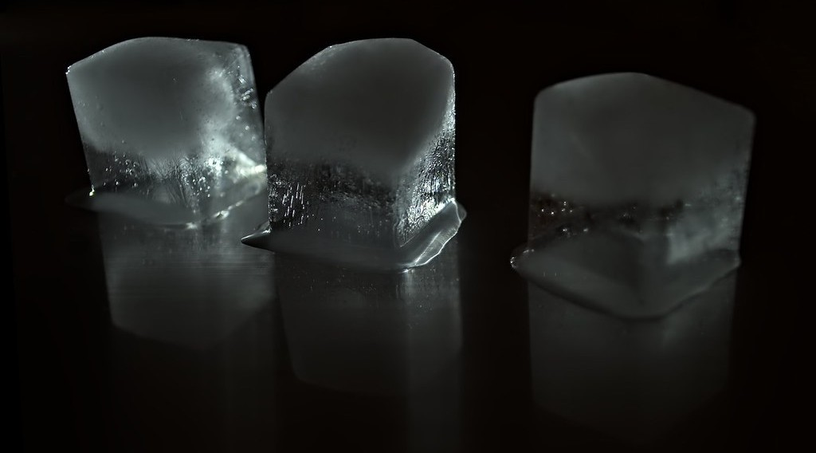
2. THE THREE STATES OF MOISTURE
Activity 2
Ice cubes melting into water.
Notes:
Activity 2. Look carefully at this picture: ice cubes melting into water. Observe every detail before I ask the question.

Slide 23
2. THE THREE STATES OF MOISTURE
Activity 2: Question
Name the three states of water. Which one is invisible?
Notes:
Here is the question for Activity 2: Name the three states of water. Which one is invisible? Take one minute to think and write your answer in your rough notebook.

Slide 24
2. THE THREE STATES OF MOISTURE
Activity 2: Answer
Solid (ice), liquid (water), gas (water vapour). Water vapour is invisible.
Notes:
Let us check the answer together. Solid (ice), liquid (water), gas (water vapour). Water vapour is invisible.

Slide 25
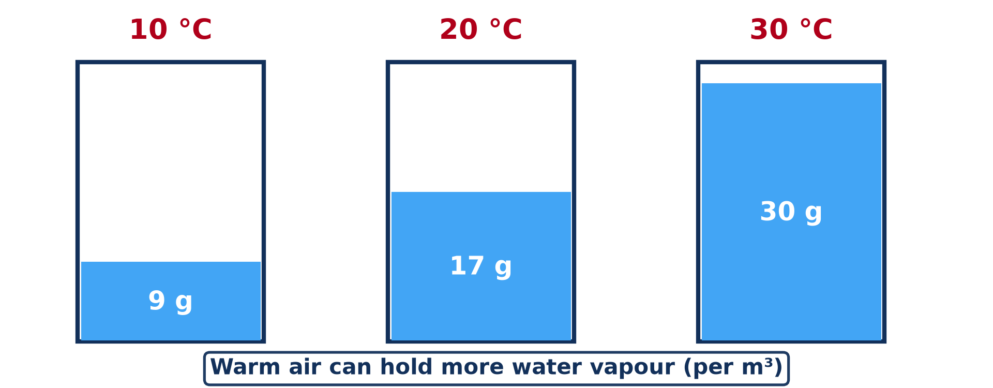
3. TYPES OF HUMIDITY
Activity 3
Maximum water vapour a cubic metre of air can hold.
Notes:
Activity 3. Look carefully at this diagram: maximum water vapour a cubic metre of air can hold. Observe every detail before I ask the question.

Slide 26
3. TYPES OF HUMIDITY
Activity 3: Question
Air at 30 °C holds 15 g of vapour. What is its relative humidity?
Notes:
Here is the question for Activity 3: Air at 30 °C holds 15 g of vapour. What is its relative humidity? Take one minute to think and write your answer in your rough notebook.

Slide 27
3. TYPES OF HUMIDITY
Activity 3: Answer
15 ÷ 30 × 100 = 50 %.
Notes:
Let us check the answer together. 15 ÷ 30 × 100 = 50 %.

Slide 28
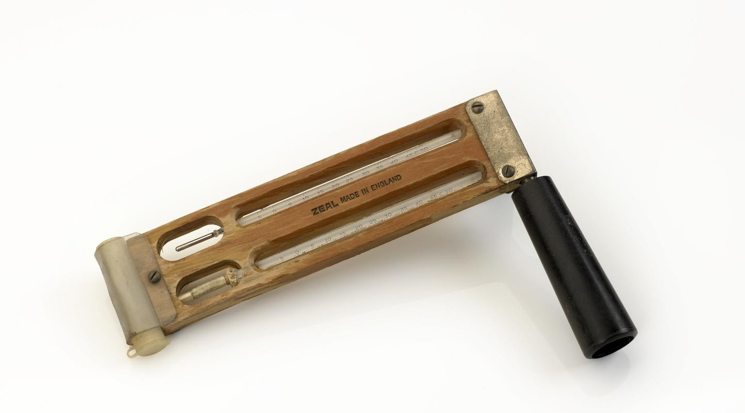
3. MEASURING HUMIDITY
Activity 4
A sling hygrometer (wet and dry bulb thermometers).
Notes:
Activity 4. Look carefully at this picture: a sling hygrometer (wet and dry bulb thermometers). Observe every detail before I ask the question.

Slide 29
3. MEASURING HUMIDITY
Activity 4: Question
Why does the wet bulb show a lower temperature than the dry bulb?
Notes:
Here is the question for Activity 4: Why does the wet bulb show a lower temperature than the dry bulb? Take one minute to think and write your answer in your rough notebook.

Slide 30
3. MEASURING HUMIDITY
Activity 4: Answer
Water evaporates from the wet bulb and cools it; the drier the air, the bigger the difference.
Notes:
Let us check the answer together. Water evaporates from the wet bulb and cools it; the drier the air, the bigger the difference.

Slide 31

4. SPATIAL DISTRIBUTION
Activity 5
A humid equatorial forest.
Notes:
Activity 5. Look carefully at this picture: a humid equatorial forest. Observe every detail before I ask the question.

Slide 32
4. SPATIAL DISTRIBUTION
Activity 5: Question
Why is humidity high in equatorial forests?
Notes:
Here is the question for Activity 5: Why is humidity high in equatorial forests? Take one minute to think and write your answer in your rough notebook.

Slide 33
4. SPATIAL DISTRIBUTION
Activity 5: Answer
High temperature, much rain and much transpiration from plants.
Notes:
Let us check the answer together. High temperature, much rain and much transpiration from plants.

Slide 34
BOARD SUMMARY
Board Summary
Topic: Moisture in the Atmosphere
Sub-topic: Atmospheric Humidity
Lesson 10: Nature of Moisture
Notes:
Now we are going to copy the board summary. Write the title and the headings neatly in your notebooks. I will give you enough time for each slide, so do not rush.

Slide 35
BOARD SUMMARY
1. Meaning and Sources of Moisture
Atmospheric moisture can be understood as follows:
Humidity: It is the amount of water vapour in the air.
Notes:
Let us copy Meaning and Sources of Moisture. Atmospheric moisture can be understood as follows. On this slide we have Humidity. Write each point on a new line, with the key term first, and explain it in your own words when we revise. When you finish, we go to the next slide.

Slide 36
BOARD SUMMARY
1. Meaning and Sources of Moisture (continued)
Sources: Water vapour comes from evaporation from oceans, lakes, rivers and wet soil, and from transpiration by plants. Together these are called evapotranspiration.
Notes:
We continue with Meaning and Sources of Moisture. On this slide we have Sources. Write each point on a new line, with the key term first, and explain it in your own words when we revise.

Slide 37
BOARD SUMMARY
2. The Three States of Moisture
Water exists in the atmosphere in three states:
Gas (water vapour): It is invisible and forms when water evaporates. It changes back into liquid by condensation.
Notes:
Let us copy The Three States of Moisture. Water exists in the atmosphere in three states. On this slide we have Gas (water vapour). Write each point on a new line, with the key term first, and explain it in your own words when we revise. When you finish, we go to the next slide.

Slide 38
BOARD SUMMARY
2. The Three States of Moisture (continued)
Liquid: It is found as cloud droplets, fog, rain and dew. It changes into ice by freezing.
Solid: It is found as ice, snow and hail. Ice can change directly into vapour by sublimation, and vapour directly into ice by deposition.
Notes:
We continue with The Three States of Moisture. On this slide we have Liquid and Solid. Write each point on a new line, with the key term first, and explain it in your own words when we revise.

Slide 39
BOARD SUMMARY
2. The Three States of Moisture
Illustration: water changes state in the water cycle
Notes:
Now draw this illustration in your notebook: water changes state in the water cycle. Give it a title and label it clearly.

Slide 40
BOARD SUMMARY
3. Types of Atmospheric Humidity
Humidity is expressed in two main ways:
Absolute humidity: It is the mass of water vapour in a volume of air, in g/m³. It is high over warm oceans and low over deserts.
Notes:
Let us copy Types of Atmospheric Humidity. Humidity is expressed in two main ways. On this slide we have Absolute humidity. Write each point on a new line, with the key term first, and explain it in your own words when we revise. When you finish, we go to the next slide.

Slide 41
BOARD SUMMARY
3. Types of Atmospheric Humidity (continued)
Relative humidity (RH): It is the amount of vapour in the air compared with the maximum it can hold at that temperature, in %. RH = actual vapour ÷ maximum vapour × 100.
Notes:
We continue with Types of Atmospheric Humidity. On this slide we have Relative humidity (RH). Write each point on a new line, with the key term first, and explain it in your own words when we revise. When you finish, we go to the next slide.

Slide 42
BOARD SUMMARY
3. Types of Atmospheric Humidity (continued)
Measurement: Humidity is measured with a hygrometer (wet and dry bulb thermometers). The bigger the difference between the two, the drier the air.
Notes:
We continue with Types of Atmospheric Humidity. On this slide we have Measurement. Write each point on a new line, with the key term first, and explain it in your own words when we revise.

Slide 43
BOARD SUMMARY
3. Types of Atmospheric Humidity
Illustration: relative humidity
Notes:
Now draw this illustration in your notebook: relative humidity. Give it a title and label it clearly.

Slide 44
BOARD SUMMARY
4. Distribution, Factors and Relevance
Humidity varies in space and depends on several factors:
Spatial distribution: Humidity is high near the Equator and over oceans, and low in deserts and polar regions. In Cameroon it is high in Douala and low in Maroua in the dry season.
Notes:
Let us copy Distribution, Factors and Relevance. Humidity varies in space and depends on several factors. On this slide we have Spatial distribution. Write each point on a new line, with the key term first, and explain it in your own words when we revise. When you finish, we go to the next slide.

Slide 45
BOARD SUMMARY
4. Distribution, Factors and Relevance (continued)
Factors: Temperature, water bodies, vegetation and winds control humidity. When temperature rises, relative humidity falls, because warm air can hold more vapour.
Notes:
We continue with Distribution, Factors and Relevance. On this slide we have Factors. Write each point on a new line, with the key term first, and explain it in your own words when we revise. When you finish, we go to the next slide.

Slide 46
BOARD SUMMARY
4. Distribution, Factors and Relevance (continued)
Relevance to weather and man: Humidity is the source of clouds and rain and keeps the Earth warm. High humidity makes people feel hot and sticky, while very dry air cracks the skin and lips.
Notes:
We continue with Distribution, Factors and Relevance. On this slide we have Relevance to weather and man. Write each point on a new line, with the key term first, and explain it in your own words when we revise.

Slide 47
FORMATIVE EVALUATION
Evaluation 1
Distinguish absolute and relative humidity.
Notes:
Now let us check what you have understood. Question 1: Distinguish absolute and relative humidity. Answer in your exercise book.

Slide 48
FORMATIVE EVALUATION
Expected Answer
Absolute: grams of vapour per m³; relative: actual vapour as a percentage of the maximum.
Notes:
The expected answer is: absolute: grams of vapour per m³; relative: actual vapour as a percentage of the maximum. If you got it right, well done.

Slide 49
FORMATIVE EVALUATION
Evaluation 2
What happens to relative humidity when air warms?
Notes:
Now let us check what you have understood. Question 2: What happens to relative humidity when air warms? Answer in your exercise book.

Slide 50
FORMATIVE EVALUATION
Expected Answer
It falls, because warm air can hold more vapour.
Notes:
The expected answer is: it falls, because warm air can hold more vapour. If you got it right, well done.

Slide 51
REMEDIATION
Remediation
Fill in the blanks:
Air holding all the vapour it can is ______.
Humidity is measured with a ______.
Warm air holds ______ vapour than cold air.
Notes:
For those who need more practice, fill in the blanks in your exercise book. The answers are: number 1, saturated; number 2, hygrometer; number 3, more.

Slide 52
HOMEWORK
Homework
Wet two pieces of cloth; dry one in the sun and one in a closed room. Explain the difference.
Notes:
For your homework: Wet two pieces of cloth; dry one in the sun and one in a closed room. Explain the difference. We shall correct it at the beginning of our next lesson.

Slide 53
NEXT LESSON
Next Lesson
Our next lesson will be on:
Lesson 11: Forms of Condensation and Precipitation
Notes:
Our next lesson will be on Lesson 11: Forms of Condensation and Precipitation. Thank you for your attention, and see you next time.

Slide 54
BILINGUAL GAME
Bilingual Game (Jeu Bilingue)
English | Français
Humidity | L'humidité
Saturation | La saturation
Dew point | Le point de rosée
Water vapour | La vapeur d'eau
Transpiration | La transpiration
Hygrometer | L'hygromètre
Notes:
Let us play the bilingual game. I say a word in English, and you give me the French word. Then we do the reverse.

Slide 55
LOGBOOK
Official Logbook (1/2)
Module / Topic | Moisture in the Atmosphere
Lesson Title | Lesson 10: Nature of Moisture
Expected Learning Outcomes | Explain the sources and the three states of moisture. Distinguish absolute and relative humidity. Explain the factors and importance of humidity.
Competence | Learners are able to measure and explain humidity and its effects on weather and people.
Notes:
I record this information in the official logbook of the class after the lesson.

Slide 56
LOGBOOK
Official Logbook (2/2)
Matter Taught | Meaning and Sources of Moisture; The Three States of Moisture; Types of Atmospheric Humidity; Distribution, Factors and Relevance.
Evaluation | Formative evaluation and remediation exercise.
Homework | Wet two pieces of cloth; dry one in the sun and one in a closed room. Explain the difference.
Enrolment / Present / Absent | ____ / ____ / ____
Achievement | To be completed after the lesson.
Notes:
I complete the second page of the logbook: the matter taught, the evaluation, the homework and the attendance.

Slide 57
TEACHER'S NOTE
Teacher's Note
Timing: Homework correction, plan, objectives 8 min | Recall, situation, action 10 min | 5 activities 30 min | Board summary (copying) 30 min | Evaluation, remediation 10 min | Homework, next lesson 5 min | Logbook 7 min
Activity 1 is an animation (GIF): it plays automatically in slide-show mode.
Without the projector (Activity 1): draw the water cycle.
Without the projector (Activity 2): show ice, water and steam from a kettle.
Without the projector (Activity 3): do the calculation on the board.
Without the projector (Activity 4): blow on a wet hand: it feels cold.
Without the projector (Activity 5): compare Douala and Maroua.
Notes:
This slide is for me, the teacher: it gives the timing of the lesson and what to do if the projector is not available.

Slide 58
REFERENCES
References
National Geography Syllabus, MINESEC/IGE/IP-SS, 2019 — Module 1 (Meteorology, Climatology & Hydrology).
Photo, Activity 2: “Thrice” by mpardo.photo, CC0 1.0, via Flickr (https://www.flickr.com/photos/130551911@N05/16875162129)
Photo, Activity 4: “Sling hydrometer used on 1953 Mount Everest expedition” by G H Zeal Limited, CC BY-NC-SA 4.0, via sciencemuseum (https://collection.sciencemuseumgroup.org.uk/objects/co8593941/sling-hydrometer-used-on-1953-mount-everest-expedition)
Photo, Activity 5: “Amazon 11” by CIAT International Center for Tropical Agriculture, CC BY-SA 2.0, via Flickr (https://www.flickr.com/photos/38476503@N08/5641587148)
Diagrams and animations: drawn for this lesson (Geography Department).
Notes:
These are the references and picture credits used to prepare this lesson.

