Slide 1
LOWER SIXTH ARTS
GEOGRAPHY
Lesson 11
Forms of Condensation and Precipitation
Notes:
Good morning, class, and welcome to our geography lesson. I am your geography teacher, Mr Kamdem. Today we are starting Lesson 11: Forms of Condensation and Precipitation.

Slide 2
CLASS INFO
Class, Chapter and Duration
Class | Lower Sixth Arts
Chapter | Module 1: Understanding and managing atmospheric and hydrological phenomena and hazards across the world in general and Cameroon in particular
Duration | 2 periods (2 × 50 minutes)
Notes:
This lesson is for Lower Sixth Arts. It belongs to Module 1: Understanding and managing atmospheric and hydrological phenomena and hazards across the world in general and Cameroon in particular. We shall need 2 periods to cover it.

Slide 3
IDENTIFICATION
Lesson Identification
Topic | Moisture in the Atmosphere
Sub-topic | Precipitation
Lesson | Lesson 11: Forms of Condensation and Precipitation
Notions / Concepts | Condensation, cloud, fog, mist, dew, precipitation, hail, convectional, orographic and frontal rain.
Syllabus focus | Cloud formation and types; fog and mist; forms of precipitation; types of rainfall.
Competence | Learners are able to identify clouds, forms of precipitation and types of rainfall and predict the weather.
Notes:
Our topic is Moisture in the Atmosphere, and the sub-topic is Precipitation. The key notions we shall use today are: condensation, cloud, fog, mist, dew, precipitation, hail, convectional, orographic and frontal rain. At the end, you should be able to do this: learners are able to identify clouds, forms of precipitation and types of rainfall and predict the weather.

Slide 4

HOMEWORK CORRECTION
Correction of the Homework
Question (Lesson 10: Nature of Moisture):
Wet two pieces of cloth; dry one in the sun and one in a closed room. Explain the difference.
Notes:
Before we start the new lesson, let us correct the homework I gave you at the end of Lesson 10: Nature of Moisture. The question was: Wet two pieces of cloth; dry one in the sun and one in a closed room. Explain the difference. Take out your exercise books.

Slide 5
HOMEWORK CORRECTION
Correction: Possible Answer
The cloth in the sun dries faster. The sun raises the temperature, the air can hold more vapour and the wind removes the moist air; in the closed room the air becomes saturated and evaporation slows.
Notes:
Here is a good answer. The cloth in the sun dries faster. The sun raises the temperature, the air can hold more vapour and the wind removes the moist air; in the closed room the air becomes saturated and evaporation slows. Compare it with your own answer and correct your work in red.

Slide 6
LESSON PLAN
Lesson Plan
Correction of the homework
Objectives and recall
Real-life situation and action to take
Learning activities
Board summary
Evaluation, remediation and homework
Notes:
Here is the plan of our lesson today. First, we shall correct the homework. Then we shall look at the objectives and recall what you already know. After that, we shall study a situation from real life and the action to take, and do the learning activities. Finally, we shall copy the board summary, do the evaluation and the remediation, and I will give you the homework.

Slide 7
OBJECTIVES
Objectives
By the end of this lesson, you should be able to:
Explain condensation and classify clouds.
Describe solid and liquid forms of precipitation.
Notes:
Take your time to copy this part; we will continue together.

Slide 8
OBJECTIVES
Objectives (continued)
Explain convectional, relief and frontal rain.
Notes:
By the end of this lesson, you should be able to do three things. Number 1: explain condensation and classify clouds. Number 2: describe solid and liquid forms of precipitation. Number 3: explain convectional, relief and frontal rain.

Slide 9
PREVIOUS KNOWLEDGE
Previous Knowledge
Air becomes saturated at the dew point.
Rising air cools.
Notes:
Let us first remember what you already know. Air becomes saturated at the dew point. Rising air cools. Keep this in mind, because we shall build on it today.

Slide 10
REAL-LIFE SITUATION
Situation in Real Life
Farmers in the West Region look at the sky each morning. When they see tall, dark clouds building up in the afternoon, they hurry home because a storm will come.
Notes:
Listen carefully to this situation from real life. Farmers in the West Region look at the sky each morning. When they see tall, dark clouds building up in the afternoon, they hurry home because a storm will come. Think about it, because I am going to ask you some questions.

Slide 11
REAL-LIFE SITUATION
Situation: Question 1
What is the problem in the situation?
Notes:
Question 1: What is the problem in the situation? Think for a moment, then raise your hand to answer.

Slide 12
REAL-LIFE SITUATION
Answer
Farmers need to predict rain from clouds.
Notes:
Good. Farmers need to predict rain from clouds.

Slide 13
REAL-LIFE SITUATION
Situation: Question 2
What type of cloud gives storms?
Notes:
Question 2: What type of cloud gives storms? Think for a moment, then raise your hand to answer.

Slide 14
REAL-LIFE SITUATION
Answer
Cumulonimbus.
Notes:
Good. Cumulonimbus.

Slide 15
REAL-LIFE SITUATION
Situation: Question 3
How do clouds form?
Notes:
Question 3: How do clouds form? Think for a moment, then raise your hand to answer.

Slide 16
REAL-LIFE SITUATION
Possible Answer
Rising air cools to dew point and vapour condenses.
Notes:
Good. Rising air cools to dew point and vapour condenses.

Slide 17
ACTION TO TAKE
Action to Take
Read the clouds to predict the weather and plan farm work.
Notes:
From this situation, the action we are working towards in this lesson is the following: read the clouds to predict the weather and plan farm work.

Slide 18
JUSTIFICATION
Justification of the Lesson
This lesson helps us to read the sky and understand how rain forms.
Notes:
Why is this lesson important for you? This lesson helps us to read the sky and understand how rain forms.

Slide 19
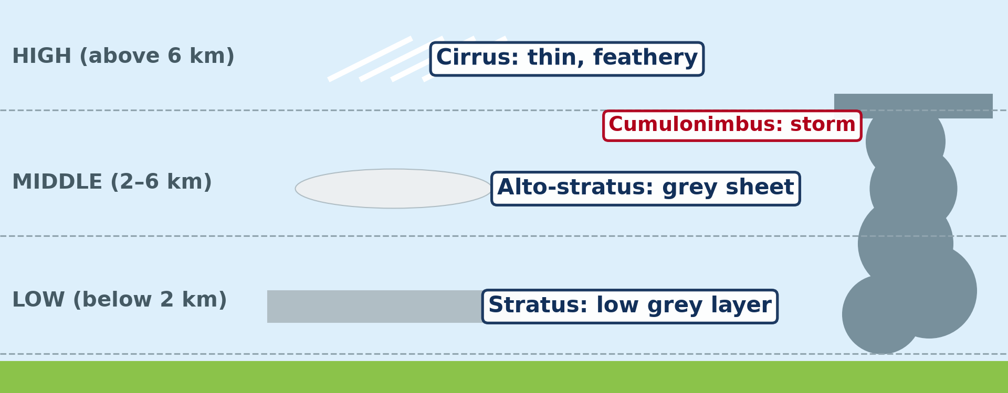
1. A) CLOUD CLASSIFICATION
Activity 1
Clouds classified by height and shape.
Notes:
Activity 1. Look carefully at this diagram: clouds classified by height and shape. Observe every detail before I ask the question.

Slide 20
1. A) CLOUD CLASSIFICATION
Activity 1: Question
Name a high cloud and a low cloud.
Notes:
Here is the question for Activity 1: Name a high cloud and a low cloud. Take one minute to think and write your answer in your rough notebook.

Slide 21
1. A) CLOUD CLASSIFICATION
Activity 1: Answer
Cirrus is high; stratus is low.
Notes:
Let us check the answer together. Cirrus is high; stratus is low.

Slide 22
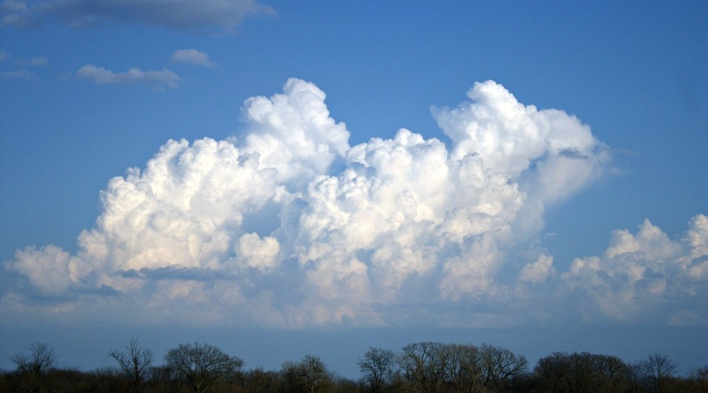
1. A) CLOUDS AND WEATHER
Activity 2
Cumulus clouds on a sunny day.
Notes:
Activity 2. Look carefully at this picture: cumulus clouds on a sunny day. Observe every detail before I ask the question.

Slide 23
1. A) CLOUDS AND WEATHER
Activity 2: Question
What weather do small white cumulus clouds show? What if they grow tall and dark?
Notes:
Here is the question for Activity 2: What weather do small white cumulus clouds show? What if they grow tall and dark? Take one minute to think and write your answer in your rough notebook.

Slide 24
1. A) CLOUDS AND WEATHER
Activity 2: Answer
Fair weather; if they grow into cumulonimbus, storms and heavy rain.
Notes:
Let us check the answer together. Fair weather; if they grow into cumulonimbus, storms and heavy rain.

Slide 25

1. B) DEW, FOG AND MIST
Activity 3
Dew drops on grass in the morning.
Notes:
Activity 3. Look carefully at this picture: dew drops on grass in the morning. Observe every detail before I ask the question.

Slide 26
1. B) DEW, FOG AND MIST
Activity 3: Question
How does dew form?
Notes:
Here is the question for Activity 3: How does dew form? Take one minute to think and write your answer in your rough notebook.

Slide 27
1. B) DEW, FOG AND MIST
Activity 3: Answer
At night the grass cools below the dew point and vapour condenses on it.
Notes:
Let us check the answer together. At night the grass cools below the dew point and vapour condenses on it.

Slide 28
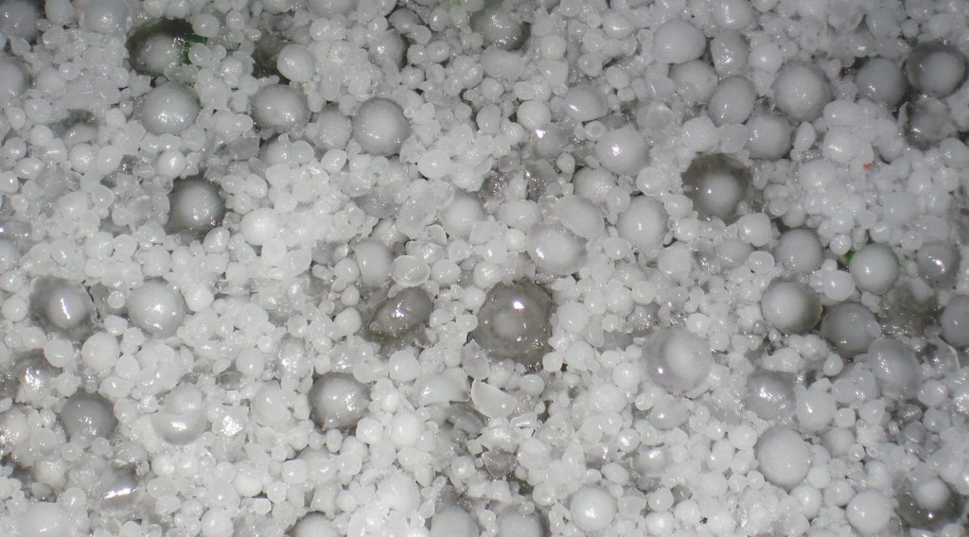
2. SOLID PRECIPITATION
Activity 4
Hailstones after a storm.
Notes:
Activity 4. Look carefully at this picture: hailstones after a storm. Observe every detail before I ask the question.

Slide 29
2. SOLID PRECIPITATION
Activity 4: Question
In which cloud does hail form?
Notes:
Here is the question for Activity 4: In which cloud does hail form? Take one minute to think and write your answer in your rough notebook.

Slide 30
2. SOLID PRECIPITATION
Activity 4: Answer
In a cumulonimbus with strong rising air that lifts drops high to freeze.
Notes:
Let us check the answer together. In a cumulonimbus with strong rising air that lifts drops high to freeze.

Slide 31

2. LIQUID PRECIPITATION: TYPES OF RAIN
Activity 5
Convectional, relief and frontal rain.
Notes:
Activity 5. Look carefully at this diagram: convectional, relief and frontal rain. Observe every detail before I ask the question.

Slide 32
2. LIQUID PRECIPITATION: TYPES OF RAIN
Activity 5: Question
Which type of rain falls on the windward side of Mount Cameroon?
Notes:
Here is the question for Activity 5: Which type of rain falls on the windward side of Mount Cameroon? Take one minute to think and write your answer in your rough notebook.

Slide 33
2. LIQUID PRECIPITATION: TYPES OF RAIN
Activity 5: Answer
Relief (orographic) rain.
Notes:
Let us check the answer together. Relief (orographic) rain.

Slide 34
BOARD SUMMARY
Board Summary
Topic: Moisture in the Atmosphere
Sub-topic: Precipitation
Lesson 11: Forms of Condensation and Precipitation
Notes:
Now we are going to copy the board summary. Write the title and the headings neatly in your notebooks. I will give you enough time for each slide, so do not rush.

Slide 35
BOARD SUMMARY
DEFINITIONS
The key terms of this lesson are defined as follows:
Condensation: It is the change of water vapour into liquid water when air cools to its dew point.
Notes:
Let us copy the definitions. The key terms of this lesson are defined as follows. On this slide we have Condensation. Write each point on a new line, with the key term first, and explain it in your own words when we revise. When you finish, we go to the next slide.

Slide 36
BOARD SUMMARY
DEFINITIONS (continued)
Precipitation: It is any form of water, liquid or solid, that falls from the atmosphere to the ground.
Dew point: It is the temperature at which air becomes saturated.
Notes:
We continue with the definitions. On this slide we have Precipitation and Dew point. Write each point on a new line, with the key term first, and explain it in your own words when we revise.

Slide 37
BOARD SUMMARY
1. Forms of Condensation
A) Clouds
Clouds are classified by height and shape:
High clouds (above 6 km): They are cirrus, cirrostratus and cirrocumulus, made of ice crystals. Cirrus often announces a change of weather.
Notes:
Let us copy Clouds. Clouds are classified by height and shape. On this slide we have High clouds (above 6 km). Write each point on a new line, with the key term first, and explain it in your own words when we revise. When you finish, we go to the next slide.

Slide 38
BOARD SUMMARY
1. Forms of Condensation
A) Clouds (continued)
Middle clouds (2–6 km): They are altostratus and altocumulus. Altostratus often brings continuous light rain.
Notes:
We continue with Clouds. On this slide we have Middle clouds (2–6 km). Write each point on a new line, with the key term first, and explain it in your own words when we revise. When you finish, we go to the next slide.

Slide 39
BOARD SUMMARY
1. Forms of Condensation
A) Clouds (continued)
Low and vertical clouds: Stratus, stratocumulus and nimbostratus are low and grey, giving drizzle or steady rain. Cumulus shows fair weather, while cumulonimbus brings thunderstorms and hail.
Notes:
We continue with Clouds. On this slide we have Low and vertical clouds. Write each point on a new line, with the key term first, and explain it in your own words when we revise.

Slide 40
BOARD SUMMARY
1. Forms of Condensation
Illustration: classification of clouds
Notes:
Now draw this illustration in your notebook: classification of clouds. Give it a title and label it clearly.

Slide 41
BOARD SUMMARY
1. Forms of Condensation
B) Fog, Mist and Dew
Condensation near the ground includes:
Fog and mist: They are clouds at ground level formed when air cools to its dew point. In fog visibility is below 1 km; in mist it is 1–2 km.
Notes:
Let us copy Fog, Mist and Dew. Condensation near the ground includes. On this slide we have Fog and mist. Write each point on a new line, with the key term first, and explain it in your own words when we revise. When you finish, we go to the next slide.

Slide 42
BOARD SUMMARY
1. Forms of Condensation
B) Fog, Mist and Dew (continued)
Dew: Dew forms when water vapour condenses on cold surfaces such as grass on clear, calm nights. If the temperature is below 0 °C, frost forms instead.
Notes:
We continue with Fog, Mist and Dew. On this slide we have Dew. Write each point on a new line, with the key term first, and explain it in your own words when we revise.

Slide 43
BOARD SUMMARY
2. Forms of Precipitation
A) Solid and Gaseous Forms
Solid forms of precipitation include:
Snow and sleet: Snow is made of ice crystals that fall when the air is below 0 °C. Sleet is a mixture of rain and snow, or frozen raindrops.
Notes:
Let us copy Solid and Gaseous Forms. Solid forms of precipitation include. On this slide we have Snow and sleet. Write each point on a new line, with the key term first, and explain it in your own words when we revise. When you finish, we go to the next slide.

Slide 44
BOARD SUMMARY
2. Forms of Precipitation
A) Solid and Gaseous Forms (continued)
Hail: Hailstones are balls of ice formed in cumulonimbus clouds by strong up-currents. They damage crops and roofs.
Frost and rime: Frost is ice deposited on cold surfaces from vapour. Rime is ice formed when fog droplets freeze on objects.
Notes:
We continue with Solid and Gaseous Forms. On this slide we have Hail and Frost and rime. Write each point on a new line, with the key term first, and explain it in your own words when we revise. When you finish, we go to the next slide.

Slide 45
BOARD SUMMARY
2. Forms of Precipitation
A) Solid and Gaseous Forms (continued)
Gaseous forms: Water vapour and fog deposit moisture directly on plants and surfaces. Fog drip is important in some coastal deserts.
Notes:
We continue with Solid and Gaseous Forms. On this slide we have Gaseous forms. Write each point on a new line, with the key term first, and explain it in your own words when we revise.

Slide 46
BOARD SUMMARY
2. Forms of Precipitation
B) Liquid Forms: Rainfall
Rain forms when air rises, cools and condenses; there are three types:
Convectional rain: The ground is heated, air rises in strong currents and forms cumulonimbus clouds.
Notes:
Let us copy Liquid Forms: Rainfall. Rain forms when air rises, cools and condenses; there are three types. On this slide we have Convectional rain. Write each point on a new line, with the key term first, and explain it in your own words when we revise. When you finish, we go to the next slide.

Slide 47
BOARD SUMMARY
2. Forms of Precipitation
B) Liquid Forms: Rainfall (continued)
It gives heavy afternoon storms, common in equatorial regions such as Yaoundé.
Notes:
We continue with Liquid Forms: Rainfall. Copy this carefully. When you finish, we go to the next slide.

Slide 48
BOARD SUMMARY
2. Forms of Precipitation
B) Liquid Forms: Rainfall (continued)
Orographic (relief) rain: Moist air is forced to rise over mountains and cools. The windward side is wet, like Debundscha on Mount Cameroon, while the leeward side is a dry rain shadow.
Notes:
We continue with Liquid Forms: Rainfall. On this slide we have Orographic (relief) rain. Write each point on a new line, with the key term first, and explain it in your own words when we revise. When you finish, we go to the next slide.

Slide 49
BOARD SUMMARY
2. Forms of Precipitation
B) Liquid Forms: Rainfall (continued)
Cyclonic (frontal) rain: Warm air rises over cold air at a front or in a low-pressure system. It gives long, steady rain in the mid-latitudes.
Notes:
We continue with Liquid Forms: Rainfall. On this slide we have Cyclonic (frontal) rain. Write each point on a new line, with the key term first, and explain it in your own words when we revise.

Slide 50
BOARD SUMMARY
2. Forms of Precipitation
Illustration: the three types of rainfall
Notes:
Now draw this illustration in your notebook: the three types of rainfall. Give it a title and label it clearly.

Slide 51
FORMATIVE EVALUATION
Evaluation 1
How does a cloud form?
Notes:
Now let us check what you have understood. Question 1: How does a cloud form? Answer in your exercise book.

Slide 52
FORMATIVE EVALUATION
Expected Answer
Rising air cools to dew point and vapour condenses on dust particles.
Notes:
The expected answer is: rising air cools to dew point and vapour condenses on dust particles. If you got it right, well done.

Slide 53
FORMATIVE EVALUATION
Evaluation 2
Name the three types of rainfall.
Notes:
Now let us check what you have understood. Question 2: Name the three types of rainfall. Answer in your exercise book.

Slide 54
FORMATIVE EVALUATION
Expected Answer
Convectional, relief (orographic) and frontal (cyclonic).
Notes:
The expected answer is: convectional, relief (orographic) and frontal (cyclonic). If you got it right, well done.

Slide 55
REMEDIATION
Remediation
Fill in the blanks:
The change from vapour to water is ______.
Storm clouds are called ______.
Rain on the windward side of a mountain is ______ rain.
Notes:
For those who need more practice, fill in the blanks in your exercise book. The answers are: number 1, condensation; number 2, cumulonimbus; number 3, relief.

Slide 56
HOMEWORK
Homework
Observe the clouds at 7 a.m. and 3 p.m. for a week and record their types.
Notes:
For your homework: Observe the clouds at 7 a.m. and 3 p.m. for a week and record their types. We shall correct it at the beginning of our next lesson.

Slide 57
NEXT LESSON
Next Lesson
Our next lesson will be on:
Lesson 12: Global Distribution of Precipitation
Notes:
Our next lesson will be on Lesson 12: Global Distribution of Precipitation. Thank you for your attention, and see you next time.

Slide 58
BILINGUAL GAME
Bilingual Game (Jeu Bilingue)
English | Français
Cloud | Le nuage
Hail | La grêle
Dew | La rosée
Condensation | La condensation
Relief rain | Pluie orographique
Storm | L'orage
Notes:
Let us play the bilingual game. I say a word in English, and you give me the French word. Then we do the reverse.

Slide 59
LOGBOOK
Official Logbook (1/2)
Module / Topic | Moisture in the Atmosphere
Lesson Title | Lesson 11: Forms of Condensation and Precipitation
Expected Learning Outcomes | Explain condensation and classify clouds. Describe solid and liquid forms of precipitation. Explain convectional, relief and frontal rain.
Competence | Learners are able to identify clouds, forms of precipitation and types of rainfall and predict the weather.
Notes:
I record this information in the official logbook of the class after the lesson.

Slide 60
LOGBOOK
Official Logbook (2/2)
Matter Taught | DEFINITIONS; Clouds; Fog, Mist and Dew; Solid and Gaseous Forms; Liquid Forms: Rainfall.
Evaluation | Formative evaluation and remediation exercise.
Homework | Observe the clouds at 7 a.m. and 3 p.m. for a week and record their types.
Enrolment / Present / Absent | ____ / ____ / ____
Achievement | To be completed after the lesson.
Notes:
I complete the second page of the logbook: the matter taught, the evaluation, the homework and the attendance.

Slide 61
TEACHER'S NOTE
Teacher's Note
Timing: Homework correction, plan, objectives 8 min | Recall, situation, action 10 min | 5 activities 30 min | Board summary (copying) 30 min | Evaluation, remediation 10 min | Homework, next lesson 5 min | Logbook 7 min
Without the projector (Activity 1): draw the three levels.
Without the projector (Activity 2): look at the clouds outside.
Without the projector (Activity 3): take a cold bottle from the fridge: drops form on it.
Without the projector (Activity 4): ask if learners have seen hail.
Without the projector (Activity 5): draw the three types.
Notes:
This slide is for me, the teacher: it gives the timing of the lesson and what to do if the projector is not available.

Slide 62
REFERENCES
References
National Geography Syllabus, MINESEC/IGE/IP-SS, 2019 — Module 1 (Meteorology, Climatology & Hydrology).
Photo, Activity 2: “Epic Cloud (Explored)” by Christina Ann VanMeter, CC BY-NC 2.0, via Flickr (https://www.flickr.com/photos/54129831@N02/6984912657)
Photo, Activity 3: “Dew drops on grass” by Ervins Strauhmanis, CC BY 2.0, via Flickr (https://www.flickr.com/photos/76523360@N03/9537409567)
Photo, Activity 4: “Hailstones (4 July 2010) (Limon, eastern Colorado, USA) 3” by James St. John, CC BY 2.0, via Flickr (https://www.flickr.com/photos/47445767@N05/15148092311)
Diagrams and animations: drawn for this lesson (Geography Department).
Notes:
These are the references and picture credits used to prepare this lesson.

