Slide 1
LOWER SIXTH ARTS
GEOGRAPHY
Lesson 13
Pressure Systems
Notes:
Good morning, class, and welcome to our geography lesson. I am your geography teacher, Mr Kamdem. Today we are starting Lesson 13: Pressure Systems.

Slide 2
CLASS INFO
Class, Chapter and Duration
Class | Lower Sixth Arts
Chapter | Module 1: Understanding and managing atmospheric and hydrological phenomena and hazards across the world in general and Cameroon in particular
Duration | 2 periods (2 × 50 minutes)
Notes:
This lesson is for Lower Sixth Arts. It belongs to Module 1: Understanding and managing atmospheric and hydrological phenomena and hazards across the world in general and Cameroon in particular. We shall need 2 periods to cover it.

Slide 3
IDENTIFICATION
Lesson Identification
Topic | Global and Local Atmospheric Circulation
Sub-topic | Pressure Belts
Lesson | Lesson 13: Pressure Systems
Notions / Concepts | Atmospheric pressure, isobar, barometer, high pressure, low pressure, Hadley cell, tricellular model.
Syllabus focus | Meaning of pressure; pressure belts; the tricellular model with emphasis on the Hadley cell.
Competence | Learners are able to explain pressure belts and the general circulation of the atmosphere.
Notes:
Our topic is Global and Local Atmospheric Circulation, and the sub-topic is Pressure Belts. The key notions we shall use today are: atmospheric pressure, isobar, barometer, high pressure, low pressure, Hadley cell, tricellular model. At the end, you should be able to do this: learners are able to explain pressure belts and the general circulation of the atmosphere.

Slide 4

HOMEWORK CORRECTION
Correction of the Homework
Question (Lesson 12: Global Distribution of Precipitation):
Compare the rainfall of Debundscha, Yaoundé and Kousseri and explain the differences.
Notes:
Before we start the new lesson, let us correct the homework I gave you at the end of Lesson 12: Global Distribution of Precipitation. The question was: Compare the rainfall of Debundscha, Yaoundé and Kousseri and explain the differences. Take out your exercise books.

Slide 5
HOMEWORK CORRECTION
Correction: Possible Answer
Debundscha (over 10,000 mm) is on the windward coast of Mount Cameroon and gets relief rain. Yaoundé (about 1,600 mm) is inland with two rainy seasons. Kousseri (about 600 mm) is far from the sea and near the Sahara, with a long dry season.
Notes:
Here is a good answer. Debundscha (over 10,000 mm) is on the windward coast of Mount Cameroon and gets relief rain. Yaoundé (about 1,600 mm) is inland with two rainy seasons. Kousseri (about 600 mm) is far from the sea and near the Sahara, with a long dry season. Compare it with your own answer and correct your work in red.

Slide 6
LESSON PLAN
Lesson Plan
Correction of the homework
Objectives and recall
Real-life situation and action to take
Learning activities
Board summary
Evaluation, remediation and homework
Notes:
Here is the plan of our lesson today. First, we shall correct the homework. Then we shall look at the objectives and recall what you already know. After that, we shall study a situation from real life and the action to take, and do the learning activities. Finally, we shall copy the board summary, do the evaluation and the remediation, and I will give you the homework.

Slide 7
OBJECTIVES
Objectives
By the end of this lesson, you should be able to:
Define atmospheric pressure and name its units.
Describe the pressure belts.
Notes:
Take your time to copy this part; we will continue together.

Slide 8
OBJECTIVES
Objectives (continued)
Explain the tricellular model and the Hadley cell.
Notes:
By the end of this lesson, you should be able to do three things. Number 1: define atmospheric pressure and name its units. Number 2: describe the pressure belts. Number 3: explain the tricellular model and the Hadley cell.

Slide 9
PREVIOUS KNOWLEDGE
Previous Knowledge
Hot air rises and cold air sinks.
Deserts lie under high pressure.
Notes:
Let us first remember what you already know. Hot air rises and cold air sinks. Deserts lie under high pressure. Keep this in mind, because we shall build on it today.

Slide 10
REAL-LIFE SITUATION
Situation in Real Life
A weather report on the radio says that low pressure is bringing storms to Douala while high pressure keeps the Sahara dry. Learners wonder what pressure is and why it changes.
Notes:
Listen carefully to this situation from real life. A weather report on the radio says that low pressure is bringing storms to Douala while high pressure keeps the Sahara dry. Learners wonder what pressure is and why it changes. Think about it, because I am going to ask you some questions.

Slide 11
REAL-LIFE SITUATION
Situation: Question 1
What is the problem in the situation?
Notes:
Question 1: What is the problem in the situation? Think for a moment, then raise your hand to answer.

Slide 12
REAL-LIFE SITUATION
Answer
Learners do not understand pressure systems.
Notes:
Good. Learners do not understand pressure systems.

Slide 13
REAL-LIFE SITUATION
Situation: Question 2
What weather comes with low pressure?
Notes:
Question 2: What weather comes with low pressure? Think for a moment, then raise your hand to answer.

Slide 14
REAL-LIFE SITUATION
Answer
Clouds and rain.
Notes:
Good. Clouds and rain.

Slide 15
REAL-LIFE SITUATION
Situation: Question 3
What weather comes with high pressure?
Notes:
Question 3: What weather comes with high pressure? Think for a moment, then raise your hand to answer.

Slide 16
REAL-LIFE SITUATION
Possible Answer
Dry, clear weather.
Notes:
Good. Dry, clear weather.

Slide 17
ACTION TO TAKE
Action to Take
Understand the pressure systems that control winds, rain and droughts.
Notes:
From this situation, the action we are working towards in this lesson is the following: understand the pressure systems that control winds, rain and droughts.

Slide 18
JUSTIFICATION
Justification of the Lesson
This lesson helps us to understand the great movements of air that control world climates.
Notes:
Why is this lesson important for you? This lesson helps us to understand the great movements of air that control world climates.

Slide 19

1. MEANING
Activity 1
A barometer measures air pressure.
Notes:
Activity 1. Look carefully at this picture: a barometer measures air pressure. Observe every detail before I ask the question.

Slide 20
1. MEANING
Activity 1: Question
What is the average pressure at sea level? In what unit?
Notes:
Here is the question for Activity 1: What is the average pressure at sea level? In what unit? Take one minute to think and write your answer in your rough notebook.

Slide 21
1. MEANING
Activity 1: Answer
About 1013 hectopascals (hPa or millibars).
Notes:
Let us check the answer together. About 1013 hectopascals (hPa or millibars).

Slide 22

1. PRESSURE BELTS
Activity 2
The pressure belts of the northern hemisphere.
Notes:
Activity 2. Look carefully at this diagram: the pressure belts of the northern hemisphere. Observe every detail before I ask the question.

Slide 23
1. PRESSURE BELTS
Activity 2: Question
Name the four pressure belts from the Equator to the pole.
Notes:
Here is the question for Activity 2: Name the four pressure belts from the Equator to the pole. Take one minute to think and write your answer in your rough notebook.

Slide 24
1. PRESSURE BELTS
Activity 2: Answer
Equatorial low, subtropical high, temperate low, polar high.
Notes:
Let us check the answer together. Equatorial low, subtropical high, temperate low, polar high.

Slide 25
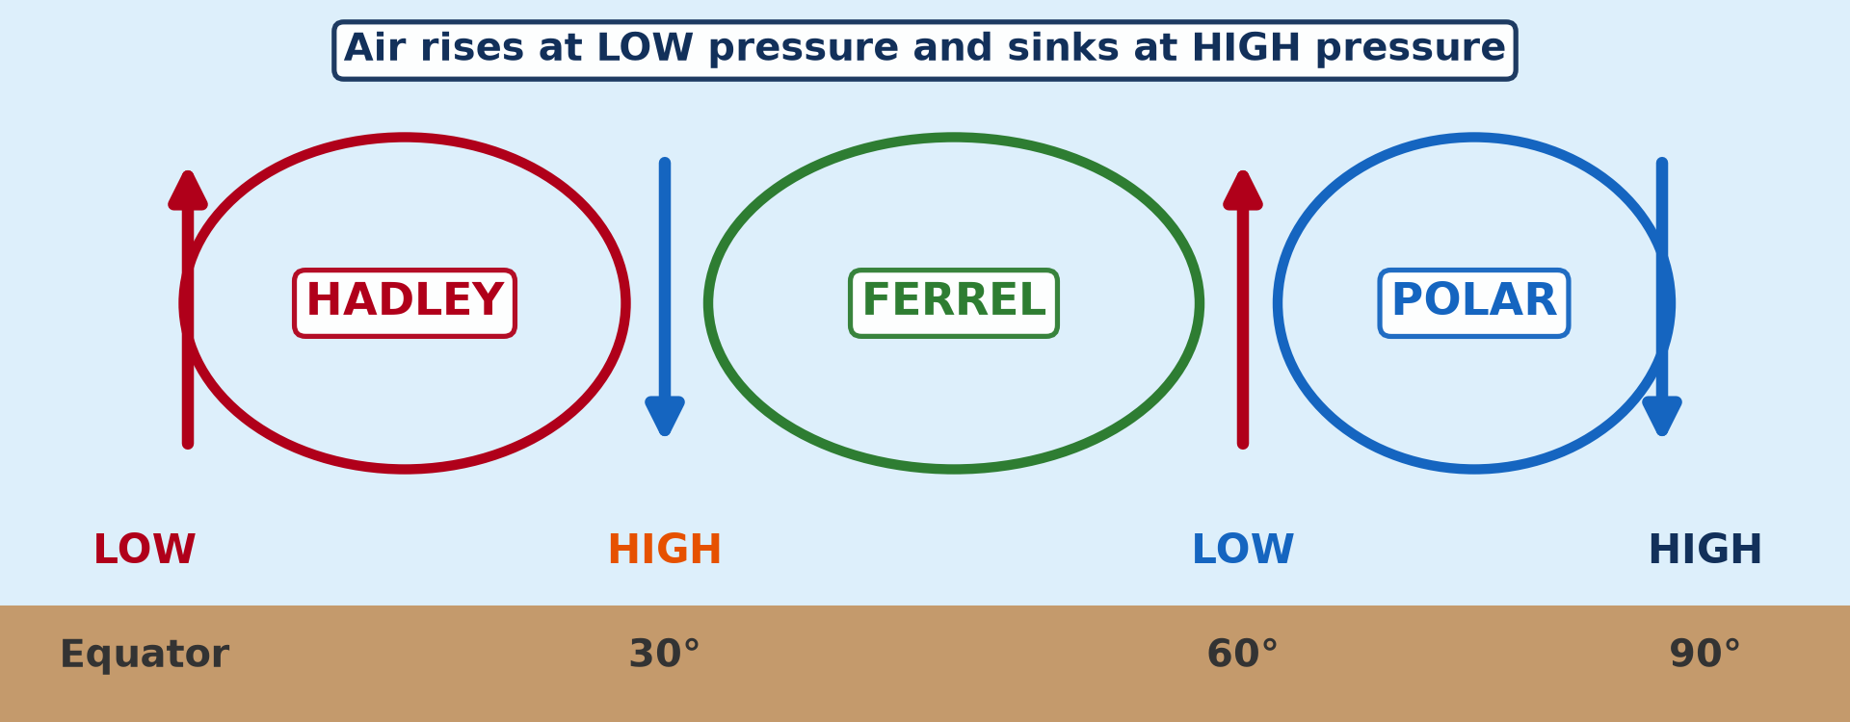
2. THE TRICELLULAR MODEL
Activity 3
The three cells of the general circulation.
Notes:
Activity 3. Look carefully at this diagram: the three cells of the general circulation. Observe every detail before I ask the question.

Slide 26
2. THE TRICELLULAR MODEL
Activity 3: Question
Name the three cells from the Equator to the pole.
Notes:
Here is the question for Activity 3: Name the three cells from the Equator to the pole. Take one minute to think and write your answer in your rough notebook.

Slide 27
2. THE TRICELLULAR MODEL
Activity 3: Answer
Hadley cell, Ferrel cell and Polar cell.
Notes:
Let us check the answer together. Hadley cell, Ferrel cell and Polar cell.

Slide 28
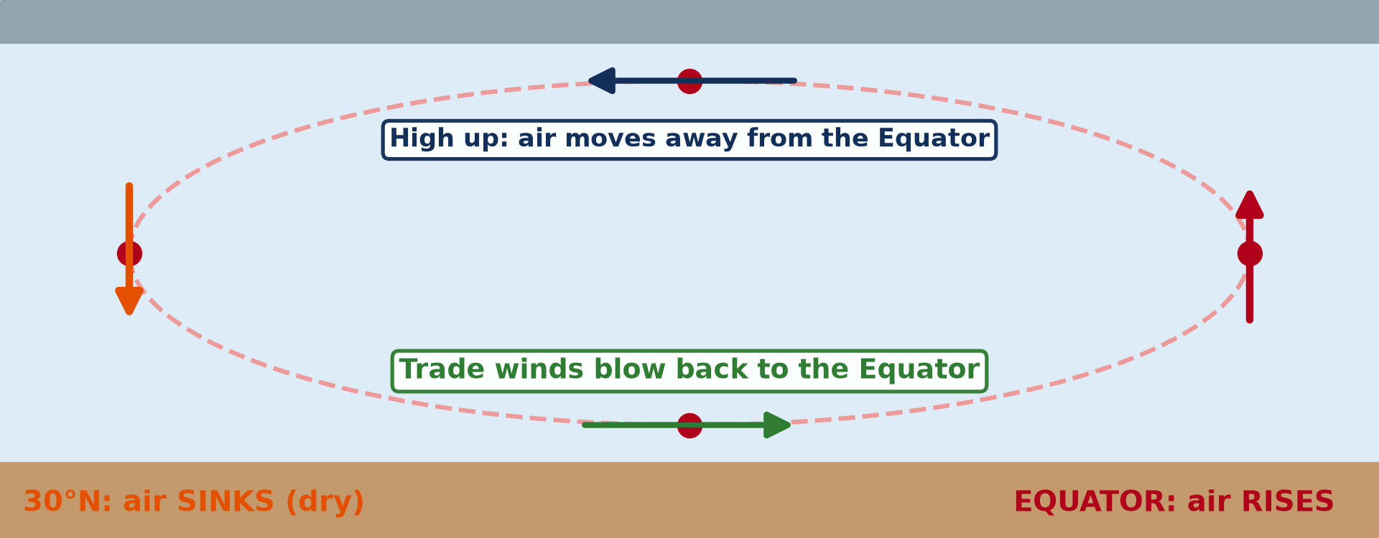
2. THE HADLEY CELL
Activity 4
Animation: the Hadley cell.
Notes:
Activity 4. Look carefully at this animation: animation: the Hadley cell. Watch the animation to the end; it will play again.

Slide 29
2. THE HADLEY CELL
Activity 4: Question
Where does air rise and where does it sink in the Hadley cell?
Notes:
Here is the question for Activity 4: Where does air rise and where does it sink in the Hadley cell? Take one minute to think and write your answer in your rough notebook.

Slide 30
2. THE HADLEY CELL
Activity 4: Answer
It rises at the Equator and sinks near 30°.
Notes:
Let us check the answer together. It rises at the Equator and sinks near 30°.

Slide 31

2. THE HADLEY CELL
Activity 5
The Sahara under the subtropical high.
Notes:
Activity 5. Look carefully at this picture: the Sahara under the subtropical high. Observe every detail before I ask the question.

Slide 32
2. THE HADLEY CELL
Activity 5: Question
What is the effect of sinking air near 30°?
Notes:
Here is the question for Activity 5: What is the effect of sinking air near 30°? Take one minute to think and write your answer in your rough notebook.

Slide 33
2. THE HADLEY CELL
Activity 5: Answer
It warms and dries, giving deserts like the Sahara.
Notes:
Let us check the answer together. It warms and dries, giving deserts like the Sahara.

Slide 34
BOARD SUMMARY
Board Summary
Topic: Global and Local Atmospheric Circulation
Sub-topic: Pressure Belts
Lesson 13: Pressure Systems
Notes:
Now we are going to copy the board summary. Write the title and the headings neatly in your notebooks. I will give you enough time for each slide, so do not rush.

Slide 35
BOARD SUMMARY
1. Meaning of Pressure Systems
Atmospheric pressure can be understood as follows:
Atmospheric pressure: It is the weight of the air pressing on a unit area of the Earth's surface. At sea level it is about 1,013 millibars.
Notes:
Let us copy Meaning of Pressure Systems. Atmospheric pressure can be understood as follows. On this slide we have Atmospheric pressure. Write each point on a new line, with the key term first, and explain it in your own words when we revise. When you finish, we go to the next slide.

Slide 36
BOARD SUMMARY
1. Meaning of Pressure Systems (continued)
Pressure systems: They are areas of high pressure (anticyclones) or low pressure (depressions) at the surface. Air moves from high to low pressure as wind.
Notes:
We continue with Meaning of Pressure Systems. On this slide we have Pressure systems. Write each point on a new line, with the key term first, and explain it in your own words when we revise.

Slide 37
BOARD SUMMARY
1. Meaning of Pressure Systems
The Global Pressure Belts
The pressure belts of the world are:
Equatorial low: It lies near the Equator, where strong heating makes air rise. It is also called the doldrums or ITCZ.
Notes:
Let us copy The Global Pressure Belts. The pressure belts of the world are. On this slide we have Equatorial low. Write each point on a new line, with the key term first, and explain it in your own words when we revise. When you finish, we go to the next slide.

Slide 38
BOARD SUMMARY
1. Meaning of Pressure Systems
The Global Pressure Belts (continued)
Subtropical highs: They lie near 30° N and S, where air sinks. They are the source of the trade winds and the westerlies.
Notes:
We continue with The Global Pressure Belts. On this slide we have Subtropical highs. Write each point on a new line, with the key term first, and explain it in your own words when we revise. When you finish, we go to the next slide.

Slide 39
BOARD SUMMARY
1. Meaning of Pressure Systems
The Global Pressure Belts (continued)
Subpolar lows and polar highs: Subpolar lows lie near 60°, where westerlies and polar easterlies meet. Polar highs lie over the cold poles.
Notes:
We continue with The Global Pressure Belts. On this slide we have Subpolar lows and polar highs. Write each point on a new line, with the key term first, and explain it in your own words when we revise.

Slide 40
BOARD SUMMARY
1. Meaning of Pressure Systems
Illustration: pressure belts
Notes:
Now draw this illustration in your notebook: pressure belts. Give it a title and label it clearly.

Slide 41
BOARD SUMMARY
2. The Tricellular Model
The general circulation of the atmosphere is explained by three cells:
Hadley cell: At the Equator hot air rises, flows poleward high up and sinks at about 30°. It returns to the Equator at the surface as the trade winds.
Notes:
Let us copy The Tricellular Model. The general circulation of the atmosphere is explained by three cells. On this slide we have Hadley cell. Write each point on a new line, with the key term first, and explain it in your own words when we revise. When you finish, we go to the next slide.

Slide 42
BOARD SUMMARY
2. The Tricellular Model (continued)
Ferrel cell: Between 30° and 60°, surface air flows poleward as the westerlies. It is driven by the two other cells.
Polar cell: Cold air sinks at the poles and flows towards 60° as the polar easterlies. There it rises again at the subpolar low.
Notes:
We continue with The Tricellular Model. On this slide we have Ferrel cell and Polar cell. Write each point on a new line, with the key term first, and explain it in your own words when we revise.

Slide 43
BOARD SUMMARY
2. The Tricellular Model
Illustration: the tricellular model
Notes:
Now draw this illustration in your notebook: the tricellular model. Give it a title and label it clearly.

Slide 44
BOARD SUMMARY
2. The Tricellular Model
Emphasis on the Hadley Cell
The Hadley cell is the most important cell for tropical regions:
Rising limb: At the ITCZ, air rises and cools, giving cumulonimbus clouds and heavy rain. This explains the rainforests of the Equator.
Notes:
Let us copy Emphasis on the Hadley Cell. The Hadley cell is the most important cell for tropical regions. On this slide we have Rising limb. Write each point on a new line, with the key term first, and explain it in your own words when we revise. When you finish, we go to the next slide.

Slide 45
BOARD SUMMARY
2. The Tricellular Model
Emphasis on the Hadley Cell (continued)
Sinking limb: Near 30° the air sinks, warms and dries, so clouds cannot form. This explains the Sahara and other hot deserts.
Seasonal shift: The Hadley cell moves north and south with the overhead sun. This brings rainy and dry seasons to Cameroon.
Notes:
We continue with Emphasis on the Hadley Cell. On this slide we have Sinking limb and Seasonal shift. Write each point on a new line, with the key term first, and explain it in your own words when we revise.

Slide 46
FORMATIVE EVALUATION
Evaluation 1
What weather is found under high pressure? Why?
Notes:
Now let us check what you have understood. Question 1: What weather is found under high pressure? Why? Answer in your exercise book.

Slide 47
FORMATIVE EVALUATION
Expected Answer
Dry, clear weather, because air sinks and warms.
Notes:
The expected answer is: dry, clear weather, because air sinks and warms. If you got it right, well done.

Slide 48
FORMATIVE EVALUATION
Evaluation 2
Describe the Hadley cell.
Notes:
Now let us check what you have understood. Question 2: Describe the Hadley cell. Answer in your exercise book.

Slide 49
FORMATIVE EVALUATION
Expected Answer
Air rises at the Equator, moves poleward high up, sinks at 30° and returns as trade winds.
Notes:
The expected answer is: air rises at the Equator, moves poleward high up, sinks at 30° and returns as trade winds. If you got it right, well done.

Slide 50
REMEDIATION
Remediation
Fill in the blanks:
Pressure is measured with a ______.
The deserts lie under the subtropical ______.
The cell between 0° and 30° is the ______ cell.
Notes:
For those who need more practice, fill in the blanks in your exercise book. The answers are: number 1, barometer; number 2, high; number 3, Hadley.

Slide 51
HOMEWORK
Homework
Draw the tricellular model and label the pressure belts.
Notes:
For your homework: Draw the tricellular model and label the pressure belts. We shall correct it at the beginning of our next lesson.

Slide 52
NEXT LESSON
Next Lesson
Our next lesson will be on:
Lesson 14: Vertical Motions: Stability and Instability
Notes:
Our next lesson will be on Lesson 14: Vertical Motions: Stability and Instability. Thank you for your attention, and see you next time.

Slide 53
BILINGUAL GAME
Bilingual Game (Jeu Bilingue)
English | Français
Pressure | La pression
Barometer | Le baromètre
Isobar | L'isobare
High pressure | Anticyclone
Low pressure | Dépression
Cell | La cellule
Notes:
Let us play the bilingual game. I say a word in English, and you give me the French word. Then we do the reverse.

Slide 54
LOGBOOK
Official Logbook (1/2)
Module / Topic | Global and Local Atmospheric Circulation
Lesson Title | Lesson 13: Pressure Systems
Expected Learning Outcomes | Define atmospheric pressure and name its units. Describe the pressure belts. Explain the tricellular model and the Hadley cell.
Competence | Learners are able to explain pressure belts and the general circulation of the atmosphere.
Notes:
I record this information in the official logbook of the class after the lesson.

Slide 55
LOGBOOK
Official Logbook (2/2)
Matter Taught | Meaning of Pressure Systems; The Global Pressure Belts; The Tricellular Model; Emphasis on the Hadley Cell.
Evaluation | Formative evaluation and remediation exercise.
Homework | Draw the tricellular model and label the pressure belts.
Enrolment / Present / Absent | ____ / ____ / ____
Achievement | To be completed after the lesson.
Notes:
I complete the second page of the logbook: the matter taught, the evaluation, the homework and the attendance.

Slide 56
TEACHER'S NOTE
Teacher's Note
Timing: Homework correction, plan, objectives 8 min | Recall, situation, action 10 min | 5 activities 30 min | Board summary (copying) 30 min | Evaluation, remediation 10 min | Homework, next lesson 5 min | Logbook 7 min
Activity 4 is an animation (GIF): it plays automatically in slide-show mode.
Without the projector (Activity 1): press on a table to show weight.
Without the projector (Activity 2): draw the belts on a circle.
Without the projector (Activity 3): draw three loops.
Without the projector (Activity 4): describe the circulation with the hands.
Without the projector (Activity 5): show the Sahara on the map.
Notes:
This slide is for me, the teacher: it gives the timing of the lesson and what to do if the projector is not available.

Slide 57
REFERENCES
References
National Geography Syllabus, MINESEC/IGE/IP-SS, 2019 — Module 1 (Meteorology, Climatology & Hydrology).
Photo, Activity 1: “Aneroid Barometer, with dial designed by Sir Napier Shaw, 1914” by Negretti & Zambra; Shaw, Sir Napier, CC BY-NC-SA 4.0, via sciencemuseum (https://collection.sciencemuseumgroup.org.uk/objects/co54459/aneroid-barometer-with-dial-designed-by-sir-napier-shaw-1914)
Photo, Activity 5: “Desert trekking in Merzouga” by Antonio Cinotti , CC BY-NC-ND 2.0, via Flickr (https://www.flickr.com/photos/46378751@N02/15331399979)
Diagrams and animations: drawn for this lesson (Geography Department).
Notes:
These are the references and picture credits used to prepare this lesson.

