Slide 1
LOWER SIXTH ARTS
GEOGRAPHY
Lesson 14
Vertical Motions: Stability and Instability
Notes:
Good morning, class, and welcome to our geography lesson. I am your geography teacher, Mr Kamdem. Today we are starting Lesson 14: Vertical Motions: Stability and Instability.

Slide 2
CLASS INFO
Class, Chapter and Duration
Class | Lower Sixth Arts
Chapter | Module 1: Understanding and managing atmospheric and hydrological phenomena and hazards across the world in general and Cameroon in particular
Duration | 2 periods (2 × 50 minutes)
Notes:
This lesson is for Lower Sixth Arts. It belongs to Module 1: Understanding and managing atmospheric and hydrological phenomena and hazards across the world in general and Cameroon in particular. We shall need 2 periods to cover it.

Slide 3
IDENTIFICATION
Lesson Identification
Topic | Global and Local Atmospheric Circulation
Sub-topic | Atmospheric Motions
Lesson | Lesson 14: Vertical Motions: Stability and Instability
Notions / Concepts | Air parcel, stability, instability, conditional instability, dry and saturated adiabatic lapse rates.
Syllabus focus | Meaning, types and weather of instability and stability.
Competence | Learners are able to explain why air rises or sinks and predict the weather that follows.
Notes:
Our topic is Global and Local Atmospheric Circulation, and the sub-topic is Atmospheric Motions. The key notions we shall use today are: air parcel, stability, instability, conditional instability, dry and saturated adiabatic lapse rates. At the end, you should be able to do this: learners are able to explain why air rises or sinks and predict the weather that follows.

Slide 4

HOMEWORK CORRECTION
Correction of the Homework
Question (Lesson 13: Pressure Systems):
Draw the tricellular model and label the pressure belts.
Notes:
Before we start the new lesson, let us correct the homework I gave you at the end of Lesson 13: Pressure Systems. The question was: Draw the tricellular model and label the pressure belts. Take out your exercise books.

Slide 5
HOMEWORK CORRECTION
Correction: Possible Answer
The diagram shows the Hadley cell (0–30°), the Ferrel cell (30–60°) and the polar cell (60–90°), with the equatorial low, subtropical highs, subpolar lows and polar highs labelled.
Notes:
Here is a good answer. The diagram shows the Hadley cell (0–30°), the Ferrel cell (30–60°) and the polar cell (60–90°), with the equatorial low, subtropical highs, subpolar lows and polar highs labelled. Compare it with your own answer and correct your work in red.

Slide 6
LESSON PLAN
Lesson Plan
Correction of the homework
Objectives and recall
Real-life situation and action to take
Learning activities
Board summary
Evaluation, remediation and homework
Notes:
Here is the plan of our lesson today. First, we shall correct the homework. Then we shall look at the objectives and recall what you already know. After that, we shall study a situation from real life and the action to take, and do the learning activities. Finally, we shall copy the board summary, do the evaluation and the remediation, and I will give you the homework.

Slide 7
OBJECTIVES
Objectives
By the end of this lesson, you should be able to:
Define stability and instability.
Compare the lapse rates of a rising parcel and the surrounding air.
Notes:
Take your time to copy this part; we will continue together.

Slide 8
OBJECTIVES
Objectives (continued)
Describe the weather of stable and unstable air.
Notes:
By the end of this lesson, you should be able to do three things. Number 1: define stability and instability. Number 2: compare the lapse rates of a rising parcel and the surrounding air. Number 3: describe the weather of stable and unstable air.

Slide 9
PREVIOUS KNOWLEDGE
Previous Knowledge
Rising air cools by expansion.
The environmental lapse rate is about 6.5 °C per 1,000 m.
Notes:
Let us first remember what you already know. Rising air cools by expansion. The environmental lapse rate is about 6.5 °C per 1,000 m. Keep this in mind, because we shall build on it today.

Slide 10
REAL-LIFE SITUATION
Situation in Real Life
On some afternoons in Yaoundé, huge clouds grow very fast and storms break out. On other days the sky stays grey and flat, and smoke hangs low over the town.
Notes:
Listen carefully to this situation from real life. On some afternoons in Yaoundé, huge clouds grow very fast and storms break out. On other days the sky stays grey and flat, and smoke hangs low over the town. Think about it, because I am going to ask you some questions.

Slide 11
REAL-LIFE SITUATION
Situation: Question 1
What is the problem in the situation?
Notes:
Question 1: What is the problem in the situation? Think for a moment, then raise your hand to answer.

Slide 12
REAL-LIFE SITUATION
Answer
Learners do not know why some days are stormy and others calm.
Notes:
Good. Learners do not know why some days are stormy and others calm.

Slide 13
REAL-LIFE SITUATION
Situation: Question 2
What happens on stormy days?
Notes:
Question 2: What happens on stormy days? Think for a moment, then raise your hand to answer.

Slide 14
REAL-LIFE SITUATION
Answer
Air rises quickly: it is unstable.
Notes:
Good. Air rises quickly: it is unstable.

Slide 15
REAL-LIFE SITUATION
Situation: Question 3
What happens on calm grey days?
Notes:
Question 3: What happens on calm grey days? Think for a moment, then raise your hand to answer.

Slide 16
REAL-LIFE SITUATION
Possible Answer
Air does not rise: it is stable.
Notes:
Good. Air does not rise: it is stable.

Slide 17
ACTION TO TAKE
Action to Take
Predict storms or calm weather from the stability of the air and protect lives and crops.
Notes:
From this situation, the action we are working towards in this lesson is the following: predict storms or calm weather from the stability of the air and protect lives and crops.

Slide 18
JUSTIFICATION
Justification of the Lesson
This lesson helps us to understand why storms form and why some days stay calm.
Notes:
Why is this lesson important for you? This lesson helps us to understand why storms form and why some days stay calm.

Slide 19
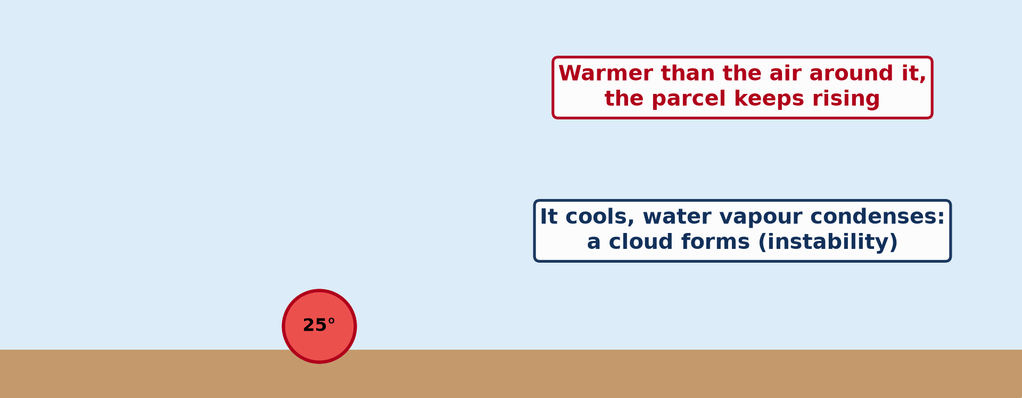
1. A) INSTABILITY: MEANING
Activity 1
Animation: a warm bubble of air rises and forms a cloud.
Notes:
Activity 1. Look carefully at this animation: animation: a warm bubble of air rises and forms a cloud. Watch the animation to the end; it will play again.

Slide 20
1. A) INSTABILITY: MEANING
Activity 1: Question
Why does the parcel keep rising?
Notes:
Here is the question for Activity 1: Why does the parcel keep rising? Take one minute to think and write your answer in your rough notebook.

Slide 21
1. A) INSTABILITY: MEANING
Activity 1: Answer
It stays warmer and lighter than the air around it.
Notes:
Let us check the answer together. It stays warmer and lighter than the air around it.

Slide 22
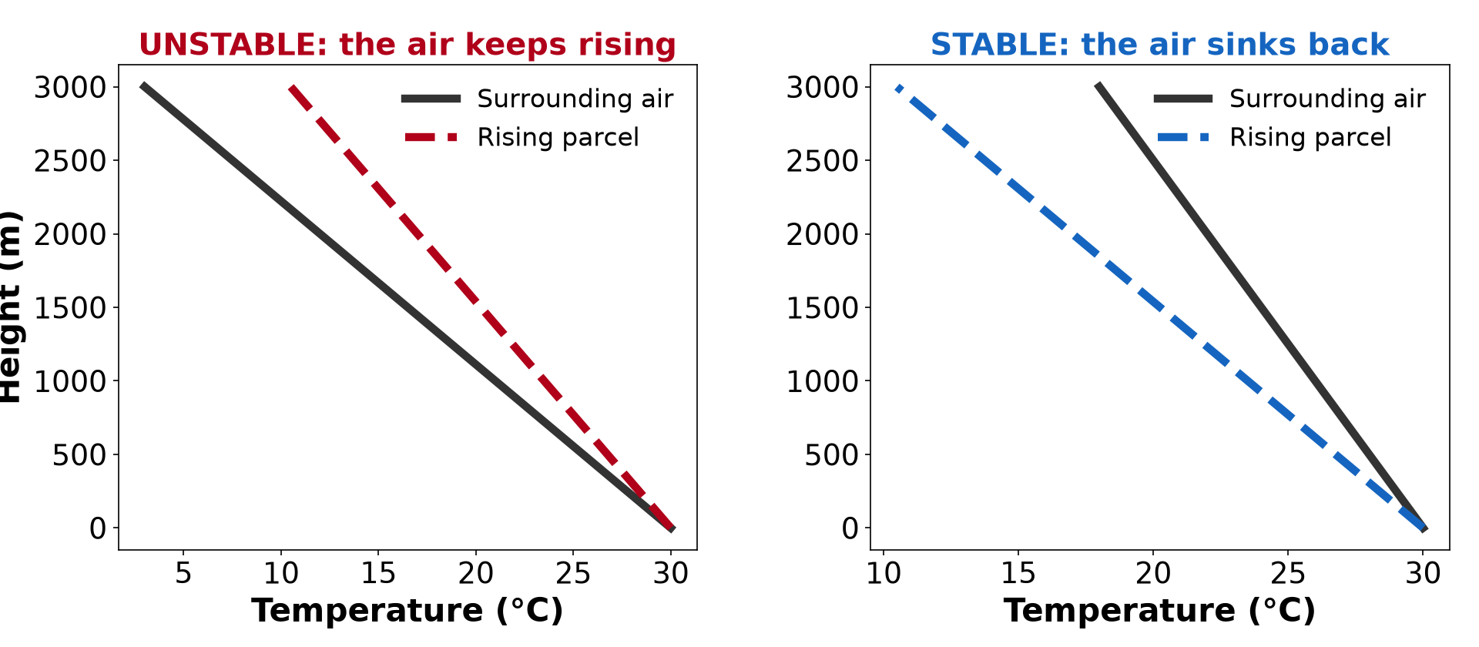
1. B) TYPES OF STABILITY
Activity 2
An unstable and a stable atmosphere.
Notes:
Activity 2. Look carefully at this diagram: an unstable and a stable atmosphere. Observe every detail before I ask the question.

Slide 23
1. B) TYPES OF STABILITY
Activity 2: Question
In the unstable case, is the rising air warmer or colder than the air around it?
Notes:
Here is the question for Activity 2: In the unstable case, is the rising air warmer or colder than the air around it? Take one minute to think and write your answer in your rough notebook.

Slide 24
1. B) TYPES OF STABILITY
Activity 2: Answer
Warmer, so it keeps rising.
Notes:
Let us check the answer together. Warmer, so it keeps rising.

Slide 25

1. C) WEATHER OF INSTABILITY
Activity 3
A cumulonimbus cloud.
Notes:
Activity 3. Look carefully at this picture: a cumulonimbus cloud. Observe every detail before I ask the question.

Slide 26
1. C) WEATHER OF INSTABILITY
Activity 3: Question
What weather comes with unstable air?
Notes:
Here is the question for Activity 3: What weather comes with unstable air? Take one minute to think and write your answer in your rough notebook.

Slide 27
1. C) WEATHER OF INSTABILITY
Activity 3: Answer
Tall clouds, heavy showers, thunder and sometimes hail.
Notes:
Let us check the answer together. Tall clouds, heavy showers, thunder and sometimes hail.

Slide 28
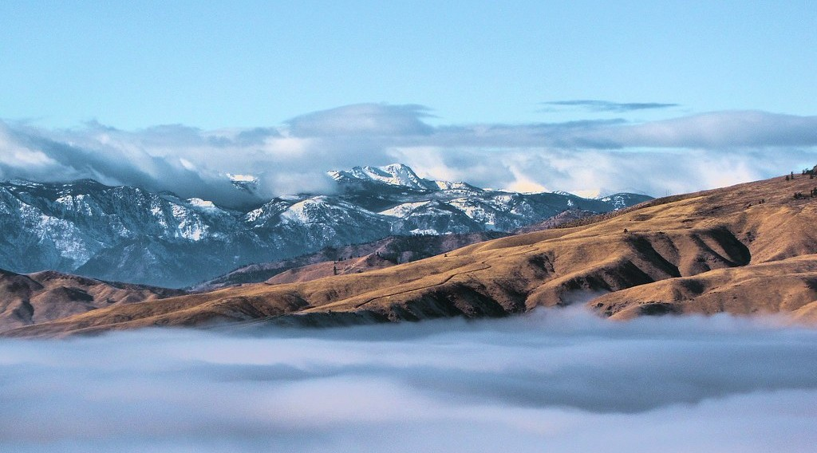
2. C) WEATHER OF STABILITY
Activity 4
Flat layers of cloud below a stable layer.
Notes:
Activity 4. Look carefully at this picture: flat layers of cloud below a stable layer. Observe every detail before I ask the question.

Slide 29
2. C) WEATHER OF STABILITY
Activity 4: Question
What weather comes with stable air?
Notes:
Here is the question for Activity 4: What weather comes with stable air? Take one minute to think and write your answer in your rough notebook.

Slide 30
2. C) WEATHER OF STABILITY
Activity 4: Answer
Flat layer clouds, fog or clear skies, and no storms.
Notes:
Let us check the answer together. Flat layer clouds, fog or clear skies, and no storms.

Slide 31

2. C) WEATHER OF STABILITY
Activity 5
Smoke and haze trapped over a city.
Notes:
Activity 5. Look carefully at this picture: smoke and haze trapped over a city. Observe every detail before I ask the question.

Slide 32
2. C) WEATHER OF STABILITY
Activity 5: Question
Why does smoke stay near the ground in stable air?
Notes:
Here is the question for Activity 5: Why does smoke stay near the ground in stable air? Take one minute to think and write your answer in your rough notebook.

Slide 33
2. C) WEATHER OF STABILITY
Activity 5: Answer
The air cannot rise, so smoke and dust are trapped.
Notes:
Let us check the answer together. The air cannot rise, so smoke and dust are trapped.

Slide 34
BOARD SUMMARY
Board Summary
Topic: Global and Local Atmospheric Circulation
Sub-topic: Atmospheric Motions
Lesson 14: Vertical Motions: Stability and Instability
Notes:
Now we are going to copy the board summary. Write the title and the headings neatly in your notebooks. I will give you enough time for each slide, so do not rush.

Slide 35
BOARD SUMMARY
DEFINITIONS
The key terms of this lesson are defined as follows:
Dry adiabatic lapse rate (DALR): It is the rate at which unsaturated rising air cools, about 10 °C per 1,000 m.
Notes:
Let us copy the definitions. The key terms of this lesson are defined as follows. On this slide we have Dry adiabatic lapse rate (DALR). Write each point on a new line, with the key term first, and explain it in your own words when we revise. When you finish, we go to the next slide.

Slide 36
BOARD SUMMARY
DEFINITIONS (continued)
Saturated adiabatic lapse rate (SALR): It is the rate at which saturated rising air cools, about 5–6 °C per 1,000 m, because condensation releases latent heat.
Notes:
We continue with the definitions. On this slide we have Saturated adiabatic lapse rate (SALR). Write each point on a new line, with the key term first, and explain it in your own words when we revise.

Slide 37
BOARD SUMMARY
1. Atmospheric Instability
Instability can be studied as follows:
Meaning: Air is unstable when a rising parcel stays warmer than the air around it. It keeps rising on its own, like a hot-air balloon.
Notes:
Let us copy Atmospheric Instability. Instability can be studied as follows. On this slide we have Meaning. Write each point on a new line, with the key term first, and explain it in your own words when we revise. When you finish, we go to the next slide.

Slide 38
BOARD SUMMARY
1. Atmospheric Instability (continued)
Types: Absolute instability occurs when the environmental lapse rate is greater than the DALR. Conditional instability occurs when it lies between the SALR and the DALR, so air becomes unstable only when saturated.
Notes:
We continue with Atmospheric Instability. On this slide we have Types. Write each point on a new line, with the key term first, and explain it in your own words when we revise. When you finish, we go to the next slide.

Slide 39
BOARD SUMMARY
1. Atmospheric Instability (continued)
Associated weather: Unstable air forms tall cumulus and cumulonimbus clouds. It brings heavy showers, thunderstorms, lightning and sometimes hail.
Notes:
We continue with Atmospheric Instability. On this slide we have Associated weather. Write each point on a new line, with the key term first, and explain it in your own words when we revise.

Slide 40
BOARD SUMMARY
1. Atmospheric Instability
Illustration: stable and unstable air
Notes:
Now draw this illustration in your notebook: stable and unstable air. Give it a title and label it clearly.

Slide 41
BOARD SUMMARY
2. Atmospheric Stability
Stability can be studied as follows:
Meaning: Air is stable when a rising parcel becomes colder than the surrounding air. It sinks back to its starting level.
Notes:
Let us copy Atmospheric Stability. Stability can be studied as follows. On this slide we have Meaning. Write each point on a new line, with the key term first, and explain it in your own words when we revise. When you finish, we go to the next slide.

Slide 42
BOARD SUMMARY
2. Atmospheric Stability (continued)
Types: Absolute stability occurs when the environmental lapse rate is lower than the SALR. Inversions are the most stable situation.
Notes:
We continue with Atmospheric Stability. On this slide we have Types. Write each point on a new line, with the key term first, and explain it in your own words when we revise. When you finish, we go to the next slide.

Slide 43
BOARD SUMMARY
2. Atmospheric Stability (continued)
Associated weather: Stable air gives clear skies or flat layer clouds such as stratus. It brings fog, calm conditions and trapped pollution.
Notes:
We continue with Atmospheric Stability. On this slide we have Associated weather. Write each point on a new line, with the key term first, and explain it in your own words when we revise.

Slide 44
FORMATIVE EVALUATION
Evaluation 1
Distinguish stability and instability.
Notes:
Now let us check what you have understood. Question 1: Distinguish stability and instability. Answer in your exercise book.

Slide 45
FORMATIVE EVALUATION
Expected Answer
Unstable air keeps rising because it stays warmer; stable air sinks back because it becomes colder.
Notes:
The expected answer is: unstable air keeps rising because it stays warmer; stable air sinks back because it becomes colder. If you got it right, well done.

Slide 46
FORMATIVE EVALUATION
Evaluation 2
Give the weather of unstable air.
Notes:
Now let us check what you have understood. Question 2: Give the weather of unstable air. Answer in your exercise book.

Slide 47
FORMATIVE EVALUATION
Expected Answer
Tall cumulonimbus clouds, heavy showers, thunderstorms.
Notes:
The expected answer is: tall cumulonimbus clouds, heavy showers, thunderstorms. If you got it right, well done.

Slide 48
REMEDIATION
Remediation
Fill in the blanks:
Unsaturated air cools at about ______ °C per 1,000 m.
Storms come with ______ air.
Fog and smog come with ______ air.
Notes:
For those who need more practice, fill in the blanks in your exercise book. The answers are: number 1, 10; number 2, unstable; number 3, stable.

Slide 49
HOMEWORK
Homework
For one week, note whether the afternoon is stormy or calm and link it to stability.
Notes:
For your homework: For one week, note whether the afternoon is stormy or calm and link it to stability. We shall correct it at the beginning of our next lesson.

Slide 50
NEXT LESSON
Next Lesson
Our next lesson will be on:
Lesson 15: Planetary Winds
Notes:
Our next lesson will be on Lesson 15: Planetary Winds. Thank you for your attention, and see you next time.

Slide 51
BILINGUAL GAME
Bilingual Game (Jeu Bilingue)
English | Français
Stability | La stabilité
Instability | L'instabilité
Air parcel | La particule d'air
Thunderstorm | L'orage
Saturated | Saturé
Lapse rate | Le gradient
Notes:
Let us play the bilingual game. I say a word in English, and you give me the French word. Then we do the reverse.

Slide 52
LOGBOOK
Official Logbook (1/2)
Module / Topic | Global and Local Atmospheric Circulation
Lesson Title | Lesson 14: Vertical Motions: Stability and Instability
Expected Learning Outcomes | Define stability and instability. Compare the lapse rates of a rising parcel and the surrounding air. Describe the weather of stable and unstable air.
Competence | Learners are able to explain why air rises or sinks and predict the weather that follows.
Notes:
I record this information in the official logbook of the class after the lesson.

Slide 53
LOGBOOK
Official Logbook (2/2)
Matter Taught | DEFINITIONS; Atmospheric Instability; Atmospheric Stability.
Evaluation | Formative evaluation and remediation exercise.
Homework | For one week, note whether the afternoon is stormy or calm and link it to stability.
Enrolment / Present / Absent | ____ / ____ / ____
Achievement | To be completed after the lesson.
Notes:
I complete the second page of the logbook: the matter taught, the evaluation, the homework and the attendance.

Slide 54
TEACHER'S NOTE
Teacher's Note
Timing: Homework correction, plan, objectives 8 min | Recall, situation, action 10 min | 5 activities 30 min | Board summary (copying) 30 min | Evaluation, remediation 10 min | Homework, next lesson 5 min | Logbook 7 min
Activity 1 is an animation (GIF): it plays automatically in slide-show mode.
Without the projector (Activity 1): describe a hot-air balloon.
Without the projector (Activity 2): draw the two graphs.
Without the projector (Activity 3): describe an afternoon storm.
Without the projector (Activity 4): describe a grey, calm morning.
Without the projector (Activity 5): watch smoke from a kitchen fire.
Notes:
This slide is for me, the teacher: it gives the timing of the lesson and what to do if the projector is not available.

Slide 55
REFERENCES
References
National Geography Syllabus, MINESEC/IGE/IP-SS, 2019 — Module 1 (Meteorology, Climatology & Hydrology).
Photo, Activity 3: “06172012 Sunday evening pulse storms/cumulonimbi” by StormRider93 | Into the Storm, CC BY-NC-ND 2.0, via Flickr (https://www.flickr.com/photos/65232104@N04/7395715628)
Photo, Activity 4: “Rising above the Inversion” by Pictoscribe -, CC BY-NC-ND 2.0, via Flickr (https://www.flickr.com/photos/70414856@N00/6535713585)
Photo, Activity 5: “Beijing smog” by kevin dooley, CC BY 2.0, via Flickr (https://www.flickr.com/photos/12836528@N00/386198516)
Diagrams and animations: drawn for this lesson (Geography Department).
Notes:
These are the references and picture credits used to prepare this lesson.

