Slide 1
LOWER SIXTH ARTS
GEOGRAPHY
Lesson 17
Local Winds
Notes:
Good morning, class, and welcome to our geography lesson. I am your geography teacher, Mr Kamdem. Today we are starting Lesson 17: Local Winds.

Slide 2
CLASS INFO
Class, Chapter and Duration
Class | Lower Sixth Arts
Chapter | Module 1: Understanding and managing atmospheric and hydrological phenomena and hazards across the world in general and Cameroon in particular
Duration | 2 periods (2 × 50 minutes)
Notes:
This lesson is for Lower Sixth Arts. It belongs to Module 1: Understanding and managing atmospheric and hydrological phenomena and hazards across the world in general and Cameroon in particular. We shall need 2 periods to cover it.

Slide 3
IDENTIFICATION
Lesson Identification
Topic | Atmospheric Motions
Sub-topic | Microscale (Local) Winds
Lesson | Lesson 17: Local Winds
Notions / Concepts | Local wind, land breeze, sea breeze, anabatic wind, katabatic wind, foehn.
Syllabus focus | Land and sea breezes, anabatic and katabatic winds, foehn winds; effects of winds on weather and man.
Competence | Learners are able to explain local winds and their effects on weather and people.
Notes:
Our topic is Atmospheric Motions, and the sub-topic is Microscale (Local) Winds. The key notions we shall use today are: local wind, land breeze, sea breeze, anabatic wind, katabatic wind, foehn. At the end, you should be able to do this: learners are able to explain local winds and their effects on weather and people.

Slide 4

HOMEWORK CORRECTION
Correction of the Homework
Question (Lesson 16: Tropical Seasonal Winds: Monsoon and Harmattan):
Write the months of the monsoon and of the Harmattan in your town.
Notes:
Before we start the new lesson, let us correct the homework I gave you at the end of Lesson 16: Tropical Seasonal Winds: Monsoon and Harmattan. The question was: Write the months of the monsoon and of the Harmattan in your town. Take out your exercise books.

Slide 5
HOMEWORK CORRECTION
Correction: Possible Answer
In Garoua the monsoon (rainy season) blows from about May to October, and the Harmattan (dry season) from about November to March or April.
Notes:
Here is a good answer. In Garoua the monsoon (rainy season) blows from about May to October, and the Harmattan (dry season) from about November to March or April. Compare it with your own answer and correct your work in red.

Slide 6
LESSON PLAN
Lesson Plan
Correction of the homework
Objectives and recall
Real-life situation and action to take
Learning activities
Board summary
Evaluation, remediation and homework
Notes:
Here is the plan of our lesson today. First, we shall correct the homework. Then we shall look at the objectives and recall what you already know. After that, we shall study a situation from real life and the action to take, and do the learning activities. Finally, we shall copy the board summary, do the evaluation and the remediation, and I will give you the homework.

Slide 7
OBJECTIVES
Objectives
By the end of this lesson, you should be able to:
Explain land and sea breezes.
Explain anabatic and katabatic winds.
Explain foehn winds and the effects of winds on man.
Notes:
By the end of this lesson, you should be able to do three things. Number 1: explain land and sea breezes. Number 2: explain anabatic and katabatic winds. Number 3: explain foehn winds and the effects of winds on man.

Slide 8
PREVIOUS KNOWLEDGE
Previous Knowledge
Land heats and cools faster than the sea.
Cold air is heavy and sinks.
Notes:
Let us first remember what you already know. Land heats and cools faster than the sea. Cold air is heavy and sinks. Keep this in mind, because we shall build on it today.

Slide 9
REAL-LIFE SITUATION
Situation in Real Life
Fishermen in Limbe go to sea very early in the morning and come back in the afternoon. They say the wind carries them out and brings them back.
Notes:
Listen carefully to this situation from real life. Fishermen in Limbe go to sea very early in the morning and come back in the afternoon. They say the wind carries them out and brings them back. Think about it, because I am going to ask you some questions.

Slide 10
REAL-LIFE SITUATION
Situation: Question 1
What is the problem in the situation?
Notes:
Question 1: What is the problem in the situation? Think for a moment, then raise your hand to answer.

Slide 11
REAL-LIFE SITUATION
Answer
The wind changes direction between night and day.
Notes:
Good. The wind changes direction between night and day.

Slide 12
REAL-LIFE SITUATION
Situation: Question 2
Which wind blows to the sea at night?
Notes:
Question 2: Which wind blows to the sea at night? Think for a moment, then raise your hand to answer.

Slide 13
REAL-LIFE SITUATION
Answer
The land breeze.
Notes:
Good. The land breeze.

Slide 14
REAL-LIFE SITUATION
Situation: Question 3
Which wind blows to the land by day?
Notes:
Question 3: Which wind blows to the land by day? Think for a moment, then raise your hand to answer.

Slide 15
REAL-LIFE SITUATION
Possible Answer
The sea breeze.
Notes:
Good. The sea breeze.

Slide 16
ACTION TO TAKE
Action to Take
Use local winds wisely (fishing, ventilation) and prevent the dangers of dry winds such as bush fires.
Notes:
From this situation, the action we are working towards in this lesson is the following: use local winds wisely (fishing, ventilation) and prevent the dangers of dry winds such as bush fires.

Slide 17
JUSTIFICATION
Justification of the Lesson
This lesson helps us to understand the small winds that affect daily life on coasts and in mountains.
Notes:
Why is this lesson important for you? This lesson helps us to understand the small winds that affect daily life on coasts and in mountains.

Slide 18

2. A) LAND AND SEA BREEZES: CAUSES
Activity 1
Animation: sea breeze by day, land breeze at night.
Notes:
Activity 1. Look carefully at this animation: animation: sea breeze by day, land breeze at night. Watch the animation to the end; it will play again.

Slide 19
2. A) LAND AND SEA BREEZES: CAUSES
Activity 1: Question
Why does the wind blow from the sea by day?
Notes:
Here is the question for Activity 1: Why does the wind blow from the sea by day? Take one minute to think and write your answer in your rough notebook.

Slide 20
2. A) LAND AND SEA BREEZES: CAUSES
Activity 1: Answer
The land is hotter; air rises over it and cool sea air replaces it.
Notes:
Let us check the answer together. The land is hotter; air rises over it and cool sea air replaces it.

Slide 21

2. A) LAND AND SEA BREEZES: EFFECTS
Activity 2
Fishermen in their canoes.
Notes:
Activity 2. Look carefully at this picture: fishermen in their canoes. Observe every detail before I ask the question.

Slide 22
2. A) LAND AND SEA BREEZES: EFFECTS
Activity 2: Question
How do fishermen use the land and sea breezes?
Notes:
Here is the question for Activity 2: How do fishermen use the land and sea breezes? Take one minute to think and write your answer in your rough notebook.

Slide 23
2. A) LAND AND SEA BREEZES: EFFECTS
Activity 2: Answer
The land breeze carries them out at night, and the sea breeze brings them back.
Notes:
Let us check the answer together. The land breeze carries them out at night, and the sea breeze brings them back.

Slide 24
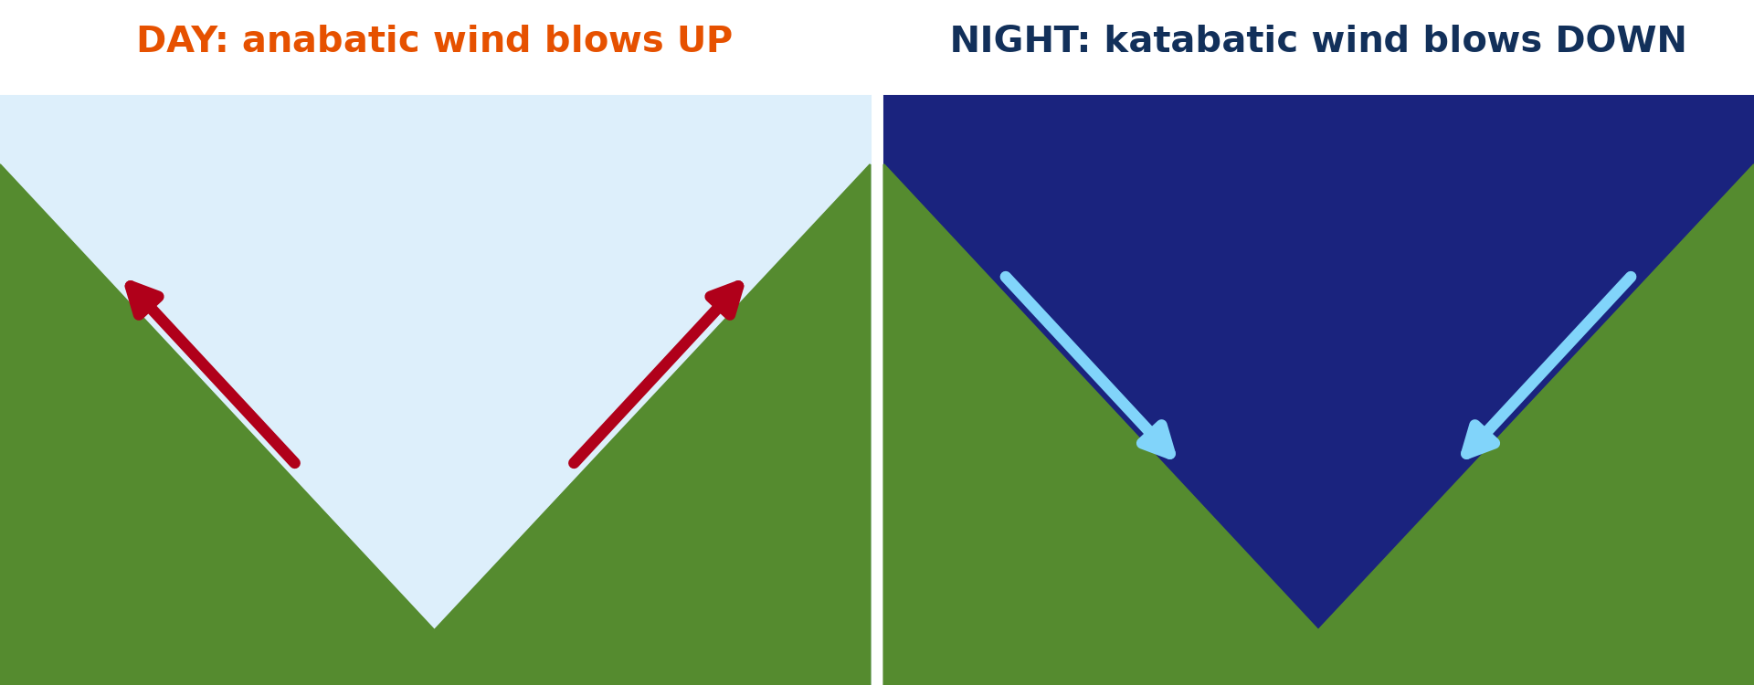
2. B) MOUNTAIN AND VALLEY WINDS
Activity 3
Anabatic and katabatic winds.
Notes:
Activity 3. Look carefully at this diagram: anabatic and katabatic winds. Observe every detail before I ask the question.

Slide 25
2. B) MOUNTAIN AND VALLEY WINDS
Activity 3: Question
Which wind blows down the slopes at night? Why?
Notes:
Here is the question for Activity 3: Which wind blows down the slopes at night? Why? Take one minute to think and write your answer in your rough notebook.

Slide 26
2. B) MOUNTAIN AND VALLEY WINDS
Activity 3: Answer
The katabatic wind; the slopes cool and cold heavy air flows down.
Notes:
Let us check the answer together. The katabatic wind; the slopes cool and cold heavy air flows down.

Slide 27
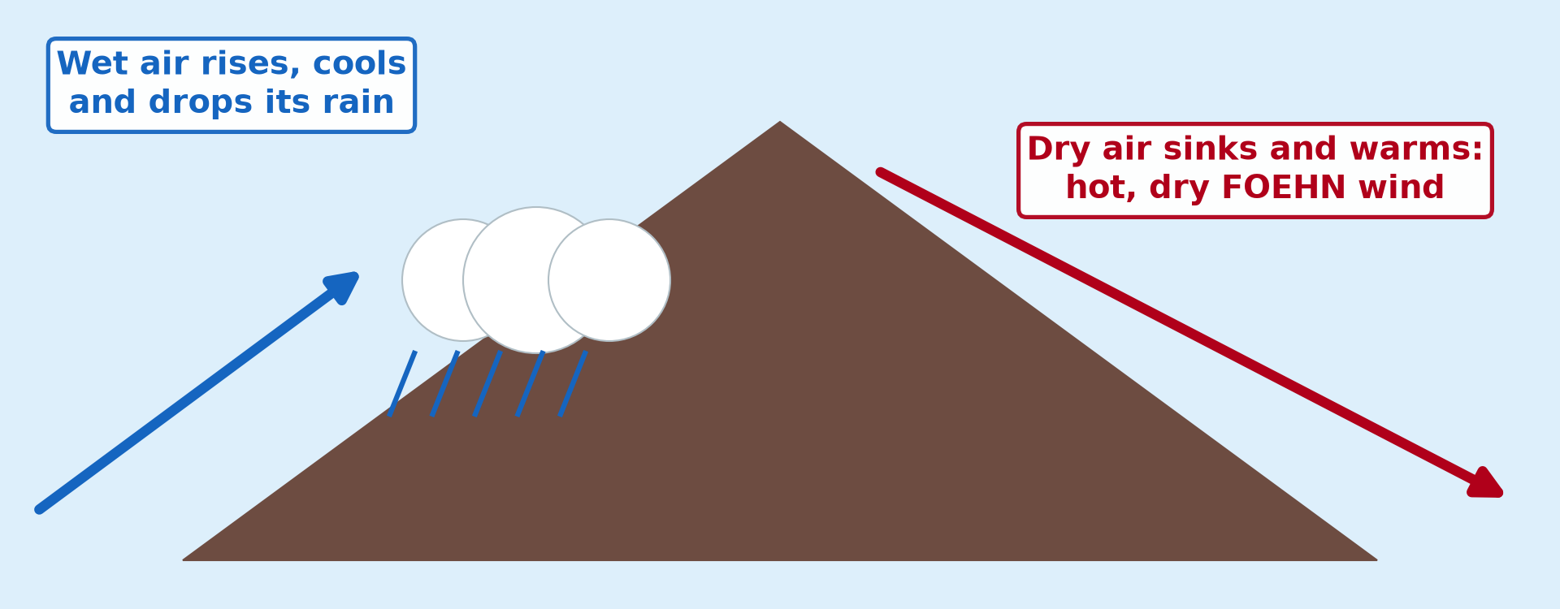
2. C) FOEHN WINDS
Activity 4
The foehn effect.
Notes:
Activity 4. Look carefully at this diagram: the foehn effect. Observe every detail before I ask the question.

Slide 28
2. C) FOEHN WINDS
Activity 4: Question
Why is the wind hot and dry on the leeward side?
Notes:
Here is the question for Activity 4: Why is the wind hot and dry on the leeward side? Take one minute to think and write your answer in your rough notebook.

Slide 29
2. C) FOEHN WINDS
Activity 4: Answer
It lost its rain on the windward side and warms as it sinks.
Notes:
Let us check the answer together. It lost its rain on the windward side and warms as it sinks.

Slide 30

3. EFFECTS OF WINDS ON WEATHER AND MAN
Activity 5
Burnt land after a bush fire.
Notes:
Activity 5. Look carefully at this picture: burnt land after a bush fire. Observe every detail before I ask the question.

Slide 31
3. EFFECTS OF WINDS ON WEATHER AND MAN
Activity 5: Question
How can a dry wind be dangerous?
Notes:
Here is the question for Activity 5: How can a dry wind be dangerous? Take one minute to think and write your answer in your rough notebook.

Slide 32
3. EFFECTS OF WINDS ON WEATHER AND MAN
Activity 5: Answer
It dries plants and spreads bush fires quickly.
Notes:
Let us check the answer together. It dries plants and spreads bush fires quickly.

Slide 33
BOARD SUMMARY
Board Summary
Topic: Atmospheric Motions
Sub-topic: Microscale (Local) Winds
Lesson 17: Local Winds
Notes:
Now we are going to copy the board summary. Write the title and the headings neatly in your notebooks. I will give you enough time for each slide, so do not rush.

Slide 34
BOARD SUMMARY
1. Meaning and Categories
Local winds can be understood as follows:
Local winds: They are small-scale winds that blow over a small area for a short time, caused by local differences in heating or by relief.
Notes:
Let us copy Meaning and Categories. Local winds can be understood as follows. On this slide we have Local winds. Write each point on a new line, with the key term first, and explain it in your own words when we revise. When you finish, we go to the next slide.

Slide 35
BOARD SUMMARY
1. Meaning and Categories (continued)
Categories: Some are caused by differences in heating, such as land and sea breezes and mountain and valley winds. Others are caused by relief, such as the Foehn.
Notes:
We continue with Meaning and Categories. On this slide we have Categories. Write each point on a new line, with the key term first, and explain it in your own words when we revise.

Slide 36
BOARD SUMMARY
2. Types of Local Winds
A) Land and Sea Breezes
Land and sea breezes can be studied as follows:
Sea breeze: By day, land heats faster than the sea and a low pressure forms over the land. Cool air blows from the sea to the land, for example in Limbe and Kribi.
Notes:
Let us copy Land and Sea Breezes. Land and sea breezes can be studied as follows. On this slide we have Sea breeze. Write each point on a new line, with the key term first, and explain it in your own words when we revise. When you finish, we go to the next slide.

Slide 37
BOARD SUMMARY
2. Types of Local Winds
A) Land and Sea Breezes (continued)
Land breeze: At night, land cools faster and a high pressure forms over it. Air blows from the land to the sea.
Notes:
We continue with Land and Sea Breezes. On this slide we have Land breeze. Write each point on a new line, with the key term first, and explain it in your own words when we revise. When you finish, we go to the next slide.

Slide 38
BOARD SUMMARY
2. Types of Local Winds
A) Land and Sea Breezes (continued)
Effects: Sea breezes cool coastal towns in the afternoon. Fishermen go out with the land breeze at night and return with the sea breeze.
Notes:
We continue with Land and Sea Breezes. On this slide we have Effects. Write each point on a new line, with the key term first, and explain it in your own words when we revise.

Slide 39
BOARD SUMMARY
2. Types of Local Winds
Illustration: sea breeze by day and land breeze by night
Notes:
Now draw this illustration in your notebook: sea breeze by day and land breeze by night. Give it a title and label it clearly.

Slide 40
BOARD SUMMARY
2. Types of Local Winds
B) Mountain and Valley Winds
Mountain and valley winds are:
Anabatic (valley) wind: By day, the slopes heat up and warm air rises up the valley. It forms clouds and afternoon showers on the mountains.
Notes:
Let us copy Mountain and Valley Winds. Mountain and valley winds are. On this slide we have Anabatic (valley) wind. Write each point on a new line, with the key term first, and explain it in your own words when we revise. When you finish, we go to the next slide.

Slide 41
BOARD SUMMARY
2. Types of Local Winds
B) Mountain and Valley Winds (continued)
Katabatic (mountain) wind: At night, cold, heavy air drains down the slopes into the valley. It causes frost and fog in valley bottoms.
Notes:
We continue with Mountain and Valley Winds. On this slide we have Katabatic (mountain) wind. Write each point on a new line, with the key term first, and explain it in your own words when we revise.

Slide 42
BOARD SUMMARY
2. Types of Local Winds
Illustration: anabatic and katabatic winds
Notes:
Now draw this illustration in your notebook: anabatic and katabatic winds. Give it a title and label it clearly.

Slide 43
BOARD SUMMARY
2. Types of Local Winds
C) Foehn Winds
The Foehn can be studied as follows:
Causes: Moist air rises over a mountain, cools and loses its water as rain. It then descends on the leeward side and warms at the dry rate, so it becomes hot and dry.
Notes:
Let us copy Foehn Winds. The Foehn can be studied as follows. On this slide we have Causes. Write each point on a new line, with the key term first, and explain it in your own words when we revise. When you finish, we go to the next slide.

Slide 44
BOARD SUMMARY
2. Types of Local Winds
C) Foehn Winds (continued)
Examples: The Foehn blows in the Alps and the Chinook on the Rockies. It melts snow quickly in spring.
Effects: It dries vegetation and can cause forest fires and avalanches. It also helps to ripen crops and melt snow for pastures.
Notes:
We continue with Foehn Winds. On this slide we have Examples and Effects. Write each point on a new line, with the key term first, and explain it in your own words when we revise.

Slide 45
BOARD SUMMARY
2. Types of Local Winds
Illustration: the Foehn effect
Notes:
Now draw this illustration in your notebook: the Foehn effect. Give it a title and label it clearly.

Slide 46
BOARD SUMMARY
3. Effects of Winds on Weather and Man
Winds affect weather and man in the following ways:
Effects on weather: Winds carry heat and moisture and bring rain or dry spells. They also help to form clouds and spread fog.
Notes:
Let us copy Effects of Winds on Weather and Man. Winds affect weather and man in the following ways. On this slide we have Effects on weather. Write each point on a new line, with the key term first, and explain it in your own words when we revise. When you finish, we go to the next slide.

Slide 47
BOARD SUMMARY
3. Effects of Winds on Weather and Man (continued)
Effects on man: Winds help sailing, fishing, wind energy and the drying of crops. Strong winds destroy roofs and crops, spread bush fires and carry dust.
Notes:
We continue with Effects of Winds on Weather and Man. On this slide we have Effects on man. Write each point on a new line, with the key term first, and explain it in your own words when we revise.

Slide 48
FORMATIVE EVALUATION
Evaluation 1
Explain the sea breeze.
Notes:
Now let us check what you have understood. Question 1: Explain the sea breeze. Answer in your exercise book.

Slide 49
FORMATIVE EVALUATION
Expected Answer
By day the land is hotter; air rises over it and cool sea air blows in.
Notes:
The expected answer is: by day the land is hotter; air rises over it and cool sea air blows in. If you got it right, well done.

Slide 50
FORMATIVE EVALUATION
Evaluation 2
What is a foehn wind?
Notes:
Now let us check what you have understood. Question 2: What is a foehn wind? Answer in your exercise book.

Slide 51
FORMATIVE EVALUATION
Expected Answer
A warm, dry wind blowing down the leeward side of a mountain.
Notes:
The expected answer is: a warm, dry wind blowing down the leeward side of a mountain. If you got it right, well done.

Slide 52
REMEDIATION
Remediation
Fill in the blanks:
The wind from the sea by day is the sea ______.
The cold wind down a slope at night is ______.
Notes:
Take your time to copy this part; we will continue together.

Slide 53
REMEDIATION
Remediation (continued)
A warm, dry wind on the leeward side is the ______.
Notes:
For those who need more practice, fill in the blanks in your exercise book. The answers are: number 1, breeze; number 2, katabatic; number 3, foehn.

Slide 54
HOMEWORK
Homework
Draw the sea breeze and the land breeze.
Notes:
For your homework: Draw the sea breeze and the land breeze. We shall correct it at the beginning of our next lesson.

Slide 55
NEXT LESSON
Next Lesson
Our next lesson will be on:
Lesson 18: Air Masses
Notes:
Our next lesson will be on Lesson 18: Air Masses. Thank you for your attention, and see you next time.

Slide 56
BILINGUAL GAME
Bilingual Game (Jeu Bilingue)
English | Français
Sea breeze | La brise de mer
Land breeze | La brise de terre
Slope | La pente
Leeward | Sous le vent
Fisherman | Le pêcheur
Bush fire | Le feu de brousse
Notes:
Let us play the bilingual game. I say a word in English, and you give me the French word. Then we do the reverse.

Slide 57
LOGBOOK
Official Logbook (1/2)
Module / Topic | Atmospheric Motions
Lesson Title | Lesson 17: Local Winds
Expected Learning Outcomes | Explain land and sea breezes. Explain anabatic and katabatic winds. Explain foehn winds and the effects of winds on man.
Competence | Learners are able to explain local winds and their effects on weather and people.
Notes:
I record this information in the official logbook of the class after the lesson.

Slide 58
LOGBOOK
Official Logbook (2/2)
Matter Taught | Meaning and Categories; Land and Sea Breezes; Mountain and Valley Winds; Foehn Winds; Effects of Winds on Weather and Man.
Evaluation | Formative evaluation and remediation exercise.
Homework | Draw the sea breeze and the land breeze.
Enrolment / Present / Absent | ____ / ____ / ____
Achievement | To be completed after the lesson.
Notes:
I complete the second page of the logbook: the matter taught, the evaluation, the homework and the attendance.

Slide 59
TEACHER'S NOTE
Teacher's Note
Timing: Homework correction, plan, objectives 8 min | Recall, situation, action 10 min | 5 activities 30 min | Board summary (copying) 30 min | Evaluation, remediation 10 min | Homework, next lesson 5 min | Logbook 7 min
Activity 1 is an animation (GIF): it plays automatically in slide-show mode.
Without the projector (Activity 1): describe the cool afternoon wind in Limbe.
Without the projector (Activity 2): ask about fishermen on Lake Chad or the coast.
Without the projector (Activity 3): describe cold nights in valleys.
Without the projector (Activity 4): compare the two sides of Mount Cameroon.
Without the projector (Activity 5): discuss bush fires in the dry season.
Notes:
This slide is for me, the teacher: it gives the timing of the lesson and what to do if the projector is not available.

Slide 60
REFERENCES
References
National Geography Syllabus, MINESEC/IGE/IP-SS, 2019 — Module 1 (Meteorology, Climatology & Hydrology).
Photo, Activity 2: “Fishermen, Lake Tana” by A.Davey, CC BY 2.0, via Flickr (https://www.flickr.com/photos/40595948@N00/2260748777)
Photo, Activity 5: “20111216-NRCS-LSC-0355” by USDAgov, CC BY 2.0, via Flickr (https://www.flickr.com/photos/41284017@N08/6551564351)
Diagrams and animations: drawn for this lesson (Geography Department).
Notes:
These are the references and picture credits used to prepare this lesson.

