Slide 1
LOWER SIXTH ARTS
GEOGRAPHY
Lesson 18
Air Masses
Notes:
Good morning, class, and welcome to our geography lesson. I am your geography teacher, Mr Kamdem. Today we are starting Lesson 18: Air Masses.

Slide 2
CLASS INFO
Class, Chapter and Duration
Class | Lower Sixth Arts
Chapter | Module 1: Understanding and managing atmospheric and hydrological phenomena and hazards across the world in general and Cameroon in particular
Duration | 2 periods (2 × 50 minutes)
Notes:
This lesson is for Lower Sixth Arts. It belongs to Module 1: Understanding and managing atmospheric and hydrological phenomena and hazards across the world in general and Cameroon in particular. We shall need 2 periods to cover it.

Slide 3
IDENTIFICATION
Lesson Identification
Topic | Climates
Sub-topic | Air Masses and Effects on Climate
Lesson | Lesson 18: Air Masses
Notions / Concepts | Air mass, source region, continental, maritime, tropical, polar, front, ITF.
Syllabus focus | Meaning, characteristics, classification, movement and development of air masses; air masses of Cameroon and West Africa.
Competence | Learners are able to classify air masses and explain their effect on the climate of Cameroon.
Notes:
Our topic is Climates, and the sub-topic is Air Masses and Effects on Climate. The key notions we shall use today are: air mass, source region, continental, maritime, tropical, polar, front, ITF. At the end, you should be able to do this: learners are able to classify air masses and explain their effect on the climate of Cameroon.

Slide 4

HOMEWORK CORRECTION
Correction of the Homework
Question (Lesson 17: Local Winds):
Draw the sea breeze and the land breeze.
Notes:
Before we start the new lesson, let us correct the homework I gave you at the end of Lesson 17: Local Winds. The question was: Draw the sea breeze and the land breeze. Take out your exercise books.

Slide 5
HOMEWORK CORRECTION
Correction: Possible Answer
The sea breeze diagram shows land heated by day, low pressure over land and wind from sea to land. The land breeze diagram shows land cooled at night, high pressure over land and wind from land to sea.
Notes:
Here is a good answer. The sea breeze diagram shows land heated by day, low pressure over land and wind from sea to land. The land breeze diagram shows land cooled at night, high pressure over land and wind from land to sea. Compare it with your own answer and correct your work in red.

Slide 6
LESSON PLAN
Lesson Plan
Correction of the homework
Objectives and recall
Real-life situation and action to take
Learning activities
Board summary
Evaluation, remediation and homework
Notes:
Here is the plan of our lesson today. First, we shall correct the homework. Then we shall look at the objectives and recall what you already know. After that, we shall study a situation from real life and the action to take, and do the learning activities. Finally, we shall copy the board summary, do the evaluation and the remediation, and I will give you the homework.

Slide 7
OBJECTIVES
Objectives
By the end of this lesson, you should be able to:
Define an air mass and a source region.
Classify air masses (cT, mT, cP, mP).
Explain the air masses that affect Cameroon.
Notes:
By the end of this lesson, you should be able to do three things. Number 1: define an air mass and a source region. Number 2: classify air masses (cT, mT, cP, mP). Number 3: explain the air masses that affect Cameroon.

Slide 8
PREVIOUS KNOWLEDGE
Previous Knowledge
The Harmattan is dry and the monsoon is wet.
The ITCZ moves with the overhead sun.
Notes:
Let us first remember what you already know. The Harmattan is dry and the monsoon is wet. The ITCZ moves with the overhead sun. Keep this in mind, because we shall build on it today.

Slide 9
REAL-LIFE SITUATION
Situation in Real Life
A meteorologist on CRTV says that "a humid maritime air mass" will bring rain to the Littoral, while "a continental air mass" keeps the Far North dry. Learners want to know what an air mass is.
Notes:
Listen carefully to this situation from real life. A meteorologist on CRTV says that "a humid maritime air mass" will bring rain to the Littoral, while "a continental air mass" keeps the Far North dry. Learners want to know what an air mass is. Think about it, because I am going to ask you some questions.

Slide 10
REAL-LIFE SITUATION
Situation: Question 1
What is the problem in the situation?
Notes:
Question 1: What is the problem in the situation? Think for a moment, then raise your hand to answer.

Slide 11
REAL-LIFE SITUATION
Answer
Learners do not know what an air mass is.
Notes:
Good. Learners do not know what an air mass is.

Slide 12
REAL-LIFE SITUATION
Situation: Question 2
Where does the humid air mass come from?
Notes:
Question 2: Where does the humid air mass come from? Think for a moment, then raise your hand to answer.

Slide 13
REAL-LIFE SITUATION
Answer
The Gulf of Guinea (sea).
Notes:
Good. The Gulf of Guinea (sea).

Slide 14
REAL-LIFE SITUATION
Situation: Question 3
Where does the dry air mass come from?
Notes:
Question 3: Where does the dry air mass come from? Think for a moment, then raise your hand to answer.

Slide 15
REAL-LIFE SITUATION
Possible Answer
The Sahara (land).
Notes:
Good. The Sahara (land).

Slide 16
ACTION TO TAKE
Action to Take
Understand the air masses that give Cameroon its seasons and plan farming accordingly.
Notes:
From this situation, the action we are working towards in this lesson is the following: understand the air masses that give Cameroon its seasons and plan farming accordingly.

Slide 17
JUSTIFICATION
Justification of the Lesson
This lesson helps us to understand where our weather comes from and why Cameroon has wet and dry seasons.
Notes:
Why is this lesson important for you? This lesson helps us to understand where our weather comes from and why Cameroon has wet and dry seasons.

Slide 18
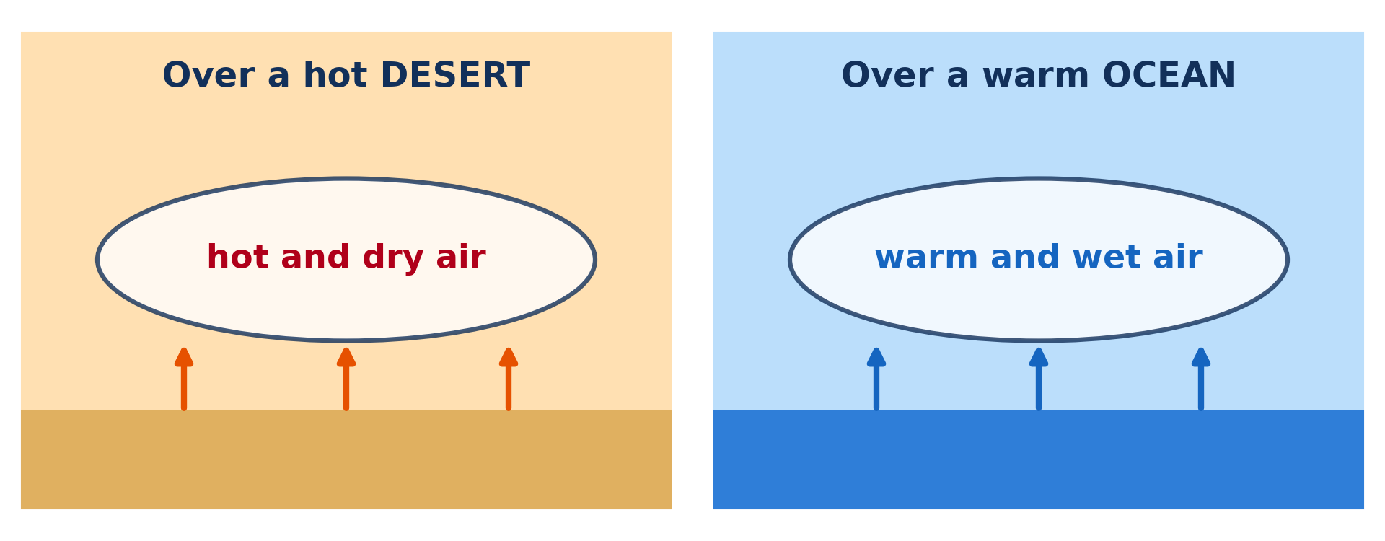
1. MEANING AND DEVELOPMENT
Activity 1
An air mass takes the properties of its source region.
Notes:
Activity 1. Look carefully at this diagram: an air mass takes the properties of its source region. Observe every detail before I ask the question.

Slide 19
1. MEANING AND DEVELOPMENT
Activity 1: Question
Air stays for weeks over a hot desert. What will it be like?
Notes:
Here is the question for Activity 1: Air stays for weeks over a hot desert. What will it be like? Take one minute to think and write your answer in your rough notebook.

Slide 20
1. MEANING AND DEVELOPMENT
Activity 1: Answer
Hot and dry.
Notes:
Let us check the answer together. Hot and dry.

Slide 21
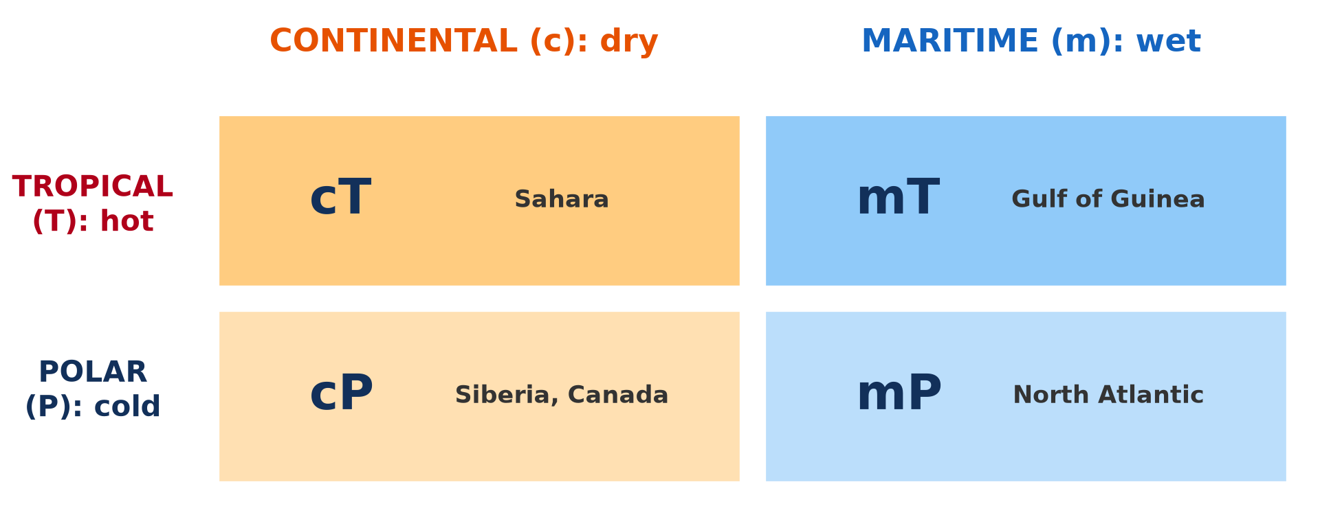
2. CLASSIFICATION
Activity 2
The four main air masses.
Notes:
Activity 2. Look carefully at this diagram: the four main air masses. Observe every detail before I ask the question.

Slide 22
2. CLASSIFICATION
Activity 2: Question
What do the letters c, m, T and P mean?
Notes:
Here is the question for Activity 2: What do the letters c, m, T and P mean? Take one minute to think and write your answer in your rough notebook.

Slide 23
2. CLASSIFICATION
Activity 2: Answer
c = continental (dry), m = maritime (wet), T = tropical (hot), P = polar (cold).
Notes:
Let us check the answer together. c = continental (dry), m = maritime (wet), T = tropical (hot), P = polar (cold).

Slide 24
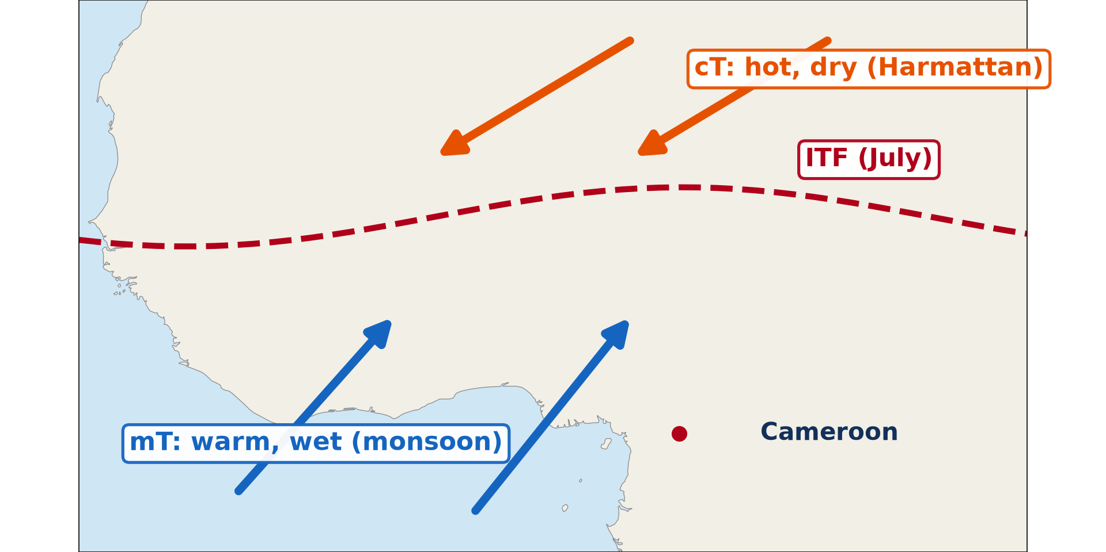
3. AIR MASSES OF CAMEROON
Activity 3
The air masses of West Africa in July.
Notes:
Activity 3. Look carefully at this diagram: the air masses of West Africa in July. Observe every detail before I ask the question.

Slide 25
3. AIR MASSES OF CAMEROON
Activity 3: Question
Which air mass brings rain to Cameroon? Which brings the Harmattan?
Notes:
Here is the question for Activity 3: Which air mass brings rain to Cameroon? Which brings the Harmattan? Take one minute to think and write your answer in your rough notebook.

Slide 26
3. AIR MASSES OF CAMEROON
Activity 3: Answer
The mT (from the Gulf of Guinea) brings rain; the cT (from the Sahara) brings the Harmattan.
Notes:
Let us check the answer together. The mT (from the Gulf of Guinea) brings rain; the cT (from the Sahara) brings the Harmattan.

Slide 27

3. CONTINENTAL TROPICAL AIR (cT)
Activity 4
Dust carried by the continental tropical air.
Notes:
Activity 4. Look carefully at this picture: dust carried by the continental tropical air. Observe every detail before I ask the question.

Slide 28
3. CONTINENTAL TROPICAL AIR (cT)
Activity 4: Question
Describe the weather of the cT air mass.
Notes:
Here is the question for Activity 4: Describe the weather of the cT air mass. Take one minute to think and write your answer in your rough notebook.

Slide 29
3. CONTINENTAL TROPICAL AIR (cT)
Activity 4: Answer
Dry, dusty, hot by day and cool at night.
Notes:
Let us check the answer together. Dry, dusty, hot by day and cool at night.

Slide 30

3. MARITIME TROPICAL AIR (mT)
Activity 5
Heavy rain in the rainy season.
Notes:
Activity 5. Look carefully at this picture: heavy rain in the rainy season. Observe every detail before I ask the question.

Slide 31
3. MARITIME TROPICAL AIR (mT)
Activity 5: Question
Describe the weather of the mT air mass.
Notes:
Here is the question for Activity 5: Describe the weather of the mT air mass. Take one minute to think and write your answer in your rough notebook.

Slide 32
3. MARITIME TROPICAL AIR (mT)
Activity 5: Answer
Warm, humid, with clouds and heavy rain.
Notes:
Let us check the answer together. Warm, humid, with clouds and heavy rain.

Slide 33
BOARD SUMMARY
Board Summary
Topic: Climates
Sub-topic: Air Masses and Effects on Climate
Lesson 18: Air Masses
Notes:
Now we are going to copy the board summary. Write the title and the headings neatly in your notebooks. I will give you enough time for each slide, so do not rush.

Slide 34
BOARD SUMMARY
DEFINITIONS
The key terms of this lesson are defined as follows:
Air mass: It is a large body of air, thousands of kilometres wide, with the same temperature and humidity at each level.
Notes:
Let us copy the definitions. The key terms of this lesson are defined as follows. On this slide we have Air mass. Write each point on a new line, with the key term first, and explain it in your own words when we revise. When you finish, we go to the next slide.

Slide 35
BOARD SUMMARY
DEFINITIONS (continued)
Front: It is the boundary between two air masses of different temperature and humidity.
ITCZ (ITF): It is the zone where the tropical air masses of the two hemispheres meet.
Notes:
We continue with the definitions. On this slide we have Front and ITCZ (ITF). Write each point on a new line, with the key term first, and explain it in your own words when we revise.

Slide 36
BOARD SUMMARY
1. Characteristics and Development
Air masses acquire their characteristics as follows:
Source regions: An air mass forms over a large, flat and uniform area such as an ocean, a desert or an ice sheet. It stays there for days or weeks.
Notes:
Let us copy Characteristics and Development. Air masses acquire their characteristics as follows. On this slide we have Source regions. Write each point on a new line, with the key term first, and explain it in your own words when we revise. When you finish, we go to the next slide.

Slide 37
BOARD SUMMARY
1. Characteristics and Development (continued)
Development: The air takes the temperature and humidity of the surface below. Air over the Sahara becomes hot and dry, while air over the Atlantic becomes warm and moist.
Modification: When an air mass moves, it is changed by the surfaces it crosses. It can become cooler, warmer, wetter or drier.
Notes:
We continue with Characteristics and Development. On this slide we have Development and Modification. Write each point on a new line, with the key term first, and explain it in your own words when we revise.

Slide 38
BOARD SUMMARY
1. Characteristics and Development
Illustration: source regions of air masses
Notes:
Now draw this illustration in your notebook: source regions of air masses. Give it a title and label it clearly.

Slide 39
BOARD SUMMARY
2. Classification and Examples
Air masses are classified by their source region:
By temperature: T (tropical) air is warm and P (polar) air is cold. A (arctic) air is very cold.
Notes:
Let us copy Classification and Examples. Air masses are classified by their source region. On this slide we have By temperature. Write each point on a new line, with the key term first, and explain it in your own words when we revise. When you finish, we go to the next slide.

Slide 40
BOARD SUMMARY
2. Classification and Examples (continued)
By humidity: m (maritime) air comes from oceans and is moist, while c (continental) air comes from land and is dry. Examples are mT, cT, mP and cP.
Notes:
We continue with Classification and Examples. On this slide we have By humidity. Write each point on a new line, with the key term first, and explain it in your own words when we revise.

Slide 41
BOARD SUMMARY
2. Classification and Examples
Illustration: classification of air masses
Notes:
Now draw this illustration in your notebook: classification of air masses. Give it a title and label it clearly.

Slide 42
BOARD SUMMARY
3. Air Masses of Cameroon and West Africa
Two air masses control the climate of Cameroon:
Maritime tropical (mT) air: It comes from the St Helena high over the South Atlantic and blows as the south-west monsoon. It is warm and moist and brings the rainy season.
Notes:
Let us copy Air Masses of Cameroon and West Africa. Two air masses control the climate of Cameroon. On this slide we have Maritime tropical (mT) air. Write each point on a new line, with the key term first, and explain it in your own words when we revise. When you finish, we go to the next slide.

Slide 43
BOARD SUMMARY
3. Air Masses of Cameroon and West Africa (continued)
Continental tropical (cT) air: It comes from the Saharan high and blows as the Harmattan. It is dry and dusty and brings the dry season.
Notes:
We continue with Air Masses of Cameroon and West Africa. On this slide we have Continental tropical (cT) air. Write each point on a new line, with the key term first, and explain it in your own words when we revise. When you finish, we go to the next slide.

Slide 44
BOARD SUMMARY
3. Air Masses of Cameroon and West Africa (continued)
Movement: The two meet at the Inter-Tropical Front, which moves north to about 20° N in July and south to about 5° N in January. This movement explains the seasons of Cameroon.
Notes:
We continue with Air Masses of Cameroon and West Africa. On this slide we have Movement. Write each point on a new line, with the key term first, and explain it in your own words when we revise.

Slide 45
BOARD SUMMARY
3. Air Masses of Cameroon and West Africa
Illustration: air masses of West Africa
Notes:
Now draw this illustration in your notebook: air masses of West Africa. Give it a title and label it clearly.

Slide 46
FORMATIVE EVALUATION
Evaluation 1
What is an air mass?
Notes:
Now let us check what you have understood. Question 1: What is an air mass? Answer in your exercise book.

Slide 47
FORMATIVE EVALUATION
Expected Answer
A large body of air with the same temperature and humidity.
Notes:
The expected answer is: a large body of air with the same temperature and humidity. If you got it right, well done.

Slide 48
FORMATIVE EVALUATION
Evaluation 2
Name the two air masses of Cameroon and their weather.
Notes:
Now let us check what you have understood. Question 2: Name the two air masses of Cameroon and their weather. Answer in your exercise book.

Slide 49
FORMATIVE EVALUATION
Expected Answer
mT: warm, humid, rain; cT: hot, dry, dusty.
Notes:
The expected answer is: mT: warm, humid, rain; cT: hot, dry, dusty. If you got it right, well done.

Slide 50
REMEDIATION
Remediation
Fill in the blanks:
An air mass from the sea is ______.
The Harmattan comes with the ______ air mass.
The boundary between two air masses is a ______.
Notes:
For those who need more practice, fill in the blanks in your exercise book. The answers are: number 1, maritime; number 2, cT (tropical continental); number 3, front.

Slide 51
HOMEWORK
Homework
Draw West Africa and show the mT, cT and the ITF in January and in July.
Notes:
For your homework: Draw West Africa and show the mT, cT and the ITF in January and in July. We shall correct it at the beginning of our next lesson.

Slide 52
NEXT LESSON
Next Lesson
Our next lesson will be on:
Lesson 19: Meaning of Climate and Köppen's Classification
Notes:
Our next lesson will be on Lesson 19: Meaning of Climate and Köppen's Classification. Thank you for your attention, and see you next time.

Slide 53
BILINGUAL GAME
Bilingual Game (Jeu Bilingue)
English | Français
Air mass | La masse d'air
Source region | La région source
Front | Le front
Maritime | Maritime
Continental | Continental
Humid | Humide
Notes:
Let us play the bilingual game. I say a word in English, and you give me the French word. Then we do the reverse.

Slide 54
LOGBOOK
Official Logbook (1/2)
Module / Topic | Climates
Lesson Title | Lesson 18: Air Masses
Expected Learning Outcomes | Define an air mass and a source region. Classify air masses (cT, mT, cP, mP). Explain the air masses that affect Cameroon.
Competence | Learners are able to classify air masses and explain their effect on the climate of Cameroon.
Notes:
I record this information in the official logbook of the class after the lesson.

Slide 55
LOGBOOK
Official Logbook (2/2)
Matter Taught | DEFINITIONS; Characteristics and Development; Classification and Examples; Air Masses of Cameroon and West Africa.
Evaluation | Formative evaluation and remediation exercise.
Homework | Draw West Africa and show the mT, cT and the ITF in January and in July.
Enrolment / Present / Absent | ____ / ____ / ____
Achievement | To be completed after the lesson.
Notes:
I complete the second page of the logbook: the matter taught, the evaluation, the homework and the attendance.

Slide 56
TEACHER'S NOTE
Teacher's Note
Timing: Homework correction, plan, objectives 8 min | Recall, situation, action 10 min | 5 activities 30 min | Board summary (copying) 30 min | Evaluation, remediation 10 min | Homework, next lesson 5 min | Logbook 7 min
Without the projector (Activity 1): describe air over the Sahara and over the sea.
Without the projector (Activity 2): draw the table.
Without the projector (Activity 3): draw the ITF across West Africa.
Without the projector (Activity 4): describe the dry season.
Without the projector (Activity 5): describe the rainy season.
Notes:
This slide is for me, the teacher: it gives the timing of the lesson and what to do if the projector is not available.

Slide 57
REFERENCES
References
National Geography Syllabus, MINESEC/IGE/IP-SS, 2019 — Module 1 (Meteorology, Climatology & Hydrology).
Photo, Activity 4: “Bamenda sob a poeira do Harmattan” by carlosoliveirareis, CC BY-NC-SA 2.0, via Flickr (https://www.flickr.com/photos/54218923@N00/387054136)
Photo, Activity 5: “Heavy rain. Johannesburg, South Africa” by varfolomeev, CC BY-NC 2.0, via Flickr (https://www.flickr.com/photos/45427632@N02/49745935146)
Diagrams and animations: drawn for this lesson (Geography Department).
Notes:
These are the references and picture credits used to prepare this lesson.

