Slide 1
LOWER SIXTH ARTS
GEOGRAPHY
Lesson 20
Micro-climates
Notes:
Good morning, class, and welcome to our geography lesson. I am your geography teacher, Mr Kamdem. Today we are starting Lesson 20: Micro-climates.

Slide 2
CLASS INFO
Class, Chapter and Duration
Class | Lower Sixth Arts
Chapter | Module 1: Understanding and managing atmospheric and hydrological phenomena and hazards across the world in general and Cameroon in particular
Duration | 2 periods (2 × 50 minutes)
Notes:
This lesson is for Lower Sixth Arts. It belongs to Module 1: Understanding and managing atmospheric and hydrological phenomena and hazards across the world in general and Cameroon in particular. We shall need 2 periods to cover it.

Slide 3
IDENTIFICATION
Lesson Identification
Topic | Climates
Sub-topic | Concept of Micro-climate
Lesson | Lesson 20: Micro-climates
Notions / Concepts | Micro-climate, urban climate, heat island, lakeside climate, forest climate.
Syllabus focus | Meaning and classification of micro-climates; characteristics and factors of urban climates.
Competence | Learners are able to describe micro-climates and explain the climate of towns.
Notes:
Our topic is Climates, and the sub-topic is Concept of Micro-climate. The key notions we shall use today are: micro-climate, urban climate, heat island, lakeside climate, forest climate. At the end, you should be able to do this: learners are able to describe micro-climates and explain the climate of towns.

Slide 4

HOMEWORK CORRECTION
Correction of the Homework
Question (Further Study 1: Tropical Weather Disturbances):
Write five safety rules for a thunderstorm in your area.
Notes:
Before we start the new lesson, let us correct the homework I gave you at the end of Further Study 1: Tropical Weather Disturbances. The question was: Write five safety rules for a thunderstorm in your area. Take out your exercise books.

Slide 5
HOMEWORK CORRECTION
Correction: Possible Answer
Stay indoors or in a car; do not shelter under a lone tree; keep away from metal fences and water; unplug electrical appliances; do not use a phone connected to the wall; wait 30 minutes after the last thunder before going out.
Notes:
Here is a good answer. Stay indoors or in a car; do not shelter under a lone tree; keep away from metal fences and water; unplug electrical appliances; do not use a phone connected to the wall; wait 30 minutes after the last thunder before going out. Compare it with your own answer and correct your work in red.

Slide 6
LESSON PLAN
Lesson Plan
Correction of the homework
Objectives and recall
Real-life situation and action to take
Learning activities
Board summary
Evaluation, remediation and homework
Notes:
Here is the plan of our lesson today. First, we shall correct the homework. Then we shall look at the objectives and recall what you already know. After that, we shall study a situation from real life and the action to take, and do the learning activities. Finally, we shall copy the board summary, do the evaluation and the remediation, and I will give you the homework.

Slide 7
OBJECTIVES
Objectives
By the end of this lesson, you should be able to:
Define micro-climate.
Classify micro-climates (urban, mountain, lakeside, forest).
Notes:
Take your time to copy this part; we will continue together.

Slide 8
OBJECTIVES
Objectives (continued)
Explain the characteristics and factors of urban climates.
Notes:
By the end of this lesson, you should be able to do three things. Number 1: define micro-climate. Number 2: classify micro-climates (urban, mountain, lakeside, forest). Number 3: explain the characteristics and factors of urban climates.

Slide 9
PREVIOUS KNOWLEDGE
Previous Knowledge
Towns are warmer than the countryside.
Sea breezes cool coastal towns.
Notes:
Let us first remember what you already know. Towns are warmer than the countryside. Sea breezes cool coastal towns. Keep this in mind, because we shall build on it today.

Slide 10
REAL-LIFE SITUATION
Situation in Real Life
In Yaoundé, it feels hotter in the city centre at Poste Centrale than in the forest at Mefou. On the shores of the Lagdo Lake, people say the air is cooler in the afternoon.
Notes:
Listen carefully to this situation from real life. In Yaoundé, it feels hotter in the city centre at Poste Centrale than in the forest at Mefou. On the shores of the Lagdo Lake, people say the air is cooler in the afternoon. Think about it, because I am going to ask you some questions.

Slide 11
REAL-LIFE SITUATION
Situation: Question 1
What is the problem in the situation?
Notes:
Question 1: What is the problem in the situation? Think for a moment, then raise your hand to answer.

Slide 12
REAL-LIFE SITUATION
Answer
The climate changes over short distances.
Notes:
Good. The climate changes over short distances.

Slide 13
REAL-LIFE SITUATION
Situation: Question 2
What do we call the climate of a small area?
Notes:
Question 2: What do we call the climate of a small area? Think for a moment, then raise your hand to answer.

Slide 14
REAL-LIFE SITUATION
Answer
A micro-climate.
Notes:
Good. A micro-climate.

Slide 15
REAL-LIFE SITUATION
Situation: Question 3
Why is the city centre hotter?
Notes:
Question 3: Why is the city centre hotter? Think for a moment, then raise your hand to answer.

Slide 16
REAL-LIFE SITUATION
Possible Answer
Buildings and tar store heat, and there are few trees.
Notes:
Good. Buildings and tar store heat, and there are few trees.

Slide 17
ACTION TO TAKE
Action to Take
Improve the climate of our towns by planting trees and creating green spaces.
Notes:
From this situation, the action we are working towards in this lesson is the following: improve the climate of our towns by planting trees and creating green spaces.

Slide 18
JUSTIFICATION
Justification of the Lesson
This lesson helps us to understand the climate of the small places where we live, especially towns.
Notes:
Why is this lesson important for you? This lesson helps us to understand the climate of the small places where we live, especially towns.

Slide 19

1. MEANING AND CLASSIFICATION
Activity 1
The centre of Yaoundé.
Notes:
Activity 1. Look carefully at this picture: the centre of Yaoundé. Observe every detail before I ask the question.

Slide 20
1. MEANING AND CLASSIFICATION
Activity 1: Question
Why is the climate of a city centre different from the countryside?
Notes:
Here is the question for Activity 1: Why is the climate of a city centre different from the countryside? Take one minute to think and write your answer in your rough notebook.

Slide 21
1. MEANING AND CLASSIFICATION
Activity 1: Answer
Buildings, roads and traffic change heat, wind and humidity.
Notes:
Let us check the answer together. Buildings, roads and traffic change heat, wind and humidity.

Slide 22
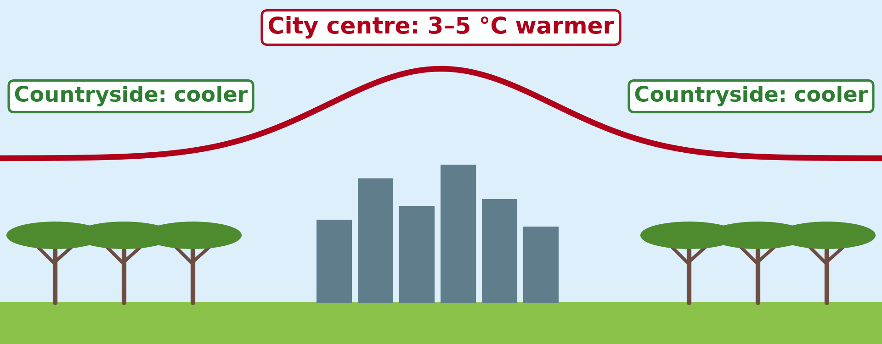
2. URBAN CLIMATE: HEAT ISLAND
Activity 2
The urban heat island.
Notes:
Activity 2. Look carefully at this diagram: the urban heat island. Observe every detail before I ask the question.

Slide 23
2. URBAN CLIMATE: HEAT ISLAND
Activity 2: Question
How much warmer can a city centre be?
Notes:
Here is the question for Activity 2: How much warmer can a city centre be? Take one minute to think and write your answer in your rough notebook.

Slide 24
2. URBAN CLIMATE: HEAT ISLAND
Activity 2: Answer
About 3 to 5 °C warmer, especially at night.
Notes:
Let us check the answer together. About 3 to 5 °C warmer, especially at night.

Slide 25

2. URBAN CLIMATE: OTHER FEATURES
Activity 3
Douala seen from above.
Notes:
Activity 3. Look carefully at this picture: douala seen from above. Observe every detail before I ask the question.

Slide 26
2. URBAN CLIMATE: OTHER FEATURES
Activity 3: Question
Give two other features of urban climates.
Notes:
Here is the question for Activity 3: Give two other features of urban climates. Take one minute to think and write your answer in your rough notebook.

Slide 27
2. URBAN CLIMATE: OTHER FEATURES
Activity 3: Answer
More haze and pollution, weaker winds, sometimes more storms.
Notes:
Let us check the answer together. More haze and pollution, weaker winds, sometimes more storms.

Slide 28
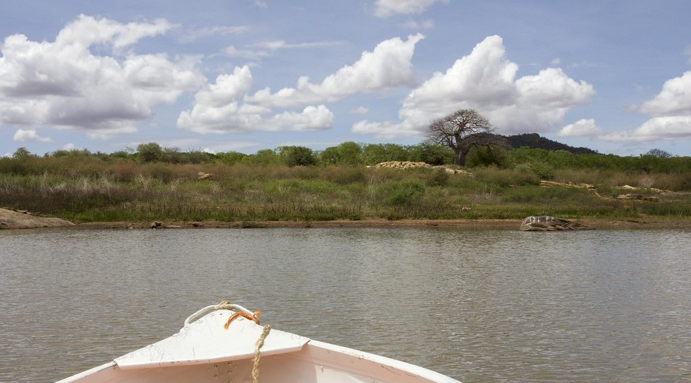
3. LAKESIDE CLIMATE
Activity 4
Lake Kamburu, Kenya.
Notes:
Activity 4. Look carefully at this picture: lake Kamburu, Kenya. Observe every detail before I ask the question.

Slide 29
3. LAKESIDE CLIMATE
Activity 4: Question
Why is it cooler near a lake in the afternoon?
Notes:
Here is the question for Activity 4: Why is it cooler near a lake in the afternoon? Take one minute to think and write your answer in your rough notebook.

Slide 30
3. LAKESIDE CLIMATE
Activity 4: Answer
The lake stays cooler than the land and gives a lake breeze.
Notes:
Let us check the answer together. The lake stays cooler than the land and gives a lake breeze.

Slide 31

3. FOREST CLIMATE
Activity 5
Inside an equatorial forest.
Notes:
Activity 5. Look carefully at this picture: inside an equatorial forest. Observe every detail before I ask the question.

Slide 32
3. FOREST CLIMATE
Activity 5: Question
How is the climate inside a forest different?
Notes:
Here is the question for Activity 5: How is the climate inside a forest different? Take one minute to think and write your answer in your rough notebook.

Slide 33
3. FOREST CLIMATE
Activity 5: Answer
It is shady, cooler by day, more humid and calm.
Notes:
Let us check the answer together. It is shady, cooler by day, more humid and calm.

Slide 34
BOARD SUMMARY
Board Summary
Topic: Climates
Sub-topic: Concept of Micro-climate
Lesson 20: Micro-climates
Notes:
Now we are going to copy the board summary. Write the title and the headings neatly in your notebooks. I will give you enough time for each slide, so do not rush.

Slide 35
BOARD SUMMARY
1. Meaning and Classification of Micro-climates
Micro-climates can be understood as follows:
Micro-climate: It is the climate of a small area, such as a town, a forest or a lakeside, which differs from the climate around it.
Notes:
Let us copy Meaning and Classification of Micro-climates. Micro-climates can be understood as follows. On this slide we have Micro-climate. Write each point on a new line, with the key term first, and explain it in your own words when we revise. When you finish, we go to the next slide.

Slide 36
BOARD SUMMARY
1. Meaning and Classification of Micro-climates (continued)
Meso-climate: It is the climate of a medium-sized area, such as a valley or a mountain range.
Classification: Micro-climates include urban, mountain, lakeside and forest climates. They are caused by local surfaces and relief.
Notes:
We continue with Meaning and Classification of Micro-climates. On this slide we have Meso-climate and Classification. Write each point on a new line, with the key term first, and explain it in your own words when we revise.

Slide 37
BOARD SUMMARY
2. Urban Climates
The characteristics of urban climates are:
Higher temperatures: Towns are warmer than the countryside, especially at night; this is the urban heat island. The difference can reach 2–10 °C.
Notes:
Let us copy Urban Climates. The characteristics of urban climates are. On this slide we have Higher temperatures. Write each point on a new line, with the key term first, and explain it in your own words when we revise. When you finish, we go to the next slide.

Slide 38
BOARD SUMMARY
2. Urban Climates (continued)
Humidity and rain: Relative humidity is lower because there are few plants and water drains away quickly. Convectional storms can be more frequent.
Notes:
We continue with Urban Climates. On this slide we have Humidity and rain. Write each point on a new line, with the key term first, and explain it in your own words when we revise. When you finish, we go to the next slide.

Slide 39
BOARD SUMMARY
2. Urban Climates (continued)
Winds and pollution: Buildings slow the wind but create strong gusts between tall buildings. Smoke and dust give more fog and smog.
Notes:
We continue with Urban Climates. On this slide we have Winds and pollution. Write each point on a new line, with the key term first, and explain it in your own words when we revise.

Slide 40
BOARD SUMMARY
2. Urban Climates
Illustration: the urban heat island
Notes:
Now draw this illustration in your notebook: the urban heat island. Give it a title and label it clearly.

Slide 41
BOARD SUMMARY
2. Urban Climates
Factors of Urban Climates
Urban climates are caused by the following factors:
Building materials: Concrete, tar and iron sheets absorb heat by day and release it at night. Their low albedo increases heating.
Notes:
Let us copy Factors of Urban Climates. Urban climates are caused by the following factors. On this slide we have Building materials. Write each point on a new line, with the key term first, and explain it in your own words when we revise. When you finish, we go to the next slide.

Slide 42
BOARD SUMMARY
2. Urban Climates
Factors of Urban Climates (continued)
Human activities: Cars, factories and air conditioners produce heat and pollution. Pollution traps heat and adds condensation nuclei.
Notes:
We continue with Factors of Urban Climates. On this slide we have Human activities. Write each point on a new line, with the key term first, and explain it in your own words when we revise. When you finish, we go to the next slide.

Slide 43
BOARD SUMMARY
2. Urban Climates
Factors of Urban Climates (continued)
Lack of vegetation and water: There is little evapotranspiration to cool the air. Drains remove rainwater quickly.
Notes:
We continue with Factors of Urban Climates. On this slide we have Lack of vegetation and water. Write each point on a new line, with the key term first, and explain it in your own words when we revise.

Slide 44
BOARD SUMMARY
3. Lakeside and Forest Climates
Other micro-climates include:
Lakeside climate: Lakes heat and cool slowly, so lakeside areas have smaller temperature ranges and lake breezes. Humidity and fog are higher, as around Lake Chad.
Notes:
Let us copy Lakeside and Forest Climates. Other micro-climates include. On this slide we have Lakeside climate. Write each point on a new line, with the key term first, and explain it in your own words when we revise. When you finish, we go to the next slide.

Slide 45
BOARD SUMMARY
3. Lakeside and Forest Climates (continued)
Forest climate: Under the forest canopy it is cooler, darker and more humid than outside. The wind is weak and the daily range is small.
Notes:
We continue with Lakeside and Forest Climates. On this slide we have Forest climate. Write each point on a new line, with the key term first, and explain it in your own words when we revise.

Slide 46
FORMATIVE EVALUATION
Evaluation 1
What is a micro-climate?
Notes:
Now let us check what you have understood. Question 1: What is a micro-climate? Answer in your exercise book.

Slide 47
FORMATIVE EVALUATION
Expected Answer
The climate of a small area that differs from the area around it.
Notes:
The expected answer is: the climate of a small area that differs from the area around it. If you got it right, well done.

Slide 48
FORMATIVE EVALUATION
Evaluation 2
Give three characteristics of urban climate.
Notes:
Now let us check what you have understood. Question 2: Give three characteristics of urban climate. Answer in your exercise book.

Slide 49
FORMATIVE EVALUATION
Expected Answer
Warmer (heat island), more pollution, weaker winds (sometimes more storms).
Notes:
The expected answer is: warmer (heat island), more pollution, weaker winds (sometimes more storms). If you got it right, well done.

Slide 50
REMEDIATION
Remediation
Fill in the blanks:
The climate of a small area is a ______.
Towns are warmer because of the urban ______.
Forests are cooler and more ______.
Notes:
For those who need more practice, fill in the blanks in your exercise book. The answers are: number 1, micro-climate; number 2, heat island; number 3, humid.

Slide 51
HOMEWORK
Homework
Measure the temperature at noon in a sunny yard and under a tree. Explain the difference.
Notes:
For your homework: Measure the temperature at noon in a sunny yard and under a tree. Explain the difference. We shall correct it at the beginning of our next lesson.

Slide 52
NEXT LESSON
Next Lesson
Our next lesson will be on:
Lesson 21: Mountain Climates
Notes:
Our next lesson will be on Lesson 21: Mountain Climates. Thank you for your attention, and see you next time.

Slide 53
BILINGUAL GAME
Bilingual Game (Jeu Bilingue)
English | Français
Micro-climate | Le microclimat
Town | La ville
Heat island | Îlot de chaleur urbain
Pollution | La pollution
Lake | Le lac
Shade | L'ombre
Notes:
Let us play the bilingual game. I say a word in English, and you give me the French word. Then we do the reverse.

Slide 54
LOGBOOK
Official Logbook (1/2)
Module / Topic | Climates
Lesson Title | Lesson 20: Micro-climates
Expected Learning Outcomes | Define micro-climate. Classify micro-climates (urban, mountain, lakeside, forest). Explain the characteristics and factors of urban climates.
Competence | Learners are able to describe micro-climates and explain the climate of towns.
Notes:
I record this information in the official logbook of the class after the lesson.

Slide 55
LOGBOOK
Official Logbook (2/2)
Matter Taught | Meaning and Classification of Micro-climates; Urban Climates; Factors of Urban Climates; Lakeside and Forest Climates.
Evaluation | Formative evaluation and remediation exercise.
Homework | Measure the temperature at noon in a sunny yard and under a tree. Explain the difference.
Enrolment / Present / Absent | ____ / ____ / ____
Achievement | To be completed after the lesson.
Notes:
I complete the second page of the logbook: the matter taught, the evaluation, the homework and the attendance.

Slide 56
TEACHER'S NOTE
Teacher's Note
Timing: Homework correction, plan, objectives 8 min | Recall, situation, action 10 min | 5 activities 30 min | Board summary (copying) 30 min | Evaluation, remediation 10 min | Homework, next lesson 5 min | Logbook 7 min
Without the projector (Activity 1): compare the town centre and a village.
Without the projector (Activity 2): draw the heat dome over a town.
Without the projector (Activity 3): describe traffic smoke.
Without the projector (Activity 4): mention the Lagdo Lake.
Without the projector (Activity 5): describe walking into a forest.
Notes:
This slide is for me, the teacher: it gives the timing of the lesson and what to do if the projector is not available.

Slide 57
REFERENCES
References
National Geography Syllabus, MINESEC/IGE/IP-SS, 2019 — Module 1 (Meteorology, Climatology & Hydrology).
Photo, Activity 1: “Yaoundé” by wili_hybrid, CC BY-NC 2.0, via Flickr (https://www.flickr.com/photos/62223880@N00/5677034246)
Photo, Activity 3: “Douala” by christing-O-, CC BY 2.0, via Flickr (https://www.flickr.com/photos/76187282@N00/7227535754)
Photo, Activity 4: “Lake Kamburu” by World Bank Photo Collection, CC BY-NC-ND 2.0, via Flickr (https://www.flickr.com/photos/10816734@N03/25644146245)
Photo, Activity 5: “Amazon 11” by CIAT International Center for Tropical Agriculture, CC BY-SA 2.0, via Flickr (https://www.flickr.com/photos/38476503@N08/5641587148)
Diagrams and animations: drawn for this lesson (Geography Department).
Notes:
These are the references and picture credits used to prepare this lesson.

