Slide 1
LOWER SIXTH ARTS
GEOGRAPHY
Further Study 2
Weather Observation, Prediction, Modification and Mapping
Notes:
Good morning, class, and welcome to our geography lesson. I am your geography teacher, Mr Kamdem. Today we are starting Further Study 2: Weather Observation, Prediction, Modification and Mapping.

Slide 2
CLASS INFO
Class, Chapter and Duration
Class | Lower Sixth Arts
Chapter | Module 1: Understanding and managing atmospheric and hydrological phenomena and hazards across the world in general and Cameroon in particular
Duration | 2 periods (2 × 50 minutes)
Notes:
This lesson is for Lower Sixth Arts. It belongs to Module 1: Understanding and managing atmospheric and hydrological phenomena and hazards across the world in general and Cameroon in particular. We shall need 2 periods to cover it.

Slide 3
IDENTIFICATION
Lesson Identification
Topic | Climates
Sub-topic | Weather Observation
Lesson | Further Study 2: Weather Observation, Prediction, Modification and Mapping
Notions / Concepts | Weather station, radiosonde, Doppler radar, weather satellite, cloud seeding, synoptic chart, isobar.
Syllabus focus | Weather observation and instruments; forecasting; weather modification; synoptic charts.
Competence | Learners are able to explain how weather is observed, forecast, modified and mapped.
Notes:
Our topic is Climates, and the sub-topic is Weather Observation. The key notions we shall use today are: weather station, radiosonde, Doppler radar, weather satellite, cloud seeding, synoptic chart, isobar. At the end, you should be able to do this: learners are able to explain how weather is observed, forecast, modified and mapped.

Slide 4

HOMEWORK CORRECTION
Correction of the Homework
Question (Lesson 21: Mountain Climates):
Compare the climate of Buea and Douala and explain two differences.
Notes:
Before we start the new lesson, let us correct the homework I gave you at the end of Lesson 21: Mountain Climates. The question was: Compare the climate of Buea and Douala and explain two differences. Take out your exercise books.

Slide 5
HOMEWORK CORRECTION
Correction: Possible Answer
Buea (about 900 m) is cooler than Douala (sea level) because temperature falls with height. Buea is also often misty and cloudy, while Douala is hotter and more humid.
Notes:
Here is a good answer. Buea (about 900 m) is cooler than Douala (sea level) because temperature falls with height. Buea is also often misty and cloudy, while Douala is hotter and more humid. Compare it with your own answer and correct your work in red.

Slide 6
LESSON PLAN
Lesson Plan
Correction of the homework
Objectives and recall
Real-life situation and action to take
Learning activities
Board summary
Evaluation, remediation and homework
Notes:
Here is the plan of our lesson today. First, we shall correct the homework. Then we shall look at the objectives and recall what you already know. After that, we shall study a situation from real life and the action to take, and do the learning activities. Finally, we shall copy the board summary, do the evaluation and the remediation, and I will give you the homework.

Slide 7
OBJECTIVES
Objectives
By the end of this lesson, you should be able to:
Name weather instruments and what they measure.
Explain modern tools of observation (radiosonde, radar, satellite).
Notes:
Take your time to copy this part; we will continue together.

Slide 8
OBJECTIVES
Objectives (continued)
Explain weather modification and read a simple synoptic chart.
Notes:
By the end of this lesson, you should be able to do three things. Number 1: name weather instruments and what they measure. Number 2: explain modern tools of observation (radiosonde, radar, satellite). Number 3: explain weather modification and read a simple synoptic chart.

Slide 9
PREVIOUS KNOWLEDGE
Previous Knowledge
Weather elements: temperature, rain, wind, pressure, humidity.
Low pressure brings rain.
Notes:
Let us first remember what you already know. Weather elements: temperature, rain, wind, pressure, humidity. Low pressure brings rain. Keep this in mind, because we shall build on it today.

Slide 10
REAL-LIFE SITUATION
Situation in Real Life
Before a football match in Garoua, the organisers listen to the weather forecast. The forecast says that storms are likely in the afternoon, so they move the match to the morning.
Notes:
Listen carefully to this situation from real life. Before a football match in Garoua, the organisers listen to the weather forecast. The forecast says that storms are likely in the afternoon, so they move the match to the morning. Think about it, because I am going to ask you some questions.

Slide 11
REAL-LIFE SITUATION
Situation: Question 1
What is the problem in the situation?
Notes:
Question 1: What is the problem in the situation? Think for a moment, then raise your hand to answer.

Slide 12
REAL-LIFE SITUATION
Answer
People need to know the weather in advance.
Notes:
Good. People need to know the weather in advance.

Slide 13
REAL-LIFE SITUATION
Situation: Question 2
How do forecasters know the weather will change?
Notes:
Question 2: How do forecasters know the weather will change? Think for a moment, then raise your hand to answer.

Slide 14
REAL-LIFE SITUATION
Answer
They use observations, radar, satellites and charts.
Notes:
Good. They use observations, radar, satellites and charts.

Slide 15
REAL-LIFE SITUATION
Situation: Question 3
Can people change the weather?
Notes:
Question 3: Can people change the weather? Think for a moment, then raise your hand to answer.

Slide 16
REAL-LIFE SITUATION
Possible Answer
A little, for example by cloud seeding.
Notes:
Good. A little, for example by cloud seeding.

Slide 17
ACTION TO TAKE
Action to Take
Use weather forecasts to plan farming, travel and safety.
Notes:
From this situation, the action we are working towards in this lesson is the following: use weather forecasts to plan farming, travel and safety.

Slide 18
JUSTIFICATION
Justification of the Lesson
This lesson helps us to understand how weather forecasts are made and used.
Notes:
Why is this lesson important for you? This lesson helps us to understand how weather forecasts are made and used.

Slide 19

1. WEATHER OBSERVATION: INSTRUMENTS
Activity 1
Basic weather instruments.
Notes:
Activity 1. Look carefully at this diagram: basic weather instruments. Observe every detail before I ask the question.

Slide 20
1. WEATHER OBSERVATION: INSTRUMENTS
Activity 1: Question
Which instrument measures rain? Which measures pressure?
Notes:
Here is the question for Activity 1: Which instrument measures rain? Which measures pressure? Take one minute to think and write your answer in your rough notebook.

Slide 21
1. WEATHER OBSERVATION: INSTRUMENTS
Activity 1: Answer
Rain gauge; barometer.
Notes:
Let us check the answer together. Rain gauge; barometer.

Slide 22
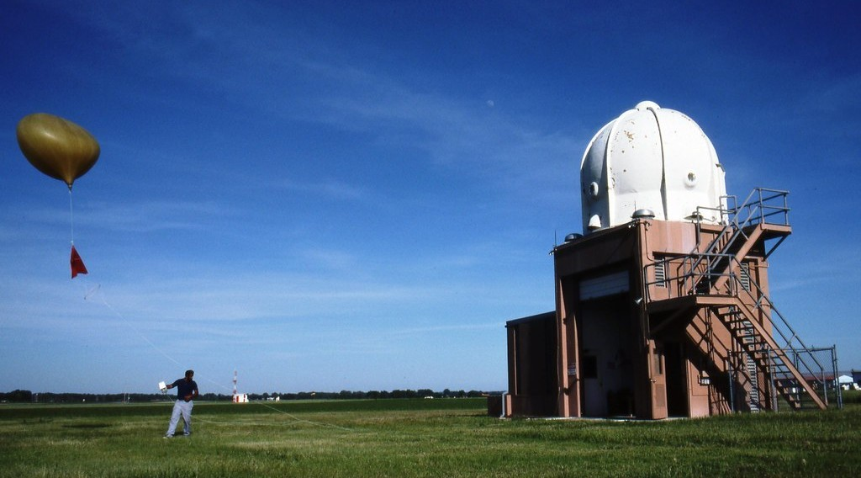
1. WEATHER OBSERVATION: RADIOSONDE
Activity 2
Launching a weather balloon with a radiosonde.
Notes:
Activity 2. Look carefully at this picture: launching a weather balloon with a radiosonde. Observe every detail before I ask the question.

Slide 23
1. WEATHER OBSERVATION: RADIOSONDE
Activity 2: Question
What does a radiosonde measure?
Notes:
Here is the question for Activity 2: What does a radiosonde measure? Take one minute to think and write your answer in your rough notebook.

Slide 24
1. WEATHER OBSERVATION: RADIOSONDE
Activity 2: Answer
Temperature, pressure, humidity and wind in the upper air.
Notes:
Let us check the answer together. Temperature, pressure, humidity and wind in the upper air.

Slide 25
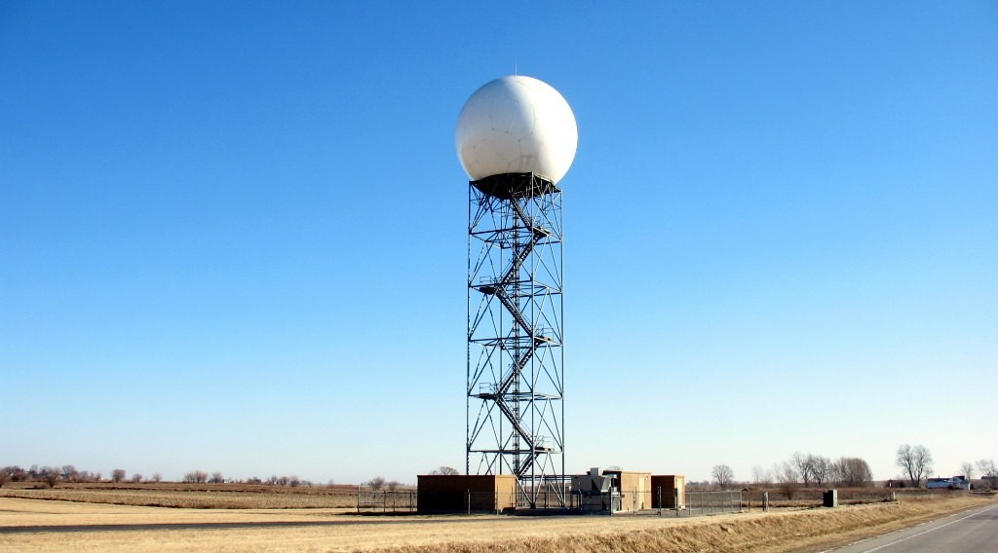
1. WEATHER OBSERVATION: RADAR
Activity 3
A Doppler weather radar.
Notes:
Activity 3. Look carefully at this picture: a Doppler weather radar. Observe every detail before I ask the question.

Slide 26
1. WEATHER OBSERVATION: RADAR
Activity 3: Question
What does a weather radar show?
Notes:
Here is the question for Activity 3: What does a weather radar show? Take one minute to think and write your answer in your rough notebook.

Slide 27
1. WEATHER OBSERVATION: RADAR
Activity 3: Answer
Where rain and storms are and how they move.
Notes:
Let us check the answer together. Where rain and storms are and how they move.

Slide 28

1. WEATHER OBSERVATION: SATELLITES
Activity 4
The Earth seen from space: satellites watch the clouds.
Notes:
Activity 4. Look carefully at this picture: the Earth seen from space: satellites watch the clouds. Observe every detail before I ask the question.

Slide 29
1. WEATHER OBSERVATION: SATELLITES
Activity 4: Question
Why are weather satellites useful for Africa?
Notes:
Here is the question for Activity 4: Why are weather satellites useful for Africa? Take one minute to think and write your answer in your rough notebook.

Slide 30
1. WEATHER OBSERVATION: SATELLITES
Activity 4: Answer
They see clouds and storms over large areas with few weather stations.
Notes:
Let us check the answer together. They see clouds and storms over large areas with few weather stations.

Slide 31
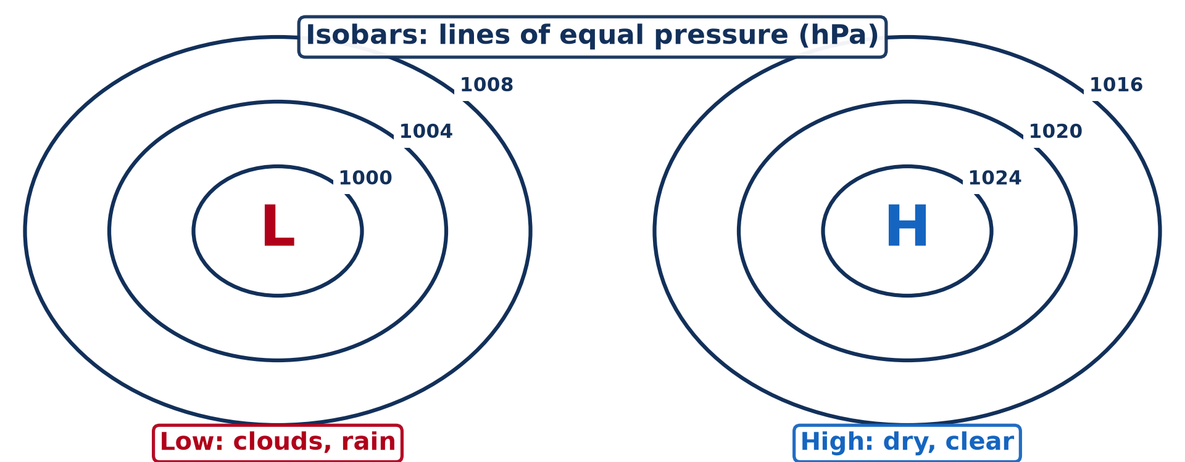
3. WEATHER MAPPING
Activity 5
A simple synoptic chart.
Notes:
Activity 5. Look carefully at this diagram: a simple synoptic chart. Observe every detail before I ask the question.

Slide 32
3. WEATHER MAPPING
Activity 5: Question
What weather do you expect under the L? Under the H?
Notes:
Here is the question for Activity 5: What weather do you expect under the L? Under the H? Take one minute to think and write your answer in your rough notebook.

Slide 33
3. WEATHER MAPPING
Activity 5: Answer
Under L: clouds and rain. Under H: dry, clear weather.
Notes:
Let us check the answer together. Under L: clouds and rain. Under H: dry, clear weather.

Slide 34
BOARD SUMMARY
Board Summary
Topic: Climates
Sub-topic: Weather Observation
Further Study 2: Weather Observation, Prediction, Modification and Mapping
Notes:
Now we are going to copy the board summary. Write the title and the headings neatly in your notebooks. I will give you enough time for each slide, so do not rush.

Slide 35
BOARD SUMMARY
DEFINITIONS
The key terms of this lesson are defined as follows:
Weather observation: It is the measurement and recording of the elements of weather at a place.
Weather forecast: It is the prediction of the weather for the coming hours or days.
Notes:
Let us copy the definitions. The key terms of this lesson are defined as follows. On this slide we have Weather observation and Weather forecast. Write each point on a new line, with the key term first, and explain it in your own words when we revise. When you finish, we go to the next slide.

Slide 36
BOARD SUMMARY
DEFINITIONS (continued)
Synoptic chart: It is a weather map showing the weather over a large area at the same time.
Notes:
We continue with the definitions. On this slide we have Synoptic chart. Write each point on a new line, with the key term first, and explain it in your own words when we revise.

Slide 37
BOARD SUMMARY
1. Weather Observation
Weather elements are observed with the following instruments:
Ground instruments: The thermometer measures temperature, the rain gauge rainfall and the barometer pressure. The hygrometer measures humidity and the wind vane and anemometer wind.
Notes:
Let us copy Weather Observation. Weather elements are observed with the following instruments. On this slide we have Ground instruments. Write each point on a new line, with the key term first, and explain it in your own words when we revise. When you finish, we go to the next slide.

Slide 38
BOARD SUMMARY
1. Weather Observation (continued)
Radiosonde: It is a small instrument carried by a balloon into the upper air. It sends back temperature, pressure and humidity by radio.
Doppler radar: It sends radio waves that bounce off raindrops. It shows where rain is falling and how storms move.
Notes:
We continue with Weather Observation. On this slide we have Radiosonde and Doppler radar. Write each point on a new line, with the key term first, and explain it in your own words when we revise. When you finish, we go to the next slide.

Slide 39
BOARD SUMMARY
1. Weather Observation (continued)
Weather satellites: They photograph clouds and measure temperatures from space. They are very useful over oceans and large regions such as Africa with few stations.
Notes:
We continue with Weather Observation. On this slide we have Weather satellites. Write each point on a new line, with the key term first, and explain it in your own words when we revise.

Slide 40
BOARD SUMMARY
1. Weather Observation
Illustration: weather instruments
Notes:
Now draw this illustration in your notebook: weather instruments. Give it a title and label it clearly.

Slide 41
BOARD SUMMARY
2. Weather Modification
People try to modify the weather in the following ways:
Cloud seeding: Silver iodide or salt is sprayed into clouds to help droplets grow and fall as rain. It has been used in dry areas.
Notes:
Let us copy Weather Modification. People try to modify the weather in the following ways. On this slide we have Cloud seeding. Write each point on a new line, with the key term first, and explain it in your own words when we revise. When you finish, we go to the next slide.

Slide 42
BOARD SUMMARY
2. Weather Modification (continued)
Hail suppression and fog dispersal: Seeding can make many small hailstones instead of large ones. Fog at airports can be cleared by heating or by seeding.
Hurricane modification: Scientists have tried to weaken hurricanes by seeding. The results are uncertain and costly.
Notes:
We continue with Weather Modification. On this slide we have Hail suppression and fog dispersal and Hurricane modification. Write each point on a new line, with the key term first, and explain it in your own words when we revise.

Slide 43
BOARD SUMMARY
3. Weather Mapping
Weather is mapped with synoptic charts:
Isobars and symbols: Isobars join places of equal pressure and show highs and lows. Station symbols show temperature, cloud cover, wind and rain.
Notes:
Let us copy Weather Mapping. Weather is mapped with synoptic charts. On this slide we have Isobars and symbols. Write each point on a new line, with the key term first, and explain it in your own words when we revise. When you finish, we go to the next slide.

Slide 44
BOARD SUMMARY
3. Weather Mapping (continued)
Reading a chart: Close isobars mean strong winds. Low pressure (L) usually brings clouds and rain, and high pressure (H) brings fair weather.
Notes:
We continue with Weather Mapping. On this slide we have Reading a chart. Write each point on a new line, with the key term first, and explain it in your own words when we revise.

Slide 45
BOARD SUMMARY
3. Weather Mapping
Illustration: a simple synoptic chart
Notes:
Now draw this illustration in your notebook: a simple synoptic chart. Give it a title and label it clearly.

Slide 46
FORMATIVE EVALUATION
Evaluation 1
Name two modern tools used to observe the weather.
Notes:
Now let us check what you have understood. Question 1: Name two modern tools used to observe the weather. Answer in your exercise book.

Slide 47
FORMATIVE EVALUATION
Expected Answer
Radiosonde and weather satellite (also Doppler radar).
Notes:
The expected answer is: radiosonde and weather satellite (also Doppler radar). If you got it right, well done.

Slide 48
FORMATIVE EVALUATION
Evaluation 2
What is cloud seeding?
Notes:
Now let us check what you have understood. Question 2: What is cloud seeding? Answer in your exercise book.

Slide 49
FORMATIVE EVALUATION
Expected Answer
Spraying chemicals into clouds to make rain.
Notes:
The expected answer is: spraying chemicals into clouds to make rain. If you got it right, well done.

Slide 50
REMEDIATION
Remediation
Fill in the blanks:
Rain is measured with a rain ______.
Lines of equal pressure are ______.
A weather map is a ______ chart.
Notes:
For those who need more practice, fill in the blanks in your exercise book. The answers are: number 1, gauge; number 2, isobars; number 3, synoptic.

Slide 51
HOMEWORK
Homework
Listen to a weather forecast on radio or TV and write what it says for three regions.
Notes:
For your homework: Listen to a weather forecast on radio or TV and write what it says for three regions. We shall correct it at the beginning of our next lesson.

Slide 52
NEXT LESSON
Next Lesson
Our next lesson will be on:
Further Study 3: The Climate of Cameroon
Notes:
Our next lesson will be on Further Study 3: The Climate of Cameroon. Thank you for your attention, and see you next time.

Slide 53
BILINGUAL GAME
Bilingual Game (Jeu Bilingue)
English | Français
Forecast | La prévision
Weather balloon | Le ballon-sonde
Radar | Le radar
Satellite | Le satellite
Weather map | La carte météo
Cloud seeding | L'ensemencement des nuages
Notes:
Let us play the bilingual game. I say a word in English, and you give me the French word. Then we do the reverse.

Slide 54
LOGBOOK
Official Logbook (1/2)
Module / Topic | Climates
Lesson Title | Further Study 2: Weather Observation, Prediction, Modification and Mapping
Expected Learning Outcomes | Name weather instruments and what they measure. Explain modern tools of observation (radiosonde, radar, satellite). Explain weather modification and read a simple synoptic chart.
Competence | Learners are able to explain how weather is observed, forecast, modified and mapped.
Notes:
I record this information in the official logbook of the class after the lesson.

Slide 55
LOGBOOK
Official Logbook (2/2)
Matter Taught | DEFINITIONS; Weather Observation; Weather Modification; Weather Mapping.
Evaluation | Formative evaluation and remediation exercise.
Homework | Listen to a weather forecast on radio or TV and write what it says for three regions.
Enrolment / Present / Absent | ____ / ____ / ____
Achievement | To be completed after the lesson.
Notes:
I complete the second page of the logbook: the matter taught, the evaluation, the homework and the attendance.

Slide 56
TEACHER'S NOTE
Teacher's Note
Timing: Homework correction, plan, objectives 8 min | Recall, situation, action 10 min | 5 activities 30 min | Board summary (copying) 30 min | Evaluation, remediation 10 min | Homework, next lesson 5 min | Logbook 7 min
Without the projector (Activity 1): list the instruments on the board.
Without the projector (Activity 2): describe a balloon rising.
Without the projector (Activity 3): explain echoes like a bat.
Without the projector (Activity 4): mention satellite images on TV.
Without the projector (Activity 5): draw isobars around H and L.
Notes:
This slide is for me, the teacher: it gives the timing of the lesson and what to do if the projector is not available.

Slide 57
REFERENCES
References
National Geography Syllabus, MINESEC/IGE/IP-SS, 2019 — Module 1 (Meteorology, Climatology & Hydrology).
Photo, Activity 2: “wea01144” by NOAA Photo Library, CC BY 2.0, via Flickr (https://www.flickr.com/photos/51647007@N08/5083800180)
Photo, Activity 3: “ILX - Central Illinois Doppler Radar - NOAA” by HAM guy, CC BY 2.0, via Flickr (https://www.flickr.com/photos/10728157@N00/363045232)
Photo, Activity 4: “Blue Marble, Eastern Hemisphere March 2014” by NASA Goddard Photo and Video, CC BY 2.0, via nasa (https://www.flickr.com/photos/24662369@N07/14990033062)
Diagrams and animations: drawn for this lesson (Geography Department).
Notes:
These are the references and picture credits used to prepare this lesson.

