Slide 1
LOWER SIXTH ARTS
GEOGRAPHY
Lesson 6
Volcanism
Notes:
Good morning, class, and welcome to our geography lesson. I am your geography teacher, Mr Kamdem. Today we are starting Lesson 6: Volcanism.

Slide 2
CLASS INFO
Class, Chapter and Duration
Class | Lower Sixth Arts
Chapter | Module 2: Understanding and managing physical landscapes, geomorphological processes and hazards across the world in general and Cameroon in particular
Duration | 2 periods (2 × 50 minutes)
Notes:
This lesson is for Lower Sixth Arts. It belongs to Module 2: Understanding and managing physical landscapes, geomorphological processes and hazards across the world in general and Cameroon in particular. We shall need 2 periods to cover it.

Slide 3
IDENTIFICATION
Lesson Identification
Topic | Crustal Processes and their Effect on the Land Surface and Man
Sub-topic | Volcanicity
Lesson | Lesson 6: Volcanism
Notions / Concepts | Volcanicity, lava, magma, cones, crater, caldera.
Syllabus focus | Meaning and process; products; types of cones and why they differ; the life cycle of a volcano.
Competence | Learners are able to identify volcanic landforms and explain why they differ.
Notes:
Our topic is Crustal Processes and their Effect on the Land Surface and Man, and the sub-topic is Volcanicity. The key notions we shall use today are: volcanicity, lava, magma, cones, crater, caldera. At the end, you should be able to do this: learners are able to identify volcanic landforms and explain why they differ.

Slide 4

HOMEWORK CORRECTION
Correction of the Homework
Question (Lesson 5: Landforms at Destructive and Conservative Margins):
Collect information about Mount Cameroon: its height and the years of its recent eruptions.
Notes:
Before we start the new lesson, let us correct the homework I gave you at the end of Lesson 5: Landforms at Destructive and Conservative Margins. The question was: Collect information about Mount Cameroon: its height and the years of its recent eruptions. Take out your exercise books.

Slide 5
HOMEWORK CORRECTION
Correction: Possible Answer
Mount Cameroon is about 4,040 m high, the highest mountain in West and Central Africa. Recent eruptions: 1959, 1982, 1999 and 2000.
Notes:
Here is a good answer. Mount Cameroon is about 4,040 m high, the highest mountain in West and Central Africa. Recent eruptions: 1959, 1982, 1999 and 2000. Compare it with your own answer and correct your work in red.

Slide 6
LESSON PLAN
Lesson Plan
Correction of the homework
Objectives and recall
Real-life situation and action to take
Learning activities
Board summary
Evaluation, remediation and homework
Notes:
Here is the plan of our lesson today. First, we shall correct the homework. Then we shall look at the objectives and recall what you already know. After that, we shall study a situation from real life and the action to take, and do the learning activities. Finally, we shall copy the board summary, do the evaluation and the remediation, and I will give you the homework.

Slide 7
OBJECTIVES
Objectives
By the end of this lesson, you should be able to:
Explain the process of volcanism.
Describe the products of volcanoes.
Explain the different types of volcanic cones and depressions.
Notes:
By the end of this lesson, you should be able to do three things. Number 1: explain the process of volcanism. Number 2: describe the products of volcanoes. Number 3: explain the different types of volcanic cones and depressions.

Slide 8
PREVIOUS KNOWLEDGE
Previous Knowledge
Magma rises at plate margins and hot spots.
Mount Cameroon is an active volcano.
Notes:
Let us first remember what you already know. Magma rises at plate margins and hot spots. Mount Cameroon is an active volcano. Keep this in mind, because we shall build on it today.

Slide 9
REAL-LIFE SITUATION
Situation in Real Life
In 2000, lava from Mount Cameroon flowed towards the road near Bakingili. Some visitors are surprised that the mountain has gentle slopes, while pictures of Mount Fuji show a steep cone.
Notes:
Listen carefully to this situation from real life. In 2000, lava from Mount Cameroon flowed towards the road near Bakingili. Some visitors are surprised that the mountain has gentle slopes, while pictures of Mount Fuji show a steep cone. Think about it, because I am going to ask you some questions.

Slide 10
REAL-LIFE SITUATION
Situation: Question 1
What is the problem in the situation?
Notes:
Question 1: What is the problem in the situation? Think for a moment, then raise your hand to answer.

Slide 11
REAL-LIFE SITUATION
Answer
The visitors do not know why volcanoes have different shapes.
Notes:
Good. The visitors do not know why volcanoes have different shapes.

Slide 12
REAL-LIFE SITUATION
Situation: Question 2
What came out of Mount Cameroon in 2000?
Notes:
Question 2: What came out of Mount Cameroon in 2000? Think for a moment, then raise your hand to answer.

Slide 13
REAL-LIFE SITUATION
Answer
Lava.
Notes:
Good. Lava.

Slide 14
REAL-LIFE SITUATION
Situation: Question 3
What decides the shape of a volcano?
Notes:
Question 3: What decides the shape of a volcano? Think for a moment, then raise your hand to answer.

Slide 15
REAL-LIFE SITUATION
Possible Answer
The type of lava and the type of eruption.
Notes:
Good. The type of lava and the type of eruption.

Slide 16
ACTION TO TAKE
Action to Take
Recognise volcanic landforms in Cameroon and understand how they formed.
Notes:
From this situation, the action we are working towards in this lesson is the following: recognise volcanic landforms in Cameroon and understand how they formed.

Slide 17
JUSTIFICATION
Justification of the Lesson
This lesson helps us to understand how volcanoes form and why their landforms differ.
Notes:
Why is this lesson important for you? This lesson helps us to understand how volcanoes form and why their landforms differ.

Slide 18
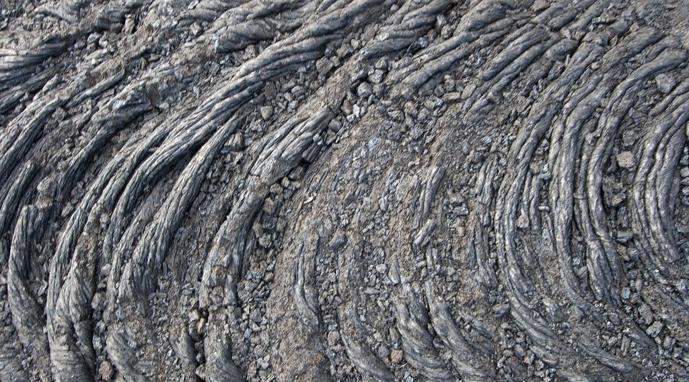
1. MEANING AND PROCESS
Activity 1
A flow of hot lava.
Notes:
Activity 1. Look carefully at this picture: a flow of hot lava. Observe every detail before I ask the question.

Slide 19
1. MEANING AND PROCESS
Activity 1: Question
What is the difference between magma and lava?
Notes:
Here is the question for Activity 1: What is the difference between magma and lava? Take one minute to think and write your answer in your rough notebook.

Slide 20
1. MEANING AND PROCESS
Activity 1: Answer
Magma is melted rock underground; lava is magma that reaches the surface.
Notes:
Let us check the answer together. Magma is melted rock underground; lava is magma that reaches the surface.

Slide 21

2. PRODUCTS
Activity 2
The parts of a volcano.
Notes:
Activity 2. Look carefully at this diagram: the parts of a volcano. Observe every detail before I ask the question.

Slide 22
2. PRODUCTS
Activity 2: Question
Name three products of a volcano.
Notes:
Here is the question for Activity 2: Name three products of a volcano. Take one minute to think and write your answer in your rough notebook.

Slide 23
2. PRODUCTS
Activity 2: Answer
Lava, ash (pyroclasts) and gases.
Notes:
Let us check the answer together. Lava, ash (pyroclasts) and gases.

Slide 24
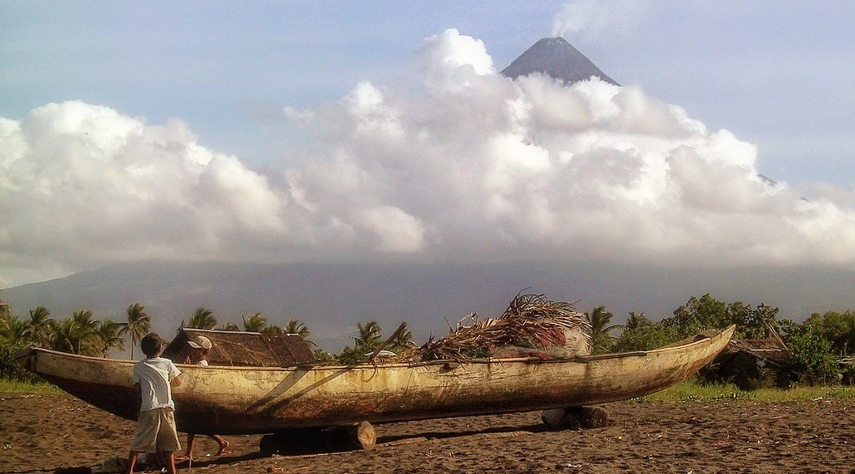
3. LANDFORMS: CONES
Activity 3
Mayon Volcano, Philippines: a steep cone of ash and lava.
Notes:
Activity 3. Look carefully at this picture: mayon Volcano, Philippines: a steep cone of ash and lava. Observe every detail before I ask the question.

Slide 25
3. LANDFORMS: CONES
Activity 3: Question
This cone has layers of ash and lava. What type of cone is it?
Notes:
Here is the question for Activity 3: This cone has layers of ash and lava. What type of cone is it? Take one minute to think and write your answer in your rough notebook.

Slide 26
3. LANDFORMS: CONES
Activity 3: Answer
A strato-volcano (composite cone).
Notes:
Let us check the answer together. A strato-volcano (composite cone).

Slide 27

3. LANDFORMS: DEPRESSIONS
Activity 4
A large lake inside an old volcano.
Notes:
Activity 4. Look carefully at this picture: a large lake inside an old volcano. Observe every detail before I ask the question.

Slide 28
3. LANDFORMS: DEPRESSIONS
Activity 4: Question
What is the difference between a crater and a caldera?
Notes:
Here is the question for Activity 4: What is the difference between a crater and a caldera? Take one minute to think and write your answer in your rough notebook.

Slide 29
3. LANDFORMS: DEPRESSIONS
Activity 4: Answer
A crater is a small hollow at the top; a caldera is a huge hollow after a collapse.
Notes:
Let us check the answer together. A crater is a small hollow at the top; a caldera is a huge hollow after a collapse.

Slide 30
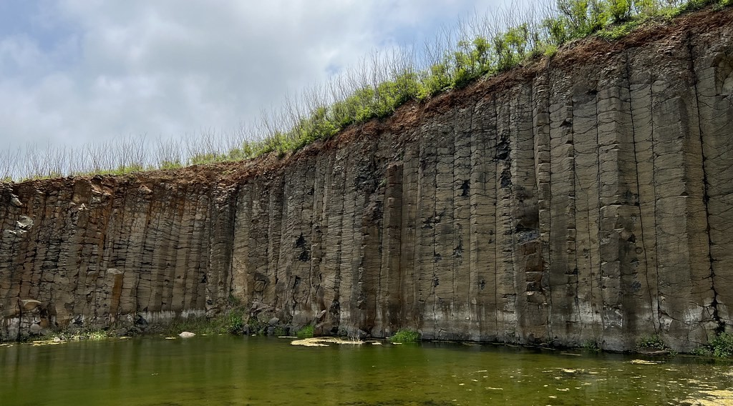
3. LANDFORMS: LAVA PLATEAUX
Activity 5
Columns of basalt from old lava.
Notes:
Activity 5. Look carefully at this picture: columns of basalt from old lava. Observe every detail before I ask the question.

Slide 31
3. LANDFORMS: LAVA PLATEAUX
Activity 5: Question
Many flows of runny lava can cover a large area. What landform do they form?
Notes:
Here is the question for Activity 5: Many flows of runny lava can cover a large area. What landform do they form? Take one minute to think and write your answer in your rough notebook.

Slide 32
3. LANDFORMS: LAVA PLATEAUX
Activity 5: Answer
A lava plateau.
Notes:
Let us check the answer together. A lava plateau.

Slide 33
BOARD SUMMARY
Board Summary
Topic: Crustal Processes and their Effect on the Land Surface and Man
Sub-topic: Volcanicity
Lesson 6: Volcanism
Notes:
Now we are going to copy the board summary. Write the title and the headings neatly in your notebooks. I will give you enough time for each slide, so do not rush.

Slide 34
BOARD SUMMARY
1. Meaning, Process and Cycle
Volcanism can be understood as follows:
Volcanism: It is the process by which magma and gases from inside the Earth reach the surface or the crust.
Notes:
Let us copy Meaning, Process and Cycle. Volcanism can be understood as follows. On this slide we have Volcanism. Write each point on a new line, with the key term first, and explain it in your own words when we revise. When you finish, we go to the next slide.

Slide 35
BOARD SUMMARY
1. Meaning, Process and Cycle (continued)
Process: Magma forms in the mantle, rises because it is lighter and collects in a magma chamber. It escapes through a vent when gas pressure is high enough.
Notes:
We continue with Meaning, Process and Cycle. On this slide we have Process. Write each point on a new line, with the key term first, and explain it in your own words when we revise. When you finish, we go to the next slide.

Slide 36
BOARD SUMMARY
1. Meaning, Process and Cycle (continued)
Life cycle of a volcano: A volcano is active when it erupts often, dormant when it is sleeping, and extinct when it will not erupt again. Mount Cameroon is active, Mount Manengouba is extinct.
Notes:
We continue with Meaning, Process and Cycle. On this slide we have Life cycle of a volcano. Write each point on a new line, with the key term first, and explain it in your own words when we revise.

Slide 37
BOARD SUMMARY
1. Meaning, Process and Cycle
Illustration: structure of a volcano
Notes:
Now draw this illustration in your notebook: structure of a volcano. Give it a title and label it clearly.

Slide 38
BOARD SUMMARY
2. Products of Volcanoes
Volcanoes produce the following materials:
Lava: It is magma at the surface; basic lava is runny, while acid lava is thick. Pahoehoe and aa are types of lava flows.
Pyroclasts: They are solid fragments: ash, lapilli and volcanic bombs. They fall around the volcano and build cones.
Notes:
Let us copy Products of Volcanoes. Volcanoes produce the following materials. On this slide we have Lava and Pyroclasts. Write each point on a new line, with the key term first, and explain it in your own words when we revise. When you finish, we go to the next slide.

Slide 39
BOARD SUMMARY
2. Products of Volcanoes (continued)
Gases: Volcanoes release water vapour, carbon dioxide and sulphur gases. These gases can be deadly, as at Lake Nyos.
Notes:
We continue with Products of Volcanoes. On this slide we have Gases. Write each point on a new line, with the key term first, and explain it in your own words when we revise.

Slide 40
BOARD SUMMARY
3. Volcanic Landforms
The type of landform depends on the lava and the eruption:
Basic lava cones: Runny lava forms wide cones with gentle slopes (shield volcanoes). Mauna Loa is an example.
Notes:
Let us copy Volcanic Landforms. The type of landform depends on the lava and the eruption. On this slide we have Basic lava cones. Write each point on a new line, with the key term first, and explain it in your own words when we revise. When you finish, we go to the next slide.

Slide 41
BOARD SUMMARY
3. Volcanic Landforms (continued)
Acid lava cones (cumulo-domes): Thick lava forms steep, dome-shaped cones. The lava does not flow far.
Ash and cinder cones: Pyroclasts pile up into small, steep, concave cones. Many exist on Mount Cameroon.
Notes:
We continue with Volcanic Landforms. On this slide we have Acid lava cones (cumulo-domes) and Ash and cinder cones. Write each point on a new line, with the key term first, and explain it in your own words when we revise. When you finish, we go to the next slide.

Slide 42
BOARD SUMMARY
3. Volcanic Landforms (continued)
Composite (strato) cones: Layers of ash and lava build large, symmetrical cones. Mount Cameroon and Mount Fuji are composite cones.
Notes:
We continue with Volcanic Landforms. On this slide we have Composite (strato) cones. Write each point on a new line, with the key term first, and explain it in your own words when we revise.

Slide 43
BOARD SUMMARY
3. Volcanic Landforms
Illustration: a composite cone
Notes:
Now draw this illustration in your notebook: a composite cone. Give it a title and label it clearly.

Slide 44
BOARD SUMMARY
3. Volcanic Landforms
Plateaux and Depressions
Other volcanic landforms include:
Lava plateaux: Many flows of runny lava from fissures cover large areas. The Deccan plateau and parts of the Adamawa and Bamenda plateaux are examples.
Notes:
Let us copy Plateaux and Depressions. Other volcanic landforms include. On this slide we have Lava plateaux. Write each point on a new line, with the key term first, and explain it in your own words when we revise. When you finish, we go to the next slide.

Slide 45
BOARD SUMMARY
3. Volcanic Landforms
Plateaux and Depressions (continued)
Craters and calderas: A crater is the small hollow at the top of the vent. A caldera is a much larger hollow formed when the top collapses; it may contain a lake like Lake Nyos.
Notes:
We continue with Plateaux and Depressions. On this slide we have Craters and calderas. Write each point on a new line, with the key term first, and explain it in your own words when we revise.

Slide 46
FORMATIVE EVALUATION
Evaluation 1
What is the difference between magma and lava?
Notes:
Now let us check what you have understood. Question 1: What is the difference between magma and lava? Answer in your exercise book.

Slide 47
FORMATIVE EVALUATION
Expected Answer
Magma is underground; lava is on the surface.
Notes:
The expected answer is: magma is underground; lava is on the surface. If you got it right, well done.

Slide 48
FORMATIVE EVALUATION
Evaluation 2
Why is a composite cone steep and layered?
Notes:
Now let us check what you have understood. Question 2: Why is a composite cone steep and layered? Answer in your exercise book.

Slide 49
FORMATIVE EVALUATION
Expected Answer
It is built of alternating layers of ash and lava.
Notes:
The expected answer is: it is built of alternating layers of ash and lava. If you got it right, well done.

Slide 50
REMEDIATION
Remediation
Fill in the blanks:
Magma on the surface is ______.
A huge hollow after a collapse is a ______.
Runny lava forms ______ volcanoes with gentle slopes.
Notes:
For those who need more practice, fill in the blanks in your exercise book. The answers are: number 1, lava; number 2, caldera; number 3, shield (basic lava).

Slide 51
HOMEWORK
Homework
Ask an adult what people grow around Buea and Limbe, and why the soils are good.
Notes:
For your homework: Ask an adult what people grow around Buea and Limbe, and why the soils are good. We shall correct it at the beginning of our next lesson.

Slide 52
NEXT LESSON
Next Lesson
Our next lesson will be on:
Lesson 7: Volcanoes and Man
Notes:
Our next lesson will be on Lesson 7: Volcanoes and Man. Thank you for your attention, and see you next time.

Slide 53
BILINGUAL GAME
Bilingual Game (Jeu Bilingue)
English | Français
Volcano | Le volcan
Lava | La lave
Ash | La cendre
Crater | Le cratère
Caldera | La caldeira
Cone | Le cône
Notes:
Let us play the bilingual game. I say a word in English, and you give me the French word. Then we do the reverse.

Slide 54
LOGBOOK
Official Logbook (1/2)
Module / Topic | Crustal Processes and their Effect on the Land Surface and Man
Lesson Title | Lesson 6: Volcanism
Expected Learning Outcomes | Explain the process of volcanism. Describe the products of volcanoes. Explain the different types of volcanic cones and depressions.
Competence | Learners are able to identify volcanic landforms and explain why they differ.
Notes:
I record this information in the official logbook of the class after the lesson.

Slide 55
LOGBOOK
Official Logbook (2/2)
Matter Taught | Meaning, Process and Cycle; Products of Volcanoes; Volcanic Landforms; Plateaux and Depressions.
Evaluation | Formative evaluation and remediation exercise.
Homework | Ask an adult what people grow around Buea and Limbe, and why the soils are good.
Enrolment / Present / Absent | ____ / ____ / ____
Achievement | To be completed after the lesson.
Notes:
I complete the second page of the logbook: the matter taught, the evaluation, the homework and the attendance.

Slide 56
TEACHER'S NOTE
Teacher's Note
Timing: Homework correction, plan, objectives 8 min | Recall, situation, action 10 min | 5 activities 30 min | Board summary (copying) 30 min | Evaluation, remediation 10 min | Homework, next lesson 5 min | Logbook 7 min
Without the projector (Activity 1): draw a volcano and mark magma and lava.
Without the projector (Activity 2): list solid, liquid and gas products.
Without the projector (Activity 3): draw alternating layers of ash and lava.
Without the projector (Activity 4): mention crater lakes of Cameroon (Barombi Mbo, Nyos).
Without the projector (Activity 5): mention the basalt plateaux of the Western Highlands.
Notes:
This slide is for me, the teacher: it gives the timing of the lesson and what to do if the projector is not available.

Slide 57
REFERENCES
References
National Geography Syllabus, MINESEC/IGE/IP-SS, 2019 — Module 2 (Geomorphology).
Photo, Activity 1: “Pahoehoe Lava Flow” by graysky., CC BY-NC-SA 2.0, via Flickr (https://www.flickr.com/photos/20021588@N00/540223861)
Photo, Activity 3: “Mayon Volcano, Albay, Luzon, Philippines” by Ray in Manila, CC BY 2.0, via Flickr (https://www.flickr.com/photos/21186555@N07/20591774278)
Photo, Activity 4: “Taal Lake and Volcano, Tagaytay, Philippines” by Ray in Manila, CC BY 2.0, via Flickr (https://www.flickr.com/photos/21186555@N07/28260012661)
Photo, Activity 5: “Snapshot, Daguoye Columnar Basalt, Penghu, Taiwan, 隨拍, 池東大菓葉玄武岩, 大菓葉柱狀” by bryan..., CC BY-SA 2.0, via Flickr (https://www.flickr.com/photos/91049143@N00/52316527525)
Diagrams and animations: drawn for this lesson (Geography Department).
Notes:
These are the references and picture credits used to prepare this lesson.

