Slide 1
LOWER SIXTH ARTS
GEOGRAPHY
Lesson 15
River Action on its Long Profile
Notes:
Good morning, class, and welcome to our geography lesson. I am your geography teacher, Mr Kamdem. Today we are starting Lesson 15: River Action on its Long Profile.

Slide 2
CLASS INFO
Class, Chapter and Duration
Class | Lower Sixth Arts
Chapter | Module 2: Understanding and managing physical landscapes, geomorphological processes and hazards across the world in general and Cameroon in particular
Duration | 2 periods (2 × 50 minutes)
Notes:
This lesson is for Lower Sixth Arts. It belongs to Module 2: Understanding and managing physical landscapes, geomorphological processes and hazards across the world in general and Cameroon in particular. We shall need 2 periods to cover it.

Slide 3
IDENTIFICATION
Lesson Identification
Topic | Denudational Processes on Slopes
Sub-topic | Erosion and Depositional Processes and Landforms
Lesson | Lesson 15: River Action on its Long Profile
Notions / Concepts | Long profile, V-shaped valley, waterfall, meander, ox-bow lake, floodplain, delta.
Syllabus focus | Upper, middle and lower courses: characteristics and features.
Competence | Learners are able to describe and explain the landforms of each course of a river.
Notes:
Our topic is Denudational Processes on Slopes, and the sub-topic is Erosion and Depositional Processes and Landforms. The key notions we shall use today are: long profile, V-shaped valley, waterfall, meander, ox-bow lake, floodplain, delta. At the end, you should be able to do this: learners are able to describe and explain the landforms of each course of a river.

Slide 4

HOMEWORK CORRECTION
Correction of the Homework
Question (Lesson 14: Erosional Processes and the Fluvial System):
Draw the long profile of a river and mark the upper, middle and lower courses.
Notes:
Before we start the new lesson, let us correct the homework I gave you at the end of Lesson 14: Erosional Processes and the Fluvial System. The question was: Draw the long profile of a river and mark the upper, middle and lower courses. Take out your exercise books.

Slide 5
HOMEWORK CORRECTION
Correction: Possible Answer
The long profile is concave: steep in the upper course near the source, gentler in the middle course, and almost flat in the lower course near the mouth.
Notes:
Here is a good answer. The long profile is concave: steep in the upper course near the source, gentler in the middle course, and almost flat in the lower course near the mouth. Compare it with your own answer and correct your work in red.

Slide 6
LESSON PLAN
Lesson Plan
Correction of the homework
Objectives and recall
Real-life situation and action to take
Learning activities
Board summary
Evaluation, remediation and homework
Notes:
Here is the plan of our lesson today. First, we shall correct the homework. Then we shall look at the objectives and recall what you already know. After that, we shall study a situation from real life and the action to take, and do the learning activities. Finally, we shall copy the board summary, do the evaluation and the remediation, and I will give you the homework.

Slide 7
OBJECTIVES
Objectives
By the end of this lesson, you should be able to:
Describe the long profile of a river.
Explain the features of the upper and middle courses.
Explain the features of the lower course.
Notes:
By the end of this lesson, you should be able to do three things. Number 1: describe the long profile of a river. Number 2: explain the features of the upper and middle courses. Number 3: explain the features of the lower course.

Slide 8
PREVIOUS KNOWLEDGE
Previous Knowledge
Rivers erode, transport and deposit.
The long profile goes from the source to the mouth.
Notes:
Let us first remember what you already know. Rivers erode, transport and deposit. The long profile goes from the source to the mouth. Keep this in mind, because we shall build on it today.

Slide 9
REAL-LIFE SITUATION
Situation in Real Life
The Vina River falls over a cliff near Ngaoundéré. Further north, the Benue at Garoua is wide and winding, with sandbanks, and in Nigeria the Niger forms a huge delta.
Notes:
Listen carefully to this situation from real life. The Vina River falls over a cliff near Ngaoundéré. Further north, the Benue at Garoua is wide and winding, with sandbanks, and in Nigeria the Niger forms a huge delta. Think about it, because I am going to ask you some questions.

Slide 10
REAL-LIFE SITUATION
Situation: Question 1
What is the problem in the situation?
Notes:
Question 1: What is the problem in the situation? Think for a moment, then raise your hand to answer.

Slide 11
REAL-LIFE SITUATION
Answer
We want to explain why rivers change from source to mouth.
Notes:
Good. We want to explain why rivers change from source to mouth.

Slide 12
REAL-LIFE SITUATION
Situation: Question 2
Describe the Vina near Ngaoundéré.
Notes:
Question 2: Describe the Vina near Ngaoundéré. Think for a moment, then raise your hand to answer.

Slide 13
REAL-LIFE SITUATION
Answer
Fast, with a waterfall and steep sides.
Notes:
Good. Fast, with a waterfall and steep sides.

Slide 14
REAL-LIFE SITUATION
Situation: Question 3
Where does the Niger end?
Notes:
Question 3: Where does the Niger end? Think for a moment, then raise your hand to answer.

Slide 15
REAL-LIFE SITUATION
Possible Answer
In a delta at the sea.
Notes:
Good. In a delta at the sea.

Slide 16
ACTION TO TAKE
Action to Take
Recognise river landforms and use river valleys wisely.
Notes:
From this situation, the action we are working towards in this lesson is the following: recognise river landforms and use river valleys wisely.

Slide 17
JUSTIFICATION
Justification of the Lesson
This lesson helps us to recognise river landforms and understand how they form.
Notes:
Why is this lesson important for you? This lesson helps us to recognise river landforms and understand how they form.

Slide 18

1. THE LONG PROFILE
Activity 1
The long profile of a river.
Notes:
Activity 1. Look carefully at this diagram: the long profile of a river. Observe every detail before I ask the question.

Slide 19
1. THE LONG PROFILE
Activity 1: Question
Describe the slope of the river from source to mouth.
Notes:
Here is the question for Activity 1: Describe the slope of the river from source to mouth. Take one minute to think and write your answer in your rough notebook.

Slide 20
1. THE LONG PROFILE
Activity 1: Answer
Steep in the upper course, gentle in the middle, almost flat in the lower course.
Notes:
Let us check the answer together. Steep in the upper course, gentle in the middle, almost flat in the lower course.

Slide 21
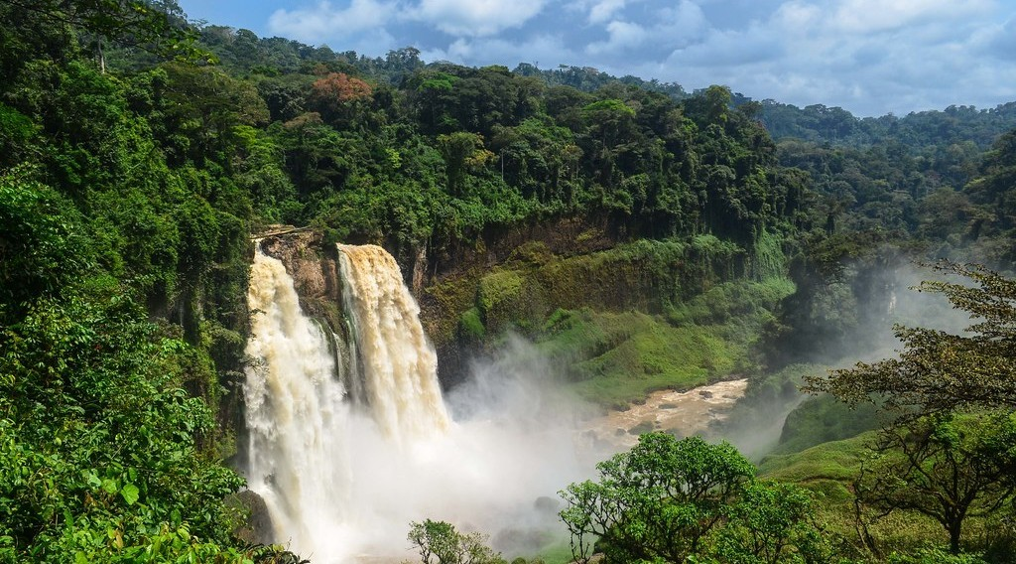
1. UPPER COURSE
Activity 2
The Ekom-Nkam waterfall, Cameroon.
Notes:
Activity 2. Look carefully at this picture: the Ekom-Nkam waterfall, Cameroon. Observe every detail before I ask the question.

Slide 22
1. UPPER COURSE
Activity 2: Question
How is a waterfall formed?
Notes:
Here is the question for Activity 2: How is a waterfall formed? Take one minute to think and write your answer in your rough notebook.

Slide 23
1. UPPER COURSE
Activity 2: Answer
Hard rock lies over soft rock; the soft rock is eroded faster.
Notes:
Let us check the answer together. Hard rock lies over soft rock; the soft rock is eroded faster.

Slide 24
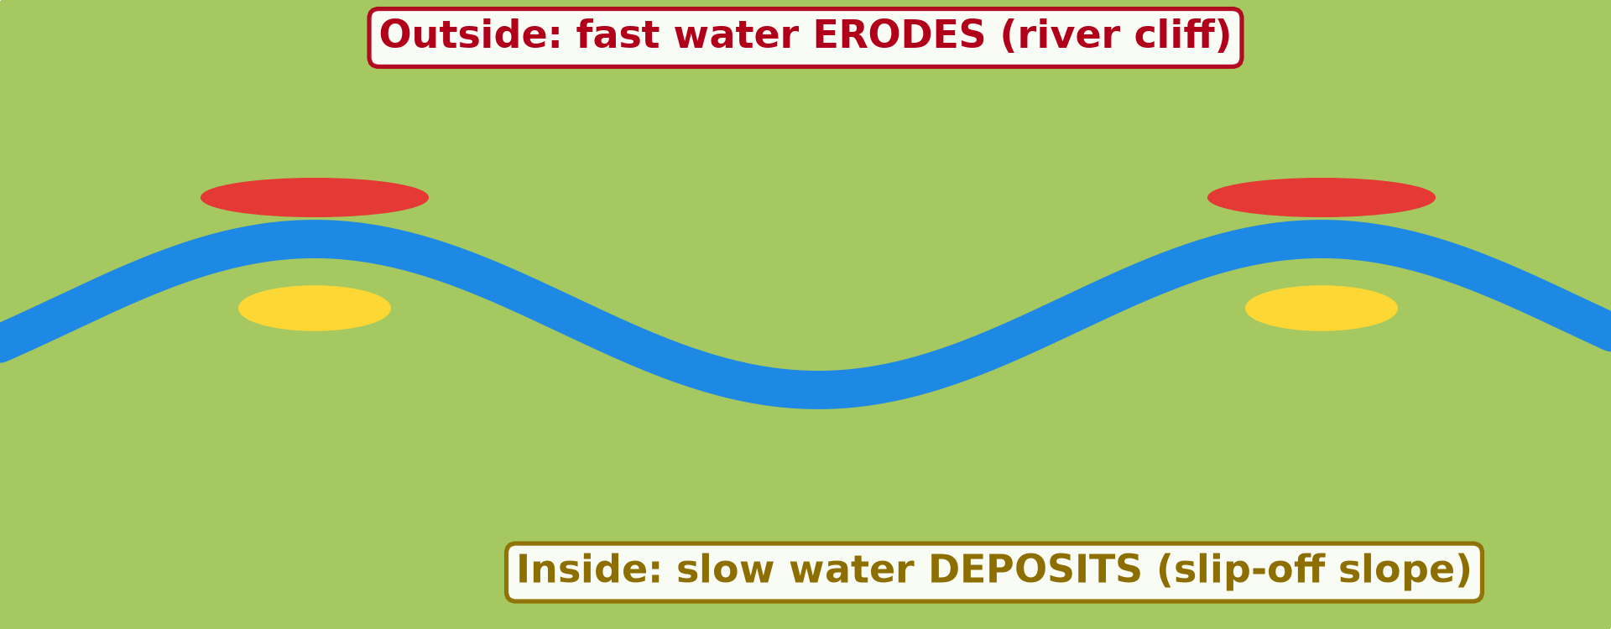
2. MIDDLE COURSE
Activity 3
Animation: a meander grows.
Notes:
Activity 3. Look carefully at this animation: animation: a meander grows. Watch the animation to the end; it will play again.

Slide 25
2. MIDDLE COURSE
Activity 3: Question
Where does the river erode and deposit in a meander?
Notes:
Here is the question for Activity 3: Where does the river erode and deposit in a meander? Take one minute to think and write your answer in your rough notebook.

Slide 26
2. MIDDLE COURSE
Activity 3: Answer
It erodes the outside of the bend and deposits on the inside.
Notes:
Let us check the answer together. It erodes the outside of the bend and deposits on the inside.

Slide 27
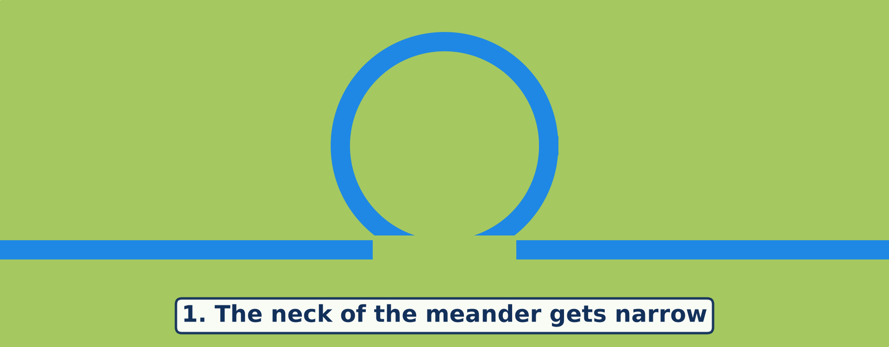
3. LOWER COURSE
Activity 4
Animation: an ox-bow lake forms.
Notes:
Activity 4. Look carefully at this animation: animation: an ox-bow lake forms. Watch the animation to the end; it will play again.

Slide 28
3. LOWER COURSE
Activity 4: Question
How does an ox-bow lake form?
Notes:
Here is the question for Activity 4: How does an ox-bow lake form? Take one minute to think and write your answer in your rough notebook.

Slide 29
3. LOWER COURSE
Activity 4: Answer
The river cuts through the neck of a meander and leaves the old bend.
Notes:
Let us check the answer together. The river cuts through the neck of a meander and leaves the old bend.

Slide 30
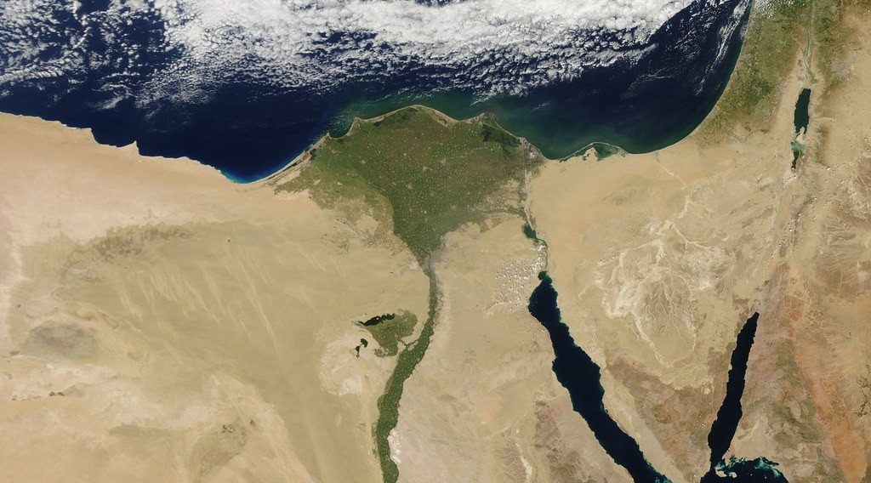
3. LOWER COURSE
Activity 5
The Nile Delta seen from space.
Notes:
Activity 5. Look carefully at this picture: the Nile Delta seen from space. Observe every detail before I ask the question.

Slide 31
3. LOWER COURSE
Activity 5: Question
Why does a delta form at the mouth of a river?
Notes:
Here is the question for Activity 5: Why does a delta form at the mouth of a river? Take one minute to think and write your answer in your rough notebook.

Slide 32
3. LOWER COURSE
Activity 5: Answer
The river slows down at the sea and deposits its load faster than waves remove it.
Notes:
Let us check the answer together. The river slows down at the sea and deposits its load faster than waves remove it.

Slide 33
BOARD SUMMARY
Board Summary
Topic: Denudational Processes on Slopes
Sub-topic: Erosion and Depositional Processes and Landforms
Lesson 15: River Action on its Long Profile
Notes:
Now we are going to copy the board summary. Write the title and the headings neatly in your notebooks. I will give you enough time for each slide, so do not rush.

Slide 34
BOARD SUMMARY
DEFINITIONS
The key terms of this lesson are defined as follows:
Long profile: It is the change in the height of a river from its source to its mouth.
Base level: It is the lowest level to which a river can erode, usually sea level.
Notes:
Let us copy the definitions. The key terms of this lesson are defined as follows. On this slide we have Long profile and Base level. Write each point on a new line, with the key term first, and explain it in your own words when we revise.

Slide 35
BOARD SUMMARY
1. Upper Course
The upper course has the following characteristics and features:
Characteristics: The gradient is steep and the channel is narrow and shallow, with large boulders. Vertical erosion is dominant.
Notes:
Let us copy Upper Course. The upper course has the following characteristics and features. On this slide we have Characteristics. Write each point on a new line, with the key term first, and explain it in your own words when we revise. When you finish, we go to the next slide.

Slide 36
BOARD SUMMARY
1. Upper Course (continued)
Features: V-shaped valleys, interlocking spurs, waterfalls and rapids form here. Waterfalls form where hard rock lies over soft rock, as at Ekom Nkam.
Notes:
We continue with Upper Course. On this slide we have Features. Write each point on a new line, with the key term first, and explain it in your own words when we revise.

Slide 37
BOARD SUMMARY
1. Upper Course
Illustration: the long profile
Notes:
Now draw this illustration in your notebook: the long profile. Give it a title and label it clearly.

Slide 38
BOARD SUMMARY
2. Middle Course
The middle course has the following characteristics and features:
Characteristics: The gradient is gentler, the valley wider and the discharge greater. Lateral erosion becomes important.
Notes:
Let us copy Middle Course. The middle course has the following characteristics and features. On this slide we have Characteristics. Write each point on a new line, with the key term first, and explain it in your own words when we revise. When you finish, we go to the next slide.

Slide 39
BOARD SUMMARY
2. Middle Course (continued)
Features: Meanders form, with river cliffs on the outside of bends and slip-off slopes (point bars) on the inside. The valley floor becomes a narrow floodplain.
Notes:
We continue with Middle Course. On this slide we have Features. Write each point on a new line, with the key term first, and explain it in your own words when we revise.

Slide 40
BOARD SUMMARY
2. Middle Course
Illustration: a meander
Notes:
Now draw this illustration in your notebook: a meander. Give it a title and label it clearly.

Slide 41
BOARD SUMMARY
3. Lower Course
The lower course has the following characteristics and features:
Characteristics: The gradient is very gentle, the channel wide and deep, and the load fine. Deposition is dominant.
Notes:
Let us copy Lower Course. The lower course has the following characteristics and features. On this slide we have Characteristics. Write each point on a new line, with the key term first, and explain it in your own words when we revise. When you finish, we go to the next slide.

Slide 42
BOARD SUMMARY
3. Lower Course (continued)
Features: Wide floodplains, levées, ox-bow lakes and braided channels form. Ox-bow lakes form when a meander neck is cut through during a flood.
Notes:
We continue with Lower Course. On this slide we have Features. Write each point on a new line, with the key term first, and explain it in your own words when we revise. When you finish, we go to the next slide.

Slide 43
BOARD SUMMARY
3. Lower Course (continued)
Mouth: Deltas form where rivers deposit more than the sea removes, like the Niger delta. Estuaries form where the sea floods the mouth, like the Wouri estuary.
Notes:
We continue with Lower Course. On this slide we have Mouth. Write each point on a new line, with the key term first, and explain it in your own words when we revise.

Slide 44
BOARD SUMMARY
3. Lower Course
Illustration: formation of an ox-bow lake
Notes:
Now draw this illustration in your notebook: formation of an ox-bow lake. Give it a title and label it clearly.

Slide 45
FORMATIVE EVALUATION
Evaluation 1
Explain the formation of a waterfall.
Notes:
Now let us check what you have understood. Question 1: Explain the formation of a waterfall. Answer in your exercise book.

Slide 46
FORMATIVE EVALUATION
Expected Answer
Soft rock under hard rock is eroded faster, so the hard rock forms a step.
Notes:
The expected answer is: soft rock under hard rock is eroded faster, so the hard rock forms a step. If you got it right, well done.

Slide 47
FORMATIVE EVALUATION
Evaluation 2
Give two features of the lower course.
Notes:
Now let us check what you have understood. Question 2: Give two features of the lower course. Answer in your exercise book.

Slide 48
FORMATIVE EVALUATION
Expected Answer
Floodplain and delta (also levees, ox-bow lakes).
Notes:
The expected answer is: floodplain and delta (also levees, ox-bow lakes). If you got it right, well done.

Slide 49
REMEDIATION
Remediation
Fill in the blanks:
A large bend in a river is a ______.
An old meander cut off is an ______ lake.
Deposits at the mouth form a ______.
Notes:
For those who need more practice, fill in the blanks in your exercise book. The answers are: number 1, meander; number 2, ox-bow; number 3, delta.

Slide 50
HOMEWORK
Homework
Describe the coast at Kribi or Limbe from a picture: beach, rocks or cliffs.
Notes:
For your homework: Describe the coast at Kribi or Limbe from a picture: beach, rocks or cliffs. We shall correct it at the beginning of our next lesson.

Slide 51
NEXT LESSON
Next Lesson
Our next lesson will be on:
Lesson 16: Coastal Processes and Features
Notes:
Our next lesson will be on Lesson 16: Coastal Processes and Features. Thank you for your attention, and see you next time.

Slide 52
BILINGUAL GAME
Bilingual Game (Jeu Bilingue)
English | Français
Long profile | Le profil en long
Waterfall | La chute d'eau
Meander | Le méandre
Ox-bow lake | Le bras mort
Floodplain | La plaine d'inondation
Delta | Le delta
Notes:
Let us play the bilingual game. I say a word in English, and you give me the French word. Then we do the reverse.

Slide 53
LOGBOOK
Official Logbook (1/2)
Module / Topic | Denudational Processes on Slopes
Lesson Title | Lesson 15: River Action on its Long Profile
Expected Learning Outcomes | Describe the long profile of a river. Explain the features of the upper and middle courses. Explain the features of the lower course.
Competence | Learners are able to describe and explain the landforms of each course of a river.
Notes:
I record this information in the official logbook of the class after the lesson.

Slide 54
LOGBOOK
Official Logbook (2/2)
Matter Taught | DEFINITIONS; Upper Course; Middle Course; Lower Course.
Evaluation | Formative evaluation and remediation exercise.
Homework | Describe the coast at Kribi or Limbe from a picture: beach, rocks or cliffs.
Enrolment / Present / Absent | ____ / ____ / ____
Achievement | To be completed after the lesson.
Notes:
I complete the second page of the logbook: the matter taught, the evaluation, the homework and the attendance.

Slide 55
TEACHER'S NOTE
Teacher's Note
Timing: Homework correction, plan, objectives 8 min | Recall, situation, action 10 min | 5 activities 30 min | Board summary (copying) 30 min | Evaluation, remediation 10 min | Homework, next lesson 5 min | Logbook 7 min
Activities 3 and 4 are animations (GIF): it plays automatically in slide-show mode.
Without the projector (Activity 1): draw a concave curve.
Without the projector (Activity 2): draw hard rock over soft rock.
Without the projector (Activity 3): draw a bend with a river cliff and a slip-off slope.
Without the projector (Activity 4): draw the three stages.
Without the projector (Activity 5): draw a triangle at a river mouth.
Notes:
This slide is for me, the teacher: it gives the timing of the lesson and what to do if the projector is not available.

Slide 56
REFERENCES
References
National Geography Syllabus, MINESEC/IGE/IP-SS, 2019 — Module 2 (Geomorphology).
Photo, Activity 2: “Ekom-Nkam waterfall” by jbdodane, CC BY-NC 2.0, via Flickr (https://www.flickr.com/photos/27998473@N02/11291226526)
Photo, Activity 5: “Egypt” by NASA Goddard Photo and Video, CC BY 2.0, via nasa (https://www.flickr.com/photos/24662369@N07/5635018418)
Diagrams and animations: drawn for this lesson (Geography Department).
Notes:
These are the references and picture credits used to prepare this lesson.

