Slide 1
LOWER SIXTH ARTS
GEOGRAPHY
Lesson 24
The Drainage Basin as an Open System
Notes:
Good morning, class, and welcome to our geography lesson. I am your geography teacher, Mr Kamdem. Today we are starting Lesson 24: The Drainage Basin as an Open System.

Slide 2
CLASS INFO
Class, Chapter and Duration
Class | Lower Sixth Arts
Chapter | Module 1: Understanding and managing atmospheric and hydrological phenomena and hazards across the world in general and Cameroon in particular
Duration | 2 periods (2 × 50 minutes)
Notes:
This lesson is for Lower Sixth Arts. It belongs to Module 1: Understanding and managing atmospheric and hydrological phenomena and hazards across the world in general and Cameroon in particular. We shall need 2 periods to cover it.

Slide 3
IDENTIFICATION
Lesson Identification
Topic | Global Water in Storage and Circulation
Sub-topic | The Hydrological Cycle
Lesson | Lesson 24: The Drainage Basin as an Open System
Notions / Concepts | Drainage basin, watershed, source, tributary, confluence, mouth, open system, input, output, throughflow.
Syllabus focus | Concept of a drainage basin; inputs, outputs, stores and flows of the basin hydrological cycle.
Competence | Learners are able to describe a drainage basin and explain how water enters, is stored, moves and leaves it.
Notes:
Our topic is Global Water in Storage and Circulation, and the sub-topic is The Hydrological Cycle. The key notions we shall use today are: drainage basin, watershed, source, tributary, confluence, mouth, open system, input, output, throughflow. At the end, you should be able to do this: learners are able to describe a drainage basin and explain how water enters, is stored, moves and leaves it.

Slide 4

HOMEWORK CORRECTION
Correction of the Homework
Question (Lesson 23: The Hydrological Cycle):
Draw the global water cycle and write the quantities on the arrows.
Notes:
Before we start the new lesson, let us correct the homework I gave you at the end of Lesson 23: The Hydrological Cycle. The question was: Draw the global water cycle and write the quantities on the arrows. Take out your exercise books.

Slide 5
HOMEWORK CORRECTION
Correction: Possible Answer
Ocean evaporation 413 → rain on oceans 373 and 40 carried to land by winds; land evaporation 73 + 40 = rain on land 113; runoff 40 returns to the oceans.
Notes:
Here is a good answer. Ocean evaporation 413 → rain on oceans 373 and 40 carried to land by winds; land evaporation 73 + 40 = rain on land 113; runoff 40 returns to the oceans. Compare it with your own answer and correct your work in red.

Slide 6
LESSON PLAN
Lesson Plan
Correction of the homework
Objectives and recall
Real-life situation and action to take
Learning activities
Board summary
Evaluation, remediation and homework
Notes:
Here is the plan of our lesson today. First, we shall correct the homework. Then we shall look at the objectives and recall what you already know. After that, we shall study a situation from real life and the action to take, and do the learning activities. Finally, we shall copy the board summary, do the evaluation and the remediation, and I will give you the homework.

Slide 7
OBJECTIVES
Objectives
By the end of this lesson, you should be able to:
Define a drainage basin and its parts.
Explain why a basin is an open system.
Describe its inputs, stores, flows and outputs.
Notes:
By the end of this lesson, you should be able to do three things. Number 1: define a drainage basin and its parts. Number 2: explain why a basin is an open system. Number 3: describe its inputs, stores, flows and outputs.

Slide 8
PREVIOUS KNOWLEDGE
Previous Knowledge
The global water cycle is a closed system.
Rivers flow from their source to their mouth.
Notes:
Let us first remember what you already know. The global water cycle is a closed system. Rivers flow from their source to their mouth. Keep this in mind, because we shall build on it today.

Slide 9
REAL-LIFE SITUATION
Situation in Real Life
After heavy rain on the Adamawa Plateau, the Sanaga rises at Nachtigal days later, far away. Learners wonder how rain on hills far away reaches the river.
Notes:
Listen carefully to this situation from real life. After heavy rain on the Adamawa Plateau, the Sanaga rises at Nachtigal days later, far away. Learners wonder how rain on hills far away reaches the river. Think about it, because I am going to ask you some questions.

Slide 10
REAL-LIFE SITUATION
Situation: Question 1
What is the problem in the situation?
Notes:
Question 1: What is the problem in the situation? Think for a moment, then raise your hand to answer.

Slide 11
REAL-LIFE SITUATION
Answer
Learners do not know how rain reaches a river.
Notes:
Good. Learners do not know how rain reaches a river.

Slide 12
REAL-LIFE SITUATION
Situation: Question 2
What do we call the area drained by a river?
Notes:
Question 2: What do we call the area drained by a river? Think for a moment, then raise your hand to answer.

Slide 13
REAL-LIFE SITUATION
Answer
A drainage basin.
Notes:
Good. A drainage basin.

Slide 14
REAL-LIFE SITUATION
Situation: Question 3
Is the drainage basin a closed system?
Notes:
Question 3: Is the drainage basin a closed system? Think for a moment, then raise your hand to answer.

Slide 15
REAL-LIFE SITUATION
Possible Answer
No, it is an open system: water enters and leaves.
Notes:
Good. No, it is an open system: water enters and leaves.

Slide 16
ACTION TO TAKE
Action to Take
Protect the drainage basins that supply our water.
Notes:
From this situation, the action we are working towards in this lesson is the following: protect the drainage basins that supply our water.

Slide 17
JUSTIFICATION
Justification of the Lesson
This lesson helps us to understand how a river basin works, which is needed to manage floods and water supply.
Notes:
Why is this lesson important for you? This lesson helps us to understand how a river basin works, which is needed to manage floods and water supply.

Slide 18
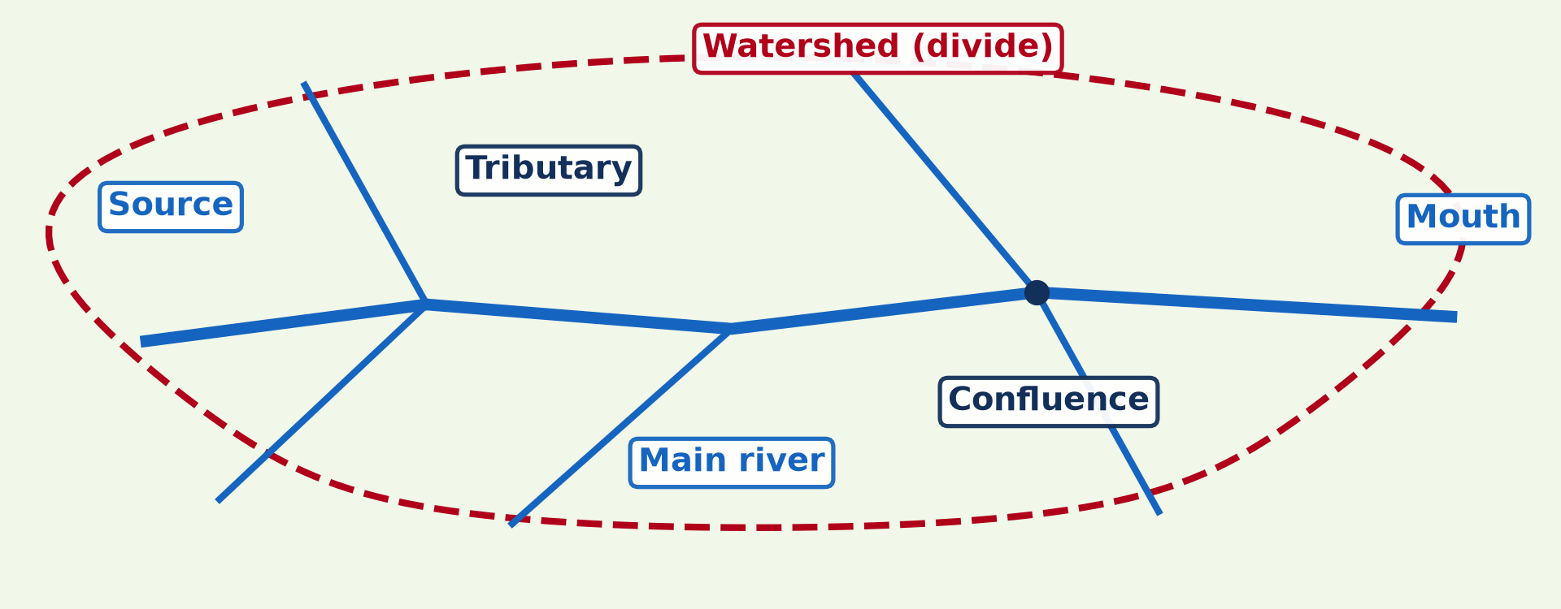
1. CONCEPT OF DRAINAGE BASIN
Activity 1
The parts of a drainage basin.
Notes:
Activity 1. Look carefully at this diagram: the parts of a drainage basin. Observe every detail before I ask the question.

Slide 19
1. CONCEPT OF DRAINAGE BASIN
Activity 1: Question
What is the line that separates two drainage basins?
Notes:
Here is the question for Activity 1: What is the line that separates two drainage basins? Take one minute to think and write your answer in your rough notebook.

Slide 20
1. CONCEPT OF DRAINAGE BASIN
Activity 1: Answer
The watershed (divide).
Notes:
Let us check the answer together. The watershed (divide).

Slide 21
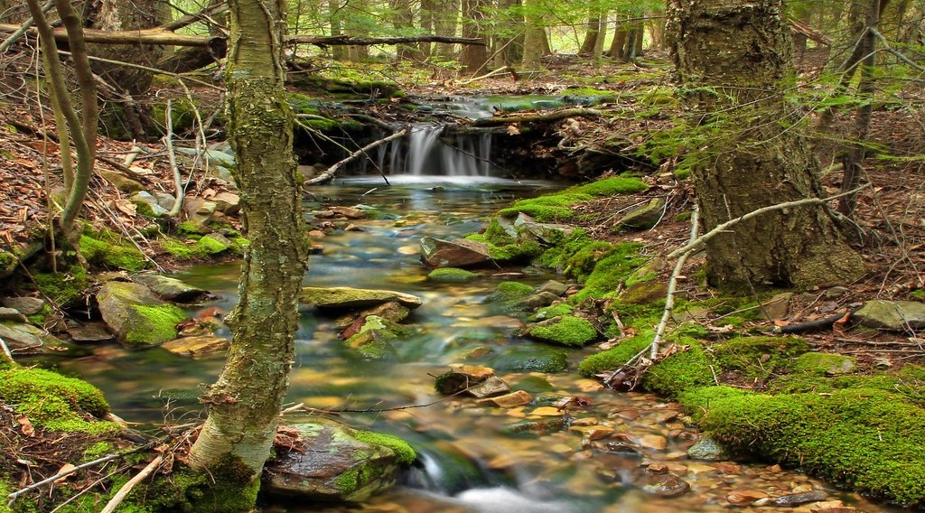
1. CONCEPT OF DRAINAGE BASIN
Activity 2
A small stream near its source.
Notes:
Activity 2. Look carefully at this picture: a small stream near its source. Observe every detail before I ask the question.

Slide 22
1. CONCEPT OF DRAINAGE BASIN
Activity 2: Question
Where does a river begin? What joins it on the way?
Notes:
Here is the question for Activity 2: Where does a river begin? What joins it on the way? Take one minute to think and write your answer in your rough notebook.

Slide 23
1. CONCEPT OF DRAINAGE BASIN
Activity 2: Answer
At its source; tributaries join it at confluences.
Notes:
Let us check the answer together. At its source; tributaries join it at confluences.

Slide 24

2. AN OPEN SYSTEM: INPUTS AND OUTPUTS
Activity 3
Inputs, stores and outputs.
Notes:
Activity 3. Look carefully at this diagram: inputs, stores and outputs. Observe every detail before I ask the question.

Slide 25
2. AN OPEN SYSTEM: INPUTS AND OUTPUTS
Activity 3: Question
What is the input and what are the outputs of a drainage basin?
Notes:
Here is the question for Activity 3: What is the input and what are the outputs of a drainage basin? Take one minute to think and write your answer in your rough notebook.

Slide 26
2. AN OPEN SYSTEM: INPUTS AND OUTPUTS
Activity 3: Answer
Input: precipitation. Outputs: evapotranspiration and runoff.
Notes:
Let us check the answer together. Input: precipitation. Outputs: evapotranspiration and runoff.

Slide 27
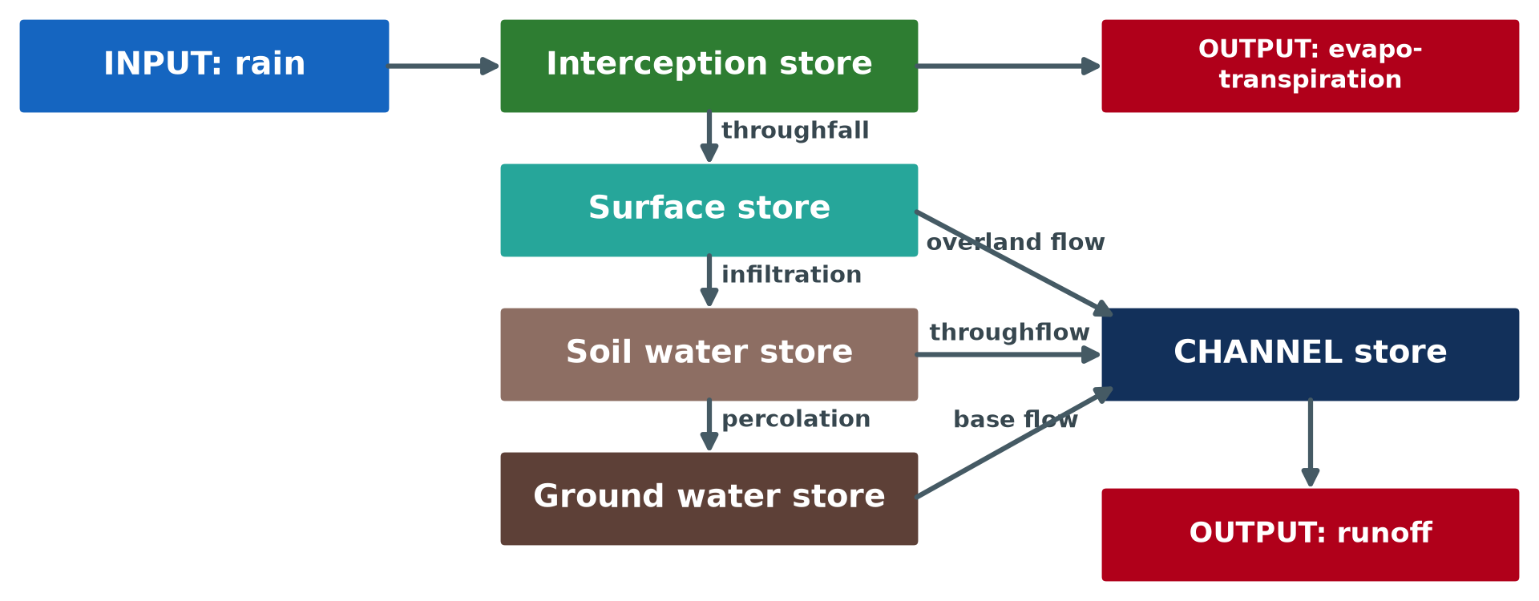
3. STORES AND FLOWS
Activity 4
Stores and flows in a drainage basin.
Notes:
Activity 4. Look carefully at this diagram: stores and flows in a drainage basin. Observe every detail before I ask the question.

Slide 28
3. STORES AND FLOWS
Activity 4: Question
Name the flows that carry water from the surface to the ground water.
Notes:
Here is the question for Activity 4: Name the flows that carry water from the surface to the ground water. Take one minute to think and write your answer in your rough notebook.

Slide 29
3. STORES AND FLOWS
Activity 4: Answer
Infiltration (into the soil) and percolation (into the rock).
Notes:
Let us check the answer together. Infiltration (into the soil) and percolation (into the rock).

Slide 30

3. STORES AND FLOWS
Activity 5
The Sanaga at the Nachtigal falls.
Notes:
Activity 5. Look carefully at this picture: the Sanaga at the Nachtigal falls. Observe every detail before I ask the question.

Slide 31
3. STORES AND FLOWS
Activity 5: Question
Which store is the river? How does water reach it?
Notes:
Here is the question for Activity 5: Which store is the river? How does water reach it? Take one minute to think and write your answer in your rough notebook.

Slide 32
3. STORES AND FLOWS
Activity 5: Answer
The channel store; by overland flow, throughflow and base flow.
Notes:
Let us check the answer together. The channel store; by overland flow, throughflow and base flow.

Slide 33
BOARD SUMMARY
Board Summary
Topic: Global Water in Storage and Circulation
Sub-topic: The Hydrological Cycle
Lesson 24: The Drainage Basin as an Open System
Notes:
Now we are going to copy the board summary. Write the title and the headings neatly in your notebooks. I will give you enough time for each slide, so do not rush.

Slide 34
BOARD SUMMARY
DEFINITIONS
The key terms of this lesson are defined as follows:
Drainage basin: It is the area of land drained by a river and its tributaries.
Watershed: It is the high ground that separates two drainage basins.
Notes:
Let us copy the definitions. The key terms of this lesson are defined as follows. On this slide we have Drainage basin and Watershed. Write each point on a new line, with the key term first, and explain it in your own words when we revise. When you finish, we go to the next slide.

Slide 35
BOARD SUMMARY
DEFINITIONS (continued)
Open system: It is a system that receives inputs from outside and loses outputs to the outside.
Notes:
We continue with the definitions. On this slide we have Open system. Write each point on a new line, with the key term first, and explain it in your own words when we revise.

Slide 36
BOARD SUMMARY
1. Concept of the Drainage Basin
A drainage basin has the following parts:
Source and mouth: A river begins at its source, often in the hills, and ends at its mouth in a sea, a lake or another river. The Benue rises on the Adamawa Plateau.
Notes:
Let us copy Concept of the Drainage Basin. A drainage basin has the following parts. On this slide we have Source and mouth. Write each point on a new line, with the key term first, and explain it in your own words when we revise. When you finish, we go to the next slide.

Slide 37
BOARD SUMMARY
1. Concept of the Drainage Basin (continued)
Tributaries and confluence: Tributaries are smaller rivers that join the main river. The point where they meet is the confluence.
Notes:
We continue with Concept of the Drainage Basin. On this slide we have Tributaries and confluence. Write each point on a new line, with the key term first, and explain it in your own words when we revise.

Slide 38
BOARD SUMMARY
1. Concept of the Drainage Basin
Illustration: parts of a drainage basin
Notes:
Now draw this illustration in your notebook: parts of a drainage basin. Give it a title and label it clearly.

Slide 39
BOARD SUMMARY
2. The Drainage Basin as an Open System
The drainage basin receives and loses water as follows:
Input: The main input is precipitation (rain, snow). Energy from the sun also enters the system.
Notes:
Let us copy The Drainage Basin as an Open System. The drainage basin receives and loses water as follows. On this slide we have Input. Write each point on a new line, with the key term first, and explain it in your own words when we revise. When you finish, we go to the next slide.

Slide 40
BOARD SUMMARY
2. The Drainage Basin as an Open System (continued)
Outputs: Water leaves by evapotranspiration to the atmosphere and by river discharge to the sea. Some may leave as deep groundwater flow.
Notes:
We continue with The Drainage Basin as an Open System. On this slide we have Outputs. Write each point on a new line, with the key term first, and explain it in your own words when we revise.

Slide 41
BOARD SUMMARY
2. The Drainage Basin as an Open System
Illustration: the drainage basin as an open system
Notes:
Now draw this illustration in your notebook: the drainage basin as an open system. Give it a title and label it clearly.

Slide 42
BOARD SUMMARY
3. Stores and Flows
Inside the basin, water is stored and transferred:
Stores: Interception (on plants), surface storage (puddles, lakes), soil moisture, groundwater and the river channel. Water stays in each store for different lengths of time.
Notes:
Let us copy Stores and Flows. Inside the basin, water is stored and transferred. On this slide we have Stores. Write each point on a new line, with the key term first, and explain it in your own words when we revise. When you finish, we go to the next slide.

Slide 43
BOARD SUMMARY
3. Stores and Flows (continued)
Flows (transfers): Throughfall and stemflow carry water to the ground; infiltration and percolation carry it down. Overland flow, throughflow and groundwater flow carry it to the river.
Notes:
We continue with Stores and Flows. On this slide we have Flows (transfers). Write each point on a new line, with the key term first, and explain it in your own words when we revise. When you finish, we go to the next slide.

Slide 44
BOARD SUMMARY
3. Stores and Flows (continued)
Cascading system: The output of one store is the input of the next. For example, infiltration moves water from the surface to the soil store.
Notes:
We continue with Stores and Flows. On this slide we have Cascading system. Write each point on a new line, with the key term first, and explain it in your own words when we revise.

Slide 45
BOARD SUMMARY
3. Stores and Flows
Illustration: stores and flows in a drainage basin
Notes:
Now draw this illustration in your notebook: stores and flows in a drainage basin. Give it a title and label it clearly.

Slide 46
FORMATIVE EVALUATION
Evaluation 1
Why is a drainage basin an open system?
Notes:
Now let us check what you have understood. Question 1: Why is a drainage basin an open system? Answer in your exercise book.

Slide 47
FORMATIVE EVALUATION
Expected Answer
Water enters as precipitation and leaves as evapotranspiration and runoff.
Notes:
The expected answer is: water enters as precipitation and leaves as evapotranspiration and runoff. If you got it right, well done.

Slide 48
FORMATIVE EVALUATION
Evaluation 2
Name three stores in a drainage basin.
Notes:
Now let us check what you have understood. Question 2: Name three stores in a drainage basin. Answer in your exercise book.

Slide 49
FORMATIVE EVALUATION
Expected Answer
Interception, soil water, ground water (also surface and channel).
Notes:
The expected answer is: interception, soil water, ground water (also surface and channel). If you got it right, well done.

Slide 50
REMEDIATION
Remediation
Fill in the blanks:
The edge of a drainage basin is the ______.
Water moving into the soil is ______.
Water moving through the soil to the river is ______.
Notes:
For those who need more practice, fill in the blanks in your exercise book. The answers are: number 1, watershed; number 2, infiltration; number 3, throughflow.

Slide 51
HOMEWORK
Homework
Draw the drainage basin of a stream near your school and label its parts.
Notes:
For your homework: Draw the drainage basin of a stream near your school and label its parts. We shall correct it at the beginning of our next lesson.

Slide 52
NEXT LESSON
Next Lesson
Our next lesson will be on:
Lesson 25: How Human Activities Affect the Hydrological Cycle
Notes:
Our next lesson will be on Lesson 25: How Human Activities Affect the Hydrological Cycle. Thank you for your attention, and see you next time.

Slide 53
BILINGUAL GAME
Bilingual Game (Jeu Bilingue)
English | Français
Drainage basin | Le bassin versant
Watershed | La ligne de partage des eaux
Tributary | L'affluent
Confluence | La confluence
Mouth | L'embouchure
Source | La source
Notes:
Let us play the bilingual game. I say a word in English, and you give me the French word. Then we do the reverse.

Slide 54
LOGBOOK
Official Logbook (1/2)
Module / Topic | Global Water in Storage and Circulation
Lesson Title | Lesson 24: The Drainage Basin as an Open System
Expected Learning Outcomes | Define a drainage basin and its parts. Explain why a basin is an open system. Describe its inputs, stores, flows and outputs.
Competence | Learners are able to describe a drainage basin and explain how water enters, is stored, moves and leaves it.
Notes:
I record this information in the official logbook of the class after the lesson.

Slide 55
LOGBOOK
Official Logbook (2/2)
Matter Taught | DEFINITIONS; Concept of the Drainage Basin; The Drainage Basin as an Open System; Stores and Flows.
Evaluation | Formative evaluation and remediation exercise.
Homework | Draw the drainage basin of a stream near your school and label its parts.
Enrolment / Present / Absent | ____ / ____ / ____
Achievement | To be completed after the lesson.
Notes:
I complete the second page of the logbook: the matter taught, the evaluation, the homework and the attendance.

Slide 56
TEACHER'S NOTE
Teacher's Note
Timing: Homework correction, plan, objectives 8 min | Recall, situation, action 10 min | 5 activities 30 min | Board summary (copying) 30 min | Evaluation, remediation 10 min | Homework, next lesson 5 min | Logbook 7 min
Without the projector (Activity 1): draw a basin with a main river and tributaries.
Without the projector (Activity 2): name tributaries of the Sanaga (Mbam, Lom).
Without the projector (Activity 3): draw three boxes.
Without the projector (Activity 4): pour water on soil in a bottle.
Without the projector (Activity 5): describe a river after rain.
Notes:
This slide is for me, the teacher: it gives the timing of the lesson and what to do if the projector is not available.

Slide 57
REFERENCES
References
National Geography Syllabus, MINESEC/IGE/IP-SS, 2019 — Module 1 (Meteorology, Climatology & Hydrology).
Photo, Activity 2: “Cherry Run (Headwaters) (3)” by Nicholas_T, CC BY 2.0, via Flickr (https://www.flickr.com/photos/14922165@N00/8690621015)
Photo, Activity 5: “Chutes de Natchigal” by friel, CC BY-NC-SA 2.0, via Flickr (https://www.flickr.com/photos/91702411@N00/2692932)
Diagrams and animations: drawn for this lesson (Geography Department).
Notes:
These are the references and picture credits used to prepare this lesson.

