Slide 1
LOWER SIXTH ARTS
GEOGRAPHY
Lesson 34
River Regimes
Notes:
Good morning, class, and welcome to our geography lesson. I am your geography teacher, Mr Kamdem. Today we are starting Lesson 34: River Regimes.

Slide 2
CLASS INFO
Class, Chapter and Duration
Class | Lower Sixth Arts
Chapter | Module 1: Understanding and managing atmospheric and hydrological phenomena and hazards across the world in general and Cameroon in particular
Duration | 2 periods (2 × 50 minutes)
Notes:
This lesson is for Lower Sixth Arts. It belongs to Module 1: Understanding and managing atmospheric and hydrological phenomena and hazards across the world in general and Cameroon in particular. We shall need 2 periods to cover it.

Slide 3
IDENTIFICATION
Lesson Identification
Topic | The Drainage Basin Hydrological Cycle
Sub-topic | Components of the Drainage Basin Hydrological Cycle
Lesson | Lesson 34: River Regimes
Notions / Concepts | River regime, simple regime, complex regime, high water, low water, regulation.
Syllabus focus | Meaning, types, illustrations and factors of river regimes (long-term, seasonal variation of runoff).
Competence | Learners are able to read a regime graph and explain the regimes of rivers in Cameroon.
Notes:
Our topic is The Drainage Basin Hydrological Cycle, and the sub-topic is Components of the Drainage Basin Hydrological Cycle. The key notions we shall use today are: river regime, simple regime, complex regime, high water, low water, regulation. At the end, you should be able to do this: learners are able to read a regime graph and explain the regimes of rivers in Cameroon.

Slide 4

HOMEWORK CORRECTION
Correction of the Homework
Question (Lesson 33: Storm Hydrographs):
Draw a flashy and a subdued hydrograph and give two causes of each.
Notes:
Before we start the new lesson, let us correct the homework I gave you at the end of Lesson 33: Storm Hydrographs. The question was: Draw a flashy and a subdued hydrograph and give two causes of each. Take out your exercise books.

Slide 5
HOMEWORK CORRECTION
Correction: Possible Answer
Flashy: steep and high, caused by heavy storms, steep slopes, clay or urban surfaces. Subdued: gentle and low, caused by forest cover, permeable soils and large, elongated basins.
Notes:
Here is a good answer. Flashy: steep and high, caused by heavy storms, steep slopes, clay or urban surfaces. Subdued: gentle and low, caused by forest cover, permeable soils and large, elongated basins. Compare it with your own answer and correct your work in red.

Slide 6
LESSON PLAN
Lesson Plan
Correction of the homework
Objectives and recall
Real-life situation and action to take
Learning activities
Board summary
Evaluation, remediation and homework
Notes:
Here is the plan of our lesson today. First, we shall correct the homework. Then we shall look at the objectives and recall what you already know. After that, we shall study a situation from real life and the action to take, and do the learning activities. Finally, we shall copy the board summary, do the evaluation and the remediation, and I will give you the homework.

Slide 7
OBJECTIVES
Objectives
By the end of this lesson, you should be able to:
Define a river regime.
Describe simple and complex regimes with examples.
Explain the factors of river regimes.
Notes:
By the end of this lesson, you should be able to do three things. Number 1: define a river regime. Number 2: describe simple and complex regimes with examples. Number 3: explain the factors of river regimes.

Slide 8
PREVIOUS KNOWLEDGE
Previous Knowledge
Rain varies with the seasons in Cameroon.
Base flow comes from ground water.
Notes:
Let us first remember what you already know. Rain varies with the seasons in Cameroon. Base flow comes from ground water. Keep this in mind, because we shall build on it today.

Slide 9
REAL-LIFE SITUATION
Situation in Real Life
In March, boats cannot reach Garoua because the Benue is too shallow. In September the same river is wide and full, and boats from Nigeria can arrive.
Notes:
Listen carefully to this situation from real life. In March, boats cannot reach Garoua because the Benue is too shallow. In September the same river is wide and full, and boats from Nigeria can arrive. Think about it, because I am going to ask you some questions.

Slide 10
REAL-LIFE SITUATION
Situation: Question 1
What is the problem in the situation?
Notes:
Question 1: What is the problem in the situation? Think for a moment, then raise your hand to answer.

Slide 11
REAL-LIFE SITUATION
Answer
The flow of the Benue changes greatly during the year.
Notes:
Good. The flow of the Benue changes greatly during the year.

Slide 12
REAL-LIFE SITUATION
Situation: Question 2
What is the yearly pattern of a river's flow called?
Notes:
Question 2: What is the yearly pattern of a river's flow called? Think for a moment, then raise your hand to answer.

Slide 13
REAL-LIFE SITUATION
Answer
Its regime.
Notes:
Good. Its regime.

Slide 14
REAL-LIFE SITUATION
Situation: Question 3
Why is the Benue full in September?
Notes:
Question 3: Why is the Benue full in September? Think for a moment, then raise your hand to answer.

Slide 15
REAL-LIFE SITUATION
Possible Answer
The rainy season in the north ends then.
Notes:
Good. The rainy season in the north ends then.

Slide 16
ACTION TO TAKE
Action to Take
Plan navigation, irrigation and hydro-electricity according to river regimes.
Notes:
From this situation, the action we are working towards in this lesson is the following: plan navigation, irrigation and hydro-electricity according to river regimes.

Slide 17
JUSTIFICATION
Justification of the Lesson
This lesson helps us to understand the seasonal flow of rivers, which is important for navigation, farming and dams.
Notes:
Why is this lesson important for you? This lesson helps us to understand the seasonal flow of rivers, which is important for navigation, farming and dams.

Slide 18
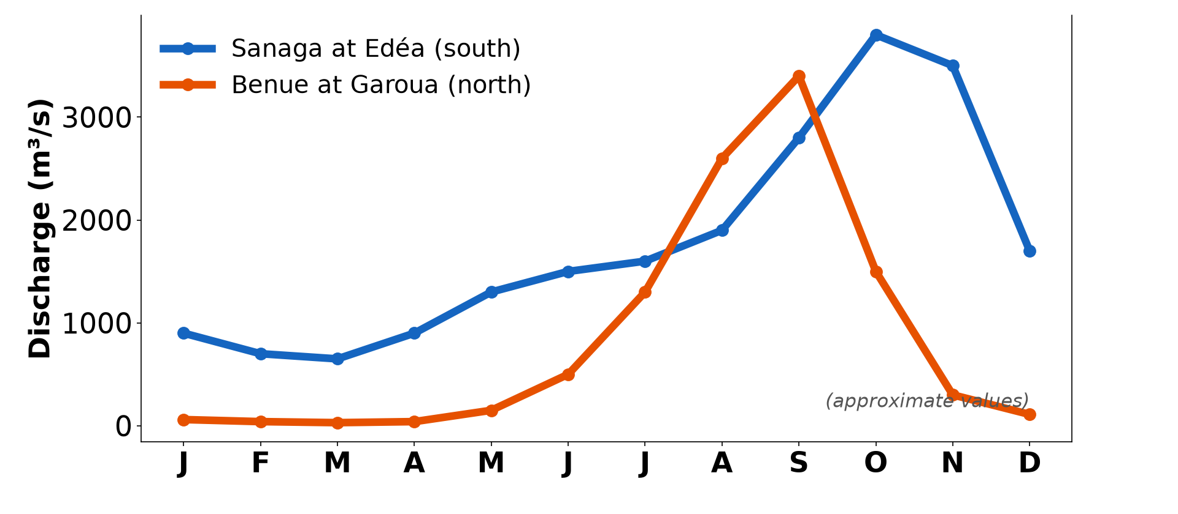
1. MEANING
Activity 1
Monthly discharge of the Sanaga and the Benue.
Notes:
Activity 1. Look carefully at this diagram: monthly discharge of the Sanaga and the Benue. Observe every detail before I ask the question.

Slide 19
1. MEANING
Activity 1: Question
When is the Benue at Garoua highest and lowest?
Notes:
Here is the question for Activity 1: When is the Benue at Garoua highest and lowest? Take one minute to think and write your answer in your rough notebook.

Slide 20
1. MEANING
Activity 1: Answer
Highest in September; lowest from February to April.
Notes:
Let us check the answer together. Highest in September; lowest from February to April.

Slide 21

1. MEANING
Activity 2
The Benue River.
Notes:
Activity 2. Look carefully at this picture: the Benue River. Observe every detail before I ask the question.

Slide 22
1. MEANING
Activity 2: Question
Why can boats reach Garoua only a few months each year?
Notes:
Here is the question for Activity 2: Why can boats reach Garoua only a few months each year? Take one minute to think and write your answer in your rough notebook.

Slide 23
1. MEANING
Activity 2: Answer
The river is deep enough only during high water (August–October).
Notes:
Let us check the answer together. The river is deep enough only during high water (August–October).

Slide 24

2. TYPES: SIMPLE REGIME
Activity 3
The Sanaga at Nachtigal.
Notes:
Activity 3. Look carefully at this picture: the Sanaga at Nachtigal. Observe every detail before I ask the question.

Slide 25
2. TYPES: SIMPLE REGIME
Activity 3: Question
The Sanaga has one main high-water period. What type of regime is this?
Notes:
Here is the question for Activity 3: The Sanaga has one main high-water period. What type of regime is this? Take one minute to think and write your answer in your rough notebook.

Slide 26
2. TYPES: SIMPLE REGIME
Activity 3: Answer
A simple (tropical) regime with one flood season.
Notes:
Let us check the answer together. A simple (tropical) regime with one flood season.

Slide 27
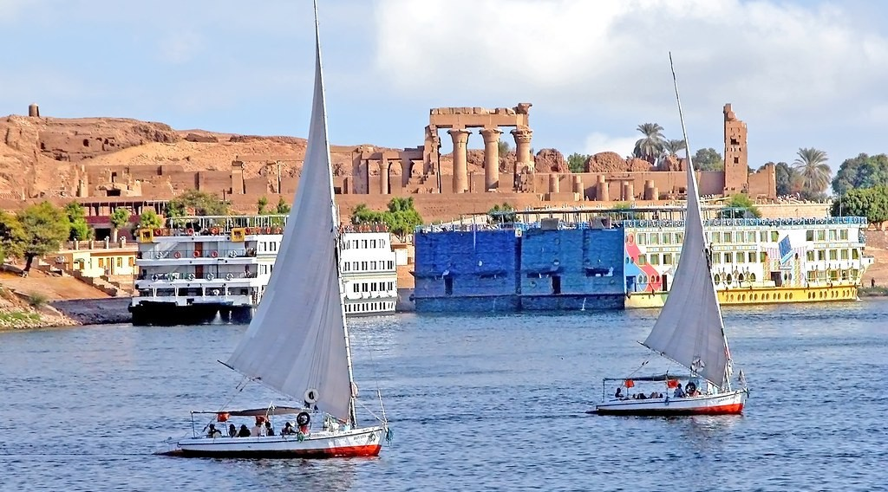
2. TYPES: COMPLEX REGIME
Activity 4
The Nile River.
Notes:
Activity 4. Look carefully at this picture: the Nile River. Observe every detail before I ask the question.

Slide 28
2. TYPES: COMPLEX REGIME
Activity 4: Question
The Nile is fed by several climate zones. What type of regime does it have?
Notes:
Here is the question for Activity 4: The Nile is fed by several climate zones. What type of regime does it have? Take one minute to think and write your answer in your rough notebook.

Slide 29
2. TYPES: COMPLEX REGIME
Activity 4: Answer
A complex regime.
Notes:
Let us check the answer together. A complex regime.

Slide 30

3. FACTORS: DAMS
Activity 5
A large dam spillway.
Notes:
Activity 5. Look carefully at this picture: a large dam spillway. Observe every detail before I ask the question.

Slide 31
3. FACTORS: DAMS
Activity 5: Question
How do dams change a river's regime?
Notes:
Here is the question for Activity 5: How do dams change a river's regime? Take one minute to think and write your answer in your rough notebook.

Slide 32
3. FACTORS: DAMS
Activity 5: Answer
They store water in the wet season and release it in the dry season (regulation).
Notes:
Let us check the answer together. They store water in the wet season and release it in the dry season (regulation).

Slide 33
BOARD SUMMARY
Board Summary
Topic: The Drainage Basin Hydrological Cycle
Sub-topic: Components of the Drainage Basin Hydrological Cycle
Lesson 34: River Regimes
Notes:
Now we are going to copy the board summary. Write the title and the headings neatly in your notebooks. I will give you enough time for each slide, so do not rush.

Slide 34
BOARD SUMMARY
1. Meaning of River Regimes
A river regime can be understood as follows:
River regime: It is the pattern of seasonal variation in the discharge of a river over a year.
Notes:
Let us copy Meaning of River Regimes. A river regime can be understood as follows. On this slide we have River regime. Write each point on a new line, with the key term first, and explain it in your own words when we revise. When you finish, we go to the next slide.

Slide 35
BOARD SUMMARY
1. Meaning of River Regimes (continued)
Example: The Benue at Garoua has high water from August to October and very low water from February to April. Boats can reach Garoua only in the high-water period.
Notes:
We continue with Meaning of River Regimes. On this slide we have Example. Write each point on a new line, with the key term first, and explain it in your own words when we revise.

Slide 36
BOARD SUMMARY
1. Meaning of River Regimes
Illustration: regime of the Benue at Garoua
Notes:
Now draw this illustration in your notebook: regime of the Benue at Garoua. Give it a title and label it clearly.

Slide 37
BOARD SUMMARY
2. Types of River Regimes
River regimes are of two main types:
Simple regime: It has one high-water period and one low-water period in a year, from one source of water. The Sanaga and the Benue have simple tropical regimes.
Notes:
Let us copy Types of River Regimes. River regimes are of two main types. On this slide we have Simple regime. Write each point on a new line, with the key term first, and explain it in your own words when we revise. When you finish, we go to the next slide.

Slide 38
BOARD SUMMARY
2. Types of River Regimes (continued)
Complex regime: It has two or more high-water periods, because the river is fed by several climate zones or by rain and snowmelt. The Nile and the Congo have complex regimes.
Notes:
We continue with Types of River Regimes. On this slide we have Complex regime. Write each point on a new line, with the key term first, and explain it in your own words when we revise.

Slide 39
BOARD SUMMARY
3. Factors of River Regimes
River regimes depend on static and dynamic factors:
Climatic (dynamic) factors: The amount and seasonality of rainfall, evaporation and snowmelt are the main factors. Rivers in wet equatorial regions have a regular flow.
Notes:
Let us copy Factors of River Regimes. River regimes depend on static and dynamic factors. On this slide we have Climatic (dynamic) factors. Write each point on a new line, with the key term first, and explain it in your own words when we revise. When you finish, we go to the next slide.

Slide 40
BOARD SUMMARY
3. Factors of River Regimes (continued)
Basin (static) factors: Rock type, soils, vegetation and the size of the basin affect how water is stored and released. Lakes and permeable rocks regulate flow.
Notes:
We continue with Factors of River Regimes. On this slide we have Basin (static) factors. Write each point on a new line, with the key term first, and explain it in your own words when we revise. When you finish, we go to the next slide.

Slide 41
BOARD SUMMARY
3. Factors of River Regimes (continued)
Human factors: Dams and reservoirs store water in the wet season and release it in the dry season. The Mbakaou and Lom Pangar dams regulate the Sanaga for Edéa and Song Loulou.
Notes:
We continue with Factors of River Regimes. On this slide we have Human factors. Write each point on a new line, with the key term first, and explain it in your own words when we revise.

Slide 42
FORMATIVE EVALUATION
Evaluation 1
What is a river regime?
Notes:
Now let us check what you have understood. Question 1: What is a river regime? Answer in your exercise book.

Slide 43
FORMATIVE EVALUATION
Expected Answer
The pattern of changes in a river's discharge during the year.
Notes:
The expected answer is: the pattern of changes in a river's discharge during the year. If you got it right, well done.

Slide 44
FORMATIVE EVALUATION
Evaluation 2
Distinguish simple and complex regimes.
Notes:
Now let us check what you have understood. Question 2: Distinguish simple and complex regimes. Answer in your exercise book.

Slide 45
FORMATIVE EVALUATION
Expected Answer
Simple: one high and one low period; complex: several high periods from different sources.
Notes:
The expected answer is: simple: one high and one low period; complex: several high periods from different sources. If you got it right, well done.

Slide 46
REMEDIATION
Remediation
Fill in the blanks:
The yearly pattern of discharge is the river ______.
A regime with one flood season is ______.
Dams ______ the flow of rivers.
Notes:
For those who need more practice, fill in the blanks in your exercise book. The answers are: number 1, regime; number 2, simple; number 3, regulate.

Slide 47
HOMEWORK
Homework
Using the regime graph, write when the Sanaga is best for hydro-electricity and why dams are needed.
Notes:
For your homework: Using the regime graph, write when the Sanaga is best for hydro-electricity and why dams are needed. We shall correct it at the beginning of our next lesson.

Slide 48
NEXT LESSON
Next Lesson
Our next lesson will be on:
Practical Work 1: Plotting and Analysing Storm Hydrographs and River Regimes
Notes:
Our next lesson will be on Practical Work 1: Plotting and Analysing Storm Hydrographs and River Regimes. Thank you for your attention, and see you next time.

Slide 49
BILINGUAL GAME
Bilingual Game (Jeu Bilingue)
English | Français
River regime | Le régime fluvial
High water | Les hautes eaux
Low water | L'étiage
Navigation | La navigation
Regulation | La régularisation
Flood season | La saison des crues
Notes:
Let us play the bilingual game. I say a word in English, and you give me the French word. Then we do the reverse.

Slide 50
LOGBOOK
Official Logbook (1/2)
Module / Topic | The Drainage Basin Hydrological Cycle
Lesson Title | Lesson 34: River Regimes
Expected Learning Outcomes | Define a river regime. Describe simple and complex regimes with examples. Explain the factors of river regimes.
Competence | Learners are able to read a regime graph and explain the regimes of rivers in Cameroon.
Notes:
I record this information in the official logbook of the class after the lesson.

Slide 51
LOGBOOK
Official Logbook (2/2)
Matter Taught | Meaning of River Regimes; Types of River Regimes; Factors of River Regimes.
Evaluation | Formative evaluation and remediation exercise.
Homework | Using the regime graph, write when the Sanaga is best for hydro-electricity and why dams are needed.
Enrolment / Present / Absent | ____ / ____ / ____
Achievement | To be completed after the lesson.
Notes:
I complete the second page of the logbook: the matter taught, the evaluation, the homework and the attendance.

Slide 52
TEACHER'S NOTE
Teacher's Note
Timing: Homework correction, plan, objectives 8 min | Recall, situation, action 10 min | 5 activities 30 min | Board summary (copying) 30 min | Evaluation, remediation 10 min | Homework, next lesson 5 min | Logbook 7 min
Without the projector (Activity 1): read the graph.
Without the projector (Activity 2): find Garoua on the map.
Without the projector (Activity 3): compare with the Benue.
Without the projector (Activity 4): trace the Nile and its sources.
Without the projector (Activity 5): mention Lagdo on the Benue and Mbakaou on the Djerem.
Notes:
This slide is for me, the teacher: it gives the timing of the lesson and what to do if the projector is not available.

Slide 53
REFERENCES
References
National Geography Syllabus, MINESEC/IGE/IP-SS, 2019 — Module 1 (Meteorology, Climatology & Hydrology).
Photo, Activity 2: “Niamey, Niger” by LenDog64, CC BY-ND 2.0, via Flickr (https://www.flickr.com/photos/45968460@N03/4422209893)
Photo, Activity 3: “Chutes de Natchigal” by friel, CC BY-NC-SA 2.0, via Flickr (https://www.flickr.com/photos/91702411@N00/2692932)
Photo, Activity 4: “Egypt-5B-023 - Approaching Aswan” by archer10 (Dennis), CC BY-SA 2.0, via Flickr (https://www.flickr.com/photos/22490717@N02/2217394088)
Photo, Activity 5: “Fontana Dam Spillway” by Frank Kehren, CC BY-NC-ND 2.0, via Flickr (https://www.flickr.com/photos/77759596@N00/9256852611)
Diagrams and animations: drawn for this lesson (Geography Department).
Notes:
These are the references and picture credits used to prepare this lesson.

