Slide 1
LOWER SIXTH ARTS
GEOGRAPHY
Practical Work 1
Plotting and Analysing Storm Hydrographs and River Regimes
Notes:
Good morning, class, and welcome to our geography lesson. I am your geography teacher, Mr Kamdem. Today we are starting Practical Work 1: Plotting and Analysing Storm Hydrographs and River Regimes.

Slide 2
CLASS INFO
Class, Chapter and Duration
Class | Lower Sixth Arts
Chapter | Module 1: Understanding and managing atmospheric and hydrological phenomena and hazards across the world in general and Cameroon in particular
Duration | 2 periods (2 × 50 minutes)
Notes:
This lesson is for Lower Sixth Arts. It belongs to Module 1: Understanding and managing atmospheric and hydrological phenomena and hazards across the world in general and Cameroon in particular. We shall need 2 periods to cover it.

Slide 3
IDENTIFICATION
Lesson Identification
Topic | Hydrology
Sub-topic | Hydrological Problems
Lesson | Practical Work 1: Plotting and Analysing Storm Hydrographs and River Regimes
Notions / Concepts | Discharge data, hydrograph, regime graph, lag time, peak flow, low flow.
Syllabus focus | Plot discharge data; interpret peak and low flows; identify regimes and their factors; uses of hydrographs in engineering.
Competence | Learners are able to plot and interpret storm hydrographs and regime graphs.
Notes:
Our topic is Hydrology, and the sub-topic is Hydrological Problems. The key notions we shall use today are: discharge data, hydrograph, regime graph, lag time, peak flow, low flow. At the end, you should be able to do this: learners are able to plot and interpret storm hydrographs and regime graphs.

Slide 4

HOMEWORK CORRECTION
Correction of the Homework
Question (Lesson 34: River Regimes):
Using the regime graph, write when the Sanaga is best for hydro-electricity and why dams are needed.
Notes:
Before we start the new lesson, let us correct the homework I gave you at the end of Lesson 34: River Regimes. The question was: Using the regime graph, write when the Sanaga is best for hydro-electricity and why dams are needed. Take out your exercise books.

Slide 5
HOMEWORK CORRECTION
Correction: Possible Answer
The Sanaga is highest from September to November, the best time for hydro-electricity. Dams such as Lom Pangar store water to keep turbines working in the low-water season (February to April).
Notes:
Here is a good answer. The Sanaga is highest from September to November, the best time for hydro-electricity. Dams such as Lom Pangar store water to keep turbines working in the low-water season (February to April). Compare it with your own answer and correct your work in red.

Slide 6
LESSON PLAN
Lesson Plan
Correction of the homework
Objectives and recall
Real-life situation and action to take
Learning activities
Board summary
Evaluation, remediation and homework
Notes:
Here is the plan of our lesson today. First, we shall correct the homework. Then we shall look at the objectives and recall what you already know. After that, we shall study a situation from real life and the action to take, and do the learning activities. Finally, we shall copy the board summary, do the evaluation and the remediation, and I will give you the homework.

Slide 7
OBJECTIVES
Objectives
By the end of this lesson, you should be able to:
Plot a storm hydrograph from data.
Calculate lag time and read peak discharge.
Notes:
Take your time to copy this part; we will continue together.

Slide 8
OBJECTIVES
Objectives (continued)
Plot and interpret a regime graph and give the uses of hydrographs.
Notes:
By the end of this lesson, you should be able to do three things. Number 1: plot a storm hydrograph from data. Number 2: calculate lag time and read peak discharge. Number 3: plot and interpret a regime graph and give the uses of hydrographs.

Slide 9
PREVIOUS KNOWLEDGE
Previous Knowledge
A storm hydrograph shows discharge after a storm.
A regime graph shows discharge over a year.
Notes:
Let us first remember what you already know. A storm hydrograph shows discharge after a storm. A regime graph shows discharge over a year. Keep this in mind, because we shall build on it today.

Slide 10
REAL-LIFE SITUATION
Situation in Real Life
The Ministry of Water wants to build a small dam on a stream in the West Region. An engineer gives the class a table of rainfall and discharge after a storm and asks them to draw and read the graph.
Notes:
Listen carefully to this situation from real life. The Ministry of Water wants to build a small dam on a stream in the West Region. An engineer gives the class a table of rainfall and discharge after a storm and asks them to draw and read the graph. Think about it, because I am going to ask you some questions.

Slide 11
REAL-LIFE SITUATION
Situation: Question 1
What is the problem in the situation?
Notes:
Question 1: What is the problem in the situation? Think for a moment, then raise your hand to answer.

Slide 12
REAL-LIFE SITUATION
Answer
The data must be plotted and interpreted.
Notes:
Good. The data must be plotted and interpreted.

Slide 13
REAL-LIFE SITUATION
Situation: Question 2
What graph will the class draw?
Notes:
Question 2: What graph will the class draw? Think for a moment, then raise your hand to answer.

Slide 14
REAL-LIFE SITUATION
Answer
A storm hydrograph.
Notes:
Good. A storm hydrograph.

Slide 15
REAL-LIFE SITUATION
Situation: Question 3
Why does the engineer need it?
Notes:
Question 3: Why does the engineer need it? Think for a moment, then raise your hand to answer.

Slide 16
REAL-LIFE SITUATION
Possible Answer
To know the highest flood the dam must resist.
Notes:
Good. To know the highest flood the dam must resist.

Slide 17
ACTION TO TAKE
Action to Take
Use hydrological data to predict floods and plan water projects.
Notes:
From this situation, the action we are working towards in this lesson is the following: use hydrological data to predict floods and plan water projects.

Slide 18
JUSTIFICATION
Justification of the Lesson
This practical work helps us to use graphs to understand floods and river flow.
Notes:
Why is this lesson important for you? This practical work helps us to use graphs to understand floods and river flow.

Slide 19
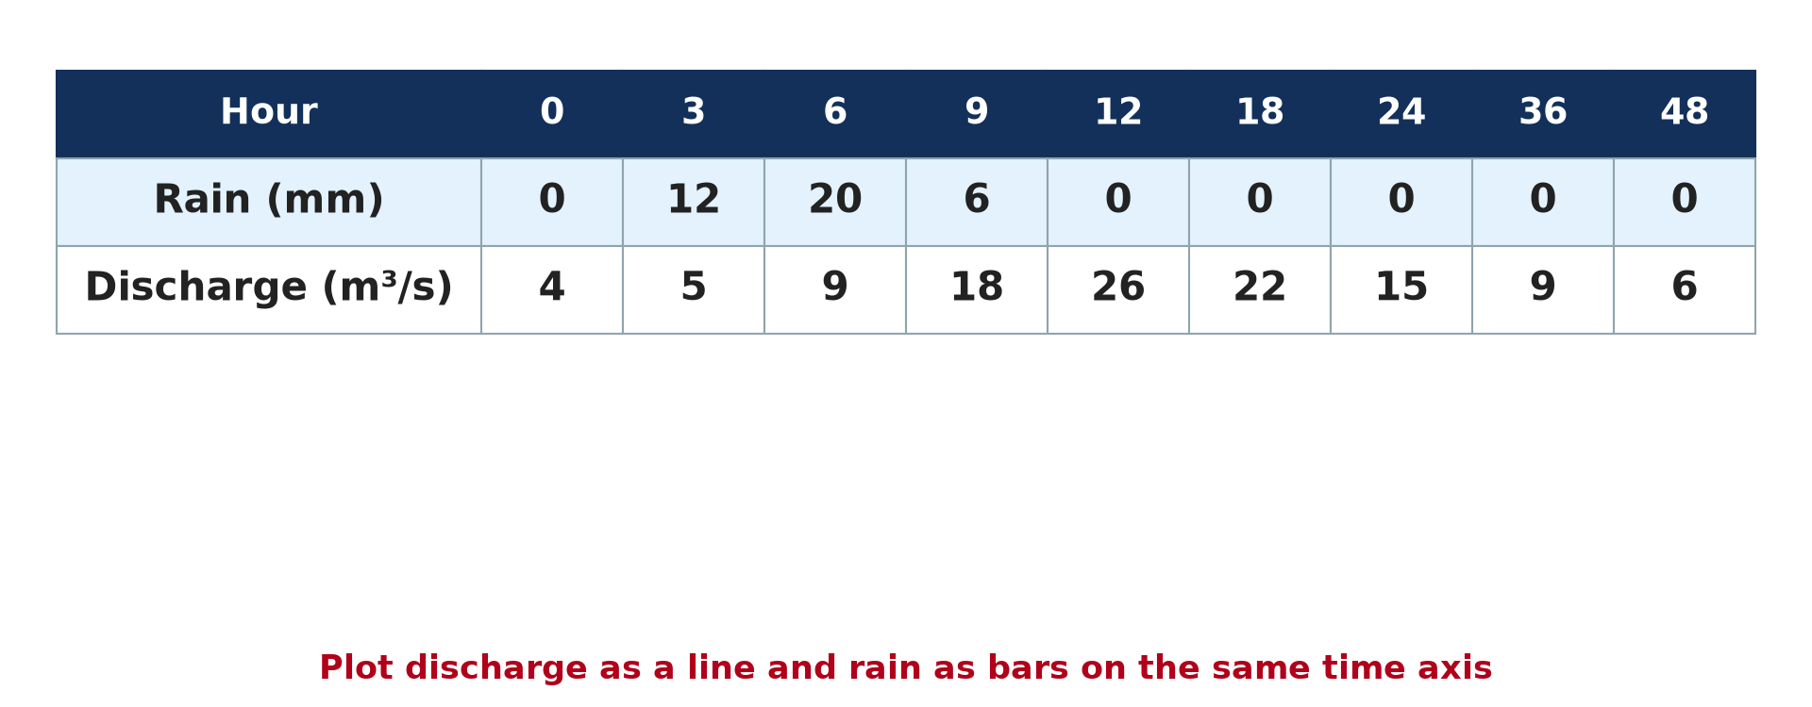
1. THE DATA
Activity 1
Rainfall and discharge after a storm.
Notes:
Activity 1. Look carefully at this diagram: rainfall and discharge after a storm. Observe every detail before I ask the question.

Slide 20
1. THE DATA
Activity 1: Question
At what hour is rain heaviest? At what hour is discharge highest?
Notes:
Here is the question for Activity 1: At what hour is rain heaviest? At what hour is discharge highest? Take one minute to think and write your answer in your rough notebook.

Slide 21
1. THE DATA
Activity 1: Answer
Rain at hour 6; discharge at hour 12.
Notes:
Let us check the answer together. Rain at hour 6; discharge at hour 12.

Slide 22
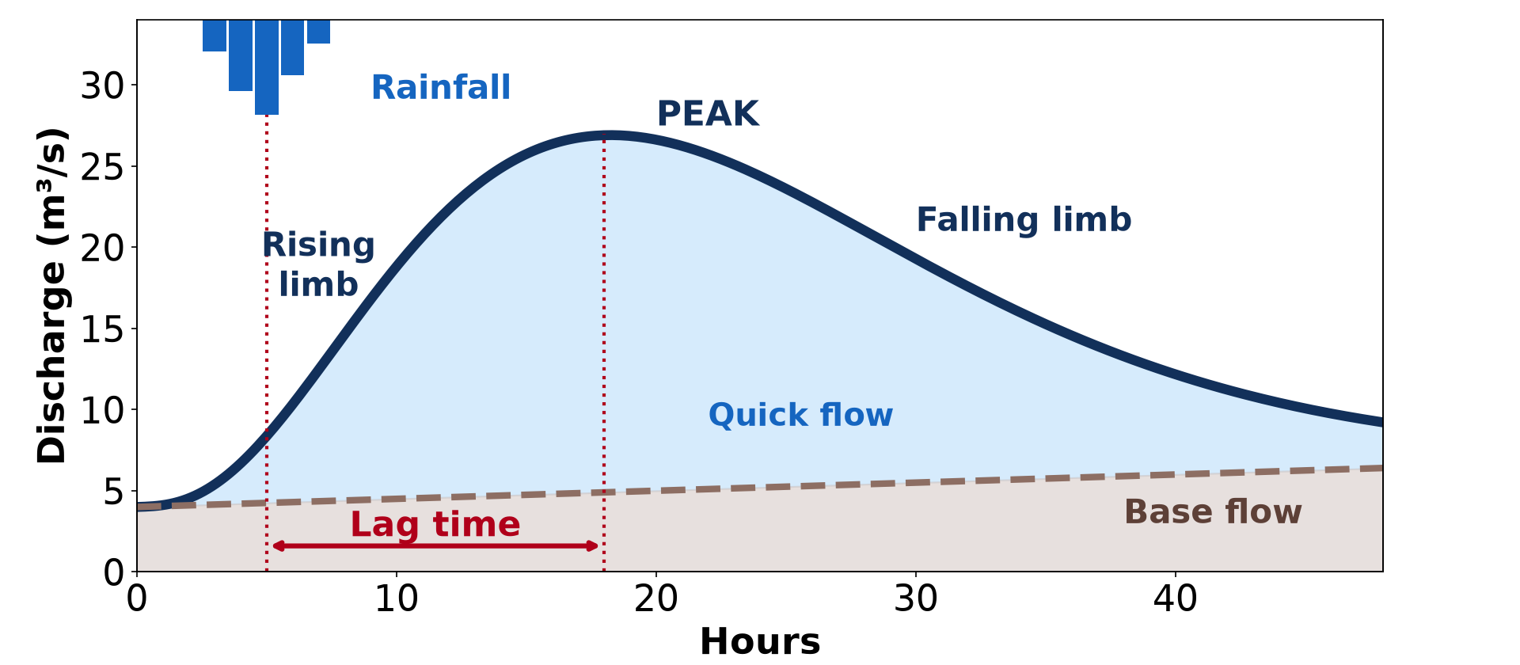
2. PLOTTING A STORM HYDROGRAPH
Activity 2
The storm hydrograph drawn from data.
Notes:
Activity 2. Look carefully at this diagram: the storm hydrograph drawn from data. Observe every detail before I ask the question.

Slide 23
2. PLOTTING A STORM HYDROGRAPH
Activity 2: Question
Using the table, what is the lag time?
Notes:
Here is the question for Activity 2: Using the table, what is the lag time? Take one minute to think and write your answer in your rough notebook.

Slide 24
2. PLOTTING A STORM HYDROGRAPH
Activity 2: Answer
12 − 6 = 6 hours.
Notes:
Let us check the answer together. 12 − 6 = 6 hours.

Slide 25
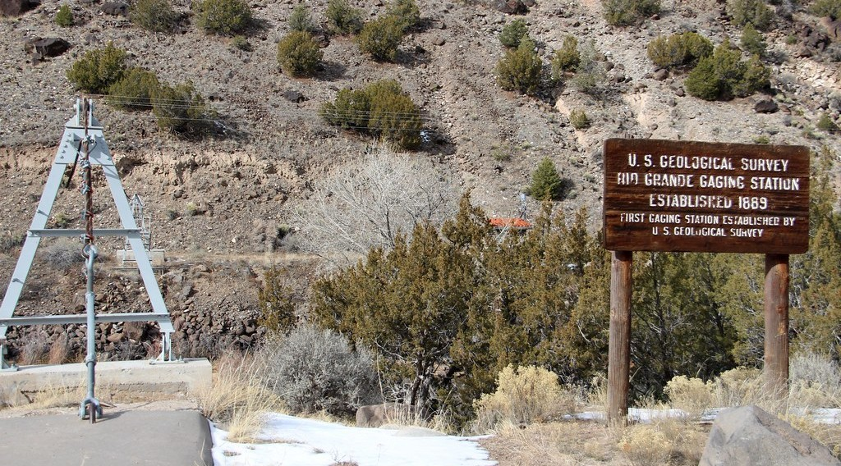
2. COLLECTING DATA
Activity 3
A gauging station that records discharge.
Notes:
Activity 3. Look carefully at this picture: a gauging station that records discharge. Observe every detail before I ask the question.

Slide 26
2. COLLECTING DATA
Activity 3: Question
How are discharge data collected?
Notes:
Here is the question for Activity 3: How are discharge data collected? Take one minute to think and write your answer in your rough notebook.

Slide 27
2. COLLECTING DATA
Activity 3: Answer
At gauging stations that measure water level and velocity.
Notes:
Let us check the answer together. At gauging stations that measure water level and velocity.

Slide 28
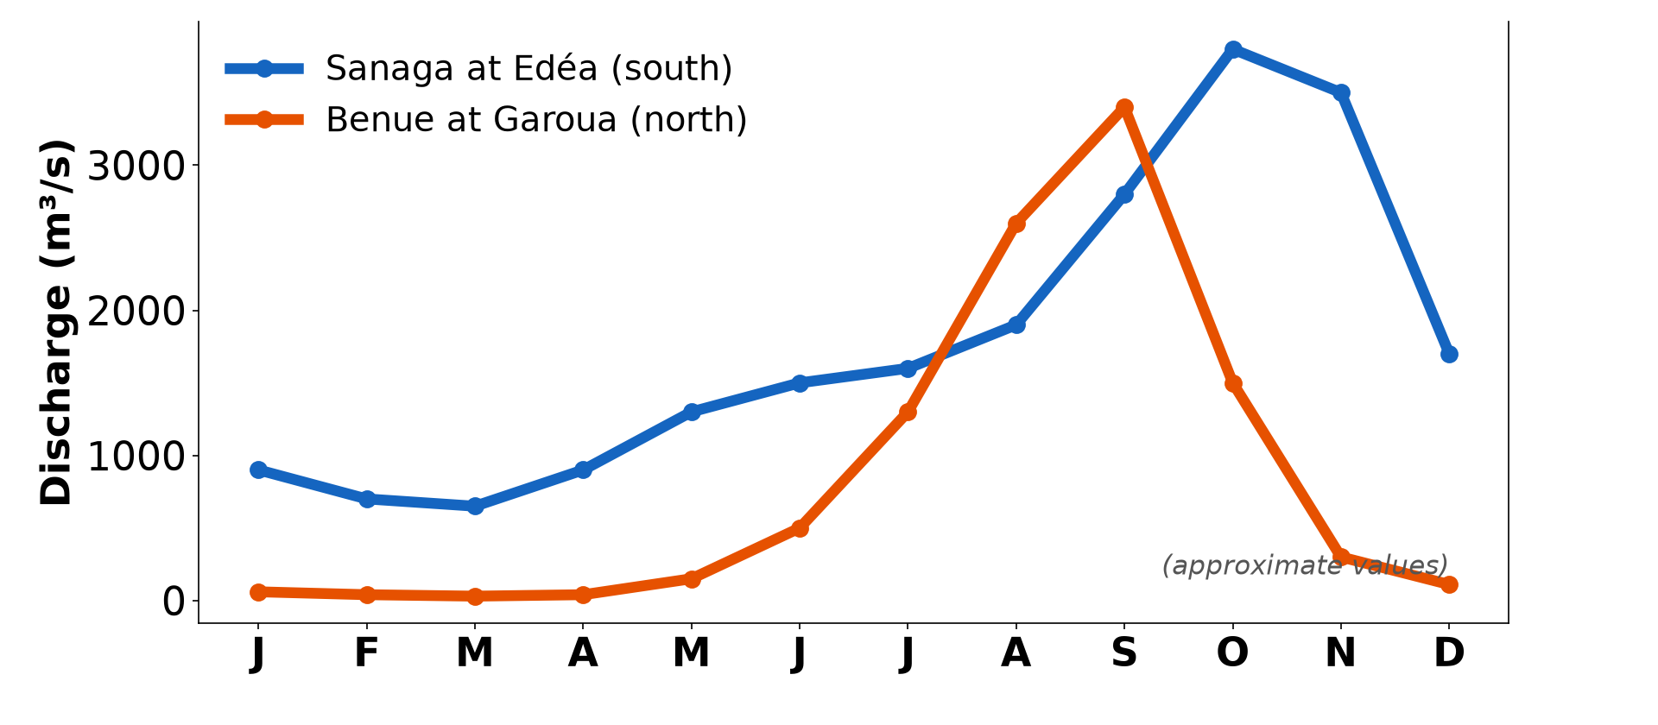
3. REGIME GRAPHS
Activity 4
Regime graphs of two rivers.
Notes:
Activity 4. Look carefully at this diagram: regime graphs of two rivers. Observe every detail before I ask the question.

Slide 29
3. REGIME GRAPHS
Activity 4: Question
What type of regime does the Benue have? What problem does its low flow cause?
Notes:
Here is the question for Activity 4: What type of regime does the Benue have? What problem does its low flow cause? Take one minute to think and write your answer in your rough notebook.

Slide 30
3. REGIME GRAPHS
Activity 4: Answer
A simple tropical regime; boats cannot reach Garoua and water is scarce.
Notes:
Let us check the answer together. A simple tropical regime; boats cannot reach Garoua and water is scarce.

Slide 31

4. INTERPRETATION AND USES
Activity 5
A dam spillway.
Notes:
Activity 5. Look carefully at this picture: a dam spillway. Observe every detail before I ask the question.

Slide 32
4. INTERPRETATION AND USES
Activity 5: Question
Why do engineers study hydrographs before building a dam?
Notes:
Here is the question for Activity 5: Why do engineers study hydrographs before building a dam? Take one minute to think and write your answer in your rough notebook.

Slide 33
4. INTERPRETATION AND USES
Activity 5: Answer
To design the spillway for the highest floods and plan water storage.
Notes:
Let us check the answer together. To design the spillway for the highest floods and plan water storage.

Slide 34
BOARD SUMMARY
Board Summary
Topic: Hydrology
Sub-topic: Hydrological Problems
Practical Work 1: Plotting and Analysing Storm Hydrographs and River Regimes
Notes:
Now we are going to copy the board summary. Write the title and the headings neatly in your notebooks. I will give you enough time for each slide, so do not rush.

Slide 35
BOARD SUMMARY
DEFINITIONS
The key terms of this lesson are defined as follows:
Storm hydrograph: It is a graph of river discharge against time during and after a storm.
Notes:
Let us copy the definitions. The key terms of this lesson are defined as follows. On this slide we have Storm hydrograph. Write each point on a new line, with the key term first, and explain it in your own words when we revise. When you finish, we go to the next slide.

Slide 36
BOARD SUMMARY
DEFINITIONS (continued)
River regime graph: It is a graph of the mean monthly discharge of a river over a year.
Notes:
We continue with the definitions. On this slide we have River regime graph. Write each point on a new line, with the key term first, and explain it in your own words when we revise.

Slide 37
BOARD SUMMARY
1. Plotting a Storm Hydrograph
A storm hydrograph is plotted as follows:
Axes: Time (hours) is placed on the x-axis and discharge (m³/s) on the left y-axis. Rainfall (mm) is shown as bars on a second y-axis at the top or right.
Notes:
Let us copy Plotting a Storm Hydrograph. A storm hydrograph is plotted as follows. On this slide we have Axes. Write each point on a new line, with the key term first, and explain it in your own words when we revise. When you finish, we go to the next slide.

Slide 38
BOARD SUMMARY
1. Plotting a Storm Hydrograph (continued)
Plotting: Plot each discharge value and join the points with a smooth curve. Draw the base flow line under the curve.
Reading: Mark the peak rainfall and the peak discharge and measure the lag time between them. Describe the rising and falling limbs.
Notes:
We continue with Plotting a Storm Hydrograph. On this slide we have Plotting and Reading. Write each point on a new line, with the key term first, and explain it in your own words when we revise.

Slide 39
BOARD SUMMARY
1. Plotting a Storm Hydrograph
Illustration: a plotted storm hydrograph
Notes:
Now draw this illustration in your notebook: a plotted storm hydrograph. Give it a title and label it clearly.

Slide 40
BOARD SUMMARY
2. Plotting and Analysing a River Regime
A regime graph is plotted and analysed as follows:
Plotting: Place the months on the x-axis and mean discharge on the y-axis. Draw bars or a line for each month.
Notes:
Let us copy Plotting and Analysing a River Regime. A regime graph is plotted and analysed as follows. On this slide we have Plotting. Write each point on a new line, with the key term first, and explain it in your own words when we revise. When you finish, we go to the next slide.

Slide 41
BOARD SUMMARY
2. Plotting and Analysing a River Regime (continued)
Analysis: Identify the high-water and low-water periods and calculate the ratio between them. Relate them to rainfall and to the type of regime.
Notes:
We continue with Plotting and Analysing a River Regime. On this slide we have Analysis. Write each point on a new line, with the key term first, and explain it in your own words when we revise. When you finish, we go to the next slide.

Slide 42
BOARD SUMMARY
2. Plotting and Analysing a River Regime (continued)
Uses: Hydrographs and regimes are used to design dams, bridges and flood warnings. They also help to plan navigation and irrigation.
Notes:
We continue with Plotting and Analysing a River Regime. On this slide we have Uses. Write each point on a new line, with the key term first, and explain it in your own words when we revise.

Slide 43
BOARD SUMMARY
2. Plotting and Analysing a River Regime
Illustration: a river regime graph
Notes:
Now draw this illustration in your notebook: a river regime graph. Give it a title and label it clearly.

Slide 44
FORMATIVE EVALUATION
Evaluation 1
Rain peaks at hour 3 and discharge at hour 9. What is the lag time?
Notes:
Now let us check what you have understood. Question 1: Rain peaks at hour 3 and discharge at hour 9. What is the lag time? Answer in your exercise book.

Slide 45
FORMATIVE EVALUATION
Expected Answer
6 hours.
Notes:
The expected answer is: 6 hours. If you got it right, well done.

Slide 46
FORMATIVE EVALUATION
Evaluation 2
Give two uses of hydrographs in engineering.
Notes:
Now let us check what you have understood. Question 2: Give two uses of hydrographs in engineering. Answer in your exercise book.

Slide 47
FORMATIVE EVALUATION
Expected Answer
Designing dams and bridges (also flood defences, irrigation).
Notes:
The expected answer is: designing dams and bridges (also flood defences, irrigation). If you got it right, well done.

Slide 48
REMEDIATION
Remediation
Fill in the blanks:
Discharge is plotted on the ______ axis.
Rain is drawn as ______.
The time between peak rain and peak discharge is the ______.
Notes:
For those who need more practice, fill in the blanks in your exercise book. The answers are: number 1, vertical; number 2, bars; number 3, lag time.

Slide 49
HOMEWORK
Homework
Plot the storm hydrograph from the table on graph paper and describe it in five sentences.
Notes:
For your homework: Plot the storm hydrograph from the table on graph paper and describe it in five sentences. We shall correct it at the beginning of our next lesson.

Slide 50
NEXT LESSON
Next Lesson
Our next lesson will be on:
Practical Work 2: Drainage Basin Morphometry
Notes:
Our next lesson will be on Practical Work 2: Drainage Basin Morphometry. Thank you for your attention, and see you next time.

Slide 51
BILINGUAL GAME
Bilingual Game (Jeu Bilingue)
English | Français
Graph | Le graphique
Axis | L'axe
Data | Les données
Peak flow | Le débit de pointe
Low flow | L'étiage
Engineer | L'ingénieur
Notes:
Let us play the bilingual game. I say a word in English, and you give me the French word. Then we do the reverse.

Slide 52
LOGBOOK
Official Logbook (1/2)
Module / Topic | Hydrology
Lesson Title | Practical Work 1: Plotting and Analysing Storm Hydrographs and River Regimes
Expected Learning Outcomes | Plot a storm hydrograph from data. Calculate lag time and read peak discharge. Plot and interpret a regime graph and give the uses of hydrographs.
Competence | Learners are able to plot and interpret storm hydrographs and regime graphs.
Notes:
I record this information in the official logbook of the class after the lesson.

Slide 53
LOGBOOK
Official Logbook (2/2)
Matter Taught | DEFINITIONS; Plotting a Storm Hydrograph; Plotting and Analysing a River Regime.
Evaluation | Formative evaluation and remediation exercise.
Homework | Plot the storm hydrograph from the table on graph paper and describe it in five sentences.
Enrolment / Present / Absent | ____ / ____ / ____
Achievement | To be completed after the lesson.
Notes:
I complete the second page of the logbook: the matter taught, the evaluation, the homework and the attendance.

Slide 54
TEACHER'S NOTE
Teacher's Note
Timing: Homework correction, plan, objectives 8 min | Recall, situation, action 10 min | 5 activities 30 min | Board summary (copying) 30 min | Evaluation, remediation 10 min | Homework, next lesson 5 min | Logbook 7 min
Without the projector (Activity 1): copy the table on the board.
Without the projector (Activity 2): plot the points on graph paper.
Without the projector (Activity 3): explain a staff gauge.
Without the projector (Activity 4): plot monthly data.
Without the projector (Activity 5): list uses of hydrographs.
Notes:
This slide is for me, the teacher: it gives the timing of the lesson and what to do if the projector is not available.

Slide 55
REFERENCES
References
National Geography Syllabus, MINESEC/IGE/IP-SS, 2019 — Module 1 (Meteorology, Climatology & Hydrology).
Photo, Activity 3: “Embudo Stream Gaging Station (Rio Arriba County, New Mexico)” by cmh2315fl, CC BY-NC 2.0, via Flickr (https://www.flickr.com/photos/21953562@N07/32142798192)
Photo, Activity 5: “Fontana Dam Spillway” by Frank Kehren, CC BY-NC-ND 2.0, via Flickr (https://www.flickr.com/photos/77759596@N00/9256852611)
Diagrams and animations: drawn for this lesson (Geography Department).
Notes:
These are the references and picture credits used to prepare this lesson.

