Slide 1
LOWER SIXTH ARTS
GEOGRAPHY
Practical Work 2
Drainage Basin Morphometry
Notes:
Good morning, class, and welcome to our geography lesson. I am your geography teacher, Mr Kamdem. Today we are starting Practical Work 2: Drainage Basin Morphometry.

Slide 2
CLASS INFO
Class, Chapter and Duration
Class | Lower Sixth Arts
Chapter | Module 1: Understanding and managing atmospheric and hydrological phenomena and hazards across the world in general and Cameroon in particular
Duration | 2 periods (2 × 50 minutes)
Notes:
This lesson is for Lower Sixth Arts. It belongs to Module 1: Understanding and managing atmospheric and hydrological phenomena and hazards across the world in general and Cameroon in particular. We shall need 2 periods to cover it.

Slide 3
IDENTIFICATION
Lesson Identification
Topic | Drainage Basin Morphometry
Sub-topic | Morphometric Analysis of Drainage Networks
Lesson | Practical Work 2: Drainage Basin Morphometry
Notions / Concepts | Morphometry, stream order, Strahler, bifurcation ratio, drainage density, hydraulic radius, sinuosity.
Syllabus focus | Linear properties (channel characteristics) and areal properties (basin size, drainage density, stream order, bifurcation ratio); morphometric laws.
Competence | Learners are able to measure and calculate the main morphometric properties of a drainage basin.
Notes:
Our topic is Drainage Basin Morphometry, and the sub-topic is Morphometric Analysis of Drainage Networks. The key notions we shall use today are: morphometry, stream order, Strahler, bifurcation ratio, drainage density, hydraulic radius, sinuosity. At the end, you should be able to do this: learners are able to measure and calculate the main morphometric properties of a drainage basin.

Slide 4

HOMEWORK CORRECTION
Correction of the Homework
Question (Practical Work 1: Plotting and Analysing Storm Hydrographs and River Regimes):
Plot the storm hydrograph from the table on graph paper and describe it in five sentences.
Notes:
Before we start the new lesson, let us correct the homework I gave you at the end of Practical Work 1: Plotting and Analysing Storm Hydrographs and River Regimes. The question was: Plot the storm hydrograph from the table on graph paper and describe it in five sentences. Take out your exercise books.

Slide 5
HOMEWORK CORRECTION
Correction: Possible Answer
The hydrograph rises from a base flow of about 5 m³/s to a peak of about 27 m³/s. The lag time is about 13 hours; the rising limb is steep and the falling limb is gentle, so the flood risk is fairly high.
Notes:
Here is a good answer. The hydrograph rises from a base flow of about 5 m³/s to a peak of about 27 m³/s. The lag time is about 13 hours; the rising limb is steep and the falling limb is gentle, so the flood risk is fairly high. Compare it with your own answer and correct your work in red.

Slide 6
LESSON PLAN
Lesson Plan
Correction of the homework
Objectives and recall
Real-life situation and action to take
Learning activities
Board summary
Evaluation, remediation and homework
Notes:
Here is the plan of our lesson today. First, we shall correct the homework. Then we shall look at the objectives and recall what you already know. After that, we shall study a situation from real life and the action to take, and do the learning activities. Finally, we shall copy the board summary, do the evaluation and the remediation, and I will give you the homework.

Slide 7
OBJECTIVES
Objectives
By the end of this lesson, you should be able to:
Order streams using Strahler's method.
Calculate the bifurcation ratio and drainage density.
Notes:
Take your time to copy this part; we will continue together.

Slide 8
OBJECTIVES
Objectives (continued)
Calculate channel properties (area, hydraulic radius, sinuosity) and interpret them.
Notes:
By the end of this lesson, you should be able to do three things. Number 1: order streams using Strahler's method. Number 2: calculate the bifurcation ratio and drainage density. Number 3: calculate channel properties (area, hydraulic radius, sinuosity) and interpret them.

Slide 9
PREVIOUS KNOWLEDGE
Previous Knowledge
A drainage basin has a main river and tributaries.
Small, round basins give flashy floods.
Notes:
Let us first remember what you already know. A drainage basin has a main river and tributaries. Small, round basins give flashy floods. Keep this in mind, because we shall build on it today.

Slide 10
REAL-LIFE SITUATION
Situation in Real Life
Learners receive a topographic map of a basin near Dschang. The teacher asks them to count the streams, give each one an order and calculate numbers that describe the basin.
Notes:
Listen carefully to this situation from real life. Learners receive a topographic map of a basin near Dschang. The teacher asks them to count the streams, give each one an order and calculate numbers that describe the basin. Think about it, because I am going to ask you some questions.

Slide 11
REAL-LIFE SITUATION
Situation: Question 1
What is the problem in the situation?
Notes:
Question 1: What is the problem in the situation? Think for a moment, then raise your hand to answer.

Slide 12
REAL-LIFE SITUATION
Answer
The basin must be described with measurements.
Notes:
Good. The basin must be described with measurements.

Slide 13
REAL-LIFE SITUATION
Situation: Question 2
What is this measurement of basins called?
Notes:
Question 2: What is this measurement of basins called? Think for a moment, then raise your hand to answer.

Slide 14
REAL-LIFE SITUATION
Answer
Morphometry.
Notes:
Good. Morphometry.

Slide 15
REAL-LIFE SITUATION
Situation: Question 3
Which method is used to order streams?
Notes:
Question 3: Which method is used to order streams? Think for a moment, then raise your hand to answer.

Slide 16
REAL-LIFE SITUATION
Possible Answer
Strahler's method.
Notes:
Good. Strahler's method.

Slide 17
ACTION TO TAKE
Action to Take
Measure drainage basins to predict floods and plan land use.
Notes:
From this situation, the action we are working towards in this lesson is the following: measure drainage basins to predict floods and plan land use.

Slide 18
JUSTIFICATION
Justification of the Lesson
This practical work helps us to describe drainage basins with numbers and to predict floods.
Notes:
Why is this lesson important for you? This practical work helps us to describe drainage basins with numbers and to predict floods.

Slide 19
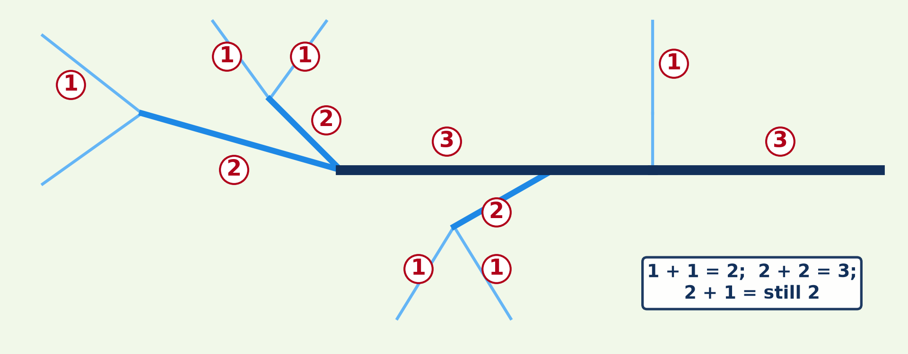
2. AREAL PROPERTIES: STREAM ORDER
Activity 1
Stream ordering by Strahler's method.
Notes:
Activity 1. Look carefully at this diagram: stream ordering by Strahler's method. Observe every detail before I ask the question.

Slide 20
2. AREAL PROPERTIES: STREAM ORDER
Activity 1: Question
When two first-order streams meet, what order is the stream below?
Notes:
Here is the question for Activity 1: When two first-order streams meet, what order is the stream below? Take one minute to think and write your answer in your rough notebook.

Slide 21
2. AREAL PROPERTIES: STREAM ORDER
Activity 1: Answer
Second order.
Notes:
Let us check the answer together. Second order.

Slide 22
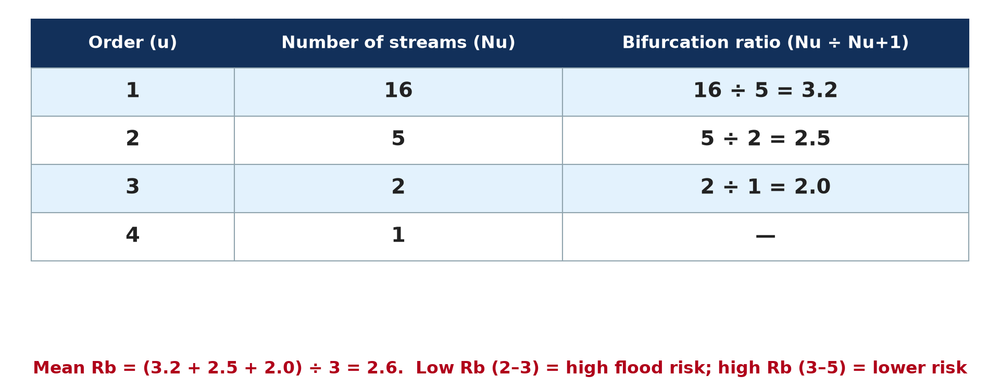
2. AREAL PROPERTIES: BIFURCATION RATIO
Activity 2
Calculating the bifurcation ratio.
Notes:
Activity 2. Look carefully at this diagram: calculating the bifurcation ratio. Observe every detail before I ask the question.

Slide 23
2. AREAL PROPERTIES: BIFURCATION RATIO
Activity 2: Question
What does a high bifurcation ratio suggest?
Notes:
Here is the question for Activity 2: What does a high bifurcation ratio suggest? Take one minute to think and write your answer in your rough notebook.

Slide 24
2. AREAL PROPERTIES: BIFURCATION RATIO
Activity 2: Answer
An elongated basin with a lower, slower flood peak.
Notes:
Let us check the answer together. An elongated basin with a lower, slower flood peak.

Slide 25
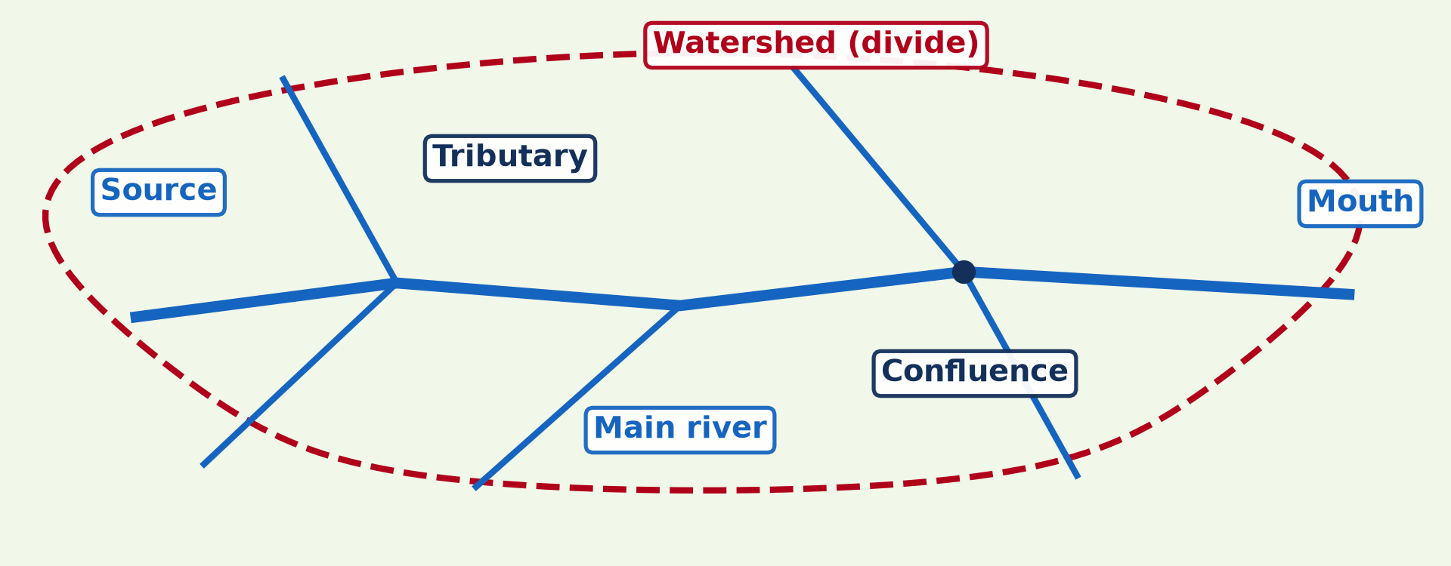
2. AREAL PROPERTIES: DRAINAGE DENSITY
Activity 3
A drainage basin.
Notes:
Activity 3. Look carefully at this diagram: a drainage basin. Observe every detail before I ask the question.

Slide 26
2. AREAL PROPERTIES: DRAINAGE DENSITY
Activity 3: Question
A basin of 50 km² has 100 km of streams. What is its drainage density?
Notes:
Here is the question for Activity 3: A basin of 50 km² has 100 km of streams. What is its drainage density? Take one minute to think and write your answer in your rough notebook.

Slide 27
2. AREAL PROPERTIES: DRAINAGE DENSITY
Activity 3: Answer
100 ÷ 50 = 2 km per km².
Notes:
Let us check the answer together. 100 ÷ 50 = 2 km per km².

Slide 28
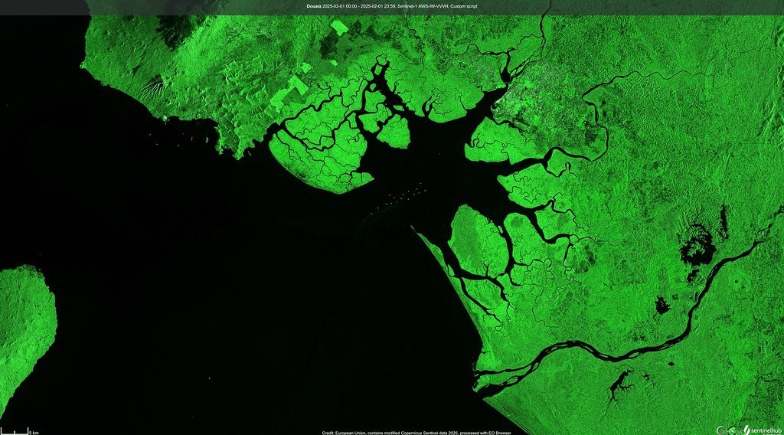
2. AREAL PROPERTIES: DRAINAGE TEXTURE
Activity 4
The Wouri estuary and Douala seen from a satellite.
Notes:
Activity 4. Look carefully at this picture: the Wouri estuary and Douala seen from a satellite. Observe every detail before I ask the question.

Slide 29
2. AREAL PROPERTIES: DRAINAGE TEXTURE
Activity 4: Question
What does a dense network of channels tell us about a basin?
Notes:
Here is the question for Activity 4: What does a dense network of channels tell us about a basin? Take one minute to think and write your answer in your rough notebook.

Slide 30
2. AREAL PROPERTIES: DRAINAGE TEXTURE
Activity 4: Answer
Impermeable ground or heavy rain; water reaches rivers quickly.
Notes:
Let us check the answer together. Impermeable ground or heavy rain; water reaches rivers quickly.

Slide 31
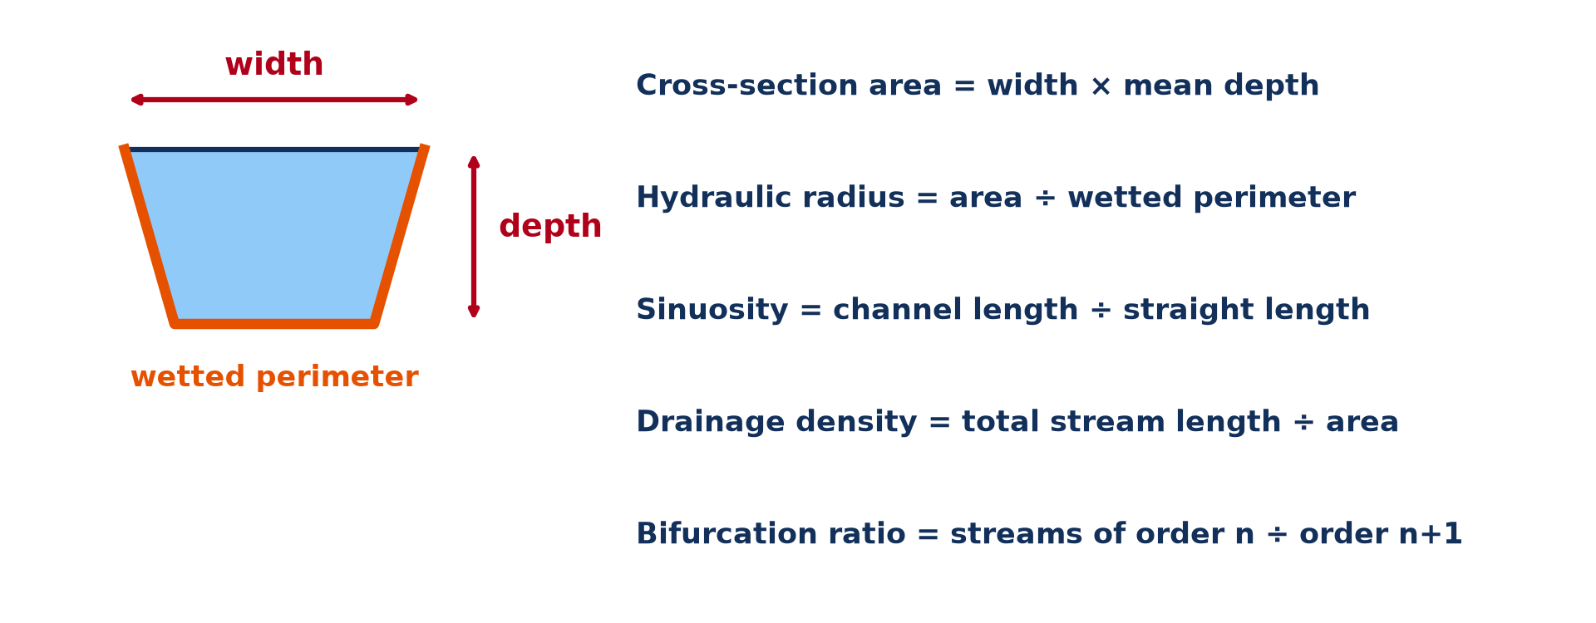
1. LINEAR PROPERTIES
Activity 5
Channel measurements and formulas.
Notes:
Activity 5. Look carefully at this diagram: channel measurements and formulas. Observe every detail before I ask the question.

Slide 32
1. LINEAR PROPERTIES
Activity 5: Question
A channel is 8 m wide with a mean depth of 2 m and a wetted perimeter of 12 m. Find the hydraulic radius.
Notes:
Here is the question for Activity 5: A channel is 8 m wide with a mean depth of 2 m and a wetted perimeter of 12 m. Find the hydraulic radius. Take one minute to think and write your answer in your rough notebook.

Slide 33
1. LINEAR PROPERTIES
Activity 5: Answer
Area = 8 × 2 = 16 m²; hydraulic radius = 16 ÷ 12 ≈ 1.3 m.
Notes:
Let us check the answer together. Area = 8 × 2 = 16 m²; hydraulic radius = 16 ÷ 12 ≈ 1.3 m.

Slide 34
BOARD SUMMARY
Board Summary
Topic: Drainage Basin Morphometry
Sub-topic: Morphometric Analysis of Drainage Networks
Practical Work 2: Drainage Basin Morphometry
Notes:
Now we are going to copy the board summary. Write the title and the headings neatly in your notebooks. I will give you enough time for each slide, so do not rush.

Slide 35
BOARD SUMMARY
1. Meaning and Classification
Basin morphometry can be understood as follows:
Basin morphometry: It is the measurement and analysis of the size, shape and network of a drainage basin.
Notes:
Let us copy Meaning and Classification. Basin morphometry can be understood as follows. On this slide we have Basin morphometry. Write each point on a new line, with the key term first, and explain it in your own words when we revise. When you finish, we go to the next slide.

Slide 36
BOARD SUMMARY
1. Meaning and Classification (continued)
Classification of properties: Linear properties concern the channels (length, width, depth, slope). Areal properties concern the basin (area, density, stream order).
Notes:
We continue with Meaning and Classification. On this slide we have Classification of properties. Write each point on a new line, with the key term first, and explain it in your own words when we revise.

Slide 37
BOARD SUMMARY
2. Linear Properties
The linear properties of a channel are calculated as follows:
Channel measurements: Length, slope, width and depth are measured in the field or on maps. Cross-section area = width × mean depth.
Notes:
Let us copy Linear Properties. The linear properties of a channel are calculated as follows. On this slide we have Channel measurements. Write each point on a new line, with the key term first, and explain it in your own words when we revise. When you finish, we go to the next slide.

Slide 38
BOARD SUMMARY
2. Linear Properties (continued)
Wetted perimeter and hydraulic radius: The wetted perimeter is the length of bed and banks in contact with water. Hydraulic radius = cross-section area ÷ wetted perimeter.
Notes:
We continue with Linear Properties. On this slide we have Wetted perimeter and hydraulic radius. Write each point on a new line, with the key term first, and explain it in your own words when we revise. When you finish, we go to the next slide.

Slide 39
BOARD SUMMARY
2. Linear Properties (continued)
Efficiency and sinuosity: A high hydraulic radius means an efficient channel with little friction and fast flow. Sinuosity = channel length ÷ straight-line length.
Notes:
We continue with Linear Properties. On this slide we have Efficiency and sinuosity. Write each point on a new line, with the key term first, and explain it in your own words when we revise.

Slide 40
BOARD SUMMARY
2. Linear Properties
Illustration: channel measurements
Notes:
Now draw this illustration in your notebook: channel measurements. Give it a title and label it clearly.

Slide 41
BOARD SUMMARY
3. Areal Properties
The areal properties of a basin are calculated as follows:
Drainage density: Drainage density = total stream length ÷ basin area (km/km²). A high density shows impermeable rock, heavy rain and a high flood risk.
Notes:
Let us copy Areal Properties. The areal properties of a basin are calculated as follows. On this slide we have Drainage density. Write each point on a new line, with the key term first, and explain it in your own words when we revise. When you finish, we go to the next slide.

Slide 42
BOARD SUMMARY
3. Areal Properties (continued)
Stream frequency: Stream frequency = number of streams ÷ basin area. It shows how finely the basin is dissected.
Notes:
We continue with Areal Properties. On this slide we have Stream frequency. Write each point on a new line, with the key term first, and explain it in your own words when we revise. When you finish, we go to the next slide.

Slide 43
BOARD SUMMARY
3. Areal Properties (continued)
Stream order and bifurcation ratio: With Strahler's method, two streams of the same order make the next order. Bifurcation ratio = number of streams of one order ÷ number of the next order; a low ratio means a higher flood risk.
Notes:
We continue with Areal Properties. On this slide we have Stream order and bifurcation ratio. Write each point on a new line, with the key term first, and explain it in your own words when we revise.

Slide 44
BOARD SUMMARY
3. Areal Properties
Illustration: Strahler stream ordering
Notes:
Now draw this illustration in your notebook: strahler stream ordering. Give it a title and label it clearly.

Slide 45
BOARD SUMMARY
4. Drainage Morphometric Laws
Horton's laws describe drainage networks:
Law of stream numbers: The number of streams decreases in a regular way as the order increases. The bifurcation ratio is fairly constant, about 3 to 5.
Notes:
Let us copy Drainage Morphometric Laws. Horton's laws describe drainage networks. On this slide we have Law of stream numbers. Write each point on a new line, with the key term first, and explain it in your own words when we revise. When you finish, we go to the next slide.

Slide 46
BOARD SUMMARY
4. Drainage Morphometric Laws (continued)
Law of stream lengths: The mean length of streams increases with order. Higher-order streams are longer.
Notes:
We continue with Drainage Morphometric Laws. On this slide we have Law of stream lengths. Write each point on a new line, with the key term first, and explain it in your own words when we revise.

Slide 47
FORMATIVE EVALUATION
Evaluation 1
A basin has 30 first-order and 8 second-order streams. Find the bifurcation ratio.
Notes:
Now let us check what you have understood. Question 1: A basin has 30 first-order and 8 second-order streams. Find the bifurcation ratio. Answer in your exercise book.

Slide 48
FORMATIVE EVALUATION
Expected Answer
30 ÷ 8 = 3.75.
Notes:
The expected answer is: 30 ÷ 8 = 3.75. If you got it right, well done.

Slide 49
FORMATIVE EVALUATION
Evaluation 2
What does a high drainage density show?
Notes:
Now let us check what you have understood. Question 2: What does a high drainage density show? Answer in your exercise book.

Slide 50
FORMATIVE EVALUATION
Expected Answer
Impermeable ground or steep, bare slopes; fast runoff and flashy floods.
Notes:
The expected answer is: impermeable ground or steep, bare slopes; fast runoff and flashy floods. If you got it right, well done.

Slide 51
REMEDIATION
Remediation
Fill in the blanks:
Stream ordering uses the method of ______.
Drainage density = total stream length ÷ ______.
Hydraulic radius = area ÷ wetted ______.
Notes:
For those who need more practice, fill in the blanks in your exercise book. The answers are: number 1, Strahler; number 2, basin area; number 3, perimeter.

Slide 52
HOMEWORK
Homework
On a topographic map, order the streams of a small basin and calculate its bifurcation ratio.
Notes:
For your homework: On a topographic map, order the streams of a small basin and calculate its bifurcation ratio. We shall correct it at the beginning of our next lesson.

Slide 53
NEXT LESSON
Next Lesson
Our next lesson will be on:
Further Study 4: The Drainage of Cameroon
Notes:
Our next lesson will be on Further Study 4: The Drainage of Cameroon. Thank you for your attention, and see you next time.

Slide 54
BILINGUAL GAME
Bilingual Game (Jeu Bilingue)
English | Français
Stream order | L'ordre des cours d'eau
Drainage density | La densité de drainage
Bifurcation ratio | Le rapport de confluence
Channel | Le chenal
Width | La largeur
Depth | La profondeur
Notes:
Let us play the bilingual game. I say a word in English, and you give me the French word. Then we do the reverse.

Slide 55
LOGBOOK
Official Logbook (1/2)
Module / Topic | Drainage Basin Morphometry
Lesson Title | Practical Work 2: Drainage Basin Morphometry
Expected Learning Outcomes | Order streams using Strahler's method. Calculate the bifurcation ratio and drainage density. Calculate channel properties (area, hydraulic radius, sinuosity) and interpret them.
Competence | Learners are able to measure and calculate the main morphometric properties of a drainage basin.
Notes:
I record this information in the official logbook of the class after the lesson.

Slide 56
LOGBOOK
Official Logbook (2/2)
Matter Taught | Meaning and Classification; Linear Properties; Areal Properties; Drainage Morphometric Laws.
Evaluation | Formative evaluation and remediation exercise.
Homework | On a topographic map, order the streams of a small basin and calculate its bifurcation ratio.
Enrolment / Present / Absent | ____ / ____ / ____
Achievement | To be completed after the lesson.
Notes:
I complete the second page of the logbook: the matter taught, the evaluation, the homework and the attendance.

Slide 57
TEACHER'S NOTE
Teacher's Note
Timing: Homework correction, plan, objectives 8 min | Recall, situation, action 10 min | 5 activities 30 min | Board summary (copying) 30 min | Evaluation, remediation 10 min | Homework, next lesson 5 min | Logbook 7 min
Without the projector (Activity 1): draw a stream network and number it.
Without the projector (Activity 2): do the division on the board.
Without the projector (Activity 3): do the calculation on the board.
Without the projector (Activity 4): compare dense and sparse networks.
Without the projector (Activity 5): do the calculation on the board.
Notes:
This slide is for me, the teacher: it gives the timing of the lesson and what to do if the projector is not available.

Slide 58
REFERENCES
References
National Geography Syllabus, MINESEC/IGE/IP-SS, 2019 — Module 1 (Meteorology, Climatology & Hydrology).
Photo, Activity 4: “Duala, Camerún (Douala, Cameroon)” by migmasat, Public domain 1.0, via Flickr (https://www.flickr.com/photos/197415759@N06/54386998088)
Diagrams and animations: drawn for this lesson (Geography Department).
Notes:
These are the references and picture credits used to prepare this lesson.

