Slide 1
FORM 2 TECHNICAL
GEOGRAPHY
Lesson 2 (Part 4)
The Tropical Grassland Region: Human Activities
Notes:
Good morning, class, and welcome to our geography lesson. I am your geography teacher, Mr Kamdem. Today we are starting Lesson 2 (Part 4): The Tropical Grassland Region: Human Activities.

Slide 2
CLASS INFO
Class, Chapter and Duration
Class | Form 2 Technical
Chapter | Economic Geography — Natural Regions: 2. The Tropical Grassland Region
Duration | 2 periods (2 × 50 minutes)
Notes:
This lesson is for Form 2 Technical. It belongs to Economic Geography — Natural Regions: 2. The Tropical Grassland Region. We shall need 2 periods to cover it.

Slide 3
IDENTIFICATION
Lesson Identification
Topic | Man in His Environment
Sub-topic | Natural Regions
Lesson | Lesson 2 (Part 4): The Tropical Grassland Region: Human Activities
Notions / Concepts | Crop farming, cash crop, food crop, livestock rearing, nomadic pastoralism, transhumance, hunting.
Syllabus focus | Human activities of the Tropical Grassland region: farming, livestock rearing, hunting, lumbering and others.
Competence | Learners are able to describe the work of farmers and herders around them and explain why herders move with their animals.
Notes:
Our topic is Man in His Environment, and the sub-topic is Natural Regions. The key notions we shall use today are: crop farming, cash crop, food crop, livestock rearing, nomadic pastoralism, transhumance, hunting. At the end, you should be able to do this: learners are able to describe the work of farmers and herders around them and explain why herders move with their animals.

Slide 4

HOMEWORK CORRECTION
Correction of the Homework
Question (Lesson 2 (Part 3): The Tropical Grassland Region: Types of Resources and Methods of Exploitation):
Ask a farmer or a herder in your area about his work: what he produces, which tools he uses and where he sells his products.
Notes:
Before we start the new lesson, let us correct the homework I gave you at the end of Lesson 2 (Part 3): The Tropical Grassland Region: Types of Resources and Methods of Exploitation. The question was: Ask a farmer or a herder in your area about his work: what he produces, which tools he uses and where he sells his products. Take out your exercise books.

Slide 5
HOMEWORK CORRECTION
Correction: Possible Answer
Answers vary. Example: a farmer produces cotton and maize with a hoe and oxen, and sells cotton to SODECOTON; a herder rears cattle, uses a stick and moves with them, and sells them at the cattle market.
Notes:
Here is a good answer. Answers vary. Example: a farmer produces cotton and maize with a hoe and oxen, and sells cotton to SODECOTON; a herder rears cattle, uses a stick and moves with them, and sells them at the cattle market. Compare it with your own answer and correct your work in red.

Slide 6
LESSON PLAN
Lesson Plan
Correction of the homework
Objectives and recall
Real-life situation and action to take
Learning activities
Board summary
Evaluation, remediation and homework
Notes:
Here is the plan of our lesson today. First, we shall correct the homework. Then we shall look at the objectives and recall what you already know. After that, we shall study a situation from real life and the action to take, and do the learning activities. Finally, we shall copy the board summary, do the evaluation and the remediation, and I will give you the homework.

Slide 7
OBJECTIVES
Objectives
By the end of this lesson, you should be able to:
Describe crop farming in the Tropical Grassland region.
Describe livestock rearing, including nomadic pastoralism and transhumance.
Notes:
Take your time to copy this part; we will continue together.

Slide 8
OBJECTIVES
Objectives (continued)
Describe hunting, fishing and wood cutting in the Tropical Grassland region.
Notes:
By the end of this lesson, you should be able to do three things. Number 1: describe crop farming in the Tropical Grassland region. Number 2: describe livestock rearing, including nomadic pastoralism and transhumance. Number 3: describe hunting, fishing and wood cutting in the Tropical Grassland region.

Slide 9
PREVIOUS KNOWLEDGE
Previous Knowledge
The resources of the savanna are pasture, farmland, wildlife, water and trees.
People exploit them by farming, livestock rearing, tourism, fishing and cutting trees.
Notes:
Let us first remember what you already know. The resources of the savanna are pasture, farmland, wildlife, water and trees. People exploit them by farming, livestock rearing, tourism, fishing and cutting trees. Keep this in mind, because we shall build on it today.

Slide 10
REAL-LIFE SITUATION
Situation in Real Life
Every year in November, Adamou, a Fulani herder, leaves his village near Garoua with his cattle. He walks south for weeks and comes back when the rains return. His classmate Paul thinks Adamou is lost.
Notes:
Listen carefully to this situation from real life. Every year in November, Adamou, a Fulani herder, leaves his village near Garoua with his cattle. He walks south for weeks and comes back when the rains return. His classmate Paul thinks Adamou is lost. Think about it, because I am going to ask you some questions.

Slide 11
REAL-LIFE SITUATION
Situation: Question 1
What is the problem in the situation?
Notes:
Question 1: What is the problem in the situation? Think for a moment, then raise your hand to answer.

Slide 12
REAL-LIFE SITUATION
Answer
Paul does not understand why Adamou moves every year.
Notes:
Good. Paul does not understand why Adamou moves every year.

Slide 13
REAL-LIFE SITUATION
Situation: Question 2
When does Adamou leave, and when does he come back?
Notes:
Question 2: When does Adamou leave, and when does he come back? Think for a moment, then raise your hand to answer.

Slide 14
REAL-LIFE SITUATION
Answer
He leaves in November and comes back when the rains return.
Notes:
Good. He leaves in November and comes back when the rains return.

Slide 15
REAL-LIFE SITUATION
Situation: Question 3
Why does he move?
Notes:
Question 3: Why does he move? Think for a moment, then raise your hand to answer.

Slide 16
REAL-LIFE SITUATION
Possible Answer
To find grass and water for his cattle.
Notes:
Good. To find grass and water for his cattle.

Slide 17
ACTION TO TAKE
Action to Take
Respect the work of farmers and herders and help them live in peace.
Notes:
From this situation, the action we are working towards in this lesson is the following: respect the work of farmers and herders and help them live in peace.

Slide 18
JUSTIFICATION
Justification of the Lesson
This lesson helps us to know the work of the people of the savanna.
Notes:
Why is this lesson important for you? This lesson helps us to know the work of the people of the savanna.

Slide 19

1. CROP FARMING
Activity 1
Farmers harvest cotton.
Notes:
Activity 1. Look carefully at this picture: farmers harvest cotton. Observe every detail before I ask the question.

Slide 20
1. CROP FARMING
Activity 1: Question
Do farmers grow cotton to eat it or to sell it? What do we call this type of crop?
Notes:
Here is the question for Activity 1: Do farmers grow cotton to eat it or to sell it? What do we call this type of crop? Take one minute to think and write your answer in your rough notebook.

Slide 21
1. CROP FARMING
Activity 1: Answer
To sell it. It is a cash crop.
Notes:
Let us check the answer together. To sell it. It is a cash crop.

Slide 22

1. CROP FARMING
Activity 2
A rice field with water.
Notes:
Activity 2. Look carefully at this picture: a rice field with water. Observe every detail before I ask the question.

Slide 23
1. CROP FARMING
Activity 2: Question
Rice needs a lot of water. How do farmers get water in the dry savanna?
Notes:
Here is the question for Activity 2: Rice needs a lot of water. How do farmers get water in the dry savanna? Take one minute to think and write your answer in your rough notebook.

Slide 24
1. CROP FARMING
Activity 2: Answer
They bring water from rivers and dams to the fields: irrigation.
Notes:
Let us check the answer together. They bring water from rivers and dams to the fields: irrigation.

Slide 25
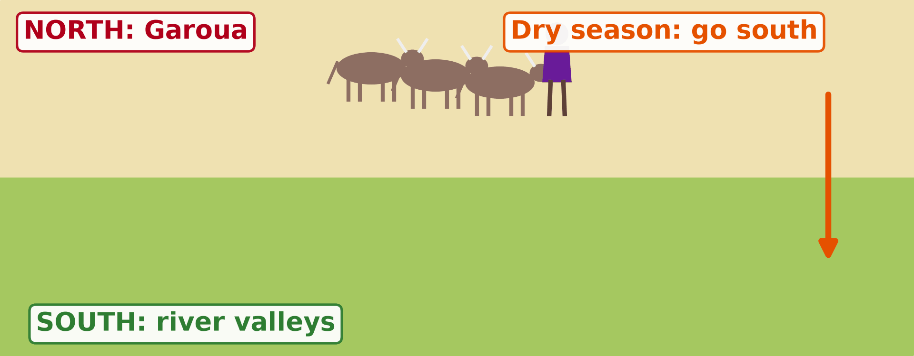
2. LIVESTOCK REARING
Activity 3
Animation: the herder moves with his cattle.
Notes:
Activity 3. Look carefully at this animation: animation: the herder moves with his cattle. Watch the animation to the end; it will play again.

Slide 26
2. LIVESTOCK REARING
Activity 3: Question
Where does the herder go in the dry season? And in the rainy season?
Notes:
Here is the question for Activity 3: Where does the herder go in the dry season? And in the rainy season? Take one minute to think and write your answer in your rough notebook.

Slide 27
2. LIVESTOCK REARING
Activity 3: Answer
South in the dry season; back north in the rainy season.
Notes:
Let us check the answer together. South in the dry season; back north in the rainy season.

Slide 28
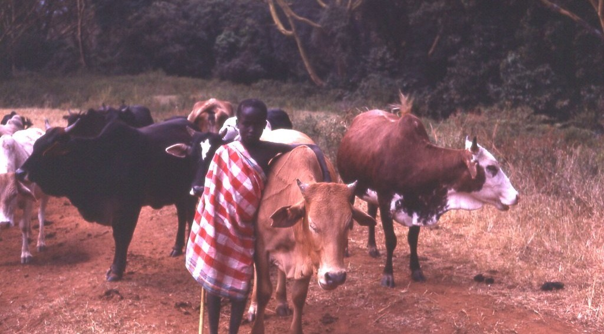
2. LIVESTOCK REARING
Activity 4
Maasai herders with their cattle in East Africa.
Notes:
Activity 4. Look carefully at this picture: maasai herders with their cattle in East Africa. Observe every detail before I ask the question.

Slide 29
2. LIVESTOCK REARING
Activity 4: Question
Why are cattle important for these herders?
Notes:
Here is the question for Activity 4: Why are cattle important for these herders? Take one minute to think and write your answer in your rough notebook.

Slide 30
2. LIVESTOCK REARING
Activity 4: Answer
Cattle give milk, meat and money. They show that a man is rich.
Notes:
Let us check the answer together. Cattle give milk, meat and money. They show that a man is rich.

Slide 31

3. OTHER ACTIVITIES
Activity 5
Fishermen in a canoe on a river.
Notes:
Activity 5. Look carefully at this picture: fishermen in a canoe on a river. Observe every detail before I ask the question.

Slide 32
3. OTHER ACTIVITIES
Activity 5: Question
Give two other activities of the people of the savanna.
Notes:
Here is the question for Activity 5: Give two other activities of the people of the savanna. Take one minute to think and write your answer in your rough notebook.

Slide 33
3. OTHER ACTIVITIES
Activity 5: Answer
Fishing and tourism. Also hunting and cutting wood.
Notes:
Let us check the answer together. Fishing and tourism. Also hunting and cutting wood.

Slide 34
BOARD SUMMARY
Board Summary
Topic: Man in His Environment
Sub-topic: Natural Regions
Lesson 2 (Part 4): The Tropical Grassland Region: Human Activities
Notes:
Now we are going to copy the board summary. Write the title and the headings neatly in your notebooks. I will give you enough time for each slide, so do not rush.

Slide 35
BOARD SUMMARY
DEFINITIONS
The key terms of this lesson are defined as follows:
Cash crop: It is a crop grown to be sold.
Food crop: It is a crop grown to feed the family.
Notes:
Let us copy the definitions. The key terms of this lesson are defined as follows. On this slide we have Cash crop and Food crop. Write each point on a new line, with the key term first, and explain it in your own words when we revise. When you finish, we go to the next slide.

Slide 36
BOARD SUMMARY
DEFINITIONS (continued)
Transhumance: It is the seasonal movement of herders with their animals.
Notes:
We continue with the definitions. On this slide we have Transhumance. Write each point on a new line, with the key term first, and explain it in your own words when we revise.

Slide 37
BOARD SUMMARY
1. Crop Farming
Crop farming in the savanna takes the following forms:
Food crops: Farmers grow sorghum, millet and maize to feed their families.
Cash crops: Farmers grow cotton and sell it to SODECOTON.
Notes:
Let us copy Crop Farming. Crop farming in the savanna takes the following forms. On this slide we have Food crops and Cash crops. Write each point on a new line, with the key term first, and explain it in your own words when we revise. When you finish, we go to the next slide.

Slide 38
BOARD SUMMARY
1. Crop Farming (continued)
Irrigated farming: Rice is grown with irrigation at Lagdo and Yagoua.
Notes:
We continue with Crop Farming. On this slide we have Irrigated farming. Write each point on a new line, with the key term first, and explain it in your own words when we revise.

Slide 39
BOARD SUMMARY
2. Livestock Rearing
Herders rear animals in three ways:
Nomadic herding: Herders move from place to place with their animals.
Transhumance: Herders move south in the dry season and come back in the wet season.
Notes:
Let us copy Livestock Rearing. Herders rear animals in three ways. On this slide we have Nomadic herding and Transhumance. Write each point on a new line, with the key term first, and explain it in your own words when we revise. When you finish, we go to the next slide.

Slide 40
BOARD SUMMARY
2. Livestock Rearing (continued)
Ranching: Cattle are kept on large farms, as on the Adamawa plateau.
Notes:
We continue with Livestock Rearing. On this slide we have Ranching. Write each point on a new line, with the key term first, and explain it in your own words when we revise.

Slide 41
BOARD SUMMARY
3. Other Activities
People also carry out the following activities:
Fishing: People fish in the Lagdo lake and the Benue.
Tourism: Tourists visit national parks such as the Benue and Waza.
Notes:
Let us copy Other Activities. People also carry out the following activities. On this slide we have Fishing and Tourism. Write each point on a new line, with the key term first, and explain it in your own words when we revise. When you finish, we go to the next slide.

Slide 42
BOARD SUMMARY
3. Other Activities (continued)
Hunting: People hunt in authorised hunting zones.
Notes:
We continue with Other Activities. On this slide we have Hunting. Write each point on a new line, with the key term first, and explain it in your own words when we revise.

Slide 43
FORMATIVE EVALUATION
Evaluation 1
What is the difference between a food crop and a cash crop?
Notes:
Now let us check what you have understood. Question 1: What is the difference between a food crop and a cash crop? Answer in your exercise book.

Slide 44
FORMATIVE EVALUATION
Expected Answer
A food crop feeds the family; a cash crop is sold.
Notes:
The expected answer is: a food crop feeds the family; a cash crop is sold. If you got it right, well done.

Slide 45
FORMATIVE EVALUATION
Evaluation 2
What is transhumance?
Notes:
Now let us check what you have understood. Question 2: What is transhumance? Answer in your exercise book.

Slide 46
FORMATIVE EVALUATION
Expected Answer
The movement of herders with their animals between seasons.
Notes:
The expected answer is: the movement of herders with their animals between seasons. If you got it right, well done.

Slide 47
REMEDIATION
Remediation
Fill in the blanks:
Cotton is a ______ crop.
The movement of herders between seasons is called ______.
Bringing water to the fields is called ______.
Notes:
For those who need more practice, fill in the blanks in your exercise book. The answers are: number 1, cash; number 2, transhumance; number 3, irrigation.

Slide 48
HOMEWORK
Homework
Write down two problems that farmers or herders around Garoua face, for example with rain, fires or pests.
Notes:
For your homework: Write down two problems that farmers or herders around Garoua face, for example with rain, fires or pests. We shall correct it at the beginning of our next lesson.

Slide 49
NEXT LESSON
Next Lesson
Our next lesson will be on:
Lesson 2 (Part 5): The Tropical Grassland Region: Problems Faced and Attempted Solutions
Notes:
Our next lesson will be on Lesson 2 (Part 5): The Tropical Grassland Region: Problems Faced and Attempted Solutions. Thank you for your attention, and see you next time.

Slide 50
BILINGUAL GAME
Bilingual Game (Jeu Bilingue)
English | Français
Cash crop | La culture de rente
Food crop | La culture vivrière
Herder | L'éleveur
Cattle | Les bovins
Transhumance | La transhumance
Nomadic | Nomade
Hunting | La chasse
Firewood | Le bois de chauffe
Notes:
Let us play the bilingual game. I say a word in English, and you give me the French word. Then we do the reverse.

Slide 51
LOGBOOK
Official Logbook (1/2)
Module / Topic | Man in His Environment
Lesson Title | Lesson 2 (Part 4): The Tropical Grassland Region: Human Activities
Expected Learning Outcomes | Describe crop farming in the Tropical Grassland region. Describe livestock rearing, including nomadic pastoralism and transhumance. Describe hunting, fishing and wood cutting in the Tropical Grassland region.
Competence | Learners are able to describe the work of farmers and herders around them and explain why herders move with their animals.
Notes:
I record this information in the official logbook of the class after the lesson.

Slide 52
LOGBOOK
Official Logbook (2/2)
Matter Taught | DEFINITIONS; Crop Farming; Livestock Rearing; Other Activities.
Evaluation | Formative evaluation and remediation exercise.
Homework | Write down two problems that farmers or herders around Garoua face, for example with rain, fires or pests.
Enrolment / Present / Absent | ____ / ____ / ____
Achievement | To be completed after the lesson.
Notes:
I complete the second page of the logbook: the matter taught, the evaluation, the homework and the attendance.

Slide 53
TEACHER'S NOTE
Teacher's Note
Timing: Homework correction, plan, objectives 8 min | Recall, situation, action 10 min | 5 activities 30 min | Board summary (copying) 30 min | Evaluation, remediation 10 min | Homework, next lesson 5 min | Logbook 7 min
SODECOTON buys the cotton of North Cameroon; SEMRY manages the irrigated rice fields of Yagoua.
Activity 3 is an animation (GIF): it plays automatically in slide-show mode.
Without the projector (Activity 1): ask learners which crops their family sells.
Without the projector (Activity 2): mention the rice fields of Lagdo and Yagoua (SEMRY).
Without the projector (Activity 3): draw an arrow going south and an arrow going north on the board.
Without the projector (Activity 4): compare with the Fulani of North Cameroon.
Notes:
Take your time to copy this part; we will continue together.

Slide 54
TEACHER'S NOTE
Teacher's Note (continued)
Without the projector (Activity 5): ask learners what work their parents do.
Notes:
This slide is for me, the teacher: it gives the timing of the lesson and what to do if the projector is not available.

Slide 55
REFERENCES
References
Harmonised Progression Sheet, Economic Geography (5051), Form 2.
Class textbook: The major biomes of the world (tropical grassland).
Photo, Activity 1: “Cotton harvest” by CIFOR, CC BY-NC-ND 2.0, via Flickr (https://www.flickr.com/photos/45423546@N07/35706862552)
Photo, Activity 2: “Irrigated rice fields in Sefula, Zambia. Photo by Kate Longley, 2013.” by WorldFish, CC BY-NC-ND 2.0, via Flickr (https://www.flickr.com/photos/61545321@N06/8608804590)
Photo, Activity 4: “Young Maasai herder, Kenya, 1979” by gbaku, CC BY-SA 2.0, via Flickr (https://www.flickr.com/photos/72105154@N00/482990998)
Photo, Activity 5: “Fishermen, Lake Tana” by A.Davey, CC BY 2.0, via Flickr (https://www.flickr.com/photos/40595948@N00/2260748777)
Diagrams and animations: drawn for this lesson (Geography Department).
Notes:
These are the references and picture credits used to prepare this lesson.

