Slide 1
FORM 2 TECHNICAL
GEOGRAPHY
Lesson 3 (Part 1)
The Desert Regions: Location, Types and Characteristics
Notes:
Good morning, class, and welcome to our geography lesson. I am your geography teacher, Mr Kamdem. Today we are starting Lesson 3 (Part 1): The Desert Regions: Location, Types and Characteristics.

Slide 2
CLASS INFO
Class, Chapter and Duration
Class | Form 2 Technical
Chapter | Economic Geography — Natural Regions: 3. Desert Regions
Duration | 2 periods (2 × 50 minutes)
Notes:
This lesson is for Form 2 Technical. It belongs to Economic Geography — Natural Regions: 3. Desert Regions. We shall need 2 periods to cover it.

Slide 3
IDENTIFICATION
Lesson Identification
Topic | Man in His Environment
Sub-topic | Natural Regions
Lesson | Lesson 3 (Part 1): The Desert Regions: Location, Types and Characteristics
Notions / Concepts | Desert, hot desert, cold desert, erg, reg, hamada, trade winds, cold ocean current, rain shadow.
Syllabus focus | Location and types of deserts; general characteristics and causes of deserts.
Competence | Learners are able to find the deserts of the world on a map and explain why the Sahara, north of Cameroon, is so dry.
Notes:
Our topic is Man in His Environment, and the sub-topic is Natural Regions. The key notions we shall use today are: desert, hot desert, cold desert, erg, reg, hamada, trade winds, cold ocean current, rain shadow. At the end, you should be able to do this: learners are able to find the deserts of the world on a map and explain why the Sahara, north of Cameroon, is so dry.

Slide 4

HOMEWORK CORRECTION
Correction of the Homework
Question (Lesson 2 (Part 5): The Tropical Grassland Region: Problems Faced and Attempted Solutions):
On a map of Africa in your atlas, find the Sahara Desert. Write the names of three countries that it covers.
Notes:
Before we start the new lesson, let us correct the homework I gave you at the end of Lesson 2 (Part 5): The Tropical Grassland Region: Problems Faced and Attempted Solutions. The question was: On a map of Africa in your atlas, find the Sahara Desert. Write the names of three countries that it covers. Take out your exercise books.

Slide 5
HOMEWORK CORRECTION
Correction: Possible Answer
The Sahara covers countries such as Algeria, Libya, Egypt, Niger, Mali and Chad.
Notes:
Here is a good answer. The Sahara covers countries such as Algeria, Libya, Egypt, Niger, Mali and Chad. Compare it with your own answer and correct your work in red.

Slide 6
LESSON PLAN
Lesson Plan
Correction of the homework
Objectives and recall
Real-life situation and action to take
Learning activities
Board summary
Evaluation, remediation and homework
Notes:
Here is the plan of our lesson today. First, we shall correct the homework. Then we shall look at the objectives and recall what you already know. After that, we shall study a situation from real life and the action to take, and do the learning activities. Finally, we shall copy the board summary, do the evaluation and the remediation, and I will give you the homework.

Slide 7
OBJECTIVES
Objectives
By the end of this lesson, you should be able to:
Define a desert.
Locate the main deserts of the world.
Notes:
Take your time to copy this part; we will continue together.

Slide 8
OBJECTIVES
Objectives (continued)
Distinguish between hot and cold deserts, and between sandy, stony and rocky deserts.
Explain the causes of deserts.
Notes:
By the end of this lesson, you should be able to do three things. Number 1: define a desert. Number 2: locate the main deserts of the world. Number 3: distinguish between hot and cold deserts, and between sandy, stony and rocky deserts. Number 4: explain the causes of deserts.

Slide 9
PREVIOUS KNOWLEDGE
Previous Knowledge
The Tropical Grassland lies between 5° and 15° north and south of the Equator.
Its drier part, the Sahel, is threatened by desertification.
North of the Sahel lies the largest hot desert in the world.
Notes:
Let us first remember what you already know. The Tropical Grassland lies between 5° and 15° north and south of the Equator. Its drier part, the Sahel, is threatened by desertification. North of the Sahel lies the largest hot desert in the world. Keep this in mind, because we shall build on it today.

Slide 10
REAL-LIFE SITUATION
Situation in Real Life
In Garoua, Salma watches a film about the Sahara. She is surprised: the desert is not only sand. There are also plains of stones and bare rocky mountains.
Notes:
Listen carefully to this situation from real life. In Garoua, Salma watches a film about the Sahara. She is surprised: the desert is not only sand. There are also plains of stones and bare rocky mountains. Think about it, because I am going to ask you some questions.

Slide 11
REAL-LIFE SITUATION
Situation: Question 1
What is the problem in the situation?
Notes:
Question 1: What is the problem in the situation? Think for a moment, then raise your hand to answer.

Slide 12
REAL-LIFE SITUATION
Answer
Salma thought that the desert was only sand.
Notes:
Good. Salma thought that the desert was only sand.

Slide 13
REAL-LIFE SITUATION
Situation: Question 2
What did she see in the film?
Notes:
Question 2: What did she see in the film? Think for a moment, then raise your hand to answer.

Slide 14
REAL-LIFE SITUATION
Answer
Sand, plains of stones and rocky mountains.
Notes:
Good. Sand, plains of stones and rocky mountains.

Slide 15
REAL-LIFE SITUATION
Situation: Question 3
Where can she learn more about deserts?
Notes:
Question 3: Where can she learn more about deserts? Think for a moment, then raise your hand to answer.

Slide 16
REAL-LIFE SITUATION
Possible Answer
In her atlas, her textbook and in this lesson.
Notes:
Good. In her atlas, her textbook and in this lesson.

Slide 17
ACTION TO TAKE
Action to Take
Locate the deserts of the world on a map and explain why they are dry.
Notes:
From this situation, the action we are working towards in this lesson is the following: locate the deserts of the world on a map and explain why they are dry.

Slide 18
JUSTIFICATION
Justification of the Lesson
This lesson helps us to know where deserts are and why they are dry.
Notes:
Why is this lesson important for you? This lesson helps us to know where deserts are and why they are dry.

Slide 19

1. MEANING AND LOCATION
Activity 1
Sand dunes in the Sahara.
Notes:
Activity 1. Look carefully at this picture: sand dunes in the Sahara. Observe every detail before I ask the question.

Slide 20
1. MEANING AND LOCATION
Activity 1: Question
This region gets less than 250 mm of rain per year. What do we call it?
Notes:
Here is the question for Activity 1: This region gets less than 250 mm of rain per year. What do we call it? Take one minute to think and write your answer in your rough notebook.

Slide 21
1. MEANING AND LOCATION
Activity 1: Answer
A desert.
Notes:
Let us check the answer together. A desert.

Slide 22

1. MEANING AND LOCATION
Activity 2
The main hot deserts of the world.
Notes:
Activity 2. Look carefully at this diagram: the main hot deserts of the world. Observe every detail before I ask the question.

Slide 23
1. MEANING AND LOCATION
Activity 2: Question
Near which lines are most hot deserts found?
Notes:
Here is the question for Activity 2: Near which lines are most hot deserts found? Take one minute to think and write your answer in your rough notebook.

Slide 24
1. MEANING AND LOCATION
Activity 2: Answer
Near the Tropic of Cancer and the Tropic of Capricorn.
Notes:
Let us check the answer together. Near the Tropic of Cancer and the Tropic of Capricorn.

Slide 25
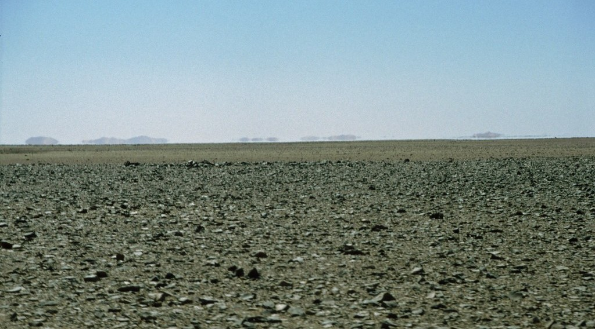
2. TYPES OF DESERTS
Activity 3
A desert covered with small stones.
Notes:
Activity 3. Look carefully at this picture: a desert covered with small stones. Observe every detail before I ask the question.

Slide 26
2. TYPES OF DESERTS
Activity 3: Question
Is this desert made of sand? What is it made of?
Notes:
Here is the question for Activity 3: Is this desert made of sand? What is it made of? Take one minute to think and write your answer in your rough notebook.

Slide 27
2. TYPES OF DESERTS
Activity 3: Answer
No. It is made of stones: it is a stony desert (reg).
Notes:
Let us check the answer together. No. It is made of stones: it is a stony desert (reg).

Slide 28
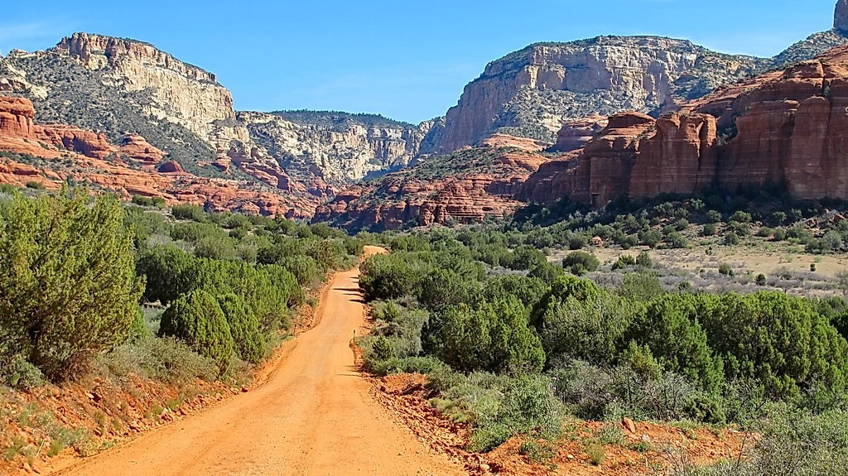
2. TYPES OF DESERTS
Activity 4
A desert of bare rock.
Notes:
Activity 4. Look carefully at this picture: a desert of bare rock. Observe every detail before I ask the question.

Slide 29
2. TYPES OF DESERTS
Activity 4: Question
This desert is made of bare rock. What do we call it?
Notes:
Here is the question for Activity 4: This desert is made of bare rock. What do we call it? Take one minute to think and write your answer in your rough notebook.

Slide 30
2. TYPES OF DESERTS
Activity 4: Answer
A rocky desert (hamada).
Notes:
Let us check the answer together. A rocky desert (hamada).

Slide 31
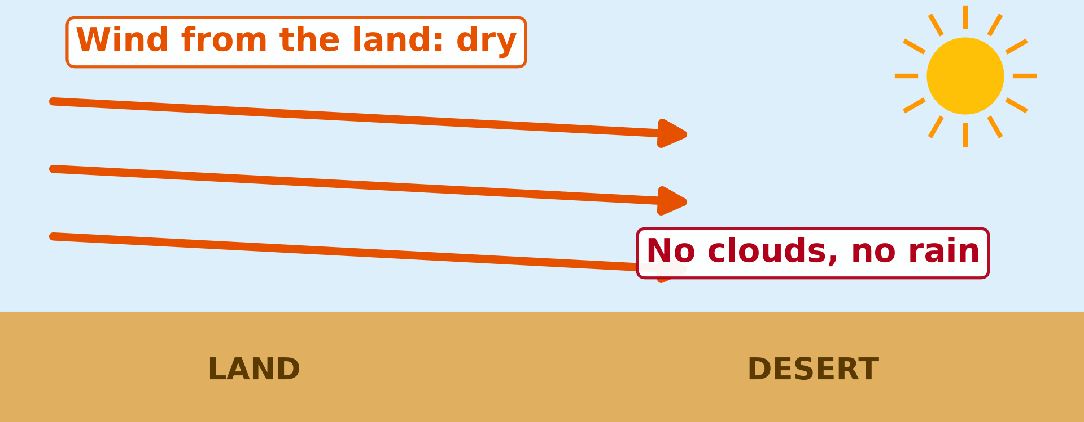
3. CAUSES OF DESERTS
Activity 5
The wind comes from the land, not from the sea.
Notes:
Activity 5. Look carefully at this picture: the wind comes from the land, not from the sea. Observe every detail before I ask the question.

Slide 32
3. CAUSES OF DESERTS
Activity 5: Question
Why does this wind bring no rain?
Notes:
Here is the question for Activity 5: Why does this wind bring no rain? Take one minute to think and write your answer in your rough notebook.

Slide 33
3. CAUSES OF DESERTS
Activity 5: Answer
It comes from the land, so it is dry. There are no clouds.
Notes:
Let us check the answer together. It comes from the land, so it is dry. There are no clouds.

Slide 34
BOARD SUMMARY
Board Summary
Topic: Man in His Environment
Sub-topic: Natural Regions
Lesson 3 (Part 1): The Desert Regions: Location, Types and Characteristics
Notes:
Now we are going to copy the board summary. Write the title and the headings neatly in your notebooks. I will give you enough time for each slide, so do not rush.

Slide 35
BOARD SUMMARY
1. Meaning and Location
A) Meaning
A desert is defined as follows:
Desert: It is a region with less than 250 mm of rain per year and very few plants.
Notes:
Let us copy Meaning. A desert is defined as follows. On this slide we have Desert. Write each point on a new line, with the key term first, and explain it in your own words when we revise.

Slide 36
BOARD SUMMARY
1. Meaning and Location
B) Location
Hot deserts are found near the tropics on the following continents:
Africa: The Sahara, the Kalahari and the Namib are in Africa.
Asia: The Arabian Desert and the Thar Desert are in Asia.
Notes:
Let us copy Location. Hot deserts are found near the tropics on the following continents. On this slide we have Africa and Asia. Write each point on a new line, with the key term first, and explain it in your own words when we revise. When you finish, we go to the next slide.

Slide 37
BOARD SUMMARY
1. Meaning and Location
B) Location (continued)
America and Australia: The Atacama, the Mojave and the Great Australian Desert are found there.
Notes:
We continue with Location. On this slide we have America and Australia. Write each point on a new line, with the key term first, and explain it in your own words when we revise.

Slide 38
BOARD SUMMARY
1. Meaning and Location
Illustration: hot deserts of the world
Notes:
Now draw this illustration in your notebook: hot deserts of the world. Give it a title and label it clearly.

Slide 39
BOARD SUMMARY
2. Types of Deserts
Deserts are classified in the following ways:
By temperature: There are hot deserts like the Sahara and cold deserts like the Gobi.
Erg: It is a sandy desert with dunes.
Notes:
Let us copy Types of Deserts. Deserts are classified in the following ways. On this slide we have By temperature and Erg. Write each point on a new line, with the key term first, and explain it in your own words when we revise. When you finish, we go to the next slide.

Slide 40
BOARD SUMMARY
2. Types of Deserts (continued)
Reg: It is a stony desert covered with pebbles.
Hamada: It is a rocky desert of bare rock.
Notes:
We continue with Types of Deserts. On this slide we have Reg and Hamada. Write each point on a new line, with the key term first, and explain it in your own words when we revise.

Slide 41
BOARD SUMMARY
3. Causes of Deserts
Deserts are dry for the following reasons:
Dry winds: The trade winds blow from the land and carry little moisture.
Cold ocean currents: Cold currents cool the air and stop rain clouds from forming, as in the Namib.
Notes:
Let us copy Causes of Deserts. Deserts are dry for the following reasons. On this slide we have Dry winds and Cold ocean currents. Write each point on a new line, with the key term first, and explain it in your own words when we revise. When you finish, we go to the next slide.

Slide 42
BOARD SUMMARY
3. Causes of Deserts (continued)
Distance from the sea: Wet winds from the sea do not reach the centre of large continents.
Mountains: Mountains stop the wet winds and leave a dry rain shadow behind them.
Notes:
We continue with Causes of Deserts. On this slide we have Distance from the sea and Mountains. Write each point on a new line, with the key term first, and explain it in your own words when we revise.

Slide 43
FORMATIVE EVALUATION
Evaluation 1
What is a desert?
Notes:
Now let us check what you have understood. Question 1: What is a desert? Answer in your exercise book.

Slide 44
FORMATIVE EVALUATION
Expected Answer
A region with less than 250 mm of rain per year and very few plants.
Notes:
The expected answer is: a region with less than 250 mm of rain per year and very few plants. If you got it right, well done.

Slide 45
FORMATIVE EVALUATION
Evaluation 2
Name the three types of desert surface.
Notes:
Now let us check what you have understood. Question 2: Name the three types of desert surface. Answer in your exercise book.

Slide 46
FORMATIVE EVALUATION
Expected Answer
Sandy (erg), stony (reg) and rocky (hamada).
Notes:
The expected answer is: sandy (erg), stony (reg) and rocky (hamada). If you got it right, well done.

Slide 47
REMEDIATION
Remediation
Fill in the blanks:
A sandy desert is called an ______.
A stony desert is called a ______.
The largest hot desert in the world is the ______.
Notes:
For those who need more practice, fill in the blanks in your exercise book. The answers are: number 1, erg; number 2, reg; number 3, Sahara.

Slide 48
HOMEWORK
Homework
Think about the hottest days of March in Garoua. Are the nights also very hot, or cooler? Write two sentences about the difference between day and night.
Notes:
For your homework: Think about the hottest days of March in Garoua. Are the nights also very hot, or cooler? Write two sentences about the difference between day and night. We shall correct it at the beginning of our next lesson.

Slide 49
NEXT LESSON
Next Lesson
Our next lesson will be on:
Lesson 3 (Part 2): The Desert Regions: Characteristics (Climate)
Notes:
Our next lesson will be on Lesson 3 (Part 2): The Desert Regions: Characteristics (Climate). Thank you for your attention, and see you next time.

Slide 50
BILINGUAL GAME
Bilingual Game (Jeu Bilingue)
English | Français
Desert | Le désert
Hot desert | Le désert chaud
Cold desert | Le désert froid
Erg (sandy desert) | L'erg
Reg (stony desert) | Le reg
Rocky desert | La hamada
Trade winds | Les alizés
Ocean current | Le courant marin
Notes:
Let us play the bilingual game. I say a word in English, and you give me the French word. Then we do the reverse.

Slide 51
LOGBOOK
Official Logbook (1/2)
Module / Topic | Man in His Environment
Lesson Title | Lesson 3 (Part 1): The Desert Regions: Location, Types and Characteristics
Expected Learning Outcomes | Define a desert. Locate the main deserts of the world. Distinguish between hot and cold deserts, and between sandy, stony and rocky deserts. Explain the causes of deserts.
Competence | Learners are able to find the deserts of the world on a map and explain why the Sahara, north of Cameroon, is so dry.
Notes:
I record this information in the official logbook of the class after the lesson.

Slide 52
LOGBOOK
Official Logbook (2/2)
Matter Taught | Meaning; Location; Types of Deserts; Causes of Deserts.
Evaluation | Formative evaluation and remediation exercise.
Homework | Think about the hottest days of March in Garoua. Are the nights also very hot, or cooler? Write two sentences about the difference between day and night.
Enrolment / Present / Absent | ____ / ____ / ____
Achievement | To be completed after the lesson.
Notes:
I complete the second page of the logbook: the matter taught, the evaluation, the homework and the attendance.

Slide 53
TEACHER'S NOTE
Teacher's Note
Timing: Homework correction, plan, objectives 8 min | Recall, situation, action 10 min | 5 activities 30 min | Board summary (copying) 30 min | Evaluation, remediation 10 min | Homework, next lesson 5 min | Logbook 7 min
Without the projector (Activity 1): ask learners to describe the Sahara from films or pictures.
Without the projector (Activity 2): draw the Equator and the two tropics on the board and place the Sahara.
Without the projector (Activity 3): show a handful of sand and a handful of gravel.
Without the projector (Activity 4): describe the rocky hills of the Sahara (Hoggar, Tibesti).
Without the projector (Activity 5): remind learners that the Harmattan is dry because it comes from the Sahara.
Notes:
This slide is for me, the teacher: it gives the timing of the lesson and what to do if the projector is not available.

Slide 54
REFERENCES
References
Harmonised Progression Sheet, Economic Geography (5051), Form 2.
Class textbook: The major biomes of the world (hot deserts).
Photo, Activity 1: “Desert trekking in Merzouga” by Antonio Cinotti , CC BY-NC-ND 2.0, via Flickr (https://www.flickr.com/photos/46378751@N02/15331399979)
Photo, Activity 3: “Libya 88” by motohakone, CC BY-NC-SA 2.0, via Flickr (https://www.flickr.com/photos/134157242@N08/42853720391)
Photo, Activity 4: “FR 525 on way to Loy Canyon - Sedona” by Al_HikesAZ, CC BY-NC 2.0, via Flickr (https://www.flickr.com/photos/7202153@N03/7200183096)
Diagrams and animations: drawn for this lesson (Geography Department).
Notes:
These are the references and picture credits used to prepare this lesson.

