Slide 1
FORM 2 TECHNICAL
GEOGRAPHY
Lesson 3 (Part 3)
The Desert Regions: Characteristics (Soils and Vegetation)
Notes:
Good morning, class, and welcome to our geography lesson. I am your geography teacher, Mr Kamdem. Today we are starting Lesson 3 (Part 3): The Desert Regions: Characteristics (Soils and Vegetation).

Slide 2
CLASS INFO
Class, Chapter and Duration
Class | Form 2 Technical
Chapter | Economic Geography — Natural Regions: 3. Desert Regions
Duration | 2 periods (2 × 50 minutes)
Notes:
This lesson is for Form 2 Technical. It belongs to Economic Geography — Natural Regions: 3. Desert Regions. We shall need 2 periods to cover it.

Slide 3
IDENTIFICATION
Lesson Identification
Topic | Man in His Environment
Sub-topic | Natural Regions
Lesson | Lesson 3 (Part 3): The Desert Regions: Characteristics (Soils and Vegetation)
Notions / Concepts | Xerophyte, succulent, ephemeral plant, desert soil, salinity, humus.
Syllabus focus | Characteristics of the soils and vegetation of hot deserts.
Competence | Learners are able to explain how plants survive with very little water, and to choose plants that resist drought for their homes.
Notes:
Our topic is Man in His Environment, and the sub-topic is Natural Regions. The key notions we shall use today are: xerophyte, succulent, ephemeral plant, desert soil, salinity, humus. At the end, you should be able to do this: learners are able to explain how plants survive with very little water, and to choose plants that resist drought for their homes.

Slide 4

HOMEWORK CORRECTION
Correction of the Homework
Question (Lesson 3 (Part 2): The Desert Regions: Characteristics (Climate)):
Look at a cactus, an acacia or a date palm near your home or in a picture. Write down one way in which it is adapted to lack of water.
Notes:
Before we start the new lesson, let us correct the homework I gave you at the end of Lesson 3 (Part 2): The Desert Regions: Characteristics (Climate). The question was: Look at a cactus, an acacia or a date palm near your home or in a picture. Write down one way in which it is adapted to lack of water. Take out your exercise books.

Slide 5
HOMEWORK CORRECTION
Correction: Possible Answer
Examples: the cactus stores water in its thick stem; the acacia has small leaves and long roots; the date palm has deep roots that reach underground water.
Notes:
Here is a good answer. Examples: the cactus stores water in its thick stem; the acacia has small leaves and long roots; the date palm has deep roots that reach underground water. Compare it with your own answer and correct your work in red.

Slide 6
LESSON PLAN
Lesson Plan
Correction of the homework
Objectives and recall
Real-life situation and action to take
Learning activities
Board summary
Evaluation, remediation and homework
Notes:
Here is the plan of our lesson today. First, we shall correct the homework. Then we shall look at the objectives and recall what you already know. After that, we shall study a situation from real life and the action to take, and do the learning activities. Finally, we shall copy the board summary, do the evaluation and the remediation, and I will give you the homework.

Slide 7
OBJECTIVES
Objectives
By the end of this lesson, you should be able to:
Describe the vegetation of hot deserts.
Explain how desert plants are adapted to the lack of water.
Describe the soils of hot deserts.
Notes:
By the end of this lesson, you should be able to do three things. Number 1: describe the vegetation of hot deserts. Number 2: explain how desert plants are adapted to the lack of water. Number 3: describe the soils of hot deserts.

Slide 8
PREVIOUS KNOWLEDGE
Previous Knowledge
Hot deserts receive less than 250 mm of rain per year.
Days are very hot, nights are cold, and the air is very dry.
Hot, dusty winds and sandstorms are common.
Notes:
Let us first remember what you already know. Hot deserts receive less than 250 mm of rain per year. Days are very hot, nights are cold, and the air is very dry. Hot, dusty winds and sandstorms are common. Keep this in mind, because we shall build on it today.

Slide 9
REAL-LIFE SITUATION
Situation in Real Life
Fanta planted a mango tree and a small cactus in front of her house in Garoua. She forgot to water them for three months. In March, the mango tree was dead, but the cactus was still green.
Notes:
Listen carefully to this situation from real life. Fanta planted a mango tree and a small cactus in front of her house in Garoua. She forgot to water them for three months. In March, the mango tree was dead, but the cactus was still green. Think about it, because I am going to ask you some questions.

Slide 10
REAL-LIFE SITUATION
Situation: Question 1
What is the problem in the situation?
Notes:
Question 1: What is the problem in the situation? Think for a moment, then raise your hand to answer.

Slide 11
REAL-LIFE SITUATION
Answer
Fanta does not know why the cactus did not die.
Notes:
Good. Fanta does not know why the cactus did not die.

Slide 12
REAL-LIFE SITUATION
Situation: Question 2
Which plant survived?
Notes:
Question 2: Which plant survived? Think for a moment, then raise your hand to answer.

Slide 13
REAL-LIFE SITUATION
Answer
The cactus.
Notes:
Good. The cactus.

Slide 14
REAL-LIFE SITUATION
Situation: Question 3
How did it survive?
Notes:
Question 3: How did it survive? Think for a moment, then raise your hand to answer.

Slide 15
REAL-LIFE SITUATION
Possible Answer
It keeps water inside its thick stem.
Notes:
Good. It keeps water inside its thick stem.

Slide 16
ACTION TO TAKE
Action to Take
Use water carefully to help plants grow in dry lands.
Notes:
From this situation, the action we are working towards in this lesson is the following: use water carefully to help plants grow in dry lands.

Slide 17
JUSTIFICATION
Justification of the Lesson
This lesson helps us to know how desert plants live with little water.
Notes:
Why is this lesson important for you? This lesson helps us to know how desert plants live with little water.

Slide 18

1. VEGETATION
Activity 1
Plants in a desert.
Notes:
Activity 1. Look carefully at this picture: plants in a desert. Observe every detail before I ask the question.

Slide 19
1. VEGETATION
Activity 1: Question
Describe the plants. Why are they far apart?
Notes:
Here is the question for Activity 1: Describe the plants. Why are they far apart? Take one minute to think and write your answer in your rough notebook.

Slide 20
1. VEGETATION
Activity 1: Answer
They are small and far apart, because there is very little water.
Notes:
Let us check the answer together. They are small and far apart, because there is very little water.

Slide 21
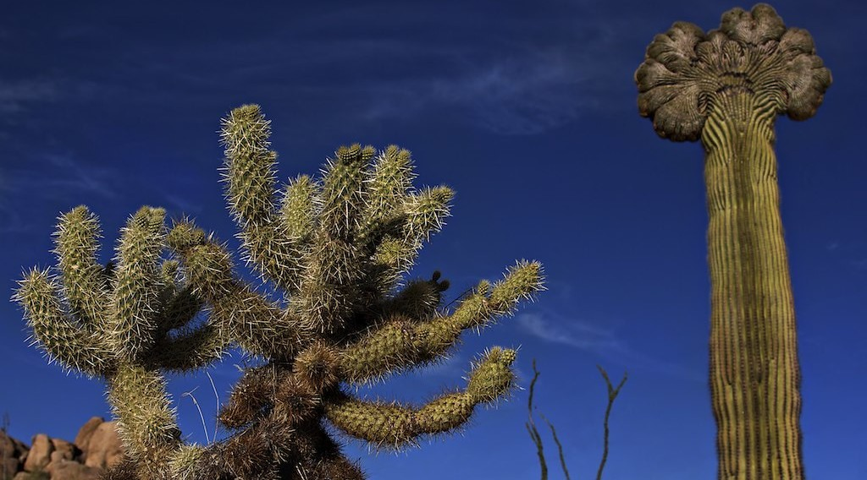
1. VEGETATION
Activity 2
A cactus.
Notes:
Activity 2. Look carefully at this picture: a cactus. Observe every detail before I ask the question.

Slide 22
1. VEGETATION
Activity 2: Question
The cactus has a thick stem and spines. How do they help it?
Notes:
Here is the question for Activity 2: The cactus has a thick stem and spines. How do they help it? Take one minute to think and write your answer in your rough notebook.

Slide 23
1. VEGETATION
Activity 2: Answer
The stem keeps water. The spines lose little water and protect it.
Notes:
Let us check the answer together. The stem keeps water. The spines lose little water and protect it.

Slide 24
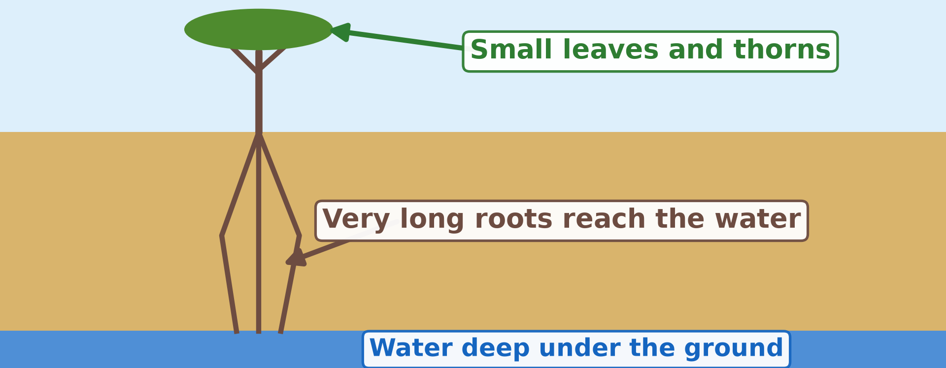
1. VEGETATION
Activity 3
An acacia in the desert.
Notes:
Activity 3. Look carefully at this diagram: an acacia in the desert. Observe every detail before I ask the question.

Slide 25
1. VEGETATION
Activity 3: Question
Why are the roots so long?
Notes:
Here is the question for Activity 3: Why are the roots so long? Take one minute to think and write your answer in your rough notebook.

Slide 26
1. VEGETATION
Activity 3: Answer
To reach water deep under the ground.
Notes:
Let us check the answer together. To reach water deep under the ground.

Slide 27

2. SOILS
Activity 4
White salt on the soil of a desert.
Notes:
Activity 4. Look carefully at this picture: white salt on the soil of a desert. Observe every detail before I ask the question.

Slide 28
2. SOILS
Activity 4: Question
The sun dries the soil and leaves white salt. Is this soil good for crops?
Notes:
Here is the question for Activity 4: The sun dries the soil and leaves white salt. Is this soil good for crops? Take one minute to think and write your answer in your rough notebook.

Slide 29
2. SOILS
Activity 4: Answer
No. Salty soil is bad for crops.
Notes:
Let us check the answer together. No. Salty soil is bad for crops.

Slide 30
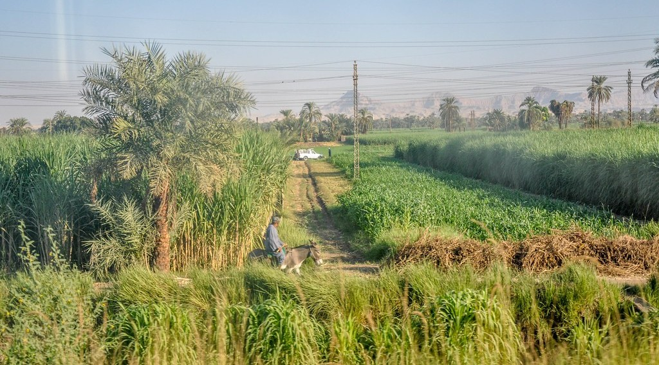
2. SOILS
Activity 5
Green fields near the River Nile, in Egypt.
Notes:
Activity 5. Look carefully at this picture: green fields near the River Nile, in Egypt. Observe every detail before I ask the question.

Slide 31
2. SOILS
Activity 5: Question
Why are the fields green here, in the middle of the desert?
Notes:
Here is the question for Activity 5: Why are the fields green here, in the middle of the desert? Take one minute to think and write your answer in your rough notebook.

Slide 32
2. SOILS
Activity 5: Answer
Water from the Nile makes the desert soil fertile.
Notes:
Let us check the answer together. Water from the Nile makes the desert soil fertile.

Slide 33
BOARD SUMMARY
Board Summary
Topic: Man in His Environment
Sub-topic: Natural Regions
Lesson 3 (Part 3): The Desert Regions: Characteristics (Soils and Vegetation)
Notes:
Now we are going to copy the board summary. Write the title and the headings neatly in your notebooks. I will give you enough time for each slide, so do not rush.

Slide 34
BOARD SUMMARY
DEFINITIONS
The key terms of this lesson are defined as follows:
Xerophyte: It is a plant that can live with very little water.
Humus: It is the dark part of the soil made of dead plants.
Notes:
Let us copy the definitions. The key terms of this lesson are defined as follows. On this slide we have Xerophyte and Humus. Write each point on a new line, with the key term first, and explain it in your own words when we revise.

Slide 35
BOARD SUMMARY
1. Vegetation
Desert plants are few, and they are adapted in the following ways:
Water storage: The cactus stores water in its thick stem.
Small leaves or spines: Small leaves or spines lose very little water.
Notes:
Let us copy Vegetation. Desert plants are few, and they are adapted in the following ways. On this slide we have Water storage and Small leaves or spines. Write each point on a new line, with the key term first, and explain it in your own words when we revise. When you finish, we go to the next slide.

Slide 36
BOARD SUMMARY
1. Vegetation (continued)
Long roots: Long roots reach water deep in the ground.
Short life: Some plants grow, flower and die quickly after rain.
Notes:
We continue with Vegetation. On this slide we have Long roots and Short life. Write each point on a new line, with the key term first, and explain it in your own words when we revise.

Slide 37
BOARD SUMMARY
2. Soils
Desert soils have the following characteristics:
Sandy or stony soils: Sandy and stony soils keep very little water.
Little humus: The soils have little humus because there are few plants.
Notes:
Let us copy Soils. Desert soils have the following characteristics. On this slide we have Sandy or stony soils and Little humus. Write each point on a new line, with the key term first, and explain it in your own words when we revise. When you finish, we go to the next slide.

Slide 38
BOARD SUMMARY
2. Soils (continued)
Salty soils: The strong sun evaporates water and leaves salt on the surface.
Fertile with water: Some desert soils become fertile when irrigated, as along the Nile.
Notes:
We continue with Soils. On this slide we have Salty soils and Fertile with water. Write each point on a new line, with the key term first, and explain it in your own words when we revise.

Slide 39
FORMATIVE EVALUATION
Evaluation 1
Give two ways desert plants are adapted.
Notes:
Now let us check what you have understood. Question 1: Give two ways desert plants are adapted. Answer in your exercise book.

Slide 40
FORMATIVE EVALUATION
Expected Answer
They keep water in their stems; they have long roots.
Notes:
The expected answer is: they keep water in their stems; they have long roots. If you got it right, well done.

Slide 41
FORMATIVE EVALUATION
Evaluation 2
Why do desert soils have little humus?
Notes:
Now let us check what you have understood. Question 2: Why do desert soils have little humus? Answer in your exercise book.

Slide 42
FORMATIVE EVALUATION
Expected Answer
Because there are few plants.
Notes:
The expected answer is: because there are few plants. If you got it right, well done.

Slide 43
REMEDIATION
Remediation
Fill in the blanks:
A plant that lives with little water is a ______.
The cactus keeps water in its ______.
Desert soils are often ______ because the sun leaves salt.
Notes:
For those who need more practice, fill in the blanks in your exercise book. The answers are: number 1, xerophyte; number 2, stem; number 3, salty.

Slide 44
HOMEWORK
Homework
Imagine you must spend one week in the Sahara. Write down three problems you would face and one way to solve each.
Notes:
For your homework: Imagine you must spend one week in the Sahara. Write down three problems you would face and one way to solve each. We shall correct it at the beginning of our next lesson.

Slide 45
NEXT LESSON
Next Lesson
Our next lesson will be on:
Lesson 3 (Part 4): The Desert Regions: Problems Faced and Adaptations
Notes:
Our next lesson will be on Lesson 3 (Part 4): The Desert Regions: Problems Faced and Adaptations. Thank you for your attention, and see you next time.

Slide 46
BILINGUAL GAME
Bilingual Game (Jeu Bilingue)
English | Français
Cactus | Le cactus
Thorn | L'épine
Root | La racine
Stem | La tige
Leaf | La feuille
Seed | La graine
Salty soil | Le sol salé
Date palm | Le palmier dattier
Notes:
Let us play the bilingual game. I say a word in English, and you give me the French word. Then we do the reverse.

Slide 47
LOGBOOK
Official Logbook (1/2)
Module / Topic | Man in His Environment
Lesson Title | Lesson 3 (Part 3): The Desert Regions: Characteristics (Soils and Vegetation)
Expected Learning Outcomes | Describe the vegetation of hot deserts. Explain how desert plants are adapted to the lack of water. Describe the soils of hot deserts.
Competence | Learners are able to explain how plants survive with very little water, and to choose plants that resist drought for their homes.
Notes:
I record this information in the official logbook of the class after the lesson.

Slide 48
LOGBOOK
Official Logbook (2/2)
Matter Taught | DEFINITIONS; Vegetation; Soils.
Evaluation | Formative evaluation and remediation exercise.
Homework | Imagine you must spend one week in the Sahara. Write down three problems you would face and one way to solve each.
Enrolment / Present / Absent | ____ / ____ / ____
Achievement | To be completed after the lesson.
Notes:
I complete the second page of the logbook: the matter taught, the evaluation, the homework and the attendance.

Slide 49
TEACHER'S NOTE
Teacher's Note
Timing: Homework correction, plan, objectives 8 min | Recall, situation, action 10 min | 5 activities 30 min | Board summary (copying) 30 min | Evaluation, remediation 10 min | Homework, next lesson 5 min | Logbook 7 min
Without the projector (Activity 1): ask learners to imagine the Sahara after the Sahel.
Without the projector (Activity 2): bring a cactus or an aloe plant to class.
Without the projector (Activity 3): draw a small tree with very long roots on the board.
Without the projector (Activity 4): describe a pot of salty water left in the sun.
Without the projector (Activity 5): compare with the dry-season gardens along the Benue.
Notes:
This slide is for me, the teacher: it gives the timing of the lesson and what to do if the projector is not available.

Slide 50
REFERENCES
References
Harmonised Progression Sheet, Economic Geography (5051), Form 2.
Class textbook: The major biomes of the world (hot deserts).
Photo, Activity 1: “Saguaro and teddy bear cholla with mountains in background” by Martin LaBar, CC BY-NC 2.0, via Flickr (https://www.flickr.com/photos/32454422@N00/443523984)
Photo, Activity 2: “Crested Saguaro” by CEBImagery.com, CC BY-NC 2.0, via Flickr (https://www.flickr.com/photos/53098051@N02/5626437842)
Photo, Activity 4: “Salt” by Phillie Casablanca, CC BY 2.0, via Flickr (https://www.flickr.com/photos/19451080@N00/2052715618)
Photo, Activity 5: “View from the train - Arriving to Luxor from Aswan by train” by Jorge Lascar, CC BY 2.0, via Flickr (https://www.flickr.com/photos/8721758@N06/14075081580)
Diagrams and animations: drawn for this lesson (Geography Department).
Notes:
These are the references and picture credits used to prepare this lesson.

