Slide 1
FORM 2 TECHNICAL
GEOGRAPHY
Lesson 3 (Part 5)
The Desert Regions: Human Activities (Farming around Oases)
Notes:
Good morning, class, and welcome to our geography lesson. I am your geography teacher, Mr Kamdem. Today we are starting Lesson 3 (Part 5): The Desert Regions: Human Activities (Farming around Oases).

Slide 2
CLASS INFO
Class, Chapter and Duration
Class | Form 2 Technical
Chapter | Economic Geography — Natural Regions: 3. Desert Regions
Duration | 2 periods (2 × 50 minutes)
Notes:
This lesson is for Form 2 Technical. It belongs to Economic Geography — Natural Regions: 3. Desert Regions. We shall need 2 periods to cover it.

Slide 3
IDENTIFICATION
Lesson Identification
Topic | Man in His Environment
Sub-topic | Natural Regions
Lesson | Lesson 3 (Part 5): The Desert Regions: Human Activities (Farming around Oases)
Notions / Concepts | Oasis, water table, irrigation, shaduf, foggara, borehole, date palm.
Syllabus focus | Formation of oases and farming around oases; irrigation in hot deserts.
Competence | Learners are able to explain how water can be brought to crops in the dry season and use water carefully in farming.
Notes:
Our topic is Man in His Environment, and the sub-topic is Natural Regions. The key notions we shall use today are: oasis, water table, irrigation, shaduf, foggara, borehole, date palm. At the end, you should be able to do this: learners are able to explain how water can be brought to crops in the dry season and use water carefully in farming.

Slide 4

HOMEWORK CORRECTION
Correction of the Homework
Question (Lesson 3 (Part 4): The Desert Regions: Problems Faced and Adaptations):
Find in your textbook or atlas the name of one oasis in the Sahara, and write the name of the country where it is found.
Notes:
Before we start the new lesson, let us correct the homework I gave you at the end of Lesson 3 (Part 4): The Desert Regions: Problems Faced and Adaptations. The question was: Find in your textbook or atlas the name of one oasis in the Sahara, and write the name of the country where it is found. Take out your exercise books.

Slide 5
HOMEWORK CORRECTION
Correction: Possible Answer
Examples: Siwa oasis in Egypt; Tafilalt oasis in Morocco; Kufra oasis in Libya; Bilma oasis in Niger.
Notes:
Here is a good answer. Examples: Siwa oasis in Egypt; Tafilalt oasis in Morocco; Kufra oasis in Libya; Bilma oasis in Niger. Compare it with your own answer and correct your work in red.

Slide 6
LESSON PLAN
Lesson Plan
Correction of the homework
Objectives and recall
Real-life situation and action to take
Learning activities
Board summary
Evaluation, remediation and homework
Notes:
Here is the plan of our lesson today. First, we shall correct the homework. Then we shall look at the objectives and recall what you already know. After that, we shall study a situation from real life and the action to take, and do the learning activities. Finally, we shall copy the board summary, do the evaluation and the remediation, and I will give you the homework.

Slide 7
OBJECTIVES
Objectives
By the end of this lesson, you should be able to:
Explain how an oasis is formed.
Describe the crops grown in oases.
Describe the methods of irrigation used in deserts.
Notes:
Take your time to copy this part; we will continue together.

Slide 8
OBJECTIVES
Objectives (continued)
Identify the problems of oasis farming.
Notes:
By the end of this lesson, you should be able to do three things. Number 1: explain how an oasis is formed. Number 2: describe the crops grown in oases. Number 3: describe the methods of irrigation used in deserts. Number 4: identify the problems of oasis farming.

Slide 9
PREVIOUS KNOWLEDGE
Previous Knowledge
Desert people face lack of water, extreme temperatures, sandstorms and poor soils.
They adapt through nomadism, camels, clothing, housing and wells.
Notes:
Let us first remember what you already know. Desert people face lack of water, extreme temperatures, sandstorms and poor soils. They adapt through nomadism, camels, clothing, housing and wells. Keep this in mind, because we shall build on it today.

Slide 10
REAL-LIFE SITUATION
Situation in Real Life
In the middle of the Sahara, travellers see a green place with tall palm trees and gardens. All around, there is only sand. Musa wonders how crops can grow there.
Notes:
Listen carefully to this situation from real life. In the middle of the Sahara, travellers see a green place with tall palm trees and gardens. All around, there is only sand. Musa wonders how crops can grow there. Think about it, because I am going to ask you some questions.

Slide 11
REAL-LIFE SITUATION
Situation: Question 1
What is the problem in the situation?
Notes:
Question 1: What is the problem in the situation? Think for a moment, then raise your hand to answer.

Slide 12
REAL-LIFE SITUATION
Answer
Musa does not know how crops grow in the desert.
Notes:
Good. Musa does not know how crops grow in the desert.

Slide 13
REAL-LIFE SITUATION
Situation: Question 2
What did the travellers see?
Notes:
Question 2: What did the travellers see? Think for a moment, then raise your hand to answer.

Slide 14
REAL-LIFE SITUATION
Answer
Palm trees and gardens in the middle of the sand.
Notes:
Good. Palm trees and gardens in the middle of the sand.

Slide 15
REAL-LIFE SITUATION
Situation: Question 3
What do crops need to grow in the desert?
Notes:
Question 3: What do crops need to grow in the desert? Think for a moment, then raise your hand to answer.

Slide 16
REAL-LIFE SITUATION
Possible Answer
Water.
Notes:
Good. Water.

Slide 17
ACTION TO TAKE
Action to Take
Use irrigation water carefully so that it lasts.
Notes:
From this situation, the action we are working towards in this lesson is the following: use irrigation water carefully so that it lasts.

Slide 18
JUSTIFICATION
Justification of the Lesson
This lesson helps us to know how people farm in the desert.
Notes:
Why is this lesson important for you? This lesson helps us to know how people farm in the desert.

Slide 19
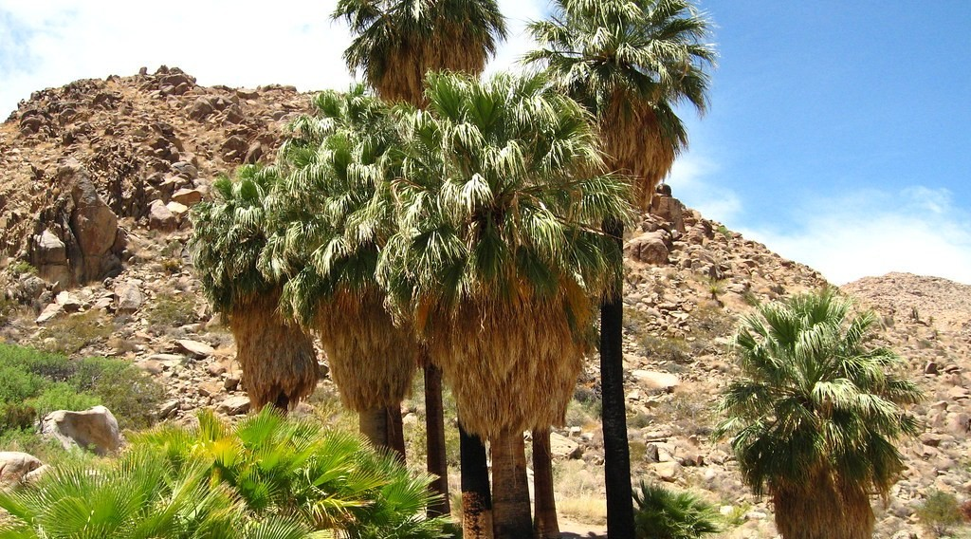
1. THE OASIS
Activity 1
An oasis in the Sahara.
Notes:
Activity 1. Look carefully at this picture: an oasis in the Sahara. Observe every detail before I ask the question.

Slide 20
1. THE OASIS
Activity 1: Question
What do we call this green place in the desert?
Notes:
Here is the question for Activity 1: What do we call this green place in the desert? Take one minute to think and write your answer in your rough notebook.

Slide 21
1. THE OASIS
Activity 1: Answer
An oasis.
Notes:
Let us check the answer together. An oasis.

Slide 22
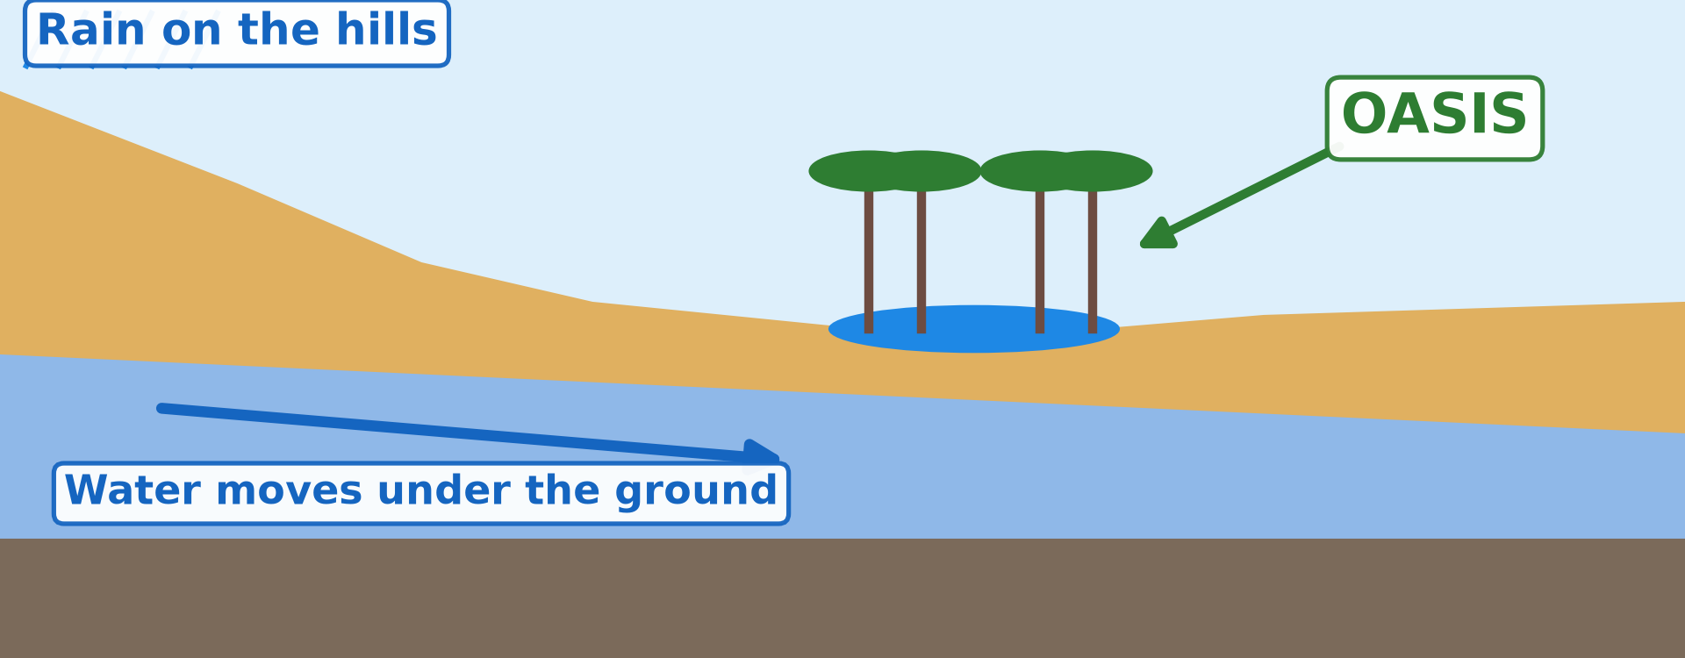
1. THE OASIS
Activity 2
How an oasis gets its water.
Notes:
Activity 2. Look carefully at this diagram: how an oasis gets its water. Observe every detail before I ask the question.

Slide 23
1. THE OASIS
Activity 2: Question
Where does the water of the oasis come from?
Notes:
Here is the question for Activity 2: Where does the water of the oasis come from? Take one minute to think and write your answer in your rough notebook.

Slide 24
1. THE OASIS
Activity 2: Answer
From rain on far hills. It moves under the ground and comes up.
Notes:
Let us check the answer together. From rain on far hills. It moves under the ground and comes up.

Slide 25
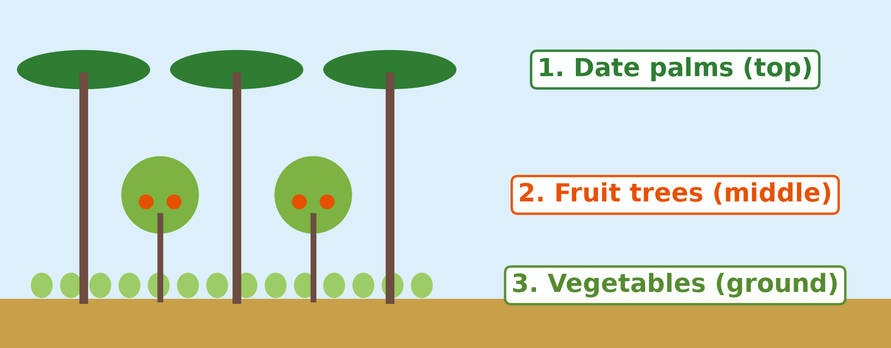
2. FARMING AROUND OASES
Activity 3
The three layers of crops in an oasis.
Notes:
Activity 3. Look carefully at this diagram: the three layers of crops in an oasis. Observe every detail before I ask the question.

Slide 26
2. FARMING AROUND OASES
Activity 3: Question
Name the three layers of crops. Why do farmers grow crops under the palms?
Notes:
Here is the question for Activity 3: Name the three layers of crops. Why do farmers grow crops under the palms? Take one minute to think and write your answer in your rough notebook.

Slide 27
2. FARMING AROUND OASES
Activity 3: Answer
Date palms, fruit trees, vegetables. The palms give shade and keep the soil wet.
Notes:
Let us check the answer together. Date palms, fruit trees, vegetables. The palms give shade and keep the soil wet.

Slide 28
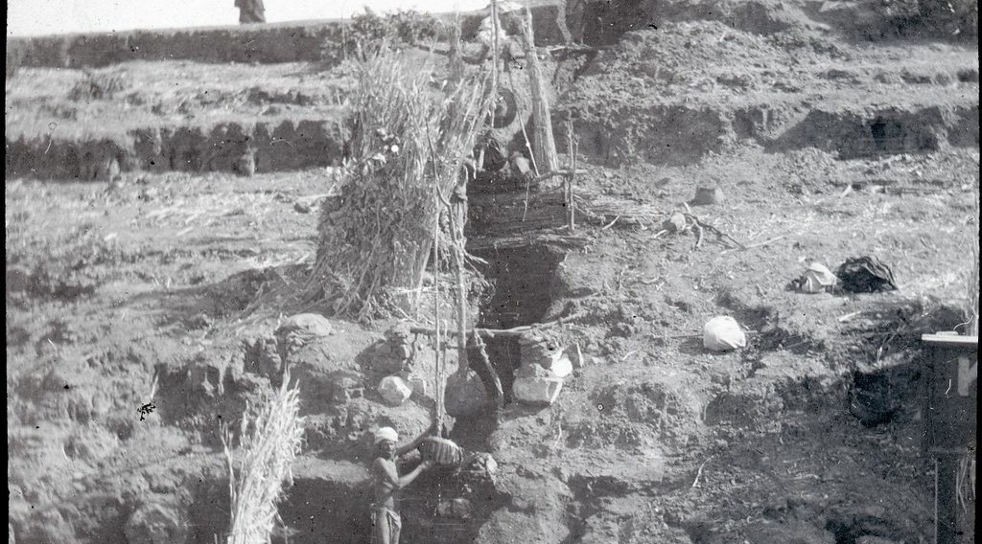
2. FARMING AROUND OASES
Activity 4
A shaduf in Egypt.
Notes:
Activity 4. Look carefully at this picture: a shaduf in Egypt. Observe every detail before I ask the question.

Slide 29
2. FARMING AROUND OASES
Activity 4: Question
What does this farmer use to lift water from the river?
Notes:
Here is the question for Activity 4: What does this farmer use to lift water from the river? Take one minute to think and write your answer in your rough notebook.

Slide 30
2. FARMING AROUND OASES
Activity 4: Answer
A shaduf: a long pole with a bucket.
Notes:
Let us check the answer together. A shaduf: a long pole with a bucket.

Slide 31

2. FARMING AROUND OASES
Activity 5
Round fields watered by machines, seen from the sky.
Notes:
Activity 5. Look carefully at this picture: round fields watered by machines, seen from the sky. Observe every detail before I ask the question.

Slide 32
2. FARMING AROUND OASES
Activity 5: Question
How do modern farmers get water in the desert?
Notes:
Here is the question for Activity 5: How do modern farmers get water in the desert? Take one minute to think and write your answer in your rough notebook.

Slide 33
2. FARMING AROUND OASES
Activity 5: Answer
They pump water from deep wells (boreholes).
Notes:
Let us check the answer together. They pump water from deep wells (boreholes).

Slide 34
BOARD SUMMARY
Board Summary
Topic: Man in His Environment
Sub-topic: Natural Regions
Lesson 3 (Part 5): The Desert Regions: Human Activities (Farming around Oases)
Notes:
Now we are going to copy the board summary. Write the title and the headings neatly in your notebooks. I will give you enough time for each slide, so do not rush.

Slide 35
BOARD SUMMARY
1. The Oasis
The oasis is explained as follows:
Oasis: It is a green place in the desert where there is water.
Formation: Rainwater from far hills flows under the ground and comes up in a low place in the desert.
Notes:
Let us copy The Oasis. The oasis is explained as follows. On this slide we have Oasis and Formation. Write each point on a new line, with the key term first, and explain it in your own words when we revise. When you finish, we go to the next slide.

Slide 36
BOARD SUMMARY
1. The Oasis (continued)
Examples: Siwa in Egypt and Tafilalt in Morocco are famous oases.
Notes:
We continue with The Oasis. On this slide we have Examples. Write each point on a new line, with the key term first, and explain it in your own words when we revise.

Slide 37
BOARD SUMMARY
1. The Oasis
Illustration: formation of an oasis
Notes:
Now draw this illustration in your notebook: formation of an oasis. Give it a title and label it clearly.

Slide 38
BOARD SUMMARY
2. Farming around Oases
Farming around oases is carried out as follows:
Three layers: Farmers grow date palms on top, fruit trees in the middle and vegetables below.
Irrigation methods: Water is lifted from wells with the shaduf, pumps and boreholes.
Notes:
Let us copy Farming around Oases. Farming around oases is carried out as follows. On this slide we have Three layers and Irrigation methods. Write each point on a new line, with the key term first, and explain it in your own words when we revise. When you finish, we go to the next slide.

Slide 39
BOARD SUMMARY
2. Farming around Oases (continued)
The Nile valley: The Aswan Dam gives water to farms along the Nile all year.
Problems: Wells can dry up and moving sand can cover the fields.
Notes:
We continue with Farming around Oases. On this slide we have The Nile valley and Problems. Write each point on a new line, with the key term first, and explain it in your own words when we revise.

Slide 40
FORMATIVE EVALUATION
Evaluation 1
What is an oasis?
Notes:
Now let us check what you have understood. Question 1: What is an oasis? Answer in your exercise book.

Slide 41
FORMATIVE EVALUATION
Expected Answer
A green place in the desert where there is water.
Notes:
The expected answer is: a green place in the desert where there is water. If you got it right, well done.

Slide 42
FORMATIVE EVALUATION
Evaluation 2
Name two ways to get water in an oasis.
Notes:
Now let us check what you have understood. Question 2: Name two ways to get water in an oasis. Answer in your exercise book.

Slide 43
FORMATIVE EVALUATION
Expected Answer
Wells and the shaduf (or pumps).
Notes:
The expected answer is: wells and the shaduf (or pumps). If you got it right, well done.

Slide 44
REMEDIATION
Remediation
Fill in the blanks:
A green place with water in the desert is an ______.
The top layer of an oasis garden is the date ______.
Notes:
Take your time to copy this part; we will continue together.

Slide 45
REMEDIATION
Remediation (continued)
A pole with a bucket for lifting water is a ______.
Notes:
For those who need more practice, fill in the blanks in your exercise book. The answers are: number 1, oasis; number 2, palm; number 3, shaduf.

Slide 46
HOMEWORK
Homework
Look at a world map in your atlas. Find two countries located between 30° and 60° north of the Equator, and write their names.
Notes:
For your homework: Look at a world map in your atlas. Find two countries located between 30° and 60° north of the Equator, and write their names. We shall correct it at the beginning of our next lesson.

Slide 47
NEXT LESSON
Next Lesson
Our next lesson will be on:
Lesson 4 (Part 1): The Temperate Region: Location, Types and Characteristics (Climate)
Notes:
Our next lesson will be on Lesson 4 (Part 1): The Temperate Region: Location, Types and Characteristics (Climate). Thank you for your attention, and see you next time.

Slide 48
BILINGUAL GAME
Bilingual Game (Jeu Bilingue)
English | Français
Oasis | L'oasis
Date | La datte
Irrigation | L'irrigation
Borehole | Le forage
Spring | La source
Water table | La nappe phréatique
Pump | La pompe
Dam | Le barrage
Notes:
Let us play the bilingual game. I say a word in English, and you give me the French word. Then we do the reverse.

Slide 49
LOGBOOK
Official Logbook (1/2)
Module / Topic | Man in His Environment
Lesson Title | Lesson 3 (Part 5): The Desert Regions: Human Activities (Farming around Oases)
Expected Learning Outcomes | Explain how an oasis is formed. Describe the crops grown in oases. Describe the methods of irrigation used in deserts. Identify the problems of oasis farming.
Competence | Learners are able to explain how water can be brought to crops in the dry season and use water carefully in farming.
Notes:
I record this information in the official logbook of the class after the lesson.

Slide 50
LOGBOOK
Official Logbook (2/2)
Matter Taught | The Oasis; Farming around Oases.
Evaluation | Formative evaluation and remediation exercise.
Homework | Look at a world map in your atlas. Find two countries located between 30° and 60° north of the Equator, and write their names.
Enrolment / Present / Absent | ____ / ____ / ____
Achievement | To be completed after the lesson.
Notes:
I complete the second page of the logbook: the matter taught, the evaluation, the homework and the attendance.

Slide 51
TEACHER'S NOTE
Teacher's Note
Timing: Homework correction, plan, objectives 8 min | Recall, situation, action 10 min | 5 activities 30 min | Board summary (copying) 30 min | Evaluation, remediation 10 min | Homework, next lesson 5 min | Logbook 7 min
Without the projector (Activity 1): describe an oasis: palm trees and water in the middle of the sand.
Without the projector (Activity 2): draw the hills, the water under the ground and the oasis.
Without the projector (Activity 3): draw a palm tree, a small fruit tree and vegetables.
Without the projector (Activity 4): draw a shaduf: a pole, a weight and a bucket.
Without the projector (Activity 5): explain that a pump brings water from deep under the ground.
Notes:
This slide is for me, the teacher: it gives the timing of the lesson and what to do if the projector is not available.

Slide 52
REFERENCES
References
Harmonised Progression Sheet, Economic Geography (5051), Form 2.
Class textbook: The major biomes of the world (hot deserts).
Photo, Activity 1: “49 Palms Oasis; Twentynine Palms, CA” by Joshua Tree National Park, Public domain 1.0, via Flickr (https://www.flickr.com/photos/115357548@N08/12525367563)
Photo, Activity 4: “A Shadoof” by 10b travelling / Carsten ten Brink, CC BY-NC-ND 2.0, via Flickr (https://www.flickr.com/photos/77334245@N00/5908489998)
Photo, Activity 5: “Mid-West Agriculture” by Djof, CC BY-NC-SA 2.0, via Flickr (https://www.flickr.com/photos/10787942@N00/147222315)
Diagrams and animations: drawn for this lesson (Geography Department).
Notes:
These are the references and picture credits used to prepare this lesson.

