Slide 1
FORM 2 TECHNICAL
GEOGRAPHY
Lesson 5 (Part 2)
The Sectors of the Economy: Formal and Informal Sectors of the Economy
Notes:
Good morning, class, and welcome to our geography lesson. I am your geography teacher, Mr Kamdem. Today we are starting Lesson 5 (Part 2): The Sectors of the Economy: Formal and Informal Sectors of the Economy.

Slide 2
CLASS INFO
Class, Chapter and Duration
Class | Form 2 Technical
Chapter | Economic Geography — Sectors of the Economy
Duration | 2 periods (2 × 50 minutes)
Notes:
This lesson is for Form 2 Technical. It belongs to Economic Geography — Sectors of the Economy. We shall need 2 periods to cover it.

Slide 3
IDENTIFICATION
Lesson Identification
Topic | Economic Activities
Sub-topic | Sectors of the Economy
Lesson | Lesson 5 (Part 2): The Sectors of the Economy: Formal and Informal Sectors of the Economy
Notions / Concepts | Formal sector, informal sector, taxes, social security (CNPS), registration.
Syllabus focus | The formal and informal sectors of the economy: definitions, characteristics, advantages and problems.
Competence | Learners are able to tell whether a job around them belongs to the formal or informal sector and explain the advantages of registering a business.
Notes:
Our topic is Economic Activities, and the sub-topic is Sectors of the Economy. The key notions we shall use today are: formal sector, informal sector, taxes, social security (CNPS), registration. At the end, you should be able to do this: learners are able to tell whether a job around them belongs to the formal or informal sector and explain the advantages of registering a business.

Slide 4

HOMEWORK CORRECTION
Correction of the Homework
Question (Lesson 5 (Part 1): The Sectors of the Economy: Introduction, Definitions and Key Concepts):
Notes:
Take your time to copy this part; we will continue together.

Slide 5
HOMEWORK CORRECTION
Correction of the Homework (continued)
Observe two workers in your area: one who works for a registered company and one who works alone in the street (for example a moto-taxi driver). Write one difference between them.
Notes:
Before we start the new lesson, let us correct the homework I gave you at the end of Lesson 5 (Part 1): The Sectors of the Economy: Introduction, Definitions and Key Concepts. The question was: Observe two workers in your area: one who works for a registered company and one who works alone in the street (for example a moto-taxi driver). Write one difference between them. Take out your exercise books.

Slide 6
HOMEWORK CORRECTION
Correction: Possible Answer
Example: a SODECOTON worker has a contract, a monthly salary and CNPS insurance, while a moto-taxi driver works alone, earns money daily and has no contract or pension.
Notes:
Here is a good answer. Example: a SODECOTON worker has a contract, a monthly salary and CNPS insurance, while a moto-taxi driver works alone, earns money daily and has no contract or pension. Compare it with your own answer and correct your work in red.

Slide 7
LESSON PLAN
Lesson Plan
Correction of the homework
Objectives and recall
Real-life situation and action to take
Learning activities
Board summary
Evaluation, remediation and homework
Notes:
Here is the plan of our lesson today. First, we shall correct the homework. Then we shall look at the objectives and recall what you already know. After that, we shall study a situation from real life and the action to take, and do the learning activities. Finally, we shall copy the board summary, do the evaluation and the remediation, and I will give you the homework.

Slide 8
OBJECTIVES
Objectives
By the end of this lesson, you should be able to:
Define the formal and informal sectors.
Give the characteristics of each sector with examples from Cameroon.
Notes:
Take your time to copy this part; we will continue together.

Slide 9
OBJECTIVES
Objectives (continued)
Give the advantages and problems of the informal sector.
Notes:
By the end of this lesson, you should be able to do three things. Number 1: define the formal and informal sectors. Number 2: give the characteristics of each sector with examples from Cameroon. Number 3: give the advantages and problems of the informal sector.

Slide 10
PREVIOUS KNOWLEDGE
Previous Knowledge
The economy has four sectors: primary, secondary, tertiary and quaternary.
The primary sector extracts, the secondary transforms, the tertiary serves and the quaternary researches.
Notes:
Let us first remember what you already know. The economy has four sectors: primary, secondary, tertiary and quaternary. The primary sector extracts, the secondary transforms, the tertiary serves and the quaternary researches. Keep this in mind, because we shall build on it today.

Slide 11
REAL-LIFE SITUATION
Situation in Real Life
Mr Bello works in a bank in Garoua. He has a contract, a salary every month and a pension later. His neighbour Moussa is a moto-taxi driver. He has no contract, and his money changes every day.
Notes:
Listen carefully to this situation from real life. Mr Bello works in a bank in Garoua. He has a contract, a salary every month and a pension later. His neighbour Moussa is a moto-taxi driver. He has no contract, and his money changes every day. Think about it, because I am going to ask you some questions.

Slide 12
REAL-LIFE SITUATION
Situation: Question 1
What is the problem in the situation?
Notes:
Question 1: What is the problem in the situation? Think for a moment, then raise your hand to answer.

Slide 13
REAL-LIFE SITUATION
Answer
Moussa has no contract and no regular money.
Notes:
Good. Moussa has no contract and no regular money.

Slide 14
REAL-LIFE SITUATION
Situation: Question 2
What does Mr Bello have that Moussa does not have?
Notes:
Question 2: What does Mr Bello have that Moussa does not have? Think for a moment, then raise your hand to answer.

Slide 15
REAL-LIFE SITUATION
Answer
A contract, a monthly salary and a pension.
Notes:
Good. A contract, a monthly salary and a pension.

Slide 16
REAL-LIFE SITUATION
Situation: Question 3
What can Moussa do?
Notes:
Question 3: What can Moussa do? Think for a moment, then raise your hand to answer.

Slide 17
REAL-LIFE SITUATION
Possible Answer
Register his work and join the CNPS.
Notes:
Good. Register his work and join the CNPS.

Slide 18
ACTION TO TAKE
Action to Take
Encourage small workers to register their work and join the CNPS.
Notes:
From this situation, the action we are working towards in this lesson is the following: encourage small workers to register their work and join the CNPS.

Slide 19
JUSTIFICATION
Justification of the Lesson
This lesson helps us to know the difference between the formal and the informal sector.
Notes:
Why is this lesson important for you? This lesson helps us to know the difference between the formal and the informal sector.

Slide 20
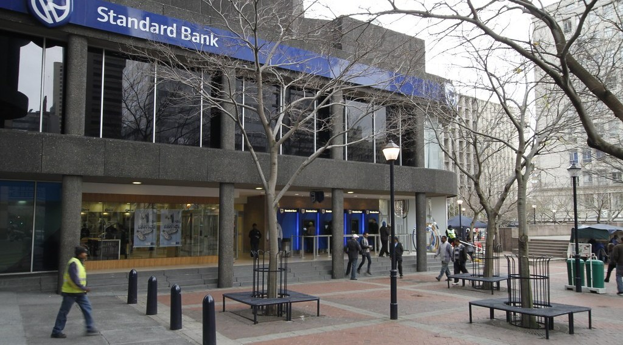
1. THE FORMAL SECTOR
Activity 1
A bank in an African city.
Notes:
Activity 1. Look carefully at this picture: a bank in an African city. Observe every detail before I ask the question.

Slide 21
1. THE FORMAL SECTOR
Activity 1: Question
The bank is registered and pays taxes. Which sector does it belong to?
Notes:
Here is the question for Activity 1: The bank is registered and pays taxes. Which sector does it belong to? Take one minute to think and write your answer in your rough notebook.

Slide 22
1. THE FORMAL SECTOR
Activity 1: Answer
The formal sector.
Notes:
Let us check the answer together. The formal sector.

Slide 23

1. THE FORMAL SECTOR
Activity 2
Workers in a food factory.
Notes:
Activity 2. Look carefully at this picture: workers in a food factory. Observe every detail before I ask the question.

Slide 24
1. THE FORMAL SECTOR
Activity 2: Question
These workers have contracts and a salary. Give one advantage.
Notes:
Here is the question for Activity 2: These workers have contracts and a salary. Give one advantage. Take one minute to think and write your answer in your rough notebook.

Slide 25
1. THE FORMAL SECTOR
Activity 2: Answer
They are paid every month and get a pension.
Notes:
Let us check the answer together. They are paid every month and get a pension.

Slide 26

2. THE INFORMAL SECTOR
Activity 3
Moto-taxis in a Cameroonian town.
Notes:
Activity 3. Look carefully at this picture: moto-taxis in a Cameroonian town. Observe every detail before I ask the question.

Slide 27
2. THE INFORMAL SECTOR
Activity 3: Question
Is the moto-taxi driver registered? Which sector is this?
Notes:
Here is the question for Activity 3: Is the moto-taxi driver registered? Which sector is this? Take one minute to think and write your answer in your rough notebook.

Slide 28
2. THE INFORMAL SECTOR
Activity 3: Answer
Usually not. It is the informal sector.
Notes:
Let us check the answer together. Usually not. It is the informal sector.

Slide 29

2. THE INFORMAL SECTOR
Activity 4
A woman sells roasted maize in the street.
Notes:
Activity 4. Look carefully at this picture: a woman sells roasted maize in the street. Observe every detail before I ask the question.

Slide 30
2. THE INFORMAL SECTOR
Activity 4: Question
Why do many young people work in the informal sector?
Notes:
Here is the question for Activity 4: Why do many young people work in the informal sector? Take one minute to think and write your answer in your rough notebook.

Slide 31
2. THE INFORMAL SECTOR
Activity 4: Answer
It is easy to start and needs little money.
Notes:
Let us check the answer together. It is easy to start and needs little money.

Slide 32
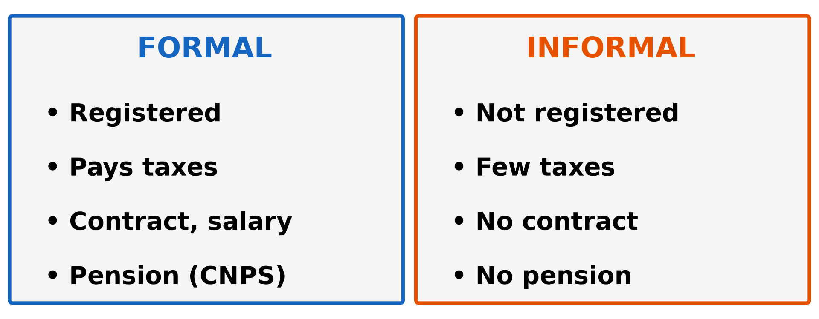
3. COMPARISON
Activity 5
Formal and informal sectors.
Notes:
Activity 5. Look carefully at this diagram: formal and informal sectors. Observe every detail before I ask the question.

Slide 33
3. COMPARISON
Activity 5: Question
Give two problems of working in the informal sector.
Notes:
Here is the question for Activity 5: Give two problems of working in the informal sector. Take one minute to think and write your answer in your rough notebook.

Slide 34
3. COMPARISON
Activity 5: Answer
No contract and no pension. The money is not regular.
Notes:
Let us check the answer together. No contract and no pension. The money is not regular.

Slide 35
BOARD SUMMARY
Board Summary
Topic: Economic Activities
Sub-topic: Sectors of the Economy
Lesson 5 (Part 2): The Sectors of the Economy: Formal and Informal Sectors of the Economy
Notes:
Now we are going to copy the board summary. Write the title and the headings neatly in your notebooks. I will give you enough time for each slide, so do not rush.

Slide 36
BOARD SUMMARY
DEFINITIONS
The key terms of this lesson are defined as follows:
Formal sector: It is work that is registered with the state and pays taxes.
Informal sector: It is small work that is not registered with the state.
Notes:
Let us copy the definitions. The key terms of this lesson are defined as follows. On this slide we have Formal sector and Informal sector. Write each point on a new line, with the key term first, and explain it in your own words when we revise. When you finish, we go to the next slide.

Slide 37
BOARD SUMMARY
DEFINITIONS (continued)
Pension: It is money paid to a worker after retirement.
Notes:
We continue with the definitions. On this slide we have Pension. Write each point on a new line, with the key term first, and explain it in your own words when we revise.

Slide 38
BOARD SUMMARY
1. The Formal Sector
The formal sector has the following characteristics:
Registration: Companies are registered and pay taxes.
Contracts: Workers have contracts and receive a monthly salary.
Notes:
Let us copy The Formal Sector. The formal sector has the following characteristics. On this slide we have Registration and Contracts. Write each point on a new line, with the key term first, and explain it in your own words when we revise. When you finish, we go to the next slide.

Slide 39
BOARD SUMMARY
1. The Formal Sector (continued)
Protection: Workers are insured by the CNPS and receive a pension.
Examples: SODECOTON, banks, schools and hospitals are in the formal sector.
Notes:
We continue with The Formal Sector. On this slide we have Protection and Examples. Write each point on a new line, with the key term first, and explain it in your own words when we revise.

Slide 40
BOARD SUMMARY
2. The Informal Sector
The informal sector is described as follows:
Examples: Moto-taxi drivers, street sellers and roadside mechanics work in the informal sector.
Importance: It gives work and income to most people in Cameroon.
Notes:
Let us copy The Informal Sector. The informal sector is described as follows. On this slide we have Examples and Importance. Write each point on a new line, with the key term first, and explain it in your own words when we revise. When you finish, we go to the next slide.

Slide 41
BOARD SUMMARY
2. The Informal Sector (continued)
Problems: Workers have no contract, no insurance and no pension.
Solutions: Workers can register their activity and join the CNPS.
Notes:
We continue with The Informal Sector. On this slide we have Problems and Solutions. Write each point on a new line, with the key term first, and explain it in your own words when we revise.

Slide 42
BOARD SUMMARY
2. The Informal Sector
Illustration: formal and informal sectors compared
Notes:
Now draw this illustration in your notebook: formal and informal sectors compared. Give it a title and label it clearly.

Slide 43
FORMATIVE EVALUATION
Evaluation 1
What is the informal sector?
Notes:
Now let us check what you have understood. Question 1: What is the informal sector? Answer in your exercise book.

Slide 44
FORMATIVE EVALUATION
Expected Answer
Small work that is not registered with the state.
Notes:
The expected answer is: small work that is not registered with the state. If you got it right, well done.

Slide 45
FORMATIVE EVALUATION
Evaluation 2
Give one problem of informal workers.
Notes:
Now let us check what you have understood. Question 2: Give one problem of informal workers. Answer in your exercise book.

Slide 46
FORMATIVE EVALUATION
Expected Answer
They have no pension (or no contract).
Notes:
The expected answer is: they have no pension (or no contract). If you got it right, well done.

Slide 47
REMEDIATION
Remediation
Fill in the blanks:
Work that is registered and pays taxes is the ______ sector.
A moto-taxi driver usually works in the ______ sector.
Notes:
Take your time to copy this part; we will continue together.

Slide 48
REMEDIATION
Remediation (continued)
Money paid after a worker stops working is a ______.
Notes:
For those who need more practice, fill in the blanks in your exercise book. The answers are: number 1, formal; number 2, informal; number 3, pension.

Slide 49
HOMEWORK
Homework
List four products of farming, fishing, forestry or mining found in the Garoua market, and say where each comes from.
Notes:
For your homework: List four products of farming, fishing, forestry or mining found in the Garoua market, and say where each comes from. We shall correct it at the beginning of our next lesson.

Slide 50
NEXT LESSON
Next Lesson
Our next lesson will be on:
Lesson 5 (Part 3): The Sectors of the Economy: The Primary Sector (Definition and Examples)
Notes:
Our next lesson will be on Lesson 5 (Part 3): The Sectors of the Economy: The Primary Sector (Definition and Examples). Thank you for your attention, and see you next time.

Slide 51
BILINGUAL GAME
Bilingual Game (Jeu Bilingue)
English | Français
Formal sector | Le secteur formel
Informal sector | Le secteur informel
Tax | L'impôt
Salary | Le salaire
Contract | Le contrat
Pension | La retraite (pension)
Street seller | Le vendeur ambulant
Registration | L'immatriculation
Notes:
Let us play the bilingual game. I say a word in English, and you give me the French word. Then we do the reverse.

Slide 52
LOGBOOK
Official Logbook (1/2)
Module / Topic | Economic Activities
Lesson Title | Lesson 5 (Part 2): The Sectors of the Economy: Formal and Informal Sectors of the Economy
Expected Learning Outcomes | Define the formal and informal sectors. Give the characteristics of each sector with examples from Cameroon. Give the advantages and problems of the informal sector.
Competence | Learners are able to tell whether a job around them belongs to the formal or informal sector and explain the advantages of registering a business.
Notes:
I record this information in the official logbook of the class after the lesson.

Slide 53
LOGBOOK
Official Logbook (2/2)
Matter Taught | DEFINITIONS; The Formal Sector; The Informal Sector.
Evaluation | Formative evaluation and remediation exercise.
Homework | List four products of farming, fishing, forestry or mining found in the Garoua market, and say where each comes from.
Enrolment / Present / Absent | ____ / ____ / ____
Achievement | To be completed after the lesson.
Notes:
I complete the second page of the logbook: the matter taught, the evaluation, the homework and the attendance.

Slide 54
TEACHER'S NOTE
Teacher's Note
Timing: Homework correction, plan, objectives 8 min | Recall, situation, action 10 min | 5 activities 30 min | Board summary (copying) 30 min | Evaluation, remediation 10 min | Homework, next lesson 5 min | Logbook 7 min
CNPS: Caisse Nationale de Prévoyance Sociale (national social insurance fund). About 9 workers out of 10 in Cameroon work in the informal sector.
Without the projector (Activity 1): ask learners to name a bank or company in Garoua.
Without the projector (Activity 2): ask learners who works for SODECOTON, a school or a hospital.
Without the projector (Activity 3): use the situation of Moussa.
Without the projector (Activity 4): ask learners about small traders in their area.
Without the projector (Activity 5): draw the two columns on the board.
Notes:
This slide is for me, the teacher: it gives the timing of the lesson and what to do if the projector is not available.

Slide 55
REFERENCES
References
Harmonised Progression Sheet, Economic Geography (5051), Form 2.
Institut National de la Statistique (INS), Enquêtes sur l'Emploi et le Secteur Informel (EESI).
Photo, Activity 1: “Thibault Square, Cape Town” by World Bank Photo Collection, CC BY-NC-ND 2.0, via Flickr (https://www.flickr.com/photos/10816734@N03/7825576852)
Photo, Activity 2: “Photo by USAID East Africa” by U.S. Agency for International Development, CC0 1.0, via rawpixel (https://www.rawpixel.com/image/4051097/image-public-domain-person-building)
Photo, Activity 3: “Cameroon - UN Women's Gender Road Project” by UN Women Gallery, CC BY-NC-ND 2.0, via Flickr (https://www.flickr.com/photos/51431730@N04/47586053052)
Photo, Activity 4: “Roadside vendor roasts maize cobs for sale in Timau” by CIMMYT, CC BY-NC 2.0, via Flickr (https://www.flickr.com/photos/44760652@N05/25375356457)
Diagrams and animations: drawn for this lesson (Geography Department).
Notes:
These are the references and picture credits used to prepare this lesson.

