Slide 1
FORM 2 TECHNICAL
GEOGRAPHY
Lesson 5 (Part 3)
The Sectors of the Economy: The Primary Sector (Definition and Examples)
Notes:
Good morning, class, and welcome to our geography lesson. I am your geography teacher, Mr Kamdem. Today we are starting Lesson 5 (Part 3): The Sectors of the Economy: The Primary Sector (Definition and Examples).

Slide 2
CLASS INFO
Class, Chapter and Duration
Class | Form 2 Technical
Chapter | Economic Geography — Sectors of the Economy
Duration | 2 periods (2 × 50 minutes)
Notes:
This lesson is for Form 2 Technical. It belongs to Economic Geography — Sectors of the Economy. We shall need 2 periods to cover it.

Slide 3
IDENTIFICATION
Lesson Identification
Topic | Economic Activities
Sub-topic | Sectors of the Economy
Lesson | Lesson 5 (Part 3): The Sectors of the Economy: The Primary Sector (Definition and Examples)
Notions / Concepts | Primary sector, agriculture, livestock rearing, fishing, forestry, mining.
Syllabus focus | Definition and examples of the primary sector, with examples from Cameroon.
Competence | Learners are able to identify primary activities around them and explain their importance for food and exports.
Notes:
Our topic is Economic Activities, and the sub-topic is Sectors of the Economy. The key notions we shall use today are: primary sector, agriculture, livestock rearing, fishing, forestry, mining. At the end, you should be able to do this: learners are able to identify primary activities around them and explain their importance for food and exports.

Slide 4

HOMEWORK CORRECTION
Correction of the Homework
Question (Lesson 5 (Part 2): The Sectors of the Economy: Formal and Informal Sectors of the Economy):
List four products of farming, fishing, forestry or mining found in the Garoua market, and say where each comes from.
Notes:
Before we start the new lesson, let us correct the homework I gave you at the end of Lesson 5 (Part 2): The Sectors of the Economy: Formal and Informal Sectors of the Economy. The question was: List four products of farming, fishing, forestry or mining found in the Garoua market, and say where each comes from. Take out your exercise books.

Slide 5
HOMEWORK CORRECTION
Correction: Possible Answer
Examples: onions and maize (farming, from Garoua and the Far North); fish (fishing, from Lagdo); charcoal and wood (forestry, from the savanna); salt or cement from limestone (mining, from Figuil).
Notes:
Here is a good answer. Examples: onions and maize (farming, from Garoua and the Far North); fish (fishing, from Lagdo); charcoal and wood (forestry, from the savanna); salt or cement from limestone (mining, from Figuil). Compare it with your own answer and correct your work in red.

Slide 6
LESSON PLAN
Lesson Plan
Correction of the homework
Objectives and recall
Real-life situation and action to take
Learning activities
Board summary
Evaluation, remediation and homework
Notes:
Here is the plan of our lesson today. First, we shall correct the homework. Then we shall look at the objectives and recall what you already know. After that, we shall study a situation from real life and the action to take, and do the learning activities. Finally, we shall copy the board summary, do the evaluation and the remediation, and I will give you the homework.

Slide 7
OBJECTIVES
Objectives
By the end of this lesson, you should be able to:
Define the primary sector.
Name the main primary activities.
Give examples of primary activities in Cameroon and explain their importance.
Notes:
By the end of this lesson, you should be able to do three things. Number 1: define the primary sector. Number 2: name the main primary activities. Number 3: give examples of primary activities in Cameroon and explain their importance.

Slide 8
PREVIOUS KNOWLEDGE
Previous Knowledge
The formal sector is registered and pays taxes; the informal sector is not registered.
Both sectors exist in primary, secondary and tertiary activities.
Notes:
Let us first remember what you already know. The formal sector is registered and pays taxes; the informal sector is not registered. Both sectors exist in primary, secondary and tertiary activities. Keep this in mind, because we shall build on it today.

Slide 9
REAL-LIFE SITUATION
Situation in Real Life
In the Garoua market, Rahila sees maize from Pitoa, fish from the Lagdo lake, beef from the Adamawa and firewood from the bush. Her mother says, "All these come from nature."
Notes:
Listen carefully to this situation from real life. In the Garoua market, Rahila sees maize from Pitoa, fish from the Lagdo lake, beef from the Adamawa and firewood from the bush. Her mother says, "All these come from nature." Think about it, because I am going to ask you some questions.

Slide 10
REAL-LIFE SITUATION
Situation: Question 1
What is the problem in the situation?
Notes:
Question 1: What is the problem in the situation? Think for a moment, then raise your hand to answer.

Slide 11
REAL-LIFE SITUATION
Answer
Rahila wants to know how these products are grouped.
Notes:
Good. Rahila wants to know how these products are grouped.

Slide 12
REAL-LIFE SITUATION
Situation: Question 2
Where does each product come from?
Notes:
Question 2: Where does each product come from? Think for a moment, then raise your hand to answer.

Slide 13
REAL-LIFE SITUATION
Answer
Maize from Pitoa, fish from Lagdo, beef from Adamawa, wood from the bush.
Notes:
Good. Maize from Pitoa, fish from Lagdo, beef from Adamawa, wood from the bush.

Slide 14
REAL-LIFE SITUATION
Situation: Question 3
What do they have in common?
Notes:
Question 3: What do they have in common? Think for a moment, then raise your hand to answer.

Slide 15
REAL-LIFE SITUATION
Possible Answer
They are all taken from nature.
Notes:
Good. They are all taken from nature.

Slide 16
ACTION TO TAKE
Action to Take
Respect farmers, herders and fishermen, who feed the nation.
Notes:
From this situation, the action we are working towards in this lesson is the following: respect farmers, herders and fishermen, who feed the nation.

Slide 17
JUSTIFICATION
Justification of the Lesson
This lesson helps us to know the jobs that take products from nature.
Notes:
Why is this lesson important for you? This lesson helps us to know the jobs that take products from nature.

Slide 18
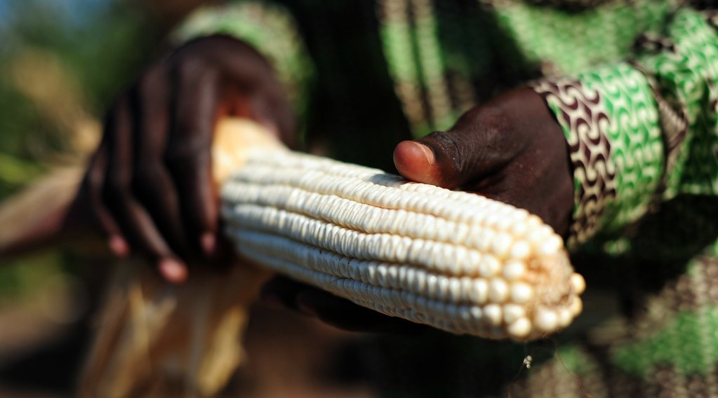
1. AGRICULTURE
Activity 1
A farmer holds a cob of maize.
Notes:
Activity 1. Look carefully at this picture: a farmer holds a cob of maize. Observe every detail before I ask the question.

Slide 19
1. AGRICULTURE
Activity 1: Question
The farmer takes food from nature. Which sector is this?
Notes:
Here is the question for Activity 1: The farmer takes food from nature. Which sector is this? Take one minute to think and write your answer in your rough notebook.

Slide 20
1. AGRICULTURE
Activity 1: Answer
The primary sector.
Notes:
Let us check the answer together. The primary sector.

Slide 21

1. LIVESTOCK REARING
Activity 2
A cattle market.
Notes:
Activity 2. Look carefully at this picture: a cattle market. Observe every detail before I ask the question.

Slide 22
1. LIVESTOCK REARING
Activity 2: Question
Where do most cattle of Cameroon come from?
Notes:
Here is the question for Activity 2: Where do most cattle of Cameroon come from? Take one minute to think and write your answer in your rough notebook.

Slide 23
1. LIVESTOCK REARING
Activity 2: Answer
From the North and the Adamawa plateau.
Notes:
Let us check the answer together. From the North and the Adamawa plateau.

Slide 24

1. FISHING
Activity 3
Fresh fish for sale.
Notes:
Activity 3. Look carefully at this picture: fresh fish for sale. Observe every detail before I ask the question.

Slide 25
1. FISHING
Activity 3: Question
Name two places where people fish in Cameroon.
Notes:
Here is the question for Activity 3: Name two places where people fish in Cameroon. Take one minute to think and write your answer in your rough notebook.

Slide 26
1. FISHING
Activity 3: Answer
The Lagdo lake and the sea at Kribi (also Limbe, Douala).
Notes:
Let us check the answer together. The Lagdo lake and the sea at Kribi (also Limbe, Douala).

Slide 27

1. FORESTRY
Activity 4
Logs from the forest of East Cameroon.
Notes:
Activity 4. Look carefully at this picture: logs from the forest of East Cameroon. Observe every detail before I ask the question.

Slide 28
1. FORESTRY
Activity 4: Question
Which primary product comes from the forest?
Notes:
Here is the question for Activity 4: Which primary product comes from the forest? Take one minute to think and write your answer in your rough notebook.

Slide 29
1. FORESTRY
Activity 4: Answer
Timber (wood).
Notes:
Let us check the answer together. Timber (wood).

Slide 30
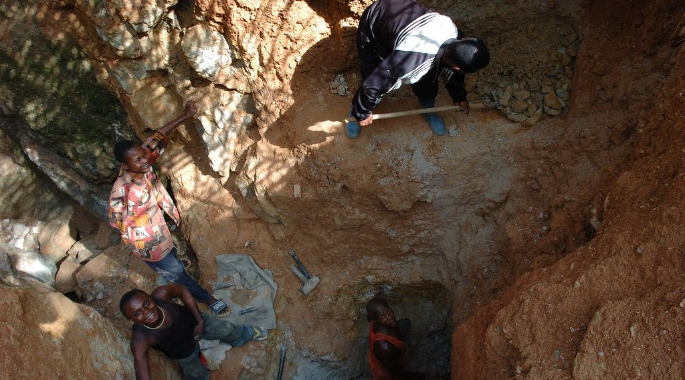
1. MINING
Activity 5
People dig for gold by hand.
Notes:
Activity 5. Look carefully at this picture: people dig for gold by hand. Observe every detail before I ask the question.

Slide 31
1. MINING
Activity 5: Question
What are these people taking from the ground?
Notes:
Here is the question for Activity 5: What are these people taking from the ground? Take one minute to think and write your answer in your rough notebook.

Slide 32
1. MINING
Activity 5: Answer
Gold. Taking minerals from the ground is mining.
Notes:
Let us check the answer together. Gold. Taking minerals from the ground is mining.

Slide 33
BOARD SUMMARY
Board Summary
Topic: Economic Activities
Sub-topic: Sectors of the Economy
Lesson 5 (Part 3): The Sectors of the Economy: The Primary Sector (Definition and Examples)
Notes:
Now we are going to copy the board summary. Write the title and the headings neatly in your notebooks. I will give you enough time for each slide, so do not rush.

Slide 34
BOARD SUMMARY
DEFINITIONS
The key terms of this lesson are defined as follows:
Primary sector: It is the sector that takes products directly from nature.
Notes:
Let us copy the definitions. The key terms of this lesson are defined as follows. On this slide we have Primary sector. Write each point on a new line, with the key term first, and explain it in your own words when we revise.

Slide 35
BOARD SUMMARY
1. Examples of the Primary Sector
The primary sector in Cameroon includes the following activities:
Agriculture: Farmers grow maize, cassava, cotton and cocoa.
Livestock rearing: Herders rear cattle in the North and on the Adamawa plateau.
Notes:
Let us copy Examples of the Primary Sector. The primary sector in Cameroon includes the following activities. On this slide we have Agriculture and Livestock rearing. Write each point on a new line, with the key term first, and explain it in your own words when we revise. When you finish, we go to the next slide.

Slide 36
BOARD SUMMARY
1. Examples of the Primary Sector (continued)
Fishing: People fish in the Lagdo lake and at sea near Kribi and Limbe.
Forestry: Timber is cut in the forests of the South and East.
Mining: Oil, gold and limestone are taken from the ground.
Notes:
We continue with Examples of the Primary Sector. On this slide we have Fishing, Forestry and Mining. Write each point on a new line, with the key term first, and explain it in your own words when we revise.

Slide 37
BOARD SUMMARY
2. Importance of the Primary Sector
The primary sector is important for the following reasons:
Food: It feeds the population.
Jobs: It employs most people in the villages.
Notes:
Let us copy Importance of the Primary Sector. The primary sector is important for the following reasons. On this slide we have Food and Jobs. Write each point on a new line, with the key term first, and explain it in your own words when we revise. When you finish, we go to the next slide.

Slide 38
BOARD SUMMARY
2. Importance of the Primary Sector (continued)
Exports: Cameroon earns money by selling cocoa, cotton, timber and oil.
Notes:
We continue with Importance of the Primary Sector. On this slide we have Exports. Write each point on a new line, with the key term first, and explain it in your own words when we revise.

Slide 39
FORMATIVE EVALUATION
Evaluation 1
What is the primary sector?
Notes:
Now let us check what you have understood. Question 1: What is the primary sector? Answer in your exercise book.

Slide 40
FORMATIVE EVALUATION
Expected Answer
The sector that takes products from nature.
Notes:
The expected answer is: the sector that takes products from nature. If you got it right, well done.

Slide 41
FORMATIVE EVALUATION
Evaluation 2
Give three primary activities.
Notes:
Now let us check what you have understood. Question 2: Give three primary activities. Answer in your exercise book.

Slide 42
FORMATIVE EVALUATION
Expected Answer
Farming, fishing and mining (also rearing, forestry).
Notes:
The expected answer is: farming, fishing and mining (also rearing, forestry). If you got it right, well done.

Slide 43
REMEDIATION
Remediation
Fill in the blanks:
Taking products from nature is the ______ sector.
Taking minerals from the ground is called ______.
Cutting trees for timber is called ______.
Notes:
For those who need more practice, fill in the blanks in your exercise book. The answers are: number 1, primary; number 2, mining; number 3, forestry (lumbering).

Slide 44
HOMEWORK
Homework
Find the names of two factories in Cameroon, and write what each one produces.
Notes:
For your homework: Find the names of two factories in Cameroon, and write what each one produces. We shall correct it at the beginning of our next lesson.

Slide 45
NEXT LESSON
Next Lesson
Our next lesson will be on:
Lesson 5 (Part 4): The Sectors of the Economy: The Secondary Sector (Definition and Examples)
Notes:
Our next lesson will be on Lesson 5 (Part 4): The Sectors of the Economy: The Secondary Sector (Definition and Examples). Thank you for your attention, and see you next time.

Slide 46
BILINGUAL GAME
Bilingual Game (Jeu Bilingue)
English | Français
Agriculture | L'agriculture
Fishing | La pêche
Livestock rearing | L'élevage
Forestry | L'exploitation forestière
Mining | L'exploitation minière
Crude oil | Le pétrole brut
Timber | Le bois d'œuvre
Export | L'exportation
Notes:
Let us play the bilingual game. I say a word in English, and you give me the French word. Then we do the reverse.

Slide 47
LOGBOOK
Official Logbook (1/2)
Module / Topic | Economic Activities
Lesson Title | Lesson 5 (Part 3): The Sectors of the Economy: The Primary Sector (Definition and Examples)
Expected Learning Outcomes | Define the primary sector. Name the main primary activities. Give examples of primary activities in Cameroon and explain their importance.
Competence | Learners are able to identify primary activities around them and explain their importance for food and exports.
Notes:
I record this information in the official logbook of the class after the lesson.

Slide 48
LOGBOOK
Official Logbook (2/2)
Matter Taught | DEFINITIONS; Examples of the Primary Sector; Importance of the Primary Sector.
Evaluation | Formative evaluation and remediation exercise.
Homework | Find the names of two factories in Cameroon, and write what each one produces.
Enrolment / Present / Absent | ____ / ____ / ____
Achievement | To be completed after the lesson.
Notes:
I complete the second page of the logbook: the matter taught, the evaluation, the homework and the attendance.

Slide 49
TEACHER'S NOTE
Teacher's Note
Timing: Homework correction, plan, objectives 8 min | Recall, situation, action 10 min | 5 activities 30 min | Board summary (copying) 30 min | Evaluation, remediation 10 min | Homework, next lesson 5 min | Logbook 7 min
Without the projector (Activity 1): ask learners which crops their family grows.
Without the projector (Activity 2): ask learners where cattle are sold in Garoua.
Without the projector (Activity 3): ask learners where the fish of the Garoua market comes from.
Without the projector (Activity 4): ask learners what wood is used for.
Without the projector (Activity 5): name minerals of Cameroon: oil, gold, bauxite, limestone.
Notes:
This slide is for me, the teacher: it gives the timing of the lesson and what to do if the projector is not available.

Slide 50
REFERENCES
References
Harmonised Progression Sheet, Economic Geography (5051), Form 2.
Photo, Activity 1: “Ghana 15” by CIAT International Center for Tropical Agriculture, CC BY-NC-SA 2.0, via Flickr (https://www.flickr.com/photos/38476503@N08/5207540264)
Photo, Activity 2: “Discussing the price” by 10b travelling / Carsten ten Brink, CC BY-NC-ND 2.0, via Flickr (https://www.flickr.com/photos/77334245@N00/7313656038)
Photo, Activity 3: “Kenyan food, farming and landscapes” by CGIAR Climate, CC BY-NC-SA 2.0, via Flickr (https://www.flickr.com/photos/55227776@N04/14310899853)
Photo, Activity 4: “Logging truck, Cameroon” by World Resources, CC BY-NC-SA 2.0, via Flickr (https://www.flickr.com/photos/26107309@N05/4764354366)
Photo, Activity 5: “Mining in Kailo” by Julien Harneis, CC BY-SA 2.0, via Flickr (https://www.flickr.com/photos/16935515@N00/1872000955)
Diagrams and animations: drawn for this lesson (Geography Department).
Notes:
These are the references and picture credits used to prepare this lesson.

