Slide 1
FORM 2 TECHNICAL
GEOGRAPHY
Lesson 5 (Part 4)
The Sectors of the Economy: The Secondary Sector (Definition and Examples)
Notes:
Good morning, class, and welcome to our geography lesson. I am your geography teacher, Mr Kamdem. Today we are starting Lesson 5 (Part 4): The Sectors of the Economy: The Secondary Sector (Definition and Examples).

Slide 2
CLASS INFO
Class, Chapter and Duration
Class | Form 2 Technical
Chapter | Economic Geography — Sectors of the Economy
Duration | 2 periods (2 × 50 minutes)
Notes:
This lesson is for Form 2 Technical. It belongs to Economic Geography — Sectors of the Economy. We shall need 2 periods to cover it.

Slide 3
IDENTIFICATION
Lesson Identification
Topic | Economic Activities
Sub-topic | Sectors of the Economy
Lesson | Lesson 5 (Part 4): The Sectors of the Economy: The Secondary Sector (Definition and Examples)
Notions / Concepts | Secondary sector, industry, manufacturing, processing, construction, energy production.
Syllabus focus | Definition and examples of the secondary sector, with examples from Cameroon.
Competence | Learners are able to recognise the products of Cameroonian factories and explain why transforming raw materials creates jobs and wealth.
Notes:
Our topic is Economic Activities, and the sub-topic is Sectors of the Economy. The key notions we shall use today are: secondary sector, industry, manufacturing, processing, construction, energy production. At the end, you should be able to do this: learners are able to recognise the products of Cameroonian factories and explain why transforming raw materials creates jobs and wealth.

Slide 4

HOMEWORK CORRECTION
Correction of the Homework
Question (Lesson 5 (Part 3): The Sectors of the Economy: The Primary Sector (Definition and Examples)):
Find the names of two factories in Cameroon, and write what each one produces.
Notes:
Before we start the new lesson, let us correct the homework I gave you at the end of Lesson 5 (Part 3): The Sectors of the Economy: The Primary Sector (Definition and Examples). The question was: Find the names of two factories in Cameroon, and write what each one produces. Take out your exercise books.

Slide 5
HOMEWORK CORRECTION
Correction: Possible Answer
Examples: CICAM in Garoua makes cloth from cotton; SABC (Brasseries du Cameroun) makes drinks; Alucam in Edéa makes aluminium; CIMENCAM in Figuil makes cement.
Notes:
Here is a good answer. Examples: CICAM in Garoua makes cloth from cotton; SABC (Brasseries du Cameroun) makes drinks; Alucam in Edéa makes aluminium; CIMENCAM in Figuil makes cement. Compare it with your own answer and correct your work in red.

Slide 6
LESSON PLAN
Lesson Plan
Correction of the homework
Objectives and recall
Real-life situation and action to take
Learning activities
Board summary
Evaluation, remediation and homework
Notes:
Here is the plan of our lesson today. First, we shall correct the homework. Then we shall look at the objectives and recall what you already know. After that, we shall study a situation from real life and the action to take, and do the learning activities. Finally, we shall copy the board summary, do the evaluation and the remediation, and I will give you the homework.

Slide 7
OBJECTIVES
Objectives
By the end of this lesson, you should be able to:
Define the secondary sector.
Name the main secondary activities.
Give examples of industries in Cameroon and explain their importance.
Notes:
By the end of this lesson, you should be able to do three things. Number 1: define the secondary sector. Number 2: name the main secondary activities. Number 3: give examples of industries in Cameroon and explain their importance.

Slide 8
PREVIOUS KNOWLEDGE
Previous Knowledge
The primary sector takes raw materials from nature.
Its activities are agriculture, livestock rearing, fishing, forestry and mining.
Notes:
Let us first remember what you already know. The primary sector takes raw materials from nature. Its activities are agriculture, livestock rearing, fishing, forestry and mining. Keep this in mind, because we shall build on it today.

Slide 9
REAL-LIFE SITUATION
Situation in Real Life
Cameroon sells raw cotton and cocoa beans at low prices. Later, it buys back clothes and chocolate made from them at high prices. Djibrilla wonders why.
Notes:
Listen carefully to this situation from real life. Cameroon sells raw cotton and cocoa beans at low prices. Later, it buys back clothes and chocolate made from them at high prices. Djibrilla wonders why. Think about it, because I am going to ask you some questions.

Slide 10
REAL-LIFE SITUATION
Situation: Question 1
What is the problem in the situation?
Notes:
Question 1: What is the problem in the situation? Think for a moment, then raise your hand to answer.

Slide 11
REAL-LIFE SITUATION
Answer
Cameroon sells raw products cheaply and buys finished goods at high prices.
Notes:
Good. Cameroon sells raw products cheaply and buys finished goods at high prices.

Slide 12
REAL-LIFE SITUATION
Situation: Question 2
What are clothes and chocolate made from?
Notes:
Question 2: What are clothes and chocolate made from? Think for a moment, then raise your hand to answer.

Slide 13
REAL-LIFE SITUATION
Answer
Cotton and cocoa.
Notes:
Good. Cotton and cocoa.

Slide 14
REAL-LIFE SITUATION
Situation: Question 3
What can Cameroon do?
Notes:
Question 3: What can Cameroon do? Think for a moment, then raise your hand to answer.

Slide 15
REAL-LIFE SITUATION
Possible Answer
Build more factories to make the goods here.
Notes:
Good. Build more factories to make the goods here.

Slide 16
ACTION TO TAKE
Action to Take
Buy goods made in Cameroon to support our industries.
Notes:
From this situation, the action we are working towards in this lesson is the following: buy goods made in Cameroon to support our industries.

Slide 17
JUSTIFICATION
Justification of the Lesson
This lesson helps us to know the jobs that make goods.
Notes:
Why is this lesson important for you? This lesson helps us to know the jobs that make goods.

Slide 18

1. MEANING
Activity 1
Machines that weave cloth in a factory.
Notes:
Activity 1. Look carefully at this picture: machines that weave cloth in a factory. Observe every detail before I ask the question.

Slide 19
1. MEANING
Activity 1: Question
This factory turns cotton into cloth. Which sector is this?
Notes:
Here is the question for Activity 1: This factory turns cotton into cloth. Which sector is this? Take one minute to think and write your answer in your rough notebook.

Slide 20
1. MEANING
Activity 1: Answer
The secondary sector.
Notes:
Let us check the answer together. The secondary sector.

Slide 21

2. EXAMPLES
Activity 2
Machines fill bottles in a drinks factory.
Notes:
Activity 2. Look carefully at this picture: machines fill bottles in a drinks factory. Observe every detail before I ask the question.

Slide 22
2. EXAMPLES
Activity 2: Question
Name two factories of North Cameroon and what they make.
Notes:
Here is the question for Activity 2: Name two factories of North Cameroon and what they make. Take one minute to think and write your answer in your rough notebook.

Slide 23
2. EXAMPLES
Activity 2: Answer
CICAM (cloth) and SODECOTON (cotton oil). Also drinks factories.
Notes:
Let us check the answer together. CICAM (cloth) and SODECOTON (cotton oil). Also drinks factories.

Slide 24
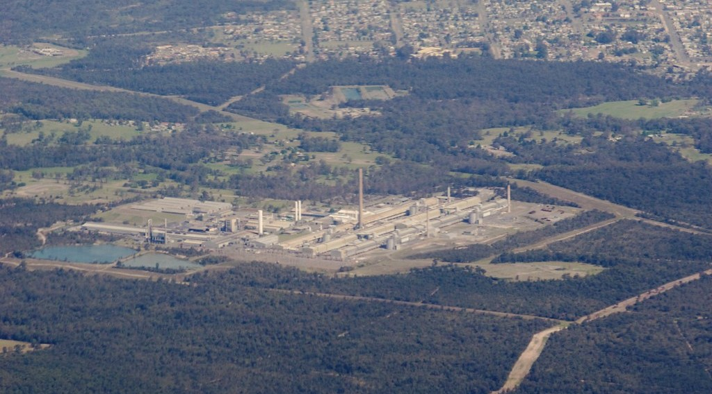
2. EXAMPLES
Activity 3
An aluminium factory seen from the sky.
Notes:
Activity 3. Look carefully at this picture: an aluminium factory seen from the sky. Observe every detail before I ask the question.

Slide 25
2. EXAMPLES
Activity 3: Question
Alucam at Edéa makes aluminium. What type of industry is this?
Notes:
Here is the question for Activity 3: Alucam at Edéa makes aluminium. What type of industry is this? Take one minute to think and write your answer in your rough notebook.

Slide 26
2. EXAMPLES
Activity 3: Answer
A heavy industry: it transforms minerals.
Notes:
Let us check the answer together. A heavy industry: it transforms minerals.

Slide 27

2. EXAMPLES
Activity 4
Workers build a house.
Notes:
Activity 4. Look carefully at this picture: workers build a house. Observe every detail before I ask the question.

Slide 28
2. EXAMPLES
Activity 4: Question
Is building houses and roads part of the secondary sector? Why?
Notes:
Here is the question for Activity 4: Is building houses and roads part of the secondary sector? Why? Take one minute to think and write your answer in your rough notebook.

Slide 29
2. EXAMPLES
Activity 4: Answer
Yes. Builders make new things from sand, cement and iron.
Notes:
Let us check the answer together. Yes. Builders make new things from sand, cement and iron.

Slide 30
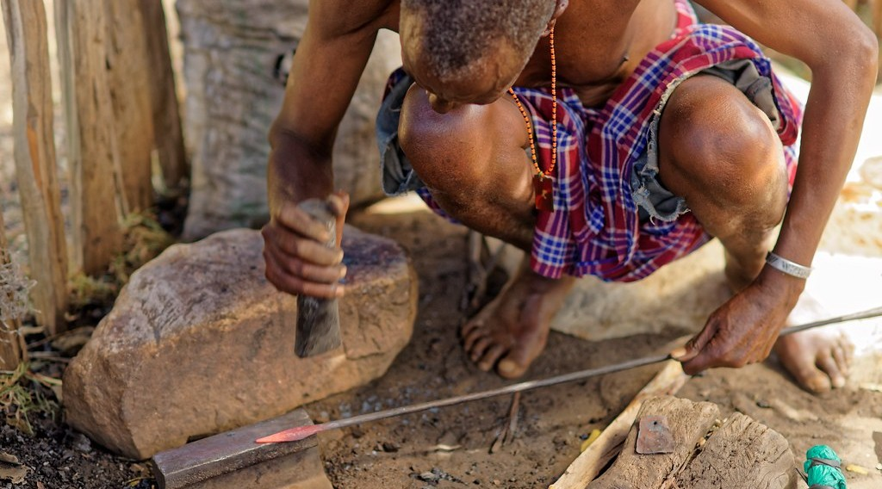
2. EXAMPLES
Activity 5
A blacksmith makes tools.
Notes:
Activity 5. Look carefully at this picture: a blacksmith makes tools. Observe every detail before I ask the question.

Slide 31
2. EXAMPLES
Activity 5: Question
The blacksmith makes tools by hand. What do we call this work?
Notes:
Here is the question for Activity 5: The blacksmith makes tools by hand. What do we call this work? Take one minute to think and write your answer in your rough notebook.

Slide 32
2. EXAMPLES
Activity 5: Answer
Crafts (handicraft).
Notes:
Let us check the answer together. Crafts (handicraft).

Slide 33
BOARD SUMMARY
Board Summary
Topic: Economic Activities
Sub-topic: Sectors of the Economy
Lesson 5 (Part 4): The Sectors of the Economy: The Secondary Sector (Definition and Examples)
Notes:
Now we are going to copy the board summary. Write the title and the headings neatly in your notebooks. I will give you enough time for each slide, so do not rush.

Slide 34
BOARD SUMMARY
1. Meaning of the Secondary Sector
The secondary sector is defined as follows:
Secondary sector: It is the sector that turns raw materials into finished goods.
Industry and craft: An industry makes goods in factories, while a craft makes goods by hand.
Notes:
Let us copy Meaning of the Secondary Sector. The secondary sector is defined as follows. On this slide we have Secondary sector and Industry and craft. Write each point on a new line, with the key term first, and explain it in your own words when we revise.

Slide 35
BOARD SUMMARY
2. Examples of the Secondary Sector
The secondary sector in Cameroon includes the following activities:
Agro-industries: CICAM makes cloth from cotton and breweries make drinks.
Heavy industries: Alucam in Edéa makes aluminium.
Notes:
Let us copy Examples of the Secondary Sector. The secondary sector in Cameroon includes the following activities. On this slide we have Agro-industries and Heavy industries. Write each point on a new line, with the key term first, and explain it in your own words when we revise. When you finish, we go to the next slide.

Slide 36
BOARD SUMMARY
2. Examples of the Secondary Sector (continued)
Construction: Workers build houses, roads and bridges.
Energy: The Lagdo and Edéa dams produce electricity.
Crafts: Tailors, blacksmiths and potters make goods by hand.
Notes:
We continue with Examples of the Secondary Sector. On this slide we have Construction, Energy and Crafts. Write each point on a new line, with the key term first, and explain it in your own words when we revise.

Slide 37
FORMATIVE EVALUATION
Evaluation 1
What is the secondary sector?
Notes:
Now let us check what you have understood. Question 1: What is the secondary sector? Answer in your exercise book.

Slide 38
FORMATIVE EVALUATION
Expected Answer
The sector that turns raw materials into goods.
Notes:
The expected answer is: the sector that turns raw materials into goods. If you got it right, well done.

Slide 39
FORMATIVE EVALUATION
Evaluation 2
Give two examples of industries in Cameroon.
Notes:
Now let us check what you have understood. Question 2: Give two examples of industries in Cameroon. Answer in your exercise book.

Slide 40
FORMATIVE EVALUATION
Expected Answer
CICAM (cloth) and Alucam (aluminium).
Notes:
The expected answer is: cICAM (cloth) and Alucam (aluminium). If you got it right, well done.

Slide 41
REMEDIATION
Remediation
Fill in the blanks:
Turning raw materials into goods is the ______ sector.
CICAM turns cotton into ______.
Alucam at Edéa makes ______.
Notes:
For those who need more practice, fill in the blanks in your exercise book. The answers are: number 1, secondary; number 2, cloth; number 3, aluminium.

Slide 42
HOMEWORK
Homework
List four services that your family uses every week, for example transport, school, hospital, market or mobile money.
Notes:
For your homework: List four services that your family uses every week, for example transport, school, hospital, market or mobile money. We shall correct it at the beginning of our next lesson.

Slide 43
NEXT LESSON
Next Lesson
Our next lesson will be on:
Lesson 5 (Part 5): The Sectors of the Economy: The Tertiary Sector (Definition and Examples)
Notes:
Our next lesson will be on Lesson 5 (Part 5): The Sectors of the Economy: The Tertiary Sector (Definition and Examples). Thank you for your attention, and see you next time.

Slide 44
BILINGUAL GAME
Bilingual Game (Jeu Bilingue)
English | Français
Industry | L'industrie
Factory | L'usine
Finished good | Le produit fini
Construction | Le bâtiment (la construction)
Energy | L'énergie
Refinery | La raffinerie
Craftsman | L'artisan
Cement | Le ciment
Notes:
Let us play the bilingual game. I say a word in English, and you give me the French word. Then we do the reverse.

Slide 45
LOGBOOK
Official Logbook (1/2)
Module / Topic | Economic Activities
Lesson Title | Lesson 5 (Part 4): The Sectors of the Economy: The Secondary Sector (Definition and Examples)
Expected Learning Outcomes | Define the secondary sector. Name the main secondary activities. Give examples of industries in Cameroon and explain their importance.
Competence | Learners are able to recognise the products of Cameroonian factories and explain why transforming raw materials creates jobs and wealth.
Notes:
I record this information in the official logbook of the class after the lesson.

Slide 46
LOGBOOK
Official Logbook (2/2)
Matter Taught | Meaning of the Secondary Sector; Examples of the Secondary Sector.
Evaluation | Formative evaluation and remediation exercise.
Homework | List four services that your family uses every week, for example transport, school, hospital, market or mobile money.
Enrolment / Present / Absent | ____ / ____ / ____
Achievement | To be completed after the lesson.
Notes:
I complete the second page of the logbook: the matter taught, the evaluation, the homework and the attendance.

Slide 47
TEACHER'S NOTE
Teacher's Note
Timing: Homework correction, plan, objectives 8 min | Recall, situation, action 10 min | 5 activities 30 min | Board summary (copying) 30 min | Evaluation, remediation 10 min | Homework, next lesson 5 min | Logbook 7 min
Without the projector (Activity 1): show raw cotton and a piece of cloth.
Without the projector (Activity 2): ask learners which products are made in Garoua.
Without the projector (Activity 3): show a cooking pot made of aluminium.
Without the projector (Activity 4): ask learners to name buildings under construction in Garoua.
Without the projector (Activity 5): ask learners to name craftsmen: tailors, potters, carpenters.
Notes:
This slide is for me, the teacher: it gives the timing of the lesson and what to do if the projector is not available.

Slide 48
REFERENCES
References
Harmonised Progression Sheet, Economic Geography (5051), Form 2.
Photo, Activity 1: “Lowell Massachusetts - Boott Cotton Mills Museum Weave Room” by Onasill ~ Bill- 81M views, CC BY-NC-SA 2.0, via Flickr (https://www.flickr.com/photos/7156765@N05/43677799854)
Photo, Activity 2: “Interior of Winston-Salem Chero-Cola Bottling Company, Winston-Salem, ” by unclibraries_commons, Public domain 1.0, via Flickr (https://www.flickr.com/photos/122654055@N06/22680169228)
Photo, Activity 3: “Kurri Kurri aluminium” by yewenyi, CC BY-NC 2.0, via Flickr (https://www.flickr.com/photos/30265340@N00/2971223932)
Photo, Activity 4: “Cementing Ethiopia's progress” by DFID - UK Department for International Development, CC BY 2.0, via Flickr (https://www.flickr.com/photos/14214150@N02/8757865770)
Photo, Activity 5: “Forging a new spear tip” by www.j-pics.info, CC BY-NC-SA 2.0, via Flickr (https://www.flickr.com/photos/33979630@N07/16024814824)
Diagrams and animations: drawn for this lesson (Geography Department).
Notes:
These are the references and picture credits used to prepare this lesson.

