Slide 1
FORM 2 TECHNICAL
GEOGRAPHY
Lesson 6 (Part 2)
Africa: Climate, Soils and Relief of Africa
Notes:
Good morning, class, and welcome to our geography lesson. I am your geography teacher, Mr Kamdem. Today we are starting Lesson 6 (Part 2): Africa: Climate, Soils and Relief of Africa.

Slide 2
CLASS INFO
Class, Chapter and Duration
Class | Form 2 Technical
Chapter | Economic Geography — Africa
Duration | 2 periods (2 × 50 minutes)
Notes:
This lesson is for Form 2 Technical. It belongs to Economic Geography — Africa. We shall need 2 periods to cover it.

Slide 3
IDENTIFICATION
Lesson Identification
Topic | Regional Geography
Sub-topic | Africa
Lesson | Lesson 6 (Part 2): Africa: Climate, Soils and Relief of Africa
Notions / Concepts | Climatic zone, relief, plateau, basin, Rift Valley, fold mountains, volcanic mountains, ferrallitic and ferruginous soils.
Syllabus focus | Climate, soils and relief of Africa.
Competence | Learners are able to relate the climate and relief of a place in Africa to the activities that people practise there.
Notes:
Our topic is Regional Geography, and the sub-topic is Africa. The key notions we shall use today are: climatic zone, relief, plateau, basin, Rift Valley, fold mountains, volcanic mountains, ferrallitic and ferruginous soils. At the end, you should be able to do this: learners are able to relate the climate and relief of a place in Africa to the activities that people practise there.

Slide 4

HOMEWORK CORRECTION
Correction of the Homework
Question (Lesson 6 (Part 1): Africa: Introduction (Location and Physical Characteristics)):
Compare the climate of Douala, Garoua and Maroua. Which town is the wettest, and which is the driest? Ask an adult or use your textbook.
Notes:
Before we start the new lesson, let us correct the homework I gave you at the end of Lesson 6 (Part 1): Africa: Introduction (Location and Physical Characteristics). The question was: Compare the climate of Douala, Garoua and Maroua. Which town is the wettest, and which is the driest? Ask an adult or use your textbook. Take out your exercise books.

Slide 5
HOMEWORK CORRECTION
Correction: Possible Answer
Douala is the wettest (about 4,000 mm of rain a year); Maroua is the driest (about 800 mm); Garoua is in between (about 1,000 mm).
Notes:
Here is a good answer. Douala is the wettest (about 4,000 mm of rain a year); Maroua is the driest (about 800 mm); Garoua is in between (about 1,000 mm). Compare it with your own answer and correct your work in red.

Slide 6
LESSON PLAN
Lesson Plan
Correction of the homework
Objectives and recall
Real-life situation and action to take
Learning activities
Board summary
Evaluation, remediation and homework
Notes:
Here is the plan of our lesson today. First, we shall correct the homework. Then we shall look at the objectives and recall what you already know. After that, we shall study a situation from real life and the action to take, and do the learning activities. Finally, we shall copy the board summary, do the evaluation and the remediation, and I will give you the homework.

Slide 7
OBJECTIVES
Objectives
By the end of this lesson, you should be able to:
Describe the main climatic zones of Africa.
Describe the main relief features of Africa.
Notes:
Take your time to copy this part; we will continue together.

Slide 8
OBJECTIVES
Objectives (continued)
Describe the main soils of Africa.
Notes:
By the end of this lesson, you should be able to do three things. Number 1: describe the main climatic zones of Africa. Number 2: describe the main relief features of Africa. Number 3: describe the main soils of Africa.

Slide 9
PREVIOUS KNOWLEDGE
Previous Knowledge
Africa lies between 37°N and 35°S, and the Equator crosses its middle.
It is a plateau continent, with Kilimanjaro as its highest point and the Nile as its longest river.
Notes:
Let us first remember what you already know. Africa lies between 37°N and 35°S, and the Equator crosses its middle. It is a plateau continent, with Kilimanjaro as its highest point and the Nile as its longest river. Keep this in mind, because we shall build on it today.

Slide 10
REAL-LIFE SITUATION
Situation in Real Life
Douala gets about 4,000 mm of rain per year, Garoua about 1,000 mm and Maroua about 800 mm. On the Adamawa plateau, the air is cooler than in Garoua. Nadia wonders why.
Notes:
Listen carefully to this situation from real life. Douala gets about 4,000 mm of rain per year, Garoua about 1,000 mm and Maroua about 800 mm. On the Adamawa plateau, the air is cooler than in Garoua. Nadia wonders why. Think about it, because I am going to ask you some questions.

Slide 11
REAL-LIFE SITUATION
Situation: Question 1
What is the problem in the situation?
Notes:
Question 1: What is the problem in the situation? Think for a moment, then raise your hand to answer.

Slide 12
REAL-LIFE SITUATION
Answer
Nadia does not know why the climate changes from place to place.
Notes:
Good. Nadia does not know why the climate changes from place to place.

Slide 13
REAL-LIFE SITUATION
Situation: Question 2
Which town is the wettest?
Notes:
Question 2: Which town is the wettest? Think for a moment, then raise your hand to answer.

Slide 14
REAL-LIFE SITUATION
Answer
Douala.
Notes:
Good. Douala.

Slide 15
REAL-LIFE SITUATION
Situation: Question 3
Why is the Adamawa cooler?
Notes:
Question 3: Why is the Adamawa cooler? Think for a moment, then raise your hand to answer.

Slide 16
REAL-LIFE SITUATION
Possible Answer
It is high: the higher we go, the cooler it is.
Notes:
Good. It is high: the higher we go, the cooler it is.

Slide 17
ACTION TO TAKE
Action to Take
Use the fertile soils of Africa carefully and protect them.
Notes:
From this situation, the action we are working towards in this lesson is the following: use the fertile soils of Africa carefully and protect them.

Slide 18
JUSTIFICATION
Justification of the Lesson
This lesson helps us to know the climate, relief and soils of Africa.
Notes:
Why is this lesson important for you? This lesson helps us to know the climate, relief and soils of Africa.

Slide 19

1. CLIMATE
Activity 1
The climates of Africa.
Notes:
Activity 1. Look carefully at this diagram: the climates of Africa. Observe every detail before I ask the question.

Slide 20
1. CLIMATE
Activity 1: Question
Which climate is found around the Equator? Which is near the tropics?
Notes:
Here is the question for Activity 1: Which climate is found around the Equator? Which is near the tropics? Take one minute to think and write your answer in your rough notebook.

Slide 21
1. CLIMATE
Activity 1: Answer
Equatorial near the Equator; desert near the tropics.
Notes:
Let us check the answer together. Equatorial near the Equator; desert near the tropics.

Slide 22

1. CLIMATE
Activity 2
Tea on the cool highlands of Kenya.
Notes:
Activity 2. Look carefully at this picture: tea on the cool highlands of Kenya. Observe every detail before I ask the question.

Slide 23
1. CLIMATE
Activity 2: Question
Nairobi is near the Equator, but it is cool. Why?
Notes:
Here is the question for Activity 2: Nairobi is near the Equator, but it is cool. Why? Take one minute to think and write your answer in your rough notebook.

Slide 24
1. CLIMATE
Activity 2: Answer
It is high. The higher the land, the cooler the air.
Notes:
Let us check the answer together. It is high. The higher the land, the cooler the air.

Slide 25
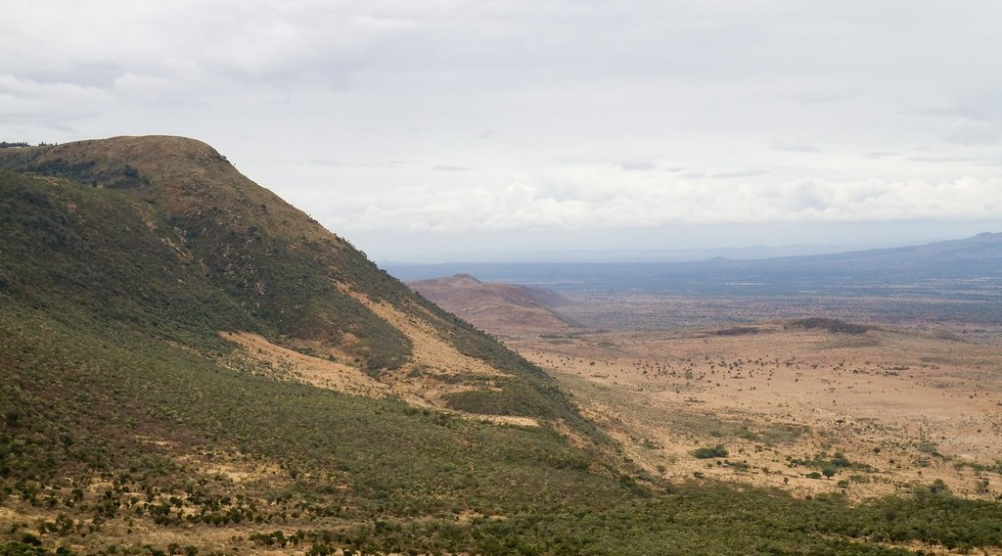
2. RELIEF
Activity 3
The Great Rift Valley in Kenya.
Notes:
Activity 3. Look carefully at this picture: the Great Rift Valley in Kenya. Observe every detail before I ask the question.

Slide 26
2. RELIEF
Activity 3: Question
The land has sunk between two lines of cracks. What is this valley called?
Notes:
Here is the question for Activity 3: The land has sunk between two lines of cracks. What is this valley called? Take one minute to think and write your answer in your rough notebook.

Slide 27
2. RELIEF
Activity 3: Answer
The Great Rift Valley.
Notes:
Let us check the answer together. The Great Rift Valley.

Slide 28
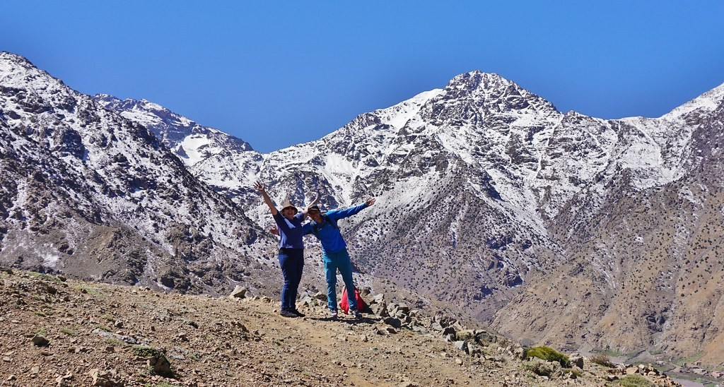
2. RELIEF
Activity 4
The Atlas Mountains in Morocco.
Notes:
Activity 4. Look carefully at this picture: the Atlas Mountains in Morocco. Observe every detail before I ask the question.

Slide 29
2. RELIEF
Activity 4: Question
These mountains were formed by folding. Name them.
Notes:
Here is the question for Activity 4: These mountains were formed by folding. Name them. Take one minute to think and write your answer in your rough notebook.

Slide 30
2. RELIEF
Activity 4: Answer
The Atlas Mountains (also the Cape Ranges).
Notes:
Let us check the answer together. The Atlas Mountains (also the Cape Ranges).

Slide 31
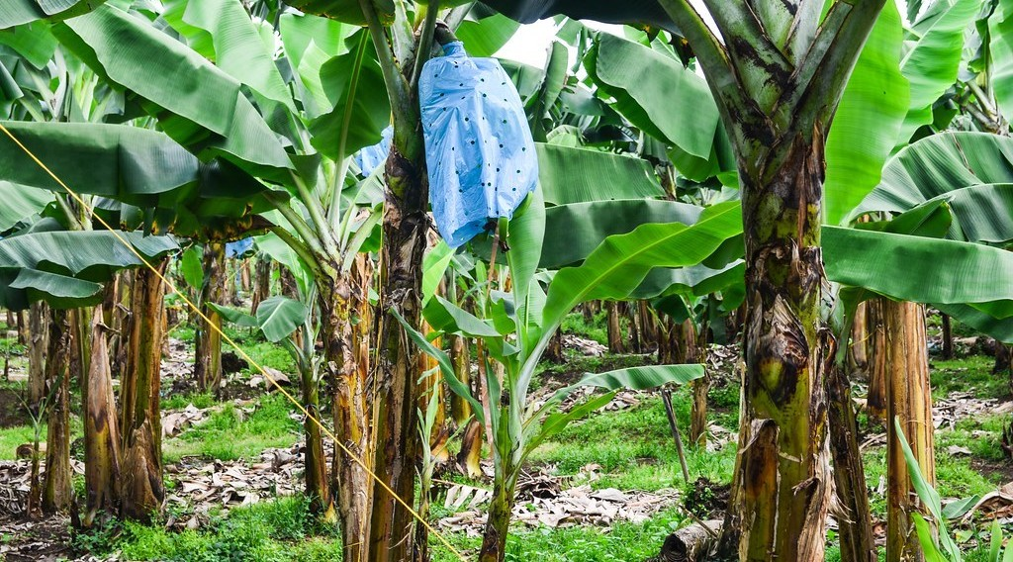
3. SOILS
Activity 5
A banana plantation.
Notes:
Activity 5. Look carefully at this picture: a banana plantation. Observe every detail before I ask the question.

Slide 32
3. SOILS
Activity 5: Question
Near Mount Cameroon, farmers grow bananas and tea. Why are the soils there so fertile?
Notes:
Here is the question for Activity 5: Near Mount Cameroon, farmers grow bananas and tea. Why are the soils there so fertile? Take one minute to think and write your answer in your rough notebook.

Slide 33
3. SOILS
Activity 5: Answer
They come from volcanic rocks.
Notes:
Let us check the answer together. They come from volcanic rocks.

Slide 34
BOARD SUMMARY
Board Summary
Topic: Regional Geography
Sub-topic: Africa
Lesson 6 (Part 2): Africa: Climate, Soils and Relief of Africa
Notes:
Now we are going to copy the board summary. Write the title and the headings neatly in your notebooks. I will give you enough time for each slide, so do not rush.

Slide 35
BOARD SUMMARY
1. Climate
Africa has the following main types of climate:
Equatorial climate: It is hot and wet all year, as in the Congo Basin and southern Cameroon.
Tropical climate: It has a wet season and a dry season, as in Garoua.
Notes:
Let us copy Climate. Africa has the following main types of climate. On this slide we have Equatorial climate and Tropical climate. Write each point on a new line, with the key term first, and explain it in your own words when we revise. When you finish, we go to the next slide.

Slide 36
BOARD SUMMARY
1. Climate (continued)
Desert climate: It has very little rain, as in the Sahara.
Mountain climate: It is cooler because of the high altitude, as in the East African highlands.
Notes:
We continue with Climate. On this slide we have Desert climate and Mountain climate. Write each point on a new line, with the key term first, and explain it in your own words when we revise.

Slide 37
BOARD SUMMARY
1. Climate
Illustration: climates of Africa
Notes:
Now draw this illustration in your notebook: climates of Africa. Give it a title and label it clearly.

Slide 38
BOARD SUMMARY
2. Relief
The relief of Africa has the following features:
Plateaux: High plateaux cover the south and east of Africa.
Basins: Large basins include the Congo and Chad basins.
Notes:
Let us copy Relief. The relief of Africa has the following features. On this slide we have Plateaux and Basins. Write each point on a new line, with the key term first, and explain it in your own words when we revise. When you finish, we go to the next slide.

Slide 39
BOARD SUMMARY
2. Relief (continued)
Mountains: The Atlas are fold mountains and Kilimanjaro is a volcano.
Rift Valley: The Great Rift Valley is a long valley in East Africa formed when land sank.
Notes:
We continue with Relief. On this slide we have Mountains and Rift Valley. Write each point on a new line, with the key term first, and explain it in your own words when we revise.

Slide 40
BOARD SUMMARY
3. Soils
Africa has the following main types of soils:
Red soils: Red soils are found in the forest and savanna regions.
Desert soils: Desert soils are sandy and poor.
Notes:
Let us copy Soils. Africa has the following main types of soils. On this slide we have Red soils and Desert soils. Write each point on a new line, with the key term first, and explain it in your own words when we revise. When you finish, we go to the next slide.

Slide 41
BOARD SUMMARY
3. Soils (continued)
Volcanic soils: Volcanic soils are very fertile, as around Mount Cameroon.
Notes:
We continue with Soils. On this slide we have Volcanic soils. Write each point on a new line, with the key term first, and explain it in your own words when we revise.

Slide 42
FORMATIVE EVALUATION
Evaluation 1
Why is Nairobi cool though it is near the Equator?
Notes:
Now let us check what you have understood. Question 1: Why is Nairobi cool though it is near the Equator? Answer in your exercise book.

Slide 43
FORMATIVE EVALUATION
Expected Answer
Because it is high.
Notes:
The expected answer is: because it is high. If you got it right, well done.

Slide 44
FORMATIVE EVALUATION
Evaluation 2
Why are the soils of Mount Cameroon fertile?
Notes:
Now let us check what you have understood. Question 2: Why are the soils of Mount Cameroon fertile? Answer in your exercise book.

Slide 45
FORMATIVE EVALUATION
Expected Answer
They come from volcanic rocks.
Notes:
The expected answer is: they come from volcanic rocks. If you got it right, well done.

Slide 46
REMEDIATION
Remediation
Fill in the blanks:
Around the Equator, the climate is ______.
The long valley of East Africa is the Great ______ Valley.
Soils made from volcano rocks are ______ soils.
Notes:
For those who need more practice, fill in the blanks in your exercise book. The answers are: number 1, equatorial; number 2, Rift; number 3, volcanic.

Slide 47
HOMEWORK
Homework
Look at a map of Africa and write the names of three big rivers. Say into which ocean or sea each one flows.
Notes:
For your homework: Look at a map of Africa and write the names of three big rivers. Say into which ocean or sea each one flows. We shall correct it at the beginning of our next lesson.

Slide 48
NEXT LESSON
Next Lesson
Our next lesson will be on:
Lesson 6 (Part 3): Africa: Vegetation and Drainage of Africa
Notes:
Our next lesson will be on Lesson 6 (Part 3): Africa: Vegetation and Drainage of Africa. Thank you for your attention, and see you next time.

Slide 49
BILINGUAL GAME
Bilingual Game (Jeu Bilingue)
English | Français
Climate | Le climat
Relief | Le relief
Plateau | Le plateau
Basin | La cuvette (le bassin)
Rift Valley | La vallée du Rift
Volcano | Le volcan
Fertile | Fertile
Altitude | L'altitude
Notes:
Let us play the bilingual game. I say a word in English, and you give me the French word. Then we do the reverse.

Slide 50
LOGBOOK
Official Logbook (1/2)
Module / Topic | Regional Geography
Lesson Title | Lesson 6 (Part 2): Africa: Climate, Soils and Relief of Africa
Expected Learning Outcomes | Describe the main climatic zones of Africa. Describe the main relief features of Africa. Describe the main soils of Africa.
Competence | Learners are able to relate the climate and relief of a place in Africa to the activities that people practise there.
Notes:
I record this information in the official logbook of the class after the lesson.

Slide 51
LOGBOOK
Official Logbook (2/2)
Matter Taught | Climate; Relief; Soils.
Evaluation | Formative evaluation and remediation exercise.
Homework | Look at a map of Africa and write the names of three big rivers. Say into which ocean or sea each one flows.
Enrolment / Present / Absent | ____ / ____ / ____
Achievement | To be completed after the lesson.
Notes:
I complete the second page of the logbook: the matter taught, the evaluation, the homework and the attendance.

Slide 52
TEACHER'S NOTE
Teacher's Note
Timing: Homework correction, plan, objectives 8 min | Recall, situation, action 10 min | 5 activities 30 min | Board summary (copying) 30 min | Evaluation, remediation 10 min | Homework, next lesson 5 min | Logbook 7 min
Without the projector (Activity 1): draw the Equator and bands of climate on the board.
Without the projector (Activity 2): compare Garoua and Ngaoundéré.
Without the projector (Activity 3): show two books pushed apart with a pencil falling between them.
Without the projector (Activity 4): fold a sheet of paper to show folding.
Without the projector (Activity 5): ask learners what grows around Buea and Limbe.
Notes:
This slide is for me, the teacher: it gives the timing of the lesson and what to do if the projector is not available.

Slide 53
REFERENCES
References
Harmonised Progression Sheet, Economic Geography (5051), Form 2.
Photo, Activity 2: “Carlo in the tea” by luigig, CC BY 2.0, via Flickr (https://www.flickr.com/photos/51035803402@N01/3175986747)
Photo, Activity 3: “Great Rift Valley” by GSAPP_SIDL, CC BY-NC-ND 2.0, via Flickr (https://www.flickr.com/photos/77974798@N04/7341392488)
Photo, Activity 4: “The Hills Are Alive - Morocco - Atlas Mountains - Mar 2018” by Gareth1953 All Right Now, CC BY 2.0, via Flickr (https://www.flickr.com/photos/40837632@N05/46588301775)
Photo, Activity 5: “20131110-DSC_4372” by jbdodane, CC BY-NC 2.0, via Flickr (https://www.flickr.com/photos/27998473@N02/11288779044)
Diagrams and animations: drawn for this lesson (Geography Department).
Notes:
These are the references and picture credits used to prepare this lesson.

