Slide 1
FORM 4
GEOGRAPHY
Lesson 5
The Rotation of the Earth
Notes:
Good morning, class, and welcome to our geography lesson. I am your geography teacher, Mr Kamdem. Today we are starting Lesson 5: The Rotation of the Earth.

Slide 2
CLASS INFO
Class, Chapter and Duration
Class | Form 4
Chapter | The Earth as a Planet in the Solar System — Location and Time
Duration | 50 minutes
Notes:
This lesson is for Form 4. It belongs to The Earth as a Planet in the Solar System — Location and Time. We shall need 50 minutes to cover it.

Slide 3
IDENTIFICATION
Lesson Identification
Topic | The Earth as a Planet in the Solar System
Sub-topic | Location and Time
Lesson | Lesson 5: The Rotation of the Earth
Notions / Concepts | Axis, rotation, tides, deflection of winds and ocean currents.
Syllabus focus | Rotation: meaning, illustration and effects.
Competence | Learners are able to explain day and night, the rising of the Sun in the east, and the difference in time between places.
Notes:
Our topic is The Earth as a Planet in the Solar System, and the sub-topic is Location and Time. The key notions we shall use today are: axis, rotation, tides, deflection of winds and ocean currents. At the end, you should be able to do this: learners are able to explain day and night, the rising of the Sun in the east, and the difference in time between places.

Slide 4

HOMEWORK CORRECTION
Correction of the Homework
Question (Practical Work 2: Calculation of Time and Date):
Watch the sunrise and the sunset one day this week and write down the times. Write a sentence to explain why the Sun rises in the east.
Notes:
Before we start the new lesson, let us correct the homework I gave you at the end of Practical Work 2: Calculation of Time and Date. The question was: Watch the sunrise and the sunset one day this week and write down the times. Write a sentence to explain why the Sun rises in the east. Take out your exercise books.

Slide 5
HOMEWORK CORRECTION
Correction: Possible Answer
Example: sunrise about 6:00 and sunset about 18:15 in Garoua. The Sun rises in the east because the Earth turns from west to east.
Notes:
Here is a good answer. Example: sunrise about 6:00 and sunset about 18:15 in Garoua. The Sun rises in the east because the Earth turns from west to east. Compare it with your own answer and correct your work in red.

Slide 6
LESSON PLAN
Lesson Plan
Correction of the homework
Objectives and recall
Real-life situation and action to take
Learning activities
Board summary
Evaluation, remediation and homework
Notes:
Here is the plan of our lesson today. First, we shall correct the homework. Then we shall look at the objectives and recall what you already know. After that, we shall study a situation from real life and the action to take, and do the learning activities. Finally, we shall copy the board summary, do the evaluation and the remediation, and I will give you the homework.

Slide 7
OBJECTIVES
Objectives
By the end of this lesson, you should be able to:
Define rotation and the axis of the Earth.
Illustrate the rotation of the Earth.
Explain the effects of rotation.
Notes:
By the end of this lesson, you should be able to do three things. Number 1: define rotation and the axis of the Earth. Number 2: illustrate the rotation of the Earth. Number 3: explain the effects of rotation.

Slide 8
PREVIOUS KNOWLEDGE
Previous Knowledge
15° of longitude = 1 hour.
Places to the east are ahead in time.
Cameroon uses GMT + 1.
Notes:
Let us first remember what you already know. 15° of longitude = 1 hour. Places to the east are ahead in time. Cameroon uses GMT + 1. Keep this in mind, because we shall build on it today.

Slide 9
REAL-LIFE SITUATION
Situation in Real Life
Every morning in Garoua, the first light appears in the east. In the evening, the Sun disappears in the west. Oumarou's little sister thinks that the Sun walks around the Earth.
Notes:
Listen carefully to this situation from real life. Every morning in Garoua, the first light appears in the east. In the evening, the Sun disappears in the west. Oumarou's little sister thinks that the Sun walks around the Earth. Think about it, because I am going to ask you some questions.

Slide 10
REAL-LIFE SITUATION
Situation: Question 1
What is the problem in the situation?
Notes:
Question 1: What is the problem in the situation? Think for a moment, then raise your hand to answer.

Slide 11
REAL-LIFE SITUATION
Answer
The sister thinks that the Sun moves around the Earth every day.
Notes:
Good. The sister thinks that the Sun moves around the Earth every day.

Slide 12
REAL-LIFE SITUATION
Situation: Question 2
Where does the Sun rise and set?
Notes:
Question 2: Where does the Sun rise and set? Think for a moment, then raise your hand to answer.

Slide 13
REAL-LIFE SITUATION
Answer
It rises in the east and sets in the west.
Notes:
Good. It rises in the east and sets in the west.

Slide 14
REAL-LIFE SITUATION
Situation: Question 3
What really moves?
Notes:
Question 3: What really moves? Think for a moment, then raise your hand to answer.

Slide 15
REAL-LIFE SITUATION
Possible Answer
The Earth turns on itself.
Notes:
Good. The Earth turns on itself.

Slide 16
ACTION TO TAKE
Action to Take
Use the rotation of the Earth to explain day, night and time differences.
Notes:
From this situation, the action we are working towards in this lesson is the following: use the rotation of the Earth to explain day, night and time differences.

Slide 17
JUSTIFICATION
Justification of the Lesson
This lesson helps us to understand day and night.
Notes:
Why is this lesson important for you? This lesson helps us to understand day and night.

Slide 18
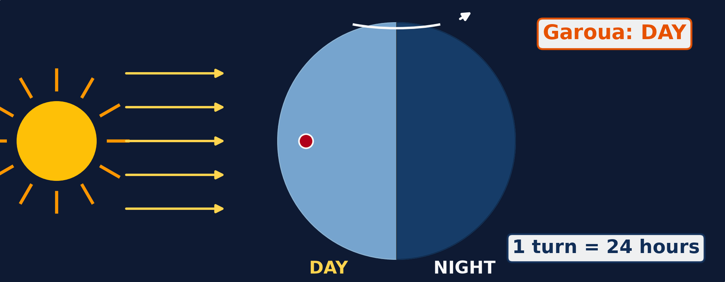
1. MEANING OF ROTATION
Activity 1
Animation: the Earth turns on itself.
Notes:
Activity 1. Look carefully at this animation: animation: the Earth turns on itself. Watch the animation to the end; it will play again.

Slide 19
1. MEANING OF ROTATION
Activity 1: Question
Watch Garoua (red dot). Why does it have day and then night?
Notes:
Here is the question for Activity 1: Watch Garoua (red dot). Why does it have day and then night? Take one minute to think and write your answer in your rough notebook.

Slide 20
1. MEANING OF ROTATION
Activity 1: Answer
The Earth turns. Garoua faces the Sun (day), then turns away (night).
Notes:
Let us check the answer together. The Earth turns. Garoua faces the Sun (day), then turns away (night).

Slide 21

2. EFFECTS OF ROTATION
Activity 2
The Sun low over the savanna.
Notes:
Activity 2. Look carefully at this picture: the Sun low over the savanna. Observe every detail before I ask the question.

Slide 22
2. EFFECTS OF ROTATION
Activity 2: Question
Why does the Sun seem to rise in the east?
Notes:
Here is the question for Activity 2: Why does the Sun seem to rise in the east? Take one minute to think and write your answer in your rough notebook.

Slide 23
2. EFFECTS OF ROTATION
Activity 2: Answer
The Earth turns from west to east.
Notes:
Let us check the answer together. The Earth turns from west to east.

Slide 24

2. EFFECTS OF ROTATION
Activity 3
A storm seen from space.
Notes:
Activity 3. Look carefully at this picture: a storm seen from space. Observe every detail before I ask the question.

Slide 25
2. EFFECTS OF ROTATION
Activity 3: Question
The winds of this storm turn in a circle. Which movement of the Earth makes them turn?
Notes:
Here is the question for Activity 3: The winds of this storm turn in a circle. Which movement of the Earth makes them turn? Take one minute to think and write your answer in your rough notebook.

Slide 26
2. EFFECTS OF ROTATION
Activity 3: Answer
The rotation of the Earth.
Notes:
Let us check the answer together. The rotation of the Earth.

Slide 27
BOARD SUMMARY
Board Summary
Topic: The Earth as a Planet in the Solar System
Sub-topic: Location and Time
Lesson 5: The Rotation of the Earth
Notes:
Now we are going to copy the board summary. Write the title and the headings neatly in your notebooks. I will give you enough time for each slide, so do not rush.

Slide 28
BOARD SUMMARY
1. Meaning of Rotation
The rotation of the Earth is explained as follows:
Rotation: It is the turning of the Earth on its axis.
Axis: It is the imaginary line from the North Pole to the South Pole, tilted at 23½°.
Notes:
Let us copy Meaning of Rotation. The rotation of the Earth is explained as follows. On this slide we have Rotation and Axis. Write each point on a new line, with the key term first, and explain it in your own words when we revise. When you finish, we go to the next slide.

Slide 29
BOARD SUMMARY
1. Meaning of Rotation (continued)
Direction and time: The Earth turns from west to east and makes one turn in 24 hours.
Notes:
We continue with Meaning of Rotation. On this slide we have Direction and time. Write each point on a new line, with the key term first, and explain it in your own words when we revise.

Slide 30
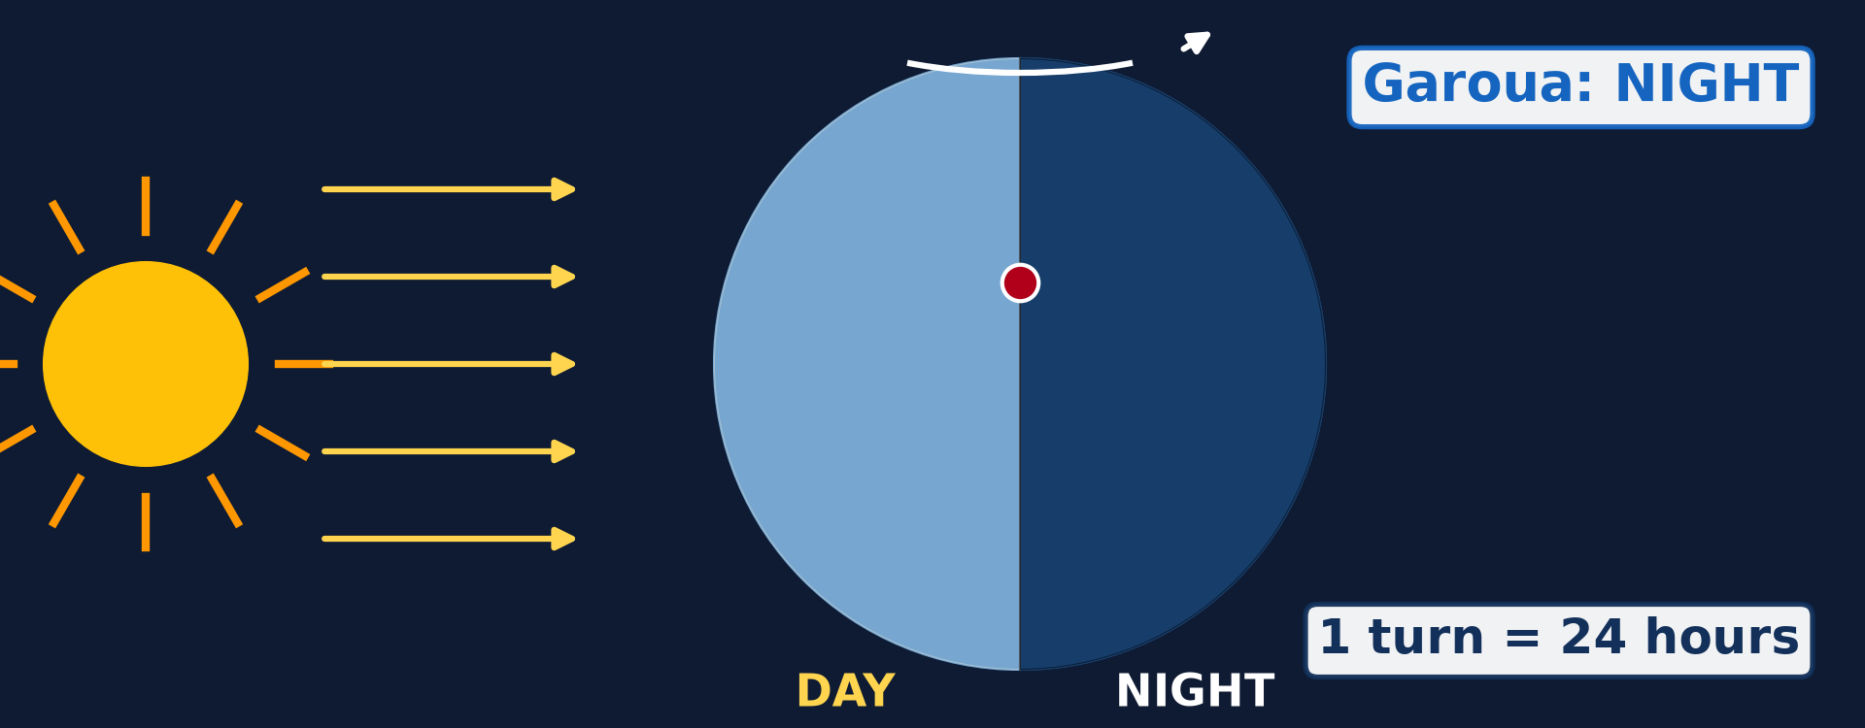
BOARD SUMMARY
1. Meaning of Rotation
Illustration: the rotation of the Earth
Notes:
Now draw this illustration in your notebook: the rotation of the Earth. Give it a title and label it clearly.

Slide 31
BOARD SUMMARY
2. Effects of Rotation
The rotation of the Earth has the following effects:
Day and night: The side facing the Sun has day while the other side has night.
Sunrise in the east: The Sun rises in the east and sets in the west because the Earth turns eastwards.
Notes:
Let us copy Effects of Rotation. The rotation of the Earth has the following effects. On this slide we have Day and night and Sunrise in the east. Write each point on a new line, with the key term first, and explain it in your own words when we revise. When you finish, we go to the next slide.

Slide 32
BOARD SUMMARY
2. Effects of Rotation (continued)
Time difference: Places to the east see the Sun first, so they are ahead in time.
Deflection of winds: Winds and ocean currents are bent to the right in the north and to the left in the south.
Tides: Rotation, with the pull of the Moon, gives two high tides a day.
Notes:
We continue with Effects of Rotation. On this slide we have Time difference, Deflection of winds and Tides. Write each point on a new line, with the key term first, and explain it in your own words when we revise.

Slide 33
FORMATIVE EVALUATION
Evaluation 1
What is rotation?
Notes:
Now let us check what you have understood. Question 1: What is rotation? Answer in your exercise book.

Slide 34
FORMATIVE EVALUATION
Expected Answer
The turning of the Earth on its axis.
Notes:
The expected answer is: the turning of the Earth on its axis. If you got it right, well done.

Slide 35
FORMATIVE EVALUATION
Evaluation 2
Give two effects of rotation.
Notes:
Now let us check what you have understood. Question 2: Give two effects of rotation. Answer in your exercise book.

Slide 36
FORMATIVE EVALUATION
Expected Answer
Day and night; the Sun seems to rise in the east.
Notes:
The expected answer is: day and night; the Sun seems to rise in the east. If you got it right, well done.

Slide 37
REMEDIATION
Remediation
Fill in the blanks:
The Earth turns on its ______.
One rotation takes ______ hours.
The Earth turns from west to ______.
Notes:
For those who need more practice, fill in the blanks in your exercise book. The answers are: number 1, axis; number 2, 24; number 3, east.

Slide 38
HOMEWORK
Homework
Ask an elder in which months the rainy season and the dry season start in Garoua. Write the months down.
Notes:
For your homework: Ask an elder in which months the rainy season and the dry season start in Garoua. Write the months down. We shall correct it at the beginning of our next lesson.

Slide 39
NEXT LESSON
Next Lesson
Our next lesson will be on:
Lesson 6: The Revolution of the Earth
Notes:
Our next lesson will be on Lesson 6: The Revolution of the Earth. Thank you for your attention, and see you next time.

Slide 40
BILINGUAL GAME
Bilingual Game (Jeu Bilingue)
English | Français
Rotation | La rotation
Axis | L'axe
Day | Le jour
Night | La nuit
Sunrise | Le lever du soleil
Sunset | Le coucher du soleil
Deflection | La déviation
Ocean current | Le courant marin
Notes:
Let us play the bilingual game. I say a word in English, and you give me the French word. Then we do the reverse.

Slide 41
LOGBOOK
Official Logbook (1/2)
Module / Topic | The Earth as a Planet in the Solar System
Lesson Title | Lesson 5: The Rotation of the Earth
Expected Learning Outcomes | Define rotation and the axis of the Earth. Illustrate the rotation of the Earth. Explain the effects of rotation.
Competence | Learners are able to explain day and night, the rising of the Sun in the east, and the difference in time between places.
Notes:
I record this information in the official logbook of the class after the lesson.

Slide 42
LOGBOOK
Official Logbook (2/2)
Matter Taught | Meaning of Rotation; Effects of Rotation.
Evaluation | Formative evaluation and remediation exercise.
Homework | Ask an elder in which months the rainy season and the dry season start in Garoua. Write the months down.
Enrolment / Present / Absent | ____ / ____ / ____
Achievement | To be completed after the lesson.
Notes:
I complete the second page of the logbook: the matter taught, the evaluation, the homework and the attendance.

Slide 43
TEACHER'S NOTE
Teacher's Note
Timing: Homework correction, plan, objectives 4 min | Recall, situation, action 6 min | 3 activities 12 min | Board summary (copying) 15 min | Evaluation, remediation 5 min | Homework, next lesson 3 min | Logbook 5 min
Activity 1 is an animation (GIF): it plays automatically in slide-show mode.
Without the projector (Activity 1): turn a ball in front of a torch with a mark on it.
Without the projector (Activity 2): ask learners where the Sun rises in Garoua.
Without the projector (Activity 3): describe water turning when it goes down a sink.
Notes:
This slide is for me, the teacher: it gives the timing of the lesson and what to do if the projector is not available.

Slide 44
REFERENCES
References
National Geography Syllabus (MINESEC), Form 4 — The Earth as a Planet in the Solar System.
Teacher's lesson notes (Form 4), checked and corrected where necessary.
Photo, Activity 2: “African Sunrise, Amboseli National Park” by Ray in Manila, CC BY 2.0, via Flickr (https://www.flickr.com/photos/21186555@N07/30385097358)
Photo, Activity 3: “NASA's Aqua Satellite Captures Hurricane Danielle” by NASA Goddard Photo and Video, CC BY 2.0, via nasa (https://www.flickr.com/photos/24662369@N07/4931591817)
Diagrams and animations: drawn for this lesson (Geography Department).
Notes:
These are the references and picture credits used to prepare this lesson.

