Slide 1
FORM 4
GEOGRAPHY
Lesson 8
Rocks
Notes:
Good morning, class, and welcome to our geography lesson. I am your geography teacher, Mr Kamdem. Today we are starting Lesson 8: Rocks.

Slide 2
CLASS INFO
Class, Chapter and Duration
Class | Form 4
Chapter | The Structure of the Earth: Building Processes and Impacts on Man — Internal Structure of the Earth
Duration | 50 minutes
Notes:
This lesson is for Form 4. It belongs to The Structure of the Earth: Building Processes and Impacts on Man — Internal Structure of the Earth. We shall need 50 minutes to cover it.

Slide 3
IDENTIFICATION
Lesson Identification
Topic | The Structure of the Earth: Building Processes and Impacts on Man
Sub-topic | Internal Structure of the Earth
Lesson | Lesson 8: Rocks
Notions / Concepts | Igneous rock, sedimentary rock, metamorphic rock.
Syllabus focus | Definition; classification according to origin (igneous, sedimentary, metamorphic): characteristics and main examples of each type; the rock cycle (illustration only).
Competence | Learners are able to recognise the main types of rocks around them and to choose suitable rocks for building.
Notes:
Our topic is The Structure of the Earth: Building Processes and Impacts on Man, and the sub-topic is Internal Structure of the Earth. The key notions we shall use today are: igneous rock, sedimentary rock, metamorphic rock. At the end, you should be able to do this: learners are able to recognise the main types of rocks around them and to choose suitable rocks for building.

Slide 4

HOMEWORK CORRECTION
Correction of the Homework
Question (Lesson 7: The Internal Structure of the Earth):
Collect three different stones or building materials (for example a piece of granite, a sandstone block and a piece of marble or tile). Write where you found each one.
Notes:
Before we start the new lesson, let us correct the homework I gave you at the end of Lesson 7: The Internal Structure of the Earth. The question was: Collect three different stones or building materials (for example a piece of granite, a sandstone block and a piece of marble or tile). Write where you found each one. Take out your exercise books.

Slide 5
HOMEWORK CORRECTION
Correction: Possible Answer
Examples: granite from a hill or a quarry; a sandstone block from a building site; marble tiles from a shop. Each should be named with where it was found.
Notes:
Here is a good answer. Examples: granite from a hill or a quarry; a sandstone block from a building site; marble tiles from a shop. Each should be named with where it was found. Compare it with your own answer and correct your work in red.

Slide 6
LESSON PLAN
Lesson Plan
Correction of the homework
Objectives and recall
Real-life situation and action to take
Learning activities
Board summary
Evaluation, remediation and homework
Notes:
Here is the plan of our lesson today. First, we shall correct the homework. Then we shall look at the objectives and recall what you already know. After that, we shall study a situation from real life and the action to take, and do the learning activities. Finally, we shall copy the board summary, do the evaluation and the remediation, and I will give you the homework.

Slide 7
OBJECTIVES
Objectives
By the end of this lesson, you should be able to:
Define a rock.
Classify rocks according to their origin.
Give the characteristics and examples of each type of rock.
Notes:
Take your time to copy this part; we will continue together.

Slide 8
OBJECTIVES
Objectives (continued)
Draw the rock cycle.
Notes:
By the end of this lesson, you should be able to do three things. Number 1: define a rock. Number 2: classify rocks according to their origin. Number 3: give the characteristics and examples of each type of rock. Number 4: draw the rock cycle.

Slide 9
PREVIOUS KNOWLEDGE
Previous Knowledge
The crust is the solid outer layer of the Earth.
The mantle is very hot rock that flows slowly.
Magma is molten rock under the ground.
Notes:
Let us first remember what you already know. The crust is the solid outer layer of the Earth. The mantle is very hot rock that flows slowly. Magma is molten rock under the ground. Keep this in mind, because we shall build on it today.

Slide 10
REAL-LIFE SITUATION
Situation in Real Life
In Garoua, a new mosque is built on hard grey stones with small crystals. Some walls are made of blocks with thin layers. Kadidja wonders why the stones are different.
Notes:
Listen carefully to this situation from real life. In Garoua, a new mosque is built on hard grey stones with small crystals. Some walls are made of blocks with thin layers. Kadidja wonders why the stones are different. Think about it, because I am going to ask you some questions.

Slide 11
REAL-LIFE SITUATION
Situation: Question 1
What is the problem in the situation?
Notes:
Question 1: What is the problem in the situation? Think for a moment, then raise your hand to answer.

Slide 12
REAL-LIFE SITUATION
Answer
Kadidja does not know why rocks are different.
Notes:
Good. Kadidja does not know why rocks are different.

Slide 13
REAL-LIFE SITUATION
Situation: Question 2
Describe the two kinds of stones.
Notes:
Question 2: Describe the two kinds of stones. Think for a moment, then raise your hand to answer.

Slide 14
REAL-LIFE SITUATION
Answer
Hard grey stones with crystals, and stones with layers.
Notes:
Good. Hard grey stones with crystals, and stones with layers.

Slide 15
REAL-LIFE SITUATION
Situation: Question 3
How are rocks grouped?
Notes:
Question 3: How are rocks grouped? Think for a moment, then raise your hand to answer.

Slide 16
REAL-LIFE SITUATION
Possible Answer
By the way they were formed: igneous, sedimentary, metamorphic.
Notes:
Good. By the way they were formed: igneous, sedimentary, metamorphic.

Slide 17
ACTION TO TAKE
Action to Take
Recognise the rocks around us and use them wisely for building.
Notes:
From this situation, the action we are working towards in this lesson is the following: recognise the rocks around us and use them wisely for building.

Slide 18
JUSTIFICATION
Justification of the Lesson
This lesson helps us to know the rocks around us.
Notes:
Why is this lesson important for you? This lesson helps us to know the rocks around us.

Slide 19

2. IGNEOUS ROCKS
Activity 1
Big granite rocks.
Notes:
Activity 1. Look carefully at this picture: big granite rocks. Observe every detail before I ask the question.

Slide 20
2. IGNEOUS ROCKS
Activity 1: Question
Granite has crystals. How was it formed?
Notes:
Here is the question for Activity 1: Granite has crystals. How was it formed? Take one minute to think and write your answer in your rough notebook.

Slide 21
2. IGNEOUS ROCKS
Activity 1: Answer
Hot magma cooled and became hard. It is an igneous rock.
Notes:
Let us check the answer together. Hot magma cooled and became hard. It is an igneous rock.

Slide 22
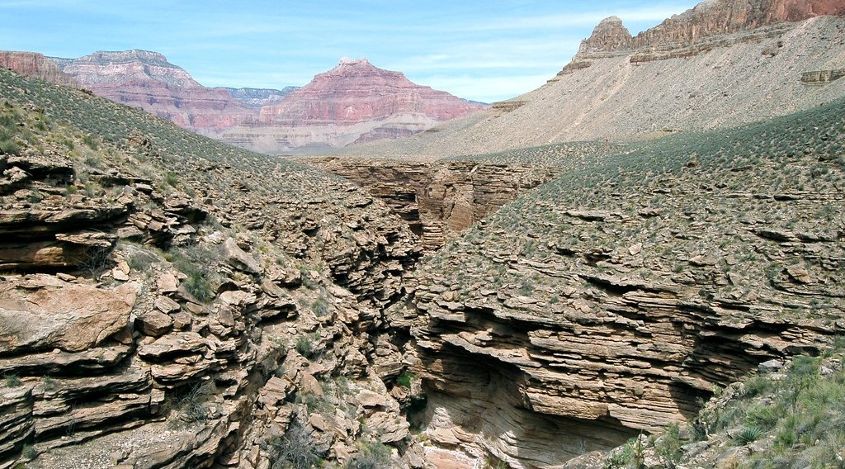
2. SEDIMENTARY ROCKS
Activity 2
A rock with layers.
Notes:
Activity 2. Look carefully at this picture: a rock with layers. Observe every detail before I ask the question.

Slide 23
2. SEDIMENTARY ROCKS
Activity 2: Question
This rock has layers. How was it formed?
Notes:
Here is the question for Activity 2: This rock has layers. How was it formed? Take one minute to think and write your answer in your rough notebook.

Slide 24
2. SEDIMENTARY ROCKS
Activity 2: Answer
Layers of sand and mud were pressed together. It is a sedimentary rock.
Notes:
Let us check the answer together. Layers of sand and mud were pressed together. It is a sedimentary rock.

Slide 25
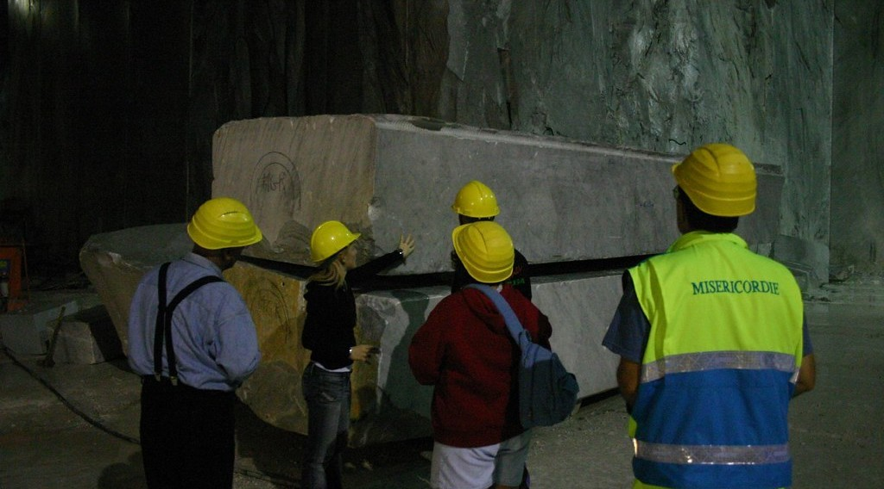
2. METAMORPHIC ROCKS
Activity 3
A block of marble in a quarry.
Notes:
Activity 3. Look carefully at this picture: a block of marble in a quarry. Observe every detail before I ask the question.

Slide 26
2. METAMORPHIC ROCKS
Activity 3: Question
Marble was limestone. What changed it?
Notes:
Here is the question for Activity 3: Marble was limestone. What changed it? Take one minute to think and write your answer in your rough notebook.

Slide 27
2. METAMORPHIC ROCKS
Activity 3: Answer
Great heat and pressure. It is a metamorphic rock.
Notes:
Let us check the answer together. Great heat and pressure. It is a metamorphic rock.

Slide 28
BOARD SUMMARY
Board Summary
Topic: The Structure of the Earth: Building Processes and Impacts on Man
Sub-topic: Internal Structure of the Earth
Lesson 8: Rocks
Notes:
Now we are going to copy the board summary. Write the title and the headings neatly in your notebooks. I will give you enough time for each slide, so do not rush.

Slide 29
BOARD SUMMARY
DEFINITIONS
The key terms of this lesson are defined as follows:
Rock: It is a hard, natural material that makes up the crust of the Earth.
Magma: It is melted rock found under the ground.
Notes:
Let us copy the definitions. The key terms of this lesson are defined as follows. On this slide we have Rock and Magma. Write each point on a new line, with the key term first, and explain it in your own words when we revise.

Slide 30
BOARD SUMMARY
1. Classification of Rocks
Rocks are classified according to their origin as follows:
Igneous rocks: They are formed when magma or lava cools and hardens, like granite and basalt.
Notes:
Let us copy Classification of Rocks. Rocks are classified according to their origin as follows. On this slide we have Igneous rocks. Write each point on a new line, with the key term first, and explain it in your own words when we revise. When you finish, we go to the next slide.

Slide 31
BOARD SUMMARY
1. Classification of Rocks (continued)
Sedimentary rocks: They are formed from layers of sediments pressed together, like sandstone and limestone.
Metamorphic rocks: They are formed when other rocks are changed by heat and pressure, like marble and slate.
Notes:
We continue with Classification of Rocks. On this slide we have Sedimentary rocks and Metamorphic rocks. Write each point on a new line, with the key term first, and explain it in your own words when we revise. When you finish, we go to the next slide.

Slide 32
BOARD SUMMARY
1. Classification of Rocks (continued)
Fossils: They are marks of old plants or animals, and they are found in sedimentary rocks.
Notes:
We continue with Classification of Rocks. On this slide we have Fossils. Write each point on a new line, with the key term first, and explain it in your own words when we revise.

Slide 33
BOARD SUMMARY
2. The Rock Cycle
The rock cycle is explained as follows:
Rock cycle: It is the process by which one type of rock slowly changes into another type.
Notes:
Let us copy The Rock Cycle. The rock cycle is explained as follows. On this slide we have Rock cycle. Write each point on a new line, with the key term first, and explain it in your own words when we revise.

Slide 34
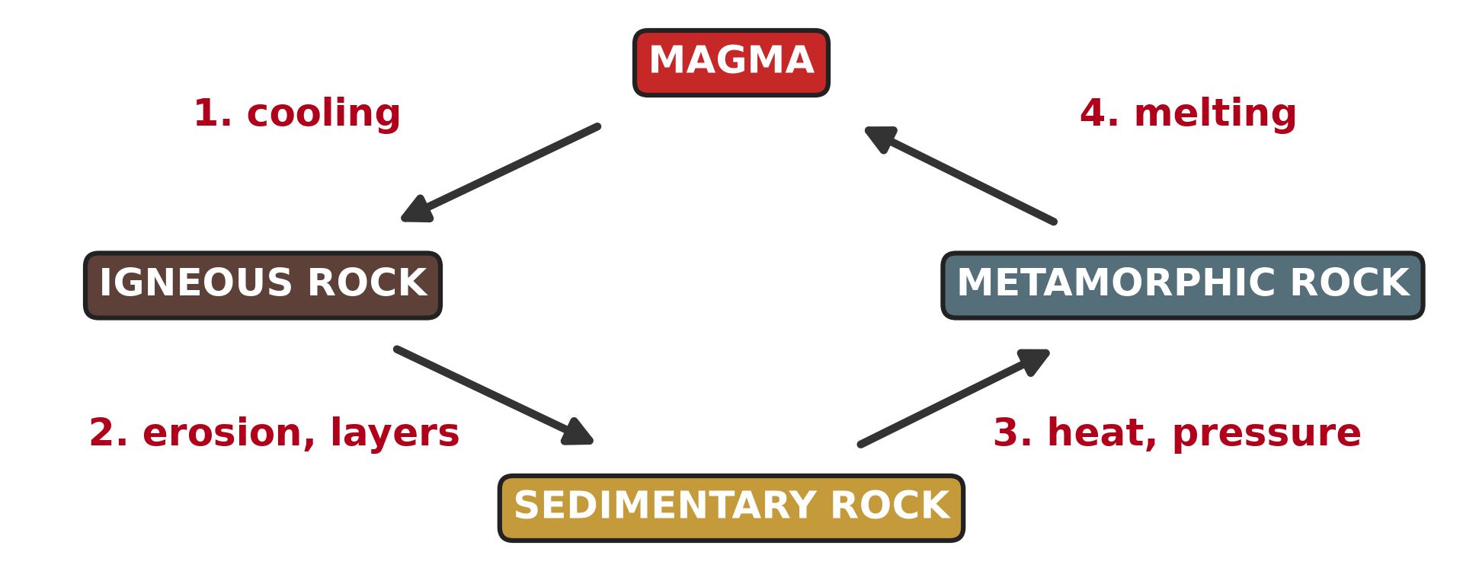
BOARD SUMMARY
2. The Rock Cycle
Illustration: the rock cycle
Notes:
Now draw this illustration in your notebook: the rock cycle. Give it a title and label it clearly.

Slide 35
FORMATIVE EVALUATION
Evaluation 1
How are igneous rocks formed?
Notes:
Now let us check what you have understood. Question 1: How are igneous rocks formed? Answer in your exercise book.

Slide 36
FORMATIVE EVALUATION
Expected Answer
When magma or lava cools and becomes hard.
Notes:
The expected answer is: when magma or lava cools and becomes hard. If you got it right, well done.

Slide 37
FORMATIVE EVALUATION
Evaluation 2
Give one example of a metamorphic rock.
Notes:
Now let us check what you have understood. Question 2: Give one example of a metamorphic rock. Answer in your exercise book.

Slide 38
FORMATIVE EVALUATION
Expected Answer
Marble (or slate, gneiss).
Notes:
The expected answer is: marble (or slate, gneiss). If you got it right, well done.

Slide 39
REMEDIATION
Remediation
Fill in the blanks:
Granite is an ______ rock.
Rocks formed from layers are ______ rocks.
Heat and pressure make ______ rocks.
Notes:
For those who need more practice, fill in the blanks in your exercise book. The answers are: number 1, igneous; number 2, sedimentary; number 3, metamorphic.

Slide 40
HOMEWORK
Homework
Look at a map of the world. Cut out, or trace, Africa and South America and try to fit their coasts together. Write what you notice.
Notes:
For your homework: Look at a map of the world. Cut out, or trace, Africa and South America and try to fit their coasts together. Write what you notice. We shall correct it at the beginning of our next lesson.

Slide 41
NEXT LESSON
Next Lesson
Our next lesson will be on:
Lesson 9: The Theory of Continental Drift
Notes:
Our next lesson will be on Lesson 9: The Theory of Continental Drift. Thank you for your attention, and see you next time.

Slide 42
BILINGUAL GAME
Bilingual Game (Jeu Bilingue)
English | Français
Rock | La roche
Mineral | Le minéral
Igneous rock | La roche magmatique
Sedimentary rock | La roche sédimentaire
Metamorphic rock | La roche métamorphique
Fossil | Le fossile
Layer | La couche / la strate
Rock cycle | Le cycle des roches
Notes:
Let us play the bilingual game. I say a word in English, and you give me the French word. Then we do the reverse.

Slide 43
LOGBOOK
Official Logbook (1/2)
Module / Topic | The Structure of the Earth: Building Processes and Impacts on Man
Lesson Title | Lesson 8: Rocks
Expected Learning Outcomes | Define a rock. Classify rocks according to their origin. Give the characteristics and examples of each type of rock. Draw the rock cycle.
Competence | Learners are able to recognise the main types of rocks around them and to choose suitable rocks for building.
Notes:
I record this information in the official logbook of the class after the lesson.

Slide 44
LOGBOOK
Official Logbook (2/2)
Matter Taught | DEFINITIONS; Classification of Rocks; The Rock Cycle.
Evaluation | Formative evaluation and remediation exercise.
Homework | Look at a map of the world. Cut out, or trace, Africa and South America and try to fit their coasts together. Write what you notice.
Enrolment / Present / Absent | ____ / ____ / ____
Achievement | To be completed after the lesson.
Notes:
I complete the second page of the logbook: the matter taught, the evaluation, the homework and the attendance.

Slide 45
TEACHER'S NOTE
Teacher's Note
Timing: Homework correction, plan, objectives 4 min | Recall, situation, action 6 min | 3 activities 12 min | Board summary (copying) 15 min | Evaluation, remediation 5 min | Homework, next lesson 3 min | Logbook 5 min
Without the projector (Activity 1): show a piece of granite from the school yard.
Without the projector (Activity 2): show layers in a cut road bank.
Without the projector (Activity 3): show a marble tile.
Notes:
This slide is for me, the teacher: it gives the timing of the lesson and what to do if the projector is not available.

Slide 46
REFERENCES
References
National Geography Syllabus (MINESEC), Form 4 — The Structure of the Earth: Building Processes and Impacts on Man.
Teacher's lesson notes (Form 4), checked and corrected where necessary.
Photo, Activity 1: “Sunset over Pyramid Rock” by Mark Wassell, CC BY-NC-ND 2.0, via Flickr (https://www.flickr.com/photos/61520356@N07/6515411027)
Photo, Activity 2: “Grand Canyon: Tapeats Sandstone 0283” by Grand Canyon NPS, CC BY 2.0, via Flickr (https://www.flickr.com/photos/50693818@N08/8238057843)
Photo, Activity 3: “Marble quarry, Carrara” by Russell Carman, CC BY-NC-SA 2.0, via Flickr (https://www.flickr.com/photos/11328254@N02/2095886412)
Diagrams and animations: drawn for this lesson (Geography Department).
Notes:
These are the references and picture credits used to prepare this lesson.

