Slide 1
FORM 4
GEOGRAPHY
Lesson 16
Physical Weathering Processes and Products
Notes:
Good morning, class, and welcome to our geography lesson. I am your geography teacher, Mr Kamdem. Today we are starting Lesson 16: Physical Weathering Processes and Products.

Slide 2
CLASS INFO
Class, Chapter and Duration
Class | Form 4
Chapter | Denudation Processes, Landforms and Impacts on Man — Weathering Processes: The Products and Impacts on Man
Duration | 50 minutes
Notes:
This lesson is for Form 4. It belongs to Denudation Processes, Landforms and Impacts on Man — Weathering Processes: The Products and Impacts on Man. We shall need 50 minutes to cover it.

Slide 3
IDENTIFICATION
Lesson Identification
Topic | Denudation Processes, Landforms and Impacts on Man
Sub-topic | Weathering Processes: The Products and Impacts on Man
Lesson | Lesson 16: Physical Weathering Processes and Products
Notions / Concepts | Temperature changes, frost action, slaking, unloading.
Syllabus focus | Thermal shattering; frost shattering; alternate wetting and drying; pressure release; physically induced biological weathering.
Competence | Learners are able to explain why rocks and walls crack in the sun or break under roots, and to protect buildings from these effects.
Notes:
Our topic is Denudation Processes, Landforms and Impacts on Man, and the sub-topic is Weathering Processes: The Products and Impacts on Man. The key notions we shall use today are: temperature changes, frost action, slaking, unloading. At the end, you should be able to do this: learners are able to explain why rocks and walls crack in the sun or break under roots, and to protect buildings from these effects.

Slide 4

HOMEWORK CORRECTION
Correction of the Homework
Question (Lesson 15: Weathering):
Touch a big rock or a cement wall at 1 p.m. and again at 7 p.m. Write what you feel, and why this could break the rock after many years.
Notes:
Before we start the new lesson, let us correct the homework I gave you at the end of Lesson 15: Weathering. The question was: Touch a big rock or a cement wall at 1 p.m. and again at 7 p.m. Write what you feel, and why this could break the rock after many years. Take out your exercise books.

Slide 5
HOMEWORK CORRECTION
Correction: Possible Answer
At 1 p.m. the rock is hot, and at 7 p.m. it is cooler. Daily heating makes the outer layer expand and cooling makes it contract; after many years this breaks the rock (thermal shattering).
Notes:
Here is a good answer. At 1 p.m. the rock is hot, and at 7 p.m. it is cooler. Daily heating makes the outer layer expand and cooling makes it contract; after many years this breaks the rock (thermal shattering). Compare it with your own answer and correct your work in red.

Slide 6
LESSON PLAN
Lesson Plan
Correction of the homework
Objectives and recall
Real-life situation and action to take
Learning activities
Board summary
Evaluation, remediation and homework
Notes:
Here is the plan of our lesson today. First, we shall correct the homework. Then we shall look at the objectives and recall what you already know. After that, we shall study a situation from real life and the action to take, and do the learning activities. Finally, we shall copy the board summary, do the evaluation and the remediation, and I will give you the homework.

Slide 7
OBJECTIVES
Objectives
By the end of this lesson, you should be able to:
Define physical weathering.
Explain the processes of physical weathering.
Name the products of each process.
Notes:
By the end of this lesson, you should be able to do three things. Number 1: define physical weathering. Number 2: explain the processes of physical weathering. Number 3: name the products of each process.

Slide 8
PREVIOUS KNOWLEDGE
Previous Knowledge
Weathering is the breaking down of rocks in their place.
Physical weathering breaks rocks without changing their minerals.
Climate is the main factor of weathering.
Notes:
Let us first remember what you already know. Weathering is the breaking down of rocks in their place. Physical weathering breaks rocks without changing their minerals. Climate is the main factor of weathering. Keep this in mind, because we shall build on it today.

Slide 9
REAL-LIFE SITUATION
Situation in Real Life
In the dry season, Yaya walks past a big granite rock. At midday, it is too hot to touch. Its outer surface peels off in thin layers, like an onion.
Notes:
Listen carefully to this situation from real life. In the dry season, Yaya walks past a big granite rock. At midday, it is too hot to touch. Its outer surface peels off in thin layers, like an onion. Think about it, because I am going to ask you some questions.

Slide 10
REAL-LIFE SITUATION
Situation: Question 1
What is the problem in the situation?
Notes:
Question 1: What is the problem in the situation? Think for a moment, then raise your hand to answer.

Slide 11
REAL-LIFE SITUATION
Answer
Yaya does not know why the rock peels off.
Notes:
Good. Yaya does not know why the rock peels off.

Slide 12
REAL-LIFE SITUATION
Situation: Question 2
When is the rock very hot?
Notes:
Question 2: When is the rock very hot? Think for a moment, then raise your hand to answer.

Slide 13
REAL-LIFE SITUATION
Answer
At midday, in the dry season.
Notes:
Good. At midday, in the dry season.

Slide 14
REAL-LIFE SITUATION
Situation: Question 3
What happens at night?
Notes:
Question 3: What happens at night? Think for a moment, then raise your hand to answer.

Slide 15
REAL-LIFE SITUATION
Possible Answer
The rock cools down.
Notes:
Good. The rock cools down.

Slide 16
ACTION TO TAKE
Action to Take
Recognise the products of physical weathering around us.
Notes:
From this situation, the action we are working towards in this lesson is the following: recognise the products of physical weathering around us.

Slide 17
JUSTIFICATION
Justification of the Lesson
This lesson helps us to know how rocks break into pieces.
Notes:
Why is this lesson important for you? This lesson helps us to know how rocks break into pieces.

Slide 18
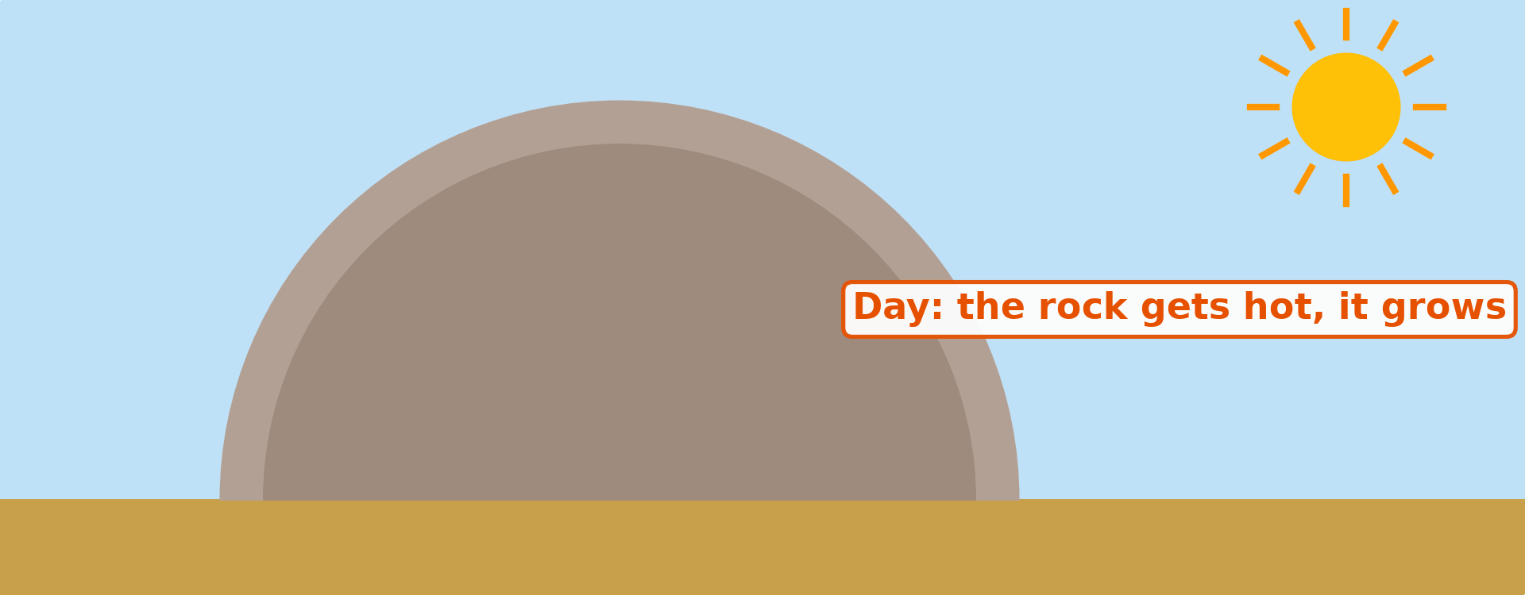
1. THERMAL SHATTERING
Activity 1
Animation: heating by day, cooling at night.
Notes:
Activity 1. Look carefully at this animation: animation: heating by day, cooling at night. Watch the animation to the end; it will play again.

Slide 19
1. THERMAL SHATTERING
Activity 1: Question
What happens to the outer layer of the rock after many days and nights?
Notes:
Here is the question for Activity 1: What happens to the outer layer of the rock after many days and nights? Take one minute to think and write your answer in your rough notebook.

Slide 20
1. THERMAL SHATTERING
Activity 1: Answer
It cracks and peels off.
Notes:
Let us check the answer together. It cracks and peels off.

Slide 21

1. THERMAL SHATTERING
Activity 2
Round granite rocks in a hot, dry area.
Notes:
Activity 2. Look carefully at this picture: round granite rocks in a hot, dry area. Observe every detail before I ask the question.

Slide 22
1. THERMAL SHATTERING
Activity 2: Question
These granite rocks lost their outer layers again and again. What do we call this peeling of rock?
Notes:
Here is the question for Activity 2: These granite rocks lost their outer layers again and again. What do we call this peeling of rock? Take one minute to think and write your answer in your rough notebook.

Slide 23
1. THERMAL SHATTERING
Activity 2: Answer
Exfoliation (onion weathering).
Notes:
Let us check the answer together. Exfoliation (onion weathering).

Slide 24

2. OTHER PROCESSES
Activity 3
Tree roots in a cracked rock.
Notes:
Activity 3. Look carefully at this picture: tree roots in a cracked rock. Observe every detail before I ask the question.

Slide 25
2. OTHER PROCESSES
Activity 3: Question
How do the roots break the rock?
Notes:
Here is the question for Activity 3: How do the roots break the rock? Take one minute to think and write your answer in your rough notebook.

Slide 26
2. OTHER PROCESSES
Activity 3: Answer
They grow bigger in the cracks and push the rock apart.
Notes:
Let us check the answer together. They grow bigger in the cracks and push the rock apart.

Slide 27
BOARD SUMMARY
Board Summary
Topic: Denudation Processes, Landforms and Impacts on Man
Sub-topic: Weathering Processes: The Products and Impacts on Man
Lesson 16: Physical Weathering Processes and Products
Notes:
Now we are going to copy the board summary. Write the title and the headings neatly in your notebooks. I will give you enough time for each slide, so do not rush.

Slide 28
BOARD SUMMARY
DEFINITIONS
The key terms of this lesson are defined as follows:
Physical weathering: It is the breaking of rocks into pieces without changing their minerals.
Exfoliation: It is the peeling of rock in thin, curved layers.
Notes:
Let us copy the definitions. The key terms of this lesson are defined as follows. On this slide we have Physical weathering and Exfoliation. Write each point on a new line, with the key term first, and explain it in your own words when we revise.

Slide 29
BOARD SUMMARY
1. Processes and Products of Physical Weathering
Physical weathering takes place through the following processes:
Thermal shattering: Daily heating and cooling make rocks expand and contract until they peel off (exfoliation).
Frost shattering: Water freezes in cracks, expands and breaks rocks into sharp pieces.
Notes:
Let us copy Processes and Products of Physical Weathering. Physical weathering takes place through the following processes. On this slide we have Thermal shattering and Frost shattering. Write each point on a new line, with the key term first, and explain it in your own words when we revise. When you finish, we go to the next slide.

Slide 30
BOARD SUMMARY
1. Processes and Products of Physical Weathering (continued)
Wetting and drying: Clay rocks swell when wet and shrink when dry, so they crumble.
Pressure release: When overlying rocks are removed, granite cracks in layers parallel to the surface.
Biological action: Roots and burrowing animals widen cracks and break rocks.
Notes:
We continue with Processes and Products of Physical Weathering. On this slide we have Wetting and drying, Pressure release and Biological action. Write each point on a new line, with the key term first, and explain it in your own words when we revise.

Slide 31
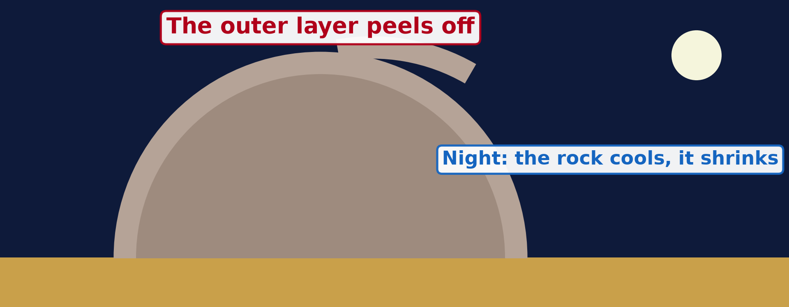
BOARD SUMMARY
1. Processes and Products of Physical Weathering
Illustration: exfoliation
Notes:
Now draw this illustration in your notebook: exfoliation. Give it a title and label it clearly.

Slide 32
FORMATIVE EVALUATION
Evaluation 1
Why does granite peel off in hot deserts?
Notes:
Now let us check what you have understood. Question 1: Why does granite peel off in hot deserts? Answer in your exercise book.

Slide 33
FORMATIVE EVALUATION
Expected Answer
It gets hot by day and cold at night, again and again.
Notes:
The expected answer is: it gets hot by day and cold at night, again and again. If you got it right, well done.

Slide 34
FORMATIVE EVALUATION
Evaluation 2
How do roots break rocks?
Notes:
Now let us check what you have understood. Question 2: How do roots break rocks? Answer in your exercise book.

Slide 35
FORMATIVE EVALUATION
Expected Answer
They grow in cracks and push the rock apart.
Notes:
The expected answer is: they grow in cracks and push the rock apart. If you got it right, well done.

Slide 36
REMEDIATION
Remediation
Fill in the blanks:
The peeling of rock like an onion is ______.
Water that freezes in cracks causes ______ shattering.
Notes:
Take your time to copy this part; we will continue together.

Slide 37
REMEDIATION
Remediation (continued)
Physical weathering does not change the ______ of the rock.
Notes:
For those who need more practice, fill in the blanks in your exercise book. The answers are: number 1, exfoliation; number 2, frost; number 3, minerals.

Slide 38
HOMEWORK
Homework
Look at an old iron gate, a roofing sheet or a nail left in the rain. Write what happened to it and what colour it became.
Notes:
For your homework: Look at an old iron gate, a roofing sheet or a nail left in the rain. Write what happened to it and what colour it became. We shall correct it at the beginning of our next lesson.

Slide 39
NEXT LESSON
Next Lesson
Our next lesson will be on:
Lesson 17: Chemical Weathering Processes and Products
Notes:
Our next lesson will be on Lesson 17: Chemical Weathering Processes and Products. Thank you for your attention, and see you next time.

Slide 40
BILINGUAL GAME
Bilingual Game (Jeu Bilingue)
English | Français
Exfoliation | L'exfoliation / la desquamation
Frost | Le gel
Crack | La fissure
To expand | Se dilater
To contract | Se contracter
Scree | L'éboulis
Root | La racine
Pressure release | La décompression
Notes:
Let us play the bilingual game. I say a word in English, and you give me the French word. Then we do the reverse.

Slide 41
LOGBOOK
Official Logbook (1/2)
Module / Topic | Denudation Processes, Landforms and Impacts on Man
Lesson Title | Lesson 16: Physical Weathering Processes and Products
Expected Learning Outcomes | Define physical weathering. Explain the processes of physical weathering. Name the products of each process.
Competence | Learners are able to explain why rocks and walls crack in the sun or break under roots, and to protect buildings from these effects.
Notes:
I record this information in the official logbook of the class after the lesson.

Slide 42
LOGBOOK
Official Logbook (2/2)
Matter Taught | DEFINITIONS; Processes and Products of Physical Weathering.
Evaluation | Formative evaluation and remediation exercise.
Homework | Look at an old iron gate, a roofing sheet or a nail left in the rain. Write what happened to it and what colour it became.
Enrolment / Present / Absent | ____ / ____ / ____
Achievement | To be completed after the lesson.
Notes:
I complete the second page of the logbook: the matter taught, the evaluation, the homework and the attendance.

Slide 43
TEACHER'S NOTE
Teacher's Note
Timing: Homework correction, plan, objectives 4 min | Recall, situation, action 6 min | 3 activities 12 min | Board summary (copying) 15 min | Evaluation, remediation 5 min | Homework, next lesson 3 min | Logbook 5 min
Activity 1 is an animation (GIF): it plays automatically in slide-show mode.
Without the projector (Activity 1): compare with a glass that breaks when hot water is poured in it.
Without the projector (Activity 2): ask learners about big granite rocks near Garoua.
Without the projector (Activity 3): show a road cracked by tree roots.
Notes:
This slide is for me, the teacher: it gives the timing of the lesson and what to do if the projector is not available.

Slide 44
REFERENCES
References
National Geography Syllabus (MINESEC), Form 4 — Denudation Processes, Landforms and Impacts on Man.
Teacher's lesson notes (Form 4), checked and corrected where necessary.
Photo, Activity 2: “Sunset over Pyramid Rock” by Mark Wassell, CC BY-NC-ND 2.0, via Flickr (https://www.flickr.com/photos/61520356@N07/6515411027)
Photo, Activity 3: “Stones 'n' Roots” by erix!, CC BY 2.0, via Flickr (https://www.flickr.com/photos/68387408@N00/55692423)
Diagrams and animations: drawn for this lesson (Geography Department).
Notes:
These are the references and picture credits used to prepare this lesson.

