Slide 1
FORM 4
GEOGRAPHY
Lesson 17
Chemical Weathering Processes and Products
Notes:
Good morning, class, and welcome to our geography lesson. I am your geography teacher, Mr Kamdem. Today we are starting Lesson 17: Chemical Weathering Processes and Products.

Slide 2
CLASS INFO
Class, Chapter and Duration
Class | Form 4
Chapter | Denudation Processes, Landforms and Impacts on Man — Weathering Processes: The Products and Impacts on Man
Duration | 50 minutes
Notes:
This lesson is for Form 4. It belongs to Denudation Processes, Landforms and Impacts on Man — Weathering Processes: The Products and Impacts on Man. We shall need 50 minutes to cover it.

Slide 3
IDENTIFICATION
Lesson Identification
Topic | Denudation Processes, Landforms and Impacts on Man
Sub-topic | Weathering Processes: The Products and Impacts on Man
Lesson | Lesson 17: Chemical Weathering Processes and Products
Notions / Concepts | Solution, carbonation, hydrolysis, oxidation, hydration, chemically induced biological weathering.
Syllabus focus | Processes and products of chemical weathering: solution, carbonation, hydrolysis, oxidation, hydration and chemically induced biological weathering.
Competence | Learners are able to explain why rocks rot and soils become red or clayey, and to protect metal and cement from the effects of water and air.
Notes:
Our topic is Denudation Processes, Landforms and Impacts on Man, and the sub-topic is Weathering Processes: The Products and Impacts on Man. The key notions we shall use today are: solution, carbonation, hydrolysis, oxidation, hydration, chemically induced biological weathering. At the end, you should be able to do this: learners are able to explain why rocks rot and soils become red or clayey, and to protect metal and cement from the effects of water and air.

Slide 4

HOMEWORK CORRECTION
Correction of the Homework
Question (Lesson 16: Physical Weathering Processes and Products):
Look at an old iron gate, a roofing sheet or a nail left in the rain. Write what happened to it and what colour it became.
Notes:
Before we start the new lesson, let us correct the homework I gave you at the end of Lesson 16: Physical Weathering Processes and Products. The question was: Look at an old iron gate, a roofing sheet or a nail left in the rain. Write what happened to it and what colour it became. Take out your exercise books.

Slide 5
HOMEWORK CORRECTION
Correction: Possible Answer
The iron became rusty: it turned reddish-brown and weak, and pieces flake off. This is oxidation, a form of chemical weathering.
Notes:
Here is a good answer. The iron became rusty: it turned reddish-brown and weak, and pieces flake off. This is oxidation, a form of chemical weathering. Compare it with your own answer and correct your work in red.

Slide 6
LESSON PLAN
Lesson Plan
Correction of the homework
Objectives and recall
Real-life situation and action to take
Learning activities
Board summary
Evaluation, remediation and homework
Notes:
Here is the plan of our lesson today. First, we shall correct the homework. Then we shall look at the objectives and recall what you already know. After that, we shall study a situation from real life and the action to take, and do the learning activities. Finally, we shall copy the board summary, do the evaluation and the remediation, and I will give you the homework.

Slide 7
OBJECTIVES
Objectives
By the end of this lesson, you should be able to:
Define chemical weathering.
Explain the main processes of chemical weathering.
Name the products of each process.
Notes:
By the end of this lesson, you should be able to do three things. Number 1: define chemical weathering. Number 2: explain the main processes of chemical weathering. Number 3: name the products of each process.

Slide 8
PREVIOUS KNOWLEDGE
Previous Knowledge
Physical weathering breaks rocks without changing their minerals.
Thermal shattering is common in hot, dry areas.
Chemical weathering is fastest in hot, wet climates.
Notes:
Let us first remember what you already know. Physical weathering breaks rocks without changing their minerals. Thermal shattering is common in hot, dry areas. Chemical weathering is fastest in hot, wet climates. Keep this in mind, because we shall build on it today.

Slide 9
REAL-LIFE SITUATION
Situation in Real Life
In the rainy season, Kaltouma sees that the old metal gate of her compound is reddish-brown. It flakes and crumbles. A new gate still shines.
Notes:
Listen carefully to this situation from real life. In the rainy season, Kaltouma sees that the old metal gate of her compound is reddish-brown. It flakes and crumbles. A new gate still shines. Think about it, because I am going to ask you some questions.

Slide 10
REAL-LIFE SITUATION
Situation: Question 1
What is the problem in the situation?
Notes:
Question 1: What is the problem in the situation? Think for a moment, then raise your hand to answer.

Slide 11
REAL-LIFE SITUATION
Answer
The old gate is rusting and breaking.
Notes:
Good. The old gate is rusting and breaking.

Slide 12
REAL-LIFE SITUATION
Situation: Question 2
What makes it rust?
Notes:
Question 2: What makes it rust? Think for a moment, then raise your hand to answer.

Slide 13
REAL-LIFE SITUATION
Answer
Rain and the air (oxygen).
Notes:
Good. Rain and the air (oxygen).

Slide 14
REAL-LIFE SITUATION
Situation: Question 3
Can rocks also rust?
Notes:
Question 3: Can rocks also rust? Think for a moment, then raise your hand to answer.

Slide 15
REAL-LIFE SITUATION
Possible Answer
Yes, rocks with iron become red: oxidation.
Notes:
Good. Yes, rocks with iron become red: oxidation.

Slide 16
ACTION TO TAKE
Action to Take
Explain the red soils and caves around us by chemical weathering.
Notes:
From this situation, the action we are working towards in this lesson is the following: explain the red soils and caves around us by chemical weathering.

Slide 17
JUSTIFICATION
Justification of the Lesson
This lesson helps us to know how rain and air change rocks.
Notes:
Why is this lesson important for you? This lesson helps us to know how rain and air change rocks.

Slide 18

1. OXIDATION
Activity 1
Rusty metal.
Notes:
Activity 1. Look carefully at this picture: rusty metal. Observe every detail before I ask the question.

Slide 19
1. OXIDATION
Activity 1: Question
Rain and air make iron red. What is this process?
Notes:
Here is the question for Activity 1: Rain and air make iron red. What is this process? Take one minute to think and write your answer in your rough notebook.

Slide 20
1. OXIDATION
Activity 1: Answer
Oxidation.
Notes:
Let us check the answer together. Oxidation.

Slide 21

1. OXIDATION
Activity 2
Red soil in a dry area.
Notes:
Activity 2. Look carefully at this picture: red soil in a dry area. Observe every detail before I ask the question.

Slide 22
1. OXIDATION
Activity 2: Question
Why are many soils around Garoua red?
Notes:
Here is the question for Activity 2: Why are many soils around Garoua red? Take one minute to think and write your answer in your rough notebook.

Slide 23
1. OXIDATION
Activity 2: Answer
The iron in the soil is oxidised (rusted).
Notes:
Let us check the answer together. The iron in the soil is oxidised (rusted).

Slide 24
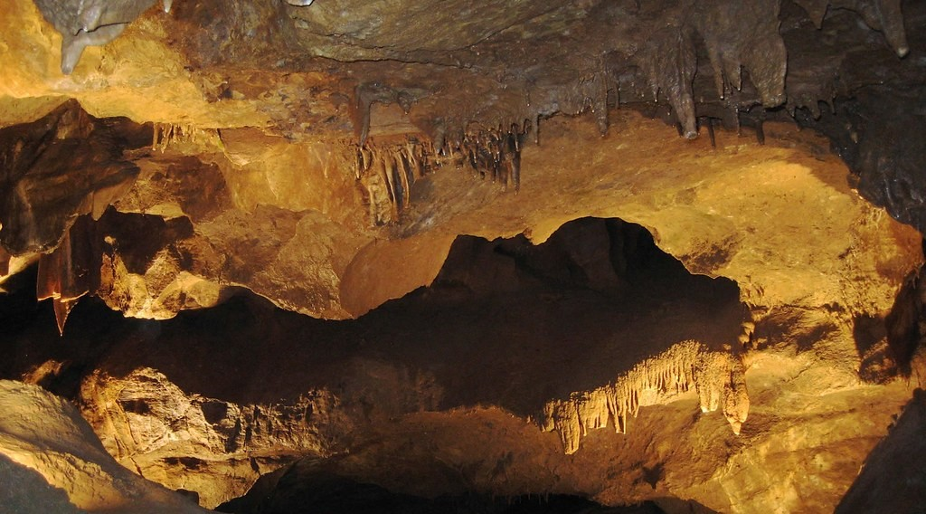
1. CARBONATION
Activity 3
A cave in limestone.
Notes:
Activity 3. Look carefully at this picture: a cave in limestone. Observe every detail before I ask the question.

Slide 25
1. CARBONATION
Activity 3: Question
Rain water dissolves limestone. What forms after a long time?
Notes:
Here is the question for Activity 3: Rain water dissolves limestone. What forms after a long time? Take one minute to think and write your answer in your rough notebook.

Slide 26
1. CARBONATION
Activity 3: Answer
Caves (with stalactites).
Notes:
Let us check the answer together. Caves (with stalactites).

Slide 27
BOARD SUMMARY
Board Summary
Topic: Denudation Processes, Landforms and Impacts on Man
Sub-topic: Weathering Processes: The Products and Impacts on Man
Lesson 17: Chemical Weathering Processes and Products
Notes:
Now we are going to copy the board summary. Write the title and the headings neatly in your notebooks. I will give you enough time for each slide, so do not rush.

Slide 28
BOARD SUMMARY
DEFINITIONS
The key terms of this lesson are defined as follows:
Chemical weathering: It is the decay of rocks by a change in their minerals.
Notes:
Let us copy the definitions. The key terms of this lesson are defined as follows. On this slide we have Chemical weathering. Write each point on a new line, with the key term first, and explain it in your own words when we revise.

Slide 29
BOARD SUMMARY
1. Processes and Products of Chemical Weathering
Chemical weathering takes place through the following processes:
Solution: Water dissolves soluble minerals such as rock salt.
Carbonation: Rainwater with carbon dioxide dissolves limestone and forms caves.
Notes:
Let us copy Processes and Products of Chemical Weathering. Chemical weathering takes place through the following processes. On this slide we have Solution and Carbonation. Write each point on a new line, with the key term first, and explain it in your own words when we revise. When you finish, we go to the next slide.

Slide 30
BOARD SUMMARY
1. Processes and Products of Chemical Weathering (continued)
Hydrolysis: Water reacts with feldspar in granite and changes it into clay.
Oxidation: Oxygen reacts with iron in rocks and makes them rusty and red, as in red soils.
Hydration: Some minerals take in water, swell and break the rock.
Notes:
We continue with Processes and Products of Chemical Weathering. On this slide we have Hydrolysis, Oxidation and Hydration. Write each point on a new line, with the key term first, and explain it in your own words when we revise. When you finish, we go to the next slide.

Slide 31
BOARD SUMMARY
1. Processes and Products of Chemical Weathering (continued)
Biological action: Acids from rotting plants and lichens attack rocks.
Notes:
We continue with Processes and Products of Chemical Weathering. On this slide we have Biological action. Write each point on a new line, with the key term first, and explain it in your own words when we revise.

Slide 32
FORMATIVE EVALUATION
Evaluation 1
Why are the soils of Garoua red?
Notes:
Now let us check what you have understood. Question 1: Why are the soils of Garoua red? Answer in your exercise book.

Slide 33
FORMATIVE EVALUATION
Expected Answer
The iron in them is oxidised.
Notes:
The expected answer is: the iron in them is oxidised. If you got it right, well done.

Slide 34
FORMATIVE EVALUATION
Evaluation 2
What does carbonation produce in limestone?
Notes:
Now let us check what you have understood. Question 2: What does carbonation produce in limestone? Answer in your exercise book.

Slide 35
FORMATIVE EVALUATION
Expected Answer
Caves.
Notes:
The expected answer is: caves. If you got it right, well done.

Slide 36
REMEDIATION
Remediation
Fill in the blanks:
The rusting of iron in rocks is ______.
Rain water dissolves limestone by ______.
Granite changes into clay by ______.
Notes:
For those who need more practice, fill in the blanks in your exercise book. The answers are: number 1, oxidation; number 2, carbonation; number 3, hydrolysis.

Slide 37
HOMEWORK
Homework
Ask a farmer in your family where the soil of his farm comes from, and ask if he has seen rocks fall or roads blocked after heavy rain. Write his answers.
Notes:
For your homework: Ask a farmer in your family where the soil of his farm comes from, and ask if he has seen rocks fall or roads blocked after heavy rain. Write his answers. We shall correct it at the beginning of our next lesson.

Slide 38
NEXT LESSON
Next Lesson
Our next lesson will be on:
Further Study 2: The Impact of Weathering on the Environment
Notes:
Our next lesson will be on Further Study 2: The Impact of Weathering on the Environment. Thank you for your attention, and see you next time.

Slide 39
BILINGUAL GAME
Bilingual Game (Jeu Bilingue)
English | Français
Solution | La dissolution
Oxidation | L'oxydation
Carbonation | La carbonatation
Hydrolysis | L'hydrolyse
Hydration | L'hydratation
Rust | La rouille
Clay | L'argile
Limestone | Le calcaire
Notes:
Let us play the bilingual game. I say a word in English, and you give me the French word. Then we do the reverse.

Slide 40
LOGBOOK
Official Logbook (1/2)
Module / Topic | Denudation Processes, Landforms and Impacts on Man
Lesson Title | Lesson 17: Chemical Weathering Processes and Products
Expected Learning Outcomes | Define chemical weathering. Explain the main processes of chemical weathering. Name the products of each process.
Competence | Learners are able to explain why rocks rot and soils become red or clayey, and to protect metal and cement from the effects of water and air.
Notes:
I record this information in the official logbook of the class after the lesson.

Slide 41
LOGBOOK
Official Logbook (2/2)
Matter Taught | DEFINITIONS; Processes and Products of Chemical Weathering.
Evaluation | Formative evaluation and remediation exercise.
Homework | Ask a farmer in your family where the soil of his farm comes from, and ask if he has seen rocks fall or roads blocked after heavy rain. Write his answers.
Enrolment / Present / Absent | ____ / ____ / ____
Achievement | To be completed after the lesson.
Notes:
I complete the second page of the logbook: the matter taught, the evaluation, the homework and the attendance.

Slide 42
TEACHER'S NOTE
Teacher's Note
Timing: Homework correction, plan, objectives 4 min | Recall, situation, action 6 min | 3 activities 12 min | Board summary (copying) 15 min | Evaluation, remediation 5 min | Homework, next lesson 3 min | Logbook 5 min
Without the projector (Activity 1): show a rusty nail and a new nail.
Without the projector (Activity 2): show red soil from the school yard.
Without the projector (Activity 3): drop a piece of chalk in vinegar: it slowly dissolves.
Notes:
This slide is for me, the teacher: it gives the timing of the lesson and what to do if the projector is not available.

Slide 43
REFERENCES
References
National Geography Syllabus (MINESEC), Form 4 — Denudation Processes, Landforms and Impacts on Man.
Teacher's lesson notes (Form 4), checked and corrected where necessary.
Photo, Activity 1: “Lock down!” by ViNo Gv, CC BY 2.0, via Flickr (https://www.flickr.com/photos/38217093@N03/20143584561)
Photo, Activity 2: “in the middle of nowhere, morocco” by mariusz kluzniak, CC BY-NC-ND 2.0, via Flickr (https://www.flickr.com/photos/39997856@N03/8398997251)
Photo, Activity 3: “Songam Cave” by D-Stanley, CC BY 2.0, via Flickr (https://www.flickr.com/photos/79721788@N00/5063216873)
Diagrams and animations: drawn for this lesson (Geography Department).
Notes:
These are the references and picture credits used to prepare this lesson.

