Slide 1
FORM 4
GEOGRAPHY
Lesson 20
The Middle Course of a River
Notes:
Good morning, class, and welcome to our geography lesson. I am your geography teacher, Mr Kamdem. Today we are starting Lesson 20: The Middle Course of a River.

Slide 2
CLASS INFO
Class, Chapter and Duration
Class | Form 4
Chapter | Denudation Processes, Landforms and Impacts on Man — The Work of Rivers on the Landscape and Impacts on Man
Duration | 50 minutes
Notes:
This lesson is for Form 4. It belongs to Denudation Processes, Landforms and Impacts on Man — The Work of Rivers on the Landscape and Impacts on Man. We shall need 50 minutes to cover it.

Slide 3
IDENTIFICATION
Lesson Identification
Topic | Denudation Processes, Landforms and Impacts on Man
Sub-topic | The Work of Rivers on the Landscape and Impacts on Man
Lesson | Lesson 20: The Middle Course of a River
Notions / Concepts | Open V-shaped valley, meanders, river cliffs, slip-off slopes.
Syllabus focus | Main characteristics and processes of the middle course; landforms of the middle course.
Competence | Learners are able to recognise the landforms of the middle course and to choose safe places to build or farm along a winding river.
Notes:
Our topic is Denudation Processes, Landforms and Impacts on Man, and the sub-topic is The Work of Rivers on the Landscape and Impacts on Man. The key notions we shall use today are: open V-shaped valley, meanders, river cliffs, slip-off slopes. At the end, you should be able to do this: learners are able to recognise the landforms of the middle course and to choose safe places to build or farm along a winding river.

Slide 4

HOMEWORK CORRECTION
Correction of the Homework
Question (Lesson 19: The Upper Course of a River):
Stand on the Benue Bridge in Garoua or look at a photo of it. Draw the river and its bends, and mark where the water seems fastest.
Notes:
Before we start the new lesson, let us correct the homework I gave you at the end of Lesson 19: The Upper Course of a River. The question was: Stand on the Benue Bridge in Garoua or look at a photo of it. Draw the river and its bends, and mark where the water seems fastest. Take out your exercise books.

Slide 5
HOMEWORK CORRECTION
Correction: Possible Answer
The drawing should show the Benue with bends (meanders) and sandbanks. The water is fastest on the outside of each bend and in the middle of the channel.
Notes:
Here is a good answer. The drawing should show the Benue with bends (meanders) and sandbanks. The water is fastest on the outside of each bend and in the middle of the channel. Compare it with your own answer and correct your work in red.

Slide 6
LESSON PLAN
Lesson Plan
Correction of the homework
Objectives and recall
Real-life situation and action to take
Learning activities
Board summary
Evaluation, remediation and homework
Notes:
Here is the plan of our lesson today. First, we shall correct the homework. Then we shall look at the objectives and recall what you already know. After that, we shall study a situation from real life and the action to take, and do the learning activities. Finally, we shall copy the board summary, do the evaluation and the remediation, and I will give you the homework.

Slide 7
OBJECTIVES
Objectives
By the end of this lesson, you should be able to:
Describe the main characteristics and processes of the middle course.
Explain how a river transports its load.
Notes:
Take your time to copy this part; we will continue together.

Slide 8
OBJECTIVES
Objectives (continued)
Explain the formation of meanders, river cliffs and slip-off slopes.
Notes:
By the end of this lesson, you should be able to do three things. Number 1: describe the main characteristics and processes of the middle course. Number 2: explain how a river transports its load. Number 3: explain the formation of meanders, river cliffs and slip-off slopes.

Slide 9
PREVIOUS KNOWLEDGE
Previous Knowledge
The upper course has steep slopes and vertical erosion.
Waterfalls form where hard rock lies on soft rock.
In the middle course, the gradient is gentler.
Notes:
Let us first remember what you already know. The upper course has steep slopes and vertical erosion. Waterfalls form where hard rock lies on soft rock. In the middle course, the gradient is gentler. Keep this in mind, because we shall build on it today.

Slide 10
REAL-LIFE SITUATION
Situation in Real Life
From the Benue Bridge in Garoua, Adama sees that the river bends. On the outside of the bend, the bank is steep. On the inside, there is a gentle beach of sand.
Notes:
Listen carefully to this situation from real life. From the Benue Bridge in Garoua, Adama sees that the river bends. On the outside of the bend, the bank is steep. On the inside, there is a gentle beach of sand. Think about it, because I am going to ask you some questions.

Slide 11
REAL-LIFE SITUATION
Situation: Question 1
What is the problem in the situation?
Notes:
Question 1: What is the problem in the situation? Think for a moment, then raise your hand to answer.

Slide 12
REAL-LIFE SITUATION
Answer
Adama does not know why the two banks are different.
Notes:
Good. Adama does not know why the two banks are different.

Slide 13
REAL-LIFE SITUATION
Situation: Question 2
Describe the two banks.
Notes:
Question 2: Describe the two banks. Think for a moment, then raise your hand to answer.

Slide 14
REAL-LIFE SITUATION
Answer
Steep outside; gentle and sandy inside.
Notes:
Good. Steep outside; gentle and sandy inside.

Slide 15
REAL-LIFE SITUATION
Situation: Question 3
What do we call a big bend in a river?
Notes:
Question 3: What do we call a big bend in a river? Think for a moment, then raise your hand to answer.

Slide 16
REAL-LIFE SITUATION
Possible Answer
A meander.
Notes:
Good. A meander.

Slide 17
ACTION TO TAKE
Action to Take
Avoid building on the outside of river bends where banks are eroded.
Notes:
From this situation, the action we are working towards in this lesson is the following: avoid building on the outside of river bends where banks are eroded.

Slide 18
JUSTIFICATION
Justification of the Lesson
This lesson helps us to know the landforms of the middle course.
Notes:
Why is this lesson important for you? This lesson helps us to know the landforms of the middle course.

Slide 19

2. MEANDERS
Activity 1
A river with big bends, seen from the sky.
Notes:
Activity 1. Look carefully at this picture: a river with big bends, seen from the sky. Observe every detail before I ask the question.

Slide 20
2. MEANDERS
Activity 1: Question
What do we call these big bends?
Notes:
Here is the question for Activity 1: What do we call these big bends? Take one minute to think and write your answer in your rough notebook.

Slide 21
2. MEANDERS
Activity 1: Answer
Meanders.
Notes:
Let us check the answer together. Meanders.

Slide 22
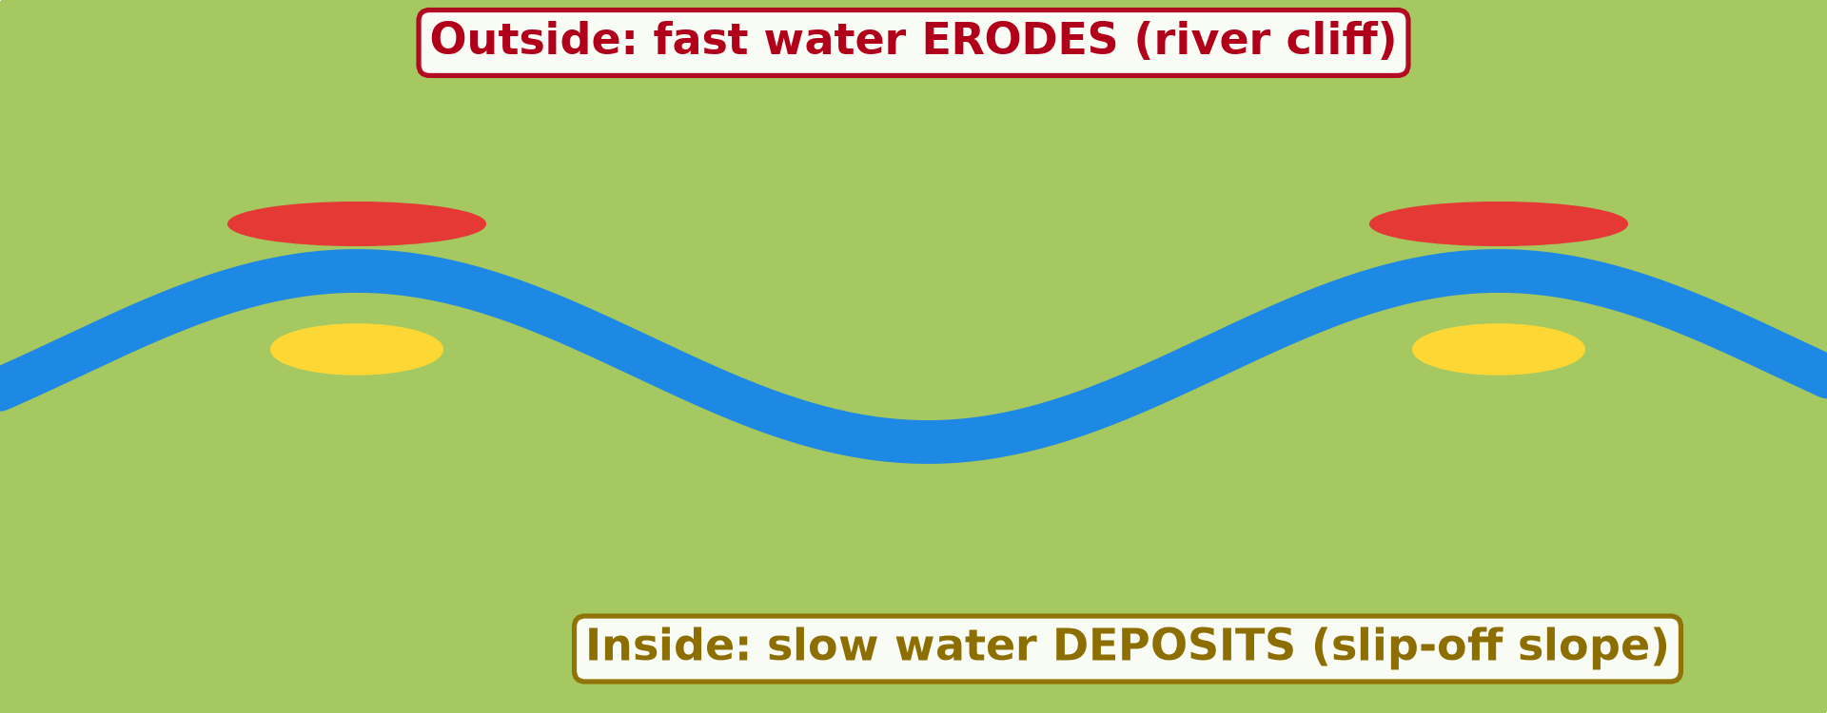
2. MEANDERS
Activity 2
Animation: a meander grows.
Notes:
Activity 2. Look carefully at this animation: animation: a meander grows. Watch the animation to the end; it will play again.

Slide 23
2. MEANDERS
Activity 2: Question
Where does the water erode? Where does it deposit?
Notes:
Here is the question for Activity 2: Where does the water erode? Where does it deposit? Take one minute to think and write your answer in your rough notebook.

Slide 24
2. MEANDERS
Activity 2: Answer
It erodes the outside of the bend and deposits on the inside.
Notes:
Let us check the answer together. It erodes the outside of the bend and deposits on the inside.

Slide 25
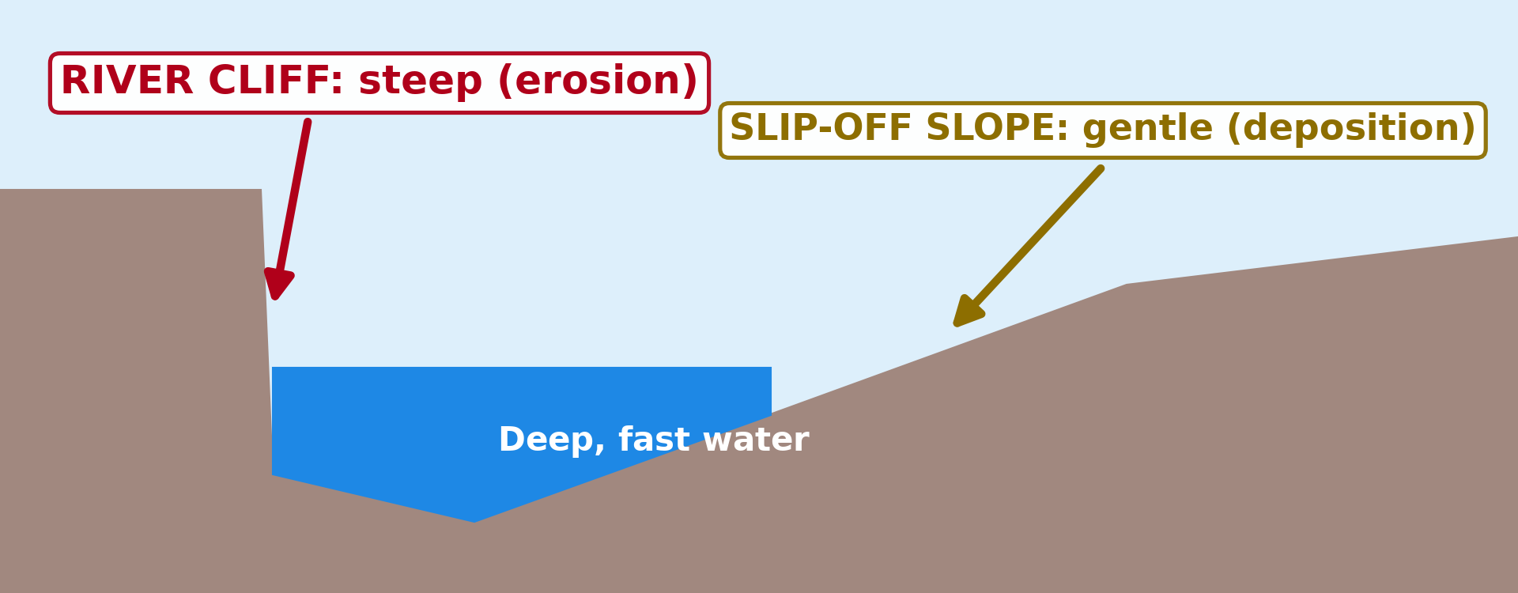
2. RIVER CLIFF AND SLIP-OFF SLOPE
Activity 3
A cross-section of a meander.
Notes:
Activity 3. Look carefully at this diagram: a cross-section of a meander. Observe every detail before I ask the question.

Slide 26
2. RIVER CLIFF AND SLIP-OFF SLOPE
Activity 3: Question
What is the steep bank on the outside of the bend called?
Notes:
Here is the question for Activity 3: What is the steep bank on the outside of the bend called? Take one minute to think and write your answer in your rough notebook.

Slide 27
2. RIVER CLIFF AND SLIP-OFF SLOPE
Activity 3: Answer
A river cliff.
Notes:
Let us check the answer together. A river cliff.

Slide 28
BOARD SUMMARY
Board Summary
Topic: Denudation Processes, Landforms and Impacts on Man
Sub-topic: The Work of Rivers on the Landscape and Impacts on Man
Lesson 20: The Middle Course of a River
Notes:
Now we are going to copy the board summary. Write the title and the headings neatly in your notebooks. I will give you enough time for each slide, so do not rush.

Slide 29
BOARD SUMMARY
1. Characteristics of the Middle Course
The middle course has the following characteristics:
Slope: The slope is gentle.
Valley: The valley is wider with a flat floor.
Notes:
Let us copy Characteristics of the Middle Course. The middle course has the following characteristics. On this slide we have Slope and Valley. Write each point on a new line, with the key term first, and explain it in your own words when we revise. When you finish, we go to the next slide.

Slide 30
BOARD SUMMARY
1. Characteristics of the Middle Course (continued)
Main process: The river cuts sideways into its banks by lateral erosion.
Notes:
We continue with Characteristics of the Middle Course. On this slide we have Main process. Write each point on a new line, with the key term first, and explain it in your own words when we revise.

Slide 31
BOARD SUMMARY
2. Landforms of the Middle Course
The middle course has the following landforms:
Meander: It is a large bend in a river.
River cliff: It is a steep bank on the outside of a bend, where the fast water erodes.
Notes:
Let us copy Landforms of the Middle Course. The middle course has the following landforms. On this slide we have Meander and River cliff. Write each point on a new line, with the key term first, and explain it in your own words when we revise. When you finish, we go to the next slide.

Slide 32
BOARD SUMMARY
2. Landforms of the Middle Course (continued)
Slip-off slope: It is a gentle bank on the inside of a bend, where the slow water deposits.
Notes:
We continue with Landforms of the Middle Course. On this slide we have Slip-off slope. Write each point on a new line, with the key term first, and explain it in your own words when we revise.

Slide 33
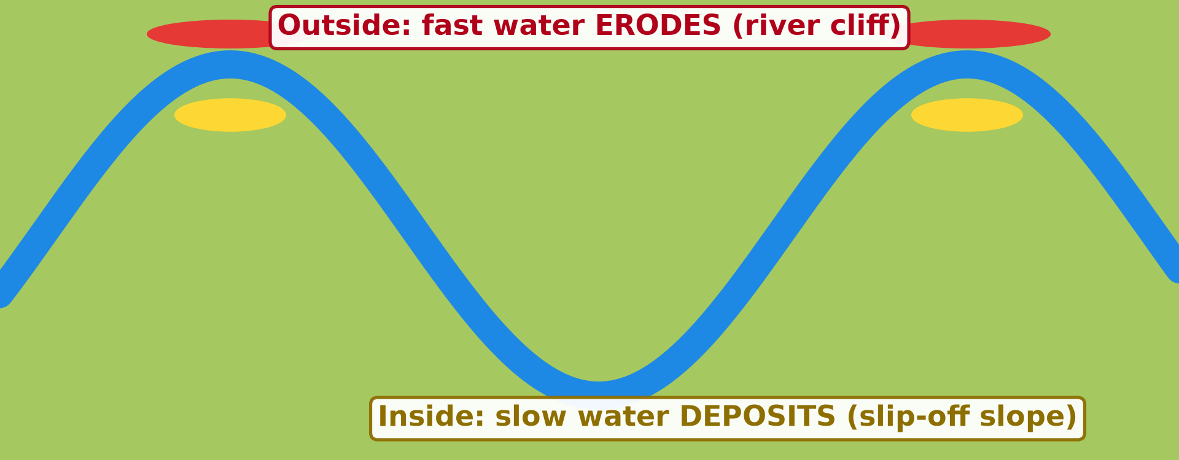
BOARD SUMMARY
2. Landforms of the Middle Course
Illustration: a meander
Notes:
Now draw this illustration in your notebook: a meander. Give it a title and label it clearly.

Slide 34
FORMATIVE EVALUATION
Evaluation 1
What is a meander?
Notes:
Now let us check what you have understood. Question 1: What is a meander? Answer in your exercise book.

Slide 35
FORMATIVE EVALUATION
Expected Answer
A big bend in a river.
Notes:
The expected answer is: a big bend in a river. If you got it right, well done.

Slide 36
FORMATIVE EVALUATION
Evaluation 2
Why is the outside of a bend steep?
Notes:
Now let us check what you have understood. Question 2: Why is the outside of a bend steep? Answer in your exercise book.

Slide 37
FORMATIVE EVALUATION
Expected Answer
The fast water erodes it.
Notes:
The expected answer is: the fast water erodes it. If you got it right, well done.

Slide 38
REMEDIATION
Remediation
Fill in the blanks:
A big bend in a river is a ______.
The steep bank on the outside is a river ______.
The gentle bank on the inside is a slip-off ______.
Notes:
For those who need more practice, fill in the blanks in your exercise book. The answers are: number 1, meander; number 2, cliff; number 3, slope.

Slide 39
HOMEWORK
Homework
Look at a map of the Niger Delta or the Nile Delta in your atlas. Draw its shape and name the sea it reaches.
Notes:
For your homework: Look at a map of the Niger Delta or the Nile Delta in your atlas. Draw its shape and name the sea it reaches. We shall correct it at the beginning of our next lesson.

Slide 40
NEXT LESSON
Next Lesson
Our next lesson will be on:
Lesson 21: The Lower Course of a River
Notes:
Our next lesson will be on Lesson 21: The Lower Course of a River. Thank you for your attention, and see you next time.

Slide 41
BILINGUAL GAME
Bilingual Game (Jeu Bilingue)
English | Français
Meander | Le méandre
River cliff | La rive concave / falaise de méandre
Slip-off slope | La rive convexe
Lateral erosion | L'érosion latérale
Suspension | La suspension
Saltation | La saltation
Traction | Le charriage / la traction
Sandbank | Le banc de sable
Notes:
Let us play the bilingual game. I say a word in English, and you give me the French word. Then we do the reverse.

Slide 42
LOGBOOK
Official Logbook (1/2)
Module / Topic | Denudation Processes, Landforms and Impacts on Man
Lesson Title | Lesson 20: The Middle Course of a River
Expected Learning Outcomes | Describe the main characteristics and processes of the middle course. Explain how a river transports its load. Explain the formation of meanders, river cliffs and slip-off slopes.
Competence | Learners are able to recognise the landforms of the middle course and to choose safe places to build or farm along a winding river.
Notes:
I record this information in the official logbook of the class after the lesson.

Slide 43
LOGBOOK
Official Logbook (2/2)
Matter Taught | Characteristics of the Middle Course; Landforms of the Middle Course.
Evaluation | Formative evaluation and remediation exercise.
Homework | Look at a map of the Niger Delta or the Nile Delta in your atlas. Draw its shape and name the sea it reaches.
Enrolment / Present / Absent | ____ / ____ / ____
Achievement | To be completed after the lesson.
Notes:
I complete the second page of the logbook: the matter taught, the evaluation, the homework and the attendance.

Slide 44
TEACHER'S NOTE
Teacher's Note
Timing: Homework correction, plan, objectives 4 min | Recall, situation, action 6 min | 3 activities 12 min | Board summary (copying) 15 min | Evaluation, remediation 5 min | Homework, next lesson 3 min | Logbook 5 min
Activity 2 is an animation (GIF): it plays automatically in slide-show mode.
Without the projector (Activity 1): draw a snake-like river on the board.
Without the projector (Activity 2): draw a bend and mark the outside and the inside.
Without the projector (Activity 3): describe the banks of the Benue at Garoua.
Notes:
This slide is for me, the teacher: it gives the timing of the lesson and what to do if the projector is not available.

Slide 45
REFERENCES
References
National Geography Syllabus (MINESEC), Form 4 — Denudation Processes, Landforms and Impacts on Man.
Teacher's lesson notes (Form 4), checked and corrected where necessary.
Photo, Activity 1: “Ox-bow” by colinjackson1972, CC BY-NC 2.0, via Flickr (https://www.flickr.com/photos/8253719@N04/2329293239)
Diagrams and animations: drawn for this lesson (Geography Department).
Notes:
These are the references and picture credits used to prepare this lesson.

