Slide 1
FORM 4
GEOGRAPHY
Lesson 22
Man and Floodplain Interactions
Notes:
Good morning, class, and welcome to our geography lesson. I am your geography teacher, Mr Kamdem. Today we are starting Lesson 22: Man and Floodplain Interactions.

Slide 2
CLASS INFO
Class, Chapter and Duration
Class | Form 4
Chapter | Denudation Processes, Landforms and Impacts on Man — The Work of Rivers on the Landscape and Impacts on Man
Duration | 50 minutes
Notes:
This lesson is for Form 4. It belongs to Denudation Processes, Landforms and Impacts on Man — The Work of Rivers on the Landscape and Impacts on Man. We shall need 50 minutes to cover it.

Slide 3
IDENTIFICATION
Lesson Identification
Topic | Denudation Processes, Landforms and Impacts on Man
Sub-topic | The Work of Rivers on the Landscape and Impacts on Man
Lesson | Lesson 22: Man and Floodplain Interactions
Notions / Concepts | Floodplain, resource, hazard.
Syllabus focus | Importance of rivers and floodplains to man; problems of living in floodplains; solutions to the problems of living in floodplains.
Competence | Learners are able to use the resources of a river safely and to take measures against floods in their community.
Notes:
Our topic is Denudation Processes, Landforms and Impacts on Man, and the sub-topic is The Work of Rivers on the Landscape and Impacts on Man. The key notions we shall use today are: floodplain, resource, hazard. At the end, you should be able to do this: learners are able to use the resources of a river safely and to take measures against floods in their community.

Slide 4

HOMEWORK CORRECTION
Correction of the Homework
Question (Lesson 21: The Lower Course of a River):
Ask two people who live or farm near the Benue: what are the advantages of the river, and what problems do the floods cause? Write their answers.
Notes:
Before we start the new lesson, let us correct the homework I gave you at the end of Lesson 21: The Lower Course of a River. The question was: Ask two people who live or farm near the Benue: what are the advantages of the river, and what problems do the floods cause? Write their answers. Take out your exercise books.

Slide 5
HOMEWORK CORRECTION
Correction: Possible Answer
Advantages: fertile soil for rice and onions, water for animals and fishing. Problems: floods destroy houses and crops, and bring diseases like cholera and malaria.
Notes:
Here is a good answer. Advantages: fertile soil for rice and onions, water for animals and fishing. Problems: floods destroy houses and crops, and bring diseases like cholera and malaria. Compare it with your own answer and correct your work in red.

Slide 6
LESSON PLAN
Lesson Plan
Correction of the homework
Objectives and recall
Real-life situation and action to take
Learning activities
Board summary
Evaluation, remediation and homework
Notes:
Here is the plan of our lesson today. First, we shall correct the homework. Then we shall look at the objectives and recall what you already know. After that, we shall study a situation from real life and the action to take, and do the learning activities. Finally, we shall copy the board summary, do the evaluation and the remediation, and I will give you the homework.

Slide 7
OBJECTIVES
Objectives
By the end of this lesson, you should be able to:
Explain the importance of rivers and floodplains to man.
Describe the problems of living on floodplains.
Notes:
Take your time to copy this part; we will continue together.

Slide 8
OBJECTIVES
Objectives (continued)
Suggest solutions to these problems.
Notes:
By the end of this lesson, you should be able to do three things. Number 1: explain the importance of rivers and floodplains to man. Number 2: describe the problems of living on floodplains. Number 3: suggest solutions to these problems.

Slide 9
PREVIOUS KNOWLEDGE
Previous Knowledge
A floodplain is a wide, flat area covered with alluvium.
Levees are raised banks built during floods.
Deposition is dominant in the lower course.
Notes:
Let us first remember what you already know. A floodplain is a wide, flat area covered with alluvium. Levees are raised banks built during floods. Deposition is dominant in the lower course. Keep this in mind, because we shall build on it today.

Slide 10
REAL-LIFE SITUATION
Situation in Real Life
In September, the Benue is very high at Garoua. In 2012, heavy rain and water from the Lagdo Dam flooded many villages. Farms and houses were destroyed.
Notes:
Listen carefully to this situation from real life. In September, the Benue is very high at Garoua. In 2012, heavy rain and water from the Lagdo Dam flooded many villages. Farms and houses were destroyed. Think about it, because I am going to ask you some questions.

Slide 11
REAL-LIFE SITUATION
Situation: Question 1
What is the problem in the situation?
Notes:
Question 1: What is the problem in the situation? Think for a moment, then raise your hand to answer.

Slide 12
REAL-LIFE SITUATION
Answer
Floods destroyed farms and houses.
Notes:
Good. Floods destroyed farms and houses.

Slide 13
REAL-LIFE SITUATION
Situation: Question 2
What caused the flood of 2012?
Notes:
Question 2: What caused the flood of 2012? Think for a moment, then raise your hand to answer.

Slide 14
REAL-LIFE SITUATION
Answer
Heavy rain and water released from the Lagdo Dam.
Notes:
Good. Heavy rain and water released from the Lagdo Dam.

Slide 15
REAL-LIFE SITUATION
Situation: Question 3
Why do people live near the river?
Notes:
Question 3: Why do people live near the river? Think for a moment, then raise your hand to answer.

Slide 16
REAL-LIFE SITUATION
Possible Answer
The soil is fertile and there is water.
Notes:
Good. The soil is fertile and there is water.

Slide 17
ACTION TO TAKE
Action to Take
Build away from rivers and follow flood warnings.
Notes:
From this situation, the action we are working towards in this lesson is the following: build away from rivers and follow flood warnings.

Slide 18
JUSTIFICATION
Justification of the Lesson
This lesson helps us to know the advantages and dangers of living near rivers.
Notes:
Why is this lesson important for you? This lesson helps us to know the advantages and dangers of living near rivers.

Slide 19

1. IMPORTANCE OF FLOODPLAINS
Activity 1
A woman in a rice field.
Notes:
Activity 1. Look carefully at this picture: a woman in a rice field. Observe every detail before I ask the question.

Slide 20
1. IMPORTANCE OF FLOODPLAINS
Activity 1: Question
Why are floodplains good for farming?
Notes:
Here is the question for Activity 1: Why are floodplains good for farming? Take one minute to think and write your answer in your rough notebook.

Slide 21
1. IMPORTANCE OF FLOODPLAINS
Activity 1: Answer
The soil is fertile (alluvium) and there is water.
Notes:
Let us check the answer together. The soil is fertile (alluvium) and there is water.

Slide 22

2. PROBLEMS
Activity 2
A flooded street.
Notes:
Activity 2. Look carefully at this picture: a flooded street. Observe every detail before I ask the question.

Slide 23
2. PROBLEMS
Activity 2: Question
What problems do floods cause?
Notes:
Here is the question for Activity 2: What problems do floods cause? Take one minute to think and write your answer in your rough notebook.

Slide 24
2. PROBLEMS
Activity 2: Answer
They destroy houses and crops, and bring diseases.
Notes:
Let us check the answer together. They destroy houses and crops, and bring diseases.

Slide 25
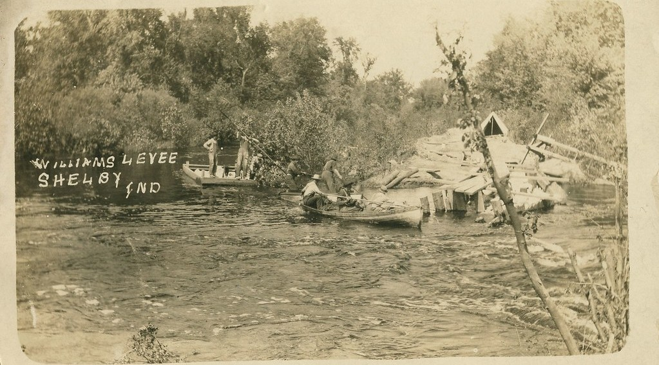
3. SOLUTIONS
Activity 3
A dyke (levee) along a river, USA, 1912.
Notes:
Activity 3. Look carefully at this picture: a dyke (levee) along a river, USA, 1912. Observe every detail before I ask the question.

Slide 26
3. SOLUTIONS
Activity 3: Question
How does this bank protect the land?
Notes:
Here is the question for Activity 3: How does this bank protect the land? Take one minute to think and write your answer in your rough notebook.

Slide 27
3. SOLUTIONS
Activity 3: Answer
It stops the river from flooding the land.
Notes:
Let us check the answer together. It stops the river from flooding the land.

Slide 28
BOARD SUMMARY
Board Summary
Topic: Denudation Processes, Landforms and Impacts on Man
Sub-topic: The Work of Rivers on the Landscape and Impacts on Man
Lesson 22: Man and Floodplain Interactions
Notes:
Now we are going to copy the board summary. Write the title and the headings neatly in your notebooks. I will give you enough time for each slide, so do not rush.

Slide 29
BOARD SUMMARY
DEFINITIONS
The key terms of this lesson are defined as follows:
Flood: It is when water covers land that is usually dry.
Alluvium: It is the fertile mud deposited by a river.
Notes:
Let us copy the definitions. The key terms of this lesson are defined as follows. On this slide we have Flood and Alluvium. Write each point on a new line, with the key term first, and explain it in your own words when we revise.

Slide 30
BOARD SUMMARY
1. Importance of Rivers and Floodplains
Rivers and floodplains are important to man for the following reasons:
Farming: Floodplains have fertile alluvium for rice, onions and vegetables.
Water and fishing: Rivers supply water for drinking, animals and fishing.
Notes:
Let us copy Importance of Rivers and Floodplains. Rivers and floodplains are important to man for the following reasons. On this slide we have Farming and Water and fishing. Write each point on a new line, with the key term first, and explain it in your own words when we revise. When you finish, we go to the next slide.

Slide 31
BOARD SUMMARY
1. Importance of Rivers and Floodplains (continued)
Energy and transport: Rivers give electricity, like the Lagdo Dam, and are used for transport.
Notes:
We continue with Importance of Rivers and Floodplains. On this slide we have Energy and transport. Write each point on a new line, with the key term first, and explain it in your own words when we revise.

Slide 32
BOARD SUMMARY
2. Problems of Living in Floodplains
People in floodplains face the following problems:
Floods: Floods destroy houses, crops and roads.
Diseases: Stagnant water spreads diseases such as cholera and malaria.
Notes:
Let us copy Problems of Living in Floodplains. People in floodplains face the following problems. On this slide we have Floods and Diseases. Write each point on a new line, with the key term first, and explain it in your own words when we revise. When you finish, we go to the next slide.

Slide 33
BOARD SUMMARY
2. Problems of Living in Floodplains (continued)
Loss of life: People and animals can drown during floods.
Notes:
We continue with Problems of Living in Floodplains. On this slide we have Loss of life. Write each point on a new line, with the key term first, and explain it in your own words when we revise.

Slide 34
BOARD SUMMARY
3. Solutions
The following solutions reduce these problems:
Dykes and dams: They control the water and hold back floods.
Warnings: Radio messages warn people before floods.
Notes:
Let us copy Solutions. The following solutions reduce these problems. On this slide we have Dykes and dams and Warnings. Write each point on a new line, with the key term first, and explain it in your own words when we revise. When you finish, we go to the next slide.

Slide 35
BOARD SUMMARY
3. Solutions (continued)
Safe building: Houses should be built on higher ground far from the river.
Trees: Trees along the banks hold the soil and slow down the water.
Notes:
We continue with Solutions. On this slide we have Safe building and Trees. Write each point on a new line, with the key term first, and explain it in your own words when we revise.

Slide 36
FORMATIVE EVALUATION
Evaluation 1
Give one advantage of living on a floodplain.
Notes:
Now let us check what you have understood. Question 1: Give one advantage of living on a floodplain. Answer in your exercise book.

Slide 37
FORMATIVE EVALUATION
Expected Answer
The soil is fertile.
Notes:
The expected answer is: the soil is fertile. If you got it right, well done.

Slide 38
FORMATIVE EVALUATION
Evaluation 2
Give two solutions to floods.
Notes:
Now let us check what you have understood. Question 2: Give two solutions to floods. Answer in your exercise book.

Slide 39
FORMATIVE EVALUATION
Expected Answer
Build dykes and give flood warnings.
Notes:
The expected answer is: build dykes and give flood warnings. If you got it right, well done.

Slide 40
REMEDIATION
Remediation
Fill in the blanks:
Fertile mud dropped by a river is ______.
A high bank built to stop floods is a ______.
In 2012, water from the ______ Dam flooded villages.
Notes:
For those who need more practice, fill in the blanks in your exercise book. The answers are: number 1, alluvium; number 2, dyke; number 3, Lagdo.

Slide 41
HOMEWORK
Homework
Watch the wind blowing on the water of the Benue or of a big basin of water. Write how the waves form and in which direction they move.
Notes:
For your homework: Watch the wind blowing on the water of the Benue or of a big basin of water. Write how the waves form and in which direction they move. We shall correct it at the beginning of our next lesson.

Slide 42
NEXT LESSON
Next Lesson
Our next lesson will be on:
Lesson 23: Wave Action in Coastal Areas
Notes:
Our next lesson will be on Lesson 23: Wave Action in Coastal Areas. Thank you for your attention, and see you next time.

Slide 43
BILINGUAL GAME
Bilingual Game (Jeu Bilingue)
English | Français
Resource | La ressource
Hazard | L'aléa
Dam | Le barrage
Irrigation | L'irrigation
Hydroelectricity | L'hydroélectricité
Warning | L'alerte
Zoning | Le zonage
Displaced person | La personne déplacée
Notes:
Let us play the bilingual game. I say a word in English, and you give me the French word. Then we do the reverse.

Slide 44
LOGBOOK
Official Logbook (1/2)
Module / Topic | Denudation Processes, Landforms and Impacts on Man
Lesson Title | Lesson 22: Man and Floodplain Interactions
Expected Learning Outcomes | Explain the importance of rivers and floodplains to man. Describe the problems of living on floodplains. Suggest solutions to these problems.
Competence | Learners are able to use the resources of a river safely and to take measures against floods in their community.
Notes:
I record this information in the official logbook of the class after the lesson.

Slide 45
LOGBOOK
Official Logbook (2/2)
Matter Taught | DEFINITIONS; Importance of Rivers and Floodplains; Problems of Living in Floodplains; Solutions.
Evaluation | Formative evaluation and remediation exercise.
Homework | Watch the wind blowing on the water of the Benue or of a big basin of water. Write how the waves form and in which direction they move.
Enrolment / Present / Absent | ____ / ____ / ____
Achievement | To be completed after the lesson.
Notes:
I complete the second page of the logbook: the matter taught, the evaluation, the homework and the attendance.

Slide 46
TEACHER'S NOTE
Teacher's Note
Timing: Homework correction, plan, objectives 4 min | Recall, situation, action 6 min | 3 activities 12 min | Board summary (copying) 15 min | Evaluation, remediation 5 min | Homework, next lesson 3 min | Logbook 5 min
Without the projector (Activity 1): ask learners what grows along the Benue.
Without the projector (Activity 2): ask learners to describe the flood of 2012.
Without the projector (Activity 3): describe sandbags put along a river.
Notes:
This slide is for me, the teacher: it gives the timing of the lesson and what to do if the projector is not available.

Slide 47
REFERENCES
References
National Geography Syllabus (MINESEC), Form 4 — Denudation Processes, Landforms and Impacts on Man.
Teacher's lesson notes (Form 4), checked and corrected where necessary.
Photo, Activity 1: “A woman harvesting rice, Barotse floodplain, Zambia. Photo by Georgina” by WorldFish, CC BY-NC-ND 2.0, via Flickr (https://www.flickr.com/photos/61545321@N06/7848727138)
Photo, Activity 2: “Flood in Accra” by Stig Nygaard, CC BY 2.0, via Flickr (https://www.flickr.com/photos/10259776@N00/181742000)
Photo, Activity 3: “Williams Levee on Kankakee River near Shelby, Indiana, May 1912” by Shook Photos, CC BY 2.0, via Flickr (https://www.flickr.com/photos/24724221@N07/18458778016)
Diagrams and animations: drawn for this lesson (Geography Department).
Notes:
These are the references and picture credits used to prepare this lesson.

