Slide 1
FORM 4
GEOGRAPHY
Lesson 23
Wave Action in Coastal Areas
Notes:
Good morning, class, and welcome to our geography lesson. I am your geography teacher, Mr Kamdem. Today we are starting Lesson 23: Wave Action in Coastal Areas.

Slide 2
CLASS INFO
Class, Chapter and Duration
Class | Form 4
Chapter | Denudation Processes, Landforms and Impacts on Man — Wave Action along the Coast and Impacts on Man
Duration | 50 minutes
Notes:
This lesson is for Form 4. It belongs to Denudation Processes, Landforms and Impacts on Man — Wave Action along the Coast and Impacts on Man. We shall need 50 minutes to cover it.

Slide 3
IDENTIFICATION
Lesson Identification
Topic | Denudation Processes, Landforms and Impacts on Man
Sub-topic | Wave Action along the Coast and Impacts on Man
Lesson | Lesson 23: Wave Action in Coastal Areas
Notions / Concepts | Wave, fetch, swash, backwash, longshore drift.
Syllabus focus | Meaning of waves; types of waves (constructive and destructive).
Competence | Learners are able to explain how waves form and to recognise dangerous waves on a beach, for example at Kribi or Limbe.
Notes:
Our topic is Denudation Processes, Landforms and Impacts on Man, and the sub-topic is Wave Action along the Coast and Impacts on Man. The key notions we shall use today are: wave, fetch, swash, backwash, longshore drift. At the end, you should be able to do this: learners are able to explain how waves form and to recognise dangerous waves on a beach, for example at Kribi or Limbe.

Slide 4

HOMEWORK CORRECTION
Correction of the Homework
Question (Lesson 22: Man and Floodplain Interactions):
Watch the wind blowing on the water of the Benue or of a big basin of water. Write how the waves form and in which direction they move.
Notes:
Before we start the new lesson, let us correct the homework I gave you at the end of Lesson 22: Man and Floodplain Interactions. The question was: Watch the wind blowing on the water of the Benue or of a big basin of water. Write how the waves form and in which direction they move. Take out your exercise books.

Slide 5
HOMEWORK CORRECTION
Correction: Possible Answer
The wind blows over the water and pushes it into small waves (ripples). The waves move in the direction the wind is blowing; a stronger wind gives bigger waves.
Notes:
Here is a good answer. The wind blows over the water and pushes it into small waves (ripples). The waves move in the direction the wind is blowing; a stronger wind gives bigger waves. Compare it with your own answer and correct your work in red.

Slide 6
LESSON PLAN
Lesson Plan
Correction of the homework
Objectives and recall
Real-life situation and action to take
Learning activities
Board summary
Evaluation, remediation and homework
Notes:
Here is the plan of our lesson today. First, we shall correct the homework. Then we shall look at the objectives and recall what you already know. After that, we shall study a situation from real life and the action to take, and do the learning activities. Finally, we shall copy the board summary, do the evaluation and the remediation, and I will give you the homework.

Slide 7
OBJECTIVES
Objectives
By the end of this lesson, you should be able to:
Define a wave and explain its cause.
Explain the factors of the strength of waves.
Notes:
Take your time to copy this part; we will continue together.

Slide 8
OBJECTIVES
Objectives (continued)
Distinguish constructive and destructive waves.
Notes:
By the end of this lesson, you should be able to do three things. Number 1: define a wave and explain its cause. Number 2: explain the factors of the strength of waves. Number 3: distinguish constructive and destructive waves.

Slide 9
PREVIOUS KNOWLEDGE
Previous Knowledge
Rivers erode, transport and deposit.
Rivers drop their load where they lose energy.
Waves are an agent of denudation along the coast.
Notes:
Let us first remember what you already know. Rivers erode, transport and deposit. Rivers drop their load where they lose energy. Waves are an agent of denudation along the coast. Keep this in mind, because we shall build on it today.

Slide 10
REAL-LIFE SITUATION
Situation in Real Life
On a windy day, Moussa sees small waves on the Benue. His cousin in Kribi says that the waves of the Atlantic Ocean are much bigger and stronger.
Notes:
Listen carefully to this situation from real life. On a windy day, Moussa sees small waves on the Benue. His cousin in Kribi says that the waves of the Atlantic Ocean are much bigger and stronger. Think about it, because I am going to ask you some questions.

Slide 11
REAL-LIFE SITUATION
Situation: Question 1
What is the problem in the situation?
Notes:
Question 1: What is the problem in the situation? Think for a moment, then raise your hand to answer.

Slide 12
REAL-LIFE SITUATION
Answer
Moussa does not know why some waves are bigger than others.
Notes:
Good. Moussa does not know why some waves are bigger than others.

Slide 13
REAL-LIFE SITUATION
Situation: Question 2
What makes the waves?
Notes:
Question 2: What makes the waves? Think for a moment, then raise your hand to answer.

Slide 14
REAL-LIFE SITUATION
Answer
The wind blowing on the water.
Notes:
Good. The wind blowing on the water.

Slide 15
REAL-LIFE SITUATION
Situation: Question 3
Why are sea waves bigger?
Notes:
Question 3: Why are sea waves bigger? Think for a moment, then raise your hand to answer.

Slide 16
REAL-LIFE SITUATION
Possible Answer
The wind blows longer over a very large area of water.
Notes:
Good. The wind blows longer over a very large area of water.

Slide 17
ACTION TO TAKE
Action to Take
Respect warnings about big waves when swimming or fishing.
Notes:
From this situation, the action we are working towards in this lesson is the following: respect warnings about big waves when swimming or fishing.

Slide 18
JUSTIFICATION
Justification of the Lesson
This lesson helps us to understand waves and their work on the coast.
Notes:
Why is this lesson important for you? This lesson helps us to understand waves and their work on the coast.

Slide 19

1. MEANING OF WAVES
Activity 1
Waves on the coast.
Notes:
Activity 1. Look carefully at this picture: waves on the coast. Observe every detail before I ask the question.

Slide 20
1. MEANING OF WAVES
Activity 1: Question
What causes most waves?
Notes:
Here is the question for Activity 1: What causes most waves? Take one minute to think and write your answer in your rough notebook.

Slide 21
1. MEANING OF WAVES
Activity 1: Answer
The wind blowing on the sea.
Notes:
Let us check the answer together. The wind blowing on the sea.

Slide 22
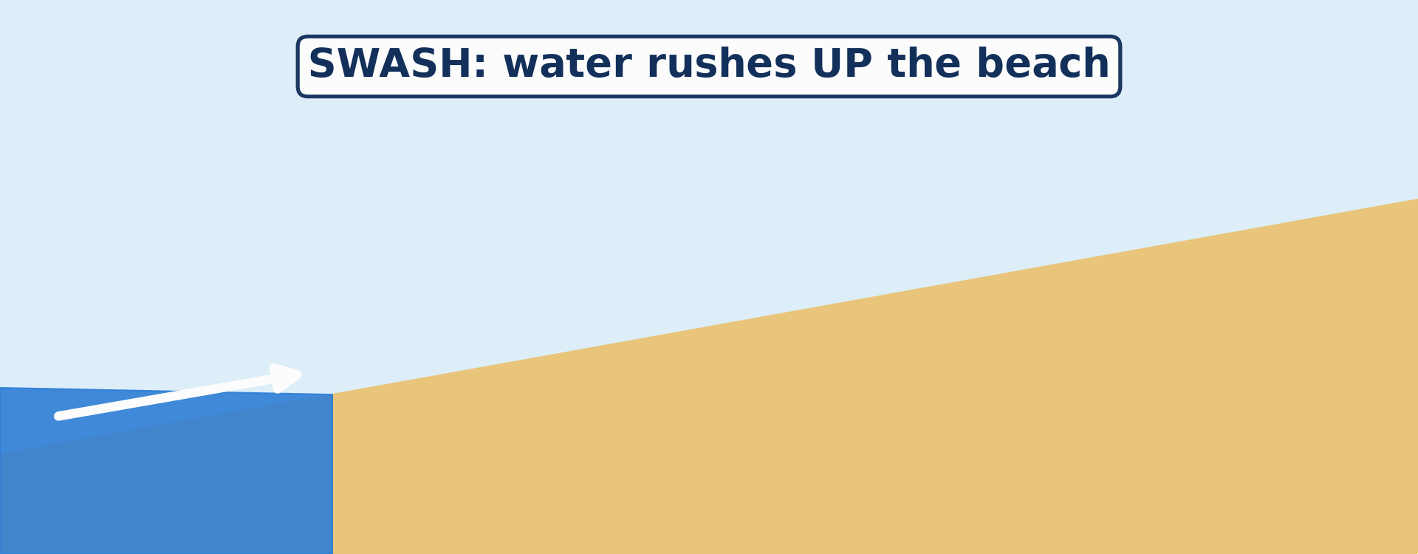
1. MEANING OF WAVES
Activity 2
Animation: the water goes up the beach and comes back.
Notes:
Activity 2. Look carefully at this animation: animation: the water goes up the beach and comes back. Watch the animation to the end; it will play again.

Slide 23
1. MEANING OF WAVES
Activity 2: Question
What do we call the water going up the beach? And coming back?
Notes:
Here is the question for Activity 2: What do we call the water going up the beach? And coming back? Take one minute to think and write your answer in your rough notebook.

Slide 24
1. MEANING OF WAVES
Activity 2: Answer
Up: the swash. Back: the backwash.
Notes:
Let us check the answer together. Up: the swash. Back: the backwash.

Slide 25

2. TYPES OF WAVES
Activity 3
Big waves in a storm.
Notes:
Activity 3. Look carefully at this picture: big waves in a storm. Observe every detail before I ask the question.

Slide 26
2. TYPES OF WAVES
Activity 3: Question
These high waves take sand away from the beach. What type of waves are they?
Notes:
Here is the question for Activity 3: These high waves take sand away from the beach. What type of waves are they? Take one minute to think and write your answer in your rough notebook.

Slide 27
2. TYPES OF WAVES
Activity 3: Answer
Destructive waves.
Notes:
Let us check the answer together. Destructive waves.

Slide 28
BOARD SUMMARY
Board Summary
Topic: Denudation Processes, Landforms and Impacts on Man
Sub-topic: Wave Action along the Coast and Impacts on Man
Lesson 23: Wave Action in Coastal Areas
Notes:
Now we are going to copy the board summary. Write the title and the headings neatly in your notebooks. I will give you enough time for each slide, so do not rush.

Slide 29
BOARD SUMMARY
1. Meaning of Waves
Waves and their parts are defined as follows:
Wave: It is a movement of the surface water of the sea caused by the wind.
Swash: It is the water that rushes up the beach after a wave breaks.
Notes:
Let us copy Meaning of Waves. Waves and their parts are defined as follows. On this slide we have Wave and Swash. Write each point on a new line, with the key term first, and explain it in your own words when we revise. When you finish, we go to the next slide.

Slide 30
BOARD SUMMARY
1. Meaning of Waves (continued)
Backwash: It is the water that flows back down the beach to the sea.
Fetch: It is the distance of open sea over which the wind blows.
Notes:
We continue with Meaning of Waves. On this slide we have Backwash and Fetch. Write each point on a new line, with the key term first, and explain it in your own words when we revise.

Slide 31
BOARD SUMMARY
2. Strength of Waves
The strength of waves depends on the following factors:
Wind speed: A stronger wind makes bigger waves.
Duration: The longer the wind blows, the bigger the waves.
Notes:
Let us copy Strength of Waves. The strength of waves depends on the following factors. On this slide we have Wind speed and Duration. Write each point on a new line, with the key term first, and explain it in your own words when we revise. When you finish, we go to the next slide.

Slide 32
BOARD SUMMARY
2. Strength of Waves (continued)
Fetch: A long fetch gives big and powerful waves.
Notes:
We continue with Strength of Waves. On this slide we have Fetch. Write each point on a new line, with the key term first, and explain it in your own words when we revise.

Slide 33
BOARD SUMMARY
3. Types of Waves
There are two types of waves:
Constructive waves: They are low waves with a strong swash, and they build up beaches.
Destructive waves: They are high waves with a strong backwash, and they erode beaches.
Notes:
Let us copy Types of Waves. There are two types of waves. On this slide we have Constructive waves and Destructive waves. Write each point on a new line, with the key term first, and explain it in your own words when we revise.

Slide 34
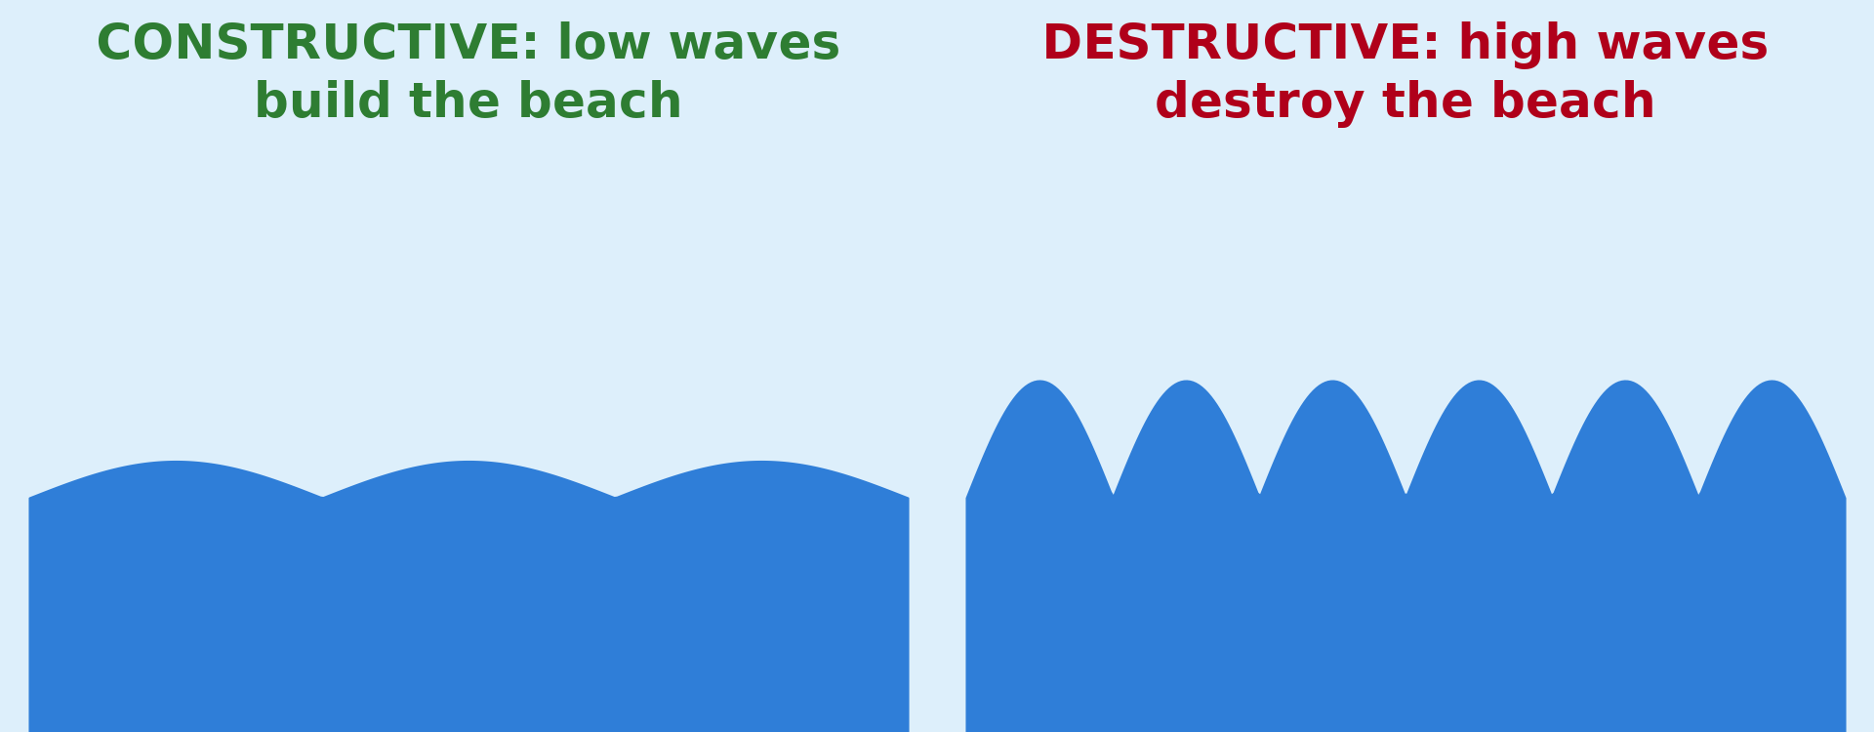
BOARD SUMMARY
3. Types of Waves
Illustration: constructive and destructive waves
Notes:
Now draw this illustration in your notebook: constructive and destructive waves. Give it a title and label it clearly.

Slide 35
FORMATIVE EVALUATION
Evaluation 1
What is the swash?
Notes:
Now let us check what you have understood. Question 1: What is the swash? Answer in your exercise book.

Slide 36
FORMATIVE EVALUATION
Expected Answer
The water that goes up the beach.
Notes:
The expected answer is: the water that goes up the beach. If you got it right, well done.

Slide 37
FORMATIVE EVALUATION
Evaluation 2
Give one difference between constructive and destructive waves.
Notes:
Now let us check what you have understood. Question 2: Give one difference between constructive and destructive waves. Answer in your exercise book.

Slide 38
FORMATIVE EVALUATION
Expected Answer
Constructive waves build the beach; destructive waves destroy it.
Notes:
The expected answer is: constructive waves build the beach; destructive waves destroy it. If you got it right, well done.

Slide 39
REMEDIATION
Remediation
Fill in the blanks:
Most waves are caused by the ______.
Water going back to the sea is the ______.
High waves that destroy the beach are ______ waves.
Notes:
For those who need more practice, fill in the blanks in your exercise book. The answers are: number 1, wind; number 2, backwash; number 3, destructive.

Slide 40
HOMEWORK
Homework
Look at photos of the coast of Limbe or Kribi. Draw a rocky part of the coast and name any holes, arches or rocks in the sea that you see.
Notes:
For your homework: Look at photos of the coast of Limbe or Kribi. Draw a rocky part of the coast and name any holes, arches or rocks in the sea that you see. We shall correct it at the beginning of our next lesson.

Slide 41
NEXT LESSON
Next Lesson
Our next lesson will be on:
Lesson 24: Main Erosional Processes and Features of Wave Action
Notes:
Our next lesson will be on Lesson 24: Main Erosional Processes and Features of Wave Action. Thank you for your attention, and see you next time.

Slide 42
BILINGUAL GAME
Bilingual Game (Jeu Bilingue)
English | Français
Wave | La vague
Coast | La côte
Beach | La plage
Swash | Le jet de rive
Backwash | La nappe de retrait / le ressac
Fetch | Le fetch
Storm | La tempête
Current | Le courant
Notes:
Let us play the bilingual game. I say a word in English, and you give me the French word. Then we do the reverse.

Slide 43
LOGBOOK
Official Logbook (1/2)
Module / Topic | Denudation Processes, Landforms and Impacts on Man
Lesson Title | Lesson 23: Wave Action in Coastal Areas
Expected Learning Outcomes | Define a wave and explain its cause. Explain the factors of the strength of waves. Distinguish constructive and destructive waves.
Competence | Learners are able to explain how waves form and to recognise dangerous waves on a beach, for example at Kribi or Limbe.
Notes:
I record this information in the official logbook of the class after the lesson.

Slide 44
LOGBOOK
Official Logbook (2/2)
Matter Taught | Meaning of Waves; Strength of Waves; Types of Waves.
Evaluation | Formative evaluation and remediation exercise.
Homework | Look at photos of the coast of Limbe or Kribi. Draw a rocky part of the coast and name any holes, arches or rocks in the sea that you see.
Enrolment / Present / Absent | ____ / ____ / ____
Achievement | To be completed after the lesson.
Notes:
I complete the second page of the logbook: the matter taught, the evaluation, the homework and the attendance.

Slide 45
TEACHER'S NOTE
Teacher's Note
Timing: Homework correction, plan, objectives 4 min | Recall, situation, action 6 min | 3 activities 12 min | Board summary (copying) 15 min | Evaluation, remediation 5 min | Homework, next lesson 3 min | Logbook 5 min
Activity 2 is an animation (GIF): it plays automatically in slide-show mode.
Without the projector (Activity 1): blow on a plate of water.
Without the projector (Activity 2): draw a beach with an arrow up and an arrow down.
Without the projector (Activity 3): compare a calm day and a stormy day at the beach.
Notes:
This slide is for me, the teacher: it gives the timing of the lesson and what to do if the projector is not available.

Slide 46
REFERENCES
References
National Geography Syllabus (MINESEC), Form 4 — Denudation Processes, Landforms and Impacts on Man.
Teacher's lesson notes (Form 4), checked and corrected where necessary.
Photo, Activity 1: “Carpinteria Bluffs, California (5)” by Ken Lund, CC BY-SA 2.0, via Flickr (https://www.flickr.com/photos/75683070@N00/4063056130)
Photo, Activity 3: “Wave Explosion, Monterey Bay, California” by John William Hammond, CC BY-NC-SA 2.0, via Flickr (https://www.flickr.com/photos/8398907@N02/16328053911)
Diagrams and animations: drawn for this lesson (Geography Department).
Notes:
These are the references and picture credits used to prepare this lesson.

