Slide 1
FORM 4
GEOGRAPHY
Lesson 24
Main Erosional Processes and Features of Wave Action
Notes:
Good morning, class, and welcome to our geography lesson. I am your geography teacher, Mr Kamdem. Today we are starting Lesson 24: Main Erosional Processes and Features of Wave Action.

Slide 2
CLASS INFO
Class, Chapter and Duration
Class | Form 4
Chapter | Denudation Processes, Landforms and Impacts on Man — Wave Action along the Coast and Impacts on Man
Duration | 50 minutes
Notes:
This lesson is for Form 4. It belongs to Denudation Processes, Landforms and Impacts on Man — Wave Action along the Coast and Impacts on Man. We shall need 50 minutes to cover it.

Slide 3
IDENTIFICATION
Lesson Identification
Topic | Denudation Processes, Landforms and Impacts on Man
Sub-topic | Wave Action along the Coast and Impacts on Man
Lesson | Lesson 24: Main Erosional Processes and Features of Wave Action
Notions / Concepts | Capes and bays, cliffs, wave-cut platforms, caves, arches, stacks and stumps.
Syllabus focus | Erosional processes of waves; erosional features (use local examples).
Competence | Learners are able to recognise and explain the landforms of a rocky coast, and to respect the dangers of cliffs and caves.
Notes:
Our topic is Denudation Processes, Landforms and Impacts on Man, and the sub-topic is Wave Action along the Coast and Impacts on Man. The key notions we shall use today are: capes and bays, cliffs, wave-cut platforms, caves, arches, stacks and stumps. At the end, you should be able to do this: learners are able to recognise and explain the landforms of a rocky coast, and to respect the dangers of cliffs and caves.

Slide 4

HOMEWORK CORRECTION
Correction of the Homework
Question (Lesson 23: Wave Action in Coastal Areas):
Look at photos of the coast of Limbe or Kribi. Draw a rocky part of the coast and name any holes, arches or rocks in the sea that you see.
Notes:
Before we start the new lesson, let us correct the homework I gave you at the end of Lesson 23: Wave Action in Coastal Areas. The question was: Look at photos of the coast of Limbe or Kribi. Draw a rocky part of the coast and name any holes, arches or rocks in the sea that you see. Take out your exercise books.

Slide 5
HOMEWORK CORRECTION
Correction: Possible Answer
The drawing should show cliffs with caves (holes at the bottom), perhaps an arch and rocks standing in the sea (stacks), as along the rocky coast near Limbe.
Notes:
Here is a good answer. The drawing should show cliffs with caves (holes at the bottom), perhaps an arch and rocks standing in the sea (stacks), as along the rocky coast near Limbe. Compare it with your own answer and correct your work in red.

Slide 6
LESSON PLAN
Lesson Plan
Correction of the homework
Objectives and recall
Real-life situation and action to take
Learning activities
Board summary
Evaluation, remediation and homework
Notes:
Here is the plan of our lesson today. First, we shall correct the homework. Then we shall look at the objectives and recall what you already know. After that, we shall study a situation from real life and the action to take, and do the learning activities. Finally, we shall copy the board summary, do the evaluation and the remediation, and I will give you the homework.

Slide 7
OBJECTIVES
Objectives
By the end of this lesson, you should be able to:
Explain the four erosional processes of waves.
Explain the formation of capes and bays, cliffs and wave-cut platforms.
Notes:
Take your time to copy this part; we will continue together.

Slide 8
OBJECTIVES
Objectives (continued)
Explain the formation of caves, arches, stacks and stumps.
Notes:
By the end of this lesson, you should be able to do three things. Number 1: explain the four erosional processes of waves. Number 2: explain the formation of capes and bays, cliffs and wave-cut platforms. Number 3: explain the formation of caves, arches, stacks and stumps.

Slide 9
PREVIOUS KNOWLEDGE
Previous Knowledge
Destructive waves erode the coast.
The backwash of destructive waves is stronger than the swash.
Rivers erode by hydraulic action, abrasion, attrition and solution.
Notes:
Let us first remember what you already know. Destructive waves erode the coast. The backwash of destructive waves is stronger than the swash. Rivers erode by hydraulic action, abrasion, attrition and solution. Keep this in mind, because we shall build on it today.

Slide 10
REAL-LIFE SITUATION
Situation in Real Life
On holiday in Limbe, Rahila sees big waves crash against the rocky coast. At the bottom of a rock face, the waves have cut a hollow and small caves.
Notes:
Listen carefully to this situation from real life. On holiday in Limbe, Rahila sees big waves crash against the rocky coast. At the bottom of a rock face, the waves have cut a hollow and small caves. Think about it, because I am going to ask you some questions.

Slide 11
REAL-LIFE SITUATION
Situation: Question 1
What is the problem in the situation?
Notes:
Question 1: What is the problem in the situation? Think for a moment, then raise your hand to answer.

Slide 12
REAL-LIFE SITUATION
Answer
Rahila wonders how waves can cut hard rock.
Notes:
Good. Rahila wonders how waves can cut hard rock.

Slide 13
REAL-LIFE SITUATION
Situation: Question 2
What did the waves make?
Notes:
Question 2: What did the waves make? Think for a moment, then raise your hand to answer.

Slide 14
REAL-LIFE SITUATION
Answer
A hollow and small caves.
Notes:
Good. A hollow and small caves.

Slide 15
REAL-LIFE SITUATION
Situation: Question 3
What will happen to the caves after many years?
Notes:
Question 3: What will happen to the caves after many years? Think for a moment, then raise your hand to answer.

Slide 16
REAL-LIFE SITUATION
Possible Answer
They will become arches and then stacks.
Notes:
Good. They will become arches and then stacks.

Slide 17
ACTION TO TAKE
Action to Take
Stay away from the edges of cliffs, which can collapse.
Notes:
From this situation, the action we are working towards in this lesson is the following: stay away from the edges of cliffs, which can collapse.

Slide 18
JUSTIFICATION
Justification of the Lesson
This lesson helps us to know the landforms made by wave erosion.
Notes:
Why is this lesson important for you? This lesson helps us to know the landforms made by wave erosion.

Slide 19
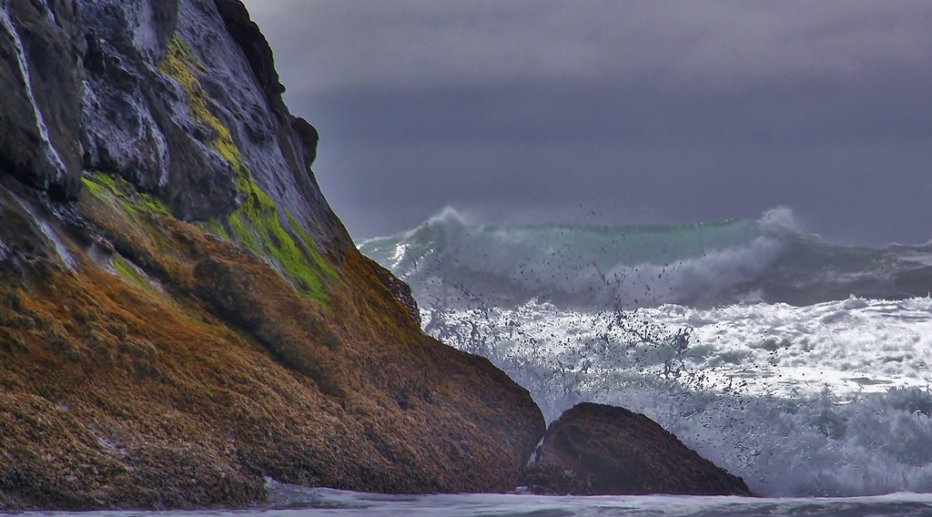
2. CLIFFS
Activity 1
Waves hit a cliff.
Notes:
Activity 1. Look carefully at this picture: waves hit a cliff. Observe every detail before I ask the question.

Slide 20
2. CLIFFS
Activity 1: Question
How do waves make a cliff?
Notes:
Here is the question for Activity 1: How do waves make a cliff? Take one minute to think and write your answer in your rough notebook.

Slide 21
2. CLIFFS
Activity 1: Answer
They cut the bottom of the rock; the top falls; a steep cliff is left.
Notes:
Let us check the answer together. They cut the bottom of the rock; the top falls; a steep cliff is left.

Slide 22
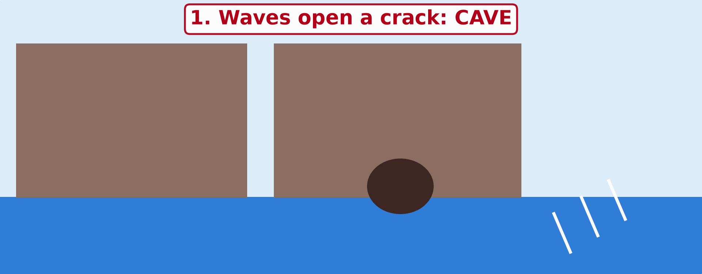
2. CAVE, ARCH AND STACK
Activity 2
Animation: a headland is worn away.
Notes:
Activity 2. Look carefully at this animation: animation: a headland is worn away. Watch the animation to the end; it will play again.

Slide 23
2. CAVE, ARCH AND STACK
Activity 2: Question
Put in order: stack, cave, stump, arch.
Notes:
Here is the question for Activity 2: Put in order: stack, cave, stump, arch. Take one minute to think and write your answer in your rough notebook.

Slide 24
2. CAVE, ARCH AND STACK
Activity 2: Answer
Cave, arch, stack, stump.
Notes:
Let us check the answer together. Cave, arch, stack, stump.

Slide 25
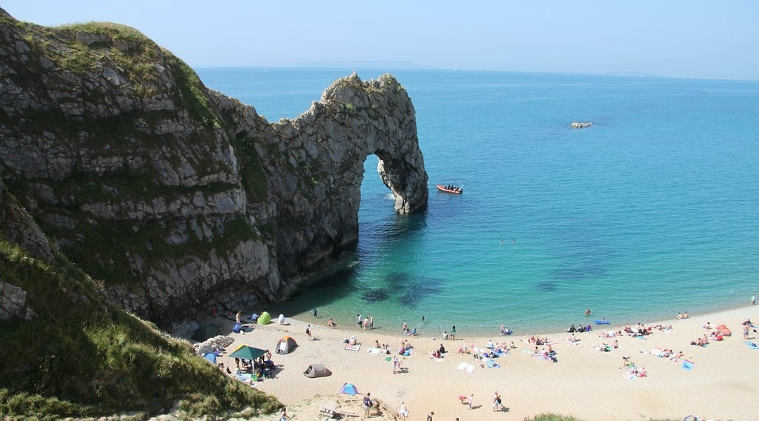
2. CAVE, ARCH AND STACK
Activity 3
A rock with a hole through it, on the coast.
Notes:
Activity 3. Look carefully at this picture: a rock with a hole through it, on the coast. Observe every detail before I ask the question.

Slide 26
2. CAVE, ARCH AND STACK
Activity 3: Question
The waves have cut a hole right through the rock. What is it called?
Notes:
Here is the question for Activity 3: The waves have cut a hole right through the rock. What is it called? Take one minute to think and write your answer in your rough notebook.

Slide 27
2. CAVE, ARCH AND STACK
Activity 3: Answer
An arch.
Notes:
Let us check the answer together. An arch.

Slide 28
BOARD SUMMARY
Board Summary
Topic: Denudation Processes, Landforms and Impacts on Man
Sub-topic: Wave Action along the Coast and Impacts on Man
Lesson 24: Main Erosional Processes and Features of Wave Action
Notes:
Now we are going to copy the board summary. Write the title and the headings neatly in your notebooks. I will give you enough time for each slide, so do not rush.

Slide 29
BOARD SUMMARY
1. Erosional Processes of Waves
Waves erode the coast through the following processes:
Hydraulic action: The force of the waves compresses air in cracks and breaks the rock.
Abrasion: Stones thrown by the waves wear away the cliff.
Notes:
Let us copy Erosional Processes of Waves. Waves erode the coast through the following processes. On this slide we have Hydraulic action and Abrasion. Write each point on a new line, with the key term first, and explain it in your own words when we revise. When you finish, we go to the next slide.

Slide 30
BOARD SUMMARY
1. Erosional Processes of Waves (continued)
Attrition: Stones hit each other and become small and round.
Solution: Sea water dissolves some rocks, such as limestone.
Notes:
We continue with Erosional Processes of Waves. On this slide we have Attrition and Solution. Write each point on a new line, with the key term first, and explain it in your own words when we revise.

Slide 31
BOARD SUMMARY
2. Erosional Features
Wave erosion forms the following features:
Capes and bays: Hard rock remains as capes while soft rock is worn back into bays.
Cliff and wave-cut platform: Waves cut the bottom of the rock, the top collapses and a flat platform is left.
Notes:
Let us copy Erosional Features. Wave erosion forms the following features. On this slide we have Capes and bays and Cliff and wave-cut platform. Write each point on a new line, with the key term first, and explain it in your own words when we revise. When you finish, we go to the next slide.

Slide 32
BOARD SUMMARY
2. Erosional Features (continued)
Cave, arch, stack and stump: A cave is enlarged into an arch, the arch collapses into a stack, and the stack is worn down into a stump.
Notes:
We continue with Erosional Features. On this slide we have Cave, arch, stack and stump. Write each point on a new line, with the key term first, and explain it in your own words when we revise.

Slide 33
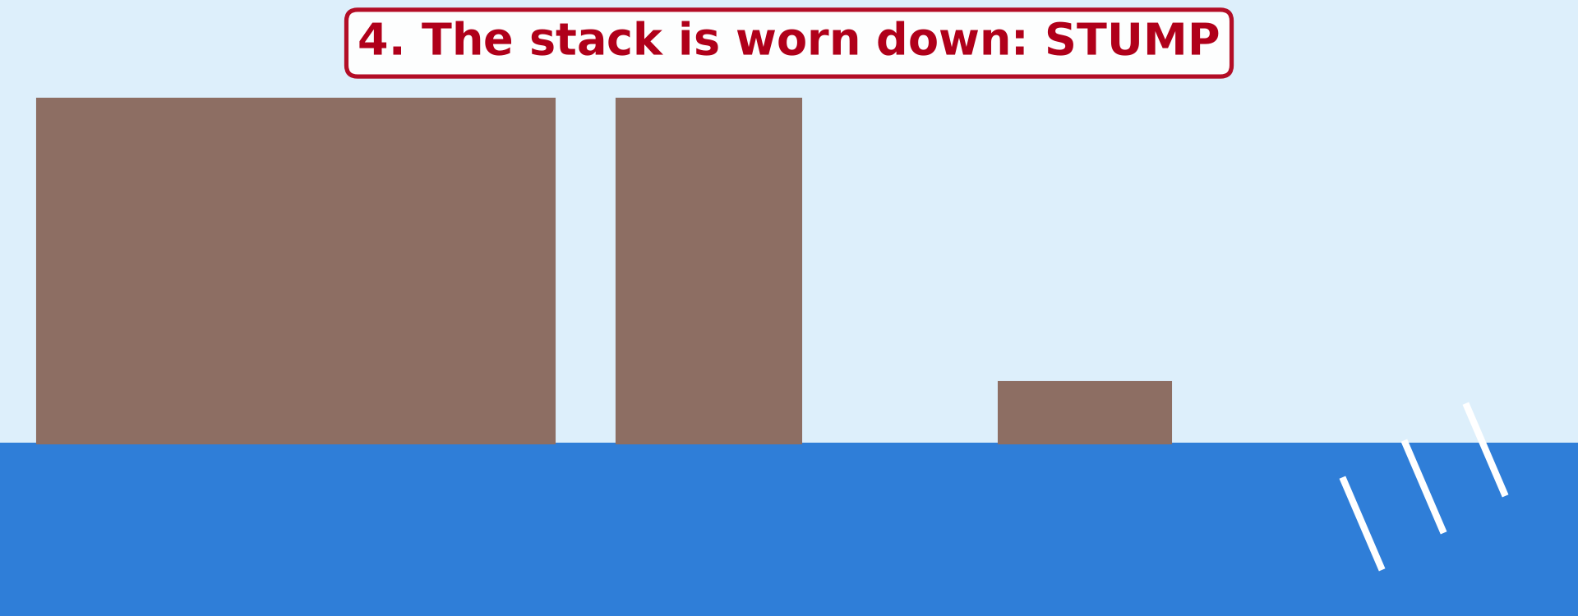
BOARD SUMMARY
2. Erosional Features
Illustration: erosion of a headland
Notes:
Now draw this illustration in your notebook: erosion of a headland. Give it a title and label it clearly.

Slide 34
FORMATIVE EVALUATION
Evaluation 1
Put in order: arch, stump, cave, stack.
Notes:
Now let us check what you have understood. Question 1: Put in order: arch, stump, cave, stack. Answer in your exercise book.

Slide 35
FORMATIVE EVALUATION
Expected Answer
Cave, arch, stack, stump.
Notes:
The expected answer is: cave, arch, stack, stump. If you got it right, well done.

Slide 36
FORMATIVE EVALUATION
Evaluation 2
What is hydraulic action?
Notes:
Now let us check what you have understood. Question 2: What is hydraulic action? Answer in your exercise book.

Slide 37
FORMATIVE EVALUATION
Expected Answer
The force of the waves breaking the rock.
Notes:
The expected answer is: the force of the waves breaking the rock. If you got it right, well done.

Slide 38
REMEDIATION
Remediation
Fill in the blanks:
A steep rock face on the coast is a ______.
A cave that goes through a headland becomes an ______.
A pillar of rock in the sea is a ______.
Notes:
For those who need more practice, fill in the blanks in your exercise book. The answers are: number 1, cliff; number 2, arch; number 3, stack.

Slide 39
HOMEWORK
Homework
Put some sand at one end of a tray of water and make waves from one corner. Write where the sand moves.
Notes:
For your homework: Put some sand at one end of a tray of water and make waves from one corner. Write where the sand moves. We shall correct it at the beginning of our next lesson.

Slide 40
NEXT LESSON
Next Lesson
Our next lesson will be on:
Lesson 25: Main Depositional Features of Wave Action
Notes:
Our next lesson will be on Lesson 25: Main Depositional Features of Wave Action. Thank you for your attention, and see you next time.

Slide 41
BILINGUAL GAME
Bilingual Game (Jeu Bilingue)
English | Français
Cliff | La falaise
Cape / headland | Le cap
Bay | La baie
Cave | La grotte
Arch | L'arche
Stack | L'aiguille / le stack
Wave-cut platform | La plate-forme d'abrasion
Notch | L'encoche
Notes:
Let us play the bilingual game. I say a word in English, and you give me the French word. Then we do the reverse.

Slide 42
LOGBOOK
Official Logbook (1/2)
Module / Topic | Denudation Processes, Landforms and Impacts on Man
Lesson Title | Lesson 24: Main Erosional Processes and Features of Wave Action
Expected Learning Outcomes | Explain the four erosional processes of waves. Explain the formation of capes and bays, cliffs and wave-cut platforms. Explain the formation of caves, arches, stacks and stumps.
Competence | Learners are able to recognise and explain the landforms of a rocky coast, and to respect the dangers of cliffs and caves.
Notes:
I record this information in the official logbook of the class after the lesson.

Slide 43
LOGBOOK
Official Logbook (2/2)
Matter Taught | Erosional Processes of Waves; Erosional Features.
Evaluation | Formative evaluation and remediation exercise.
Homework | Put some sand at one end of a tray of water and make waves from one corner. Write where the sand moves.
Enrolment / Present / Absent | ____ / ____ / ____
Achievement | To be completed after the lesson.
Notes:
I complete the second page of the logbook: the matter taught, the evaluation, the homework and the attendance.

Slide 44
TEACHER'S NOTE
Teacher's Note
Timing: Homework correction, plan, objectives 4 min | Recall, situation, action 6 min | 3 activities 12 min | Board summary (copying) 15 min | Evaluation, remediation 5 min | Homework, next lesson 3 min | Logbook 5 min
Activity 2 is an animation (GIF): it plays automatically in slide-show mode.
Without the projector (Activity 1): draw a rock with a hollow at the bottom.
Without the projector (Activity 2): draw the four steps on the board.
Without the projector (Activity 3): use the drawing on the board.
Notes:
This slide is for me, the teacher: it gives the timing of the lesson and what to do if the projector is not available.

Slide 45
REFERENCES
References
National Geography Syllabus (MINESEC), Form 4 — Denudation Processes, Landforms and Impacts on Man.
Teacher's lesson notes (Form 4), checked and corrected where necessary.
Photo, Activity 1: “Forces of Nature” by liquidcrash, CC BY-SA 2.0, via Flickr (https://www.flickr.com/photos/124320023@N06/13938903780)
Photo, Activity 3: “Jurassic Coast Coastal Landform - Sea Arch - Durdle Door” by Richard Allaway, CC BY 2.0, via Flickr (https://www.flickr.com/photos/16287002@N00/9503598134)
Diagrams and animations: drawn for this lesson (Geography Department).
Notes:
These are the references and picture credits used to prepare this lesson.

