Slide 1
FORM 4
GEOGRAPHY
Lesson 25
Main Depositional Features of Wave Action
Notes:
Good morning, class, and welcome to our geography lesson. I am your geography teacher, Mr Kamdem. Today we are starting Lesson 25: Main Depositional Features of Wave Action.

Slide 2
CLASS INFO
Class, Chapter and Duration
Class | Form 4
Chapter | Denudation Processes, Landforms and Impacts on Man — Wave Action along the Coast and Impacts on Man
Duration | 50 minutes
Notes:
This lesson is for Form 4. It belongs to Denudation Processes, Landforms and Impacts on Man — Wave Action along the Coast and Impacts on Man. We shall need 50 minutes to cover it.

Slide 3
IDENTIFICATION
Lesson Identification
Topic | Denudation Processes, Landforms and Impacts on Man
Sub-topic | Wave Action along the Coast and Impacts on Man
Lesson | Lesson 25: Main Depositional Features of Wave Action
Notions / Concepts | Beach, spits, bars, tombolos, longshore drift.
Syllabus focus | Major depositional process (longshore drift); depositional features.
Competence | Learners are able to explain how beaches and spits are built, and why sand moves along a coast.
Notes:
Our topic is Denudation Processes, Landforms and Impacts on Man, and the sub-topic is Wave Action along the Coast and Impacts on Man. The key notions we shall use today are: beach, spits, bars, tombolos, longshore drift. At the end, you should be able to do this: learners are able to explain how beaches and spits are built, and why sand moves along a coast.

Slide 4

HOMEWORK CORRECTION
Correction of the Homework
Question (Lesson 24: Main Erosional Processes and Features of Wave Action):
Put some sand at one end of a tray of water and make waves from one corner. Write where the sand moves.
Notes:
Before we start the new lesson, let us correct the homework I gave you at the end of Lesson 24: Main Erosional Processes and Features of Wave Action. The question was: Put some sand at one end of a tray of water and make waves from one corner. Write where the sand moves. Take out your exercise books.

Slide 5
HOMEWORK CORRECTION
Correction: Possible Answer
The sand moves along the tray in the direction the waves travel, in a zigzag: this is longshore drift.
Notes:
Here is a good answer. The sand moves along the tray in the direction the waves travel, in a zigzag: this is longshore drift. Compare it with your own answer and correct your work in red.

Slide 6
LESSON PLAN
Lesson Plan
Correction of the homework
Objectives and recall
Real-life situation and action to take
Learning activities
Board summary
Evaluation, remediation and homework
Notes:
Here is the plan of our lesson today. First, we shall correct the homework. Then we shall look at the objectives and recall what you already know. After that, we shall study a situation from real life and the action to take, and do the learning activities. Finally, we shall copy the board summary, do the evaluation and the remediation, and I will give you the homework.

Slide 7
OBJECTIVES
Objectives
By the end of this lesson, you should be able to:
Explain longshore drift.
Explain the formation of beaches, spits, bars and tombolos.
Give examples of these features.
Notes:
By the end of this lesson, you should be able to do three things. Number 1: explain longshore drift. Number 2: explain the formation of beaches, spits, bars and tombolos. Number 3: give examples of these features.

Slide 8
PREVIOUS KNOWLEDGE
Previous Knowledge
Constructive waves build beaches.
Waves erode rocky coasts and form cliffs, caves, arches and stacks.
The swash goes up the beach; the backwash goes down.
Notes:
Let us first remember what you already know. Constructive waves build beaches. Waves erode rocky coasts and form cliffs, caves, arches and stacks. The swash goes up the beach; the backwash goes down. Keep this in mind, because we shall build on it today.

Slide 9
REAL-LIFE SITUATION
Situation in Real Life
In Kribi, Maïmouna builds a sandcastle. The waves reach the beach at an angle. After an hour, some sand of her castle has moved along the beach.
Notes:
Listen carefully to this situation from real life. In Kribi, Maïmouna builds a sandcastle. The waves reach the beach at an angle. After an hour, some sand of her castle has moved along the beach. Think about it, because I am going to ask you some questions.

Slide 10
REAL-LIFE SITUATION
Situation: Question 1
What is the problem in the situation?
Notes:
Question 1: What is the problem in the situation? Think for a moment, then raise your hand to answer.

Slide 11
REAL-LIFE SITUATION
Answer
Maïmouna does not know why the sand moved along the beach.
Notes:
Good. Maïmouna does not know why the sand moved along the beach.

Slide 12
REAL-LIFE SITUATION
Situation: Question 2
How do the waves reach the beach?
Notes:
Question 2: How do the waves reach the beach? Think for a moment, then raise your hand to answer.

Slide 13
REAL-LIFE SITUATION
Answer
At an angle.
Notes:
Good. At an angle.

Slide 14
REAL-LIFE SITUATION
Situation: Question 3
What do we call this movement of sand?
Notes:
Question 3: What do we call this movement of sand? Think for a moment, then raise your hand to answer.

Slide 15
REAL-LIFE SITUATION
Possible Answer
Longshore drift.
Notes:
Good. Longshore drift.

Slide 16
ACTION TO TAKE
Action to Take
Protect beaches by not removing sand from them.
Notes:
From this situation, the action we are working towards in this lesson is the following: protect beaches by not removing sand from them.

Slide 17
JUSTIFICATION
Justification of the Lesson
This lesson helps us to know the landforms made when waves drop sand.
Notes:
Why is this lesson important for you? This lesson helps us to know the landforms made when waves drop sand.

Slide 18
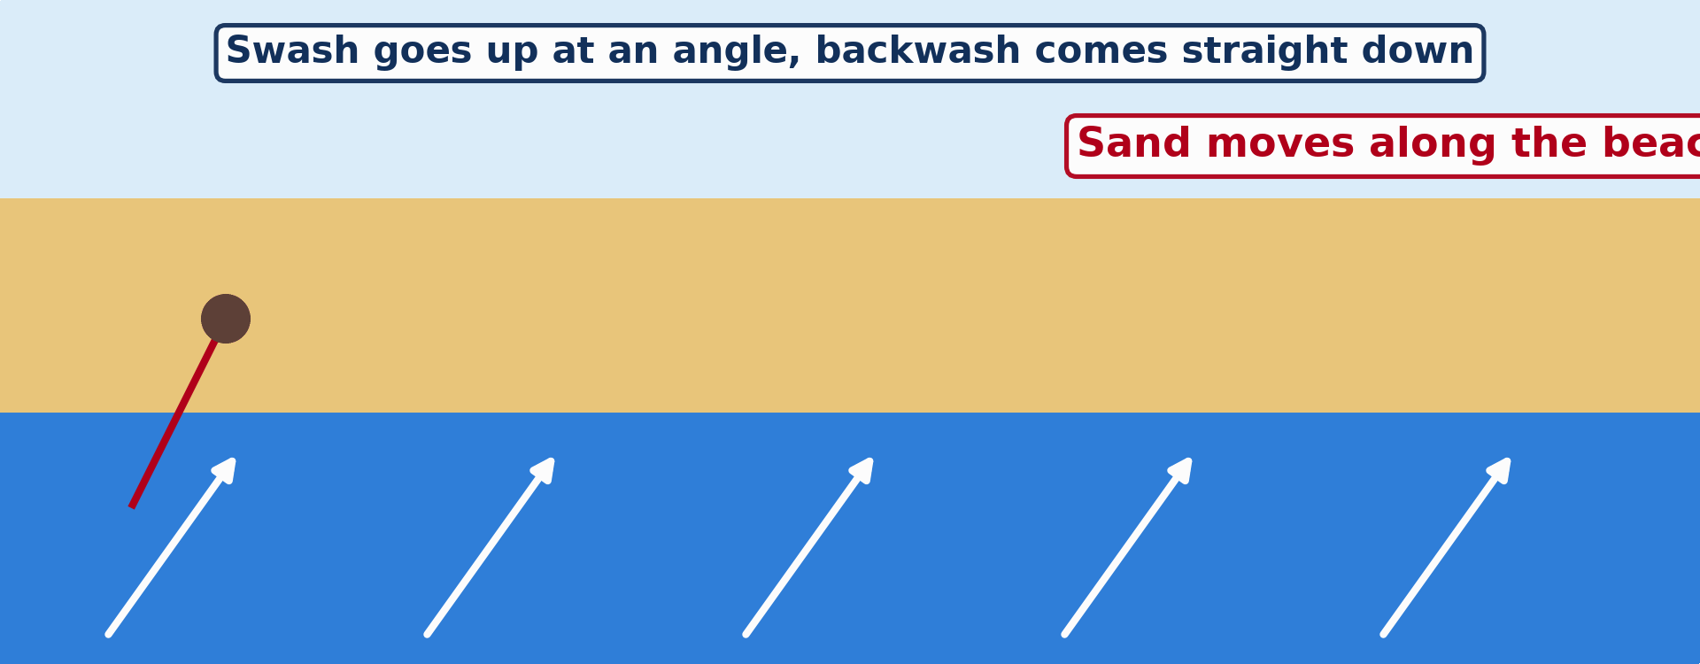
1. LONGSHORE DRIFT
Activity 1
Animation: sand moves along the beach.
Notes:
Activity 1. Look carefully at this animation: animation: sand moves along the beach. Watch the animation to the end; it will play again.

Slide 19
1. LONGSHORE DRIFT
Activity 1: Question
How does the sand move along the beach?
Notes:
Here is the question for Activity 1: How does the sand move along the beach? Take one minute to think and write your answer in your rough notebook.

Slide 20
1. LONGSHORE DRIFT
Activity 1: Answer
The swash pushes it up at an angle; the backwash brings it straight down.
Notes:
Let us check the answer together. The swash pushes it up at an angle; the backwash brings it straight down.

Slide 21

2. SPITS
Activity 2
A long, narrow strip of sand and land in the sea (England).
Notes:
Activity 2. Look carefully at this picture: a long, narrow strip of sand and land in the sea (England). Observe every detail before I ask the question.

Slide 22
2. SPITS
Activity 2: Question
This strip of sand is joined to the land at one end. What is it?
Notes:
Here is the question for Activity 2: This strip of sand is joined to the land at one end. What is it? Take one minute to think and write your answer in your rough notebook.

Slide 23
2. SPITS
Activity 2: Answer
A spit.
Notes:
Let us check the answer together. A spit.

Slide 24
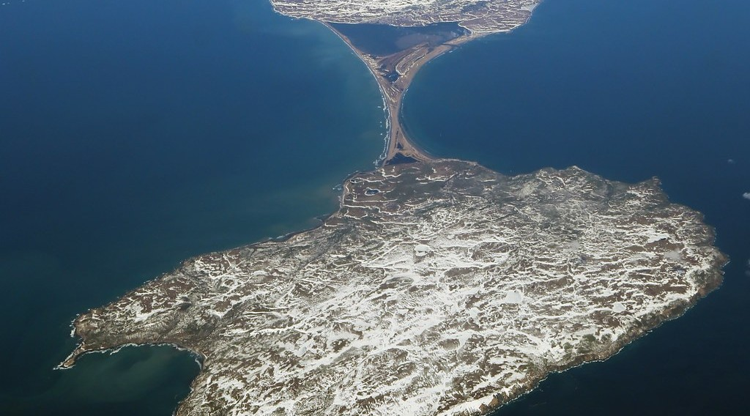
2. TOMBOLOS
Activity 3
Sand joins an island to the land.
Notes:
Activity 3. Look carefully at this picture: sand joins an island to the land. Observe every detail before I ask the question.

Slide 25
2. TOMBOLOS
Activity 3: Question
What do we call sand that joins an island to the land?
Notes:
Here is the question for Activity 3: What do we call sand that joins an island to the land? Take one minute to think and write your answer in your rough notebook.

Slide 26
2. TOMBOLOS
Activity 3: Answer
A tombolo.
Notes:
Let us check the answer together. A tombolo.

Slide 27
BOARD SUMMARY
Board Summary
Topic: Denudation Processes, Landforms and Impacts on Man
Sub-topic: Wave Action along the Coast and Impacts on Man
Lesson 25: Main Depositional Features of Wave Action
Notes:
Now we are going to copy the board summary. Write the title and the headings neatly in your notebooks. I will give you enough time for each slide, so do not rush.

Slide 28
BOARD SUMMARY
1. Longshore Drift
Longshore drift takes place in the following steps:
Meaning: Longshore drift is the movement of sand and pebbles along the coast by waves.
Step 1: Waves reach the beach at an angle because of the wind.
Notes:
Let us copy Longshore Drift. Longshore drift takes place in the following steps. On this slide we have Meaning and Step 1. Write each point on a new line, with the key term first, and explain it in your own words when we revise. When you finish, we go to the next slide.

Slide 29
BOARD SUMMARY
1. Longshore Drift (continued)
Step 2: The swash pushes sand up the beach at the same angle.
Step 3: The backwash brings the sand straight back down, so it moves along the beach in zigzags.
Notes:
We continue with Longshore Drift. On this slide we have Step 2 and Step 3. Write each point on a new line, with the key term first, and explain it in your own words when we revise.

Slide 30
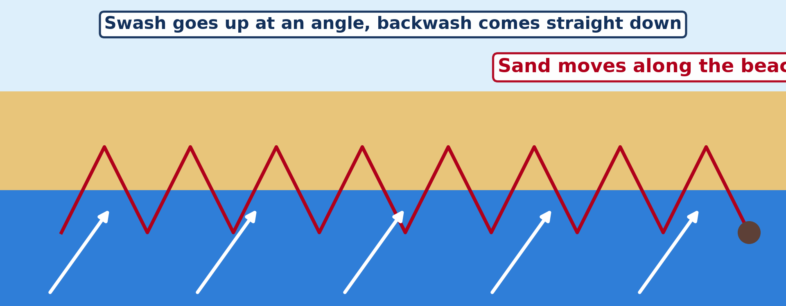
BOARD SUMMARY
1. Longshore Drift
Illustration: longshore drift
Notes:
Now draw this illustration in your notebook: longshore drift. Give it a title and label it clearly.

Slide 31
BOARD SUMMARY
2. Depositional Features
Wave deposition forms the following features:
Beach: It is a gentle slope of sand and pebbles between low and high tide, like the beaches of Kribi.
Spit: It is a long strip of sand joined to the land at one end.
Notes:
Let us copy Depositional Features. Wave deposition forms the following features. On this slide we have Beach and Spit. Write each point on a new line, with the key term first, and explain it in your own words when we revise. When you finish, we go to the next slide.

Slide 32
BOARD SUMMARY
2. Depositional Features (continued)
Bar: It is a strip of sand that grows across a bay.
Tombolo: It is a strip of sand that joins an island to the mainland.
Notes:
We continue with Depositional Features. On this slide we have Bar and Tombolo. Write each point on a new line, with the key term first, and explain it in your own words when we revise.

Slide 33
FORMATIVE EVALUATION
Evaluation 1
What is longshore drift?
Notes:
Now let us check what you have understood. Question 1: What is longshore drift? Answer in your exercise book.

Slide 34
FORMATIVE EVALUATION
Expected Answer
The movement of sand along the beach by waves.
Notes:
The expected answer is: the movement of sand along the beach by waves. If you got it right, well done.

Slide 35
FORMATIVE EVALUATION
Evaluation 2
What is the difference between a spit and a bar?
Notes:
Now let us check what you have understood. Question 2: What is the difference between a spit and a bar? Answer in your exercise book.

Slide 36
FORMATIVE EVALUATION
Expected Answer
A spit is joined at one end; a bar closes a bay.
Notes:
The expected answer is: a spit is joined at one end; a bar closes a bay. If you got it right, well done.

Slide 37
REMEDIATION
Remediation
Fill in the blanks:
The movement of sand along the beach is ______ drift.
A strip of sand joined at one end is a ______.
Notes:
Take your time to copy this part; we will continue together.

Slide 38
REMEDIATION
Remediation (continued)
Sand joining an island to the land is a ______.
Notes:
For those who need more practice, fill in the blanks in your exercise book. The answers are: number 1, longshore; number 2, spit; number 3, tombolo.

Slide 39
HOMEWORK
Homework
List five goods sold in the market of Garoua that come from abroad. Ask a trader through which port they entered Cameroon.
Notes:
For your homework: List five goods sold in the market of Garoua that come from abroad. Ask a trader through which port they entered Cameroon. We shall correct it at the beginning of our next lesson.

Slide 40
NEXT LESSON
Next Lesson
Our next lesson will be on:
Lesson 26: Impact of Wave Action on Human Development along Coastal Areas
Notes:
Our next lesson will be on Lesson 26: Impact of Wave Action on Human Development along Coastal Areas. Thank you for your attention, and see you next time.

Slide 41
BILINGUAL GAME
Bilingual Game (Jeu Bilingue)
English | Français
Longshore drift | La dérive littorale
Beach | La plage
Spit | La flèche littorale
Bar | Le cordon littoral
Lagoon | La lagune
Tombolo | Le tombolo
Sand | Le sable
Pebble | Le galet
Notes:
Let us play the bilingual game. I say a word in English, and you give me the French word. Then we do the reverse.

Slide 42
LOGBOOK
Official Logbook (1/2)
Module / Topic | Denudation Processes, Landforms and Impacts on Man
Lesson Title | Lesson 25: Main Depositional Features of Wave Action
Expected Learning Outcomes | Explain longshore drift. Explain the formation of beaches, spits, bars and tombolos. Give examples of these features.
Competence | Learners are able to explain how beaches and spits are built, and why sand moves along a coast.
Notes:
I record this information in the official logbook of the class after the lesson.

Slide 43
LOGBOOK
Official Logbook (2/2)
Matter Taught | Longshore Drift; Depositional Features.
Evaluation | Formative evaluation and remediation exercise.
Homework | List five goods sold in the market of Garoua that come from abroad. Ask a trader through which port they entered Cameroon.
Enrolment / Present / Absent | ____ / ____ / ____
Achievement | To be completed after the lesson.
Notes:
I complete the second page of the logbook: the matter taught, the evaluation, the homework and the attendance.

Slide 44
TEACHER'S NOTE
Teacher's Note
Timing: Homework correction, plan, objectives 4 min | Recall, situation, action 6 min | 3 activities 12 min | Board summary (copying) 15 min | Evaluation, remediation 5 min | Homework, next lesson 3 min | Logbook 5 min
Activity 1 is an animation (GIF): it plays automatically in slide-show mode.
Without the projector (Activity 1): draw a zigzag line along a beach.
Without the projector (Activity 2): draw a coast with a finger of sand.
Without the projector (Activity 3): draw an island joined to the coast by sand.
Notes:
This slide is for me, the teacher: it gives the timing of the lesson and what to do if the projector is not available.

Slide 45
REFERENCES
References
National Geography Syllabus (MINESEC), Form 4 — Denudation Processes, Landforms and Impacts on Man.
Teacher's lesson notes (Form 4), checked and corrected where necessary.
Photo, Activity 2: “Coastal defences no longer being maintained - Why? Spurn Head, Yorkshi” by Richard Allaway, CC BY 2.0, via Flickr (https://www.flickr.com/photos/16287002@N00/6605676971)
Photo, Activity 3: “2017_04_10_lhr-ewr_083” by dsearls, CC BY 2.0, via Flickr (https://www.flickr.com/photos/52614599@N00/33953233846)
Diagrams and animations: drawn for this lesson (Geography Department).
Notes:
These are the references and picture credits used to prepare this lesson.

