Slide 1
FORM 4
GEOGRAPHY
Lesson 26
Impact of Wave Action on Human Development along Coastal Areas
Notes:
Good morning, class, and welcome to our geography lesson. I am your geography teacher, Mr Kamdem. Today we are starting Lesson 26: Impact of Wave Action on Human Development along Coastal Areas.

Slide 2
CLASS INFO
Class, Chapter and Duration
Class | Form 4
Chapter | Denudation Processes, Landforms and Impacts on Man — Wave Action along the Coast and Impacts on Man
Duration | 50 minutes
Notes:
This lesson is for Form 4. It belongs to Denudation Processes, Landforms and Impacts on Man — Wave Action along the Coast and Impacts on Man. We shall need 50 minutes to cover it.

Slide 3
IDENTIFICATION
Lesson Identification
Topic | Denudation Processes, Landforms and Impacts on Man
Sub-topic | Wave Action along the Coast and Impacts on Man
Lesson | Lesson 26: Impact of Wave Action on Human Development along Coastal Areas
Notions / Concepts | Resource, hazard, coastal management.
Syllabus focus | Importance of coasts (resources); coastal hazards; coastal management strategies.
Competence | Learners are able to explain why coasts are important for Cameroon, and to suggest simple ways to protect them.
Notes:
Our topic is Denudation Processes, Landforms and Impacts on Man, and the sub-topic is Wave Action along the Coast and Impacts on Man. The key notions we shall use today are: resource, hazard, coastal management. At the end, you should be able to do this: learners are able to explain why coasts are important for Cameroon, and to suggest simple ways to protect them.

Slide 4

HOMEWORK CORRECTION
Correction of the Homework
Question (Lesson 25: Main Depositional Features of Wave Action):
List five goods sold in the market of Garoua that come from abroad. Ask a trader through which port they entered Cameroon.
Notes:
Before we start the new lesson, let us correct the homework I gave you at the end of Lesson 25: Main Depositional Features of Wave Action. The question was: List five goods sold in the market of Garoua that come from abroad. Ask a trader through which port they entered Cameroon. Take out your exercise books.

Slide 5
HOMEWORK CORRECTION
Correction: Possible Answer
Examples: rice, frozen fish, second-hand clothes, cars, phones and cement clinker. Traders say they entered through the port of Douala (some through Kribi).
Notes:
Here is a good answer. Examples: rice, frozen fish, second-hand clothes, cars, phones and cement clinker. Traders say they entered through the port of Douala (some through Kribi). Compare it with your own answer and correct your work in red.

Slide 6
LESSON PLAN
Lesson Plan
Correction of the homework
Objectives and recall
Real-life situation and action to take
Learning activities
Board summary
Evaluation, remediation and homework
Notes:
Here is the plan of our lesson today. First, we shall correct the homework. Then we shall look at the objectives and recall what you already know. After that, we shall study a situation from real life and the action to take, and do the learning activities. Finally, we shall copy the board summary, do the evaluation and the remediation, and I will give you the homework.

Slide 7
OBJECTIVES
Objectives
By the end of this lesson, you should be able to:
Explain the importance of coasts.
Describe the main coastal hazards.
Explain coastal management strategies.
Notes:
By the end of this lesson, you should be able to do three things. Number 1: explain the importance of coasts. Number 2: describe the main coastal hazards. Number 3: explain coastal management strategies.

Slide 8
PREVIOUS KNOWLEDGE
Previous Knowledge
Longshore drift moves sand along the coast.
Beaches, spits and bars are built by wave deposition.
Destructive waves erode the coast.
Notes:
Let us first remember what you already know. Longshore drift moves sand along the coast. Beaches, spits and bars are built by wave deposition. Destructive waves erode the coast. Keep this in mind, because we shall build on it today.

Slide 9
REAL-LIFE SITUATION
Situation in Real Life
In the market of Garoua, Idrissa sees phones, cloth and rice from abroad. Most of them came by ship to the ports of Douala or Kribi, then by road to Garoua.
Notes:
Listen carefully to this situation from real life. In the market of Garoua, Idrissa sees phones, cloth and rice from abroad. Most of them came by ship to the ports of Douala or Kribi, then by road to Garoua. Think about it, because I am going to ask you some questions.

Slide 10
REAL-LIFE SITUATION
Situation: Question 1
What is the problem in the situation?
Notes:
Question 1: What is the problem in the situation? Think for a moment, then raise your hand to answer.

Slide 11
REAL-LIFE SITUATION
Answer
Idrissa wants to know how goods from abroad reach Garoua.
Notes:
Good. Idrissa wants to know how goods from abroad reach Garoua.

Slide 12
REAL-LIFE SITUATION
Situation: Question 2
Where do the ships arrive?
Notes:
Question 2: Where do the ships arrive? Think for a moment, then raise your hand to answer.

Slide 13
REAL-LIFE SITUATION
Answer
At the ports of Douala and Kribi.
Notes:
Good. At the ports of Douala and Kribi.

Slide 14
REAL-LIFE SITUATION
Situation: Question 3
Why is the coast important for Garoua?
Notes:
Question 3: Why is the coast important for Garoua? Think for a moment, then raise your hand to answer.

Slide 15
REAL-LIFE SITUATION
Possible Answer
Goods arrive at the coast and then go north by road.
Notes:
Good. Goods arrive at the coast and then go north by road.

Slide 16
ACTION TO TAKE
Action to Take
Protect mangroves and keep beaches clean.
Notes:
From this situation, the action we are working towards in this lesson is the following: protect mangroves and keep beaches clean.

Slide 17
JUSTIFICATION
Justification of the Lesson
This lesson helps us to know the importance and the dangers of the coast.
Notes:
Why is this lesson important for you? This lesson helps us to know the importance and the dangers of the coast.

Slide 18

1. IMPORTANCE OF COASTS
Activity 1
A port with a container ship.
Notes:
Activity 1. Look carefully at this picture: a port with a container ship. Observe every detail before I ask the question.

Slide 19
1. IMPORTANCE OF COASTS
Activity 1: Question
Why are ports important for Cameroon?
Notes:
Here is the question for Activity 1: Why are ports important for Cameroon? Take one minute to think and write your answer in your rough notebook.

Slide 20
1. IMPORTANCE OF COASTS
Activity 1: Answer
Ships bring and take goods: trade.
Notes:
Let us check the answer together. Ships bring and take goods: trade.

Slide 21

2. COASTAL HAZARDS
Activity 2
Old sea defences broken by the waves (England).
Notes:
Activity 2. Look carefully at this picture: old sea defences broken by the waves (England). Observe every detail before I ask the question.

Slide 22
2. COASTAL HAZARDS
Activity 2: Question
What are the waves doing to this coast?
Notes:
Here is the question for Activity 2: What are the waves doing to this coast? Take one minute to think and write your answer in your rough notebook.

Slide 23
2. COASTAL HAZARDS
Activity 2: Answer
Coastal erosion: waves wear away the beach and houses.
Notes:
Let us check the answer together. Coastal erosion: waves wear away the beach and houses.

Slide 24
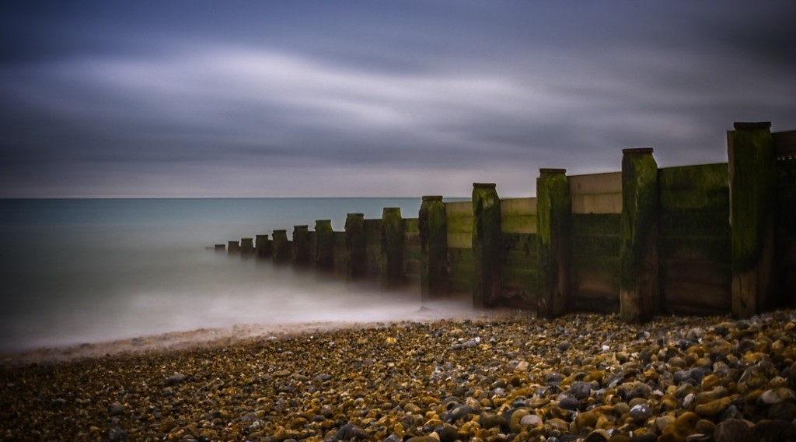
3. COASTAL MANAGEMENT
Activity 3
Low walls built across a beach.
Notes:
Activity 3. Look carefully at this picture: low walls built across a beach. Observe every detail before I ask the question.

Slide 25
3. COASTAL MANAGEMENT
Activity 3: Question
How do these low walls protect the beach?
Notes:
Here is the question for Activity 3: How do these low walls protect the beach? Take one minute to think and write your answer in your rough notebook.

Slide 26
3. COASTAL MANAGEMENT
Activity 3: Answer
They stop the sand from moving away.
Notes:
Let us check the answer together. They stop the sand from moving away.

Slide 27
BOARD SUMMARY
Board Summary
Topic: Denudation Processes, Landforms and Impacts on Man
Sub-topic: Wave Action along the Coast and Impacts on Man
Lesson 26: Impact of Wave Action on Human Development along Coastal Areas
Notes:
Now we are going to copy the board summary. Write the title and the headings neatly in your notebooks. I will give you enough time for each slide, so do not rush.

Slide 28
BOARD SUMMARY
1. Importance of Coasts
Coasts provide the following resources:
Ports: Ports such as Douala and Kribi handle the trade of Cameroon and its neighbours.
Fishing: Coastal waters provide fish and shrimps.
Notes:
Let us copy Importance of Coasts. Coasts provide the following resources. On this slide we have Ports and Fishing. Write each point on a new line, with the key term first, and explain it in your own words when we revise. When you finish, we go to the next slide.

Slide 29
BOARD SUMMARY
1. Importance of Coasts (continued)
Tourism: The beaches of Kribi and Limbe attract tourists.
Oil and gas: Oil and gas are extracted under the sea near the coast.
Notes:
We continue with Importance of Coasts. On this slide we have Tourism and Oil and gas. Write each point on a new line, with the key term first, and explain it in your own words when we revise.

Slide 30
BOARD SUMMARY
2. Coastal Hazards
People on the coast face the following hazards:
Coastal erosion: Waves destroy beaches, roads and houses.
Floods: The sea covers low-lying land during storms and high tides.
Notes:
Let us copy Coastal Hazards. People on the coast face the following hazards. On this slide we have Coastal erosion and Floods. Write each point on a new line, with the key term first, and explain it in your own words when we revise. When you finish, we go to the next slide.

Slide 31
BOARD SUMMARY
2. Coastal Hazards (continued)
Sea-level rise: Rising sea levels threaten low coastal towns such as Douala.
Notes:
We continue with Coastal Hazards. On this slide we have Sea-level rise. Write each point on a new line, with the key term first, and explain it in your own words when we revise.

Slide 32
BOARD SUMMARY
3. Coastal Management Strategies
Coasts are protected with the following strategies:
Sea walls: They are strong walls that stop waves from reaching the land.
Groynes: They are low walls built across a beach to trap sand.
Notes:
Let us copy Coastal Management Strategies. Coasts are protected with the following strategies. On this slide we have Sea walls and Groynes. Write each point on a new line, with the key term first, and explain it in your own words when we revise. When you finish, we go to the next slide.

Slide 33
BOARD SUMMARY
3. Coastal Management Strategies (continued)
Mangroves: These trees protect the coast by reducing the force of waves.
Notes:
We continue with Coastal Management Strategies. On this slide we have Mangroves. Write each point on a new line, with the key term first, and explain it in your own words when we revise.

Slide 34
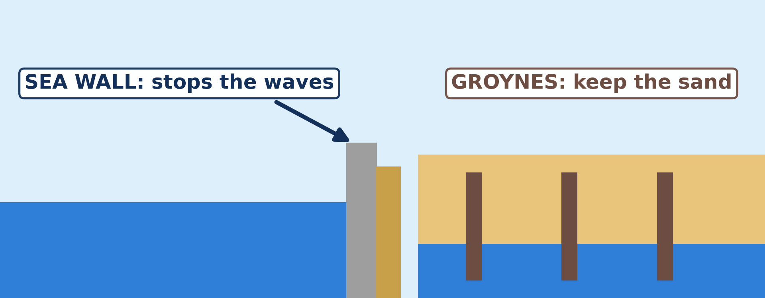
BOARD SUMMARY
3. Coastal Management Strategies
Illustration: coastal defences
Notes:
Now draw this illustration in your notebook: coastal defences. Give it a title and label it clearly.

Slide 35
FORMATIVE EVALUATION
Evaluation 1
Name two ports of Cameroon.
Notes:
Now let us check what you have understood. Question 1: Name two ports of Cameroon. Answer in your exercise book.

Slide 36
FORMATIVE EVALUATION
Expected Answer
Douala and Kribi.
Notes:
The expected answer is: douala and Kribi. If you got it right, well done.

Slide 37
FORMATIVE EVALUATION
Evaluation 2
Give two ways to protect the coast.
Notes:
Now let us check what you have understood. Question 2: Give two ways to protect the coast. Answer in your exercise book.

Slide 38
FORMATIVE EVALUATION
Expected Answer
Sea walls and groynes (also mangroves).
Notes:
The expected answer is: sea walls and groynes (also mangroves). If you got it right, well done.

Slide 39
REMEDIATION
Remediation
Fill in the blanks:
A place where ships load goods is a ______.
A low wall across a beach is a ______.
The wearing away of the coast is coastal ______.
Notes:
For those who need more practice, fill in the blanks in your exercise book. The answers are: number 1, port; number 2, groyne; number 3, erosion.

Slide 40
HOMEWORK
Homework
On a map of Africa in your atlas, find the Sahara, the Sahel and the Kalahari. Write in which part of Africa each one is located.
Notes:
For your homework: On a map of Africa in your atlas, find the Sahara, the Sahel and the Kalahari. Write in which part of Africa each one is located. We shall correct it at the beginning of our next lesson.

Slide 41
NEXT LESSON
Next Lesson
Our next lesson will be on:
Lesson 27: Semi-Arid and Desert Landscapes
Notes:
Our next lesson will be on Lesson 27: Semi-Arid and Desert Landscapes. Thank you for your attention, and see you next time.

Slide 42
BILINGUAL GAME
Bilingual Game (Jeu Bilingue)
English | Français
Port | Le port
Coastal erosion | L'érosion côtière
Sea wall | La digue / le mur de protection
Groyne | L'épi
Mangrove | La mangrove
Sea-level rise | L'élévation du niveau de la mer
Estuary | L'estuaire
Pollution | La pollution
Notes:
Let us play the bilingual game. I say a word in English, and you give me the French word. Then we do the reverse.

Slide 43
LOGBOOK
Official Logbook (1/2)
Module / Topic | Denudation Processes, Landforms and Impacts on Man
Lesson Title | Lesson 26: Impact of Wave Action on Human Development along Coastal Areas
Expected Learning Outcomes | Explain the importance of coasts. Describe the main coastal hazards. Explain coastal management strategies.
Competence | Learners are able to explain why coasts are important for Cameroon, and to suggest simple ways to protect them.
Notes:
I record this information in the official logbook of the class after the lesson.

Slide 44
LOGBOOK
Official Logbook (2/2)
Matter Taught | Importance of Coasts; Coastal Hazards; Coastal Management Strategies.
Evaluation | Formative evaluation and remediation exercise.
Homework | On a map of Africa in your atlas, find the Sahara, the Sahel and the Kalahari. Write in which part of Africa each one is located.
Enrolment / Present / Absent | ____ / ____ / ____
Achievement | To be completed after the lesson.
Notes:
I complete the second page of the logbook: the matter taught, the evaluation, the homework and the attendance.

Slide 45
TEACHER'S NOTE
Teacher's Note
Timing: Homework correction, plan, objectives 4 min | Recall, situation, action 6 min | 3 activities 12 min | Board summary (copying) 15 min | Evaluation, remediation 5 min | Homework, next lesson 3 min | Logbook 5 min
Without the projector (Activity 1): ask learners what products come from the port of Douala.
Without the projector (Activity 2): describe houses near the sea that are damaged by waves.
Without the projector (Activity 3): draw a beach with walls across it.
Notes:
This slide is for me, the teacher: it gives the timing of the lesson and what to do if the projector is not available.

Slide 46
REFERENCES
References
National Geography Syllabus (MINESEC), Form 4 — Denudation Processes, Landforms and Impacts on Man.
Teacher's lesson notes (Form 4), checked and corrected where necessary.
Photo, Activity 1: “JAXPORT Welcomes Largest Container Ship To Date” by JAXPORT, CC BY-NC 2.0, via Flickr (https://www.flickr.com/photos/24847875@N05/17069054628)
Photo, Activity 2: “Coastal defences no longer being maintained - Why? Spurn Head, Yorkshi” by Richard Allaway, CC BY 2.0, via Flickr (https://www.flickr.com/photos/16287002@N00/6605676971)
Photo, Activity 3: “Wooden groynes” by aevarg, CC BY 2.0, via Flickr (https://www.flickr.com/photos/25999920@N00/17139000460)
Diagrams and animations: drawn for this lesson (Geography Department).
Notes:
These are the references and picture credits used to prepare this lesson.

