Slide 1
FORM 4
GEOGRAPHY
Lesson 32
Weather Elements: Atmospheric Temperatures
Notes:
Good morning, class, and welcome to our geography lesson. I am your geography teacher, Mr Kamdem. Today we are starting Lesson 32: Weather Elements: Atmospheric Temperatures.

Slide 2
CLASS INFO
Class, Chapter and Duration
Class | Form 4
Chapter | Module 3: Weather and Climate — Adaptation to Climatic Excesses
Duration | 50 minutes
Notes:
This lesson is for Form 4. It belongs to Module 3: Weather and Climate — Adaptation to Climatic Excesses. We shall need 50 minutes to cover it.

Slide 3
IDENTIFICATION
Lesson Identification
Topic | The Earth-Atmosphere System
Sub-topic | Measurement of Weather Elements
Lesson | Lesson 32: Weather Elements: Atmospheric Temperatures
Notions / Concepts | Temperature, thermometer, Stevenson screen.
Syllabus focus | Meaning of atmospheric temperature; measurement and presentation; siting of the Stevenson screen.
Competence | Learners are able to measure the temperature of the air correctly and calculate daily means and ranges.
Notes:
Our topic is The Earth-Atmosphere System, and the sub-topic is Measurement of Weather Elements. The key notions we shall use today are: temperature, thermometer, Stevenson screen. At the end, you should be able to do this: learners are able to measure the temperature of the air correctly and calculate daily means and ranges.

Slide 4

HOMEWORK CORRECTION
Correction of the Homework
Question (Lesson 31: Weather and Climate):
Put one bottle of water in the sun and another in the shade for one hour. Touch both and write down which is hotter and why.
Notes:
Before we start the new lesson, let us correct the homework I gave you at the end of Lesson 31: Weather and Climate. The question was: Put one bottle of water in the sun and another in the shade for one hour. Touch both and write down which is hotter and why. Take out your exercise books.

Slide 5
HOMEWORK CORRECTION
Correction: Possible Answer
The bottle in the sun is hotter, because it receives the direct rays of the Sun, while the one in the shade is protected from them.
Notes:
Here is a good answer. The bottle in the sun is hotter, because it receives the direct rays of the Sun, while the one in the shade is protected from them. Compare it with your own answer and correct your work in red.

Slide 6
LESSON PLAN
Lesson Plan
Correction of the homework
Objectives and recall
Real-life situation and action to take
Learning activities
Board summary
Evaluation, remediation and homework
Notes:
Here is the plan of our lesson today. First, we shall correct the homework. Then we shall look at the objectives and recall what you already know. After that, we shall study a situation from real life and the action to take, and do the learning activities. Finally, we shall copy the board summary, do the evaluation and the remediation, and I will give you the homework.

Slide 7
OBJECTIVES
Objectives
By the end of this lesson, you should be able to:
Define atmospheric temperature.
Describe how temperature is measured and calculate mean and range.
Notes:
Take your time to copy this part; we will continue together.

Slide 8
OBJECTIVES
Objectives (continued)
Describe the Stevenson screen and the rules for siting it.
Notes:
By the end of this lesson, you should be able to do three things. Number 1: define atmospheric temperature. Number 2: describe how temperature is measured and calculate mean and range. Number 3: describe the Stevenson screen and the rules for siting it.

Slide 9
PREVIOUS KNOWLEDGE
Previous Knowledge
Weather is the condition of the atmosphere at a given time; climate is the average over 30 years.
Each weather element has its instrument, unit and isoline.
Temperature is measured with a thermometer, in °C.
Notes:
Let us first remember what you already know. Weather is the condition of the atmosphere at a given time; climate is the average over 30 years. Each weather element has its instrument, unit and isoline. Temperature is measured with a thermometer, in °C. Keep this in mind, because we shall build on it today.

Slide 10
REAL-LIFE SITUATION
Situation in Real Life
Ali puts his thermometer in the sun on the concrete and reads 45 °C. Bouba hangs his in the shade of a tree and reads 36 °C. They wonder which reading is correct.
Notes:
Listen carefully to this situation from real life. Ali puts his thermometer in the sun on the concrete and reads 45 °C. Bouba hangs his in the shade of a tree and reads 36 °C. They wonder which reading is correct. Think about it, because I am going to ask you some questions.

Slide 11
REAL-LIFE SITUATION
Situation: Question 1
What is the problem in the situation?
Notes:
Question 1: What is the problem in the situation? Think for a moment, then raise your hand to answer.

Slide 12
REAL-LIFE SITUATION
Answer
The two readings are different.
Notes:
Good. The two readings are different.

Slide 13
REAL-LIFE SITUATION
Situation: Question 2
Which reading is correct?
Notes:
Question 2: Which reading is correct? Think for a moment, then raise your hand to answer.

Slide 14
REAL-LIFE SITUATION
Answer
Bouba's, in the shade.
Notes:
Good. Bouba's, in the shade.

Slide 15
REAL-LIFE SITUATION
Situation: Question 3
Where should a thermometer be placed?
Notes:
Question 3: Where should a thermometer be placed? Think for a moment, then raise your hand to answer.

Slide 16
REAL-LIFE SITUATION
Possible Answer
In the shade, in a Stevenson screen.
Notes:
Good. In the shade, in a Stevenson screen.

Slide 17
ACTION TO TAKE
Action to Take
Measure temperatures correctly in the shade, not in the Sun.
Notes:
From this situation, the action we are working towards in this lesson is the following: measure temperatures correctly in the shade, not in the Sun.

Slide 18
JUSTIFICATION
Justification of the Lesson
This lesson helps us to measure the temperature of the air correctly.
Notes:
Why is this lesson important for you? This lesson helps us to measure the temperature of the air correctly.

Slide 19
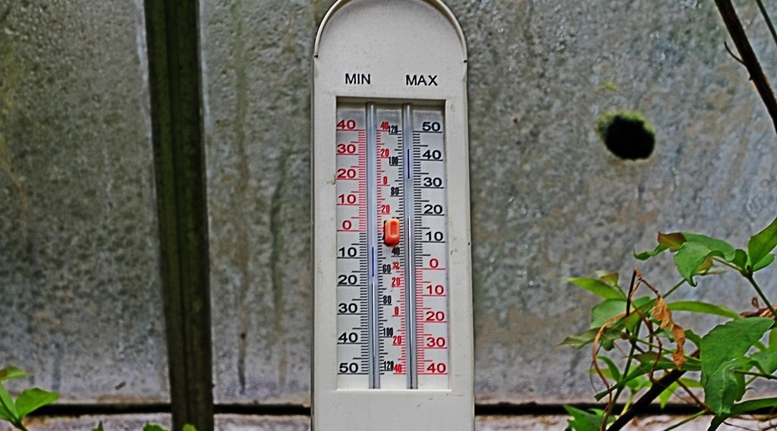
1. MEASUREMENT
Activity 1
A thermometer that shows the highest and the lowest temperature.
Notes:
Activity 1. Look carefully at this picture: a thermometer that shows the highest and the lowest temperature. Observe every detail before I ask the question.

Slide 20
1. MEASUREMENT
Activity 1: Question
What does this thermometer record?
Notes:
Here is the question for Activity 1: What does this thermometer record? Take one minute to think and write your answer in your rough notebook.

Slide 21
1. MEASUREMENT
Activity 1: Answer
The maximum and the minimum temperature of the day.
Notes:
Let us check the answer together. The maximum and the minimum temperature of the day.

Slide 22
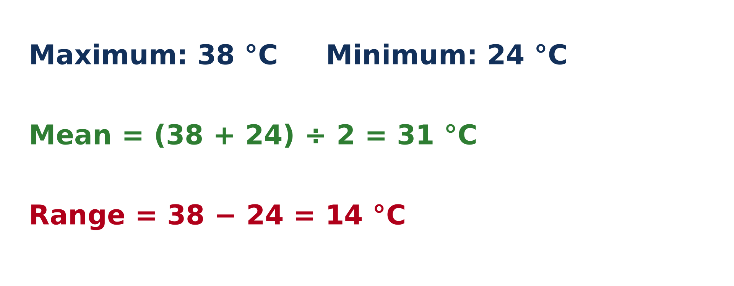
2. CALCULATIONS
Activity 2
A worked example.
Notes:
Activity 2. Look carefully at this diagram: a worked example. Observe every detail before I ask the question.

Slide 23
2. CALCULATIONS
Activity 2: Question
Maximum 38 °C, minimum 24 °C. Find the mean and the range.
Notes:
Here is the question for Activity 2: Maximum 38 °C, minimum 24 °C. Find the mean and the range. Take one minute to think and write your answer in your rough notebook.

Slide 24
2. CALCULATIONS
Activity 2: Answer
Mean: 31 °C. Range: 14 °C.
Notes:
Let us check the answer together. Mean: 31 °C. Range: 14 °C.

Slide 25

3. THE STEVENSON SCREEN
Activity 3
A Stevenson screen.
Notes:
Activity 3. Look carefully at this picture: a Stevenson screen. Observe every detail before I ask the question.

Slide 26
3. THE STEVENSON SCREEN
Activity 3: Question
Why is this box white with openings on the sides?
Notes:
Here is the question for Activity 3: Why is this box white with openings on the sides? Take one minute to think and write your answer in your rough notebook.

Slide 27
3. THE STEVENSON SCREEN
Activity 3: Answer
White reflects the sun; the openings let the air pass.
Notes:
Let us check the answer together. White reflects the sun; the openings let the air pass.

Slide 28
BOARD SUMMARY
Board Summary
Topic: The Earth-Atmosphere System
Sub-topic: Measurement of Weather Elements
Lesson 32: Weather Elements: Atmospheric Temperatures
Notes:
Now we are going to copy the board summary. Write the title and the headings neatly in your notebooks. I will give you enough time for each slide, so do not rush.

Slide 29
BOARD SUMMARY
1. Meaning and Measurement of Temperature
Temperature is defined and measured as follows:
Temperature: It is the degree of hotness or coldness of the air.
Thermometer: It shows the temperature of the air at the moment it is read.
Notes:
Let us copy Meaning and Measurement of Temperature. Temperature is defined and measured as follows. On this slide we have Temperature and Thermometer. Write each point on a new line, with the key term first, and explain it in your own words when we revise. When you finish, we go to the next slide.

Slide 30
BOARD SUMMARY
1. Meaning and Measurement of Temperature (continued)
Six's thermometer: It records the maximum and the minimum temperatures of the day.
Notes:
We continue with Meaning and Measurement of Temperature. On this slide we have Six's thermometer. Write each point on a new line, with the key term first, and explain it in your own words when we revise.

Slide 31
BOARD SUMMARY
2. Presentation of Temperature
Temperature data are presented with the following calculations:
Mean daily temperature: It is (maximum + minimum) ÷ 2, for example (38 + 24) ÷ 2 = 31 °C.
Daily range: It is maximum − minimum, for example 38 − 24 = 14 °C.
Notes:
Let us copy Presentation of Temperature. Temperature data are presented with the following calculations. On this slide we have Mean daily temperature and Daily range. Write each point on a new line, with the key term first, and explain it in your own words when we revise.

Slide 32
BOARD SUMMARY
2. Presentation of Temperature
Illustration: calculating the mean and the range
Notes:
Now draw this illustration in your notebook: calculating the mean and the range. Give it a title and label it clearly.

Slide 33
BOARD SUMMARY
3. Siting of the Stevenson Screen
The Stevenson screen is built and placed as follows:
Colour: It is painted white to reflect sunlight.
Louvred sides: Its slatted sides let the air move freely inside.
Notes:
Let us copy Siting of the Stevenson Screen. The Stevenson screen is built and placed as follows. On this slide we have Colour and Louvred sides. Write each point on a new line, with the key term first, and explain it in your own words when we revise. When you finish, we go to the next slide.

Slide 34
BOARD SUMMARY
3. Siting of the Stevenson Screen (continued)
Siting: It stands on grass in an open place, about 1.2 m above the ground.
Notes:
We continue with Siting of the Stevenson Screen. On this slide we have Siting. Write each point on a new line, with the key term first, and explain it in your own words when we revise.

Slide 35
FORMATIVE EVALUATION
Evaluation 1
Maximum 34 °C, minimum 20 °C. What is the mean?
Notes:
Now let us check what you have understood. Question 1: Maximum 34 °C, minimum 20 °C. What is the mean? Answer in your exercise book.

Slide 36
FORMATIVE EVALUATION
Expected Answer
27 °C.
Notes:
The expected answer is: 27 °C. If you got it right, well done.

Slide 37
FORMATIVE EVALUATION
Evaluation 2
Why is the Stevenson screen painted white?
Notes:
Now let us check what you have understood. Question 2: Why is the Stevenson screen painted white? Answer in your exercise book.

Slide 38
FORMATIVE EVALUATION
Expected Answer
To reflect the sunlight.
Notes:
The expected answer is: to reflect the sunlight. If you got it right, well done.

Slide 39
REMEDIATION
Remediation
Fill in the blanks:
The highest and lowest temperatures are recorded by the ______ thermometer.
Mean = (maximum + minimum) ÷ ______.
Thermometers are kept in a ______ screen.
Notes:
For those who need more practice, fill in the blanks in your exercise book. The answers are: number 1, Six's; number 2, 2; number 3, Stevenson.

Slide 40
HOMEWORK
Homework
Wet a piece of cloth and hang it outside in the morning and in the afternoon. Note how long it takes to dry each time.
Notes:
For your homework: Wet a piece of cloth and hang it outside in the morning and in the afternoon. Note how long it takes to dry each time. We shall correct it at the beginning of our next lesson.

Slide 41
NEXT LESSON
Next Lesson
Our next lesson will be on:
Lesson 33: Weather Elements: Humidity, Wind, Pressure and Sunshine
Notes:
Our next lesson will be on Lesson 33: Weather Elements: Humidity, Wind, Pressure and Sunshine. Thank you for your attention, and see you next time.

Slide 42
BILINGUAL GAME
Bilingual Game (Jeu Bilingue)
English | Français
Temperature | La température
Maximum | Le maximum
Minimum | Le minimum
Range | L'amplitude
Mean | La moyenne
Stevenson screen | L'abri météorologique
Shade | L'ombre
Isotherm | L'isotherme
Notes:
Let us play the bilingual game. I say a word in English, and you give me the French word. Then we do the reverse.

Slide 43
LOGBOOK
Official Logbook (1/2)
Module / Topic | The Earth-Atmosphere System
Lesson Title | Lesson 32: Weather Elements: Atmospheric Temperatures
Expected Learning Outcomes | Define atmospheric temperature. Describe how temperature is measured and calculate mean and range. Describe the Stevenson screen and the rules for siting it.
Competence | Learners are able to measure the temperature of the air correctly and calculate daily means and ranges.
Notes:
I record this information in the official logbook of the class after the lesson.

Slide 44
LOGBOOK
Official Logbook (2/2)
Matter Taught | Meaning and Measurement of Temperature; Presentation of Temperature; Siting of the Stevenson Screen.
Evaluation | Formative evaluation and remediation exercise.
Homework | Wet a piece of cloth and hang it outside in the morning and in the afternoon. Note how long it takes to dry each time.
Enrolment / Present / Absent | ____ / ____ / ____
Achievement | To be completed after the lesson.
Notes:
I complete the second page of the logbook: the matter taught, the evaluation, the homework and the attendance.

Slide 45
TEACHER'S NOTE
Teacher's Note
Timing: Homework correction, plan, objectives 4 min | Recall, situation, action 6 min | 3 activities 12 min | Board summary (copying) 15 min | Evaluation, remediation 5 min | Homework, next lesson 3 min | Logbook 5 min
Without the projector (Activity 1): draw a U-shaped thermometer.
Without the projector (Activity 2): write the example on the board.
Without the projector (Activity 3): describe a white wooden box on legs.
Notes:
This slide is for me, the teacher: it gives the timing of the lesson and what to do if the projector is not available.

Slide 46
REFERENCES
References
National Geography Syllabus (MINESEC), Form 4 — Module 3: Weather and Climate.
Teacher's lesson notes (f4.docx), checked and corrected where necessary.
WMO Guide to Instruments and Methods of Observation (WMO-No. 8).
Photo, Activity 1: “maximum minimum thermometer” by Leo Reynolds, CC BY-NC-SA 2.0, via Flickr (https://www.flickr.com/photos/49968232@N00/7928521796)
Photo, Activity 3: “Adelaide. Urrbrae. The weather station at the Waite campus of the Univ” by denisbin, CC BY-ND 2.0, via Flickr (https://www.flickr.com/photos/82134796@N03/49865994827)
Diagrams and animations: drawn for this lesson (Geography Department).
Notes:
These are the references and picture credits used to prepare this lesson.

