Slide 1
FORM 4
GEOGRAPHY
Lesson 33
Weather Elements: Humidity, Wind, Pressure and Sunshine
Notes:
Good morning, class, and welcome to our geography lesson. I am your geography teacher, Mr Kamdem. Today we are starting Lesson 33: Weather Elements: Humidity, Wind, Pressure and Sunshine.

Slide 2
CLASS INFO
Class, Chapter and Duration
Class | Form 4
Chapter | Module 3: Weather and Climate — Adaptation to Climatic Excesses
Duration | 50 minutes
Notes:
This lesson is for Form 4. It belongs to Module 3: Weather and Climate — Adaptation to Climatic Excesses. We shall need 50 minutes to cover it.

Slide 3
IDENTIFICATION
Lesson Identification
Topic | The Earth-Atmosphere System
Sub-topic | Measurement of Weather Elements
Lesson | Lesson 33: Weather Elements: Humidity, Wind, Pressure and Sunshine
Notions / Concepts | Humidity, wind direction, wind speed, atmospheric pressure, sunshine.
Syllabus focus | Atmospheric humidity; wind direction; wind speed; atmospheric pressure; amount of sunshine.
Competence | Learners are able to observe the humidity, wind and sky and predict simple changes in the weather around them.
Notes:
Our topic is The Earth-Atmosphere System, and the sub-topic is Measurement of Weather Elements. The key notions we shall use today are: humidity, wind direction, wind speed, atmospheric pressure, sunshine. At the end, you should be able to do this: learners are able to observe the humidity, wind and sky and predict simple changes in the weather around them.

Slide 4

HOMEWORK CORRECTION
Correction of the Homework
Question (Lesson 32: Weather Elements: Atmospheric Temperatures):
Wet a piece of cloth and hang it outside in the morning and in the afternoon. Note how long it takes to dry each time.
Notes:
Before we start the new lesson, let us correct the homework I gave you at the end of Lesson 32: Weather Elements: Atmospheric Temperatures. The question was: Wet a piece of cloth and hang it outside in the morning and in the afternoon. Note how long it takes to dry each time. Take out your exercise books.

Slide 5
HOMEWORK CORRECTION
Correction: Possible Answer
The cloth dries faster in the afternoon because the air is hotter and drier (lower humidity), so water evaporates faster.
Notes:
Here is a good answer. The cloth dries faster in the afternoon because the air is hotter and drier (lower humidity), so water evaporates faster. Compare it with your own answer and correct your work in red.

Slide 6
LESSON PLAN
Lesson Plan
Correction of the homework
Objectives and recall
Real-life situation and action to take
Learning activities
Board summary
Evaluation, remediation and homework
Notes:
Here is the plan of our lesson today. First, we shall correct the homework. Then we shall look at the objectives and recall what you already know. After that, we shall study a situation from real life and the action to take, and do the learning activities. Finally, we shall copy the board summary, do the evaluation and the remediation, and I will give you the homework.

Slide 7
OBJECTIVES
Objectives
By the end of this lesson, you should be able to:
Define humidity and relative humidity, and name their instrument.
Describe how wind direction and wind speed are measured.
Notes:
Take your time to copy this part; we will continue together.

Slide 8
OBJECTIVES
Objectives (continued)
Define atmospheric pressure and sunshine and name their instruments.
Notes:
By the end of this lesson, you should be able to do three things. Number 1: define humidity and relative humidity, and name their instrument. Number 2: describe how wind direction and wind speed are measured. Number 3: define atmospheric pressure and sunshine and name their instruments.

Slide 9
PREVIOUS KNOWLEDGE
Previous Knowledge
Temperature is measured with a thermometer inside a Stevenson screen.
Mean daily temperature = (maximum + minimum) ÷ 2.
Temperature data is shown with isotherms.
Notes:
Let us first remember what you already know. Temperature is measured with a thermometer inside a Stevenson screen. Mean daily temperature = (maximum + minimum) ÷ 2. Temperature data is shown with isotherms. Keep this in mind, because we shall build on it today.

Slide 10
REAL-LIFE SITUATION
Situation in Real Life
In August, Hadja's washing takes a whole day to dry and the air feels heavy. In January, during the Harmattan, the same clothes dry in less than one hour.
Notes:
Listen carefully to this situation from real life. In August, Hadja's washing takes a whole day to dry and the air feels heavy. In January, during the Harmattan, the same clothes dry in less than one hour. Think about it, because I am going to ask you some questions.

Slide 11
REAL-LIFE SITUATION
Situation: Question 1
What is the problem in the situation?
Notes:
Question 1: What is the problem in the situation? Think for a moment, then raise your hand to answer.

Slide 12
REAL-LIFE SITUATION
Answer
Hadja does not know why clothes dry slowly in August.
Notes:
Good. Hadja does not know why clothes dry slowly in August.

Slide 13
REAL-LIFE SITUATION
Situation: Question 2
When do clothes dry fast?
Notes:
Question 2: When do clothes dry fast? Think for a moment, then raise your hand to answer.

Slide 14
REAL-LIFE SITUATION
Answer
In January, during the Harmattan.
Notes:
Good. In January, during the Harmattan.

Slide 15
REAL-LIFE SITUATION
Situation: Question 3
Why?
Notes:
Question 3: Why? Think for a moment, then raise your hand to answer.

Slide 16
REAL-LIFE SITUATION
Possible Answer
The air is dry: there is little water vapour.
Notes:
Good. The air is dry: there is little water vapour.

Slide 17
ACTION TO TAKE
Action to Take
Use weather instruments carefully and record the readings every day.
Notes:
From this situation, the action we are working towards in this lesson is the following: use weather instruments carefully and record the readings every day.

Slide 18
JUSTIFICATION
Justification of the Lesson
This lesson helps us to know humidity, wind, pressure and sunshine.
Notes:
Why is this lesson important for you? This lesson helps us to know humidity, wind, pressure and sunshine.

Slide 19
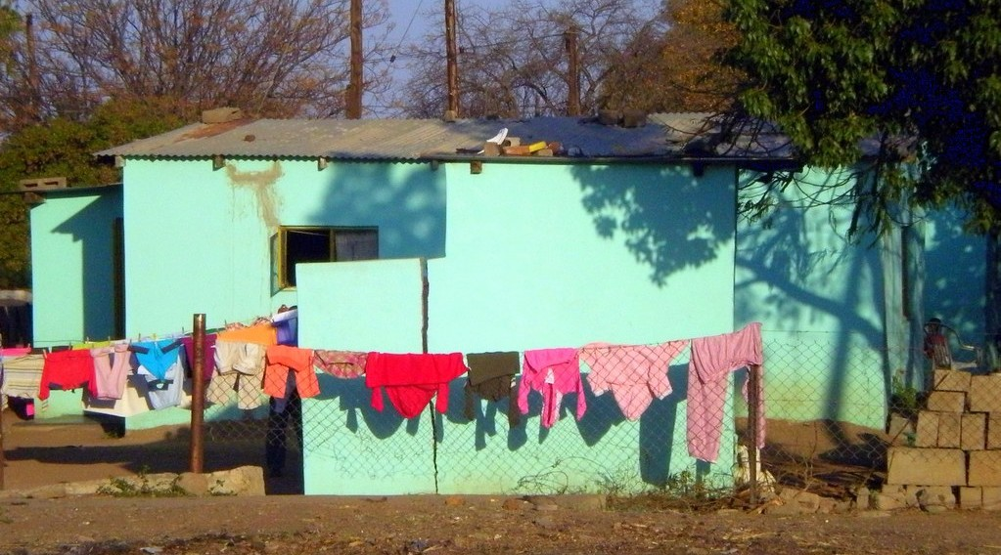
1. HUMIDITY
Activity 1
Clothes drying on a line.
Notes:
Activity 1. Look carefully at this picture: clothes drying on a line. Observe every detail before I ask the question.

Slide 20
1. HUMIDITY
Activity 1: Question
Why do clothes dry slowly when the air is wet?
Notes:
Here is the question for Activity 1: Why do clothes dry slowly when the air is wet? Take one minute to think and write your answer in your rough notebook.

Slide 21
1. HUMIDITY
Activity 1: Answer
The air already has a lot of water vapour (high humidity).
Notes:
Let us check the answer together. The air already has a lot of water vapour (high humidity).

Slide 22

2. WIND
Activity 2
A windsock at an airport.
Notes:
Activity 2. Look carefully at this picture: a windsock at an airport. Observe every detail before I ask the question.

Slide 23
2. WIND
Activity 2: Question
What does the windsock show? Why is it useful for pilots?
Notes:
Here is the question for Activity 2: What does the windsock show? Why is it useful for pilots? Take one minute to think and write your answer in your rough notebook.

Slide 24
2. WIND
Activity 2: Answer
The direction and the force of the wind. Planes take off against the wind.
Notes:
Let us check the answer together. The direction and the force of the wind. Planes take off against the wind.

Slide 25

3. PRESSURE AND SUNSHINE
Activity 3
A barometer.
Notes:
Activity 3. Look carefully at this picture: a barometer. Observe every detail before I ask the question.

Slide 26
3. PRESSURE AND SUNSHINE
Activity 3: Question
What does a barometer measure? What if it falls quickly?
Notes:
Here is the question for Activity 3: What does a barometer measure? What if it falls quickly? Take one minute to think and write your answer in your rough notebook.

Slide 27
3. PRESSURE AND SUNSHINE
Activity 3: Answer
Air pressure. A quick fall means rain or a storm.
Notes:
Let us check the answer together. Air pressure. A quick fall means rain or a storm.

Slide 28
BOARD SUMMARY
Board Summary
Topic: The Earth-Atmosphere System
Sub-topic: Measurement of Weather Elements
Lesson 33: Weather Elements: Humidity, Wind, Pressure and Sunshine
Notes:
Now we are going to copy the board summary. Write the title and the headings neatly in your notebooks. I will give you enough time for each slide, so do not rush.

Slide 29
BOARD SUMMARY
1. Atmospheric Humidity
Humidity is explained as follows:
Humidity: It is the amount of water vapour in the air.
Measurement: It is measured with a hygrometer (wet and dry bulb thermometers) and given in percent.
Notes:
Let us copy Atmospheric Humidity. Humidity is explained as follows. On this slide we have Humidity and Measurement. Write each point on a new line, with the key term first, and explain it in your own words when we revise. When you finish, we go to the next slide.

Slide 30
BOARD SUMMARY
1. Atmospheric Humidity (continued)
Example: In Garoua humidity is high in August and low in January.
Notes:
We continue with Atmospheric Humidity. On this slide we have Example. Write each point on a new line, with the key term first, and explain it in your own words when we revise.

Slide 31
BOARD SUMMARY
2. Wind
Wind is observed and measured as follows:
Wind: It is air moving from high pressure to low pressure.
Wind direction: It is shown by a wind vane, and a wind is named after the direction it comes from.
Notes:
Let us copy Wind. Wind is observed and measured as follows. On this slide we have Wind and Wind direction. Write each point on a new line, with the key term first, and explain it in your own words when we revise. When you finish, we go to the next slide.

Slide 32
BOARD SUMMARY
2. Wind (continued)
Wind speed: It is measured with an anemometer in km/h or knots.
Notes:
We continue with Wind. On this slide we have Wind speed. Write each point on a new line, with the key term first, and explain it in your own words when we revise.

Slide 33
BOARD SUMMARY
3. Pressure and Sunshine
Pressure and sunshine are measured as follows:
Atmospheric pressure: It is the weight of the air, measured with a barometer in millibars.
Sunshine: The number of hours of sunshine is measured with a sunshine recorder.
Notes:
Let us copy Pressure and Sunshine. Pressure and sunshine are measured as follows. On this slide we have Atmospheric pressure and Sunshine. Write each point on a new line, with the key term first, and explain it in your own words when we revise.

Slide 34
FORMATIVE EVALUATION
Evaluation 1
What is humidity?
Notes:
Now let us check what you have understood. Question 1: What is humidity? Answer in your exercise book.

Slide 35
FORMATIVE EVALUATION
Expected Answer
The amount of water vapour in the air.
Notes:
The expected answer is: the amount of water vapour in the air. If you got it right, well done.

Slide 36
FORMATIVE EVALUATION
Evaluation 2
The Harmattan blows from the north-east. What is its name as a wind direction?
Notes:
Now let us check what you have understood. Question 2: The Harmattan blows from the north-east. What is its name as a wind direction? Answer in your exercise book.

Slide 37
FORMATIVE EVALUATION
Expected Answer
A north-easterly wind.
Notes:
The expected answer is: a north-easterly wind. If you got it right, well done.

Slide 38
REMEDIATION
Remediation
Fill in the blanks:
Humidity is measured with a ______.
Air pressure is measured with a ______.
A wind is named after the direction it comes ______.
Notes:
For those who need more practice, fill in the blanks in your exercise book. The answers are: number 1, hygrometer; number 2, barometer; number 3, from.

Slide 39
HOMEWORK
Homework
Early tomorrow morning, look at the grass, leaves or cars near your house. Write down whether you see drops of water on them, and where you think the water came from.
Notes:
For your homework: Early tomorrow morning, look at the grass, leaves or cars near your house. Write down whether you see drops of water on them, and where you think the water came from. We shall correct it at the beginning of our next lesson.

Slide 40
NEXT LESSON
Next Lesson
Our next lesson will be on:
Lesson 34: Condensation
Notes:
Our next lesson will be on Lesson 34: Condensation. Thank you for your attention, and see you next time.

Slide 41
BILINGUAL GAME
Bilingual Game (Jeu Bilingue)
English | Français
Humidity | L'humidité
Hygrometer | L'hygromètre
Wind direction | La direction du vent
Wind speed | La vitesse du vent
Pressure | La pression
Barometer | Le baromètre
Sunshine | L'ensoleillement
Isobar | L'isobare
Notes:
Let us play the bilingual game. I say a word in English, and you give me the French word. Then we do the reverse.

Slide 42
LOGBOOK
Official Logbook (1/2)
Module / Topic | The Earth-Atmosphere System
Lesson Title | Lesson 33: Weather Elements: Humidity, Wind, Pressure and Sunshine
Expected Learning Outcomes | Define humidity and relative humidity, and name their instrument. Describe how wind direction and wind speed are measured. Define atmospheric pressure and sunshine and name their instruments.
Competence | Learners are able to observe the humidity, wind and sky and predict simple changes in the weather around them.
Notes:
I record this information in the official logbook of the class after the lesson.

Slide 43
LOGBOOK
Official Logbook (2/2)
Matter Taught | Atmospheric Humidity; Wind; Pressure and Sunshine.
Evaluation | Formative evaluation and remediation exercise.
Homework | Early tomorrow morning, look at the grass, leaves or cars near your house. Write down whether you see drops of water on them, and where you think the water came from.
Enrolment / Present / Absent | ____ / ____ / ____
Achievement | To be completed after the lesson.
Notes:
I complete the second page of the logbook: the matter taught, the evaluation, the homework and the attendance.

Slide 44
TEACHER'S NOTE
Teacher's Note
Timing: Homework correction, plan, objectives 4 min | Recall, situation, action 6 min | 3 activities 12 min | Board summary (copying) 15 min | Evaluation, remediation 5 min | Homework, next lesson 3 min | Logbook 5 min
Without the projector (Activity 1): use the situation of Hadja.
Without the projector (Activity 2): hold a piece of cloth in the wind.
Without the projector (Activity 3): explain that air has weight.
Notes:
This slide is for me, the teacher: it gives the timing of the lesson and what to do if the projector is not available.

Slide 45
REFERENCES
References
National Geography Syllabus (MINESEC), Form 4 — Module 3: Weather and Climate.
Teacher's lesson notes (f4.docx), checked and corrected where necessary.
Photo, Activity 1: “Bright Blue Home” by Clav, CC BY-NC-SA 2.0, via Flickr (https://www.flickr.com/photos/37005711@N00/2797194021)
Photo, Activity 2: “Windsock” by Wajahat Mahmood, CC BY-SA 2.0, via Flickr (https://www.flickr.com/photos/26116471@N03/6613272897)
Photo, Activity 3: “Aneroid Barometer, with dial designed by Sir Napier Shaw, 1914” by Negretti & Zambra; Shaw, Sir Napier, CC BY-NC-SA 4.0, via sciencemuseum (https://collection.sciencemuseumgroup.org.uk/objects/co54459/aneroid-barometer-with-dial-designed-by-sir-napier-shaw-1914)
Diagrams and animations: drawn for this lesson (Geography Department).
Notes:
These are the references and picture credits used to prepare this lesson.

