Slide 1
FORM 4
GEOGRAPHY
Lesson 37
Local Winds
Notes:
Good morning, class, and welcome to our geography lesson. I am your geography teacher, Mr Kamdem. Today we are starting Lesson 37: Local Winds.

Slide 2
CLASS INFO
Class, Chapter and Duration
Class | Form 4
Chapter | Module 3: Weather and Climate — Adaptation to Climatic Excesses
Duration | 50 minutes
Notes:
This lesson is for Form 4. It belongs to Module 3: Weather and Climate — Adaptation to Climatic Excesses. We shall need 50 minutes to cover it.

Slide 3
IDENTIFICATION
Lesson Identification
Topic | The Earth-Atmosphere System
Sub-topic | Pressure and Winds
Lesson | Lesson 37: Local Winds
Notions / Concepts | Land and sea breezes, monsoon, mountain and valley winds.
Syllabus focus | Definition of local winds; types of local winds.
Competence | Learners are able to explain the daily change of winds at the coast and in the mountains, and to use this knowledge for fishing, farming or building.
Notes:
Our topic is The Earth-Atmosphere System, and the sub-topic is Pressure and Winds. The key notions we shall use today are: land and sea breezes, monsoon, mountain and valley winds. At the end, you should be able to do this: learners are able to explain the daily change of winds at the coast and in the mountains, and to use this knowledge for fishing, farming or building.

Slide 4

HOMEWORK CORRECTION
Correction of the Homework
Question (Lesson 36: Pressure Belts and Planetary Winds):
Ask someone who has lived by the sea (Douala, Kribi or Limbe) or in the mountains (Buea, Mokolo) whether the wind changes between day and night. Write down what they say.
Notes:
Before we start the new lesson, let us correct the homework I gave you at the end of Lesson 36: Pressure Belts and Planetary Winds. The question was: Ask someone who has lived by the sea (Douala, Kribi or Limbe) or in the mountains (Buea, Mokolo) whether the wind changes between day and night. Write down what they say. Take out your exercise books.

Slide 5
HOMEWORK CORRECTION
Correction: Possible Answer
By the sea, the wind blows from the sea by day (sea breeze) and from the land at night (land breeze). In the mountains, it blows up the slopes by day and down the slopes at night.
Notes:
Here is a good answer. By the sea, the wind blows from the sea by day (sea breeze) and from the land at night (land breeze). In the mountains, it blows up the slopes by day and down the slopes at night. Compare it with your own answer and correct your work in red.

Slide 6
LESSON PLAN
Lesson Plan
Correction of the homework
Objectives and recall
Real-life situation and action to take
Learning activities
Board summary
Evaluation, remediation and homework
Notes:
Here is the plan of our lesson today. First, we shall correct the homework. Then we shall look at the objectives and recall what you already know. After that, we shall study a situation from real life and the action to take, and do the learning activities. Finally, we shall copy the board summary, do the evaluation and the remediation, and I will give you the homework.

Slide 7
OBJECTIVES
Objectives
By the end of this lesson, you should be able to:
Define a local wind.
Explain land and sea breezes.
Explain mountain and valley breezes.
Explain the monsoon.
Notes:
By the end of this lesson, you should be able to do three things. Number 1: define a local wind. Number 2: explain land and sea breezes. Number 3: explain mountain and valley breezes. Number 4: explain the monsoon.

Slide 8
PREVIOUS KNOWLEDGE
Previous Knowledge
Pressure belts are zones of high or low pressure around the Earth.
Planetary winds blow from high to low pressure, like the Trade Winds.
The rotation of the Earth deflects winds (Ferrel's law).
Notes:
Let us first remember what you already know. Pressure belts are zones of high or low pressure around the Earth. Planetary winds blow from high to low pressure, like the Trade Winds. The rotation of the Earth deflects winds (Ferrel's law). Keep this in mind, because we shall build on it today.

Slide 9
REAL-LIFE SITUATION
Situation in Real Life
In Kribi, fishermen leave the beach very early, before sunrise, and come back in the afternoon. They say the wind pushes their canoes to the sea in the morning and back to land later.
Notes:
Listen carefully to this situation from real life. In Kribi, fishermen leave the beach very early, before sunrise, and come back in the afternoon. They say the wind pushes their canoes to the sea in the morning and back to land later. Think about it, because I am going to ask you some questions.

Slide 10
REAL-LIFE SITUATION
Situation: Question 1
What is the problem in the situation?
Notes:
Question 1: What is the problem in the situation? Think for a moment, then raise your hand to answer.

Slide 11
REAL-LIFE SITUATION
Answer
We want to know why the wind changes direction during the day.
Notes:
Good. We want to know why the wind changes direction during the day.

Slide 12
REAL-LIFE SITUATION
Situation: Question 2
When do the fishermen leave?
Notes:
Question 2: When do the fishermen leave? Think for a moment, then raise your hand to answer.

Slide 13
REAL-LIFE SITUATION
Answer
Early in the morning.
Notes:
Good. Early in the morning.

Slide 14
REAL-LIFE SITUATION
Situation: Question 3
Which wind brings them back?
Notes:
Question 3: Which wind brings them back? Think for a moment, then raise your hand to answer.

Slide 15
REAL-LIFE SITUATION
Possible Answer
The sea breeze in the afternoon.
Notes:
Good. The sea breeze in the afternoon.

Slide 16
ACTION TO TAKE
Action to Take
Fishermen use the land breeze at night and the sea breeze by day.
Notes:
From this situation, the action we are working towards in this lesson is the following: fishermen use the land breeze at night and the sea breeze by day.

Slide 17
JUSTIFICATION
Justification of the Lesson
This lesson helps us to know winds that blow over small areas.
Notes:
Why is this lesson important for you? This lesson helps us to know winds that blow over small areas.

Slide 18

1. LAND AND SEA BREEZES
Activity 1
Animation: the wind by day and by night.
Notes:
Activity 1. Look carefully at this animation: animation: the wind by day and by night. Watch the animation to the end; it will play again.

Slide 19
1. LAND AND SEA BREEZES
Activity 1: Question
By day, does the wind blow from the sea or from the land? And at night?
Notes:
Here is the question for Activity 1: By day, does the wind blow from the sea or from the land? And at night? Take one minute to think and write your answer in your rough notebook.

Slide 20
1. LAND AND SEA BREEZES
Activity 1: Answer
Day: from the sea (sea breeze). Night: from the land (land breeze).
Notes:
Let us check the answer together. Day: from the sea (sea breeze). Night: from the land (land breeze).

Slide 21

1. LAND AND SEA BREEZES
Activity 2
Fishermen in canoes.
Notes:
Activity 2. Look carefully at this picture: fishermen in canoes. Observe every detail before I ask the question.

Slide 22
1. LAND AND SEA BREEZES
Activity 2: Question
Why do fishermen leave early in the morning?
Notes:
Here is the question for Activity 2: Why do fishermen leave early in the morning? Take one minute to think and write your answer in your rough notebook.

Slide 23
1. LAND AND SEA BREEZES
Activity 2: Answer
The land breeze pushes the canoes to the sea.
Notes:
Let us check the answer together. The land breeze pushes the canoes to the sea.

Slide 24
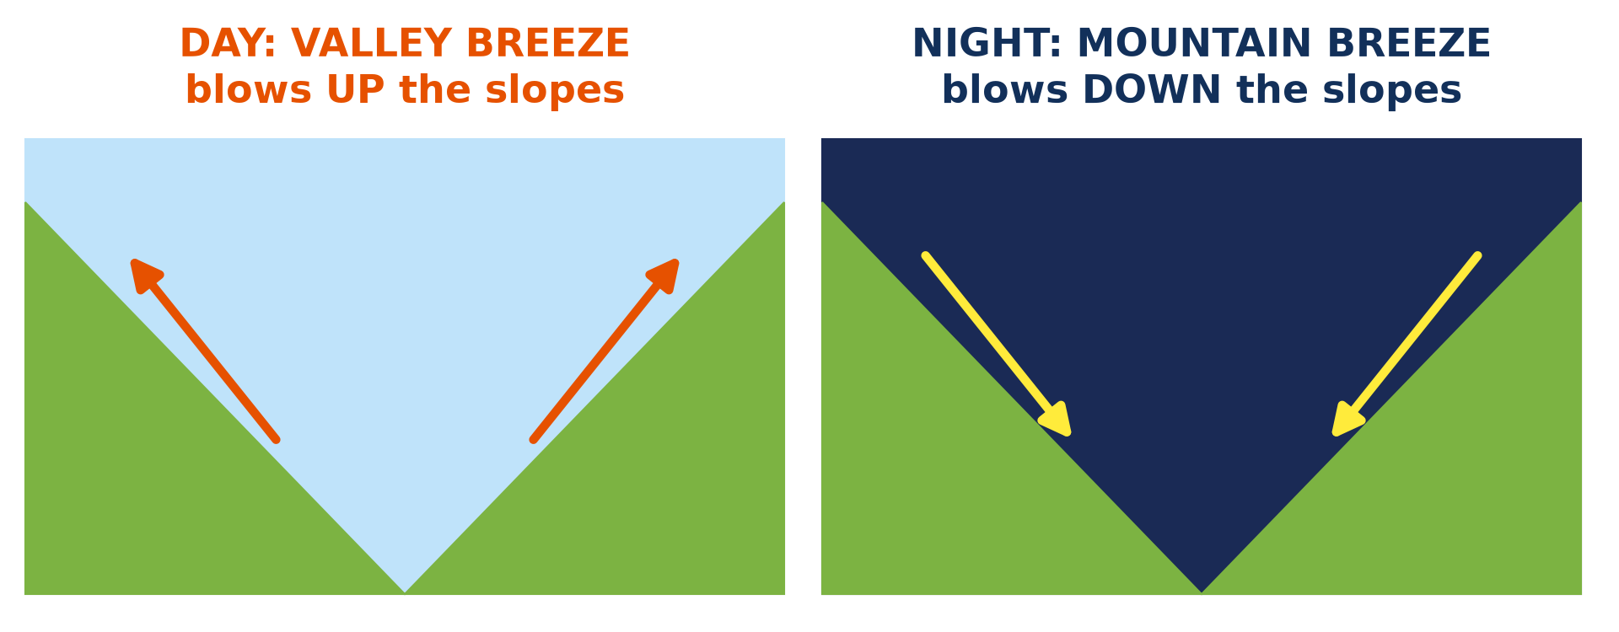
1. MOUNTAIN AND VALLEY BREEZES
Activity 3
Winds in a valley by day and by night.
Notes:
Activity 3. Look carefully at this diagram: winds in a valley by day and by night. Observe every detail before I ask the question.

Slide 25
1. MOUNTAIN AND VALLEY BREEZES
Activity 3: Question
Which wind blows up the slopes by day?
Notes:
Here is the question for Activity 3: Which wind blows up the slopes by day? Take one minute to think and write your answer in your rough notebook.

Slide 26
1. MOUNTAIN AND VALLEY BREEZES
Activity 3: Answer
The valley breeze.
Notes:
Let us check the answer together. The valley breeze.

Slide 27
BOARD SUMMARY
Board Summary
Topic: The Earth-Atmosphere System
Sub-topic: Pressure and Winds
Lesson 37: Local Winds
Notes:
Now we are going to copy the board summary. Write the title and the headings neatly in your notebooks. I will give you enough time for each slide, so do not rush.

Slide 28
BOARD SUMMARY
DEFINITIONS
The key terms of this lesson are defined as follows:
Local wind: It is a wind that blows over a small area for a short time.
Notes:
Let us copy the definitions. The key terms of this lesson are defined as follows. On this slide we have Local wind. Write each point on a new line, with the key term first, and explain it in your own words when we revise.

Slide 29
BOARD SUMMARY
1. Types of Local Winds
The main local winds are the following:
Sea breeze: By day the land is hotter than the sea, so cool air blows from the sea to the land.
Land breeze: At night the sea is warmer than the land, so air blows from the land to the sea.
Notes:
Let us copy Types of Local Winds. The main local winds are the following. On this slide we have Sea breeze and Land breeze. Write each point on a new line, with the key term first, and explain it in your own words when we revise. When you finish, we go to the next slide.

Slide 30
BOARD SUMMARY
1. Types of Local Winds (continued)
Valley breeze: By day warm air rises up the mountain slopes from the valley.
Mountain breeze: At night cold air flows down the slopes into the valley.
Notes:
We continue with Types of Local Winds. On this slide we have Valley breeze and Mountain breeze. Write each point on a new line, with the key term first, and explain it in your own words when we revise.

Slide 31
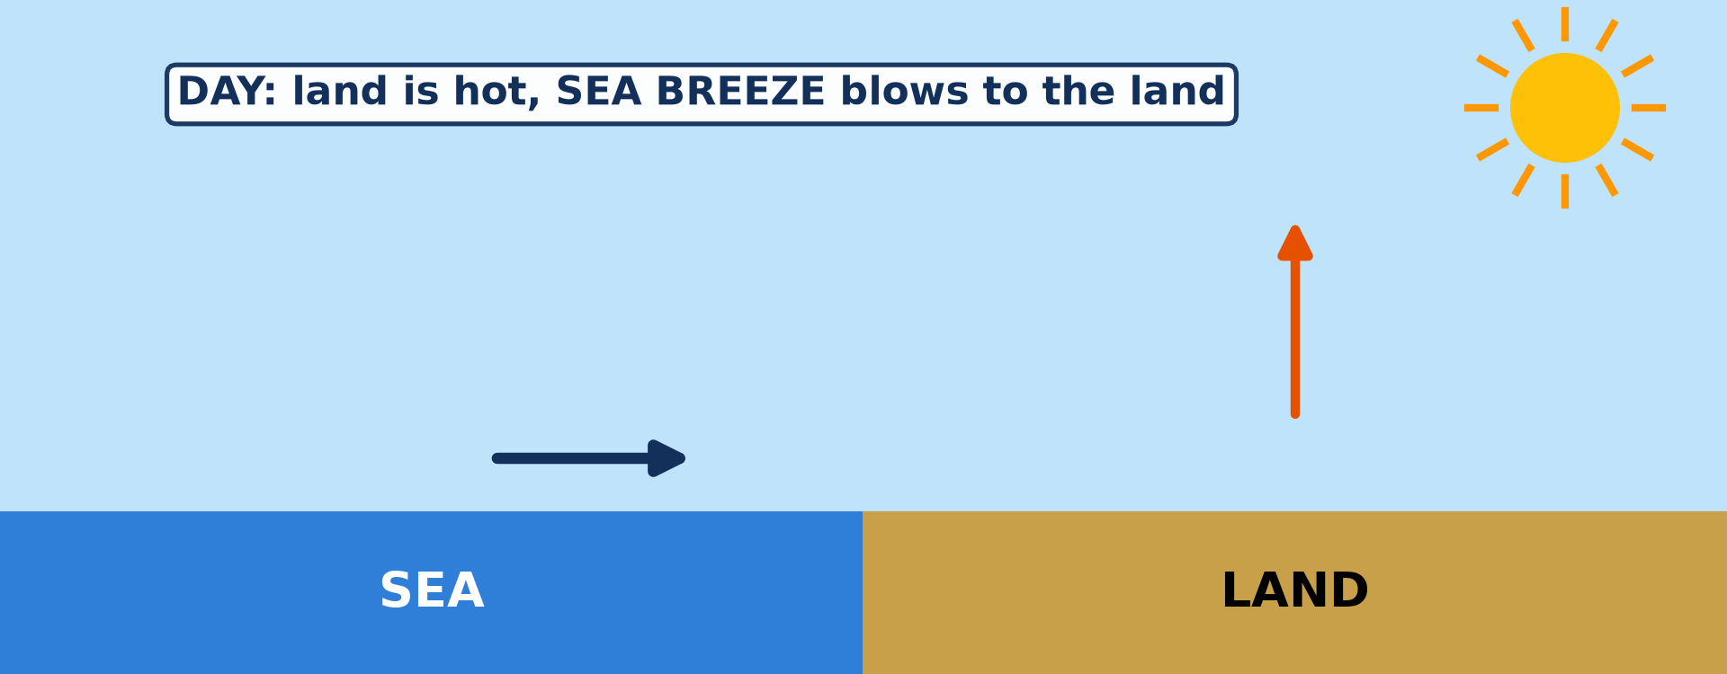
BOARD SUMMARY
1. Types of Local Winds
Illustration: the sea breeze
Notes:
Now draw this illustration in your notebook: the sea breeze. Give it a title and label it clearly.

Slide 32
FORMATIVE EVALUATION
Evaluation 1
Why does the sea breeze blow by day?
Notes:
Now let us check what you have understood. Question 1: Why does the sea breeze blow by day? Answer in your exercise book.

Slide 33
FORMATIVE EVALUATION
Expected Answer
The land heats faster than the sea.
Notes:
The expected answer is: the land heats faster than the sea. If you got it right, well done.

Slide 34
FORMATIVE EVALUATION
Evaluation 2
Which wind blows down the slopes at night?
Notes:
Now let us check what you have understood. Question 2: Which wind blows down the slopes at night? Answer in your exercise book.

Slide 35
FORMATIVE EVALUATION
Expected Answer
The mountain breeze.
Notes:
The expected answer is: the mountain breeze. If you got it right, well done.

Slide 36
REMEDIATION
Remediation
Fill in the blanks:
By day, the ______ breeze blows from the sea.
At night, the ______ breeze blows from the land.
Notes:
Take your time to copy this part; we will continue together.

Slide 37
REMEDIATION
Remediation (continued)
The wind that blows up the slopes by day is the ______ breeze.
Notes:
For those who need more practice, fill in the blanks in your exercise book. The answers are: number 1, sea; number 2, land; number 3, valley.

Slide 38
HOMEWORK
Homework
Compare the temperature of Garoua with that of Ngaoundéré (ask an adult who has travelled there). Write one sentence to say which town is cooler and one possible reason.
Notes:
For your homework: Compare the temperature of Garoua with that of Ngaoundéré (ask an adult who has travelled there). Write one sentence to say which town is cooler and one possible reason. We shall correct it at the beginning of our next lesson.

Slide 39
NEXT LESSON
Next Lesson
Our next lesson will be on:
Lesson 38: Factors of Temperature
Notes:
Our next lesson will be on Lesson 38: Factors of Temperature. Thank you for your attention, and see you next time.

Slide 40
BILINGUAL GAME
Bilingual Game (Jeu Bilingue)
English | Français
Local wind | Le vent local
Sea breeze | La brise de mer
Land breeze | La brise de terre
Valley breeze | La brise de vallée
Mountain breeze | La brise de montagne
Monsoon | La mousson
Slope | La pente
Coast | La côte
Notes:
Let us play the bilingual game. I say a word in English, and you give me the French word. Then we do the reverse.

Slide 41
LOGBOOK
Official Logbook (1/2)
Module / Topic | The Earth-Atmosphere System
Lesson Title | Lesson 37: Local Winds
Expected Learning Outcomes | Define a local wind. Explain land and sea breezes. Explain mountain and valley breezes. Explain the monsoon.
Competence | Learners are able to explain the daily change of winds at the coast and in the mountains, and to use this knowledge for fishing, farming or building.
Notes:
I record this information in the official logbook of the class after the lesson.

Slide 42
LOGBOOK
Official Logbook (2/2)
Matter Taught | DEFINITIONS; Types of Local Winds.
Evaluation | Formative evaluation and remediation exercise.
Homework | Compare the temperature of Garoua with that of Ngaoundéré (ask an adult who has travelled there). Write one sentence to say which town is cooler and one possible reason.
Enrolment / Present / Absent | ____ / ____ / ____
Achievement | To be completed after the lesson.
Notes:
I complete the second page of the logbook: the matter taught, the evaluation, the homework and the attendance.

Slide 43
TEACHER'S NOTE
Teacher's Note
Timing: Homework correction, plan, objectives 4 min | Recall, situation, action 6 min | 3 activities 12 min | Board summary (copying) 15 min | Evaluation, remediation 5 min | Homework, next lesson 3 min | Logbook 5 min
Activity 1 is an animation (GIF): it plays automatically in slide-show mode.
Without the projector (Activity 1): draw the sea and the land with arrows.
Without the projector (Activity 2): use the situation of Kribi.
Without the projector (Activity 3): mention the Mandara Mountains near Mokolo.
Notes:
This slide is for me, the teacher: it gives the timing of the lesson and what to do if the projector is not available.

Slide 44
REFERENCES
References
National Geography Syllabus (MINESEC), Form 4 — Module 3: Weather and Climate.
Teacher's lesson notes (f4.docx), checked and corrected where necessary.
Photo, Activity 2: “Fishermen, Lake Tana” by A.Davey, CC BY 2.0, via Flickr (https://www.flickr.com/photos/40595948@N00/2260748777)
Diagrams and animations: drawn for this lesson (Geography Department).
Notes:
These are the references and picture credits used to prepare this lesson.

