Slide 1
LOWER SIXTH ARTS
GEOGRAPHY
Lesson 7
Soil Formation
Notes:
Good morning, class, and welcome to our geography lesson. I am your geography teacher, Mr Kamdem. Today we are starting Lesson 7: Soil Formation.

Slide 2
CLASS INFO
Class, Chapter and Duration
Class | Lower Sixth Arts
Chapter | Module 3: Understanding and managing biogeographic zones across the world in general and Cameroon in particular
Duration | 2 periods (2 × 50 minutes)
Notes:
This lesson is for Lower Sixth Arts. It belongs to Module 3: Understanding and managing biogeographic zones across the world in general and Cameroon in particular. We shall need 2 periods to cover it.

Slide 3
IDENTIFICATION
Lesson Identification
Topic | Soil Development
Sub-topic | Soil Formation
Lesson | Lesson 7: Soil Formation
Notions / Concepts | Pedogenesis, parent material, Jenny's equation, active factors, passive factors.
Syllabus focus | Stages of soil formation; factors (Cl, O, R, P, T): active and passive, and the role of each.
Competence | Learners are able to explain how soils form and the role of each soil-forming factor.
Notes:
Our topic is Soil Development, and the sub-topic is Soil Formation. The key notions we shall use today are: pedogenesis, parent material, Jenny's equation, active factors, passive factors. At the end, you should be able to do this: learners are able to explain how soils form and the role of each soil-forming factor.

Slide 4

HOMEWORK CORRECTION
Correction of the Homework
Question (Lesson 6: Soil Fertility):
Ask a farmer how he keeps his soil fertile and write a short report.
Notes:
Before we start the new lesson, let us correct the homework I gave you at the end of Lesson 6: Soil Fertility. The question was: Ask a farmer how he keeps his soil fertile and write a short report. Take out your exercise books.

Slide 5
HOMEWORK CORRECTION
Correction: Possible Answer
Example: the farmer uses cow dung and compost, rotates maize with groundnuts, leaves some land fallow and avoids burning crop residues.
Notes:
Here is a good answer. Example: the farmer uses cow dung and compost, rotates maize with groundnuts, leaves some land fallow and avoids burning crop residues. Compare it with your own answer and correct your work in red.

Slide 6
LESSON PLAN
Lesson Plan
Correction of the homework
Objectives and recall
Real-life situation and action to take
Learning activities
Board summary
Evaluation, remediation and homework
Notes:
Here is the plan of our lesson today. First, we shall correct the homework. Then we shall look at the objectives and recall what you already know. After that, we shall study a situation from real life and the action to take, and do the learning activities. Finally, we shall copy the board summary, do the evaluation and the remediation, and I will give you the homework.

Slide 7
OBJECTIVES
Objectives
By the end of this lesson, you should be able to:
Describe the stages of soil formation.
State Jenny's equation.
Explain the role of active and passive factors.
Notes:
By the end of this lesson, you should be able to do three things. Number 1: describe the stages of soil formation. Number 2: state Jenny's equation. Number 3: explain the role of active and passive factors.

Slide 8
PREVIOUS KNOWLEDGE
Previous Knowledge
Weathering breaks rocks.
Humus comes from dead organic matter.
Notes:
Let us first remember what you already know. Weathering breaks rocks. Humus comes from dead organic matter. Keep this in mind, because we shall build on it today.

Slide 9
REAL-LIFE SITUATION
Situation in Real Life
On the 1999 lava flow of Mount Cameroon there is almost no soil yet, but on older flows there are farms. Learners ask how long it takes to make soil.
Notes:
Listen carefully to this situation from real life. On the 1999 lava flow of Mount Cameroon there is almost no soil yet, but on older flows there are farms. Learners ask how long it takes to make soil. Think about it, because I am going to ask you some questions.

Slide 10
REAL-LIFE SITUATION
Situation: Question 1
What is the problem in the situation?
Notes:
Question 1: What is the problem in the situation? Think for a moment, then raise your hand to answer.

Slide 11
REAL-LIFE SITUATION
Answer
Learners do not know how soil forms.
Notes:
Good. Learners do not know how soil forms.

Slide 12
REAL-LIFE SITUATION
Situation: Question 2
Why is there no soil on the new lava?
Notes:
Question 2: Why is there no soil on the new lava? Think for a moment, then raise your hand to answer.

Slide 13
REAL-LIFE SITUATION
Answer
There has not been enough time for weathering and plants.
Notes:
Good. There has not been enough time for weathering and plants.

Slide 14
REAL-LIFE SITUATION
Situation: Question 3
What are the main factors of soil formation?
Notes:
Question 3: What are the main factors of soil formation? Think for a moment, then raise your hand to answer.

Slide 15
REAL-LIFE SITUATION
Possible Answer
Climate, organisms, relief, parent material and time.
Notes:
Good. Climate, organisms, relief, parent material and time.

Slide 16
ACTION TO TAKE
Action to Take
Understand how soils form in order to protect them, because they form very slowly.
Notes:
From this situation, the action we are working towards in this lesson is the following: understand how soils form in order to protect them, because they form very slowly.

Slide 17
JUSTIFICATION
Justification of the Lesson
This lesson helps us to understand that soil forms very slowly and must be protected.
Notes:
Why is this lesson important for you? This lesson helps us to understand that soil forms very slowly and must be protected.

Slide 18

1. STAGES
Activity 1
Animation: from bare rock to deep soil.
Notes:
Activity 1. Look carefully at this animation: animation: from bare rock to deep soil. Watch the animation to the end; it will play again.

Slide 19
1. STAGES
Activity 1: Question
What is the first stage of soil formation?
Notes:
Here is the question for Activity 1: What is the first stage of soil formation? Take one minute to think and write your answer in your rough notebook.

Slide 20
1. STAGES
Activity 1: Answer
Weathering of the parent rock.
Notes:
Let us check the answer together. Weathering of the parent rock.

Slide 21
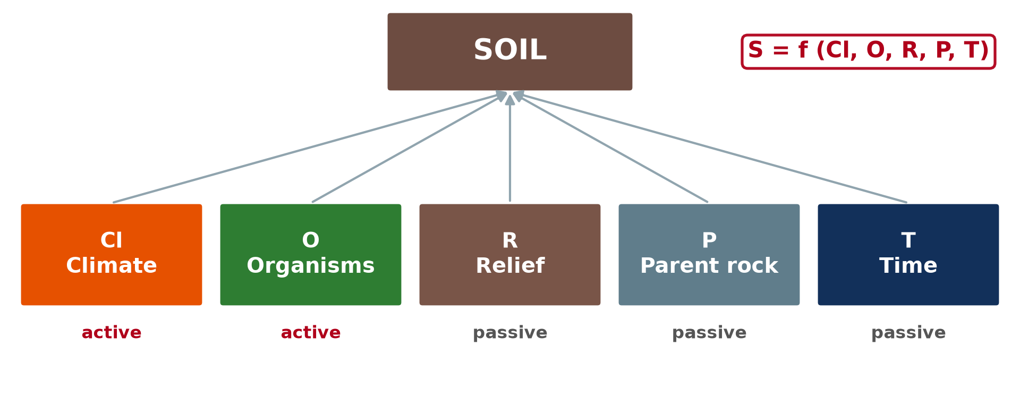
2. FACTORS (CLORPT)
Activity 2
Jenny's equation: the five factors.
Notes:
Activity 2. Look carefully at this diagram: jenny's equation: the five factors. Observe every detail before I ask the question.

Slide 22
2. FACTORS (CLORPT)
Activity 2: Question
Which factors are called active? Why?
Notes:
Here is the question for Activity 2: Which factors are called active? Why? Take one minute to think and write your answer in your rough notebook.

Slide 23
2. FACTORS (CLORPT)
Activity 2: Answer
Climate and organisms, because they drive the processes.
Notes:
Let us check the answer together. Climate and organisms, because they drive the processes.

Slide 24

2. A) ACTIVE FACTORS: CLIMATE
Activity 3
A deep red soil of the humid tropics.
Notes:
Activity 3. Look carefully at this picture: a deep red soil of the humid tropics. Observe every detail before I ask the question.

Slide 25
2. A) ACTIVE FACTORS: CLIMATE
Activity 3: Question
How does a hot, wet climate affect soil formation?
Notes:
Here is the question for Activity 3: How does a hot, wet climate affect soil formation? Take one minute to think and write your answer in your rough notebook.

Slide 26
2. A) ACTIVE FACTORS: CLIMATE
Activity 3: Answer
It speeds up chemical weathering and gives deep, leached soils.
Notes:
Let us check the answer together. It speeds up chemical weathering and gives deep, leached soils.

Slide 27

2. B) PASSIVE FACTORS: RELIEF
Activity 4
Steep mountain slopes.
Notes:
Activity 4. Look carefully at this picture: steep mountain slopes. Observe every detail before I ask the question.

Slide 28
2. B) PASSIVE FACTORS: RELIEF
Activity 4: Question
How does relief affect soils?
Notes:
Here is the question for Activity 4: How does relief affect soils? Take one minute to think and write your answer in your rough notebook.

Slide 29
2. B) PASSIVE FACTORS: RELIEF
Activity 4: Answer
Steep slopes have thin soils; valleys collect deep, wet soils.
Notes:
Let us check the answer together. Steep slopes have thin soils; valleys collect deep, wet soils.

Slide 30
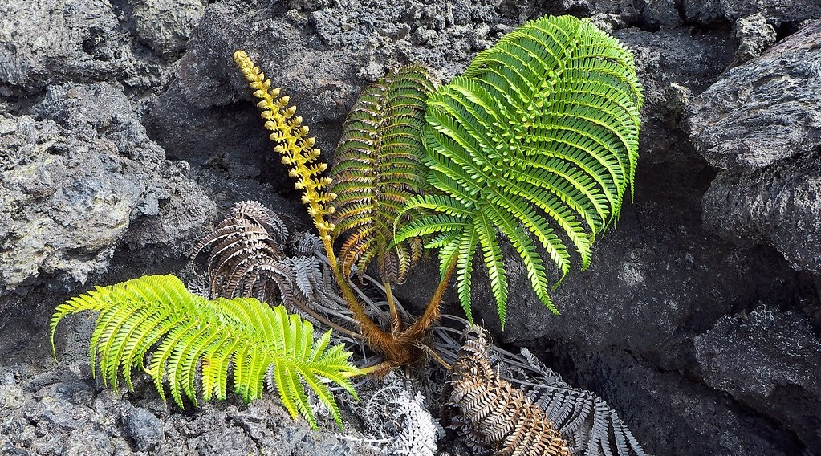
2. B) PASSIVE FACTORS: TIME
Activity 5
A fern growing on young lava.
Notes:
Activity 5. Look carefully at this picture: a fern growing on young lava. Observe every detail before I ask the question.

Slide 31
2. B) PASSIVE FACTORS: TIME
Activity 5: Question
Why is time an important factor?
Notes:
Here is the question for Activity 5: Why is time an important factor? Take one minute to think and write your answer in your rough notebook.

Slide 32
2. B) PASSIVE FACTORS: TIME
Activity 5: Answer
Soil forms very slowly, about 1 cm in 100 to 1,000 years.
Notes:
Let us check the answer together. Soil forms very slowly, about 1 cm in 100 to 1,000 years.

Slide 33
BOARD SUMMARY
Board Summary
Topic: Soil Development
Sub-topic: Soil Formation
Lesson 7: Soil Formation
Notes:
Now we are going to copy the board summary. Write the title and the headings neatly in your notebooks. I will give you enough time for each slide, so do not rush.

Slide 34
BOARD SUMMARY
DEFINITIONS
The key terms of this lesson are defined as follows:
Pedogenesis: It is the process of soil formation.
Parent material: It is the rock or deposit from which a soil is formed.
Notes:
Let us copy the definitions. The key terms of this lesson are defined as follows. On this slide we have Pedogenesis and Parent material. Write each point on a new line, with the key term first, and explain it in your own words when we revise.

Slide 35
BOARD SUMMARY
1. Stages of Soil Formation
Soil forms in the following stages:
Weathering of the parent rock: The rock breaks down into regolith by physical, chemical and biological weathering. This gives the mineral part of the soil.
Notes:
Let us copy Stages of Soil Formation. Soil forms in the following stages. On this slide we have Weathering of the parent rock. Write each point on a new line, with the key term first, and explain it in your own words when we revise. When you finish, we go to the next slide.

Slide 36
BOARD SUMMARY
1. Stages of Soil Formation (continued)
Colonisation and humus formation: Lichens, mosses and then plants grow on the regolith. Their remains decompose into humus.
Horizon development: Water moves materials down and up the profile, forming horizons. A mature soil develops after thousands of years.
Notes:
We continue with Stages of Soil Formation. On this slide we have Colonisation and humus formation and Horizon development. Write each point on a new line, with the key term first, and explain it in your own words when we revise.

Slide 37
BOARD SUMMARY
1. Stages of Soil Formation
Illustration: stages of soil formation
Notes:
Now draw this illustration in your notebook: stages of soil formation. Give it a title and label it clearly.

Slide 38
BOARD SUMMARY
2. Factors of Soil Formation
Jenny's equation S = f (CL, O, R, P, T) groups the factors:
Active factor – Climate: Temperature and rainfall control weathering, leaching and decomposition. Hot, wet climates form deep, red, leached soils; dry climates form thin soils.
Notes:
Let us copy Factors of Soil Formation. Jenny's equation S = f (CL, O, R, P, T) groups the factors. On this slide we have Active factor – Climate. Write each point on a new line, with the key term first, and explain it in your own words when we revise. When you finish, we go to the next slide.

Slide 39
BOARD SUMMARY
2. Factors of Soil Formation (continued)
Active factor – Organisms: Plants supply organic matter and animals mix the soil. Man changes soils by farming, burning and fertilising.
Notes:
We continue with Factors of Soil Formation. On this slide we have Active factor – Organisms. Write each point on a new line, with the key term first, and explain it in your own words when we revise. When you finish, we go to the next slide.

Slide 40
BOARD SUMMARY
2. Factors of Soil Formation (continued)
Passive factor – Parent material: It determines texture, colour and minerals. Basalt gives fertile clay soils, while granite gives sandy soils.
Notes:
We continue with Factors of Soil Formation. On this slide we have Passive factor – Parent material. Write each point on a new line, with the key term first, and explain it in your own words when we revise. When you finish, we go to the next slide.

Slide 41
BOARD SUMMARY
2. Factors of Soil Formation (continued)
Passive factors – Relief and time: Soils are thin on steep slopes and deep and wet in valleys. Older soils are deeper and have clearer horizons.
Notes:
We continue with Factors of Soil Formation. On this slide we have Passive factors – Relief and time. Write each point on a new line, with the key term first, and explain it in your own words when we revise.

Slide 42
BOARD SUMMARY
2. Factors of Soil Formation
Illustration: factors of soil formation
Notes:
Now draw this illustration in your notebook: factors of soil formation. Give it a title and label it clearly.

Slide 43
FORMATIVE EVALUATION
Evaluation 1
State Jenny's equation.
Notes:
Now let us check what you have understood. Question 1: State Jenny's equation. Answer in your exercise book.

Slide 44
FORMATIVE EVALUATION
Expected Answer
S = f (Cl, O, R, P, T): soil depends on climate, organisms, relief, parent material and time.
Notes:
The expected answer is: s = f (Cl, O, R, P, T): soil depends on climate, organisms, relief, parent material and time. If you got it right, well done.

Slide 45
FORMATIVE EVALUATION
Evaluation 2
Why are climate and organisms called active factors?
Notes:
Now let us check what you have understood. Question 2: Why are climate and organisms called active factors? Answer in your exercise book.

Slide 46
FORMATIVE EVALUATION
Expected Answer
They drive the soil-forming processes.
Notes:
The expected answer is: they drive the soil-forming processes. If you got it right, well done.

Slide 47
REMEDIATION
Remediation
Fill in the blanks:
Soil formation is called ______.
The rock from which soil forms is the ______ material.
Soil forms very ______.
Notes:
For those who need more practice, fill in the blanks in your exercise book. The answers are: number 1, pedogenesis; number 2, parent; number 3, slowly.

Slide 48
HOMEWORK
Homework
Explain why the soils of Mount Cameroon differ from those of the Far North.
Notes:
For your homework: Explain why the soils of Mount Cameroon differ from those of the Far North. We shall correct it at the beginning of our next lesson.

Slide 49
NEXT LESSON
Next Lesson
Our next lesson will be on:
Lesson 8: The Soil Profile
Notes:
Our next lesson will be on Lesson 8: The Soil Profile. Thank you for your attention, and see you next time.

Slide 50
BILINGUAL GAME
Bilingual Game (Jeu Bilingue)
English | Français
Soil formation | La pédogenèse
Parent rock | La roche mère
Climate | Le climat
Relief | Le relief
Time | Le temps
Organism | L'organisme
Notes:
Let us play the bilingual game. I say a word in English, and you give me the French word. Then we do the reverse.

Slide 51
LOGBOOK
Official Logbook (1/2)
Module / Topic | Soil Development
Lesson Title | Lesson 7: Soil Formation
Expected Learning Outcomes | Describe the stages of soil formation. State Jenny's equation. Explain the role of active and passive factors.
Competence | Learners are able to explain how soils form and the role of each soil-forming factor.
Notes:
I record this information in the official logbook of the class after the lesson.

Slide 52
LOGBOOK
Official Logbook (2/2)
Matter Taught | DEFINITIONS; Stages of Soil Formation; Factors of Soil Formation.
Evaluation | Formative evaluation and remediation exercise.
Homework | Explain why the soils of Mount Cameroon differ from those of the Far North.
Enrolment / Present / Absent | ____ / ____ / ____
Achievement | To be completed after the lesson.
Notes:
I complete the second page of the logbook: the matter taught, the evaluation, the homework and the attendance.

Slide 53
TEACHER'S NOTE
Teacher's Note
Timing: Homework correction, plan, objectives 8 min | Recall, situation, action 10 min | 5 activities 30 min | Board summary (copying) 30 min | Evaluation, remediation 10 min | Homework, next lesson 5 min | Logbook 7 min
Activity 1 is an animation (GIF): it plays automatically in slide-show mode.
Without the projector (Activity 1): draw the five stages.
Without the projector (Activity 2): write S = f(Cl, O, R, P, T).
Without the projector (Activity 3): compare the south and the north.
Without the projector (Activity 4): compare hilltop and valley soils.
Without the projector (Activity 5): compare new and old lava flows.
Notes:
This slide is for me, the teacher: it gives the timing of the lesson and what to do if the projector is not available.

Slide 54
REFERENCES
References
National Geography Syllabus, MINESEC/IGE/IP-SS, 2019 — Module 3 (Biogeography).
Photo, Activity 3: “in the middle of nowhere, morocco” by mariusz kluzniak, CC BY-NC-ND 2.0, via Flickr (https://www.flickr.com/photos/39997856@N03/8398997251)
Photo, Activity 4: “Full Screen Plate Tectonics” by subarcticmike, CC BY 2.0, via Flickr (https://www.flickr.com/photos/31856336@N03/3109980958)
Photo, Activity 5: “Fern Growing in Lava” by Ed Suominen, CC BY-NC 2.0, via Flickr (https://www.flickr.com/photos/37960170@N07/9688955410)
Diagrams and animations: drawn for this lesson (Geography Department).
Notes:
These are the references and picture credits used to prepare this lesson.

