Slide 1
LOWER SIXTH ARTS
GEOGRAPHY
Lesson 3
Solar Radiation
Notes:
Good morning, class, and welcome to our geography lesson. I am your geography teacher, Mr Kamdem. Today we are starting Lesson 3: Solar Radiation.

Slide 2
CLASS INFO
Class, Chapter and Duration
Class | Lower Sixth Arts
Chapter | Module 1: Understanding and managing atmospheric and hydrological phenomena and hazards across the world in general and Cameroon in particular
Duration | 2 periods (2 × 50 minutes)
Notes:
This lesson is for Lower Sixth Arts. It belongs to Module 1: Understanding and managing atmospheric and hydrological phenomena and hazards across the world in general and Cameroon in particular. We shall need 2 periods to cover it.

Slide 3
IDENTIFICATION
Lesson Identification
Topic | Energy in the Atmosphere
Sub-topic | Transfer of Solar Energy
Lesson | Lesson 3: Solar Radiation
Notions / Concepts | Solar radiation, insolation, short-wave radiation, reflection, scattering, absorption, albedo.
Syllabus focus | Sources and nature of solar radiation; depletion by reflection, scattering and absorption.
Competence | Learners are able to explain how solar energy reaches the Earth and what happens to it in the atmosphere.
Notes:
Our topic is Energy in the Atmosphere, and the sub-topic is Transfer of Solar Energy. The key notions we shall use today are: solar radiation, insolation, short-wave radiation, reflection, scattering, absorption, albedo. At the end, you should be able to do this: learners are able to explain how solar energy reaches the Earth and what happens to it in the atmosphere.

Slide 4

HOMEWORK CORRECTION
Correction of the Homework
Question (Lesson 2: Structure of the Atmosphere):
Draw the layers of the atmosphere with their heights and one feature of each.
Notes:
Before we start the new lesson, let us correct the homework I gave you at the end of Lesson 2: Structure of the Atmosphere. The question was: Draw the layers of the atmosphere with their heights and one feature of each. Take out your exercise books.

Slide 5
HOMEWORK CORRECTION
Correction: Possible Answer
Troposphere (0–16 km): weather and clouds. Stratosphere (16–50 km): ozone layer, calm air for planes. Mesosphere (50–80 km): coldest layer, meteors burn. Thermosphere (above 80 km): very hot, aurora and radio waves. Exosphere (above 500 km): satellites, gases escape.
Notes:
Here is a good answer. Troposphere (0–16 km): weather and clouds. Stratosphere (16–50 km): ozone layer, calm air for planes. Mesosphere (50–80 km): coldest layer, meteors burn. Thermosphere (above 80 km): very hot, aurora and radio waves. Exosphere (above 500 km): satellites, gases escape. Compare it with your own answer and correct your work in red.

Slide 6
LESSON PLAN
Lesson Plan
Correction of the homework
Objectives and recall
Real-life situation and action to take
Learning activities
Board summary
Evaluation, remediation and homework
Notes:
Here is the plan of our lesson today. First, we shall correct the homework. Then we shall look at the objectives and recall what you already know. After that, we shall study a situation from real life and the action to take, and do the learning activities. Finally, we shall copy the board summary, do the evaluation and the remediation, and I will give you the homework.

Slide 7
OBJECTIVES
Objectives
By the end of this lesson, you should be able to:
Explain the source and nature of solar radiation.
Describe reflection, scattering and absorption.
Notes:
Take your time to copy this part; we will continue together.

Slide 8
OBJECTIVES
Objectives (continued)
Explain albedo.
Notes:
By the end of this lesson, you should be able to do three things. Number 1: explain the source and nature of solar radiation. Number 2: describe reflection, scattering and absorption. Number 3: explain albedo.

Slide 9
PREVIOUS KNOWLEDGE
Previous Knowledge
The Sun is a star.
The troposphere contains clouds, dust and water vapour.
Notes:
Let us first remember what you already know. The Sun is a star. The troposphere contains clouds, dust and water vapour. Keep this in mind, because we shall build on it today.

Slide 10
REAL-LIFE SITUATION
Situation in Real Life
On a cloudy day in Bamenda, Nkeng notices that she does not feel as hot as on a clear day, even at midday. She also wonders why the sky is blue.
Notes:
Listen carefully to this situation from real life. On a cloudy day in Bamenda, Nkeng notices that she does not feel as hot as on a clear day, even at midday. She also wonders why the sky is blue. Think about it, because I am going to ask you some questions.

Slide 11
REAL-LIFE SITUATION
Situation: Question 1
What is the problem in the situation?
Notes:
Question 1: What is the problem in the situation? Think for a moment, then raise your hand to answer.

Slide 12
REAL-LIFE SITUATION
Answer
Nkeng does not know what happens to sunlight in the atmosphere.
Notes:
Good. Nkeng does not know what happens to sunlight in the atmosphere.

Slide 13
REAL-LIFE SITUATION
Situation: Question 2
Why is it cooler on a cloudy day?
Notes:
Question 2: Why is it cooler on a cloudy day? Think for a moment, then raise your hand to answer.

Slide 14
REAL-LIFE SITUATION
Answer
Clouds reflect part of the sunlight back to space.
Notes:
Good. Clouds reflect part of the sunlight back to space.

Slide 15
REAL-LIFE SITUATION
Situation: Question 3
Why is the sky blue?
Notes:
Question 3: Why is the sky blue? Think for a moment, then raise your hand to answer.

Slide 16
REAL-LIFE SITUATION
Possible Answer
Air molecules scatter the blue light of the Sun.
Notes:
Good. Air molecules scatter the blue light of the Sun.

Slide 17
ACTION TO TAKE
Action to Take
Use solar energy wisely and protect ourselves from strong ultraviolet rays.
Notes:
From this situation, the action we are working towards in this lesson is the following: use solar energy wisely and protect ourselves from strong ultraviolet rays.

Slide 18
JUSTIFICATION
Justification of the Lesson
This lesson helps us to understand the source of energy that drives weather and climate.
Notes:
Why is this lesson important for you? This lesson helps us to understand the source of energy that drives weather and climate.

Slide 19
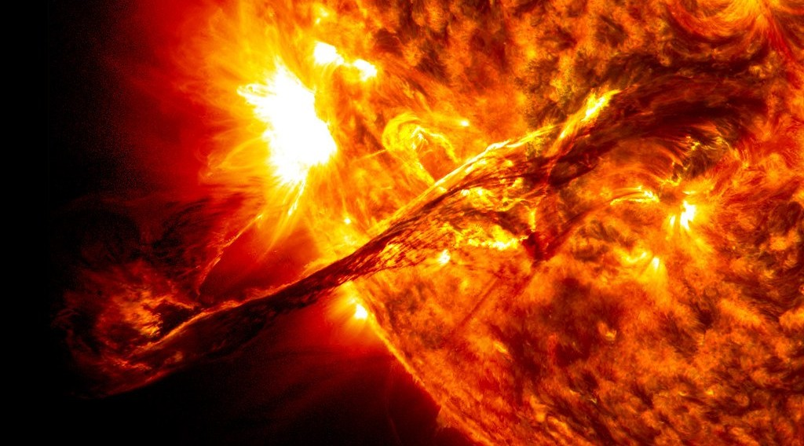
1. SOURCE OF SOLAR RADIATION
Activity 1
The surface of the Sun (NASA image).
Notes:
Activity 1. Look carefully at this picture: the surface of the Sun (NASA image). Observe every detail before I ask the question.

Slide 20
1. SOURCE OF SOLAR RADIATION
Activity 1: Question
Where does the energy of the Sun come from?
Notes:
Here is the question for Activity 1: Where does the energy of the Sun come from? Take one minute to think and write your answer in your rough notebook.

Slide 21
1. SOURCE OF SOLAR RADIATION
Activity 1: Answer
From nuclear reactions (fusion) in the core of the Sun.
Notes:
Let us check the answer together. From nuclear reactions (fusion) in the core of the Sun.

Slide 22
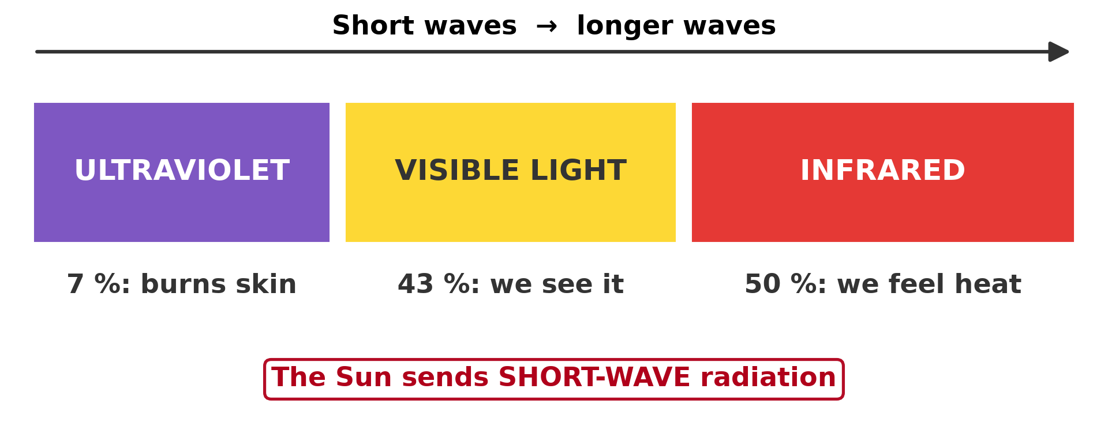
1. NATURE OF SOLAR RADIATION
Activity 2
The three parts of solar radiation.
Notes:
Activity 2. Look carefully at this diagram: the three parts of solar radiation. Observe every detail before I ask the question.

Slide 23
1. NATURE OF SOLAR RADIATION
Activity 2: Question
Which part of solar radiation burns the skin? Which part do we feel as heat?
Notes:
Here is the question for Activity 2: Which part of solar radiation burns the skin? Which part do we feel as heat? Take one minute to think and write your answer in your rough notebook.

Slide 24
1. NATURE OF SOLAR RADIATION
Activity 2: Answer
Ultraviolet burns the skin. Infrared is felt as heat.
Notes:
Let us check the answer together. Ultraviolet burns the skin. Infrared is felt as heat.

Slide 25
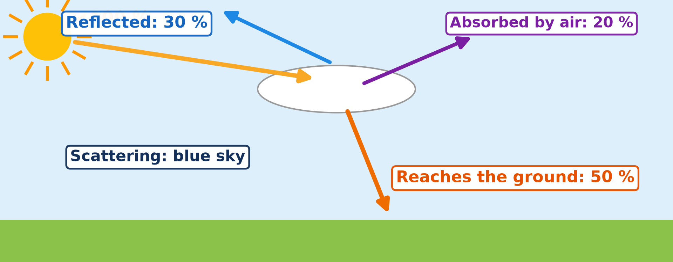
2. DEPLETION: ABSORPTION
Activity 3
What happens to 100 units of sunlight.
Notes:
Activity 3. Look carefully at this diagram: what happens to 100 units of sunlight. Observe every detail before I ask the question.

Slide 26
2. DEPLETION: ABSORPTION
Activity 3: Question
Out of 100 units of sunlight, how many reach the ground?
Notes:
Here is the question for Activity 3: Out of 100 units of sunlight, how many reach the ground? Take one minute to think and write your answer in your rough notebook.

Slide 27
2. DEPLETION: ABSORPTION
Activity 3: Answer
About 50 units; 30 are reflected and 20 are absorbed.
Notes:
Let us check the answer together. About 50 units; 30 are reflected and 20 are absorbed.

Slide 28

2. DEPLETION: SCATTERING
Activity 4
A red sky at sunrise.
Notes:
Activity 4. Look carefully at this picture: a red sky at sunrise. Observe every detail before I ask the question.

Slide 29
2. DEPLETION: SCATTERING
Activity 4: Question
Why is the sky blue at midday but red at sunrise?
Notes:
Here is the question for Activity 4: Why is the sky blue at midday but red at sunrise? Take one minute to think and write your answer in your rough notebook.

Slide 30
2. DEPLETION: SCATTERING
Activity 4: Answer
Air scatters blue light. At sunrise light crosses more air, so only red light reaches us.
Notes:
Let us check the answer together. Air scatters blue light. At sunrise light crosses more air, so only red light reaches us.

Slide 31
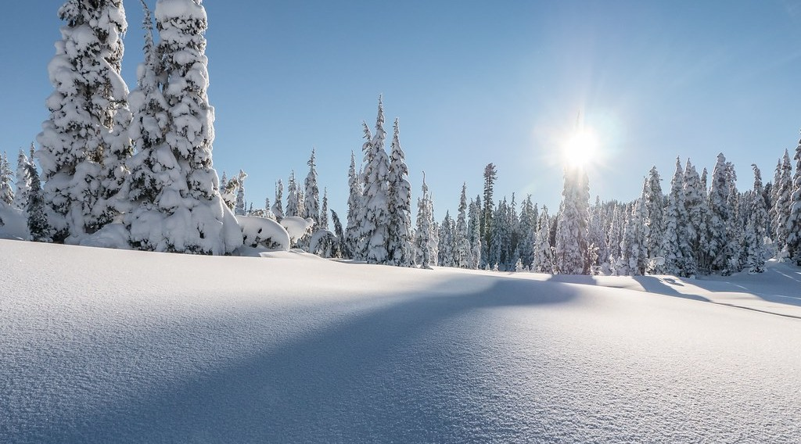
2. DEPLETION: REFLECTION AND ALBEDO
Activity 5
Snow reflects most of the sunlight.
Notes:
Activity 5. Look carefully at this picture: snow reflects most of the sunlight. Observe every detail before I ask the question.

Slide 32
2. DEPLETION: REFLECTION AND ALBEDO
Activity 5: Question
Why does snow stay cold even in the sun?
Notes:
Here is the question for Activity 5: Why does snow stay cold even in the sun? Take one minute to think and write your answer in your rough notebook.

Slide 33
2. DEPLETION: REFLECTION AND ALBEDO
Activity 5: Answer
It has a high albedo: it reflects up to 90 % of the sunlight.
Notes:
Let us check the answer together. It has a high albedo: it reflects up to 90 % of the sunlight.

Slide 34
BOARD SUMMARY
Board Summary
Topic: Energy in the Atmosphere
Sub-topic: Transfer of Solar Energy
Lesson 3: Solar Radiation
Notes:
Now we are going to copy the board summary. Write the title and the headings neatly in your notebooks. I will give you enough time for each slide, so do not rush.

Slide 35
BOARD SUMMARY
DEFINITIONS
The key terms of this lesson are defined as follows:
Solar radiation (insolation): It is the energy sent out by the sun and received by the Earth.
Albedo: It is the percentage of solar radiation reflected by a surface.
Notes:
Let us copy the definitions. The key terms of this lesson are defined as follows. On this slide we have Solar radiation (insolation) and Albedo. Write each point on a new line, with the key term first, and explain it in your own words when we revise. When you finish, we go to the next slide.

Slide 36
BOARD SUMMARY
DEFINITIONS (continued)
Depletion: It is the loss of solar radiation as it passes through the atmosphere.
Notes:
We continue with the definitions. On this slide we have Depletion. Write each point on a new line, with the key term first, and explain it in your own words when we revise.

Slide 37
BOARD SUMMARY
1. Sources and Nature of Solar Radiation
The source and nature of solar radiation are as follows:
Source: The sun produces energy by nuclear fusion, when hydrogen changes into helium in its core at about 15 million °C. This energy travels to the Earth in about 8 minutes.
Notes:
Let us copy Sources and Nature of Solar Radiation. The source and nature of solar radiation are as follows. On this slide we have Source. Write each point on a new line, with the key term first, and explain it in your own words when we revise. When you finish, we go to the next slide.

Slide 38
BOARD SUMMARY
1. Sources and Nature of Solar Radiation (continued)
Nature: Solar radiation travels as short waves. It is made up of ultraviolet rays (about 9 %), visible light (about 41 %) and infrared rays (about 50 %).
Solar constant: At the top of the atmosphere the Earth receives about 1,370 W/m². Only part of it reaches the ground.
Notes:
We continue with Sources and Nature of Solar Radiation. On this slide we have Nature and Solar constant. Write each point on a new line, with the key term first, and explain it in your own words when we revise.

Slide 39
BOARD SUMMARY
2. Depletion of Solar Radiation
Solar radiation is intercepted by the atmosphere through the following processes:
Absorption: Ozone absorbs ultraviolet rays, while water vapour, carbon dioxide and dust absorb infrared rays. About 20 % of insolation is absorbed by the atmosphere.
Notes:
Let us copy Depletion of Solar Radiation. Solar radiation is intercepted by the atmosphere through the following processes. On this slide we have Absorption. Write each point on a new line, with the key term first, and explain it in your own words when we revise. When you finish, we go to the next slide.

Slide 40
BOARD SUMMARY
2. Depletion of Solar Radiation (continued)
Scattering: Gas molecules and dust spread light in all directions. Blue light is scattered most, which makes the sky blue, and the sun looks red at sunrise because its light crosses more air.
Notes:
We continue with Depletion of Solar Radiation. On this slide we have Scattering. Write each point on a new line, with the key term first, and explain it in your own words when we revise. When you finish, we go to the next slide.

Slide 41
BOARD SUMMARY
2. Depletion of Solar Radiation (continued)
Reflection: Clouds, the ground and water send part of the radiation back to space. About 30 % of insolation is reflected; this is the Earth's albedo.
Notes:
We continue with Depletion of Solar Radiation. On this slide we have Reflection. Write each point on a new line, with the key term first, and explain it in your own words when we revise.

Slide 42
BOARD SUMMARY
2. Depletion of Solar Radiation
Illustration: what happens to 100 units of solar radiation
Notes:
Now draw this illustration in your notebook: what happens to 100 units of solar radiation. Give it a title and label it clearly.

Slide 43
BOARD SUMMARY
2. Depletion of Solar Radiation
Albedo of Surfaces
The albedo of a surface depends on its colour and nature:
High albedo: Fresh snow reflects 80–95 % and thick clouds about 70 %. Such surfaces stay cool.
Notes:
Let us copy Albedo of Surfaces. The albedo of a surface depends on its colour and nature. On this slide we have High albedo. Write each point on a new line, with the key term first, and explain it in your own words when we revise. When you finish, we go to the next slide.

Slide 44
BOARD SUMMARY
2. Depletion of Solar Radiation
Albedo of Surfaces (continued)
Low albedo: Forests reflect 10–20 %, dark soil and water about 5–10 %. These surfaces absorb more heat and become warm.
Notes:
We continue with Albedo of Surfaces. On this slide we have Low albedo. Write each point on a new line, with the key term first, and explain it in your own words when we revise.

Slide 45
FORMATIVE EVALUATION
Evaluation 1
What is albedo? Give a surface with a high albedo.
Notes:
Now let us check what you have understood. Question 1: What is albedo? Give a surface with a high albedo. Answer in your exercise book.

Slide 46
FORMATIVE EVALUATION
Expected Answer
The part of sunlight reflected by a surface. Snow.
Notes:
The expected answer is: the part of sunlight reflected by a surface. Snow. If you got it right, well done.

Slide 47
FORMATIVE EVALUATION
Evaluation 2
Name three ways sunlight is depleted in the atmosphere.
Notes:
Now let us check what you have understood. Question 2: Name three ways sunlight is depleted in the atmosphere. Answer in your exercise book.

Slide 48
FORMATIVE EVALUATION
Expected Answer
Reflection, scattering and absorption.
Notes:
The expected answer is: reflection, scattering and absorption. If you got it right, well done.

Slide 49
REMEDIATION
Remediation
Fill in the blanks:
The Sun sends ______-wave radiation.
Reflection of sunlight by a surface is called ______.
The sky is blue because of ______.
Notes:
For those who need more practice, fill in the blanks in your exercise book. The answers are: number 1, short; number 2, albedo; number 3, scattering.

Slide 50
HOMEWORK
Homework
Put a white cloth and a black cloth in the sun for 10 minutes. Touch them and explain the difference.
Notes:
For your homework: Put a white cloth and a black cloth in the sun for 10 minutes. Touch them and explain the difference. We shall correct it at the beginning of our next lesson.

Slide 51
NEXT LESSON
Next Lesson
Our next lesson will be on:
Lesson 4: The Earth's Radiation Balance
Notes:
Our next lesson will be on Lesson 4: The Earth's Radiation Balance. Thank you for your attention, and see you next time.

Slide 52
BILINGUAL GAME
Bilingual Game (Jeu Bilingue)
English | Français
Solar radiation | Le rayonnement solaire
Reflection | La réflexion
Absorption | L'absorption
Scattering | La diffusion
Albedo | L'albédo
Sunlight | La lumière du soleil
Notes:
Let us play the bilingual game. I say a word in English, and you give me the French word. Then we do the reverse.

Slide 53
LOGBOOK
Official Logbook (1/2)
Module / Topic | Energy in the Atmosphere
Lesson Title | Lesson 3: Solar Radiation
Expected Learning Outcomes | Explain the source and nature of solar radiation. Describe reflection, scattering and absorption. Explain albedo.
Competence | Learners are able to explain how solar energy reaches the Earth and what happens to it in the atmosphere.
Notes:
I record this information in the official logbook of the class after the lesson.

Slide 54
LOGBOOK
Official Logbook (2/2)
Matter Taught | DEFINITIONS; Sources and Nature of Solar Radiation; Depletion of Solar Radiation; Albedo of Surfaces.
Evaluation | Formative evaluation and remediation exercise.
Homework | Put a white cloth and a black cloth in the sun for 10 minutes. Touch them and explain the difference.
Enrolment / Present / Absent | ____ / ____ / ____
Achievement | To be completed after the lesson.
Notes:
I complete the second page of the logbook: the matter taught, the evaluation, the homework and the attendance.

Slide 55
TEACHER'S NOTE
Teacher's Note
Timing: Homework correction, plan, objectives 8 min | Recall, situation, action 10 min | 5 activities 30 min | Board summary (copying) 30 min | Evaluation, remediation 10 min | Homework, next lesson 5 min | Logbook 7 min
Without the projector (Activity 1): ask how we feel standing in the sun.
Without the projector (Activity 2): list the three parts on the board.
Without the projector (Activity 3): draw the sun, a cloud and the ground.
Without the projector (Activity 4): describe the colour of the sky at sunset.
Without the projector (Activity 5): compare a white shirt and a black shirt in the sun.
Notes:
This slide is for me, the teacher: it gives the timing of the lesson and what to do if the projector is not available.

Slide 56
REFERENCES
References
National Geography Syllabus, MINESEC/IGE/IP-SS, 2019 — Module 1 (Meteorology, Climatology & Hydrology).
Photo, Activity 1: “Scientists Propose Mechanism to Describe Solar Eruptions of All Sizes” by NASA's Marshall Space Flight Center, CC BY-NC 2.0, via nasa (https://www.flickr.com/photos/28634332@N05/36084784530)
Photo, Activity 4: “African Sunrise, Amboseli National Park” by Ray in Manila, CC BY 2.0, via Flickr (https://www.flickr.com/photos/21186555@N07/30385097358)
Photo, Activity 5: “Peaceful Winter” by `James Wheeler, CC BY-NC-SA 2.0, via Flickr (https://www.flickr.com/photos/24128704@N08/25673217581)
Diagrams and animations: drawn for this lesson (Geography Department).
Notes:
These are the references and picture credits used to prepare this lesson.

