Slide 1
LOWER SIXTH ARTS
GEOGRAPHY
Lesson 16
Tropical Seasonal Winds: Monsoon and Harmattan
Notes:
Good morning, class, and welcome to our geography lesson. I am your geography teacher, Mr Kamdem. Today we are starting Lesson 16: Tropical Seasonal Winds: Monsoon and Harmattan.

Slide 2
CLASS INFO
Class, Chapter and Duration
Class | Lower Sixth Arts
Chapter | Module 1: Understanding and managing atmospheric and hydrological phenomena and hazards across the world in general and Cameroon in particular
Duration | 2 periods (2 × 50 minutes)
Notes:
This lesson is for Lower Sixth Arts. It belongs to Module 1: Understanding and managing atmospheric and hydrological phenomena and hazards across the world in general and Cameroon in particular. We shall need 2 periods to cover it.

Slide 3
IDENTIFICATION
Lesson Identification
Topic | Global and Local Atmospheric Circulation
Sub-topic | Mesoscale Winds
Lesson | Lesson 16: Tropical Seasonal Winds: Monsoon and Harmattan
Notions / Concepts | Monsoon, Harmattan, ITCZ, seasonal reversal of winds.
Syllabus focus | Monsoon winds (meaning, causes, areas, effects) and the Harmattan, with effects in Asia and West Africa/Cameroon.
Competence | Learners are able to explain seasonal winds and their effects on people in Asia and Cameroon.
Notes:
Our topic is Global and Local Atmospheric Circulation, and the sub-topic is Mesoscale Winds. The key notions we shall use today are: monsoon, Harmattan, ITCZ, seasonal reversal of winds. At the end, you should be able to do this: learners are able to explain seasonal winds and their effects on people in Asia and Cameroon.

Slide 4

HOMEWORK CORRECTION
Correction of the Homework
Question (Lesson 15: Planetary Winds):
Draw the planetary winds and pressure belts on one diagram.
Notes:
Before we start the new lesson, let us correct the homework I gave you at the end of Lesson 15: Planetary Winds. The question was: Draw the planetary winds and pressure belts on one diagram. Take out your exercise books.

Slide 5
HOMEWORK CORRECTION
Correction: Possible Answer
The diagram shows the equatorial low, subtropical highs (30°), subpolar lows (60°) and polar highs, with the NE and SE trade winds, the westerlies and the polar easterlies deflected by the Coriolis force.
Notes:
Here is a good answer. The diagram shows the equatorial low, subtropical highs (30°), subpolar lows (60°) and polar highs, with the NE and SE trade winds, the westerlies and the polar easterlies deflected by the Coriolis force. Compare it with your own answer and correct your work in red.

Slide 6
LESSON PLAN
Lesson Plan
Correction of the homework
Objectives and recall
Real-life situation and action to take
Learning activities
Board summary
Evaluation, remediation and homework
Notes:
Here is the plan of our lesson today. First, we shall correct the homework. Then we shall look at the objectives and recall what you already know. After that, we shall study a situation from real life and the action to take, and do the learning activities. Finally, we shall copy the board summary, do the evaluation and the remediation, and I will give you the homework.

Slide 7
OBJECTIVES
Objectives
By the end of this lesson, you should be able to:
Define monsoon and explain its causes.
Describe the Asian and West African monsoons.
Notes:
Take your time to copy this part; we will continue together.

Slide 8
OBJECTIVES
Objectives (continued)
Explain the causes and effects of the Harmattan.
Notes:
By the end of this lesson, you should be able to do three things. Number 1: define monsoon and explain its causes. Number 2: describe the Asian and West African monsoons. Number 3: explain the causes and effects of the Harmattan.

Slide 9
PREVIOUS KNOWLEDGE
Previous Knowledge
Land heats faster than the sea.
The overhead sun moves between the tropics.
Notes:
Let us first remember what you already know. Land heats faster than the sea. The overhead sun moves between the tropics. Keep this in mind, because we shall build on it today.

Slide 10
REAL-LIFE SITUATION
Situation in Real Life
In Garoua the rainy season starts in May when the wind comes from the south-west. In November the wind turns and blows from the north-east, bringing dust, dry skin and meningitis.
Notes:
Listen carefully to this situation from real life. In Garoua the rainy season starts in May when the wind comes from the south-west. In November the wind turns and blows from the north-east, bringing dust, dry skin and meningitis. Think about it, because I am going to ask you some questions.

Slide 11
REAL-LIFE SITUATION
Situation: Question 1
What is the problem in the situation?
Notes:
Question 1: What is the problem in the situation? Think for a moment, then raise your hand to answer.

Slide 12
REAL-LIFE SITUATION
Answer
The wind changes direction with the seasons and changes life.
Notes:
Good. The wind changes direction with the seasons and changes life.

Slide 13
REAL-LIFE SITUATION
Situation: Question 2
What is the wet south-west wind called?
Notes:
Question 2: What is the wet south-west wind called? Think for a moment, then raise your hand to answer.

Slide 14
REAL-LIFE SITUATION
Answer
The West African monsoon.
Notes:
Good. The West African monsoon.

Slide 15
REAL-LIFE SITUATION
Situation: Question 3
What is the dry north-east wind called?
Notes:
Question 3: What is the dry north-east wind called? Think for a moment, then raise your hand to answer.

Slide 16
REAL-LIFE SITUATION
Possible Answer
The Harmattan.
Notes:
Good. The Harmattan.

Slide 17
ACTION TO TAKE
Action to Take
Adapt farming and health habits to the monsoon and Harmattan seasons.
Notes:
From this situation, the action we are working towards in this lesson is the following: adapt farming and health habits to the monsoon and Harmattan seasons.

Slide 18
JUSTIFICATION
Justification of the Lesson
This lesson helps us to understand the winds that make the rainy and dry seasons of Cameroon.
Notes:
Why is this lesson important for you? This lesson helps us to understand the winds that make the rainy and dry seasons of Cameroon.

Slide 19
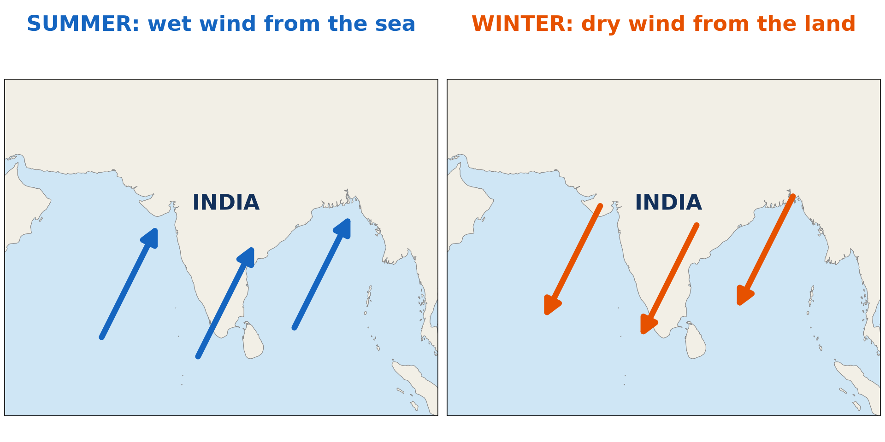
1. MONSOON: MEANING AND CAUSES
Activity 1
The summer and winter monsoons of India.
Notes:
Activity 1. Look carefully at this diagram: the summer and winter monsoons of India. Observe every detail before I ask the question.

Slide 20
1. MONSOON: MEANING AND CAUSES
Activity 1: Question
In which season does the wind blow from the sea to India? What does it bring?
Notes:
Here is the question for Activity 1: In which season does the wind blow from the sea to India? What does it bring? Take one minute to think and write your answer in your rough notebook.

Slide 21
1. MONSOON: MEANING AND CAUSES
Activity 1: Answer
In summer; it brings heavy rain.
Notes:
Let us check the answer together. In summer; it brings heavy rain.

Slide 22
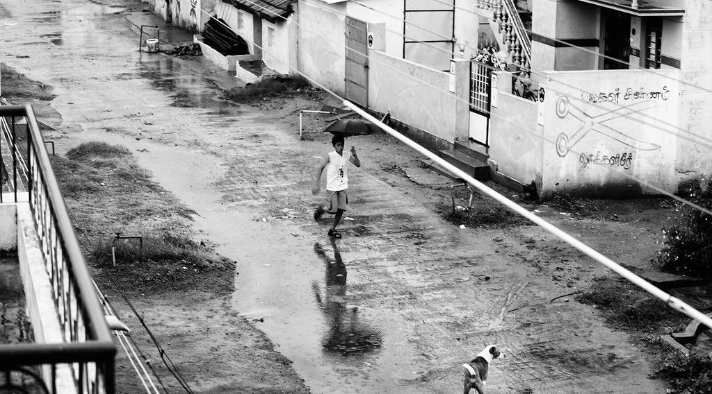
1. MONSOON: EFFECTS IN ASIA
Activity 2
A street in heavy rain in India.
Notes:
Activity 2. Look carefully at this picture: a street in heavy rain in India. Observe every detail before I ask the question.

Slide 23
1. MONSOON: EFFECTS IN ASIA
Activity 2: Question
Give one good and one bad effect of monsoon rain.
Notes:
Here is the question for Activity 2: Give one good and one bad effect of monsoon rain. Take one minute to think and write your answer in your rough notebook.

Slide 24
1. MONSOON: EFFECTS IN ASIA
Activity 2: Answer
Good: water for rice farming. Bad: floods and landslides.
Notes:
Let us check the answer together. Good: water for rice farming. Bad: floods and landslides.

Slide 25

1. MONSOON IN WEST AFRICA
Activity 3
Animation: the rain belt moves north and south.
Notes:
Activity 3. Look carefully at this animation: animation: the rain belt moves north and south. Watch the animation to the end; it will play again.

Slide 26
1. MONSOON IN WEST AFRICA
Activity 3: Question
Why does the rain belt move north in July?
Notes:
Here is the question for Activity 3: Why does the rain belt move north in July? Take one minute to think and write your answer in your rough notebook.

Slide 27
1. MONSOON IN WEST AFRICA
Activity 3: Answer
The overhead sun moves north and heats the land, pulling in wet sea winds.
Notes:
Let us check the answer together. The overhead sun moves north and heats the land, pulling in wet sea winds.

Slide 28

2. HARMATTAN: MEANING AND CAUSES
Activity 4
Bamenda under the Harmattan dust.
Notes:
Activity 4. Look carefully at this picture: bamenda under the Harmattan dust. Observe every detail before I ask the question.

Slide 29
2. HARMATTAN: MEANING AND CAUSES
Activity 4: Question
Where does the Harmattan come from? What does it bring?
Notes:
Here is the question for Activity 4: Where does the Harmattan come from? What does it bring? Take one minute to think and write your answer in your rough notebook.

Slide 30
2. HARMATTAN: MEANING AND CAUSES
Activity 4: Answer
From the Sahara (north-east); it brings dry, dusty, cool air.
Notes:
Let us check the answer together. From the Sahara (north-east); it brings dry, dusty, cool air.

Slide 31

2. HARMATTAN: EFFECTS
Activity 5
Dust carried by a strong wind.
Notes:
Activity 5. Look carefully at this picture: dust carried by a strong wind. Observe every detail before I ask the question.

Slide 32
2. HARMATTAN: EFFECTS
Activity 5: Question
Give two effects of the Harmattan on people.
Notes:
Here is the question for Activity 5: Give two effects of the Harmattan on people. Take one minute to think and write your answer in your rough notebook.

Slide 33
2. HARMATTAN: EFFECTS
Activity 5: Answer
Poor visibility (flights cancelled) and diseases such as meningitis and colds.
Notes:
Let us check the answer together. Poor visibility (flights cancelled) and diseases such as meningitis and colds.

Slide 34
BOARD SUMMARY
Board Summary
Topic: Global and Local Atmospheric Circulation
Sub-topic: Mesoscale Winds
Lesson 16: Tropical Seasonal Winds: Monsoon and Harmattan
Notes:
Now we are going to copy the board summary. Write the title and the headings neatly in your notebooks. I will give you enough time for each slide, so do not rush.

Slide 35
BOARD SUMMARY
DEFINITIONS
The key terms of this lesson are defined as follows:
Monsoon: It is a seasonal reversal of winds, from the Arabic word mausim, meaning season.
Harmattan: It is the dry, dusty north-east wind that blows from the Sahara to West Africa in the dry season.
Notes:
Let us copy the definitions. The key terms of this lesson are defined as follows. On this slide we have Monsoon and Harmattan. Write each point on a new line, with the key term first, and explain it in your own words when we revise. When you finish, we go to the next slide.

Slide 36
BOARD SUMMARY
DEFINITIONS (continued)
ITCZ: It is the zone where the trade winds of the two hemispheres meet.
Notes:
We continue with the definitions. On this slide we have ITCZ. Write each point on a new line, with the key term first, and explain it in your own words when we revise.

Slide 37
BOARD SUMMARY
1. Monsoon Winds
The monsoon can be studied under the following points:
Causes: In summer, land heats more than the sea and a low pressure forms over the continent, so moist winds blow from the sea to the land.
Notes:
Let us copy Monsoon Winds. The monsoon can be studied under the following points. On this slide we have Causes. Write each point on a new line, with the key term first, and explain it in your own words when we revise. When you finish, we go to the next slide.

Slide 38
BOARD SUMMARY
1. Monsoon Winds (continued)
In winter the land is colder, a high forms and dry winds blow from land to sea.
Areas of occurrence: Monsoons occur in South and East Asia (India, Bangladesh, China) and in West Africa. They are also found in northern Australia.
Notes:
We continue with Monsoon Winds. On this slide we have Areas of occurrence. Write each point on a new line, with the key term first, and explain it in your own words when we revise. When you finish, we go to the next slide.

Slide 39
BOARD SUMMARY
1. Monsoon Winds (continued)
Effects in Asia: The summer monsoon brings heavy rain for rice growing and drinking water. When it is too strong it causes floods in Bangladesh; when it fails it causes drought and famine.
Notes:
We continue with Monsoon Winds. On this slide we have Effects in Asia. Write each point on a new line, with the key term first, and explain it in your own words when we revise.

Slide 40
BOARD SUMMARY
1. Monsoon Winds
Illustration: summer and winter monsoon in India
Notes:
Now draw this illustration in your notebook: summer and winter monsoon in India. Give it a title and label it clearly.

Slide 41
BOARD SUMMARY
1. Monsoon Winds
The West African Monsoon
In West Africa and Cameroon:
Cause: The south-west monsoon is maritime tropical air from the Gulf of Guinea. It moves north behind the ITCZ from March to August.
Notes:
Let us copy The West African Monsoon. In West Africa and Cameroon. On this slide we have Cause. Write each point on a new line, with the key term first, and explain it in your own words when we revise. When you finish, we go to the next slide.

Slide 42
BOARD SUMMARY
1. Monsoon Winds
The West African Monsoon (continued)
Effects: It brings the rainy season to Cameroon, long in the south and short in the north. Its variations cause floods or droughts in the Sahel.
Notes:
We continue with The West African Monsoon. On this slide we have Effects. Write each point on a new line, with the key term first, and explain it in your own words when we revise.

Slide 43
BOARD SUMMARY
2. Harmattan Winds
The Harmattan can be studied under the following points:
Causes: In the dry season (November to March) the ITCZ moves south. Dry continental air from the Saharan high blows south-west over West Africa.
Notes:
Let us copy Harmattan Winds. The Harmattan can be studied under the following points. On this slide we have Causes. Write each point on a new line, with the key term first, and explain it in your own words when we revise. When you finish, we go to the next slide.

Slide 44
BOARD SUMMARY
2. Harmattan Winds (continued)
Characteristics: The Harmattan is dry and dusty, with hot days and cool nights. Relative humidity can fall below 20 %.
Notes:
We continue with Harmattan Winds. On this slide we have Characteristics. Write each point on a new line, with the key term first, and explain it in your own words when we revise. When you finish, we go to the next slide.

Slide 45
BOARD SUMMARY
2. Harmattan Winds (continued)
Effects in Cameroon: It reduces visibility, disturbs flights and dries crops and pastures. It causes meningitis, colds, cracked lips and skin, but it also helps to dry grain and fish.
Notes:
We continue with Harmattan Winds. On this slide we have Effects in Cameroon. Write each point on a new line, with the key term first, and explain it in your own words when we revise.

Slide 46
FORMATIVE EVALUATION
Evaluation 1
What is a monsoon?
Notes:
Now let us check what you have understood. Question 1: What is a monsoon? Answer in your exercise book.

Slide 47
FORMATIVE EVALUATION
Expected Answer
A wind that changes direction with the seasons.
Notes:
The expected answer is: a wind that changes direction with the seasons. If you got it right, well done.

Slide 48
FORMATIVE EVALUATION
Evaluation 2
Give two effects of the Harmattan in Cameroon.
Notes:
Now let us check what you have understood. Question 2: Give two effects of the Harmattan in Cameroon. Answer in your exercise book.

Slide 49
FORMATIVE EVALUATION
Expected Answer
Dust and poor visibility; diseases such as meningitis (also cold nights, dry skin).
Notes:
The expected answer is: dust and poor visibility; diseases such as meningitis (also cold nights, dry skin). If you got it right, well done.

Slide 50
REMEDIATION
Remediation
Fill in the blanks:
The wet south-west wind of West Africa is the ______.
The Harmattan comes from the ______.
Monsoon rain is important for ______ farming.
Notes:
For those who need more practice, fill in the blanks in your exercise book. The answers are: number 1, monsoon; number 2, Sahara; number 3, rice.

Slide 51
HOMEWORK
Homework
Write the months of the monsoon and of the Harmattan in your town.
Notes:
For your homework: Write the months of the monsoon and of the Harmattan in your town. We shall correct it at the beginning of our next lesson.

Slide 52
NEXT LESSON
Next Lesson
Our next lesson will be on:
Lesson 17: Local Winds
Notes:
Our next lesson will be on Lesson 17: Local Winds. Thank you for your attention, and see you next time.

Slide 53
BILINGUAL GAME
Bilingual Game (Jeu Bilingue)
English | Français
Monsoon | La mousson
Harmattan | L'harmattan
Dust | La poussière
Dry season | La saison sèche
Rainy season | La saison des pluies
Meningitis | La méningite
Notes:
Let us play the bilingual game. I say a word in English, and you give me the French word. Then we do the reverse.

Slide 54
LOGBOOK
Official Logbook (1/2)
Module / Topic | Global and Local Atmospheric Circulation
Lesson Title | Lesson 16: Tropical Seasonal Winds: Monsoon and Harmattan
Expected Learning Outcomes | Define monsoon and explain its causes. Describe the Asian and West African monsoons. Explain the causes and effects of the Harmattan.
Competence | Learners are able to explain seasonal winds and their effects on people in Asia and Cameroon.
Notes:
I record this information in the official logbook of the class after the lesson.

Slide 55
LOGBOOK
Official Logbook (2/2)
Matter Taught | DEFINITIONS; Monsoon Winds; The West African Monsoon; Harmattan Winds.
Evaluation | Formative evaluation and remediation exercise.
Homework | Write the months of the monsoon and of the Harmattan in your town.
Enrolment / Present / Absent | ____ / ____ / ____
Achievement | To be completed after the lesson.
Notes:
I complete the second page of the logbook: the matter taught, the evaluation, the homework and the attendance.

Slide 56
TEACHER'S NOTE
Teacher's Note
Timing: Homework correction, plan, objectives 8 min | Recall, situation, action 10 min | 5 activities 30 min | Board summary (copying) 30 min | Evaluation, remediation 10 min | Homework, next lesson 5 min | Logbook 7 min
Activity 3 is an animation (GIF): it plays automatically in slide-show mode.
Without the projector (Activity 1): draw India with arrows.
Without the projector (Activity 2): compare with the rainy season in Douala.
Without the projector (Activity 3): move a paper band up and down a map.
Without the projector (Activity 4): describe Harmattan mornings.
Without the projector (Activity 5): ask learners how the Harmattan affects them.
Notes:
This slide is for me, the teacher: it gives the timing of the lesson and what to do if the projector is not available.

Slide 57
REFERENCES
References
National Geography Syllabus, MINESEC/IGE/IP-SS, 2019 — Module 1 (Meteorology, Climatology & Hydrology).
Photo, Activity 2: “Running in the rain” by VinothChandar, CC BY 2.0, via Flickr (https://www.flickr.com/photos/44345361@N06/10960940954)
Photo, Activity 4: “Bamenda sob a poeira do Harmattan” by carlosoliveirareis, CC BY-NC-SA 2.0, via Flickr (https://www.flickr.com/photos/54218923@N00/387054136)
Photo, Activity 5: “Sandstorm at Camp Bastion, Afghanistan” by Defence Images, CC BY-NC 2.0, via Flickr (https://www.flickr.com/photos/48399297@N04/10343833885)
Diagrams and animations: drawn for this lesson (Geography Department).
Notes:
These are the references and picture credits used to prepare this lesson.

